Slide 1
Autonomous Taxi Control
via Reward Designing .
SARSA, Prioritized Sweeping, & Geometrical Kernels
Presented by:
Baraah Dahle
Marwan Zayyad

Slide 2

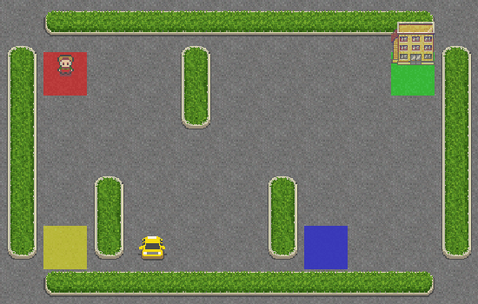
The Environment: Taxi-v4 Map
State Space Composition
500 Discrete States: Combinatorial product of Taxi(25) × Passenger(5) × Destination(4).
Action Space: 6 Discrete maneuvers (N, S, E, W, Pickup, Dropoff).
Complexity: Grid walls prevent direct Manhattan transit, requiring pathfinding.

Slide 3





Core Algorithms: Learning & Planning
SARSA
Planning
Prioritized Sweeping
Dyna-Q
Core RL algorithm
Learns directly from real interactions
Updates the Q-table after every step using bootstrap
Stores experienced transitions
Performs additional simulated updates
Improves sample efficiency
Replays the most important transitions
Priority based on TD error metric
Focuses computation dynamically
Combines SARSA and Planning
Uses both real and simulated experience
Faster
α = 0.1 - learning rate
γ = 0.95 -discount factor
ε=0.1 - greedy policy
Planning Steps = 5
(δ) = TD Error
↓
↓

Slide 4
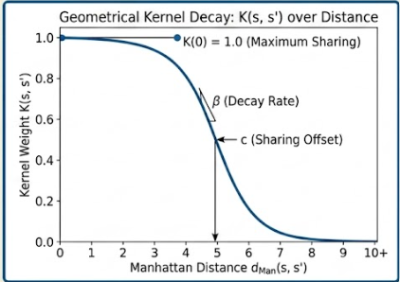

The Geometrical Kernel K(s, s')
To overcome the limitations of tabular independence, we inject a Continuous Generalization Kernel:
Reasoning: Spatially adjacent states in the same sub-task should share value updates.
Effect: Contracts the 500-state matrix into unified local "patches".
β = 4.0 → Controls how quickly similarity decreases with distance.
c = 0.5 → Distance threshold where similarity begins to decay.
k = 5 neighbors → Only the 5 nearest task-equivalent states receive updates.

Slide 5
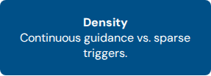

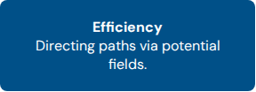
Reward Design & Intuition
Why Design Custom Rewards?
The goal was to test the agent's robustness by completely replacing the environment's native feedback. We moved from "What the goal is" to "How the agent should feel" while navigating.

Slide 6


Environment Feedback Defines The Baseline
1. Base Reward (Native)
2. Sparse Reward (Stress)
Tests the agent's ability to learn with near-zero feedback until completion.
The standard benchmark utilized to calibrate our MBRL implementation against native Gym results.
•
+0.5 for successful drop-off.
+0.5 for successful pick-up.
•
+20 for successful drop-off.
•
-1 per active time step.
•
•
0 for all intermediate states.
•
-10 for illegal actions .
Forces reliance on exploration heuristics.

Slide 7






Custom Shaping Accelerates Convergence
Fast Delivery Reward
Safe Driving Reward
Progress Shaping
Incentivizes the agent to complete tasks in minimal time. A dynamic bonus for successful drop-off to +20 is granted based on the step count efficiency.
-1 per active time step.
-10 for illegal maneuvers.
Bonus = max(0,20-(step_count/10))
Heavily discourages inefficient behavior by increasing the penalty for illegal actions and introducing specific wall-collision costs.
Provides continuous feedback using Manhattan Distance. Directs the agent step-by-step toward the passenger or destination.
Illegal: -15 | Wall: -3 +30 for successful drop-off
-1 per active time step
Closer: +1 | Further: -2 -1 no change
-10 for illegal maneuvers
+30 for successful drop-off

Slide 8
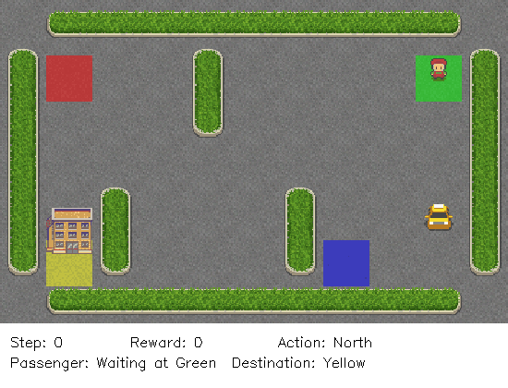

Policy Evolution: The Training Story
base_reward_Kernel
base_reward_Planning
base_reward_Sarsa

Slide 9
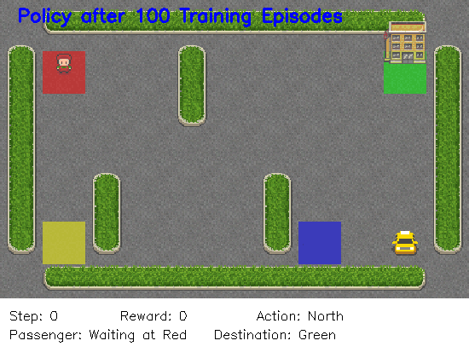
Policy Evolution – Full Algorithm
(SARSA + Kernel + Planning)

Slide 10
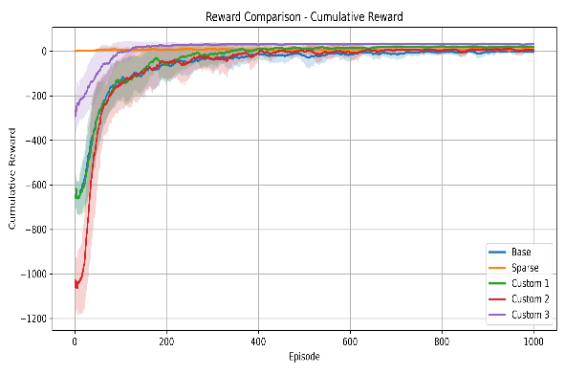
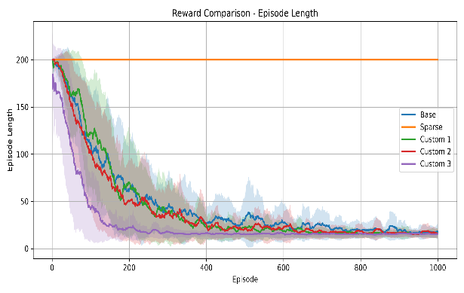
Experimental Results: Design Success
Custom Reward 3 learns the fastest and reaches stable performance earliest.
Sparse Reward fails to learn efficiently due to extremely limited feedback.
Our custom rewards improve both cumulative reward and learning speed.
Reward design directly shapes agent behavior and convergence.

Slide 11
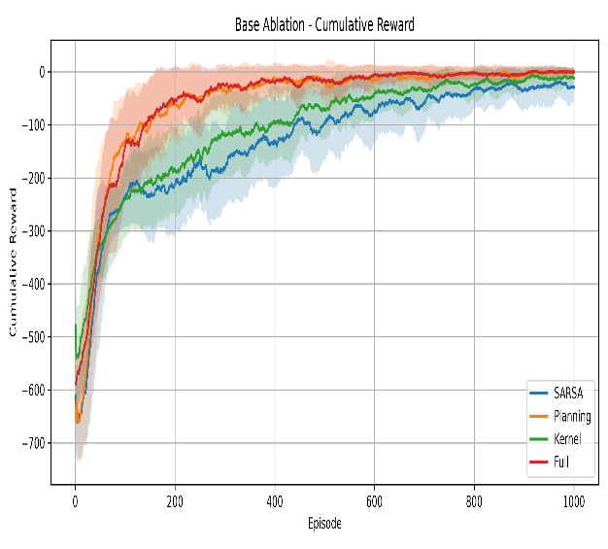
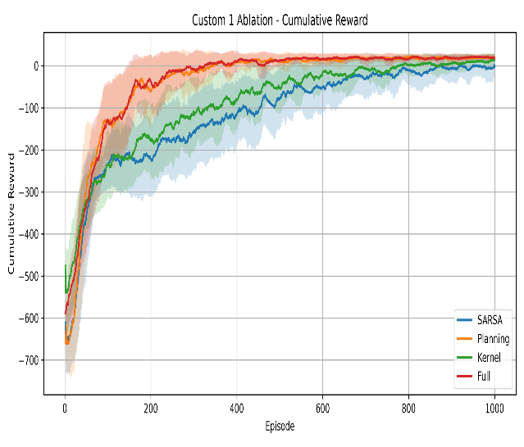
Ablation Study:
Reward Comparison
Planning provides the greatest performance gain.
Kernel improves learning but has a smaller effect.
Full algorithm consistently performs best.
Results are consistent across both reward settings.

Slide 12
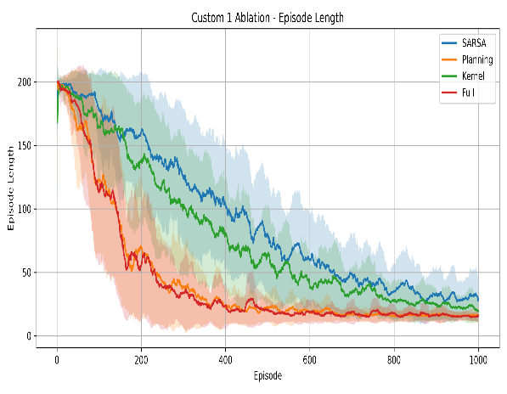
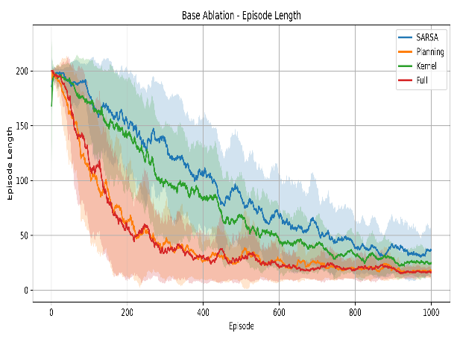
Ablation Study:
Episode Length Comparison
Planning rapidly reduces episode length.
Kernel improves efficiency over SARSA.
Full algorithm reaches near-optimal paths the fastest.
Results are consistent across both reward functions.

Slide 13
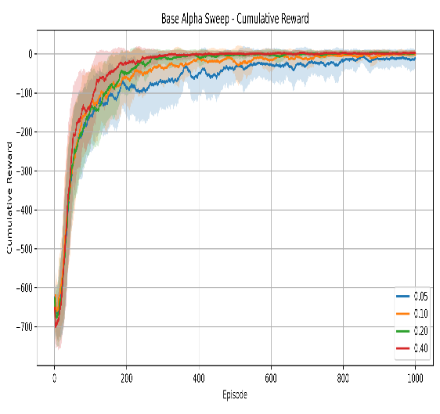
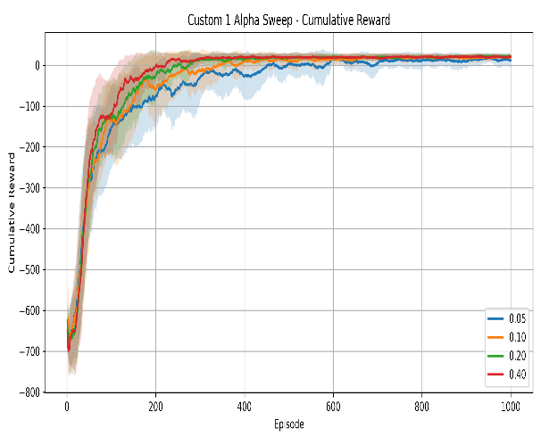
Hyperparameter (α) Analysis:
Reward Comparison
α = 0.20–0.40 reaches the highest returns.
Lower α slows convergence and final performance.
Custom Reward 1 achieves faster, more stable learning.
Higher α increases reward more rapidly.

Slide 14
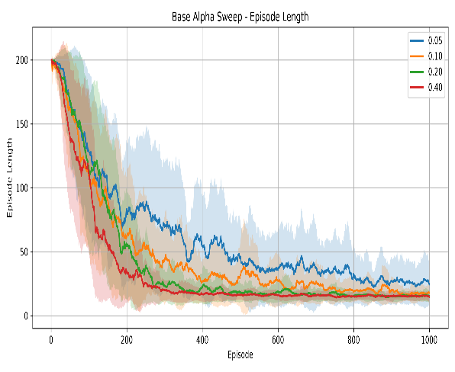
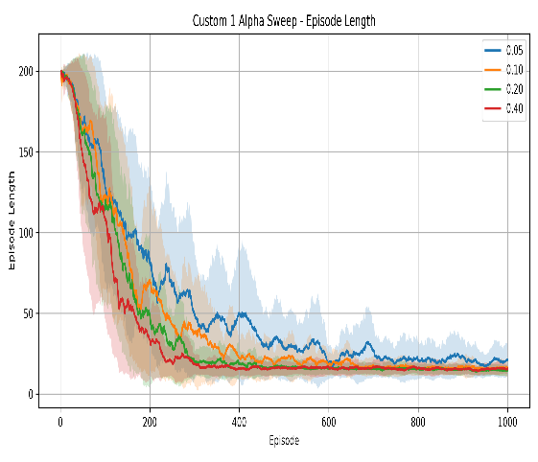
Hyperparameter (α) Analysis:
Episode Length Comparison
Higher α accelerates convergence
α = 0.40 was selected for the final model.
Lower α requires substantially more training.
Results are consistent across both reward functions.

Slide 15
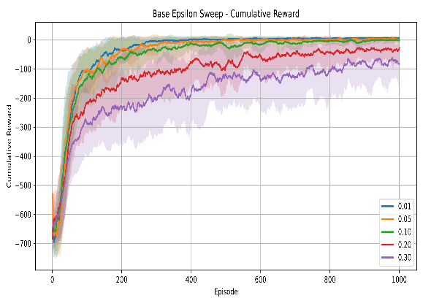
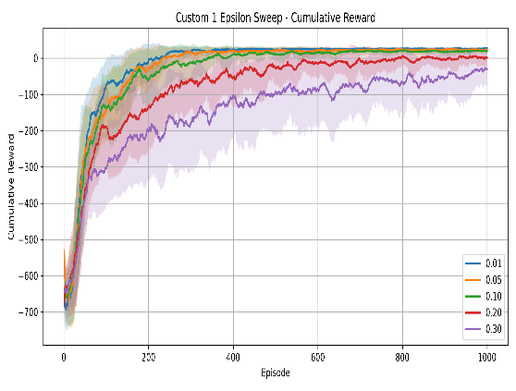
Hyperparameter (ε) Analysis:
Reward Comparison
Lower exploration accelerates reward accumulation.
ε = 0.01 was selected for the final model.
Higher ε delays convergence by exploring too often
Results are consistent across both reward functions.

Slide 16
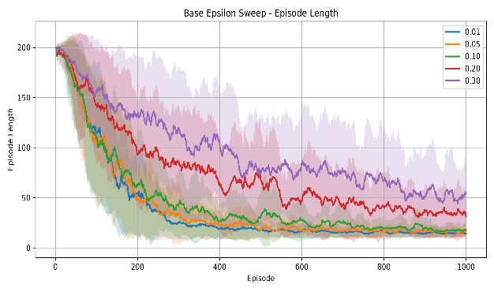
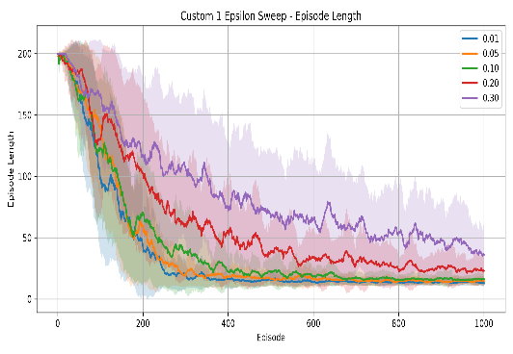
Hyperparameter (ε) Analysis:
Episode Length Comparison
Lower ε reduces episode length more quickly.
ε = 0.01–0.05 achieves the fastest convergence.
Higher ε keeps exploring after good policies are found
Both reward functions show the same behavior.

Slide 17

Storytelling: Decisions & Parameters
Key Hyper-parameters
α = 0.40 : Best balance between convergence speed and final performance.
ε = 0.01: Achieved the most stable learning with the shortest episodes..
Interesting Finding
Planning Steps = 5: Five prioritized planning updates performed after every real interaction.
Larger kernel neighborhoods (20 neighbors) degraded learning quality.
Limiting updates to (5 neighbors) produced faster and more stable convergence.
Kernel Neighbors = 5: Limited updates to the 5 nearest task-equivalent states.
5 Seeds: Used to report reliable averages

Slide 18

Questions?
Thank you for your attention.

