Slide 1
Buildyard Agenda
What is this?
Motivation
First example
How does it work?
Future

Slide 2
What is Buildyard?
Build environment based on CMake
Facilitate build of multiple dependent projects
Dependencies can be installed packages or compiled from git or svn repositories
Extensible to user's need
Buildyard repository: https://github.com/BlueBrain/Buildyard

Slide 3
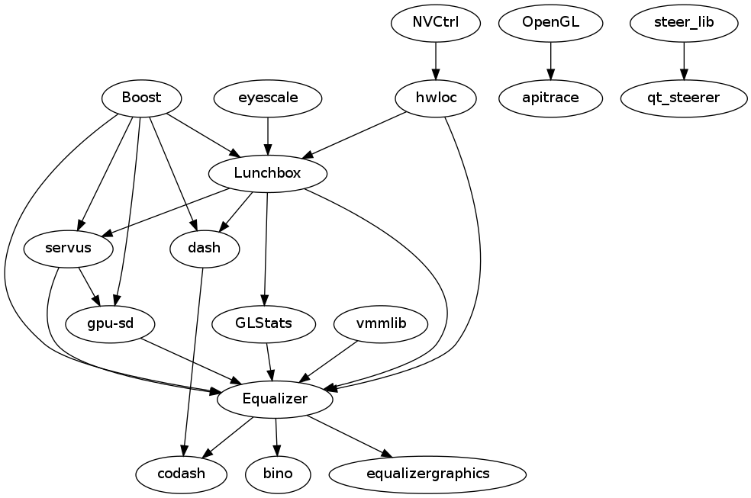
Motivation

Slide 4
Motivation
Goal: 'make <Project>' to build your code
Automatic checkout, update, build and install of dependent projects in the correct order
Comfortable daily development, consolidate code at one location
Developer environment: implement, test, commit, …

Slide 5
How does it work
Foundation is ExternalProject.cmake, shipped with every CMake installation
Buildyard enhances this with UseExternal.cmake
Generates Makefile in project folder: forwards args to Buildyard make
Reads build configurations from config folders
config/ default shipped, config.local/ optional for overrides

Slide 6
How does it work
config variables
  NAME_VERSION: required version for find_package
  NAME_REPO_URL: URL to source code
  NAME_REPO_TYPE: git, git-svn, svn
  NAME_REPO_TAG: svn revision, git tag
  NAME_DEPENDS: list of dependencies
  NAME_TAIL_REVISION: oldest svn rev for git-svn clone
Local overrides (config.local folder always used as last)
  Any of the above
  NAME_USER_URL: new git remote as origin

Slide 7
How does it work
Buildyard make targets
  clobber: remove build folders
  clean: clean all projects
  all: build debug & release
  {Project}: build & install + dependencies
make {Project}-target, make targets
  download: git clone, git-svn clone, svn checkout
  update: git pull, git-svn rebase, svn update
  configure: cmake run
  build: make
  install, test, package, doxygen

Slide 8
Future
GNU modules: make {Project}-module
Release procedure support: tag, branch, package, ...

