Slide 1
Document processer

Slide 2
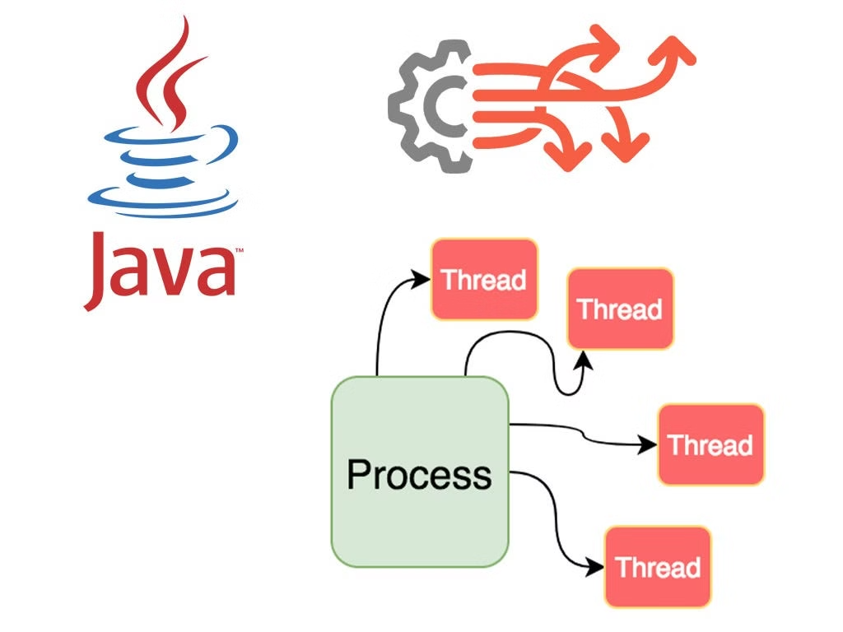
Multi-Threaded Document Processor
Welcome! This presentation introduces our new Java application, a multi-threaded document processor designed for efficient handling of large text documents. Let's explore its capabilities, implementation, and potential benefits.

Slide 3
Processing Power
Thread Management
The project demonstrates effective thread management by dynamically allocating tasks to threads based on user input. It uses a spinner to control the number of threads, ensuring adaptability to different workloads. Each thread processes a distinct chunk of the document, operating independently while contributing to the overall task. Threads are carefully synchronized to avoid conflicts when updating shared data, ensuring accuracy and consistency. This approach highlights how controlled thread management can optimize performance and maintain system stability in multi-threaded applications.
Concurrency Benefits
The project showcases the benefits of concurrency by splitting document processing tasks across multiple threads, enabling faster execution and efficient use of system resources. The design ensures that the GUI remains responsive by handling thread operations asynchronously. Thread safety is maintained using synchronized blocks, preventing data inconsistencies. This approach highlights practical applications of parallel processing in tasks like document analysis, making the system scalable and efficient for varying workloads

Slide 4

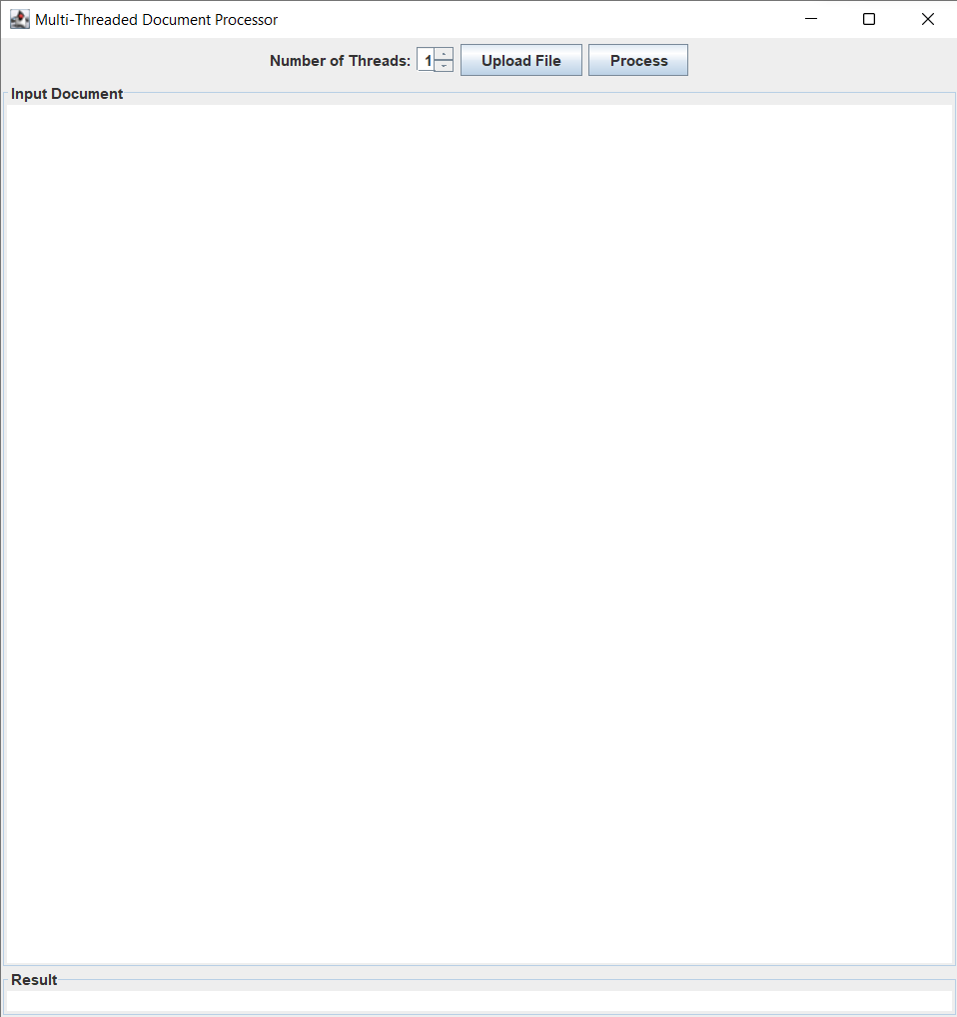
User Interface
Document Input
Thread Selection
The application features a dedicated area for users to paste or upload their text document. Users can then select the number of threads they wish to use for processing.
The user interface includes a slider or input field to adjust the number of threads for processing. The application ensures that the chosen number is within a valid range, avoiding potential issues.
Processing & Results
A “Process” button triggers the processing operation. Upon completion, the application displays the total word count in the main window and provides detailed results for each thread in separate windows.

Slide 5
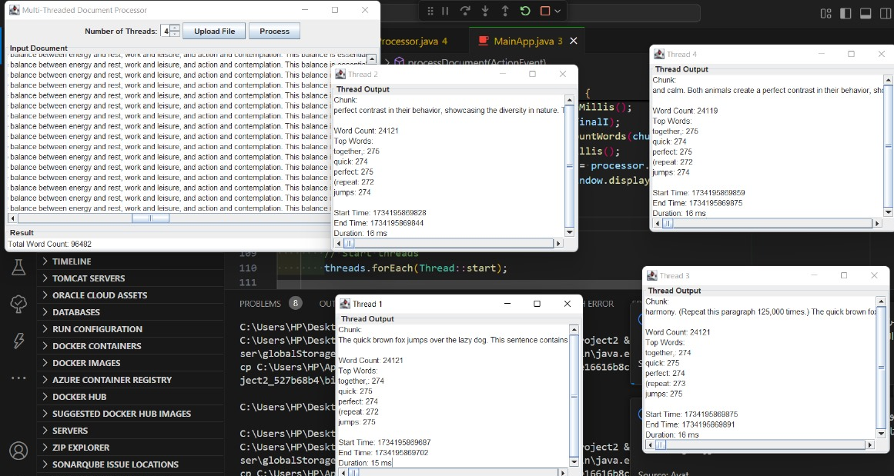
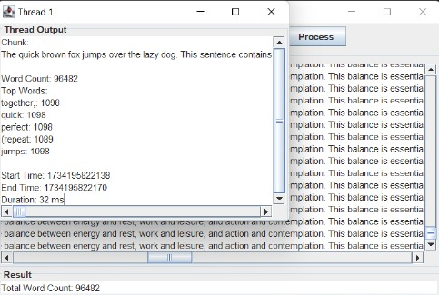
Did the project make effective use of threads
multi-threaded
single-threaded

Slide 6
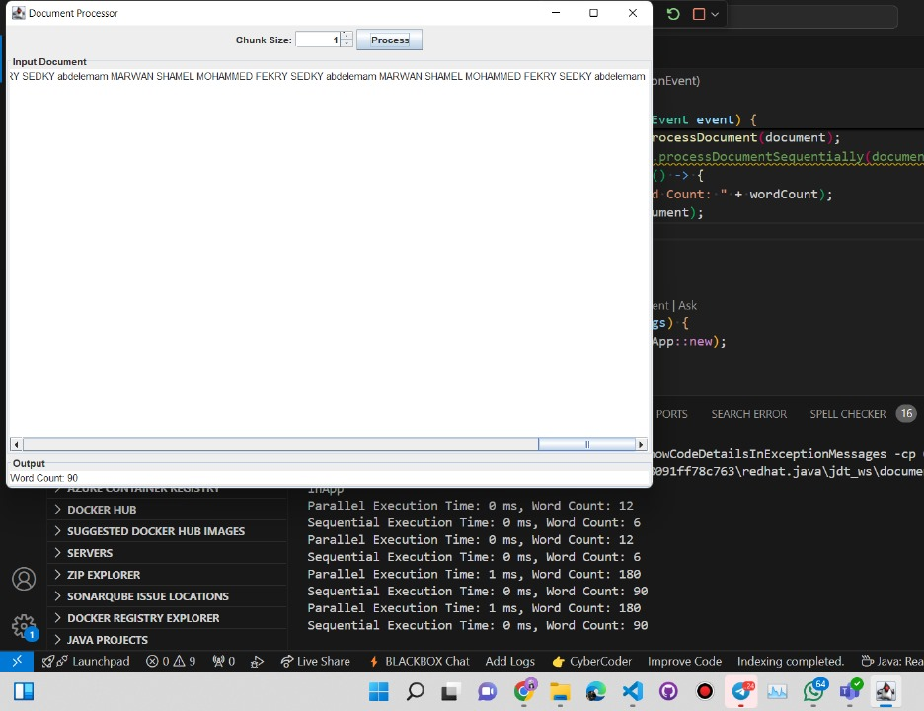
Were issues like race conditions and deadlocks?
Problem: Race Condition:
A race condition occurred because multiple threads tried to access and modify the shared resource (wordCount in this case) simultaneously. This led to inconsistent results, as threads could overwrite each other's updates unpredictably.
Solution: Synchronization To resolve this issue, we added synchronization to ensure that only one thread can access the critical section at a time. This prevents concurrent modifications to the shared resource and ensures consistent behavi

Slide 7
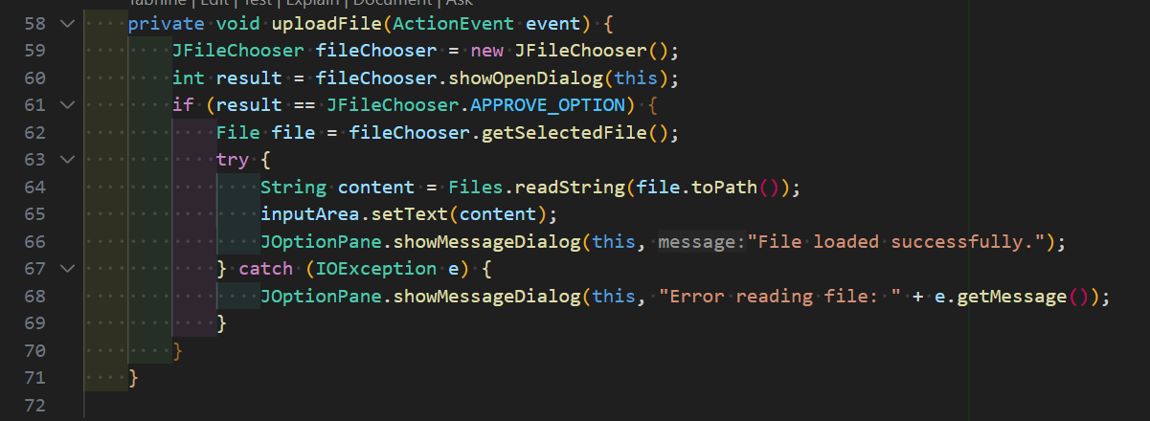
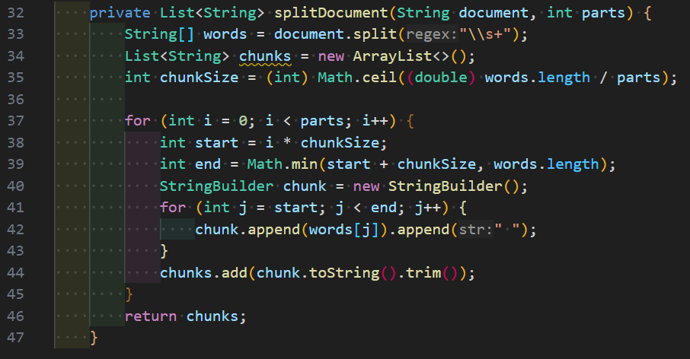
System Complexity
• Is it modeled after real-life systems?
Does the project reflect a realistic and challenging problem?

Slide 8





How much faster or more efficient is the system with multithreading compared to a single-threaded version? Does the system achieve its goals?
Are all main features implemented and working as intended?
multi-threaded
single-threaded

Slide 9



Is the code well-written, easy to understand, and modular?
Does it follow good programming practices?
Processor
1
Responsible for splitting the document into chunks and counting the words in each chunk. The core class for processing functionality.
MainApp
2
Manages the GUI, user interactions, and orchestrates the processing logic.
SubWindow
3
Displays the word count results for each thread in separate windows, enhancing the user experience.

Slide 10
Did the team come up with creative solutions or add any unique features to enhance the project ?
File Upload Feature : The system includes a file upload functionality, allowing users to load and process external documents easily. This improves usability and demonstrates an understanding of user needs.
Word Frequency : AnalysisA unique feature is the ability to calculate and display the frequency of words in each chunk of the document. It even highlights the top 5 most frequent words, providing insightful data beyond simple word counts.These features add significant value to the project, making it more user-friendly and informative.

Slide 11

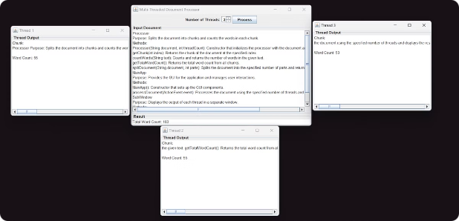


Thread Synchronization & Data Integrity
Synchronized Methods
Thread-Safe Structures
The Processor class uses synchronized methods to update the total word count, preventing race conditions and ensuring data integrity.
We utilize thread-safe data structures, such as ConcurrentHashMap, for storing results, ensuring thread-safe access and modification.

Slide 12
Error Handling & Robustness
Input Validation
1
The application carefully validates user input, ensuring the thread count is a positive integer and within the bounds of the document.
Exception Handling
2
Exception handling is implemented throughout the application to gracefully catch and manage unexpected errors or interruptions.
Thread Interruption
3
The application handles thread interruptions effectively, ensuring a smooth and controlled termination of processing threads.

Slide 13
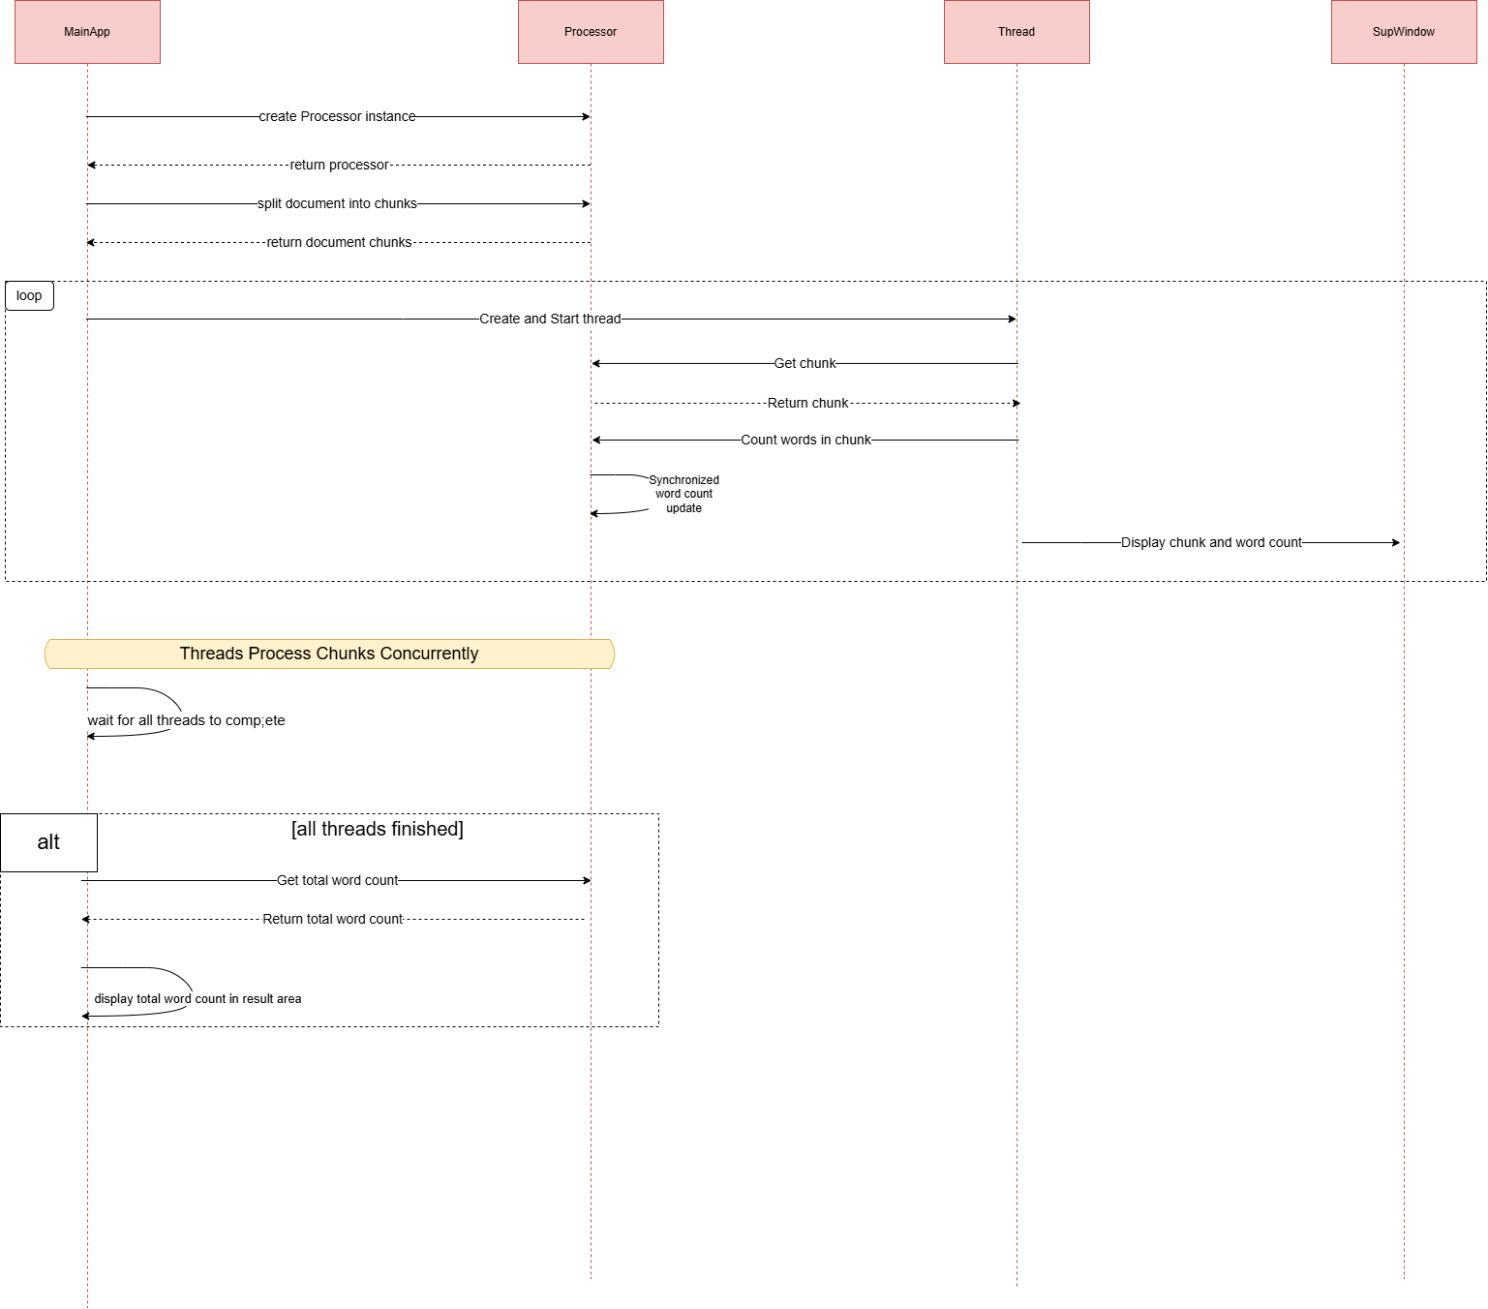
Sequance diagram

Slide 14
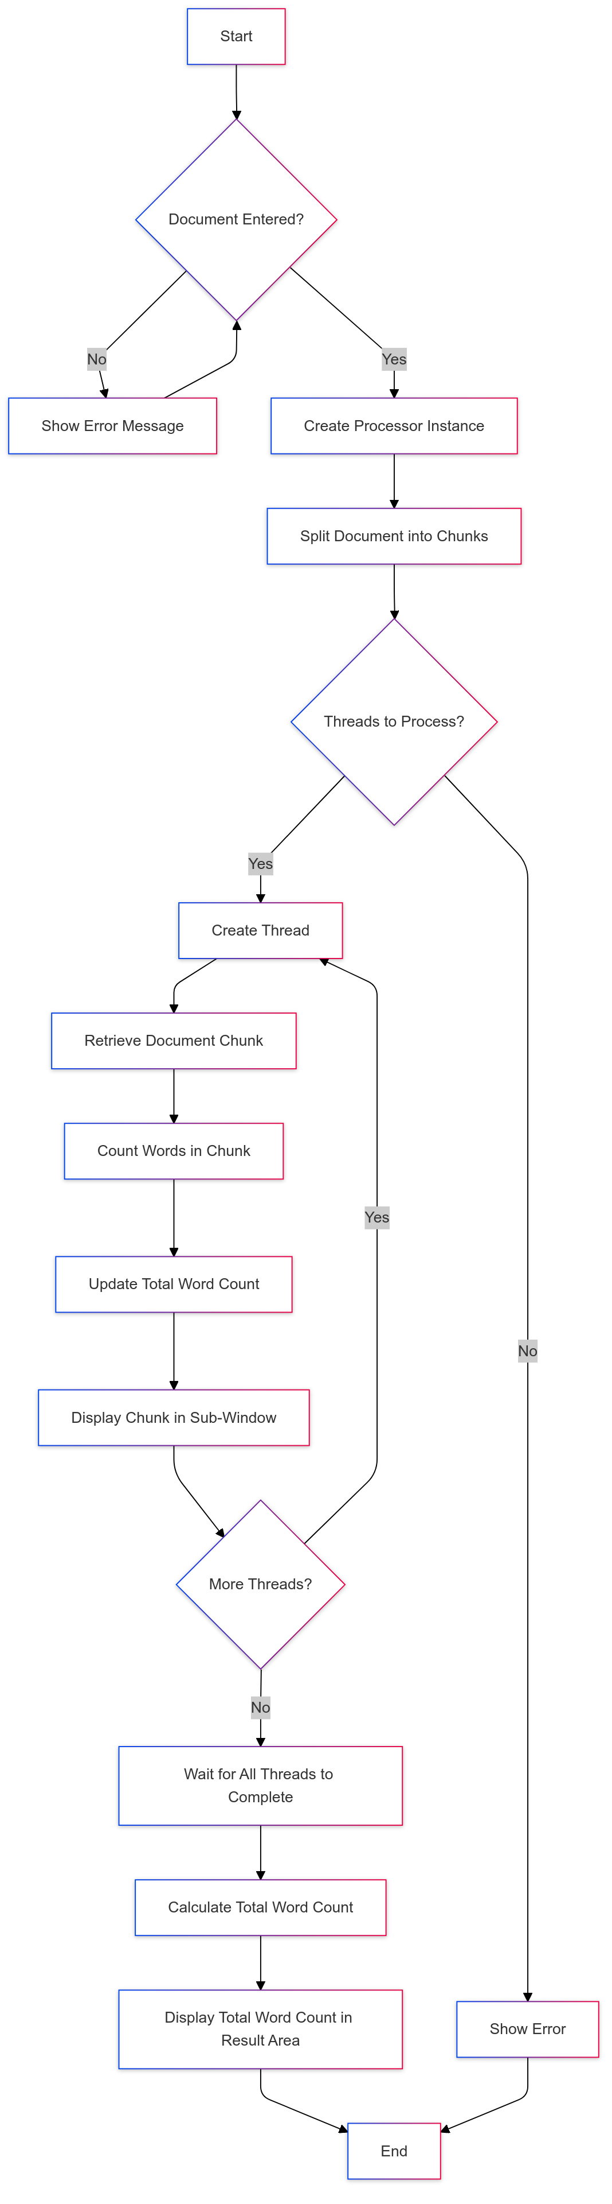
Activity diagram

Slide 15

Thank you ❤️

