Slide 1

FlightIQ
A Real-Time Big Data Analytics & Flight Delay Detection System
PROJECT PROPOSAL
SUMMER TRAINING PROGRAM
TRACK
GROUP
August – September 2026
Big Data Analysis
S26-B8-BIG DATA-G8-M
Marwan Khaled Sayed Boraiy • Abdullah Hussein Mohammed Elsayed • Roqaia Gamal Hosny Mohamed • Basmala Atef Mohamed Darwesh
GitHub: github.com/marwan5aled26/flight-iq

Slide 2

INTRODUCTION · 01
Executive Summary
FlightIQ is a Big Data project designed to track and predict flight delays. It combines historical datasets with live data streams from the Bureau of Transportation Statistics (BTS).
By combining Kafka, Spark, HDFS, and PostgreSQL, the system turns raw flight data into clear charts and live delay predictions — bridging the gap between historical analytics and real-time intelligence.
From raw records to real-time answers
Historical Data + Live Streams → Predictions
4+
2
<2s
Core Big Data Tools
Processing Modes: Batch & Stream
Target Streaming Latency
FlightIQ | Real-Time Flight Intelligence
2

Slide 3


INTRODUCTION · 02
Business Problem Statement
Flight delays cause significant problems for airlines and passengers. FlightIQ addresses two core technical challenges:
Huge Historical Data
Lack of Live Tracking
Past flight data is far too large to analyze quickly on a normal computer without dedicated Big Data tools.
Most current systems only look at past data — they cannot track or predict delays as they happen in real time.
FlightIQ | Real-Time Flight Intelligence
3

Slide 4


INTRODUCTION · 03
Project Overview & Concept
FlightIQ is built around two complementary engines that meet in one shared platform.
Batch Side
Streaming Side
For historical data
For live data
This system enables the team to:
Track live flights and catch delays instantly.
Analyze historical data to see which airlines or airports have the most delays.
Use a Machine Learning model to predict if a flight will be late — before it even lands.
FlightIQ | Real-Time Flight Intelligence
4

Slide 5





ARCHITECTURE · 04
Tools & Technologies Used
Data Storage & Lakehouse
HDFS & PostgreSQL
Storage for historical & streaming flight datasets with SQL querying capabilities.
Message Broker
Apache Kafka
Ingestion of real-time flight event streams with low latency.
Processing & ML Engine
Apache Spark (SQL, Streaming, MLlib)
Batch ETL, real-time stream processing, and ML delay predictions.
Visualization & Reporting
Power BI
Interactive dashboards for monitoring real-time flight metrics and historical analytics.
Infrastructure
Docker
Runs and manages all Big Data tools in isolated environments via a single file.
Version Control
Git & GitHub
Codebase management, collaborative development, and project tracking.
FlightIQ | Real-Time Flight Intelligence
5

Slide 6
ARCHITECTURE · 05
Project Workflow & Process
5.1
5.2
Storage & Batch Foundation
Stream Simulation & Ingestion
Upload raw historical CSVs into HDFS
Clean data with Spark; save as Parquet
Set up PostgreSQL tables for SQL queries
Python script simulates live flight rows
Live data pushed into Kafka topics
5.3
5.4
Real-Time Processing & ML Inference
Visualization
Spark Streaming reads Kafka, computes stats every 5 min
Pre-trained ML model predicts delays live
Dashboard unifies batch & streaming results into one clear view
FlightIQ | Real-Time Flight Intelligence
6

Slide 7
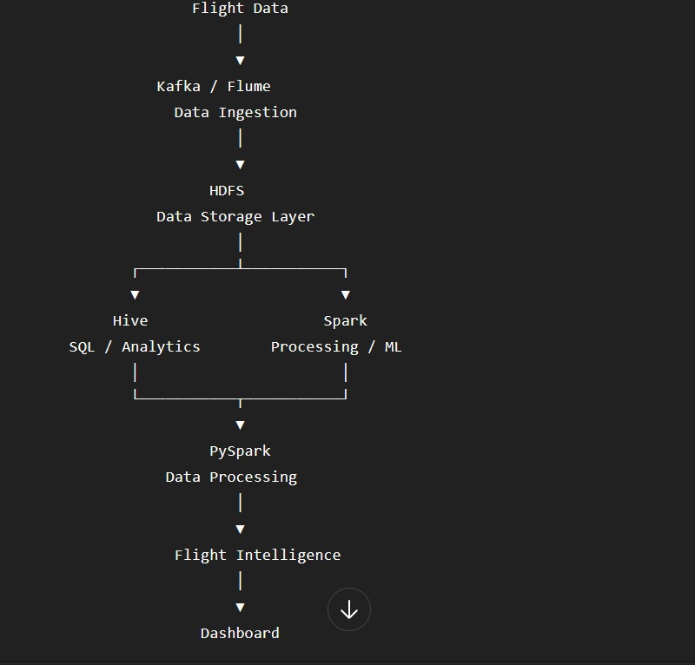
ARCHITECTURE · 06
System Architecture
From Data to Decisions — Faster Flights, Happier Journeys
1
Ingestion
Kafka streams real-time flight events with low latency
2
Storage
HDFS holds raw & historical data; PostgreSQL serves queries
3
Processing
Spark runs batch ETL and real-time streaming analytics
4
Intelligence
MLlib model scores live streams for delay prediction
5
Delivery
Power BI dashboards reach airlines, passengers & analysts
FlightIQ | Real-Time Flight Intelligence
7

Slide 8


INTELLIGENCE · 07
Machine Learning Pipeline & Strategy
The Goal
Key Features
Training the Model
Using the Model
Predict if a flight will be delayed by more than 15 minutes (Yes / No).
Time, Distance, Day of the Week, Airline, and Airport.
Train a Random Forest model using Spark MLlib on historical data.
Plug the trained model into the live Spark stream to predict delays instantly.
FlightIQ | Real-Time Flight Intelligence
8

Slide 9

REQUIREMENTS · 08
Functional Requirements
Real-Time Stream Processing
Delay Cause Categorization
Read JSON flight events from Kafka and process them in Spark using 5-minute windows.
Group delays by reason (Carrier, Weather, NAS, Security, Late Aircraft) and calculate percentages.
Carrier & Airport Rankings
Predictive Delay Inference
Compute On-Time Performance (OTP %) and average delays, saved to partitioned PostgreSQL tables.
Apply a pre-trained ML model to live streams to predict delays over 15 minutes.
FlightIQ | Real-Time Flight Intelligence
9

Slide 10

REQUIREMENTS · 09
Non-Functional Requirements
Scalability
Performance & Latency
Scale horizontally by adding Spark workers, HDFS DataNodes, or Kafka partitions.
End-to-end stream processing under 2 seconds; Parquet format for fast PostgreSQL queries.
Fault Tolerance
Portability
Spark checkpointing and HDFS replication prevent data loss if a node crashes.
Spin up the entire environment (Kafka, Spark, HDFS, PostgreSQL) with a single docker-compose command.
FlightIQ | Real-Time Flight Intelligence
10

Slide 11

DELIVERY · 10
Challenges & Mitigation Strategies
Unbalanced Data
Most flights are on time, so the ML model might get confused.
Use techniques like SMOTE in Spark to balance the data before training.
Missing Values
Canceled or on-time flights have empty delay columns.
Fill empty delay times with “0” and handle canceled flights separately.
Heavy on Computer RAM
Running Kafka, Spark, and Hadoop together is heavy on a local machine.
Cap Spark Worker memory (~2GB), tune JVM heap, and optimize Docker resource allocation.
FlightIQ | Real-Time Flight Intelligence
11

Slide 12
DELIVERY · 11
Project Deliverables
1
Code
A GitHub repository with all Python and Spark scripts.
2
Setup File
A docker-compose.yml file to run the entire environment with one click.
3
Database
PostgreSQL tables ready for running queries.
4
Dashboard
A visual interface presenting all results.
5
Report & Video
A document explaining the project plus a short video demo.
FlightIQ | Real-Time Flight Intelligence
12

Slide 13
Thank You
From Data to Decisions — Faster Flights, Happier Journeys
Marwan Khaled Sayed Boraiy • Abdullah Hussein Mohammed Elsayed • Roqaia Gamal Hosny Mohamed • Basmala Atef Mohamed Darwesh
github.com/marwan5aled26/flight-iq

