Slide 1

PowerPoint O H Classification: Confidential/

Slide 2


PowerPoint O H Classification: Confidential/
EMPLOYEE
INDUCTION
Presented by: Waleed Abo Alola
Introduction
02

Slide 3
PowerPoint O H Classification: Confidential/
Welcome On Board

Slide 4
PowerPoint O H Classification: Confidential/
Agenda
Time | Duration | Activity
10:00 AM | 60 mins | About My Clinic
11:00 AM | 15 mins | Break
11:15 AM | 60 mins | HR policies
12:15 am | 30 mins | Break
12:45 pm | 45 mins | Health & Safety
01:30 pm | 45 mins | Clinical Risk
02:15 pm | 45 mins | Infection Control
Agenda
04

Slide 5

PowerPoint O H Classification: Confidential/
Let Us Know Each Other
Todays question:
If you had one million Saudi Riyals, where would you spend it?

Slide 6
PowerPoint O H Classification: Confidential/
Oracle
43

Slide 7
PowerPoint O H Classification: Confidential/
Overview
01
02
03
04
Our Purpose
& Mission
Core Values
Company
Strategy
Our Leaders
05
06
07
08
Our
Branches
Company History
Key Awards
Code of Ethics & Professional Conduct
Overview
06

Slide 8
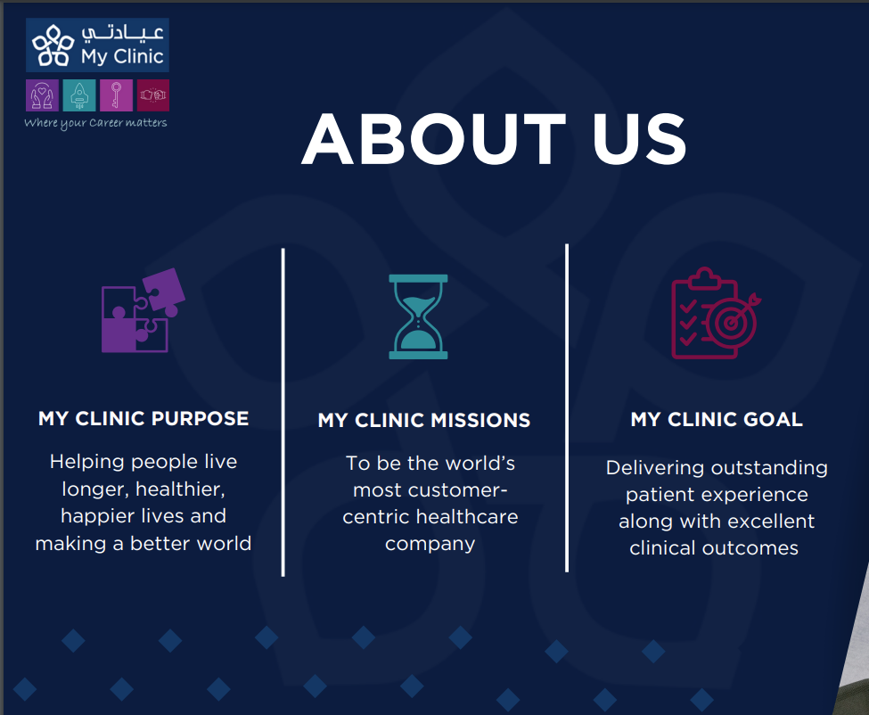
PowerPoint O H Classification: Confidential/

Slide 9




PowerPoint O H Classification: Confidential/
Why Our Values Matter
Each value is a steppingstone toward achieving our purpose.
Actions We Take
Caring
Ambitious
Responsible
Collaborative
Putting empathy first
Set new standards
Creating a culture
of accountability
Unites diverse
Act with empathy
Everyone matters
Love our customers
Deliver with quality
Go above and beyond
Make new possibilities happen
Challenge the status quo
Become industry shapers
Deliver outstanding results
Own our decisions and actions
Make things happen
Demonstrate high professional standards
Hold yourself and each other accountable
Act together
Treat everyone with respect
Be transparent
Embrace diverse perspectives
Deliver outstanding results
Collective Impact:
Together, our values shape a culture of care, responsibility, ambition, and collaboration that positively impacts both individuals and society.
Our Why
10

Slide 10







PowerPoint O H Classification: Confidential/
Our Customer Proposition
Who do we server?
Patient & his family sick or healthy
I
The Community
I
Corporates & Insurance
Strategic Objectives
How are we going to progress? Plan, Goals, Sequencing
Care
CURE
CLOSER
A Legendary Service & Care
Tackle the biggest HC challenge
Convenient & Easy Access
How do
we deliver
Seamless customer experience
Empathy & Compassion
Build Loyalty through My Care
Service & Advocacy mindset
The best Saudi doctors
Focusing on clinical outcome
Centers of excellence
Prevention & Wellbeing
Convenient physical access
Community Clinics & HHC access
Digital leadership through Access & Services
Reliable Call Centre & Telemed services
CLINICIANS
CULTURE
CAPABILITIES
COST
An Attractive Doctor Value Proposition
The way we do things around here
A repeatable business model
What are
the enablers
Serve & caring environment
Competitive benefits
Growth and development
Our Mission, Values & Beliefs
Servant Leadership
A culture of excellence
A repeatable operational & expansion model
With a robust Governance & compliance
Powered by Peopleware, Software & Hardware capabilities
With a Competitive cost 2 serve
Competitive cost to serve
Revenue cycle management
Operational efficiency
Overhead management
Customer Proposition
11

Slide 11
PowerPoint O H Classification: Confidential/
Meet Our Leaders
Our Leaders
12

Slide 12

PowerPoint O H Classification: Confidential/
Mr. Abdullah Alghamdi
Chief Executive Officer
Our Leaders
13

Slide 13
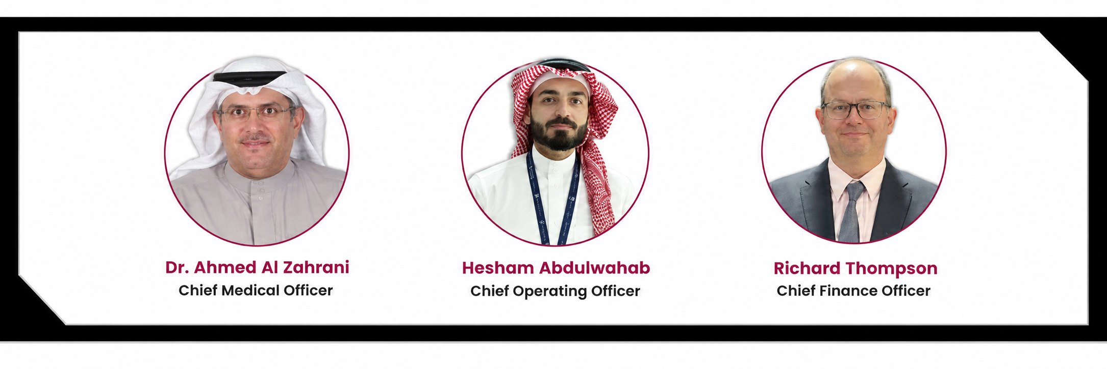

PowerPoint O H Classification: Confidential/
Meet
Our Leaders
Our Leaders
14

Slide 14
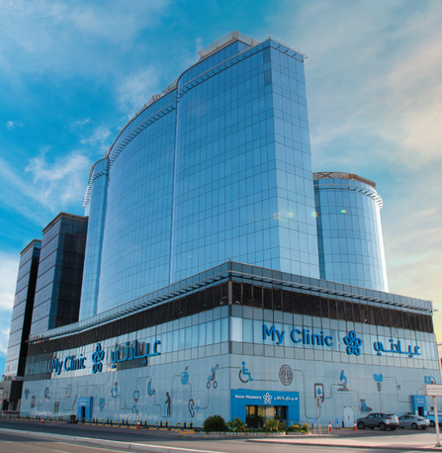

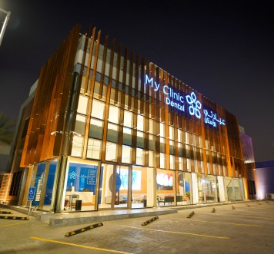
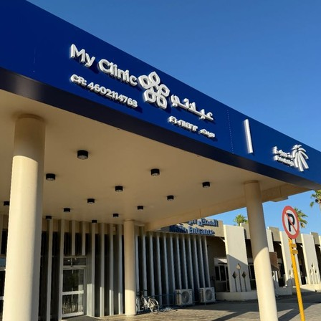
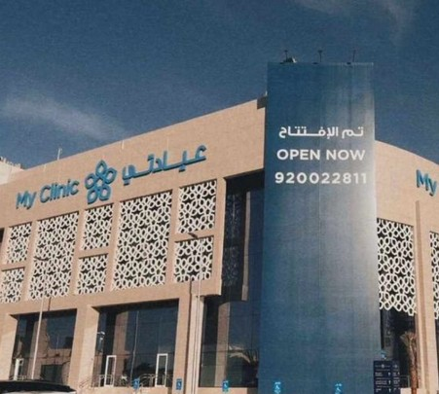
PowerPoint O H Classification: Confidential/
OUR BRANCHES
(J1)
Our first full- service outpatient clinic in North Jeddah
Opened 2017
(J2)
Our second full- service outpatient clinic in East Jeddah
Opened 2021
(D1)
Our Dental Centre in Jeddah
Opened 2022
(PRC)
Our Clinic
in Petro-Rabigh
Opened 2023
(R1)
Our first clinic in Riyadh.
A flagship in a prestigious part, to establish our brand
Opened 2024
OUR BRANCHES
15

Slide 15
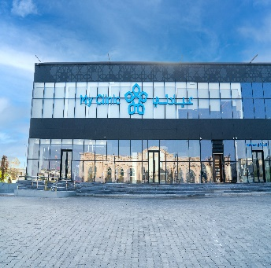
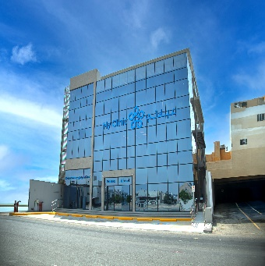
PowerPoint O H Classification: Confidential/
OUR BRANCHES
(J3)
Al Andalus Branch
Our first community clinic in Jeddah
Opened 2025
(J4)
Abhor Branch
Our Second Community Clinic
in Jeddah
Opened 2026
OUR BRANCHES
15

Slide 16
PowerPoint O H Classification: Confidential/
2017
2019
2022
2024
2026
Established
Corporate check-up
Expansion
Expansion
Expansion
We opened My Clinic (MCJ1)
We started the Employment check-up unit
We opened My Clinic (MCD1)
We opened My Clinic (MCR)
We opened
Obhur Branch
2018
2021
2023
2025
New Products
Launched
Expansion
Expansion
Expansion
We opened My Clinic (MCJ2)
We opened My Clinic (PRC)
We opened Al Tahlia Branch
New programs: Such as In-House clinics
OUR BRANCHES
16

Slide 17



PowerPoint O H Classification: Confidential/
Key Awards
Centre of Excellence
International Finance
CBAHI
Best new clinic for
customer service (2018)
Best New Premium Clinic
(2018-19)
Most innovative corporate wellness
initiative in Saudi Arabia (2019)
Central Board for
Accreditation of Healthcare
Institutions
MCJ1 Score: 98.67 (2022)
MCJ2 Score: 100 (2023)
Best Clinical Patient Outcome (2019-2020)
Key Awards
15

Slide 18

PowerPoint O H Classification: Confidential/
Key Awards
Key Awards
15

Slide 19
PowerPoint O H Classification: Confidential/
Code of Ethics and Professional Conduct

Slide 20

PowerPoint O H Classification: Confidential/
Core Values of My Clinic Ethics
Respect:
Ensure the rights, privacy, and dignity of patients, families, and colleagues are always upheld.
Integrity:
Engage in transparent practices; disclose any potential conflicts of interest related to recruitment, procurement, or other business dealings.
Accountability:
A culture of accountability encourages reporting of safety concerns and adherence to established policies.
Innovation and Collaboration:
Support research and community engagement to enhance healthcare quality and outcomes.

Slide 21
PowerPoint O H Classification: Confidential/
Ethical Decision-Making and Reporting
Ethical Decision-Making:
Consult with colleagues for cases beyond your expertise to ensure quality patient care. (Through committee)
Reporting Ethical Dilemmas:
If faced with an ethical dilemma, complete an Incident Report within 24 hours.
Engage the ethics team for further guidance and support.

Slide 22
PowerPoint O H Classification: Confidential/
Responsibilities and Conclusion
Your Role:
Every employee is responsible for upholding these ethical standards and contributing to a positive work environment.
Conclusion:
Your commitment to the Code of Ethics is vital in providing quality care and supporting our mission at My Clinic.

Slide 23
PowerPoint O H Classification: Confidential/
Rights and Responsibilities of Patients and Families

Slide 24
PowerPoint O H Classification: Confidential/
Patients' Rights
Rights Include:
Access to Care: Impartial access regardless of race, gender, or disability.
Information and Informed Consent: Knowledge of care providers and treatment options.
Privacy and Confidentiality: Protection of personal health information.
Pain Management: Right to appropriate assessment and management of pain.
Refusal of Treatment: Patients can refuse treatment after understanding risks.
Have access to a patient advocacy representative or clinic administrator upon complain request at any time.
Note: Please refer back to the posted in the receptions area at My Clinic

Slide 25
PowerPoint O H Classification: Confidential/
Patients' Responsibilities
Responsibilities Include:
Provision of Information: Accurate health information must be provided.
Compliance with Instructions: Follow treatment plans and attend appointments.
Respect for Others: Be considerate of other patients and staff.
Note: Please refer back to the posted in the receptions area at MyClinic

Slide 26
PowerPoint O H Classification: Confidential/
Conclusion
Conclusion:
Understanding and respecting these rights and responsibilities is essential for providing quality care at My Clinic.

Slide 27
PowerPoint O H Classification: Confidential/
Break Time

Slide 28
PowerPoint O H Classification: Confidential/
Human Capital
Human Capital
22

Slide 29
PowerPoint O H Classification: Confidential/
Oracle
43

Slide 30
PowerPoint O H Classification: Confidential/
Help Desk- HR Services
Business Unit | E-mail | Key Person
J1 | HR.MC1@myclinic.com.sa | Fisal Alharthy
J2 | HR.MC2@myclinic.com.sa | Ahmed Alzahrani
R1 | MCRHR@myclinic.com.sa | Abdulaziz Alshair
PRC | HR.PRC@myclinic.com.sa | Nasser
SABIC | Abdulrahman.Alharbi@myclinic.com.sa Muhammad.Fahad@myclinic.com.sa | Abdulrhman / Muhammad
Agenda
23

Slide 31
PowerPoint O H Classification: Confidential/
Overview
01
02
03
04
Types
of Leaves
Letters
Overtime
GOSI
05
06
07
08
Oracle HR
System
ID Card, Benefits & Dress code
Resignation & Employment Contract
SCFHS
Overview
24

Slide 32
PowerPoint O H Classification: Confidential/
Types
of Leaves
Annual Leave
Sick Leave
Maternity Leave
Educational Examination Leave
Compassionate Leave (including Marriage Leave, Bereavement Leave, and Paternity Leave)
Scientific Leave
Leaves
25

Slide 33
PowerPoint O H Classification: Confidential/
Annual
Leave
Employees may begin using their annual leave immediately after completing their probationary period, subject to prior approval from their line manager.
The limit for carrying over annual leave is up to 5 days. Any carried-over leave must be utilized by the end of March of the following calendar year.
For Consulting Room Physicians, carried-over leave must be taken by the end of June.
Annual leave does not include weekends, days off, public holidays, or Saturdays if they fall within an approved annual leave period.
Leaves
26

Slide 34
PowerPoint O H Classification: Confidential/
Annual
Leave
Entitlement is based on employee grade:
30 working days for Grade H
27 working days for Grade G
25 working days for Grades F and Consultant
22 working days for Grades A to E
Leaves
27

Slide 35
PowerPoint O H Classification: Confidential/
Sick
Leave
An employee who feels unwell must notify their line manager. Sick leave will only be accepted with a valid medical report. Additionally, approval from the Staff Health Clinic is required for sick leave reports issued by healthcare providers other than My Clinic. If the report is from My Clinic, Staff Health Clinic approval is not necessary.
For the first 30 days of sick leave (whether continuous or separated), the employee will receive full salary.
From 31 to 90 days (whether continuous or separated), 25% will be deducted from the salary.
From 91 to 120 days (whether continuous or separated), the leave will be unpaid.
Leaves
28

Slide 36
PowerPoint O H Classification: Confidential/
Work
injury
This policy applies to both Saudi and expatriate employees. It may occur:
During work hours
While commuting to or from work
Employees are responsible for reporting the incident to their line manager and HR on the same day or the following day. Additionally, employees must provide documentation for any treatment costs or sick leave taken. HR will then report the case to GOSI. Coverage applies only to treatment invoices related to work injuries.
Leaves
29

Slide 37
PowerPoint O H Classification: Confidential/
Maternity
Leave
Female employees are entitled to maternity leave according to the following guidelines:
A total of 12 weeks of maternity leave.
Flexibility in the start date of maternity leave, allowing for a maximum of 4 weeks prior to the expected delivery date.
Leaves
29

Slide 38
PowerPoint O H Classification: Confidential/
Educational
Examination Leave
Employees are granted paid leave for academic examinations. However, repeated exams are not covered.
Leave days are limited to the actual examination days, not the entire exam week.
Documentation supporting the leave request must be submitted at least two weeks in advance and should include the following: Exam Schedule, Student Course Schedule, and, after the exams, a Result Transcript.
Eligible exams must be for academic purposes only; tests such as TOEFL, IELTS, and Microsoft certifications are not eligible for this leave.
Leaves
30

Slide 39
PowerPoint O H Classification: Confidential/
Scientific
Leave
To provide healthcare practitioners with adequate time for continuous development, scientific leave days are allocated as outlined in the table below:
Healthcare Profession | Number of Days Per Year
Consultants | 7 Calendar days
Other Physicians (Medical & Administrative) and Dentists | 5 Calendar days
Pharmacists | 4 Calendar days
Nurses | 3 Calendar days
Technicians (Lab, Radiology) | 2 Calendar day
Leaves
31

Slide 40
PowerPoint O H Classification: Confidential/
Scientific
Leave
Supporting documents must be submitted with the pre-approval of the MD.
Scientific leave days cannot be carried over to the following year.
These leave days may be taken either consecutively or separately.
Leaves
32

Slide 41
PowerPoint O H Classification: Confidential/
Hajj
Leave
This policy applies to Muslim employees who have completed two full years of continuous service with My Clinic.
For performing Hajj, employees are eligible for 10 to 15 days of leave, including the days of Eid. An official copy of the Hajj permit must be submitted with the request; otherwise, the employee will not be eligible for the leave.
Leave is subject to the line manager's approval based on business needs.
Leaves
33

Slide 42
PowerPoint O H Classification: Confidential/
Compassionate Leave
Occasion | Number of Days
Employee Marriage | 5 Calendar days
Paternity Leave | 3 days
Death of an Immediate Relative (Spouse, Parents, Child | 5 Calendar days
Death of a Sibling | 3 Calendar days
Death of a Husband (for Muslim Female Employees) | 130 Calendar day
Death of a Husband (for Non-Muslim Female Employees) | 15 Calendar day
Leaves
35

Slide 43
PowerPoint O H Classification: Confidential/
Official
Holidays
Eid al-Adha: 4 days
Eid al-Fitr: 4 days
Founding Day: February 22
Saudi National Day: September 23
Leaves
34

Slide 44
PowerPoint O H Classification: Confidential/
General Organization of Social Insurance - GOSI
The General Organization for Social Insurance (GOSI) is a financially and administratively independent government entity that provides social protection and insurance coverage in the Kingdom of Saudi Arabia.
Leaves
36

Slide 45
PowerPoint O H Classification: Confidential/
GOSI
Deduction: A percentage of 9.75% will be deducted from the basic salary and housing allowance until the employee retires at the age of 60 (applicable only to Saudis).
GOSI Deductions:
Employee deduction: 9.75%
Company deduction: 11.75%
Total deduction: 21.5%"
Leaves
37

Slide 46
PowerPoint O H Classification: Confidential/
Calculation for GOSI Deduction:
Deduction=(Basic Salary + Housing Allowance)×9.75%
Example:
(4800+1200)×9.75%
6000×9.75%=585 (deducted from total salary)
Leaves
38

Slide 47
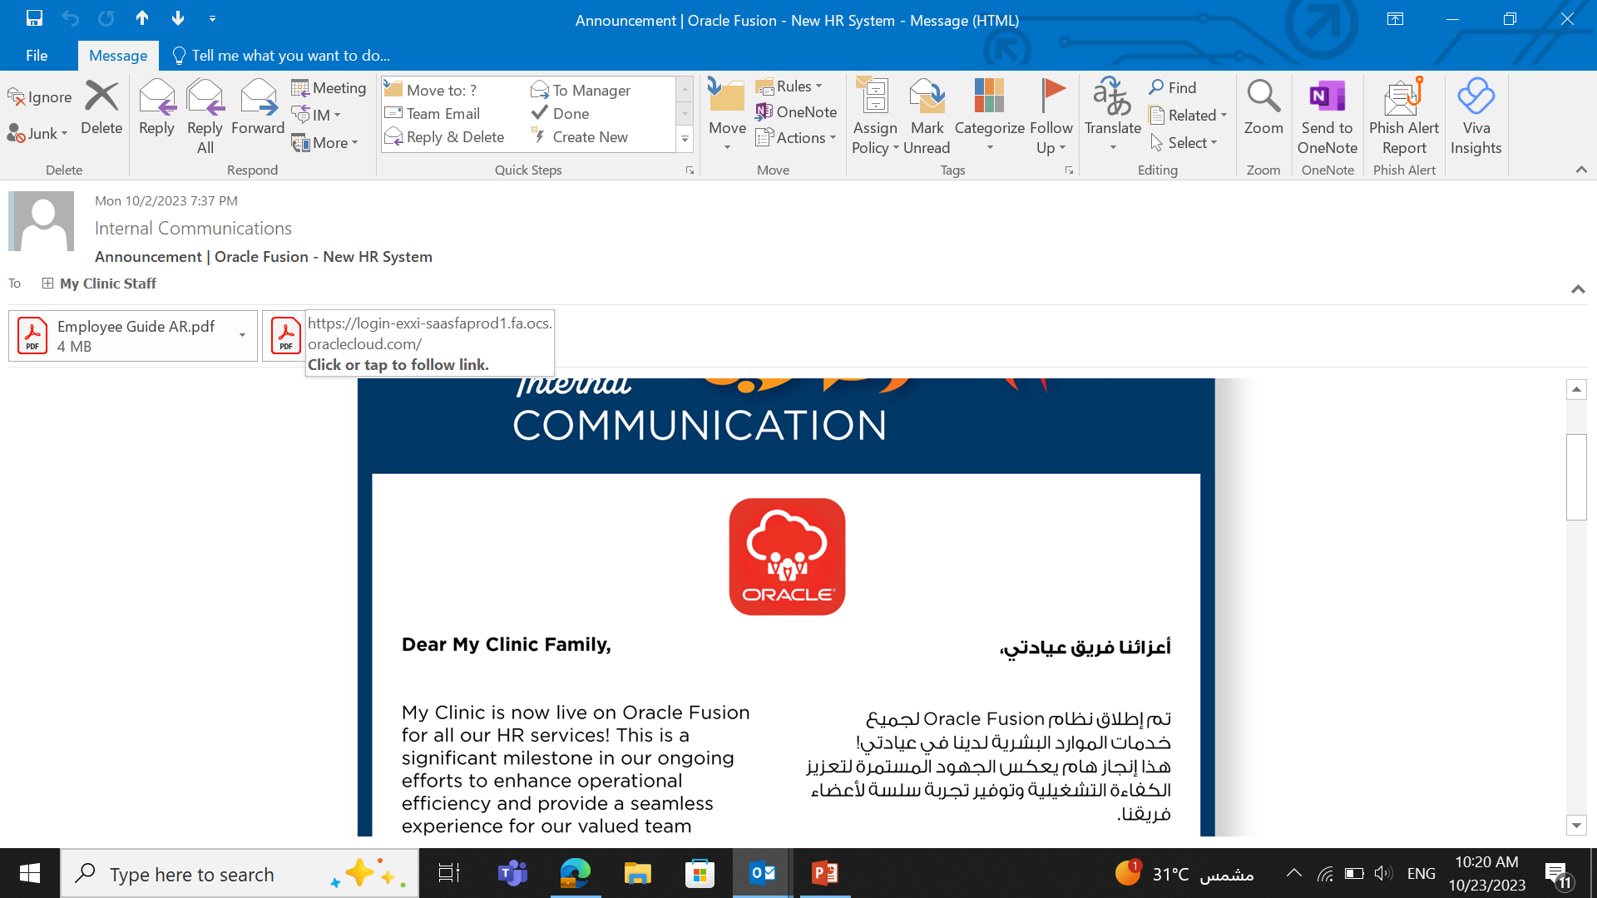
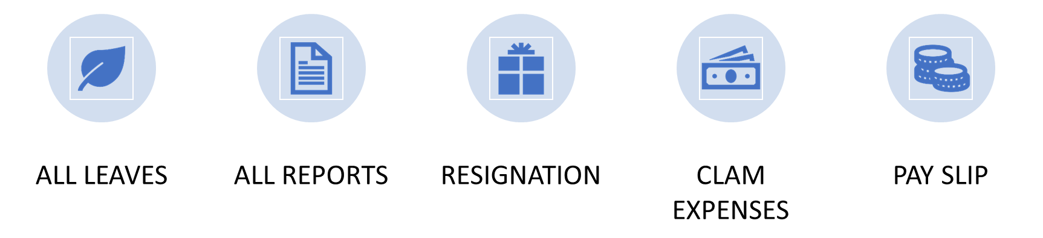
PowerPoint O H Classification: Confidential/
Letters
Letters can be requested through the Oracle system, with or without salary details included.
Examples:
Letters to governmental entities
Vacation approval letters"
Letters
40

Slide 48
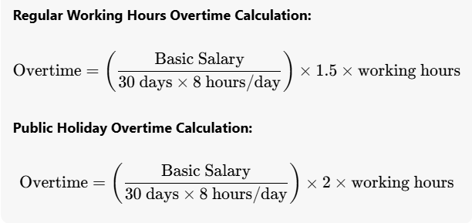
PowerPoint O H Classification: Confidential/
Overtime
Overtime pay depends on the employee's grade.
Overtime
41

Slide 49
PowerPoint O H Classification: Confidential/
SCFHS
Mumaris is the unified portal for the services of the Saudi Commission for Health Specialties (SCFHS) for health practitioners in the Kingdom of Saudi Arabia.
Health practitioners must renew their licenses, and HR will cover the expense claims only. Furthermore, my clinic will not pay any penalties incurred due to delays in renewing practitioners' licenses.
If a practitioner does not renew their license and only has 30 days left until expiration, HR may suspend them from work.
SCFHS
42

Slide 50
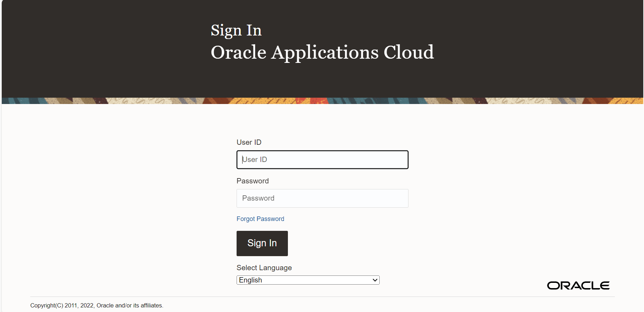
PowerPoint O H Classification: Confidential/
Leaves
43

Slide 51




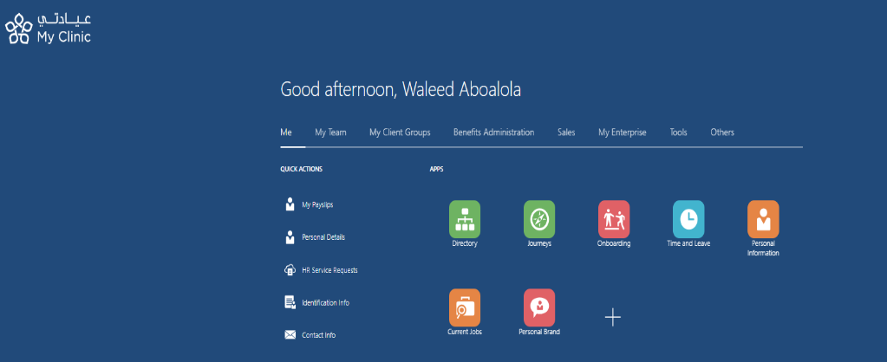
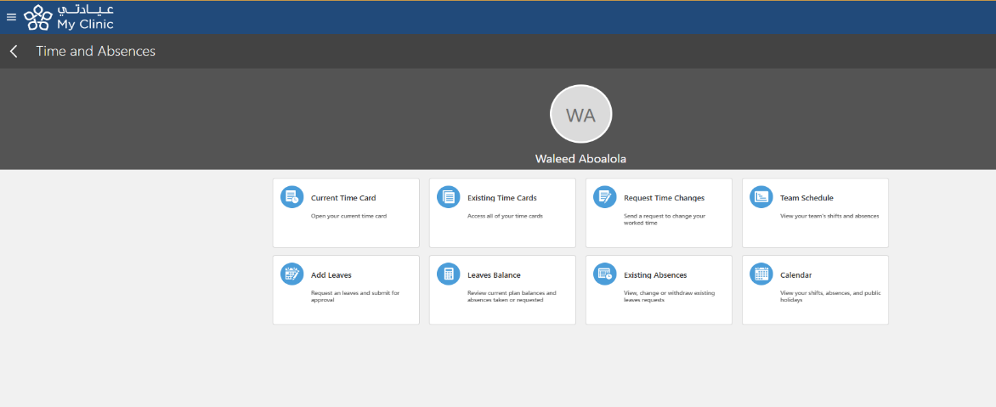
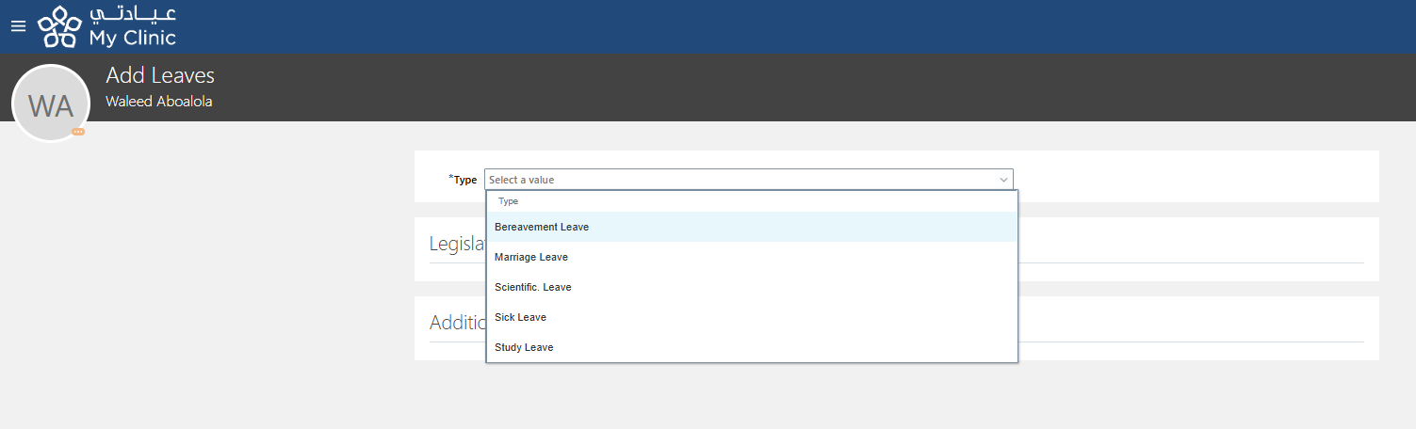
PowerPoint O H Classification: Confidential/
Vacation Request

Slide 52

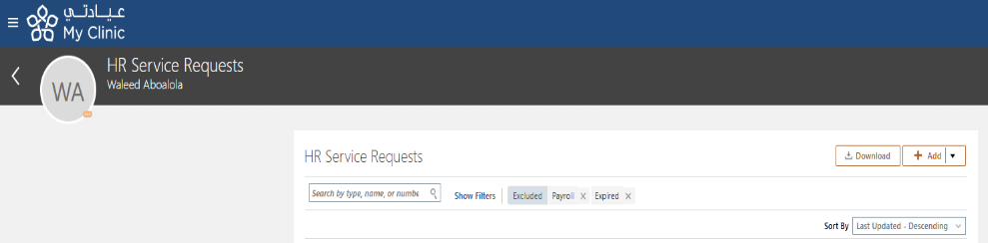
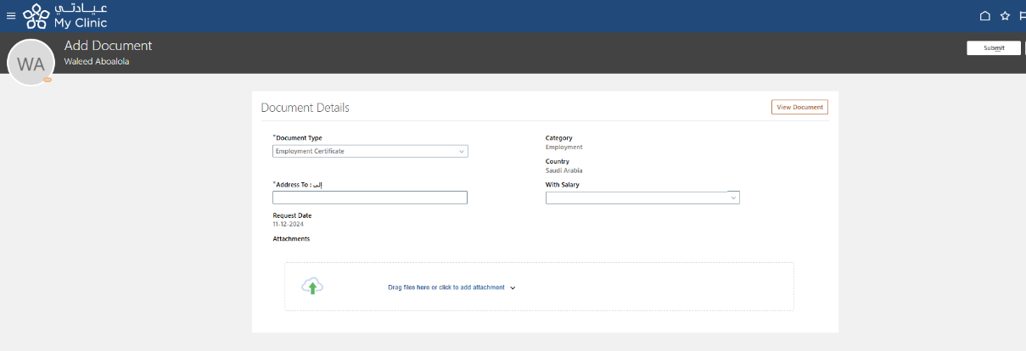
PowerPoint O H Classification: Confidential/
Employment Certificate Request
Certificate Request
45

Slide 53
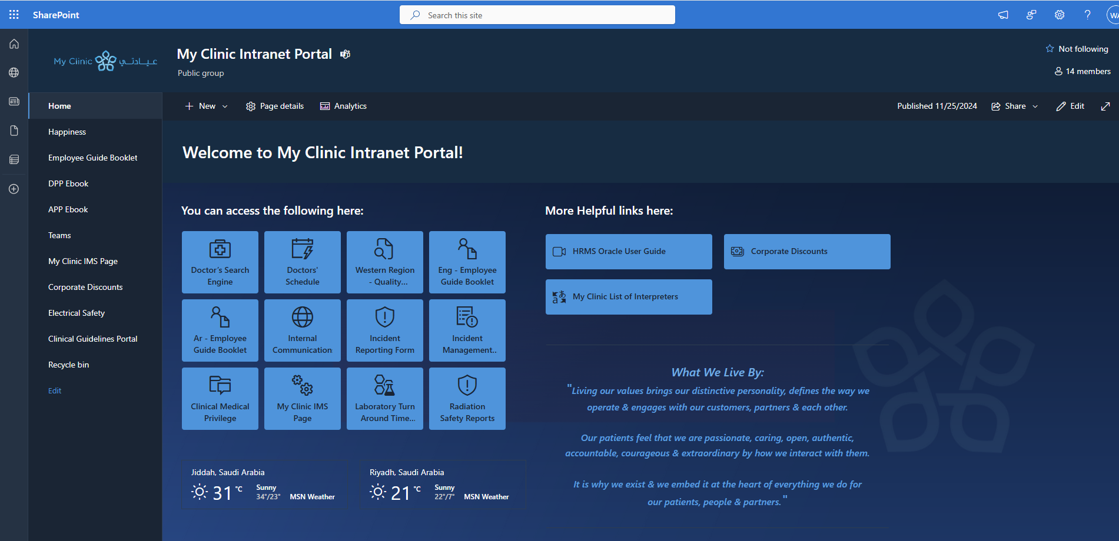
PowerPoint O H Classification: Confidential/
My Clinic Intranet Portal
My Clinic Intranet Portal - Home (sharepoint.com)
Portal
46

Slide 54
PowerPoint O H Classification: Confidential/
HRMS Oracle User Guide
Oracle
43

Slide 55
PowerPoint O H Classification: Confidential/
ID Card
In the event that an ID card is lost, the employee must send an email to HR.
An employee will incur a penalty of 100 SAR, which will be deducted from their monthly salary.
If the ID card is damaged or broken, the employee will receive a replacement ID card at no charge.
ID Card
47

Slide 56

PowerPoint O H Classification: Confidential/
Benefits & Dress
Code
Dress Code
19

Slide 57
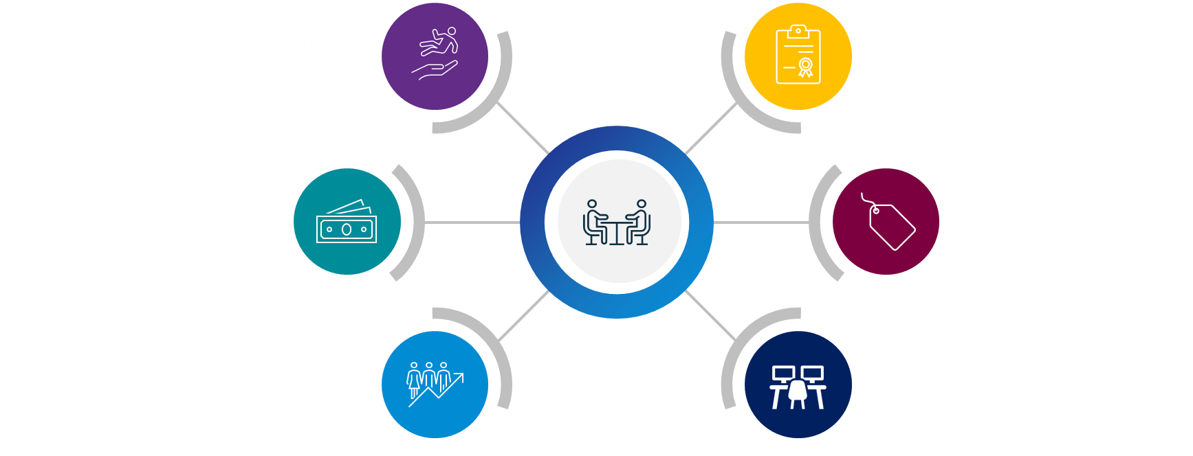
PowerPoint O H Classification: Confidential/
Benefits
Benefits
Health Insurance
Internal Advancement Opportunities
Annual Performance Bonuses
Discounts
Employee Development Opportunities
Hybrid Work Policy
Benefits
18

Slide 58
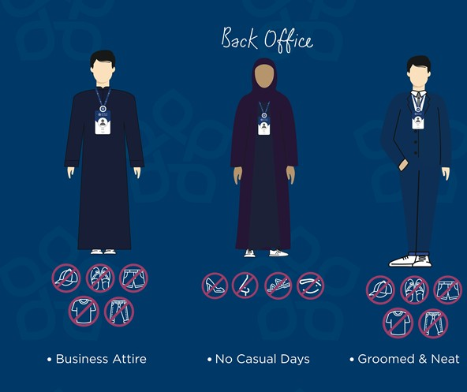
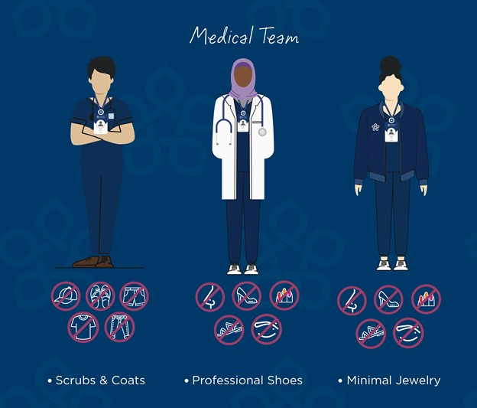
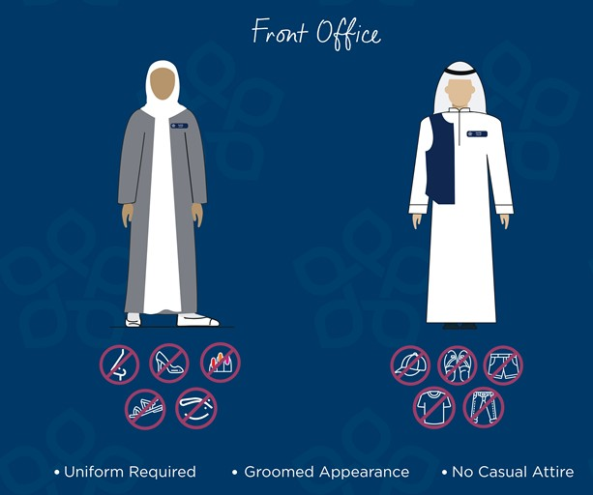
PowerPoint O H Classification: Confidential/
Dress Code Policy
Dress Code
20

Slide 59
PowerPoint O H Classification: Confidential/
Resignation
Resignation is a voluntary request by the employee to terminate their contract.
Resignations must be submitted through Oracle.
The agreed-upon notice period, as stipulated in the employment contract, is two months and must be honoured by both parties.
In the event of termination by the organization, payment will be processed within one week.
End-of-service benefits will be prepared at the conclusion of the notice period, along with the experience certificate, and will be disbursed within 15 days of the employee's last working day.
Resignation
48

Slide 60
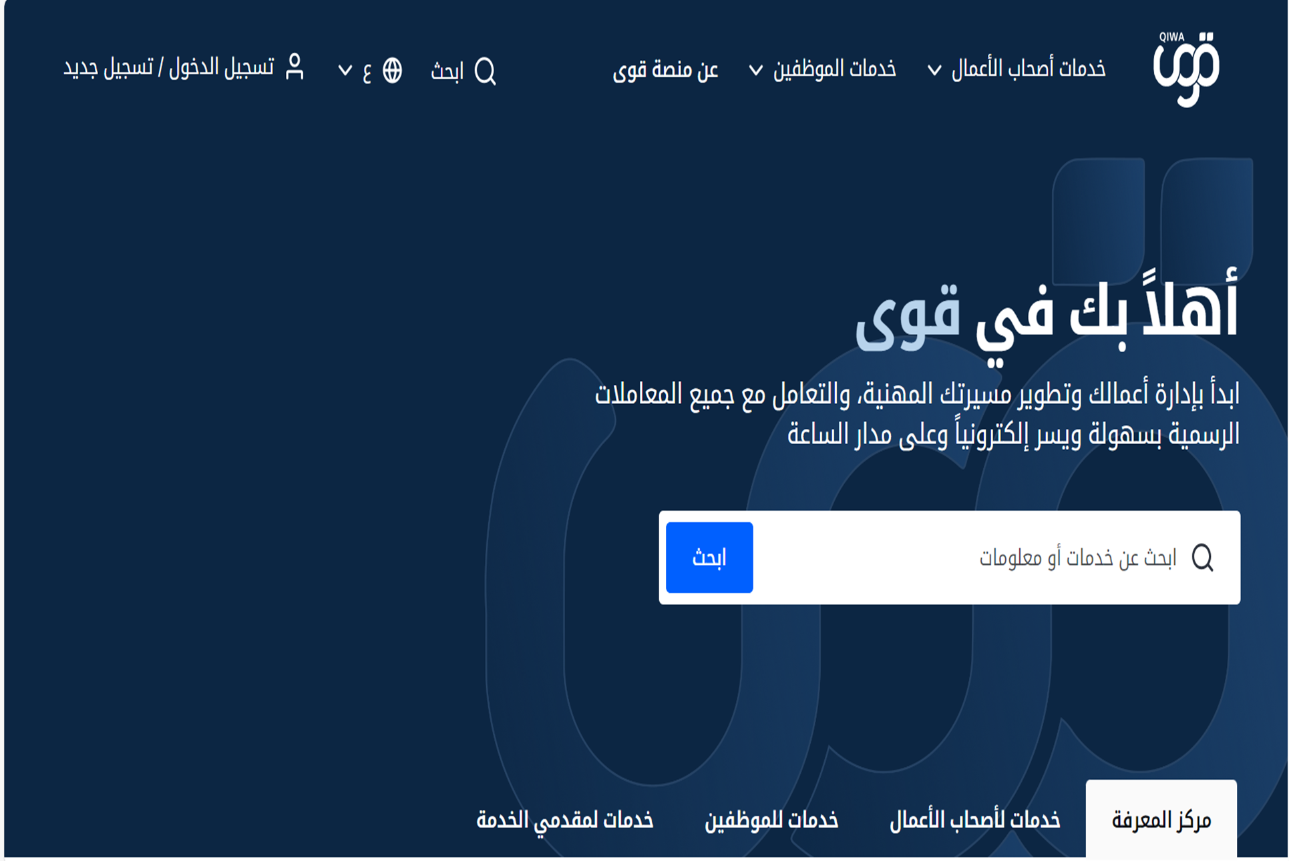
PowerPoint O H Classification: Confidential/
Contracts
Acceptances the contract to Qiwa.
Contracts
49

Slide 61

PowerPoint O H Classification: Confidential/

Slide 62

PowerPoint O H Classification: Confidential/
Thanks

