Slide 1
Project: Manual Backend Testing with WeatherMap API
Application: SauceDemo + WeatherMap API
Prepared by: Marwan Alaa Fathy Ahmed
Diploma: Software Testing (SWT 513)
Note:
This presentation covers the API Testing part of the project.
An Excel sheet containing all Manual Test Cases and Bug Tracking is attached separately.

Slide 2
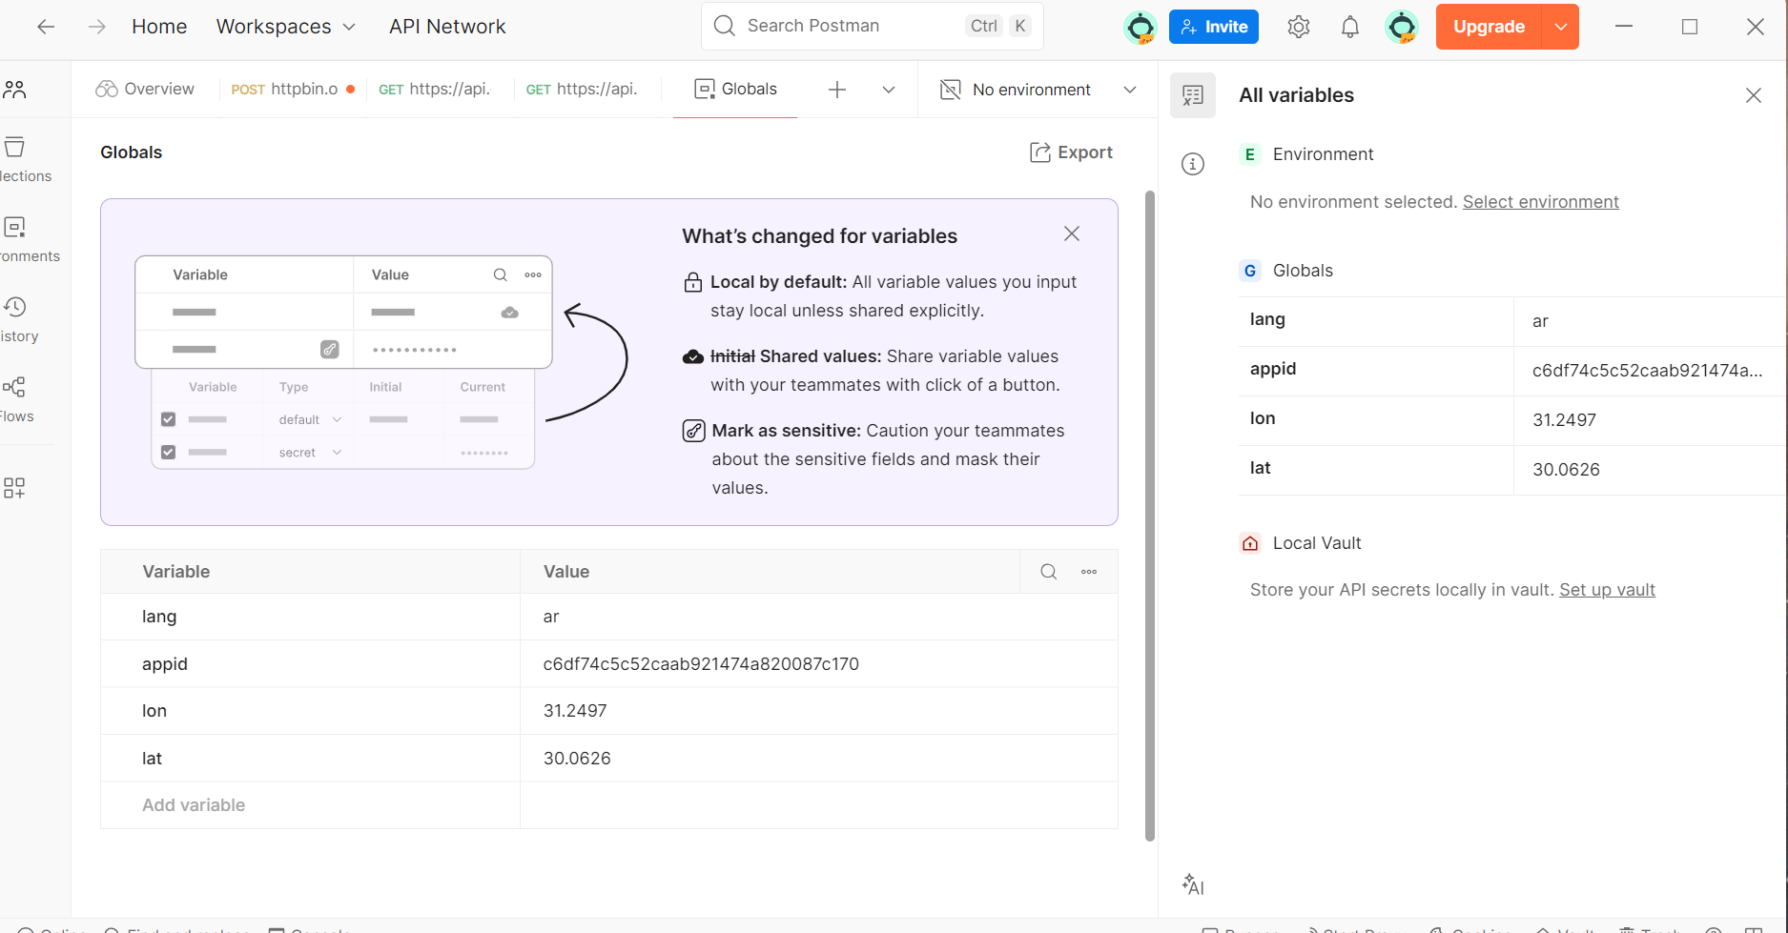
Global Varivbles Created

Slide 3
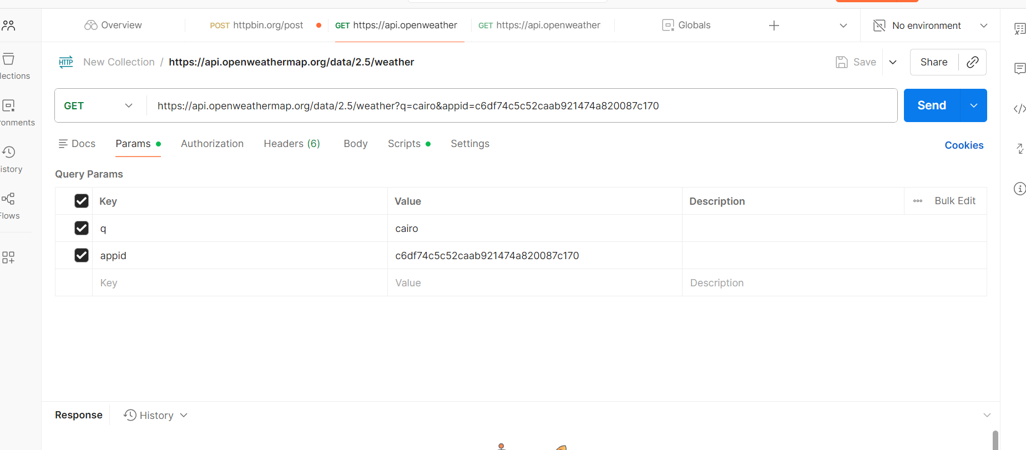
API Request by City Name

Slide 4
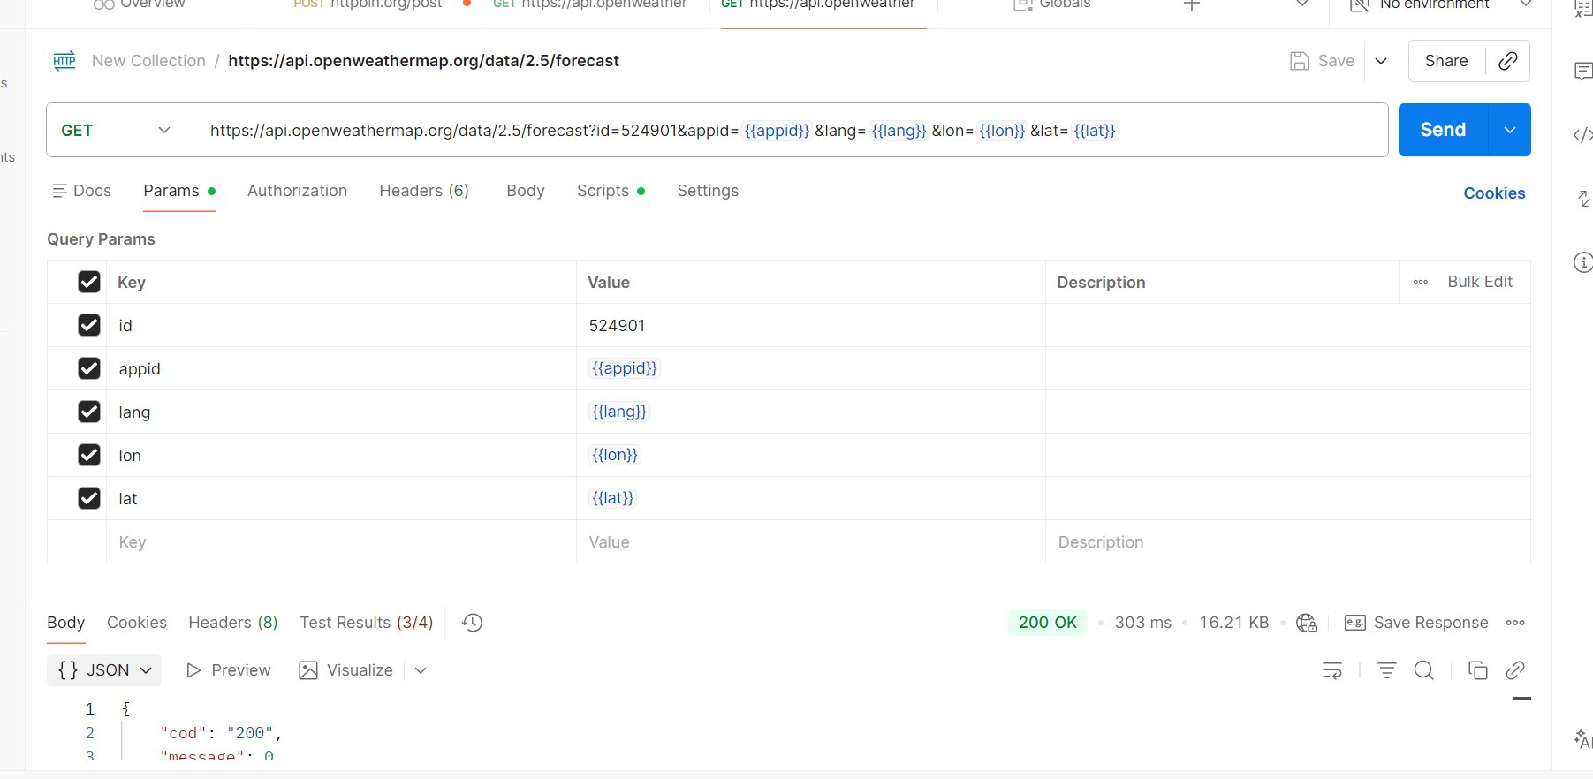
API Request with Multilingual Support

Slide 5
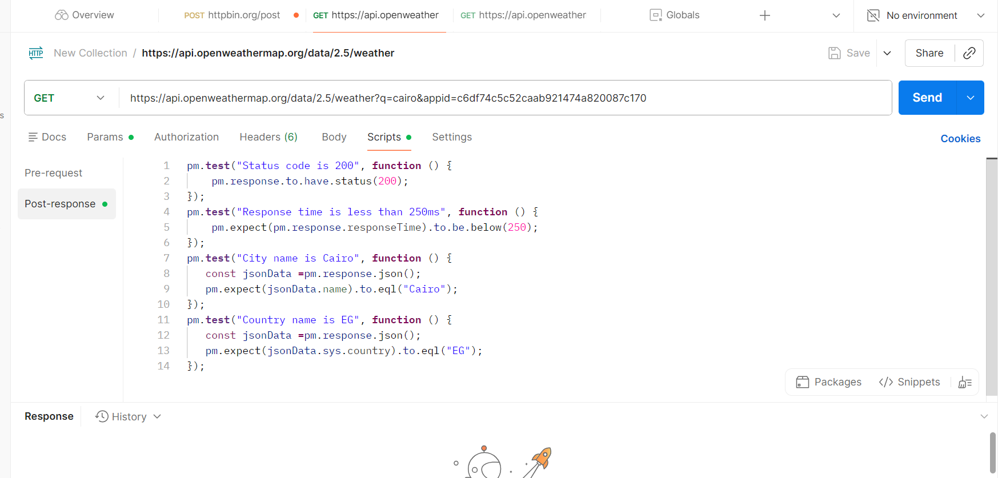
Suggested Test Cases for API Request by City Name

Slide 6
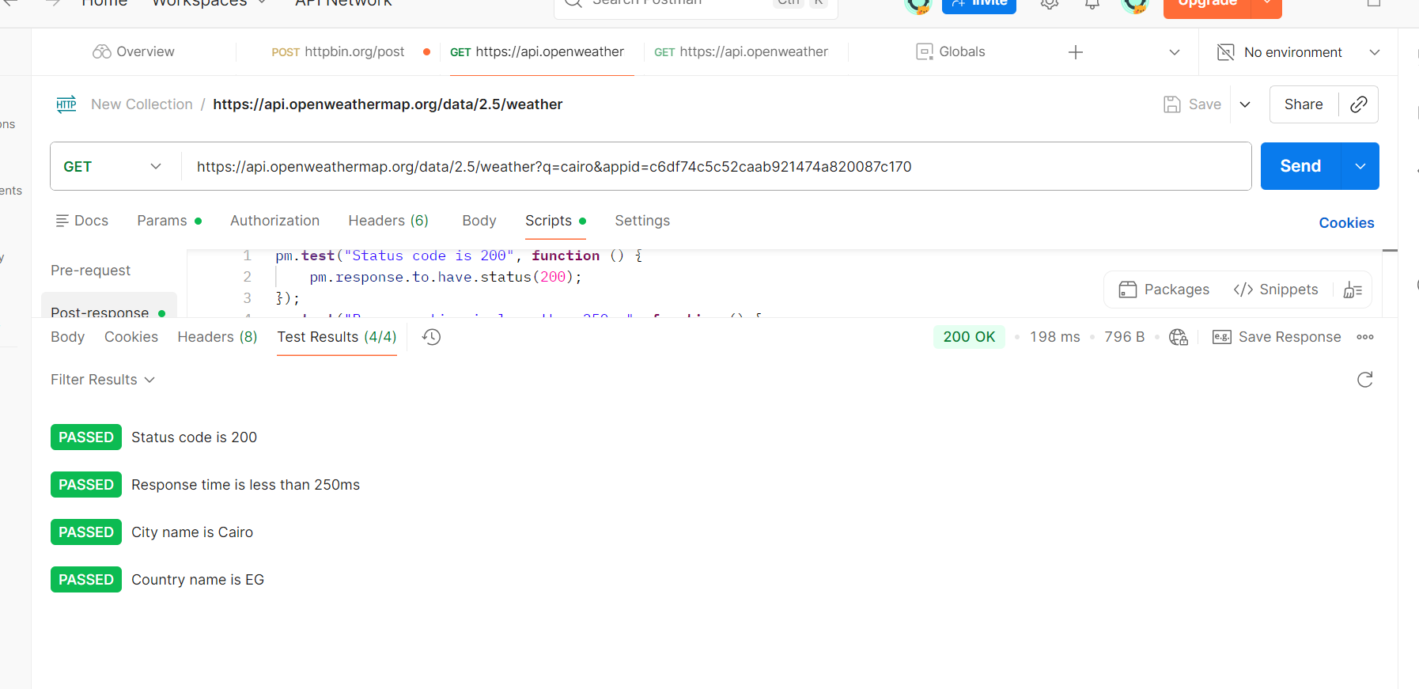
Test Results for API Request by City Name

Slide 7
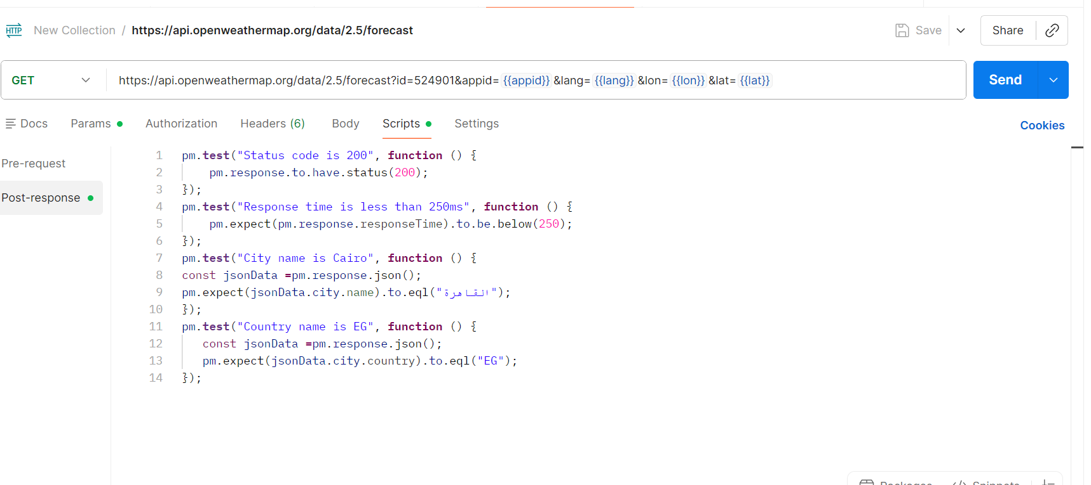
Suggested Test Cases for API Request with Multilingual Support

Slide 8
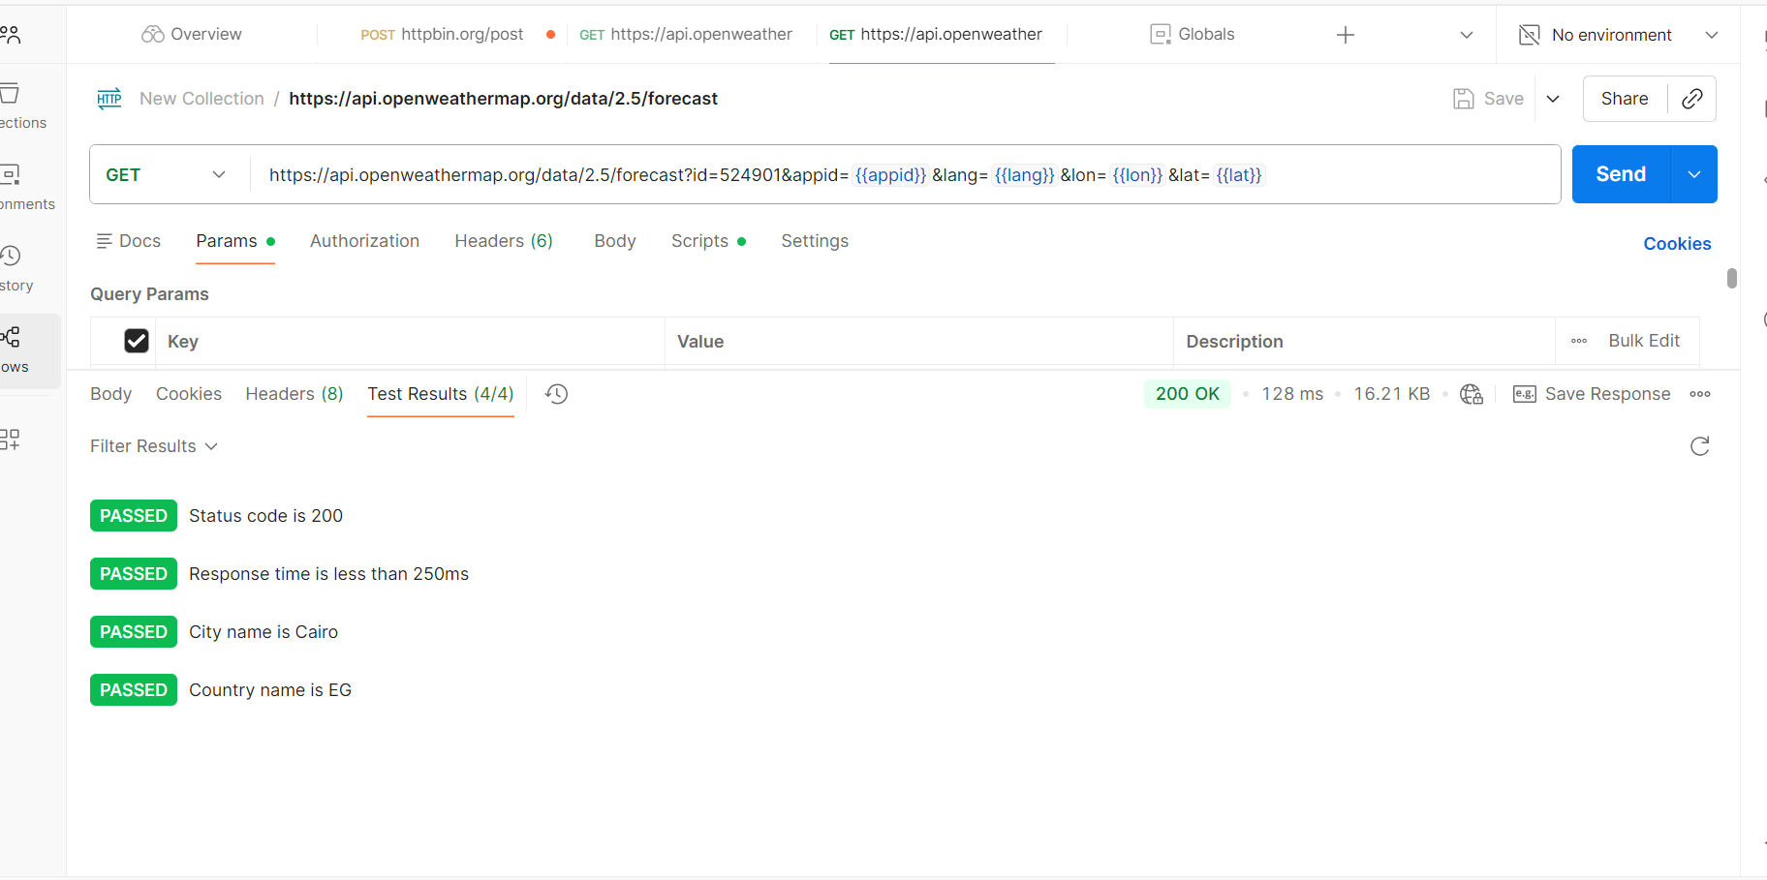
Test Results for API Request with Multilingual Support

Slide 9
API Project Summary
The WeatherMap API was successfully tested using Postman.
Global variables (appid, lang, lon, lat) were created and applied correctly.
API requests by city name and with multilingual support executed without errors.
All assertions passed:
Status code = 200
Response time < 250ms
City name = القاهرة
Country = EG
ID validated successfully
The project demonstrates complete backend validation with proper documentation, execution, and evidence..

Slide 10
Manual Testing SauceDemo Test Summary
Scope
Manual testing for Login, Inventory, Cart, Checkout
Objectives
Validate functional correctness
Identify UI/UX issues and bugs
Coverage
Login: valid/invalid credentials, empty fields, password masking
Inventory: product listing, sorting, filtering, add-to-cart
Cart: add/remove items, quantity, price calculation
Checkout: user info entry, mandatory fields, order completion
Results
Positive scenarios passed successfully
Negative scenarios revealed bugs (Filter issue, Last Name not mandatory, minor UI inconsistencies)
Bug Tracking
Documented in Excel with Severity & Priority
Linked Test Case IDs to Bug IDs
Conclusion
Full coverage of critical flows achieved
Bugs identified and documented for developer follow-up
Strong QA methodology demonstrated

