Slide 1
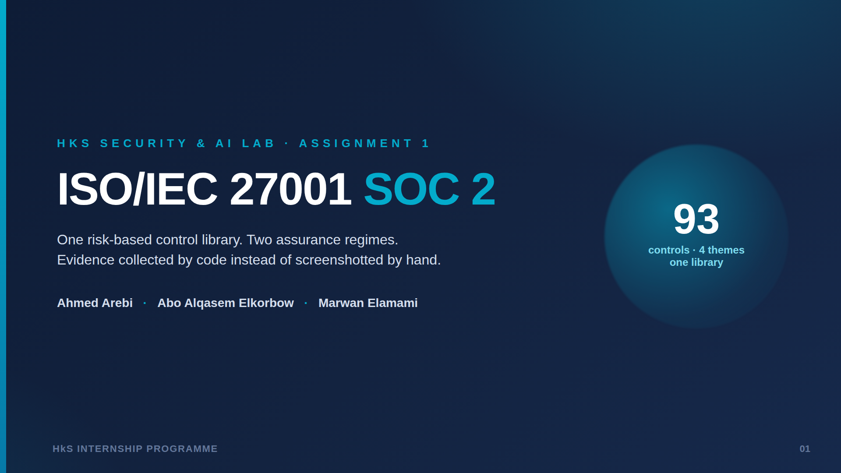
Notes:
Opening: three of us researched independently, challenged each other, merged into one report. Deck weighted toward controls and our AI proposal.

Slide 2
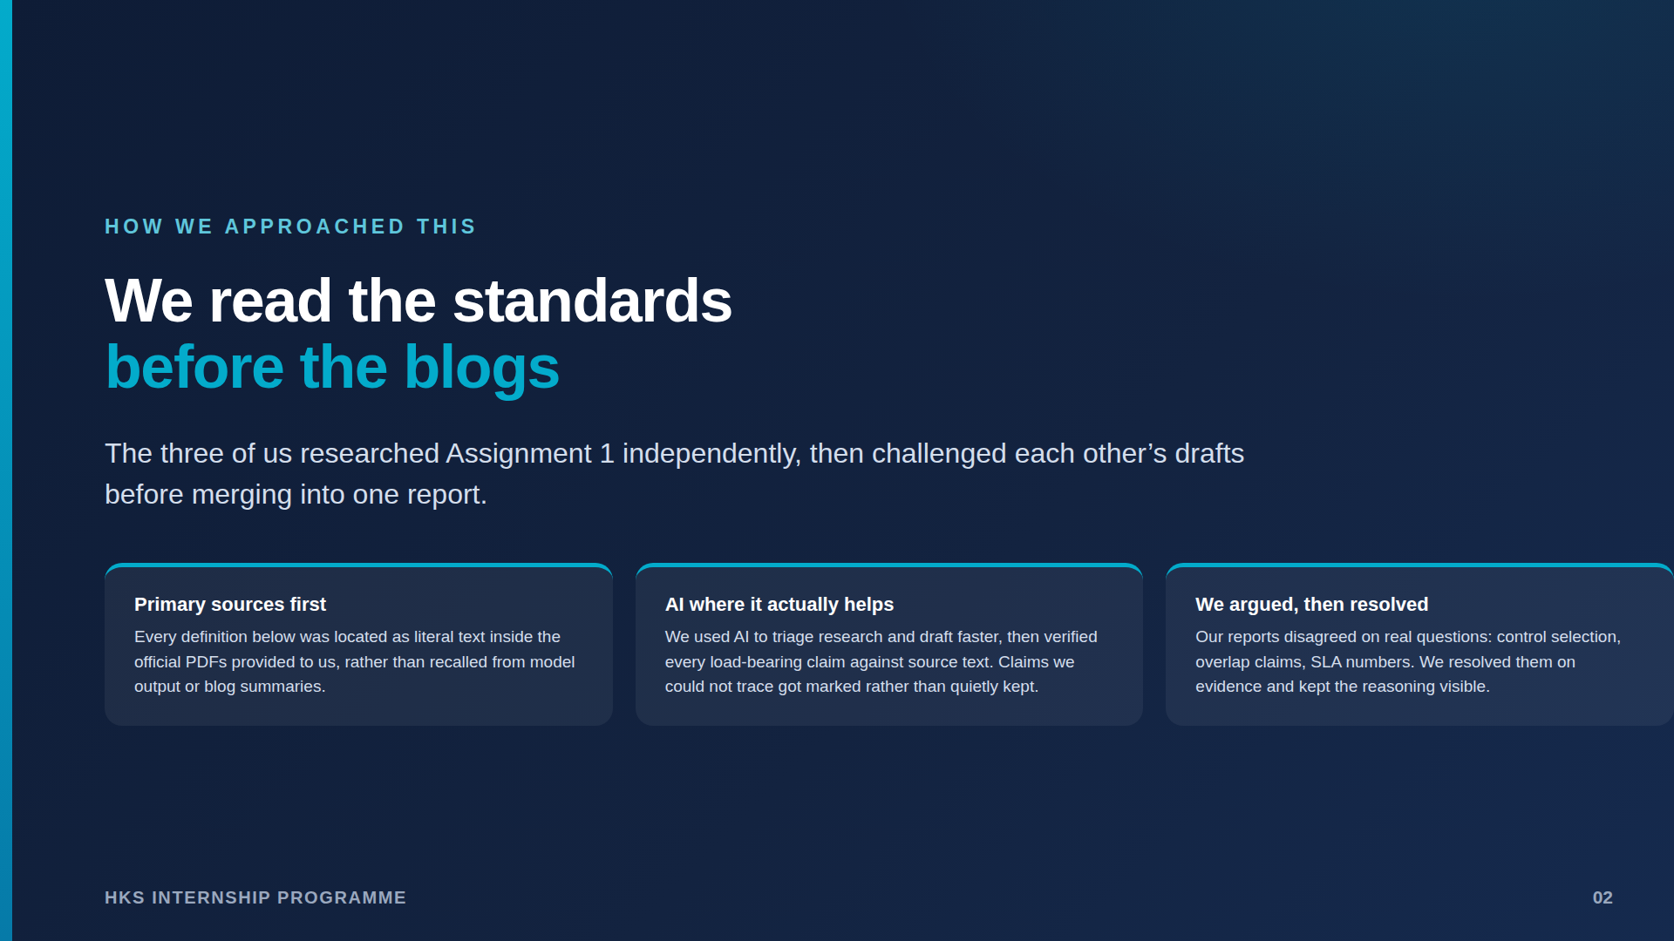
Notes:
Our method - this is what the brief grades. AI used for acceleration; every load-bearing claim checked against the provided PDFs. We argued then resolved.

Slide 3
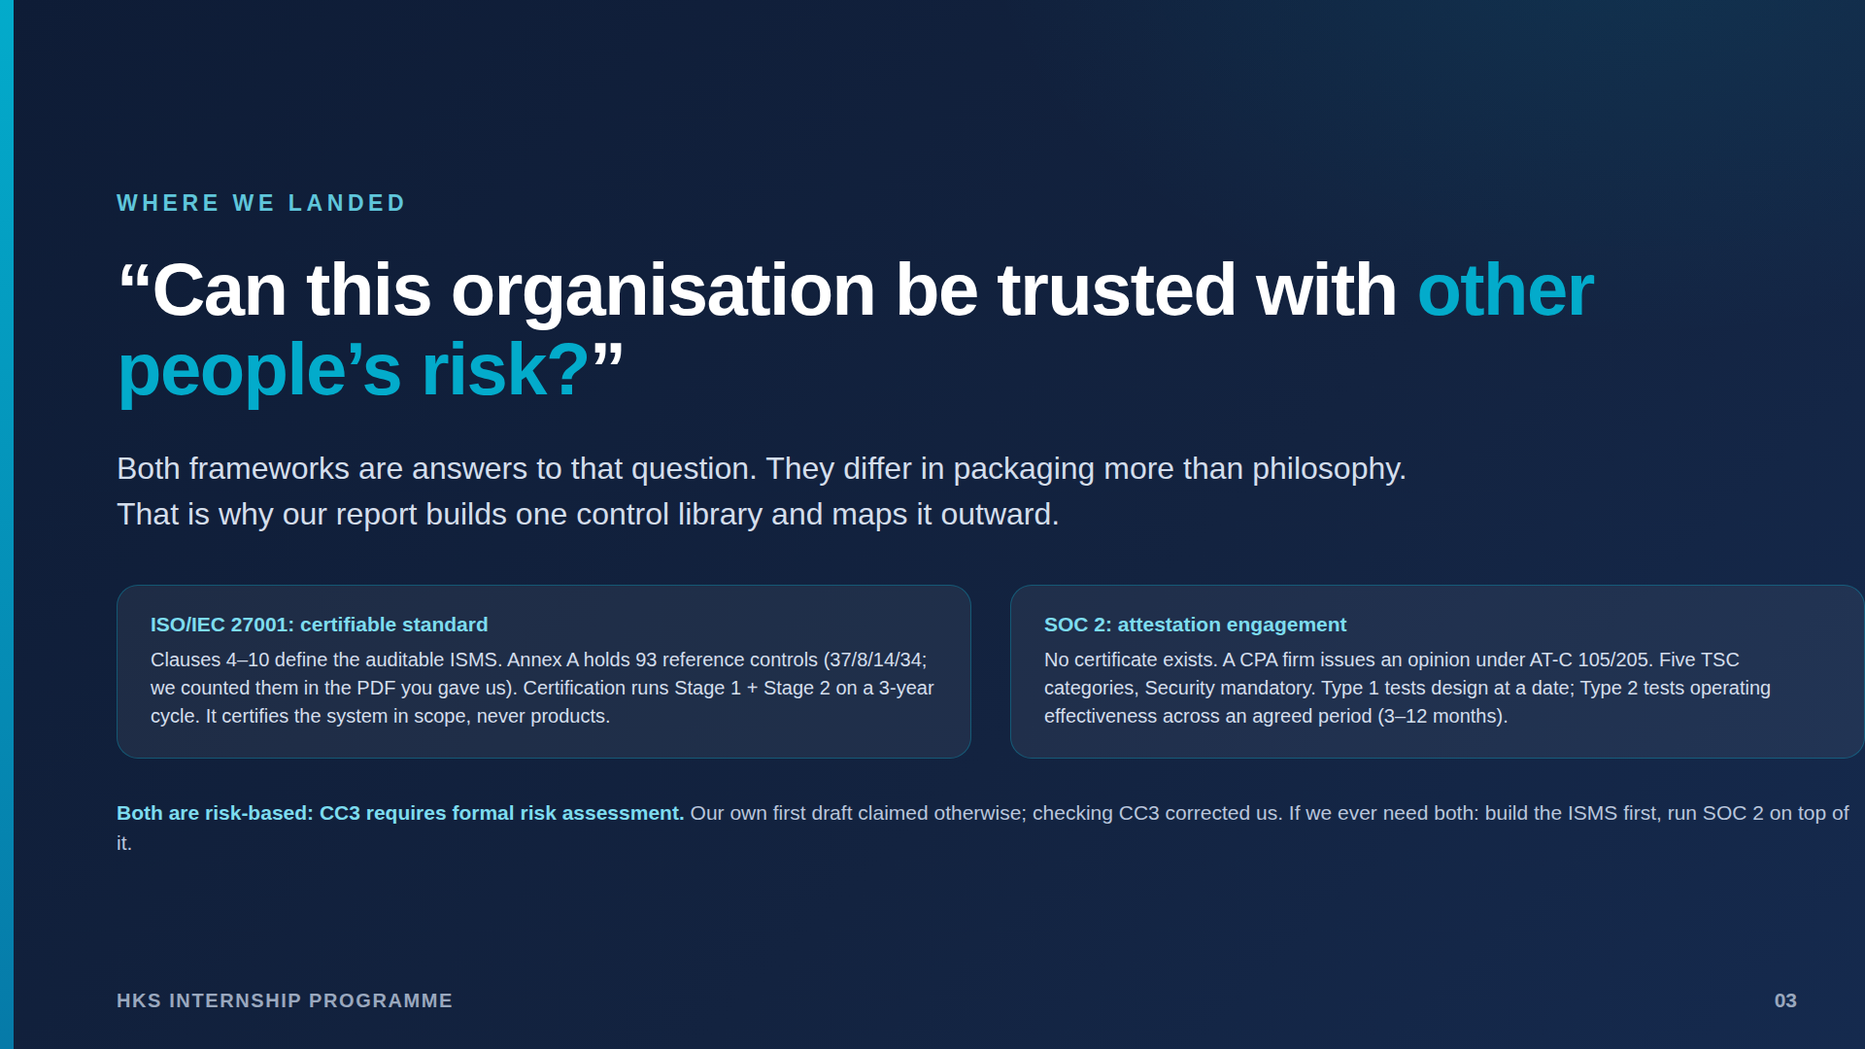
Notes:
The one-sentence frame. Both risk-based via CC3 - we corrected our own draft on this. If both frameworks ever needed: ISMS first, SOC 2 on top.

Slide 4
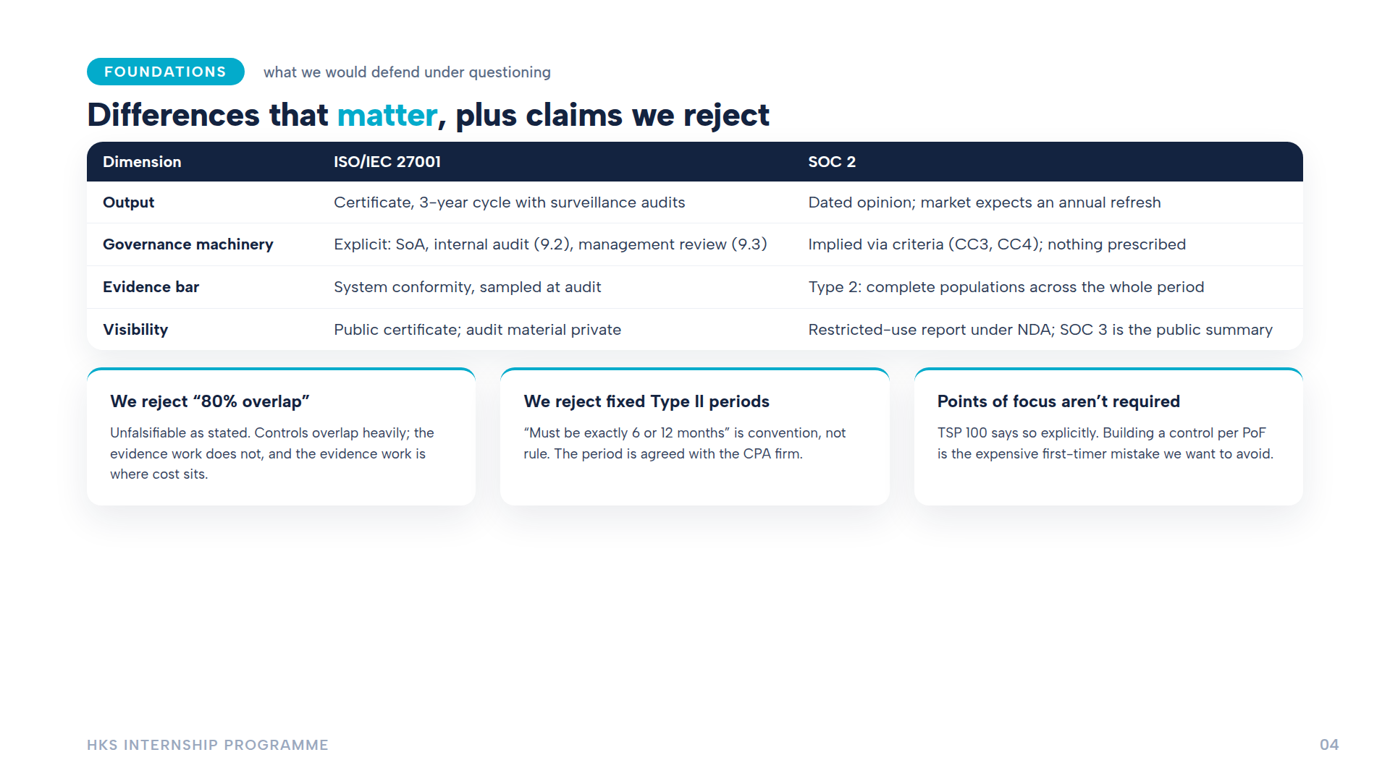
Notes:
Differences + three claims we reject (80% overlap, fixed Type II periods, PoF-per-control). PoFs explicitly not required per TSP 100.

Slide 5
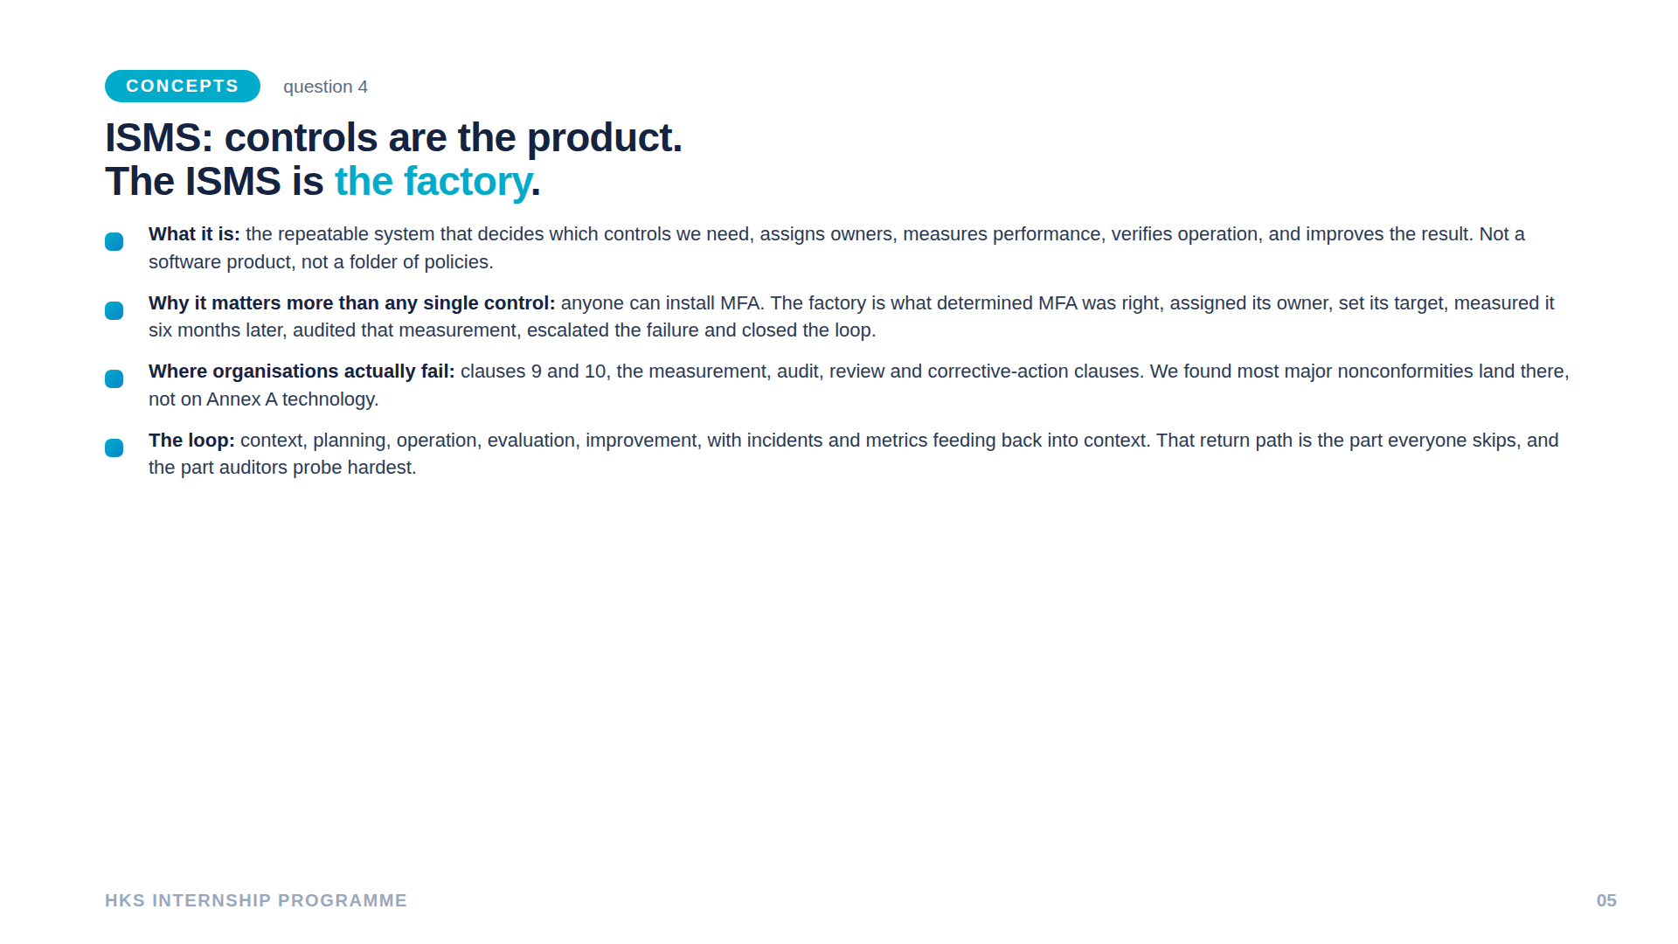
Notes:
ISMS = factory metaphor. Most major nonconformities hit clauses 9-10, not Annex A tech - that surprised all of us.

Slide 6
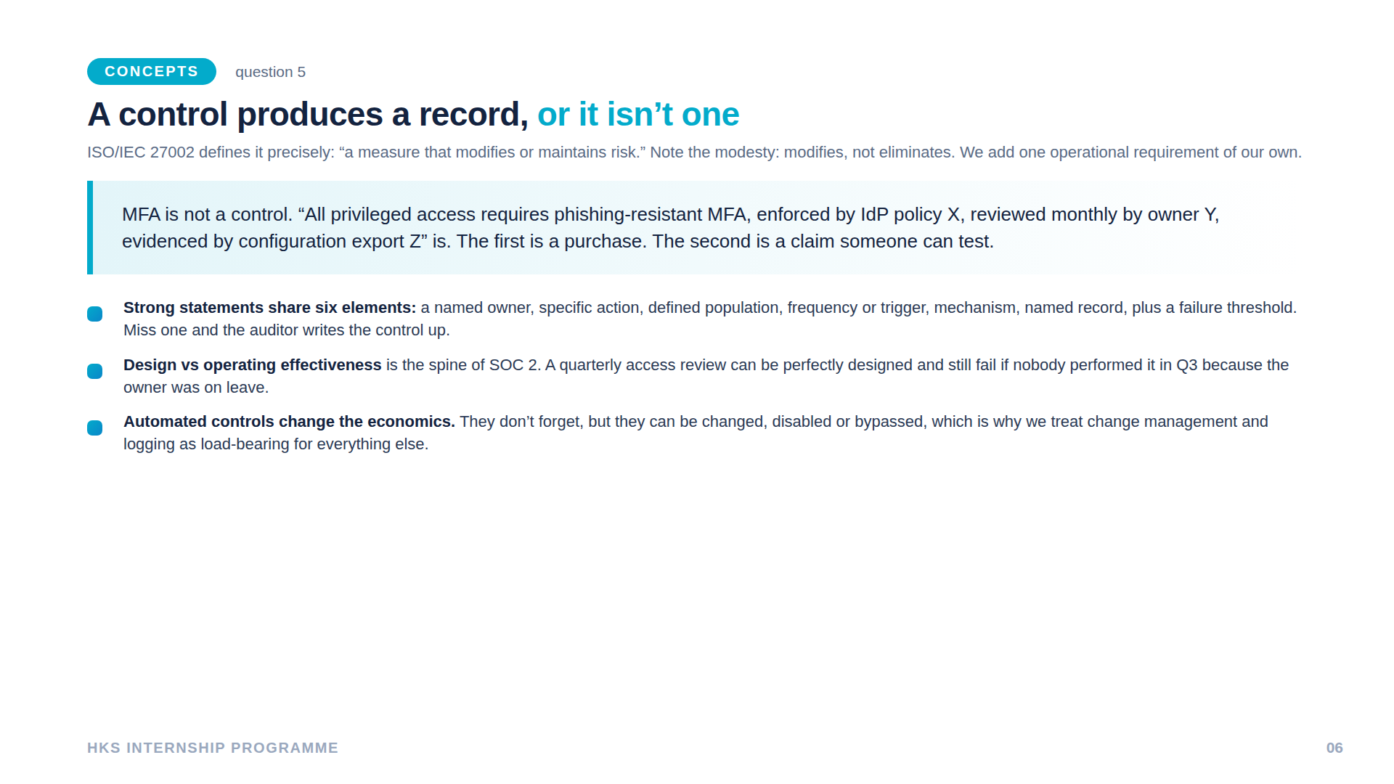
Notes:
The MFA line is our own formulation - purchase vs testable claim. Design vs operating effectiveness is SOC 2's spine.

Slide 7
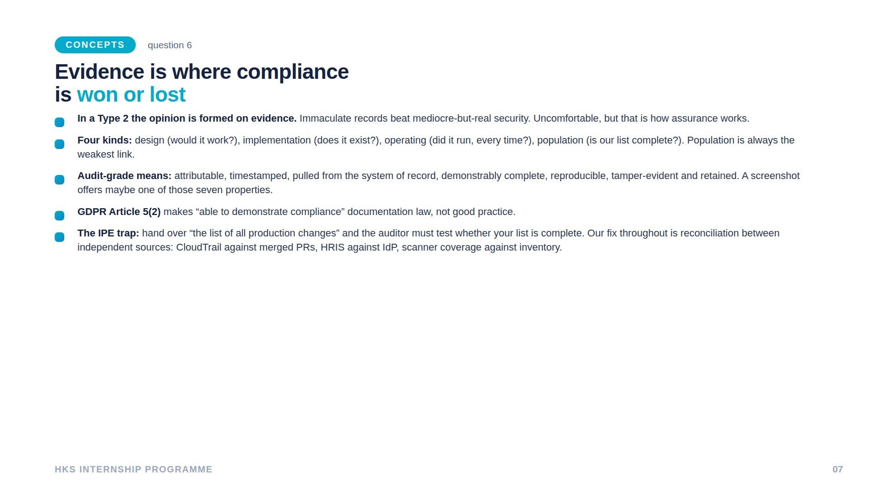
Notes:
Evidence wins or loses the audit. IPE trap: reconciliation proves completeness, single-source reports cannot.

Slide 8
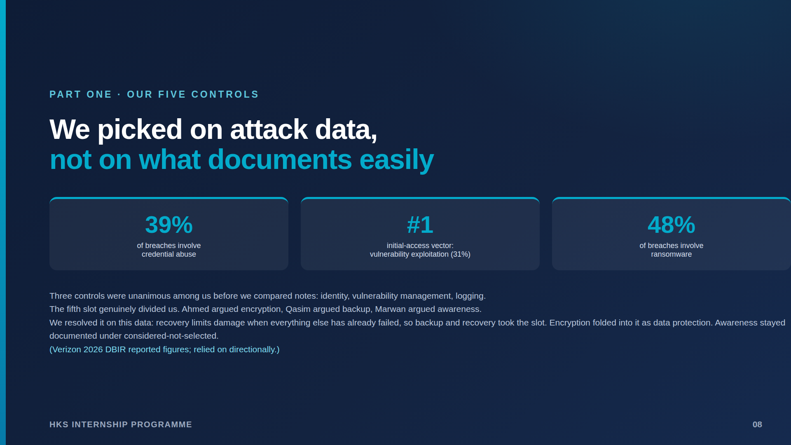
Notes:
Selection on attack data. Three unanimous; fifth slot divided us - encryption vs backup vs awareness - resolved on DBIR figures toward recovery. Encryption folded into BR-06; awareness documented as considered-not-selected.

Slide 9
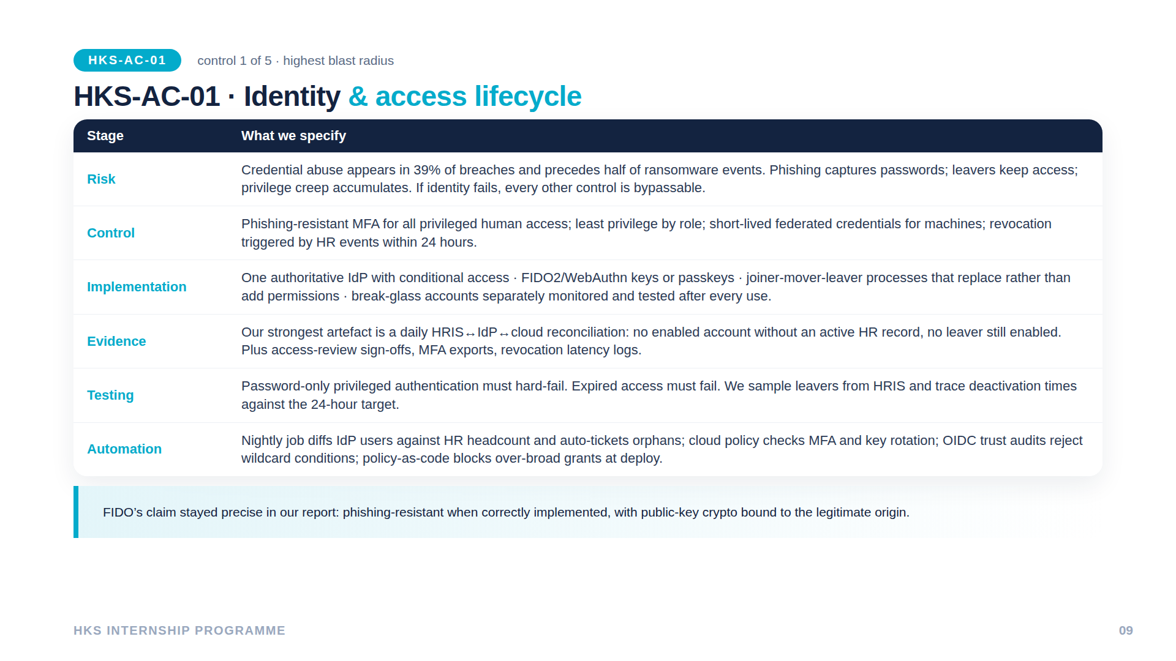
Notes:
AC-01 worked chain. FIDO nuance precise: phishing-resistant WHEN CORRECTLY IMPLEMENTED. Strongest artefact: daily HRIS-IdP-cloud reconciliation.

Slide 10
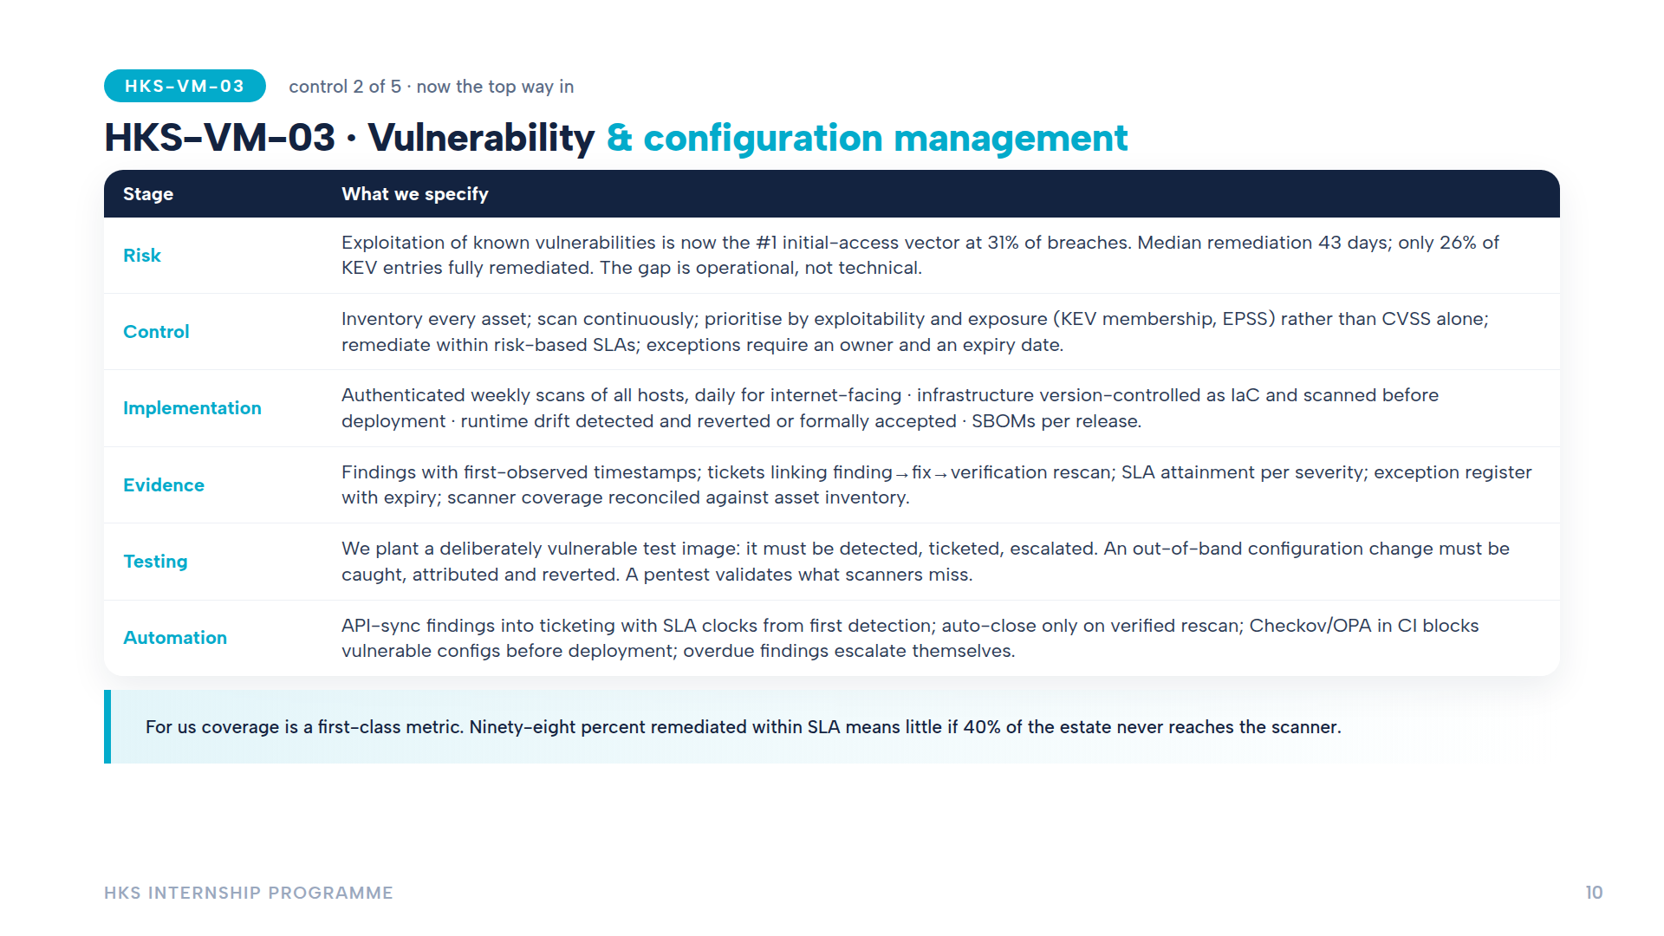
Notes:
VM-03: KEV/EPSS prioritisation over CVSS alone. Coverage reconciled against inventory every cycle - a coverage gap IS a control gap.

Slide 11
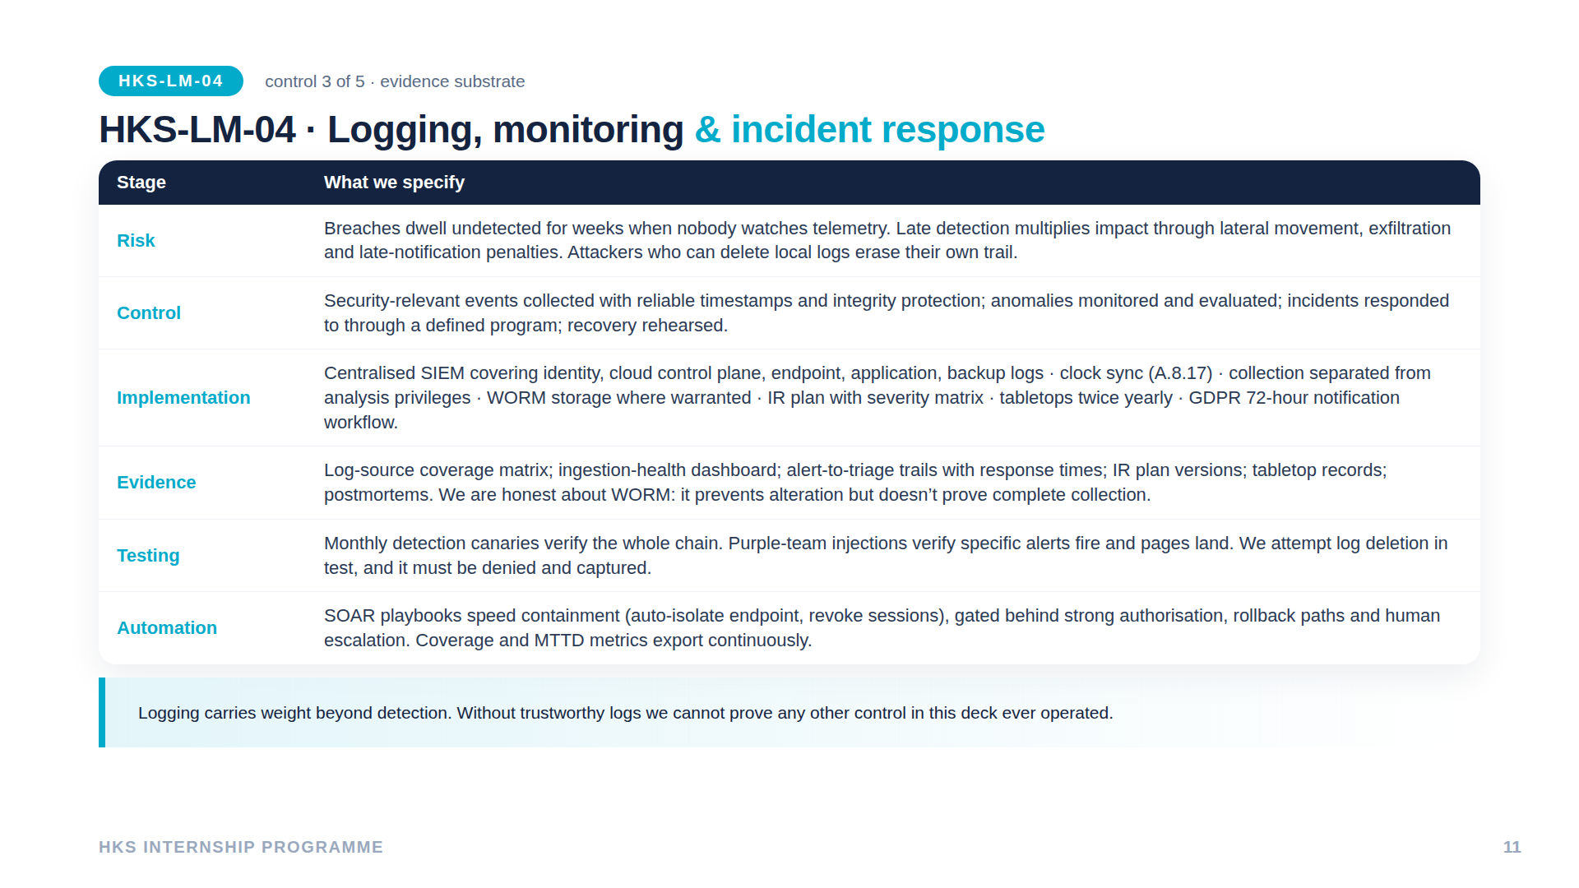
Notes:
LM-04: substrate for everything else's evidence. Honest WORM caveat: prevents alteration, doesn't prove complete collection. Log-deletion attempts must be denied and captured.

Slide 12
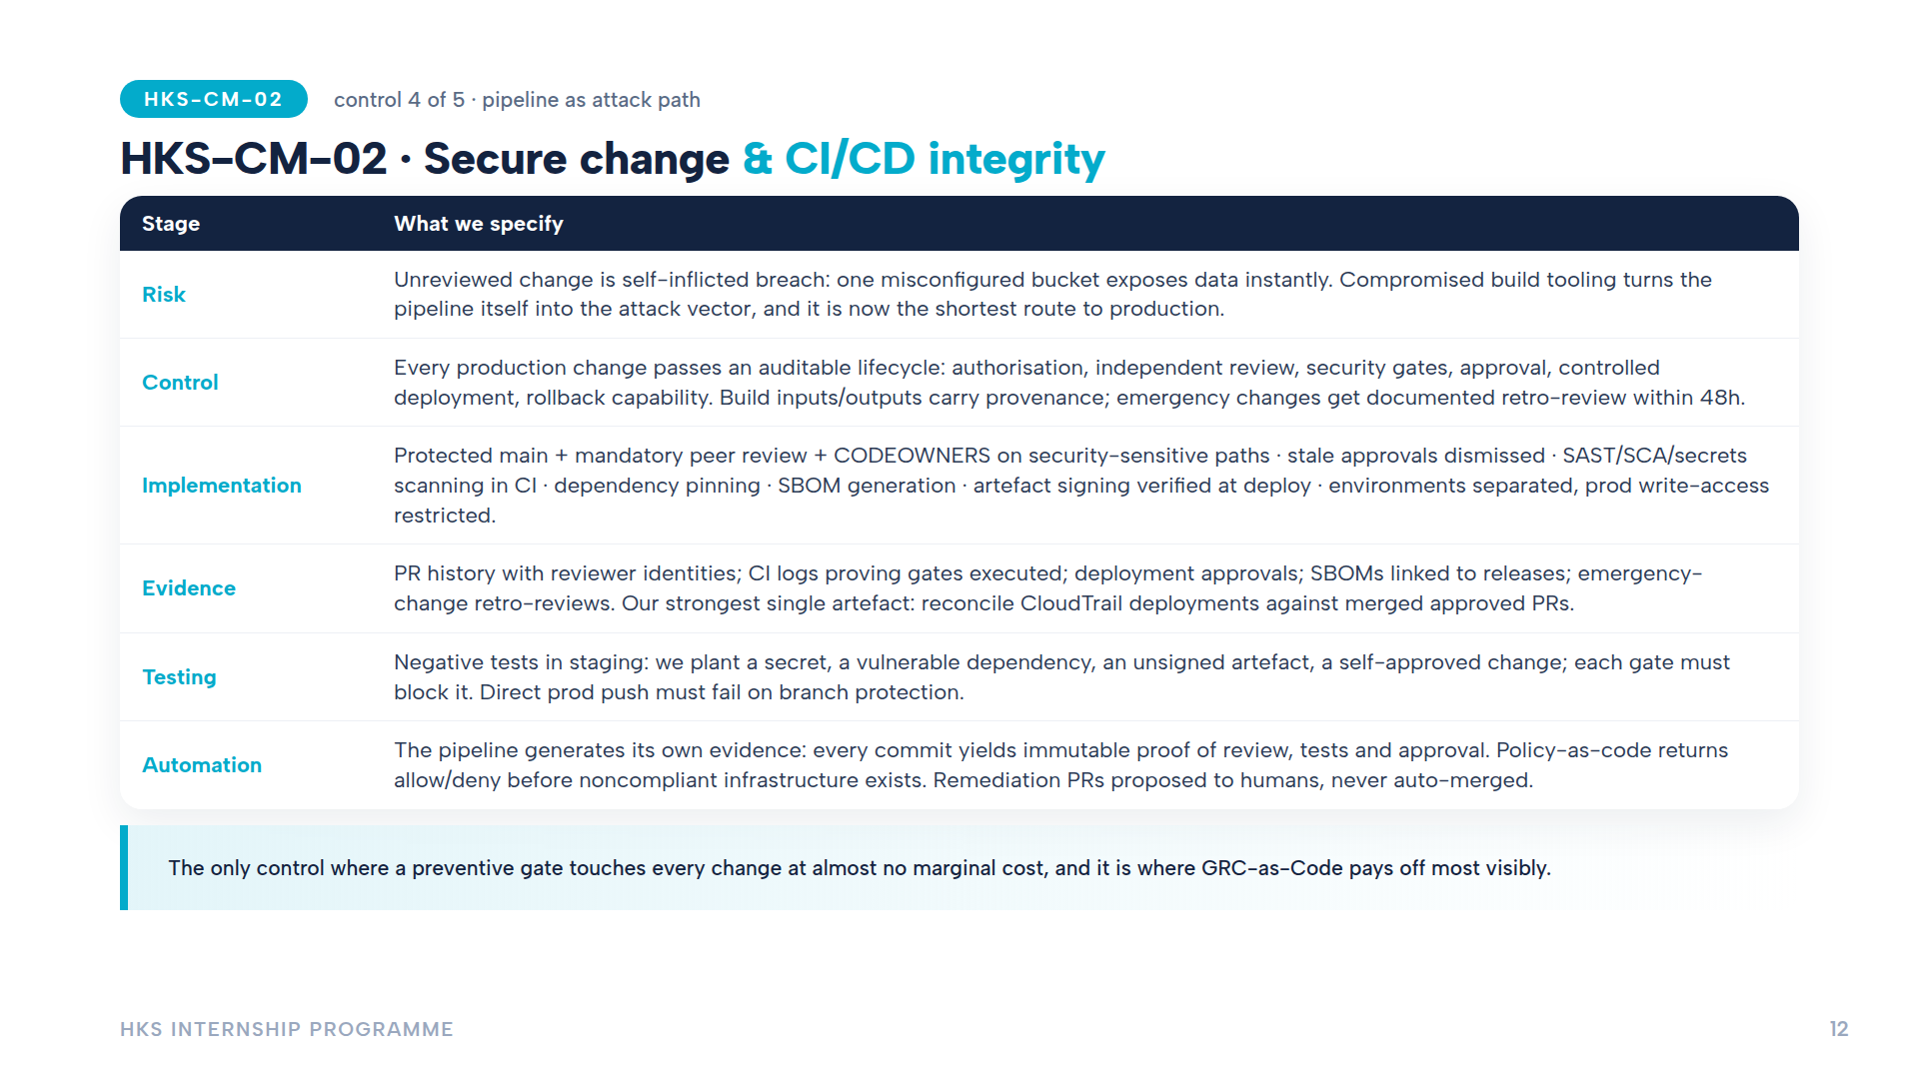
Notes:
CM-02: pipeline generates its own evidence per commit. Negative tests - planted secret/vuln dep/unsigned artefact must each be blocked. CloudTrail-vs-PR reconciliation.

Slide 13
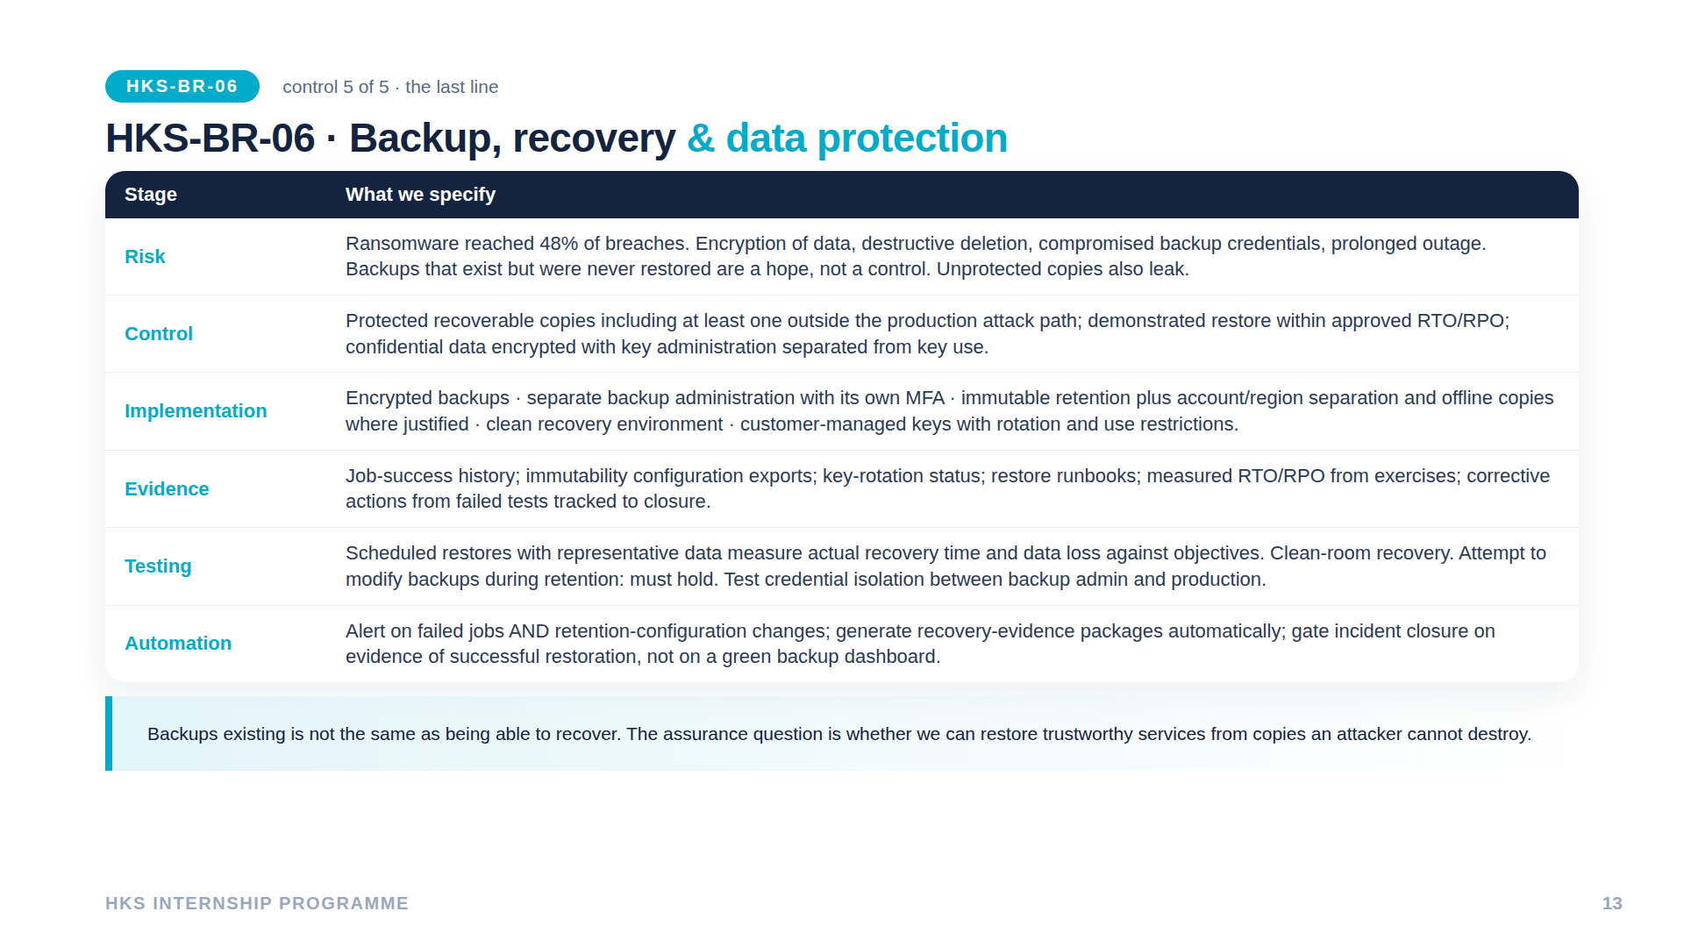
Notes:
BR-06: gate closure on successful restore, not green backup job. Keys administered separately from use. Ransomware 48% drove the selection.

Slide 14
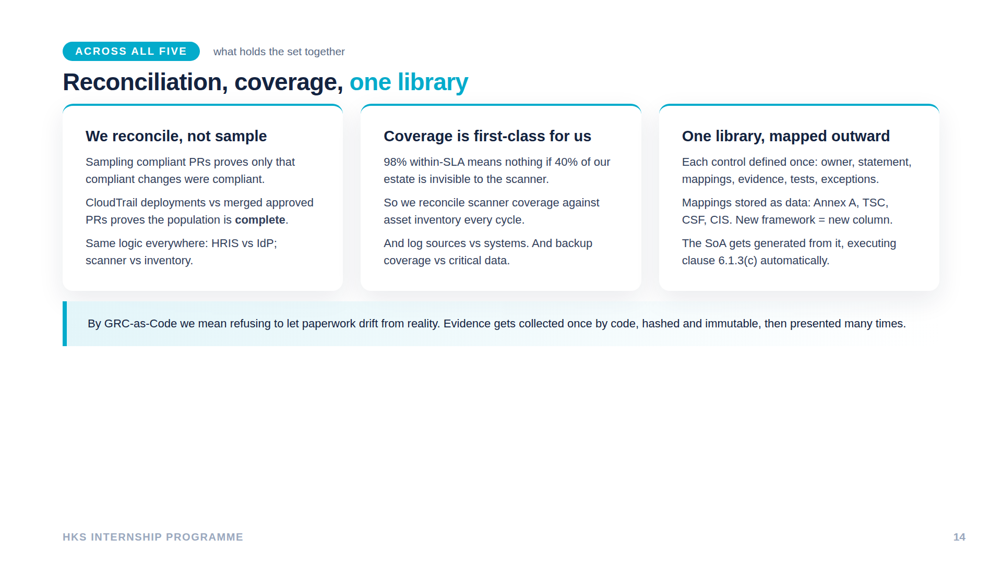
Notes:
The three patterns holding it together. GRC-as-Code = refusing to let paperwork and reality diverge. SoA generated from library - clause 6.1.3(c) executed automatically.

Slide 15
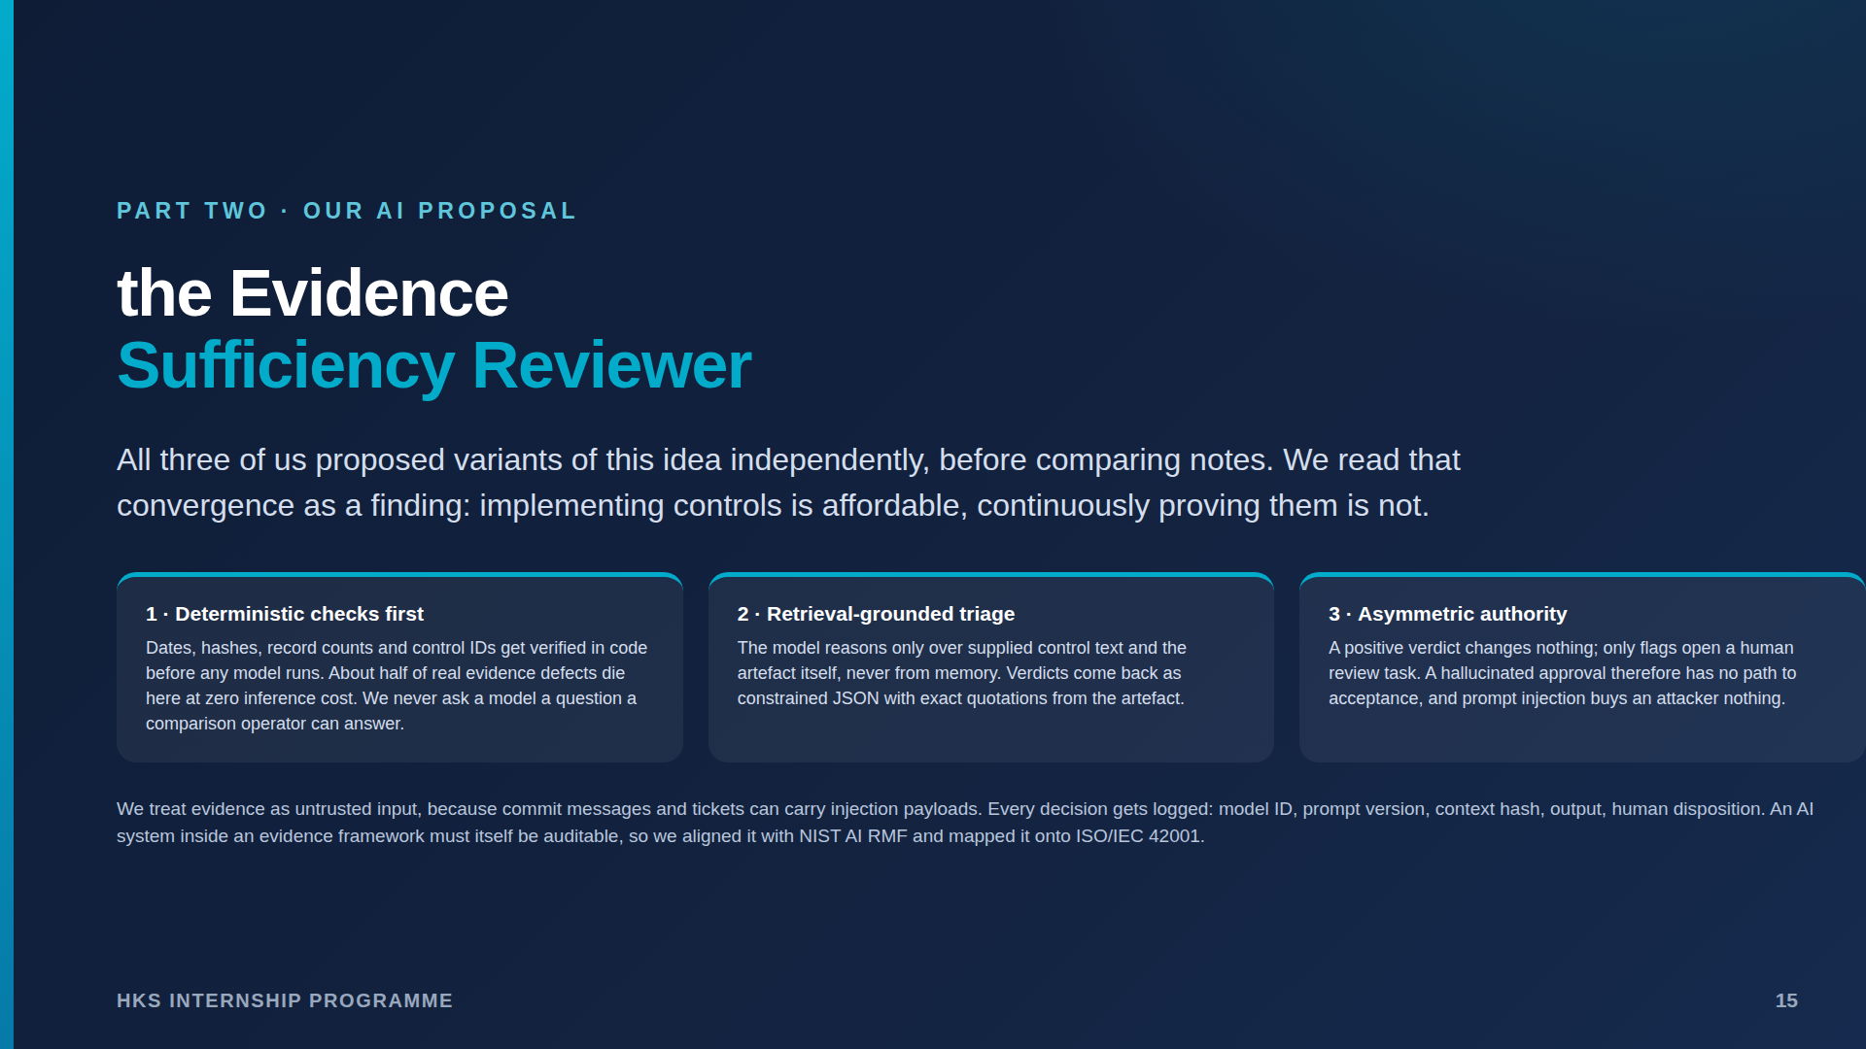
Notes:
ESR proposal. All three converged independently - convergence IS the finding about the bottleneck. Asymmetric authority: hallucinated approval has no path; injection becomes no-op. OWASP LLM mapping if probed: LLM01 structural, LLM02 schema, LLM06 agency removed, LLM09 human decision.

Slide 16
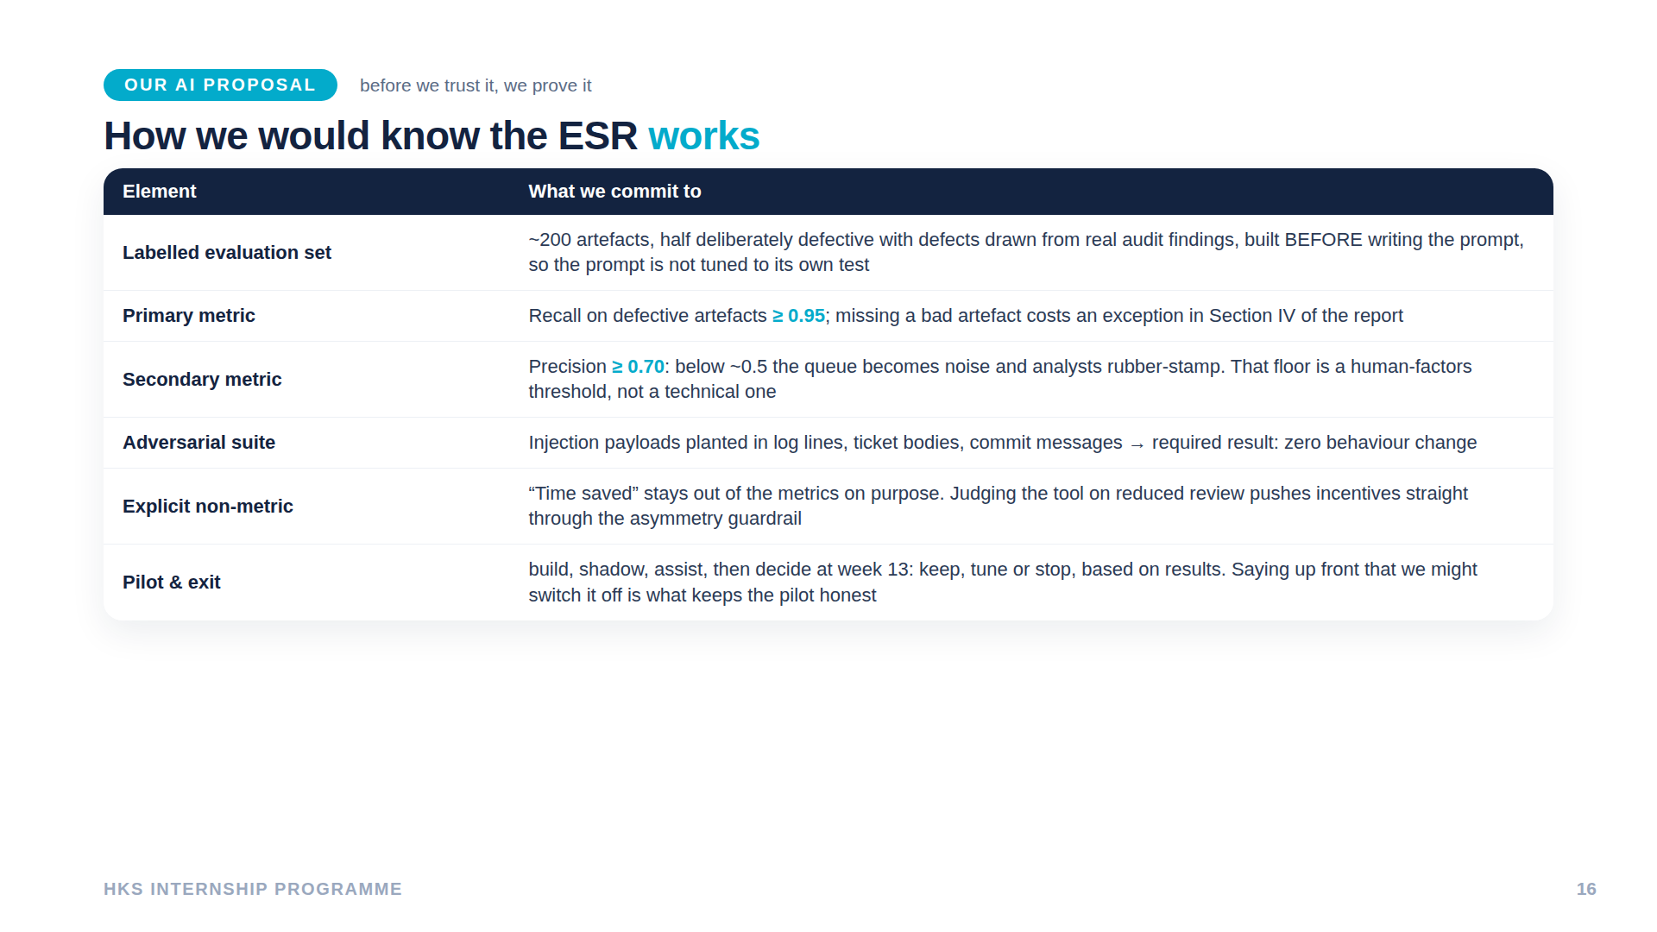
Notes:
Recall >=0.95 primary - missing bad artefact costs Section IV exception. Precision floor human-factors. Time-saved deliberately NOT a metric. Week-13 kill criterion keeps pilot honest.

Slide 17
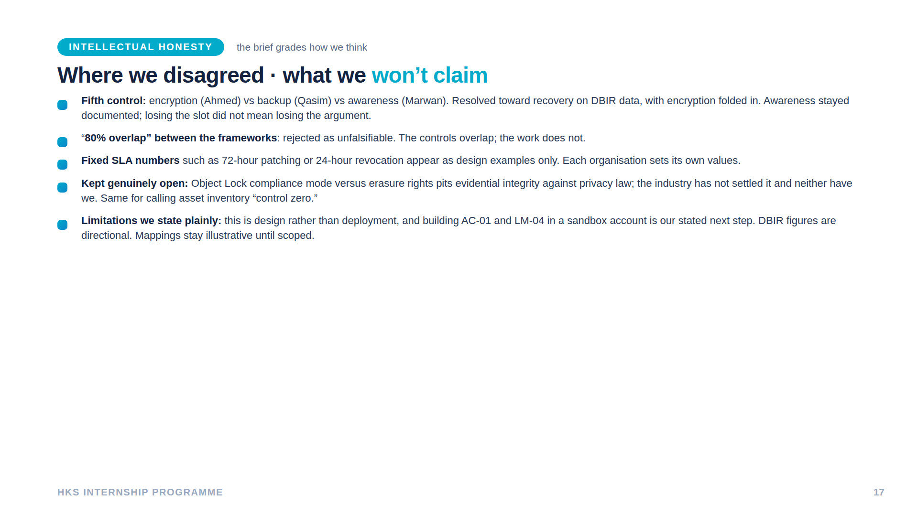
Notes:
Live disagreements kept open on purpose: Object Lock vs erasure rights unresolved industry-wide; control-zero question. Limitations stated unprompted.

Slide 18
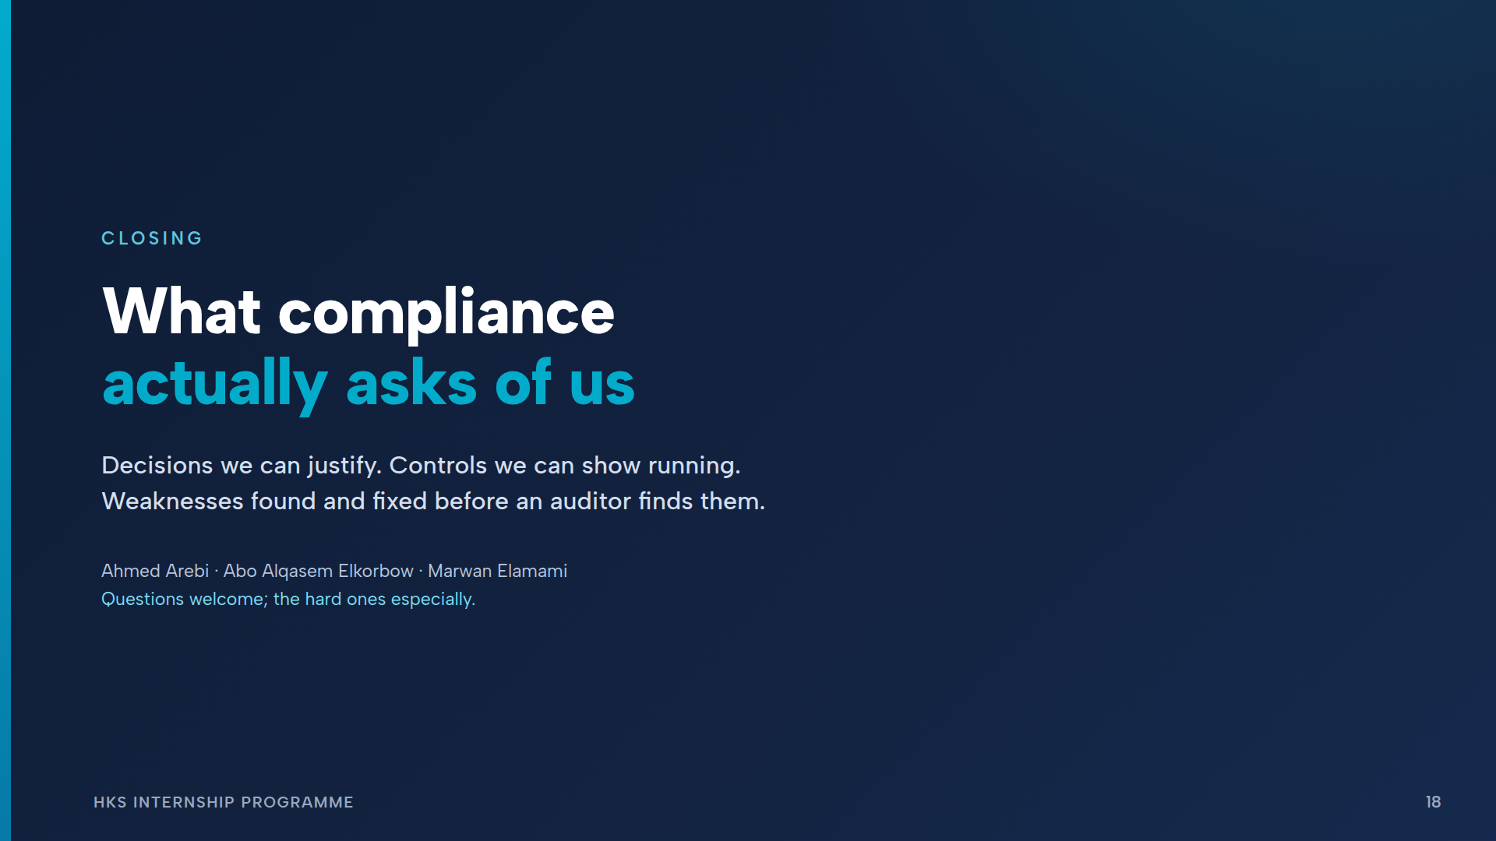
Notes:
Close on thesis, invite hard questions. Likely probes: fifth control (slide 8), ESR safety (15), why ISO-first if both (slide 3).

