Slide 1
MAZE SOLVER (2017)
Marwan Jalaleddine
Yasmine Wehbe
Mosbah Aouad

Slide 2
What Have we done?
We initialized the screen
We created the Main Menu
We created the modes
We created the algorithm

Slide 3
Main Menu

Slide 4
At first we initialize the registers
MOVLW d'5'
MOVWF OBSTACLES ;INITIALIZED MAX NUMBER OF OBSTACLES
MOVLW d'20'
MOVWF Count_Print_FSR
MOVLW d'1'
MOVWF S_Counter
MOVWF E_Counter
MOVLW d'0'
MOVWF I_1
MOVLW d'1'
MOVwf I_2

Slide 5
We then write the Menu Options and go into an infinite loop
Call Default_Line ;We are going to the Default line
Call Menu_Flag ;We are setting the General Flag as Menu Flag
Call S_Pointer ;Setting a Pointer
Call L_D .
Call L_E .
Call L_F .
Call L_A
Call L_U
Call L_L
Call L_T
Notes:
Here we should explain more

Slide 6
INFINITE LOOP TATATADUM!
We put an infinite loop to accept interrupts!
BTFSC INTCON ,RBIF
GOTO RBIFINT
BTFSC INTCON, T0IF
GOTO TMR0INT
RBIFINT CALL DELAY1m
BTFSS PORTB,4
GOTO MOVE
BTFSS PORTB,5
GOTO CONFIRM
BTFSS PORTB,6
GOTO START_OL
BTFSS PORTB,7
GOTO END_OL
To select which interrupt we wish to service
If we have an interrupt on Port B we need to know which one changed

Slide 7
Flags

Slide 8
Flag General
No Bit is Set | We’re in the Menu
Bit 1 is Set | We’re in the Default Mode
Bit 2 is Set | We’re in the Obstacle Mode
Bit 3 is Set | We’re in the Maze Mode

Slide 9
Interrupts
Depending on the interrupts we are going to Move or Confirm

Slide 10
Move
BTFSC FlagGEN,0
CALL Move_Menu
BTFSC FlagGEN,2
Call Move_Mode_2
GOTO FOUNDIT
We only enable the move in the Menu and Mode
This choice depends on the Flag General

Slide 11
Move Branching
Move_Menu BTFSC FlagMenu,0
GOTO Default_Menu
BTFSC FlagMenu,1
GOTO Obstacle_Menu
BTFSC FlagMenu,2
GOTO Maze_Menu
RETURN

Slide 12
Confirms
Similarly , we service the confirms

Slide 13
Confirm
Confirm Menu
Confirm Mode1
Confirm Mode 2
Confirm Mode 3
We choose either Mode 1 Mode 2 or mode 3
We Start the algorithm after pressing confirm
We put an obstacle here
We put an obstacle here
Notes:
In each confirm we check the General flag and In modes 2 and 3 we check the number of remaining obstacles

Slide 14
TIMER ZERO INTERRUPT
TMR0INT DECFSZ TMR0_COUNT, F
GOTO RET
CALL Move_Mode_3
MOVLW 0x20
MOVWF TMR0_COUNT
CLRF TMR0
RET BCF INTCON, 2
RETFIE

Slide 15
Conventions

Slide 16
INDF Conventions
Dash | 00000001
Block | 10000010
Start | 10000100
End | 10001000
Visited | 01000000

Slide 17
WE CHOSE A CHALLENGING FSR
WE’RE NOT NORMAL YOU KNOW ;)

Slide 18
FSR SCREEN MAPPING
FIRST ROW | 30 | 31 | 32 | 33 | 34 | 35 | 36 | 37 | 38 | 39
SECOND ROWN | 49 | 48 | 47 | 46 | 45 | 44 | 43 | 42 | 41 | 40
This challenging choice made it a more complex algorithm!

Slide 19
How did we map the FSR to the LCD screen??

Slide 20
The Star Function
CURSOR_right_position MOVF FSR,0
MOVWF COUNT4
MOVLW d'40'
SUBWF COUNT4,1
BTFSC STATUS,0
GOTO SECOND_LINE
GOTO FIRST_LINE

Slide 21
If we’re on the first line, we adjust cursor to FSR address
FIRST_LINE MOVLW b'000000001'
MOVWF LINE_NUMBER
MOVF FSR,W
MOVWF COUNT4
MOVLW d'30'
SUBWF COUNT4,1
MOVLW B'01000';
Call LETTERS
MOVF COUNT4,W
Call LETTERS
return

Slide 22
Similarly, for the second line we do the same!
SECOND_LINE MOVLW b'000000010'
MOVWF LINE_NUMBER
MOVLW d'49'
MOVWF COUNT4
MOVF FSR,W
SUBWF COUNT4,F
MOVLW B'01100';
Call LETTERS
MOVF COUNT4,W
Call LETTERS
Return

Slide 23
How to Remove The Pointer??
RESET_MEMORY MOVLW d'20'
MOVWF COUNT8
MOVLW d'30'
MOVWF FSR

Slide 24
This is just a loop inside Reset_Memory
TEMP_MEMORY BTFSC INDF,6
call REMOVE_POINTER
INCF FSR,F
DECFSZ COUNT8,F
GOTO TEMP_MEMORY
return

Slide 25
Here, we effectively remove the Pointers
REMOVE_POINTER MOVLW b'00000001'
MOVWF INDF
call CURSOR_right_position
call S_DASH
return

Slide 26
How did we go down?
DOWN_FSR MOVF FSR,w
MOVWF COUNT4 ; we did not call current position we just changed fsr
MOVLW d'30'
SUBWF COUNT4,F
MOVLW d'49'
MOVWF COUNT5
MOVF COUNT4,W
SUBWF COUNT5,W
MOVWF FSR
return

Slide 27
How did we go up?
UP_FSR MOVLW d'49' MOVWF COUNT4
MOVF FSR,W
SUBWF COUNT4,F
MOVF COUNT4,W
ADDLW d'30'
MOVWF FSR
return

Slide 28
Inserting a Block
Oh well ☺

Slide 29
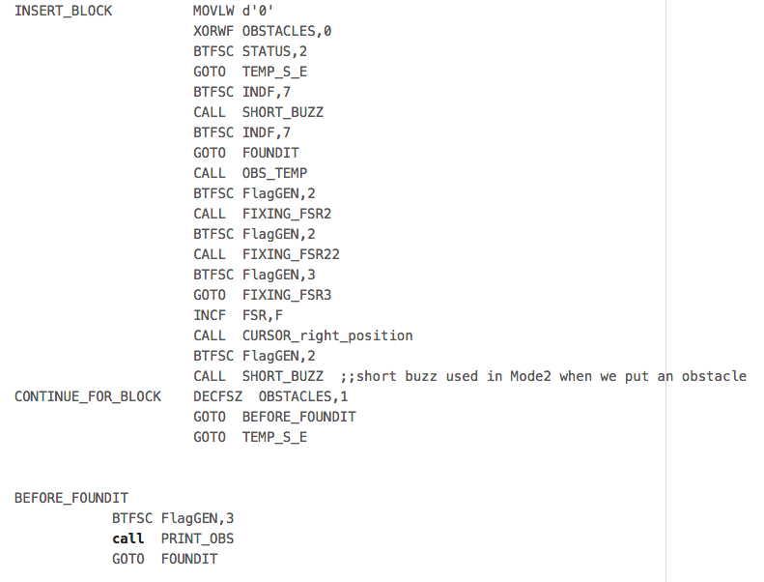
Inserting a Block:

Slide 30
How did we Insert the Dashes?

Slide 31
Print Dashes Function
PRINT_DASHES_TEMP CALL CURSOR_right_position
MOVLW b'00000001'
MOVWF INDF
CALL S_DASH
MOVLW d'49'
MOVWF COUNT4
MOVF FSR,W
SUBWF COUNT4,F
BTFSC STATUS,2
Return
INCF FSR,F
GOTO PRINT_DASHES_TEMP
return

Slide 32
The Algorithm!
Let’s be serious!

Slide 33
Problems we faced while designing it
To go right on first line , we increment
To go right on second line we decrement
To go left on first line , we decrement
To go left on second line we increment
To go up, we needed to use a formula (not so straight forward)
To go down, we also needed to use a formula (which required difficult to ) design functions

Slide 34
Let’s Get Started!

Slide 35
Right
Go_Right CALL CURSOR_right_position
BTFSS LINE_NUMBER,1
GOTO Go_Right_first_line if we’re on the 1st line
GOTO Go_Right_second_line if we’re on the 2nd line
If we’re up we don’t do next Instruction

Slide 36
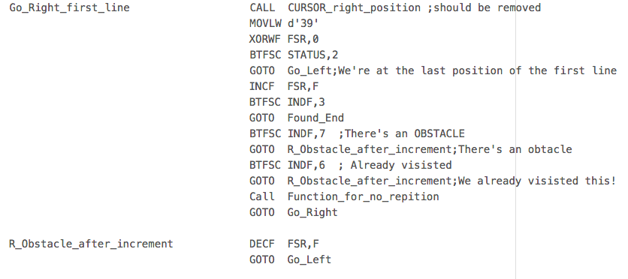
When We’re on the first line, we increment

Slide 37
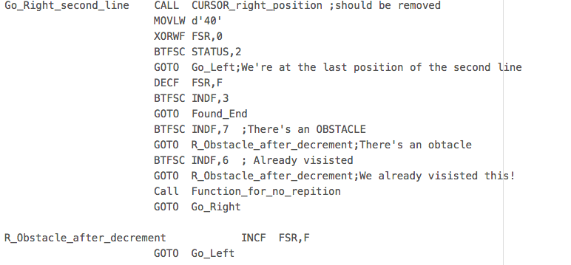
If we’re on the second line we decrement

Slide 38
Similarly we do the Go_Left
But with different FSR values (and we go to Up afterwards)

Slide 39
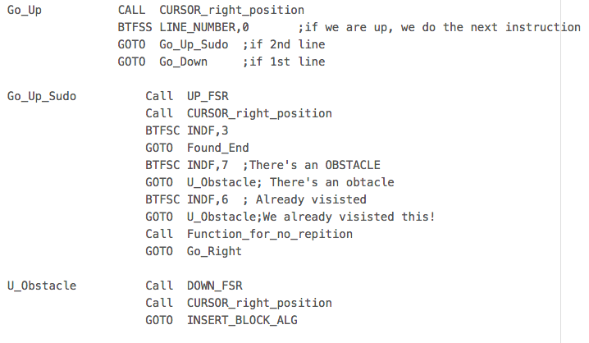
Go Up!

Slide 40
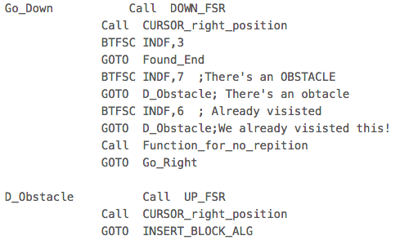
GO GO GO DOWN!

