Slide 1
Ship Detection using Satellite Imagery
Marwan Kalo
marwinkalo@gmail.com
https://github.com/marwankalo

Slide 2
Project Goals
I propose two models that seek to automate the detection of ships in satellite images
Identifying images that contain ships and those that do not
2. Detecting and delineating each ship from its background
Using satellite imagery, in conjunction with traditional AIS monitoring, stakeholders can benefit from a clearer, more complete picture of the seas

Slide 3
Part I : Our Data
Contains ship
Contains no ship

Slide 4
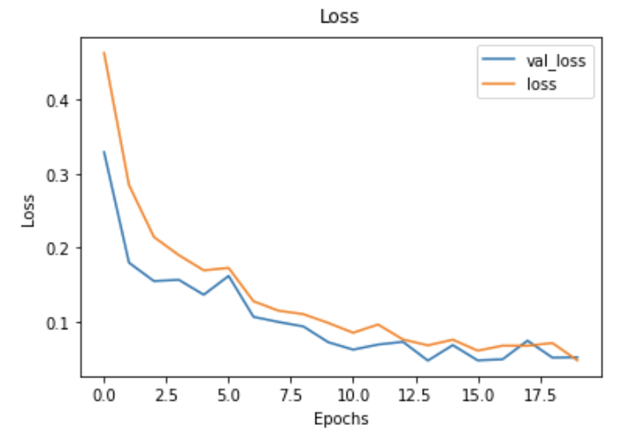
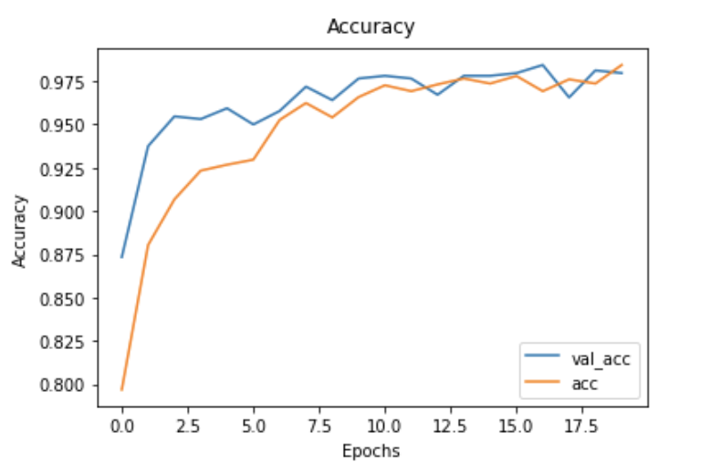
Ship Image Classification: Part I
Using 4000+ images
Baseline model: Decision Tree Classifier
Validation accuracy: 86.25%
Final model: Convolutional Neural Network
Validation accuracy: 97.9%
Test accuracy: 97.8%

Slide 5
Part II: Ship Instance Segmentation
Utilised Mask R-CNN, a deep neural network framework proposed by Facebook AI researchers.
Transfer learning approach using ResNet101 trained on MS COCO dataset
Used 30,000 + images
Final model:
Test accuracy: 79%

Slide 6
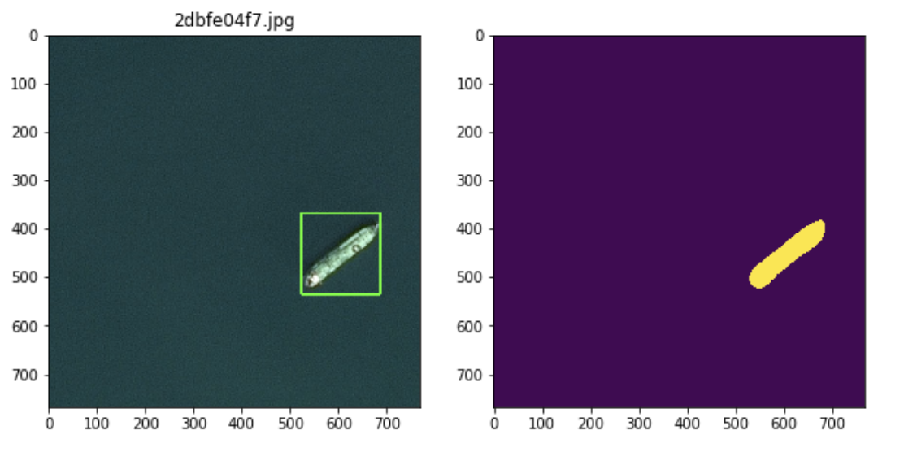
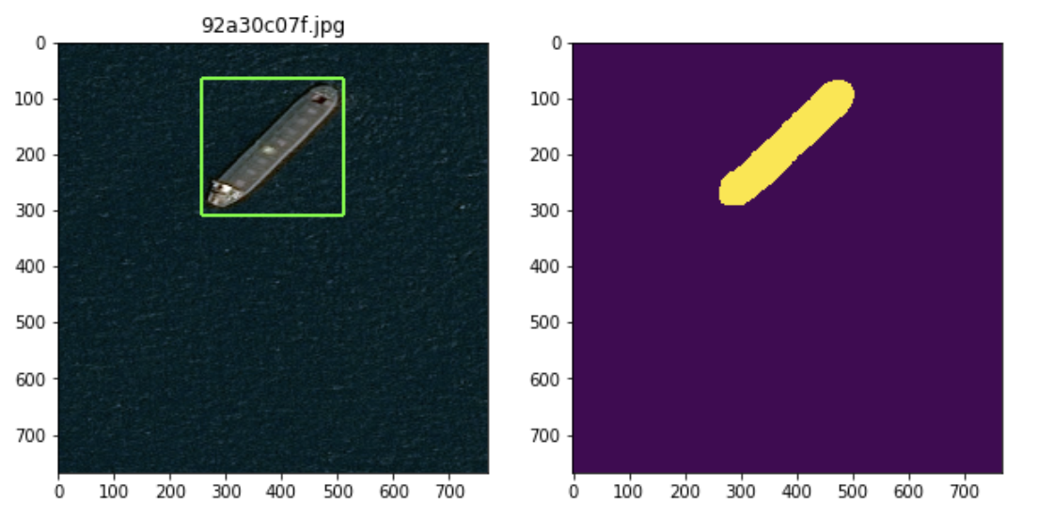
Examples of predictions
Object detection and segmentation mask predictions on test set

Slide 7
Thank you!
Marwan Kalo
marwinkalo@gmail.com
https://github.com/marwankalo

