Slide 1
Comparing the Effectiveness of Stemming and Lemmatization in Arabic Text Summarization with XLSum
Ahmed Eid, Marwan Farag, Mohamed Abdelhamid
Supervised by:
Dr. Mervat Abulkheir
Eng. Mayar Osama

Slide 2
Contents
Overview / Related Work
Limitations of the dataset
Methodology
Results

Slide 3
Related Work
-Statistical based method * (e.g. mostly by sentence frequency).
It is the most commonly used method for scoring sentences: The sentence’s score is determined by the number of occurences.
Disadvantages:
1-Lack of Contextual Understanding
2-Vulnerability to Noise
3-Lack of Coherence
* F. Alotaiby, ‘‘New approaches to automatic headline generation for Arabic documents,’’ J. Eng. Comput. Innov., vol. 3, no. 1, pp. 11–25, Feb. 2012
Notes:
Lack of Contextual Understanding: Statistical-based methods do not have a deep understanding of the meaning of the text. They rely solely on the frequency of words and the relationships between them to generate a summary. This can result in summaries that do not capture the overall context and meaning of the original text.
Difficulty in Handling Ambiguity: Statistical-based methods may struggle to deal with ambiguous words and phrases, which can result in inaccurate or misleading summaries. For example, a word like "bank" can have multiple meanings (e.g. financial institution, riverbank, etc.), and statistical-based methods may not be able to determine the correct meaning in a given context.
Limited Coverage: Statistical-based methods may not be able to summarize texts that contain rare or uncommon words or phrases, which can result in incomplete summaries.
Vulnerability to Noise: Statistical-based methods may be sensitive to noise in the text, such as spelling errors or typos, which can result in inaccurate or misleading summaries.
Lack of Coherence: Since statistical-based methods rely solely on frequency and relationships between words, they may produce summaries that lack coherence and do not flow smoothly, making them difficult to read and understand.

Slide 4
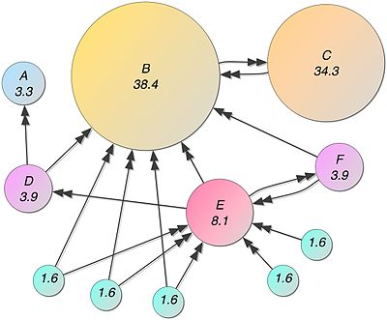
Related Work
-Graph based method * (e.g. PageRanking algorithm).
Calculate sentences similarity
Cluster similar sentences in one group.
Select sentences with a high score from each cluster to reduce redundancy
Avoid selecting sentences from the same cluster at the same time. To eliminate repetition and
boost relevance, they extract and give scores to the most important and distinctive
phrases in the document.
Disadvantages of Graph based methods
-Lack of semantic understanding.
-Overemphasis on connectivity.
-Lack of coherence
* Al-Taani, A. T., & Al-Omour, M. M. (2014). An extractive graph-based Arabic text summarization approach. In The International Arab Conference on Information Technology (pp. 158-163).

Slide 5
Related Work
Tree based summarization *
The input text is first parsed and analyzed to identify the most important concepts and ideas
These concepts are then organized into a tree structure, with the most important ideas forming the roots of the tree and the less important ideas forming the branches and leaves.
The tree is then pruned, which means removing unnecessary parts, and converted to a concise summary.
Disadvantages
-Difficulty with Complex Sentences and high computational costs.
-It is also more focused on syntax than semantics, which limits its effectiveness.
Other methodologies include semantic based summarization and ontology based summarization
* Knight, K., & Marcu, D. (2000). Statistics-based summarization step one: Sentence compression. In AAAI-00.

Slide 6
Related Work
Abstractive Summarization
Deep Learning Seq2Seq models
RNNs, LSTMs, Transformers, BART, and….
AraBART *: AraBART achieves the best performance on multiple abstractive summarization datasets, outperforming strong baselines including a pretrained Arabic BERT-based models and multilingual mBART and mT5 models.
* Moussa Kamal Eddine, Nadi Tomeh, Nizar Habash, Joseph Le Roux, and Michalis Vazirgiannis. Arabart: a pretrained arabic sequence-to-sequence model for abstractive summarization. arXiv preprint arXiv:2203.10945, 2022

Slide 7
What we are doing
- Done some analysis of the XLSum dataset that helped us to do the preprocessing.
Done Preprocessing: Removing punctuation removal, diacritics removal, stop words removal, homography, normalization
Three Setups: 1-With stemming 2-With lemmatization 3-With neither stemming nor lemmatization
We fine-tuned AraBART to do the Arabic text summarization task.
We will compare the training outcome when using stemming/lemmatization/no stemming or lemmatization in the preprocessing.

Slide 8
Limitations OF the dataset
Limited Genre Coverage
Limited Human Annotation
Limited Text Length Variation
Dataset Size and Training Time

Slide 9
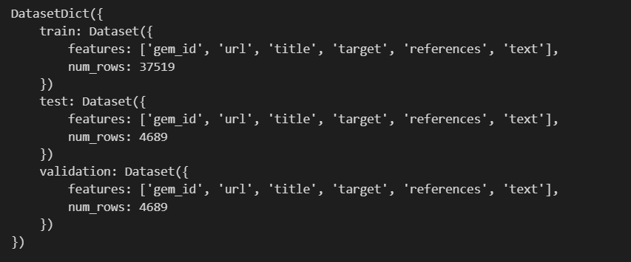
Dataset: Xlsum arabic
The XLSum Arabic dataset consists of approximately 45,000 news articles collected from various Arabic news sources, such as Al Jazeera, Al Arabiya, and BBC Arabic.
The articles cover a wide range of topics, including politics, economics, sports, and culture.
Each article in the dataset is accompanied by a corresponding summary, which was manually created by a human summarizer.

Slide 10
Methodology
Preprocessing (Lemmatization, Stemming)
3 datasets → Stemming vs Lemmatization vs Neither
Pre-trained model (AraBART) + Fine tuning
Tokenize the data based on the pre-trained model
Model training
Predictions & Evaluation

Slide 11
Evaluation and results
F-score = 2 * (precision * recall) / (precision + recall)
Evaluation Metric we will use is Rouge
Rouge types are
Rouge-1
Rouge-2
Rouge-L

Slide 12
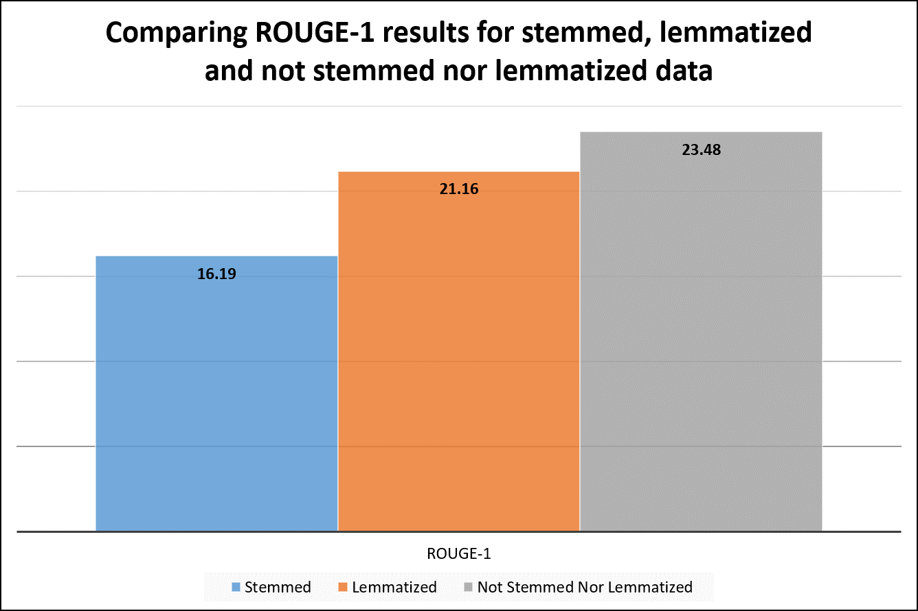
Evaluation and results

Slide 13
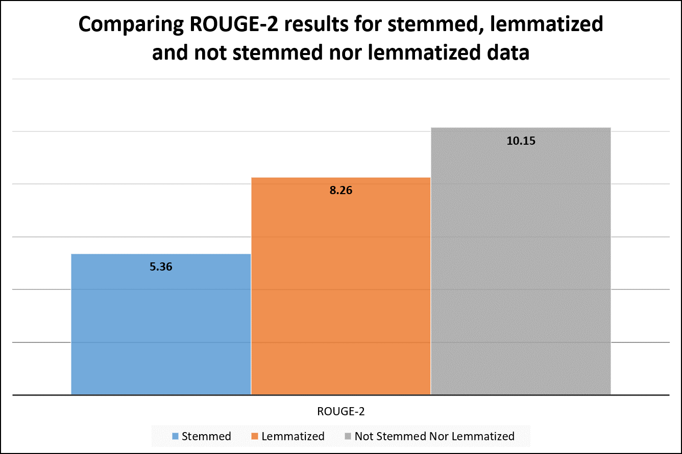
Evaluation and results

Slide 14
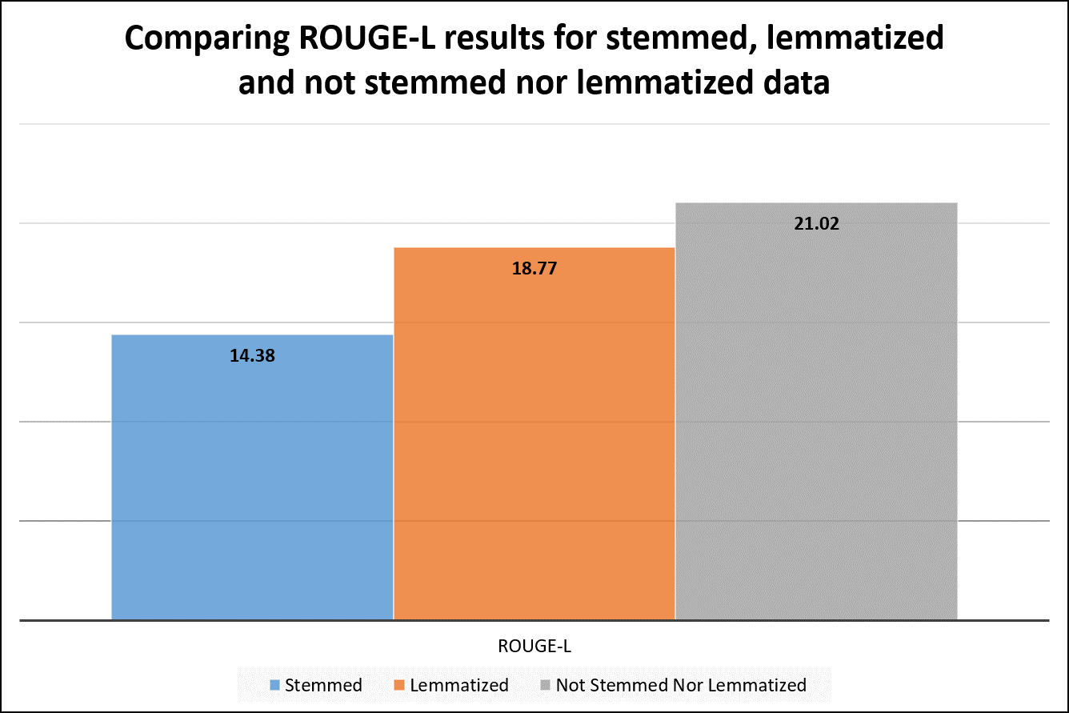
Evaluation and results

Slide 15
Thank you
Any Questions?

