Slide 1
Deep learning
Sardi irfansyah

Slide 2
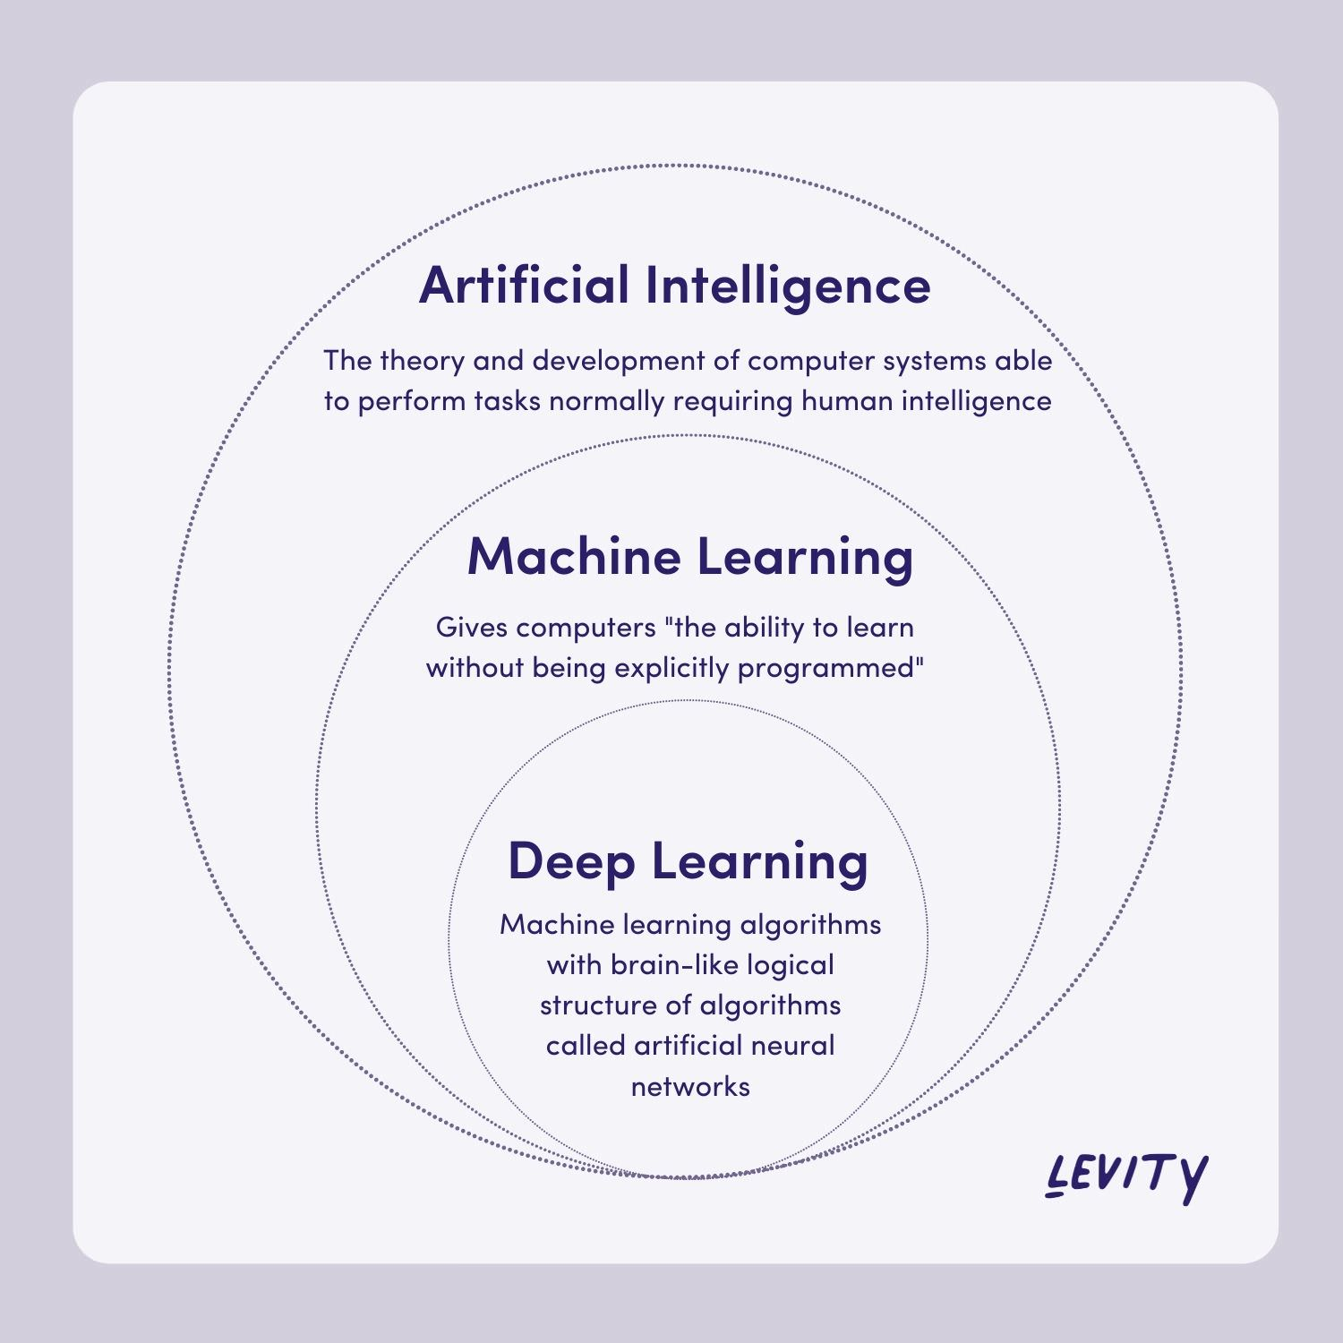
DEEP LEarning
Deep Learning is a subset of machine learning, which is essentially a neural network with three or more layers. These neural networks attempt to simulate the behavior of the human brain—albeit far from matching its ability—allowing it to “learn” from large amounts of data.
Notes:
https://levity.ai/blog/difference-machine-learning-deep-learning

Slide 3
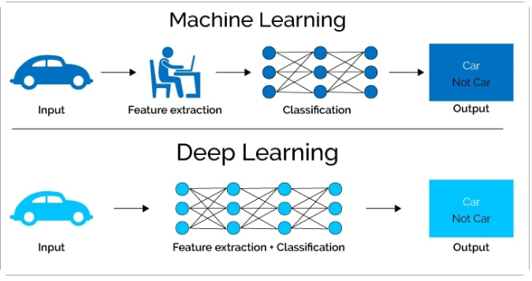
Machine Learning VS Deep Learning
Notes:
https://levity.ai/blog/difference-machine-learning-deep-learning#:~:text=Machine%20learning%20means%20computers%20learning,as%20documents%2C%20images%20and%20text.

Slide 4
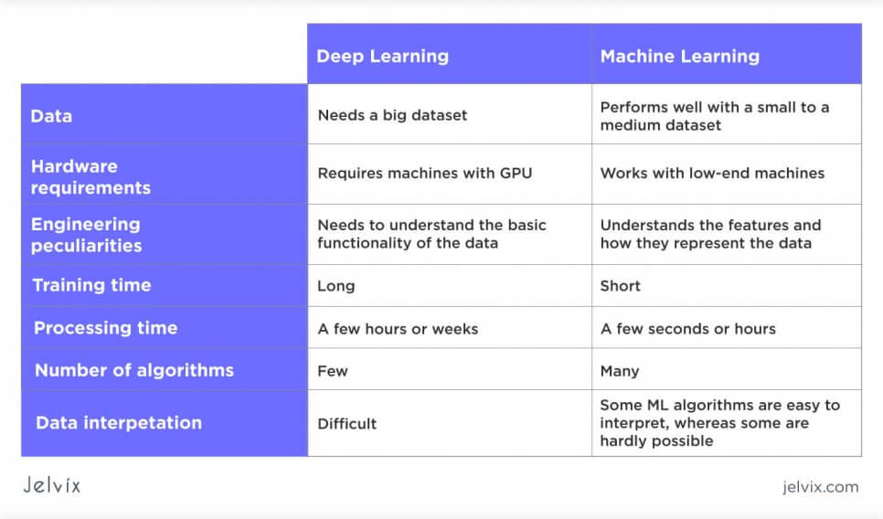
Machine Learning VS Deep Learning
Notes:
https://jelvix.com/blog/ai-vs-machine-learning-vs-deep-learning

Slide 5
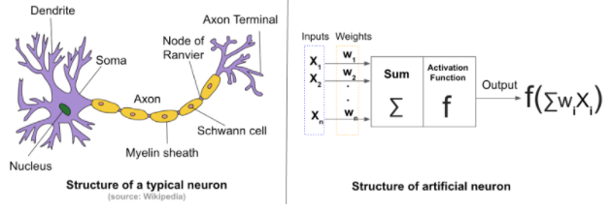
Different types of Neural Networks in Deep Learning
Artificial Neural Networks (ANN)
Convolution Neural Networks (CNN)
Recurrent Neural Networks (RNN)
Notes:
https://www.analyticsvidhya.com/blog/2020/02/cnn-vs-rnn-vs-mlp-analyzing-3-types-of-neural-networks-in-deep-learning/
https://news.sophos.com/en-us/2017/09/21/man-vs-machine-comparing-artificial-and-biological-neural-networks/
https://steemit.com/technology/@davidfumo/a-gentle-introduction-to-neural-networks

Slide 6
ANN
The definition of a neural network, more properly referred to as an 'artificial' neural network (ANN), is provided by the inventor of one of the first neurocomputers, dr. Robert hecht-nielsen. He defines a neural network as:
"...a computing system made up of a number of simple, highly interconnected processing elements, which process information by their dynamic state response to external inputs.“
Notes:
https://deepai.org/machine-learning-glossary-and-terms/weight-artificial-neural-network#:~:text=What%20is%20Weight%20(Artificial%20Neural,weight%2C%20and%20a%20bias%20value.

Slide 7
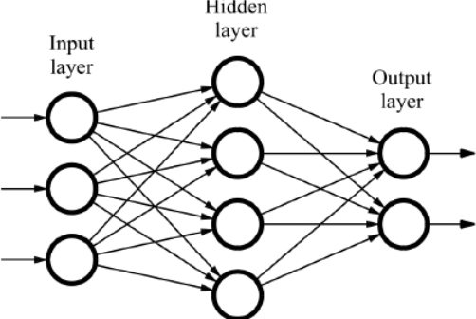
Layer
Any deep neural network will consist of three types of layers:
Input layer/input nodes: no computation is done here within this layer, they just pass the information to the next layer (hidden layer most of the time). A block of nodes is also called layer.
Hidden nodes (hidden layer): in hidden layers is where intermediate processing or computation is done, they perform computations and then transfer the weights (signals or information) from the input layer to the following layer (another hidden layer or to the output layer).
Output nodes (output layer): here we finally use an activation function that maps to the desired output format (sigmoid or softmax).
Notes:
https://steemit.com/technology/@davidfumo/a-gentle-introduction-to-neural-networks

Slide 8
Perceptron
Perceptron was introduced by frank rosenblatt in 1957. A perceptron is an algorithm for supervised learning of binary classifiers. This algorithm enables neurons to learn and processes elements in the training set one at a time.
Further, perceptron is also understood as an artificial neuron or neural network unit that helps to detect certain input data computations in business intelligence.
We can consider it as a single-layer neural network with four main parameters: Input values, weights, net sum, and an activation function.
Notes:
https://www.javatpoint.com/perceptron-in-machine-learning
https://www.simplilearn.com/tutorials/deep-learning-tutorial/perceptron
https://www.w3schools.com/ai/ai_perceptrons.asp

Slide 9
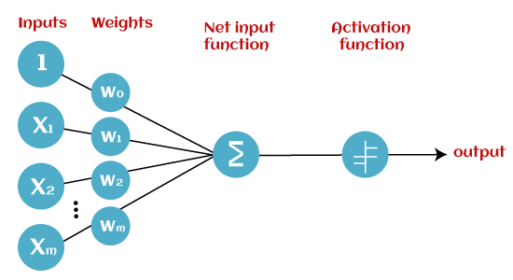
Basic Components of Perceptron
Binary classifiers can be considered as linear classifiers. In simple words, we can understand it as a classification algorithm that can predict linear predictor function in terms of weight and feature vectors.
Weight parameter represents the strength of the connection between units. This is another most important parameter of perceptron components. Weight is directly proportional to the strength of the associated input neuron in deciding the output. Further, bias can be considered as the line of intercept in a linear equation. A bias value allows you to shift the activation function curve up or down (To improve the model's performance).
Notes:
https://www.javatpoint.com/perceptron-in-machine-learning

Slide 10

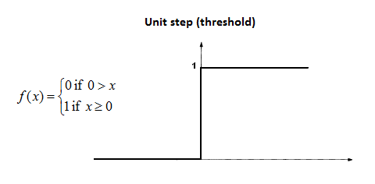
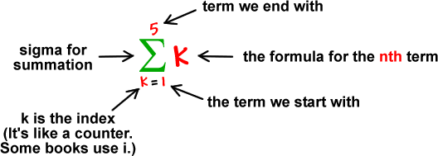

Basic Components of Perceptron
All the inputs x are multiplied with their weights w. Let’s call it k.
Add all the multiplied values and call them weighted sum.
Apply that weighted sum to the correct activation function. For example: unit/binary/heaviside step activation function.
Notes:
https://towardsdatascience.com/what-the-hell-is-perceptron-626217814f53
Tetha= threshold
In short, the activation functions are used to map the input between the required values like (0, 1) or (-1, 1).

Slide 11
Example 1
Bayangkan sebuah perceptron (di otak anda).
Perceptron mencoba memutuskan apakah anda harus pergi ke konser (1) atau tidak (0) dengan pertimbangan: Apakah artisnya good looking?, Cuaca bagus?, Ada makanan?, Ada air mineral?
Berapa bobot yang harus dimiliki dari setiap kondisi diatas?
Criteria | Input (0 or 1) | Weight
Artis Good Looking? | x1 = 1 | w1 = 0.4
Cuaca Bagus? | x2 = 0 | w2 = 0.2
Ada Temen? | x3 = 1 | w3 = 0.2
Ada Makanan? | x4 = 0 | w4 = 0.1
Ada Air Mineral? | x5 = 1 | w5 = 0.1
Notes:
Anggap data ini 1 baris dengan 5 fitur dan target/classnya 2
https://www.w3schools.com/ai/ai_perceptrons.asp

Slide 12
Example 1
Joko menyarankan untuk:
Set threshold value = 0.5
Multiply all inputs with its weights :
X1 * w1 = 1 * 0,4 = 0,4
X2 * w2 = 0 * 0,2 = 0
X3 * w3 = 1 * 0,2 = 0,2
X4 * w4 = 0 * 0,1 = 0
X5 * w5 = 1 * 0,1 = 0,1
Sum all the results : 0.4 + 0 + 0.2 + 0 + 0.1 = 0.7 (the weighted sum)
Activate the output: return true jika jumlahnya > 0.5 ("ya saya akan pergi ke konser")
Catatan: Jika bobot X1= 0,4 untuk anda, mungkin bisa berbeda untuk orang lain. Bobot X1 yang lebih tinggi berarti lebih penting bagi mereka.
Jika threshold= 0.5 untuk anda, mungkin berbeda untuk orang lain. Threshold yang lebih rendah berarti mereka lebih ingin pergi ke konser.

Slide 13
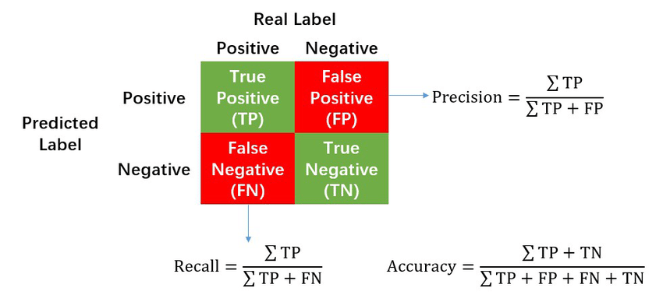
Evaluation
Precision: sangat bagus untuk fokus jika anda ingin meminimalkan kesalahan positif. Precision berbicara tentang seberapa tepat/akurat model anda dari yang diprediksi positif, berapa banyak dari mereka yang benar-benar positif. Semakin kecil FP makan semakin tinggi precision.
Jika anda menaikkan threshold maka precision?
Recall/Sensitivity: sangat penting dalam domain seperti medis (misalnya, mengidentifikasi kanker), di mana anda benar-benar ingin meminimalkan kemungkinan kehilangan kasus positif (meminimalkan memprediksi negatif palsu). Ini biasanya kasus di mana kehilangan kasus positif memiliki biaya yang jauh lebih besar daripada salah mengklasifikasikan sesuatu sebagai positif.
Notes:
https://towardsdatascience.com/a-look-at-precision-recall-and-f1-score-36b5fd0dd3ec#:~:text=F1%2Dscore%20when%20Precision%20%3D%201.0%20and%20Recall%20%3D%200.01%20to%201.0&text=F1%2Dscore%20when%20precision%20%3D%201.0,varies%20from%200.01%20to%201.0.
https://developers.google.com/machine-learning/crash-course/classification/check-your-understanding-accuracy-precision-recall?hl=id
https://datascience.stackexchange.com/questions/73143/will-increasing-threshold-always-increase-precision
Dalam kasus ini misal kita ingin lebih banyak yang ke konser maka
Precision is great to focus on if you want to minimize false positives. Precision talks about how precise/accurate your model is out of those predicted positive, how many of them are actual positive.
In general, raising the classification threshold reduces false positives, thus raising precision.
Meminimalkan kesalahan positif (orang tidak pergi ke konser tapi dianggap pergi) atau kita ingin banyak yg prediksi yg ke konser.
Raising our classification threshold will cause the number of true positives to decrease or stay the same and will cause the number of false negatives to increase or stay the same. Thus, recall will either stay constant or decrease.
Tetap sama recallnya atau menurun

Slide 14
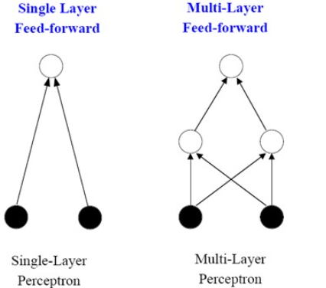
Types of Perceptron Models
Single-layer Perceptron Model
Multi-layer Perceptron model
Notes:
https://www.javatpoint.com/perceptron-in-machine-learning
https://hackernoon.com/everything-you-need-to-know-about-neural-networks-8988c3ee4491
BIAS: https://deepai.org/machine-learning-glossary-and-terms/weight-artificial-neural-network#:~:text=What%20is%20Weight%20(Artificial%20Neural,weight%2C%20and%20a%20bias%20value.

Slide 15
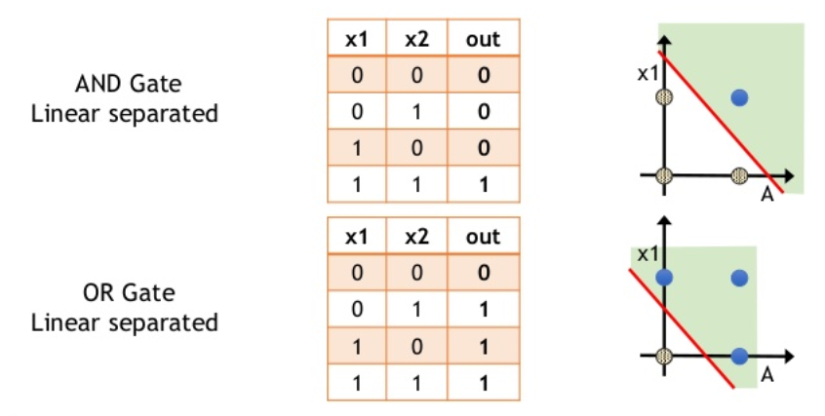
Single-layer Perceptron Model
This is one of the easiest artificial neural networks (ANN) types. A single-layered perceptron model consists feed-forward network and also includes a threshold transfer function inside the model. The main objective of the single-layer perceptron model is to analyze the linearly separable objects with binary outcomes.
Notes:
https://vincentmichael089.medium.com/machine-learning-1-single-layer-perceptron-9d94c62f1970
https://yunusmuhammad007.medium.com/6-artificial-neural-network-ann-part-2-single-layer-perceptron-83f922fefea0
https://slideplayer.com/slide/6318596/
https://www.slideshare.net/TamerAhmedFarrag/03-single-layer-perception-classifier

Slide 16
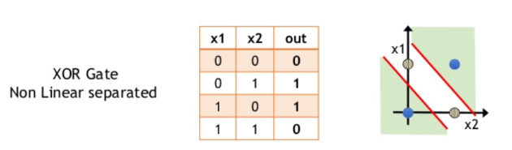
Multi-layer Perceptron model
Like a single-layer perceptron model, a multi-layer perceptron model also has the same model structure but has a greater number of hidden layers.
The multi-layer perceptron model is also known as the backpropagation algorithm, which executes in two stages as follows:
Forward stage: activation functions start from the input layer in the forward stage and terminate on the output layer.
Backward stage: in the backward stage, weight and bias values are modified as per the model's requirement. In this stage, the error between actual output and demanded originated backward on the output layer and ended on the input layer.
A multi-layer perceptron model has greater processing power and can process linear and non-linear patterns. Further, it can also implement logic gates such as AND, OR, XOR, NAND, NOT, XNOR, NOR.
Notes:
https://medium.com/@samuelsena/pengenalan-deep-learning-part-2-multilayer-perceptron-e8f98d625b09

Slide 17
Advantages of Multi-Layer Perceptron
A multi-layered perceptron model can be used to solve complex non-linear problems.
It works well with both small and large input data.
It helps us to obtain quick predictions after the training.
It helps to obtain the same accuracy ratio with large as well as small data.
Notes:
https://www.analyticsvidhya.com/blog/2021/06/how-does-backward-propagation-work-in-neural-networks/#:~:text=Forward%20Propagation%20is%20the%20way,is%20called%20the%20Backward%20Propagation.

Slide 18
Disadvantages of Multi-Layer Perceptron:
In Multi-layer perceptron, computations are difficult and time-consuming.
In multi-layer Perceptron, it is difficult to predict how much the dependent variable affects each independent variable.
The model functioning depends on the quality of the training.

Slide 19
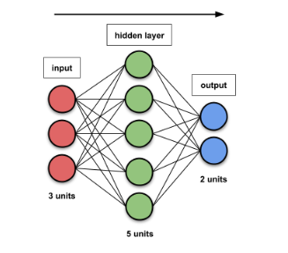
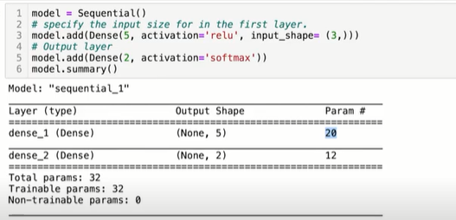
Soal
Notes:
https://towardsdatascience.com/counting-no-of-parameters-in-deep-learning-models-by-hand-8f1716241889

Slide 20
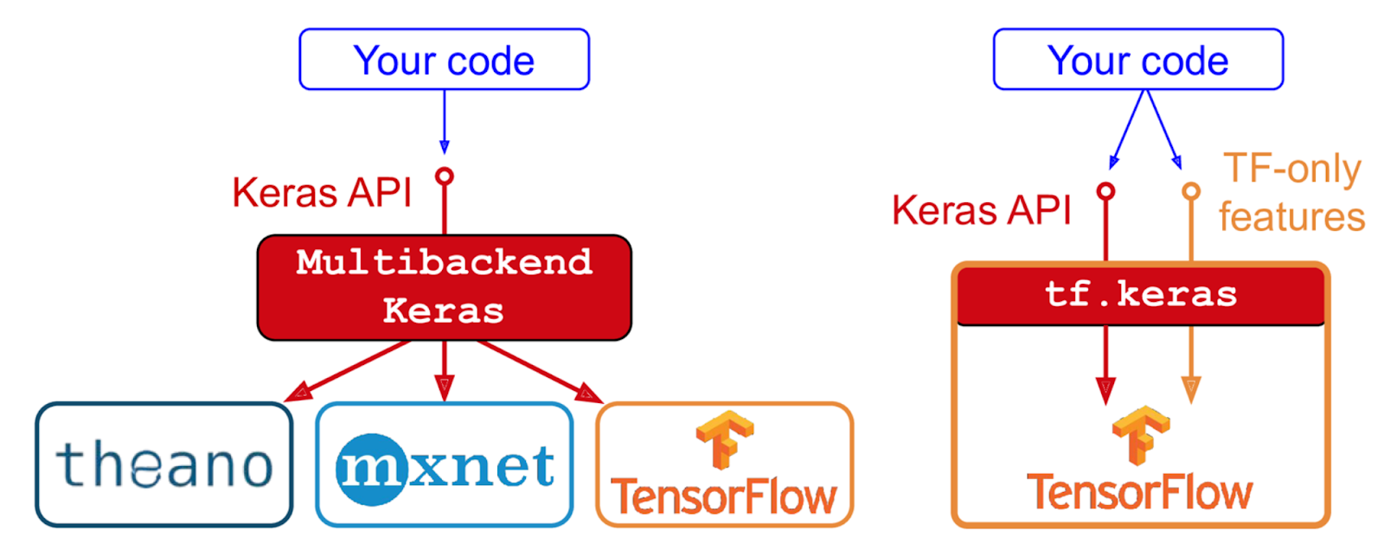
Keras
Keras is a high-level deep learning API that allows you to easily build, train, evaluate, and execute all sorts of neural networks.

Slide 21
Sequential vs functional
Sequential API | Functional API
Simple to use | Complex to implement
Can’t have multiple input layer | Can have multiple input layer
Can’t have multiple output layer | Can have multiple output layer
Layer-by-layer | Can sharing of layers
Output from a layer can only be input for one next layer | Output from a layer can be input for multi next layers
Rigid architecture | Flexible architecture
Notes:
https://machinelearningmastery.com/precision-recall-and-f-measure-for-imbalanced-classification/https://machinelearningmastery.com/precision-recall-and-f-measure-for-imbalanced-classification/
https://towardsdatascience.com/a-look-at-precision-recall-and-f1-score-36b5fd0dd3ec#:~:text=F1%2Dscore%20when%20Precision%20%3D%201.0%20and%20Recall%20%3D%200.01%20to%201.0&text=F1%2Dscore%20when%20precision%20%3D%201.0,varies%20from%200.01%20to%201.0.
https://towardsdatascience.com/under-the-hood-how-do-neural-networks-really-work-7b48b171dc8c
https://machinelearningmastery.com/weight-initialization-for-deep-learning-neural-networks/
https://towardsdatascience.com/activation-functions-neural-networks-1cbd9f8d91d6

Slide 22
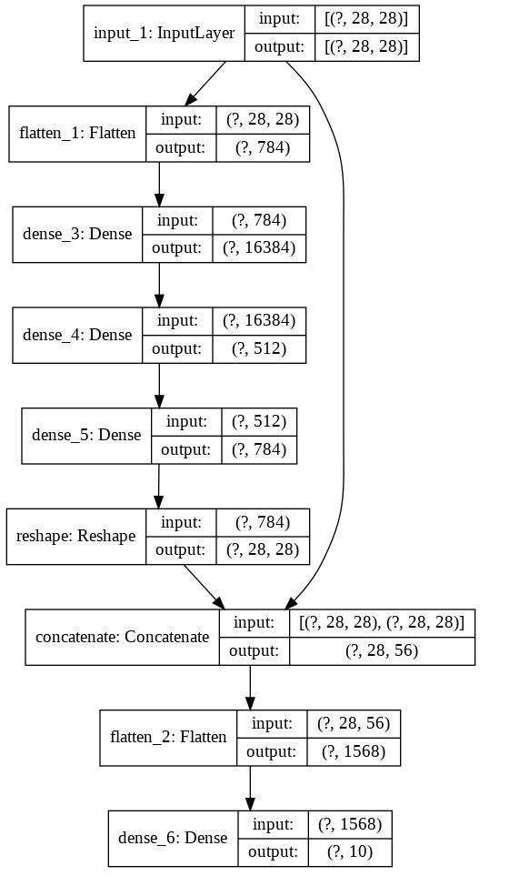
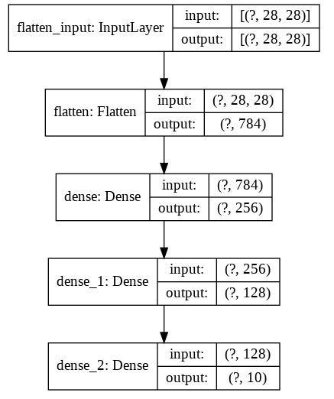
Sequential API
Functional API

Slide 23
https://www.kaggle.com/code/mirichoi0218/ann-making-model-for-binary-classification/notebook
https://www.kaggle.com/code/prashant111/comprehensive-guide-to-ann-with-keras/notebook
https://www.kaggle.com/code/shrutimechlearn/deep-tutorial-1-ann-and-classification/notebook
https://www.kaggle.com/code/melihemin/tumor-dedection-tensorflow-functional-api
https://www.kaggle.com/code/prashant111/keras-basics-for-beginners
Notes:
https://www.kaggle.com/code/vitorgamalemos/multilayer-perceptron-from-scratch
https://www.kaggle.com/search?q=iris+ANN+in%3Anotebooks
https://www.kaggle.com/code/yuqizheng/neural-networks-for-beginners-math-programming
https://www.kaggle.com/code/aishmore/iris-classification-using-ann

Slide 24
https://www.kaggle.com/code/vitorgamalemos/multilayer-perceptron-from-scratch bagus untuk analisis
Notes:
https://slideplayer.com/slide/6318596/
https://slideplayer.com/slide/5726881/

