Slide 1

Customer Analytics
CUSTOMER ANALYTICS
END-TO-END DATA PROJECT
Tools Used
Python
Excel
Power BI
Prepared by:
Marwan Mohamed
Mohamed Yasser
Mahmoud Elsaid

Slide 2
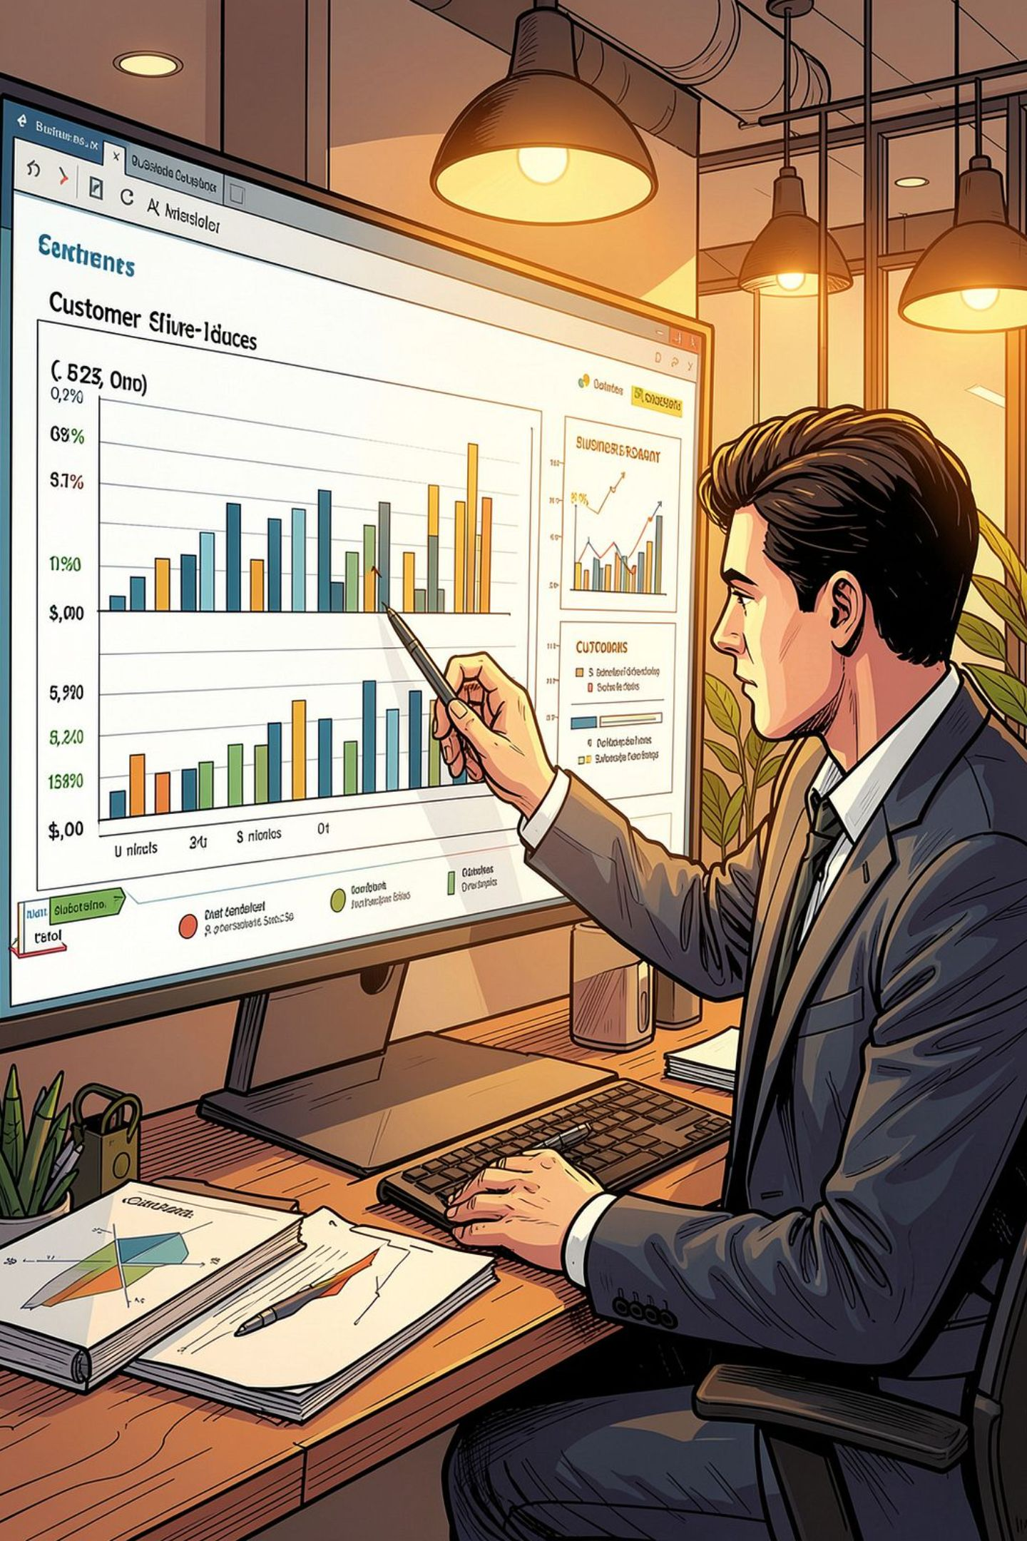
Project Objective
The goal of this project is to analyze customer behavior and business performance through:
Data Cleaning
Data Transformation
Feature Engineering
Exploratory Data Analysis (EDA)
Dashboard Development
The project transforms raw customer data into meaningful business insights.

Slide 3
Dataset Overview
Dataset Information
The dataset contains customer-related information including:
Customer ID
Country
City
Product Purchased
Salary
Bonus
Account Balance
Satisfaction Score
Performance Score
Order Status
Premium Customer
Dataset Size
460K+ Records
Multiple Business Attributes
Financial & Customer Metrics

Slide 4
Data Cleaning Process
Data Quality Issues Identified
Missing Values
Incorrect Data Types
Inconsistent Values
Invalid Performance Scores
Date Formatting Issues
Cleaning Actions
Converted Order Date to Date Format
Replaced Salary Nulls using Mean
Replaced Bonus Nulls using Mean
Replaced Missing Phone Values with "Unknown"
Removed Invalid Performance Scores (>5)
Standardized Customer Fields

Slide 5
Feature Engineering
New Features Created
Satisfaction Level
Customer satisfaction categorized into:
Low
Medium
High
Salary Category
Customers grouped into:
Low Income
Medium Income
High Income
Tenure Years
Calculated customer relationship duration.
Premium Customer Classification
Used for customer segmentation and analysis.

Slide 6
Exploratory Data Analysis (EDA)
Analysis Performed
Revenue Analysis
Revenue distribution
Product contribution
Customer Analysis
Customer segmentation
Premium vs Non-Premium
Geographic Analysis
Country performance
City performance
Satisfaction Analysis
Customer satisfaction trends
Performance evaluation

Slide 7
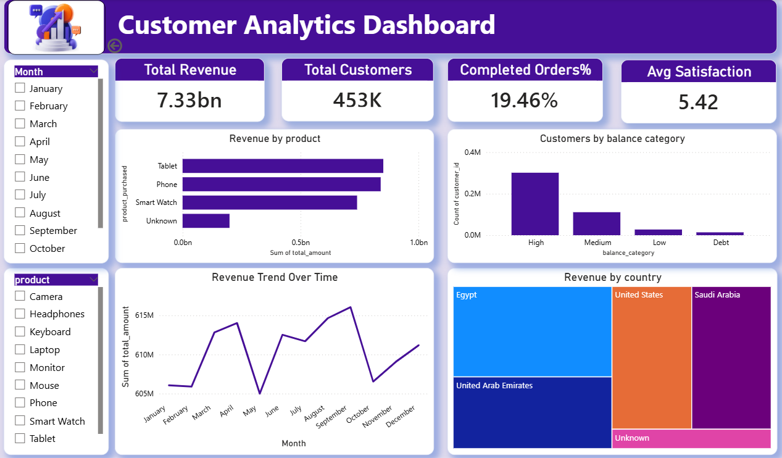
Dashboard 1
Executive Overview Dashboard
KPIs
Total Revenue
Total Customers
Average Satisfaction Score
Completed Orders %
Visualizations
Revenue Trend
Revenue by Product
Customer Distribution Tree Map
Revenue Distribution Analysis
Purpose
Provides a quick business overview for decision makers.

Slide 8
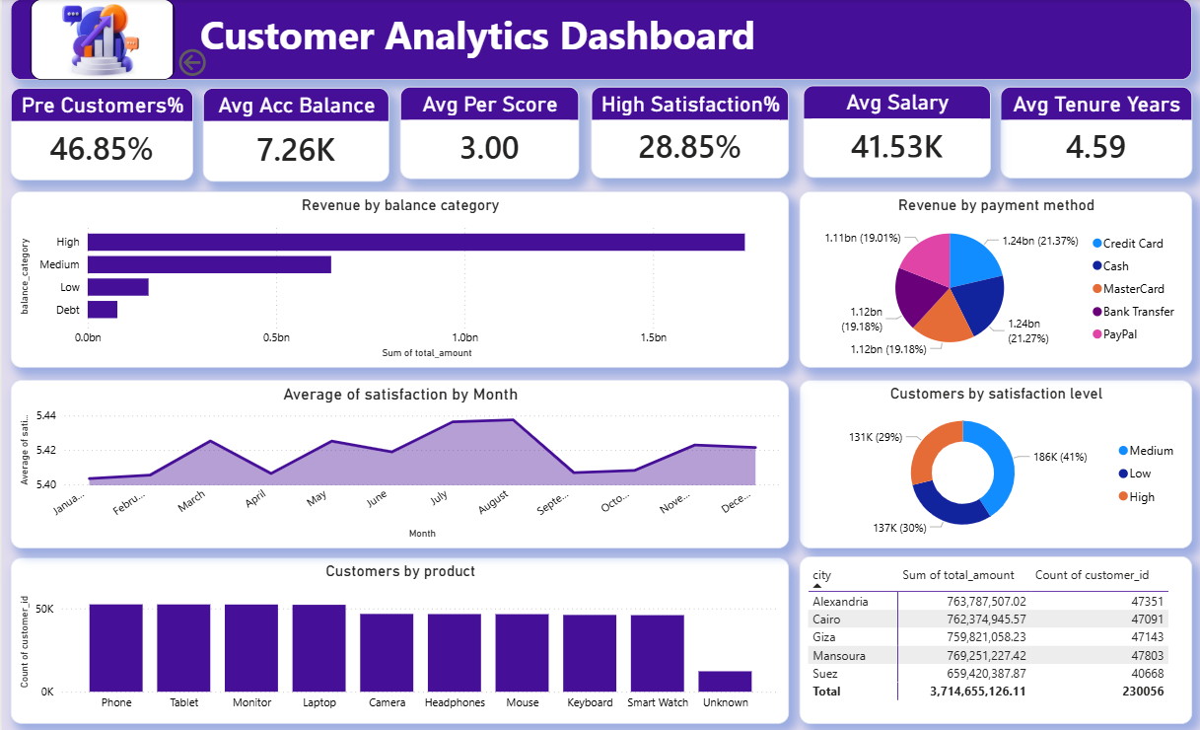
Dashboard 2
Customer Insights Dashboard
KPIs
Average Salary
Average Account Balance
Average Tenure
Average Performance Score
Premium Customers %
High Satisfaction %
Visualizations
Matrix Analysis
Pie Chart
Donut Chart
Column Chart
Area Chart
Bar Chart
Purpose
Provides deeper customer-level insights.

Slide 9
Key Insights
Main Findings
Customer Insights
Premium customers generate significant business value.
Customer satisfaction varies across segments.
Some products contribute more revenue than others.
Business Insights
Revenue distribution is not equal across categories.
Geographic regions show different performance levels.
Customer behavior patterns can support better business decisions.

Slide 10

Conclusion
Project Summary
This project demonstrates a complete analytics workflow:
Data Preparation
✔ Cleaning
Data Transformation
✔ Feature Engineering
Analysis
✔ EDA
Reporting
✔ Interactive Dashboards
Technologies Used
Python
Excel
Power BI
Result: Raw data transformed into actionable business insights.

