Slide 1
SRS Presentation
Marwan Nassef
Karim Salama
Mohamed El Maachi
Medhat Meebed

Slide 2
Media Streaming
Introduction

Slide 3
Problem scenario
Streaming Media may be defined as listening or viewing media in real-time as it comes across the World Wide Web. With streaming technology, users can watch and listen to media while it is being sent to their browser, instead of waiting for it to completely download and then playing it. Before streaming technology was available, a user might wait an hour (or more!) to completely
In general, media files are huge. For example, five minutes of uncompressed video would require almost one gigabyte of space! So, when the audio and video is prepared for streaming, the media file is compressed to make the file size smaller. When a user requests the file, the compressed file is sent from the video server in a steady stream and is decompressed by a streaming media player on the user's computer to play automatically in real-time. A user can jump to any location in the video or audio presentation. Streaming media generally tries to keep pace with the user's connection speed to reduce interruptions and stalling. Though general network congestion is unavoidable, the streaming server attempts to compensate by maintaining a constant connection

Slide 4
Problem scenario cont.
A client end-user can use their media player to start playing digital video or digital audio content before the entire file has been transmitted. Distinguishing delivery method from the media distributed applies specifically to telecommunications networks, as most of the delivery systems are either inherently streaming (e.g. radio, television, streaming apps) or inherently no streaming (e.g. books, video cassettes, audio CDs)
Streaming technology allows users to receive live or pre-recorded audio and video, as well as "illustrated audio" (sound synchronized to still pictures). To access streaming media, the user must have a player capable of displaying the presentation

Slide 5
Use-Case Diagram
Media Streaming

Slide 6
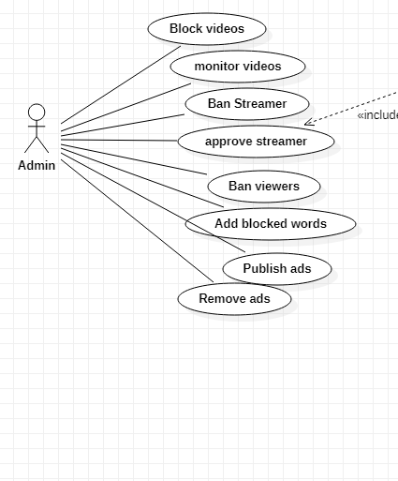
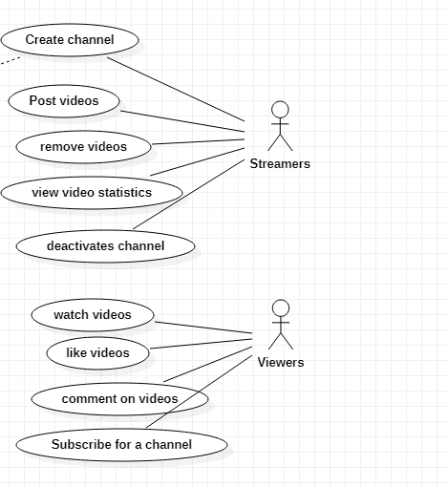
Use-case Diagram

Slide 7
Sequence/VOPC diagram
Media Streaming

Slide 8
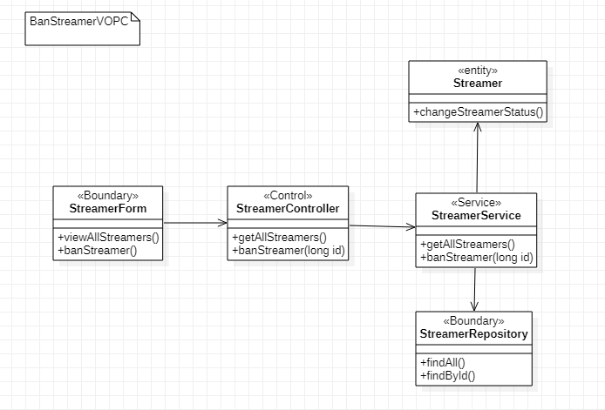
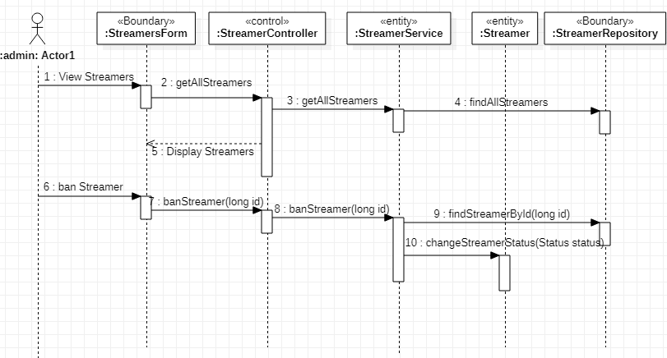
Sequence/VOPC Ban Streamer - Diagram

Slide 9
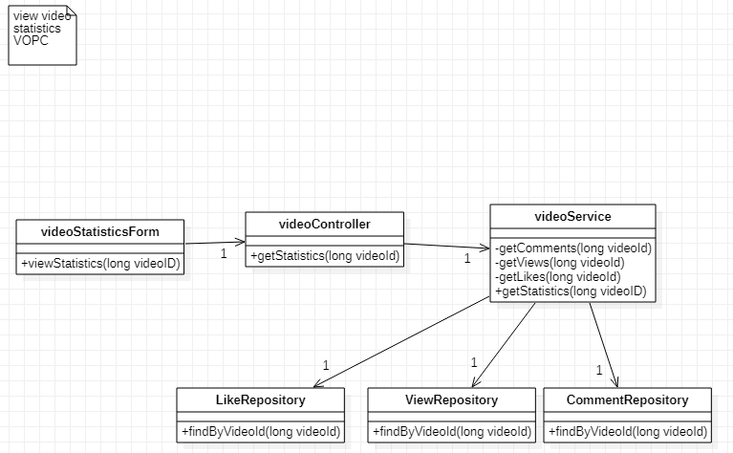
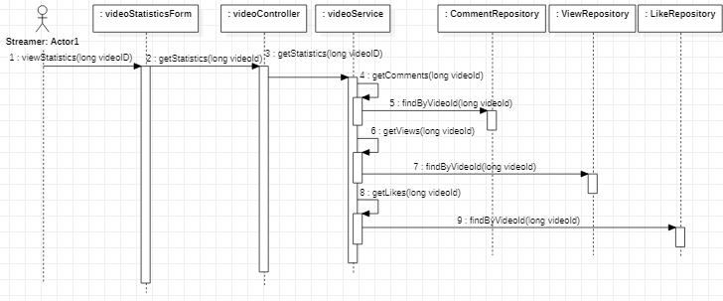
Sequence/VOPC Ban Streamer - Diagram

Slide 10
Domain diagram
Media Streaming

Slide 11
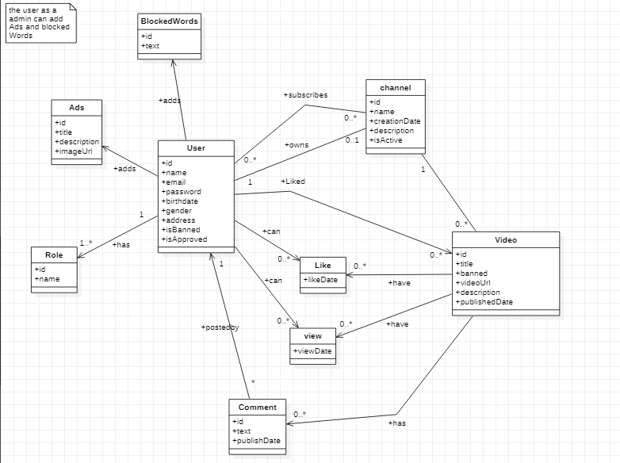
Domain model

Slide 12
ER diagram
Media Streaming

Slide 13
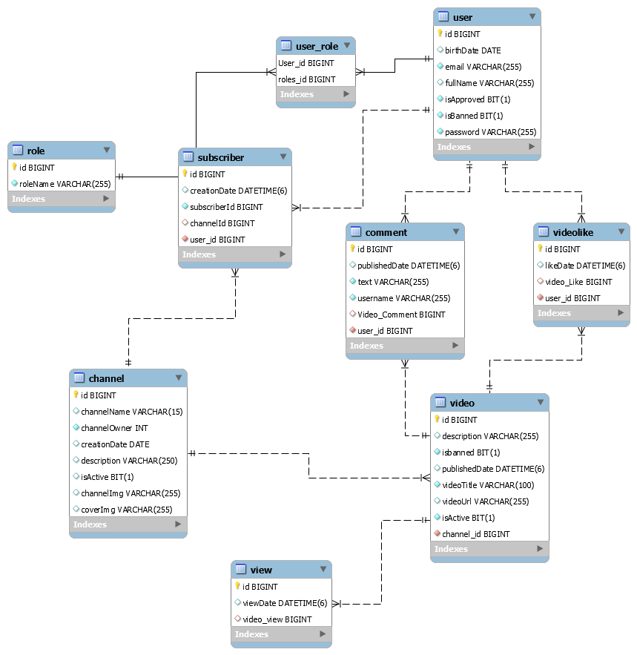
ER diagram

Slide 14
Technologies
Media Streaming

Slide 15
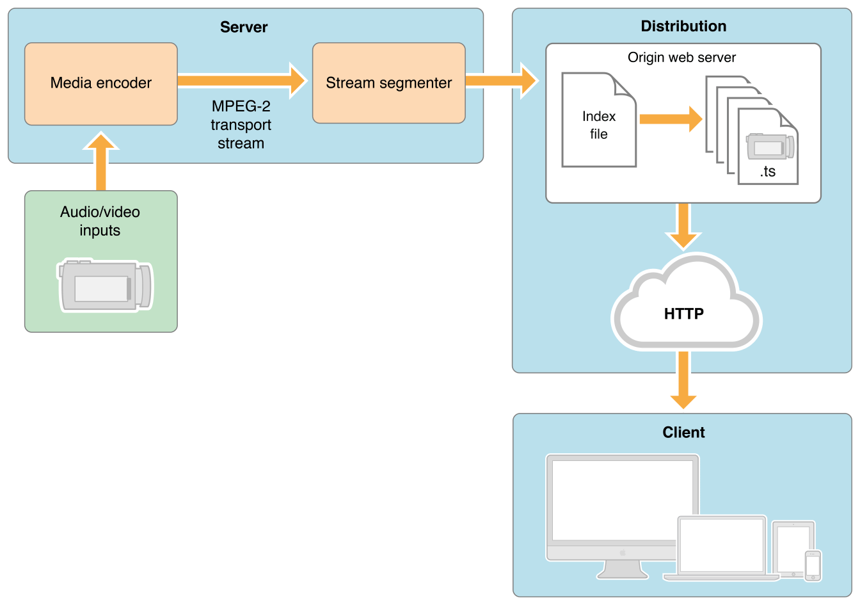
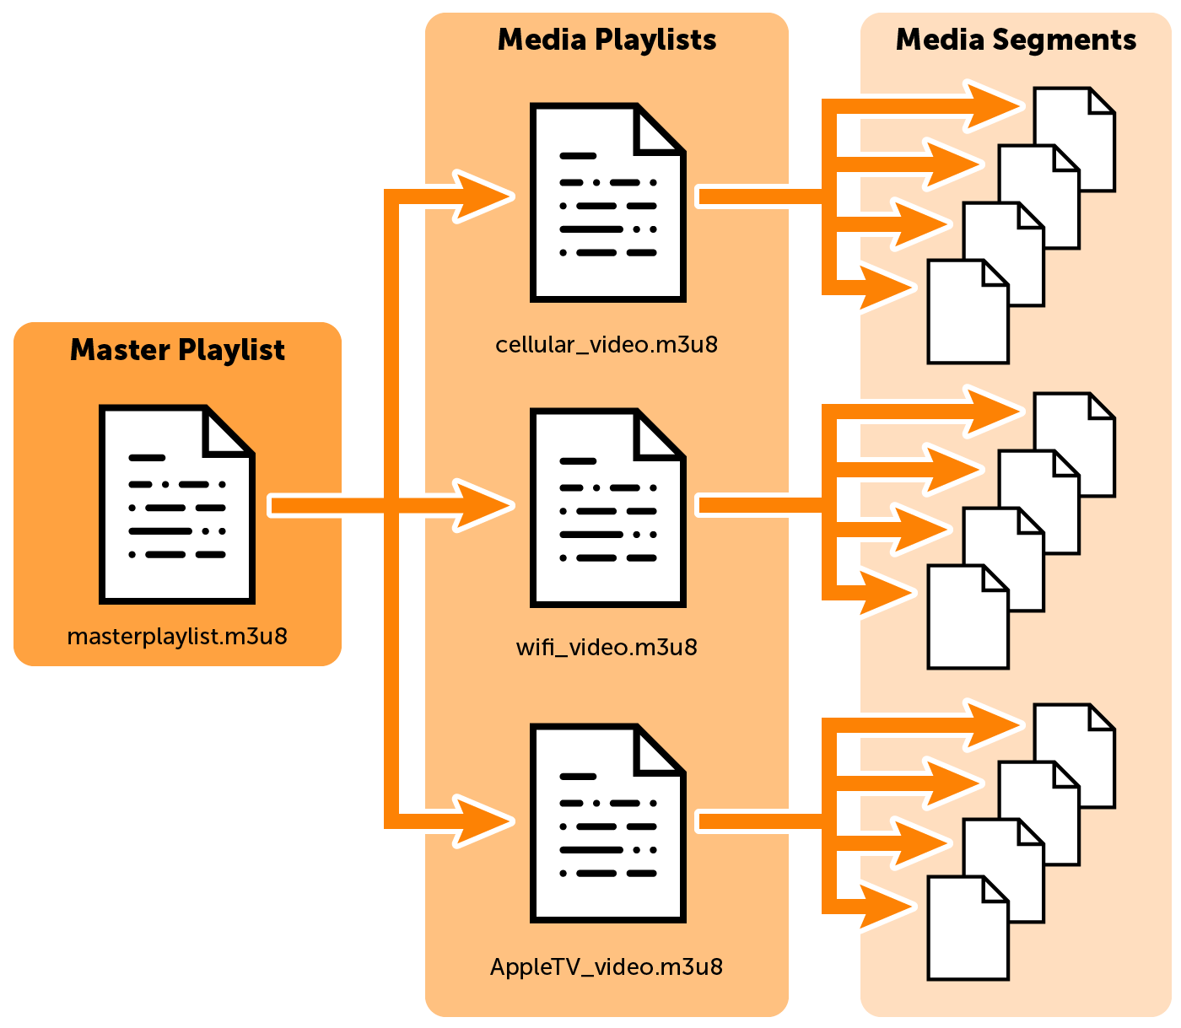
HLS-Streaming-Flow

Slide 16
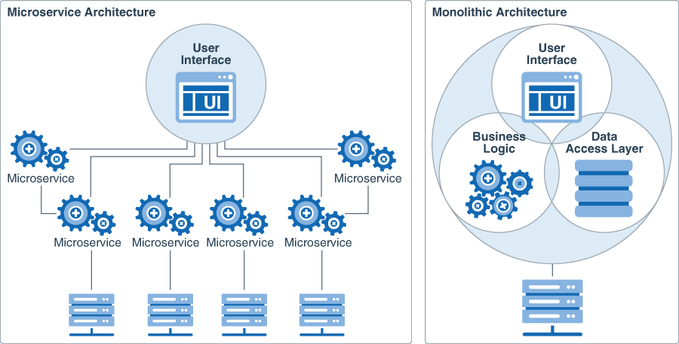
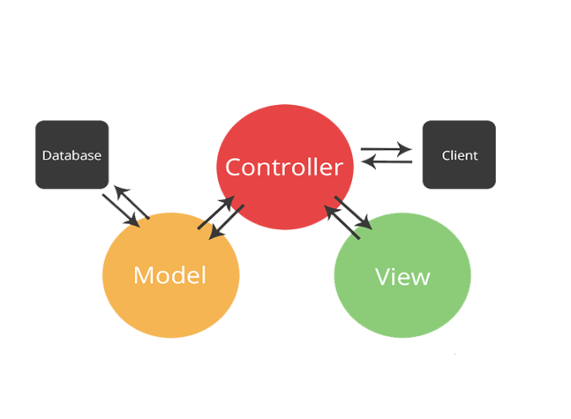
Microservices vs Monolithic

Slide 17
Why Microservices ?
Isolation
Microservices are profitable due to their isolation and resilience. If one of the components fail, developers have the option to use another service and the application will continue to run independently.
Scalability
With the architecture of microservices based on small components, it’s easier for development teams to scale up or down following the requirements of a specific element Productivity
Flexibility
The microservice approach lets developers choose the right tools for the right task. They can build each server utilizing a language or framework they need without affecting the communication between microservices.
Faster project development
Microservices work independently, so you don’t have to change the codebase in order to modify the features. You can change one component, test, and then deploy it individually.

Slide 18
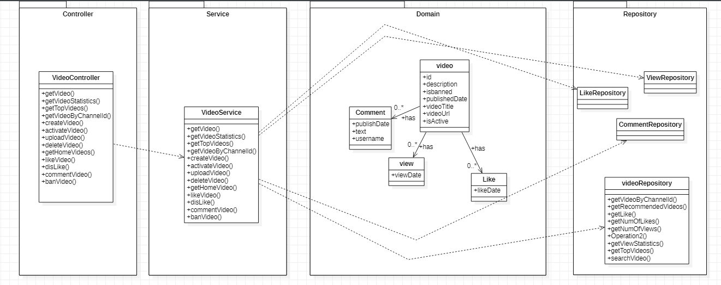
Video – Microservice Example

Slide 19
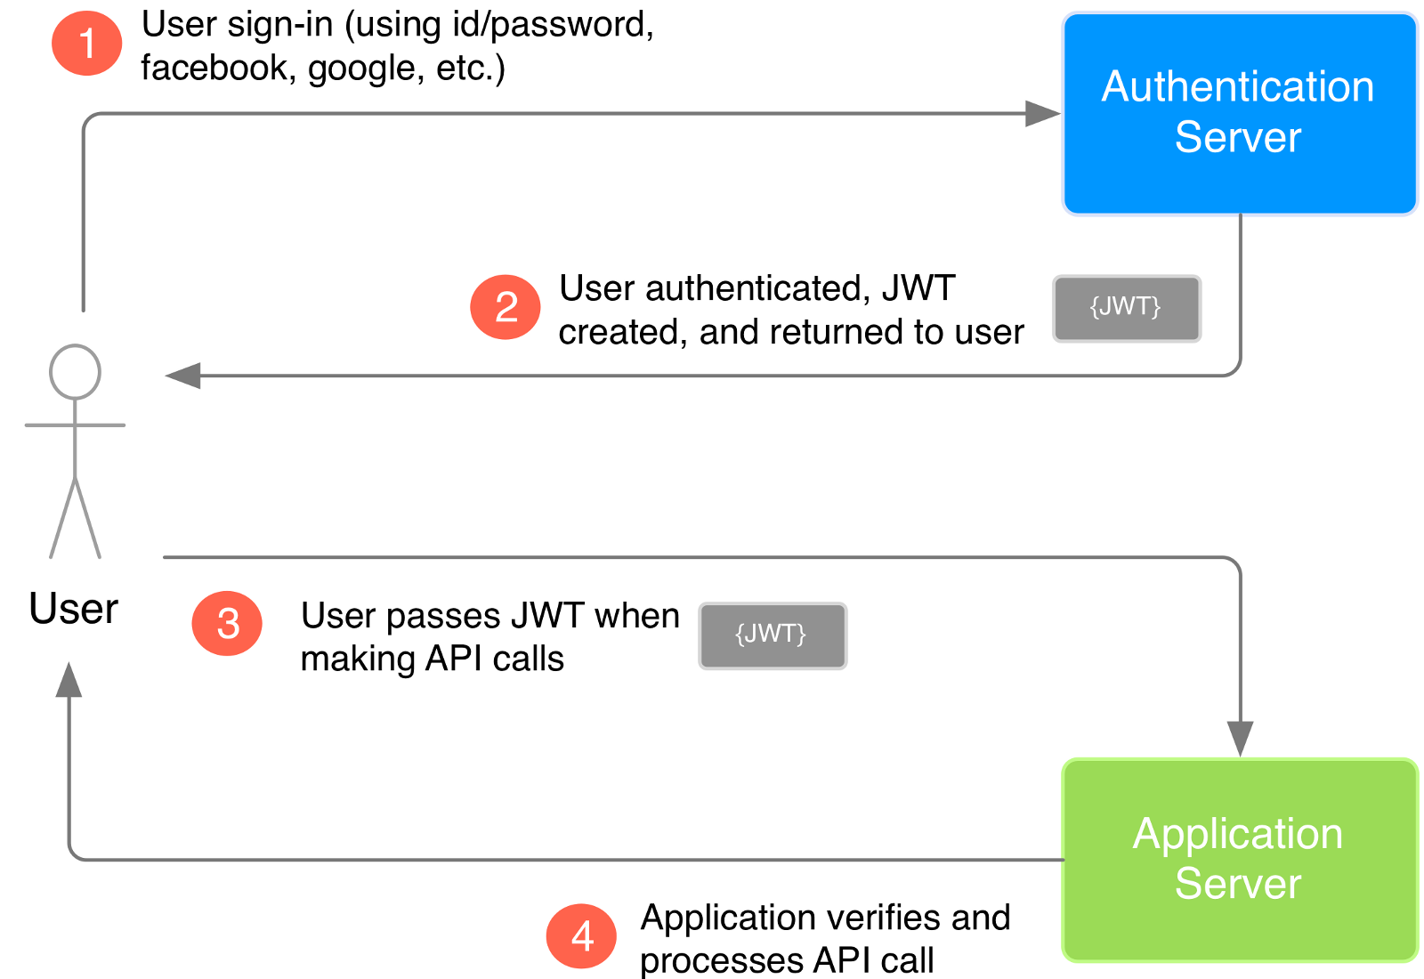

Security

Slide 20


Supportive technologies

Slide 21



Video processing

Slide 22
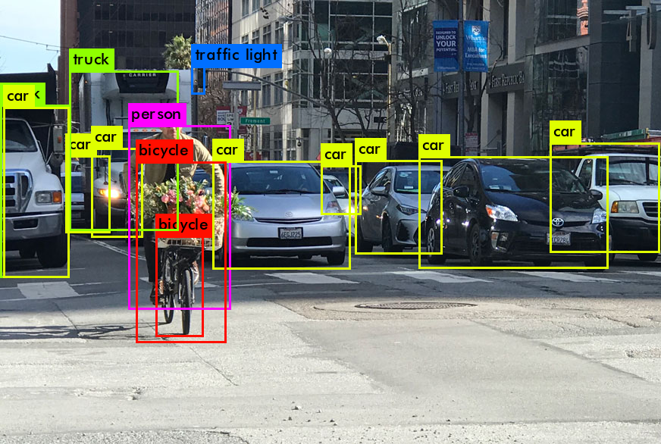

Object detection

Slide 23
Thank You

