Slide 1


Slide 2
Data Mining Project (Part 1)
-Marwan Salah Shipl Mohamed 20201374603
-Ahmed Maged Mounir Mahmoud 20201374583
-Mohaned Mohamed Mahmoud Mohamed 20201373760
-Mohamed Ahmed Abd-Elatty Hakam 20201447462
-Rewan Mohamed Abdou 20201373309
-Mayar Mohamed Darwish Mohaned 20201496986

Slide 3
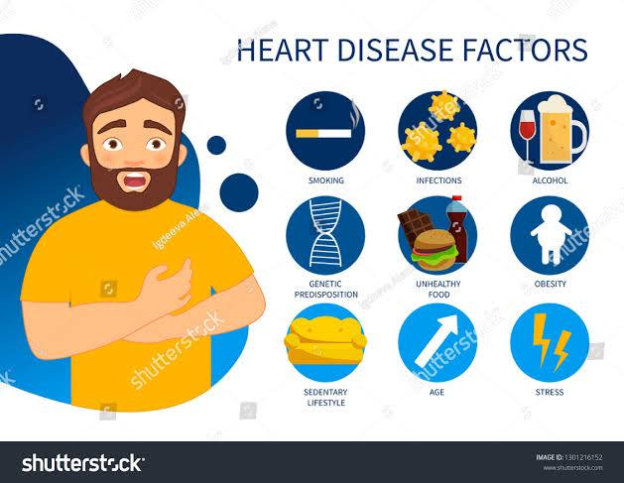

Slide 4
Introduction to the used dataset (Key Indicators of Heart Disease)
The dataset come from the CDC (Centers For Disease Control Prevention) and is a major part of the Behavioral Risk Factor Surveillance System (BRFSS), which conducts annual telephone surveys to gather data on the health status of U.S. residents.
Heart disease is the leading cause of death for men, women, and people of most racial and ethnic groups in the United States.
One person dies every 36 seconds in the United States from cardiovascular disease.
About 659,000 people in the United States die from heart disease each year—that’s 1 in every 4 deaths.

Slide 5
Heart disease costs the United States about $363 billion each year from 2016 to 2017. This includes the cost of health care services, medicines, and lost productivity due to death.
Heart Attack
In the United States, someone has a heart attack every 40 seconds.
Every year, about 805,000 people in the United States have a heart attack. Of these,
605,000 are a first heart attack
200,000 happen to people who have already had a heart attack
About 1 in 5 heart attacks is silent—the damage is done, but the person is not aware of it.

Slide 6
According to the CDC, heart disease is one of the leading causes of death for people of most races in the US (African Americans, American Indians and Alaska Natives, and white people). About half of all Americans (47%) have at least 1 of 3 key risk factors for heart disease:
-high blood pressure -high cholesterol -smoking

Slide 7
In the table below we will show the percentages of all deaths caused by heart disease in 2015, listed by ethnicity, race, and sex.
Race of Ethnic Group % of Deaths Men% women%
American Indian or Alaska Native 18.3 19.4 17.0
Asian American or Pacific Islander 21.4 22.9 19.9
Black (Non-Hispanic) 23.5 23.9 23.1
White (Non-Hispanic) 23.7 24.9 22.5
Hispanic 20.3 20.6 19.9
All 23.4 24.4 22.3

Slide 8
Other key indicator include diabetic status, Overweight or obesity (high BMI), not getting enough physical activity or drinking too much alcohol. Detecting and preventing the factors that have the greatest impact on heart disease is very important in healthcare. Computational developments, in turn, allow the application of machine learning methods to detect "patterns" from the data that can predict a patient's condition.

Slide 9
In the next few slides we will talk about the risk factors mentioned above and how they affect the numbers mentioned according to the CDC
(U.S. Centers for Disease Control and Prevention).
We will show the reason for the enormous numbers of people with heart problems in general and especially in the united states.

Slide 10
First: high blood pressure.
High blood pressure is a major risk factor for heart disease. It is a medical condition that happens when the pressure of the blood in your arteries and other blood vessels is too high. The high pressure, if not controlled, can affect your heart and other major organs of your body, including your kidneys and brain.
High blood pressure is often called a “silent killer” because it usually has no symptoms. The only way to know whether you have high blood pressure is to measure your blood pressure. You can lower your blood pressure with lifestyle changes or with medicine to reduce your risk for heart disease and heart attack.

Slide 11
Second: High cholesterol.
Unhealthy blood cholesterol levels. Cholesterol is a waxy, fat-like substance made by the liver or found in certain foods. Your liver makes enough for your body’s needs, but we often get more cholesterol from the foods we eat.
If we take in more cholesterol than the body can use, the extra cholesterol can build up in the walls of the arteries, including those of the heart. This leads to narrowing of the arteries and can decrease the blood flow to the heart, brain, kidneys, and other parts of the body.

Slide 12
There are two main types of blood cholesterol: LDL (low-density lipoprotein) cholesterol, which is considered to be “bad” cholesterol because it can cause plaque buildup in your arteries, and HDL (high-density lipoprotein) cholesterol, which is considered to be “good” cholesterol because higher levels provide some protection against heart disease.
High blood cholesterol usually has no signs or symptoms. The only way to know whether you have high cholesterol is to get your cholesterol checked. Your health care team can do a simple blood test, called a “lipid profile,” to measure your cholesterol levels.

Slide 13
Third: Diabetes.
Diabetes mellitus. Your body needs glucose (sugar) for energy. Insulin is a hormone made in the pancreas that helps move glucose from the food you eat to your body’s cells for energy. If you have diabetes, your body doesn’t make enough insulin, can’t use its own insulin as well as it should, or both.
Diabetes causes sugar to build up in the blood. The risk of death from heart disease for adults with diabetes is higher than for adults who do not have diabetes. Talk with your doctor about ways to prevent or manage diabetes and control other risk factors.

Slide 14
Fourth: Obesity.
Obesity is excess body fat. Obesity is linked to higher “bad” cholesterol and triglyceride levels and to lower “good” cholesterol levels. Obesity can lead to high blood pressure and diabetes as well as heart disease. Talk with your health care team about a plan to reduce your weight to a healthy level.

Slide 15
Fifth: Smoking.
Tobacco use increases the risk for heart disease and heart attack:
Cigarette smoking can damage the heart and blood vessels, which increases your risk for heart conditions such as atherosclerosis and heart attack.
Nicotine raises blood pressure.
Carbon monoxide from cigarette smoke reduces the amount of oxygen that your blood can carry.
Exposure to secondhand smoke can also increase the risk for heart disease, even for nonsmokers.

Slide 16
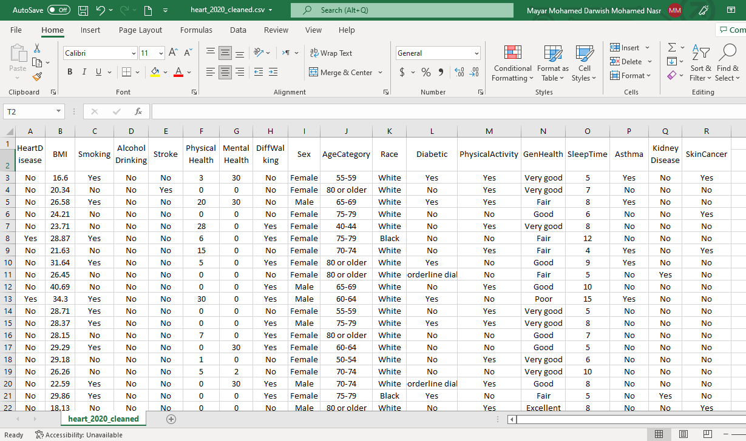

Slide 17
Dataset attributes
● HeartDisease: Respondents that have ever reported having coronary heart disease (CHD) or myocardial infarction (MI).
● BMI: Body Mass Index.
● Smoking: Have you smoked at least 100 cigarettes in your entire life?
● AlcoholDrinking: Heavy drinkers (adult men having more than 14 drinks per week and adult women having more than 7 drinks per week.
● Stroke: Ever told you had a stroke?
● PhysicalHealth: Now thinking about your physical health, which includes physical illness and injury, for how many days during the past 30.
● MentalHealth: Thinking about your mental health, for how many days during the past 30 days was your mental health not good?
● DiffWalking: Do you have serious difficulty walking or climbing stairs?

Slide 18
● Sex: Male or Female? ● AgeCategory: Fourteen-level age range. ● Race(strain): Imputed race/ethnicity value. ● Diabetic: Ever told you have Diabetes? ● PhysicalActivity: Adults who reported doing physical activity or exercise during the past 30 days other than their regular job. ● GenHealth: Your general health is... (Poor,Fair,Good,Very good,Excellent). ● SleepTime: On average, how many hours of sleep do you get in a 24-hour period? ● Asthma: Ever told you had asthma? ● KidneyDisease: Not including kidney stones, bladder infection or incontinence, were you ever told you had kidney disease? ● SkinCancer : Ever told you had skin cancer?

Slide 19
First, importing the required libraries:
(Pandas ,numpy ,seaborn ,matplotlib).
Pandas library is used for data manipulation and analysis.
(it offers data structures and operations for manipulating numerical tables and time series.)
NumPy is general purpose array-processing package.
(perform a wide variety of mathematical operations on arrays)
Seaborn library is used for making statistical graphics.
Matplotlib library is used for creating static ,animated and interactive visualization.
KBinsDiscretizer is used to discretize continuous features.

Slide 20
Data Wrangling Phase:
Data wrangling is the process of cleaning and unifying messy and complex data sets for easy access and analysis. With the amount of data and data sources rapidly growing and expanding, it is getting increasingly essential for large amounts of available data to be organized for analysis.
-Considering the next four steps regarding this phase:
Loading the dataset.
Displaying data content.
General data properties.
Cleaning phase.

Slide 21
Loading the dataset:
-using the pandas library to load the dataset.
Displaying data content:
-Displaying the first 15 rows of the dataset.
General properties:
-Containing:
The shape of the data, including number of rows and columns.
It contains 319795 rows and 18 columns.
Data information ,including data types and checking for any missing values.
It appears no missing values in the data.
Describing the data ,includes statistical values.
There is an error in "SleepTime" column as its maximum value is 24 hours and that’s immpossible (will be handled in data cleaning phase)

Slide 22
Cleaning phase:
-Handling the missing values and errors found in the used data during describing the data.
In this phase we will go through several steps which are :
Step 1: Remove irrelevant data.
Step 2: De-duplicate our data.(Remove duplicates from data, using drop duplicate() function)
Step 3: Fix structural errors.
Step 4: Deal with missing data.
Step 5: Filter out data outliers.
Step 6: Validate our data

Slide 23
Checking whether the data contain any duplicated rows or not and calculate the sum either ways.
-Found 18087 duplicated rows needs to be dropped.
Using the drop_duplicates functions to drop the duplicated rows and calculating the sum.
-Now the number of the duplicated rows is zero.
Checking for errors in data entry where values in PhysicalHealth=0 and dropping them.
Same goes for the data entry where MentalHealth=0 and dropping them.
Displaying the rows containing 24 hours in “SleepTime” as an error.
-Creating a list of indices of the wrong entry rows in “SleepTime” to be passed to drop.
-Checking after for any 24 Hrs of “SleepTime” ,now there are none.

Slide 24
Detecting outliers:
-By adding a subplot to a figure with width=16 and height=5.
-Representing the overall distribution of continuous data variables by distplot function.
-Used on the “BMI” attribute and “SleepTime” attribute.
Removing outliers:
-Calculating the 1st and 3rd quartiles, the inter quartile range ,the lower and the upper limits.
-Removing the outliers and updating the data frame.

Slide 25
-Encoding binary attributes:
Creating an array holding the data attributes.
Creating a function “encode” with a for loop going over the data attributes to define the “Sex” attribute ,using the “get_dummies” function.
“get_dummies” function is used to convert categorical variables into indicator variables.
In other words converting Yes to 1 and No to 0.
If the “Sex” is “Male” ,will be defined as “1” ,otherwise(Female) will be defined as “0”.

Slide 26
-Checking for values of the GenHealth attribute:
Using the unique function to display the values.
Converting the ordinal attributes (poor ,good ,….) to numerical attributes (1,2,3,…).
Updating the dataset with the new GenHealth attribute values, using the map function.
-Checking for values of the Race attribute:
With the same steps with the GenHealth attribute.
Replacing the categorical values (White ,Black ,…..) with numerical values (0,1,…..).
-Checking for values of the AgeCategory attribute:
With the same steps with the GenHealth attribute.
Replacing the categorical values (’55-59’, ’80 or older’ ,….) with numerical values (57,95,….).

Slide 27
-Creating the correlation matrix:
Creating a figure with width=15 and height=15.
Using a heatmap to plot the correlation matrix with the title “Correlation Matrix”.
A correlation heatmap is a 2D correlation matrix between 2 discrete dimensions using colored cells to represent data.
There's No Attributes With Correlation rate Greater than or equal 0.8 for +ve correlation.
There's No Attributes With Correlation rate less than or equal -0.8 for -ve correlation.
So no attributes need to be removed.

Slide 28
-Exploratory Data Analysis:
This list of lists contains all the columns which have binary categorical values.
Creating an array of size 3 for the attributes.
Creating a “printCount” function, this function prints the countplots, counting the number of people in each category.
Countplot : Show the count of observations in each categorical bin using bars.
Creating a subplot with 3 columns and 3 rows with width=20 ,height=20.
Creating a nested for loop for rows and columns to:
Read column name from the list “column” .
Plotting the counts of a particular column using the “countplot” function , the hue parameter denotes which column decides the kind of color .
Setting the title of the corresponding plot along with plot number.

Slide 29
-Checking heart disease among races:
Creating a figure with width=12 and height=6.
Using the countplot function to count how many people suffer from heart disease among races and displaying it on the plot called “Variation of Heart Disease among Races”.
As 0 stands for white people...white people are more likely to have heart diseases.
-Checking heart diseases for diabetic people:
Following the same steps as the previous process to display the number of diabetic people who suffer from heart diseases ,on a plot called “Variation of Heart Disease among Diabetic People”.
People who don't suffer from diabetes have higher risk of heart diseases.

Slide 30
-Checking heart diseases compared to general health:
Following the same steps as the previous process to display people’s general health and who’s likely to suffer from heart diseases ,on a plot called “Variation of Heart Disease compared to genhealth”.
People ranked with 'Excellent' health have the lowest chance of heart diseases.
-Checking heart diseases compared to age:
Following the same steps as the previous process to display people’s age and who’s likely to suffer from heart diseases ,on a plot called “Variation of Heart Disease compared to Age”.
-People above 80 are more likely to have heart diseases.
-People in range 55-75 have the lowest chance of heart diseases.
-Checking heart diseases compared to sleep time factor:
Creating a palette with Following the same steps as the previous process with a figure named “Sleep Time vs Heart Disease” to display how many hours are good for health.
Seems like 7 hours of sleeping is the better for your health.

Slide 31
-Discretizing the attributes:
Using the KBinsDiscretizer function to discretize continuous features ,creating 5 bins and returning integer values using the uniform strategy.
Discretizing and fitting the “BMI” attribute then mapping the discretized values (0,1,…) as categorical values (under weight ,normal,……).
Discretizing and fitting the “SleepTime” attribute then mapping the discretized values (0,1,…) as categorical values (very low, low,….).

Slide 32
Training and Testing :
Training data (or a training dataset) is the initial data used to train machine learning models.
Training datasets are fed to machine learning algorithms to teach them how to make predictions or perform a desired task.
while testing or validation data is used to evaluate your model’s accuracy.
And for that we will be using KNN (K nearest neighbor ) algorithm.

Slide 33
KNN algorithm:
The k-nearest neighbors (KNN) algorithm is a simple, supervised machine learning algorithm that can be used to solve both classification and regression problems. It’s easy to implement and understand, but has a major drawback of becoming significantly slows as the size of that data in use grows that's why they call it "lazy algorithm"
KNN works by finding the distances between a query-(point) and all the examples in the data, selecting the specified number examples (K) closest to the query, then votes for the most frequent label (in the case of classification) or averages the labels (in the case of regression)

Slide 34
In our dataset :
We will divide our data into training sets (features ) X ,
And target ( validation or testing sets ) Y
We will start by importing the required libraries:
First:
klearn.model_selection import train_test_split :
which Split arrays or matrices into random train and test subsets.
Sklearn.neighbors.KNeighborsClassifier :
which Classifier implementing the k-nearest neighbors vote.

Slide 35
sklearn.metrics import accuracy_score:
which is used for Accuracy classification score.
In multilabel classification, this function computes subset accuracy: the set of labels predicted for a sample must exactly match the corresponding set of labels in y_true
sklearn.metrics import confusion_matrix:
Compute confusion matrix to evaluate the accuracy of a classification.
By definition a confusion matrix C is such that Ci,j is equal to the number of observations known to be in group i and predicted to be in group J

Slide 36
sklearn.metrics import precision_score,recall_score:
Compute the recall.
The recall is the ratio tp / (tp + fn) where tp is the number of true positives and fn the number of false negatives. The recall is intuitively the ability of the classifier to find all the positive samples.
The best value is 1 and the worst value is 0.

Slide 37
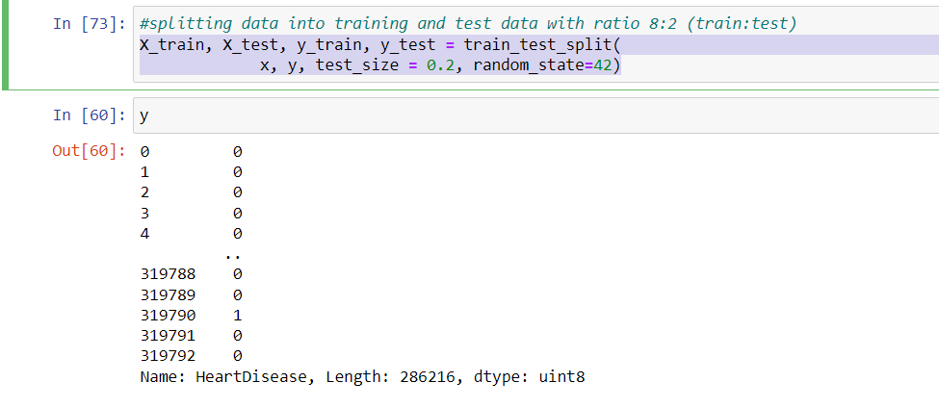
The Code :
#splitting data into training and test data with ratio 8:2 (train:test)
X_train, X_test, y_train, y_test = train_test_split(
x, y, test_size = 0.2, random_state=42)

Slide 38
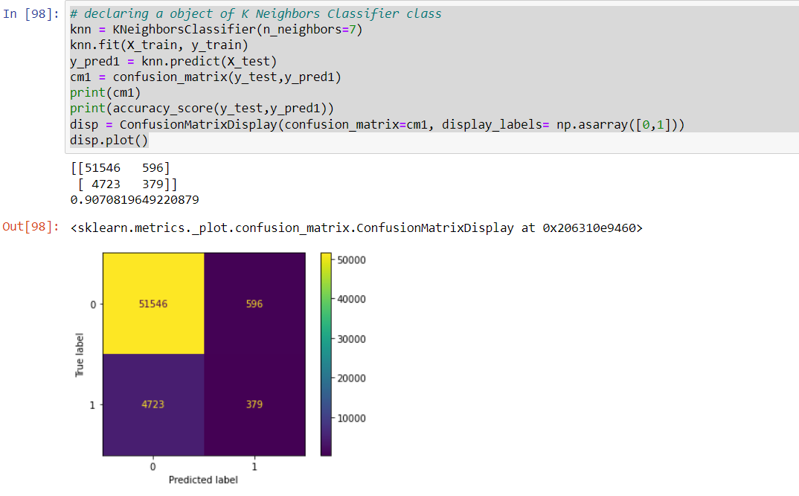
# declaring a object of K Neighbors Classifier class

Slide 39
First: the code printed the confusion matrix which is compares the actual target values with those predicted by the KNN algorithm
-TN (True NoHeartDisease): 51546 (Values that actually have heart diseases)
-FP (False HeartDisease): 596 (represents the number of misclassified patients with the disease but actually they are healthy)
-TN (True HeartDisease): 379 (Number of patients which are truely predicted with heart disease)
-FN (False NoHeartDisease): 4723 (Number of patients misclassified as healthy but actually they are suffering from the disease)

Slide 40
Accuarcy= (TP+TN)/(TP+TN+FP+FN)
-Precision score = (TP)/(TP+FP)...... Ratio of correctly classified patients with the disease (TP) to the total patients predicted to have the disease (TP+FP)
-Recall score = (TP)/(TP+FN).......Ratio of correctly classified diseased patients (TP) divided by total number of patients who have actually the disease

Slide 41
The decision tree:
A decision tree is a decision support tool that uses a tree-like model of decisions and their possible consequences, including chance event outcomes, resource costs, and utility. It is one way to display an algorithm that only contains conditional control statements.
We will start by importing the library required which is :
from sklearn.tree import DecisionTreeClassifier

Slide 42
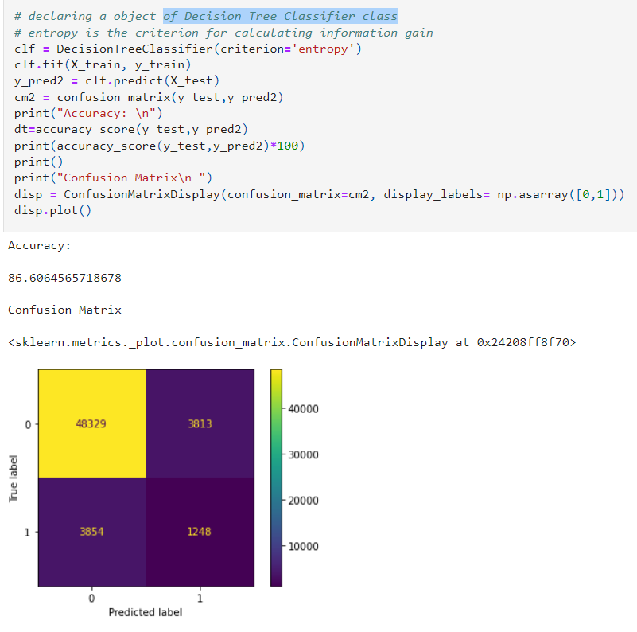
First we will start by declaring an object of Decision Tree Classifier class
We will calculate the accuracy for y-test and predicted
We are going to display the confusuion matrix as well.

Slide 43
First: the code printed the confusion matrix which compares the actual target values with those predicted by the KNN algorithm
-TN (True NoHeartDisease): 48289 (Values that actually have no heart diseases)
-FP (False HeartDisease): 3853 (represents the number of misclassified patients with the disease but actually they are healthy)
-TP (True HeartDisease): 1216 (Number of patients which are truely predicted with heart disease)
-FN (False NoHeartDisease): 3886 (Number of patients misclassified as healthy but actually they are suffering from the disease)

Slide 44
Naive Bayes:
Naive Bayes methods are a set of supervised learning algorithms based on applying Bayes’ theorem with the “naive” assumption of conditional independence between every pair of features given the value of the class variable.
importing the used libraries
from sklearn.naive_bayes import GaussianNB

Slide 45
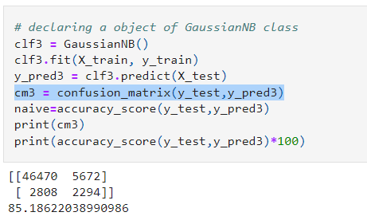
First by first we will declare an object of GaussianNB class
Then we will calculate the confusion matrix.
We are also calculating the accuracy score.

Slide 46
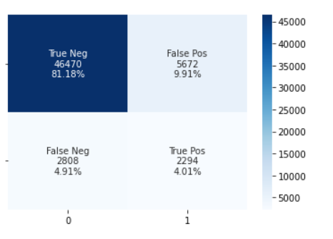
A clear full display fir the confusion matrix:

Slide 47
First: the code printed the confusion matrix which is compares the actual target values with those predicted by the KNN algorithm
-TN (True NoHeartDisease): 46470 (Values that actually have no heart diseases)
-FP (False HeartDisease): 5672 (represents the number of misclassified patients with the disease but actually they are healthy)
-TP (True HeartDisease): 2294 (Number of patients which are truely predicted with heart disease)
-FN (False NoHeartDisease): 2808 (Number of patients misclassified as healthy but actually they are suffering from the disease)

Slide 48
Logistic Regression:
Logistic regression is a process of modeling the probability of a discrete outcome given an input variable. The most common logistic regression models a binary outcome; something that can take two values such as true/false, yes/no, and so on.
At first :declaring an object of Logistic regression class.
Then we willpredict the result using the trained data
And we will calculate the confusion matrix and display it as well

Slide 49
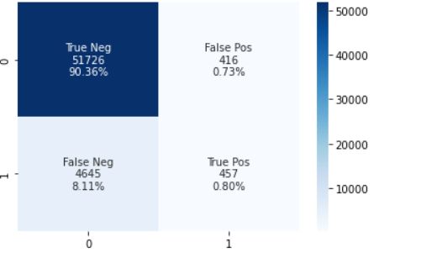
First: the code printed the confusion matrix which is compares the actual target values with those predicted by the KNN algorithm
-TN (True NoHeartDisease): 51726 (Values that actually havenot heart diseases)
-FP (False HeartDisease): 416 (represents the number of misclassified patients with the disease but actually they are healthy)
-TP (True HeartDisease): 457 (Number of patients which are truely predicted with heart disease)
-FN (False NoHeartDisease): 4645 (Number of patients misclassified as healthy but actually they are suffering from the disease)

