Slide 1



Data Science Capstone (1) Big Mountain Resort Data Science Project
Presented by: Marwan Ali
Special Thanks for Springboard Monitor: Juanjo Milla
Notes:
A quick welcoming message to the leadership.
A quick introduction about the Presenter and the business problem

Slide 2

Context
Scoop of Solution Space
01
03
Criteria for Success
Constraints
02
04
Problem Identification
Big Mountain Resort is a ski resort located in Montana that offers great skiing activities.
Ticket prices should be determined through rigid pricing strategies and processes that includes checking the related data and market .
Trying different pricing models rather than just adding extra amount over the average pricing will reveal more interesting insights.
Losing some market share to other better priced tickets provided by leading parties as well as some active skiers.
Notes:
1- Context: Operations have indicated that the ticket price is generated by adding a premium to the average price of all the resorts in its market segment.
With the expectations of value created for customers from visiting this resort, the price should also reflect this value. Big mountain has the longest run and the second vertical drop, and the third summit elevation. These added values could also be considered in adding a premium. The cause of this problem is either not including all related cost, and/ or missing added values, Management has expressed a desire to know which pricing policy is the best based on the available data.
2- Criteria for Success: Using more than one model will help identify the best pricing technique (i.e. cost-plus pricing model, value-based pricing, fixed pricing model, etc.)
3- Scope of solution Space: Ticket prices should be determined through rigid pricing strategies and processes that includes checking the related data and market .
4- Constraint: Losing some market share to other better priced tickets provided by leading parties as well as some active skiers.

Slide 3

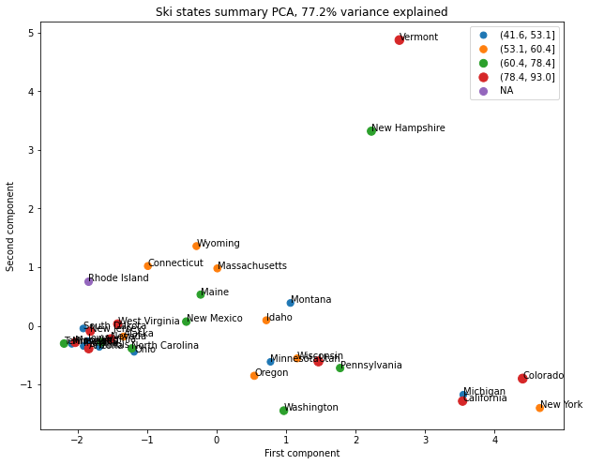
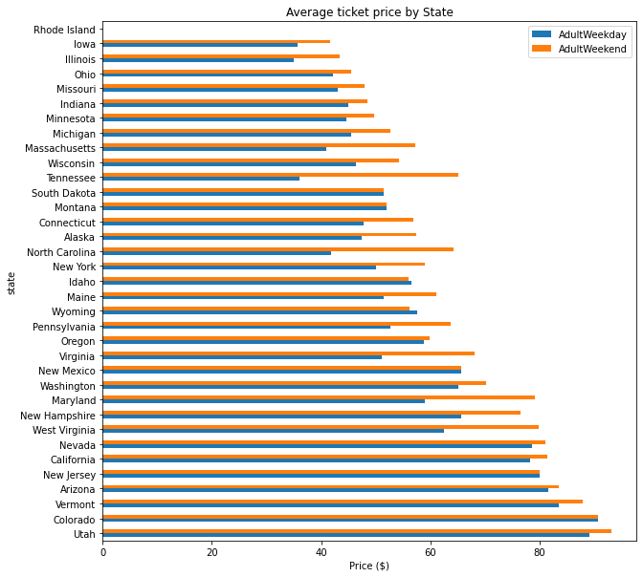
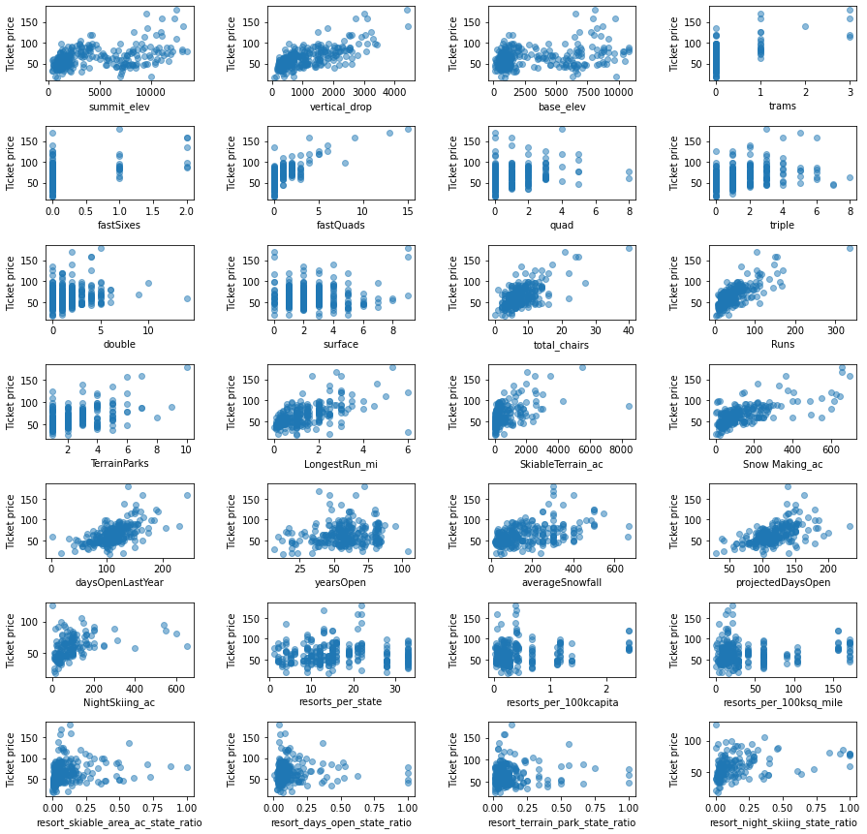
Recommendations and Key Findings
Figure (1) Average Ticket Price by State
Figure (2) Ticket Price Correlation with Variables
Figure (3) Market Size and Ticket Price
Distribution of ticket prices by State was conducted. Montana was on the 23rd place out of 34 States
A correlation heat map was created to look for the correlations in all variables.
The red points representing the upper quartile of price can be seen to the left, the right, and up top.
Notes:
# 1/ Different plots were created on the EDA stage to create and visualize the correlation between the ticket prices and the other variables.
# 2/
The variables vertical_drop and projected days open have the most correlations.
The variable “AdultWeekend” has many different correlations with other variables. The examples are: snow making and runs.
The variables (summit and base elevation) were extremely correlated with the night skiing and number of resorts per capita.
#3/ There's also a spread of the other quartiles as well. In this representation of the ski summaries for each state, which accounts for some 77% of the variance. No consistent pattern.

Slide 4
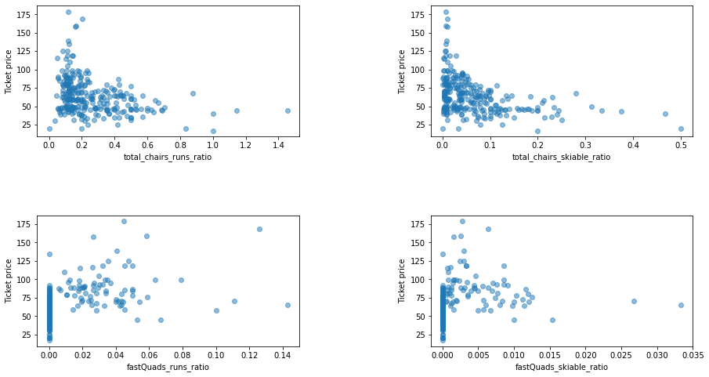
Modeling Results and Analysis 1
Figure (4) The Ratio of Chairs to runs
Getting the ratio of chairs to runs is very useful to determine how a resort can transport people around is by relating the numbers of various chairs, and the number of runs to each others.
First scatterplot shows the total chairs to runs ratio.
Second scatterplot to the right is showing the total chairs to the skiable ratio.
Third scatterplot in the bottom left is showing the fast squad runs ratio.
Forth scatterplot is showing the fast squad skiable ratio.
Notes:
At first these relationships are quite counterintuitive. It seems that the more chairs a resort has to move people around, relative to the number of runs, ticket price rapidly plummets and stays low. What we may be seeing here is an exclusive vs. mass market resort effect; if we don't have so many chairs, we can charge more for our tickets, although with fewer chairs we're inevitably going to be able to serve fewer visitors.
The price per visitor is high but our number of visitors may be low. Something very useful that's missing from the data is the number of visitors per year!
It also appears that having no fast quads may limit the ticket price, but if our resort covers a wide area then getting a small number of fast quads may be beneficial to the ticket price.

Slide 5
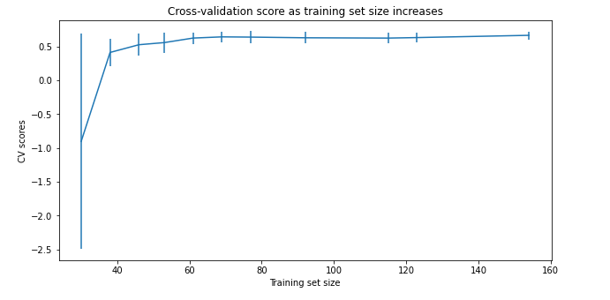
Modeling Results and Analysis 2
Figure (5) The Cross Validation Score as training Set Size Increases
Data Quantity Assessment
Before we move forward and finalize the results, an assessment for the quantity od data was conducted to check if we still need to get more data or not.
There's an initial rapid improvement in model scores as one would expect, but it's essentially levelled off by around a sample size of 40-50.

Slide 6
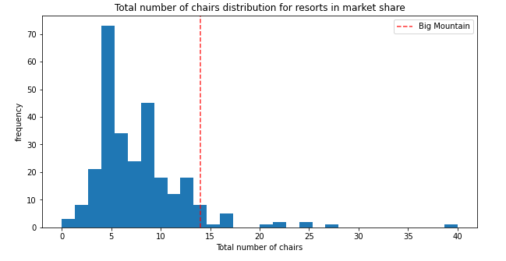
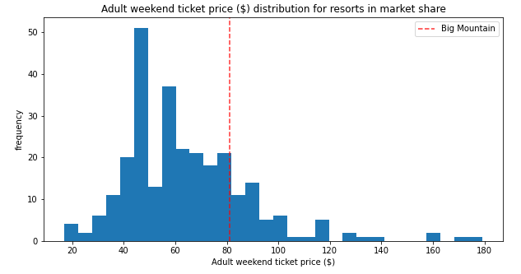
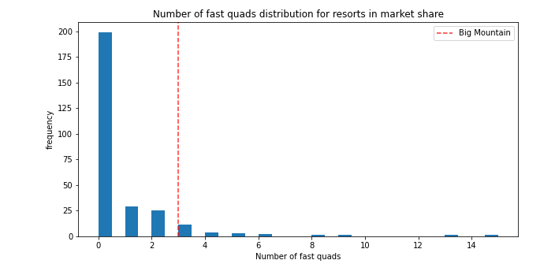
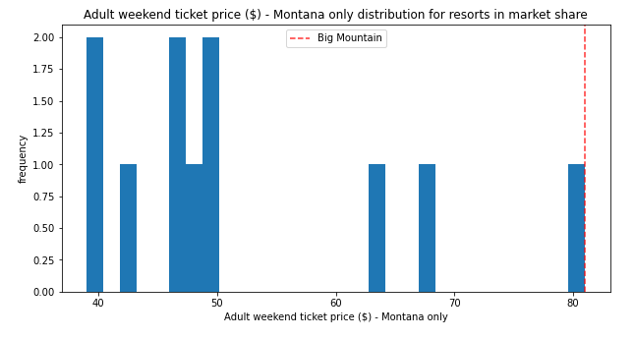
Modeling Results and Analysis 3
Figure (6) Total Number of Chairs Distribution for resorts in Market Share
Figure (8) Adult Weekend Ticket price ($)/ Distribution for resorts in market share
Figure (7) Average Ticket Price by State
Figure (9) Adult Weekend Ticket price ($)/ Montana’s only
Notes:
These visuals are explaining exactly where Big Mountain sits overall amongst all resorts for other resorts in Montana regarding the price, the redline is where the resort sits.
Beside the ticket price, fast squad and the number of chairs distribution above; another five visuals were also generated to check the vertical drop, snow making area, runs, longest run, trams, and skiable terrain area, the findings are below:
Big Mountain is doing well for vertical drop, but there are still quite a few resorts with a greater drop.
Big Mountain is very high up the league table of snow making area.
Big Mountain has amongst the highest number of total chairs, resorts with more appear to be outliers.
Most resorts have no fast quads. Big Mountain has 3, which puts it high up that league table. There are some values much higher, but they are rare.
Big Mountain compares well for the number of runs. There are some resorts with more, but not many.
Big Mountain has one of the longest runs. Although it is just over half the length of the longest, the longer ones are rare.
The vast majority of resorts, such as Big Mountain, have no trams.
Big Mountain is amongst the resorts with the largest amount of skiable terrain.

Slide 7

Scenario (1): Closing down up to 10 of the least used runs. This doesn't impact any other resort statistics.
Summary and Conclusions
Scenario (2): Increase the vertical drop by adding a run to a point 150 feet lower down but requiring the installation of an additional chair lift to bring skiers back up, without additional snow making coverage
Scenario (3): Same as number 2, but adding 2 acres of snow making cove
Scenario (4): Increase the longest run by 0.2 mile to boast 3.5 miles length, requiring an additional snow making coverage of 4 acres
Notes:
The expected number of visitors over the season is 350,000 and, on average, visitors ski for five days. Assume the provided data includes the additional lift that Big Mountain recently installed.
Scenario (1): The model says closing one run makes no difference. Closing 2 and 3 successively reduces support for ticket price and so revenue. If Big Mountain closes down 3 runs, it seems they may as well close down 4 or 5 as there's no further loss in ticket price. Increasing the closures down to 6 or more leads to a large drop.
Scenario (2): This scenario will increases support for ticket price by $1.99 Over the season, this could be expected to amount of $3,474,638.00.
Scenario (3): Results are the same of Scenario (2), such a small increase in the snow making area makes no difference
Scenario (4): No difference. Although the longest run feature was used in the linear model, the random forest model (the one we chose because of its better performance) only has longest run way down in the feature importance list.
Scenario (1) is the best Scenario.

