Slide 1


Data Science Capstone (1) Big Mountain Resort Data Science Project
Presented by: Marwan Ali
Notes:
A quick welcoming message to the leadership.
A quick introduction about the Presenter and the business problem

Slide 2

Context
Scoop of Solution Space
01
03
Criteria for Success
Constraints
02
04
Problem Identification
Big Mountain Resort is a ski resort located in Montana that offers great skiing activities.
Ticket prices should be determined through rigid pricing strategies and processes that includes checking the related data and market .
Trying different pricing models rather than just adding extra amount over the average pricing will reveal more interesting insights.
Losing some market share to other better priced tickets provided by leading parties as well as some active skiers.
Notes:
1- Context: Operations have indicated that the ticket price is generated by adding a premium to the average price of all the resorts in its market segment.
With the expectations of value created for customers from visiting this resort, the price should also reflect this value. Big mountain has the longest run and the second vertical drop, and the third summit elevation. These added values could also be considered in adding a premium. The cause of this problem is either not including all related cost, and/ or missing added values, Management has expressed a desire to know which pricing policy is the best based on the available data.
2- Criteria for Success: Using more than one model will help identify the best pricing technique (i.e. cost-plus pricing model, value-based pricing, fixed pricing model, etc.)
3- Scope of solution Space:

Slide 3

Recommendations and Key Findings
The variables vertical_drop and projected days open have the most correlations.
The variables (summit and base elevation) were extremely correlated with the night skiing and number of resorts per capita.
Scatter plots were created to visualize the correlation of ticket prices and the other variables.
The variable “AdultWeekend” has many different correlations with other variables
A correlation heat map was created to look for the correlations in all variables.
The examples are: snow making and runs.

Slide 4
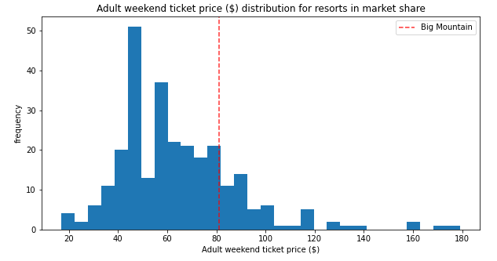
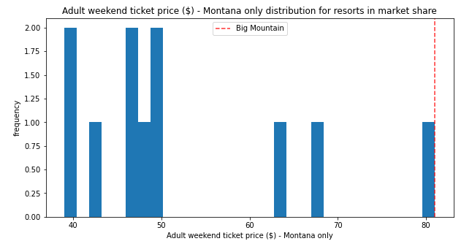
Modeling Results and Analysis 1

Slide 5
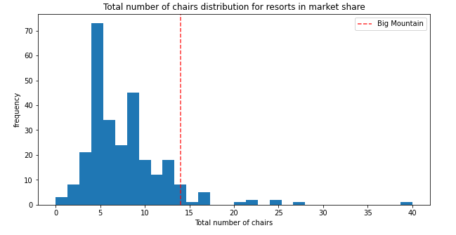
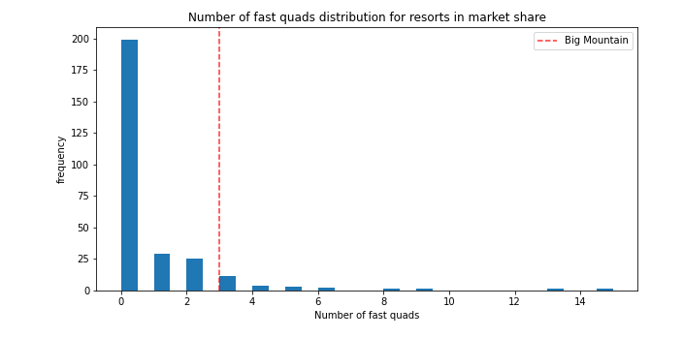
Modeling Results and Analysis 2
Notes:
Preprocess the dataset, briefly exploring features & engineering new features where possible.
Experiment with sampling techniques - see if these are effective.
Build the most effective XGBoost classifier.
Select an optimal cutoff for the model, as though it were being implemented as a fraud detection system.
Estimate the business impact and potential savings.

Slide 6
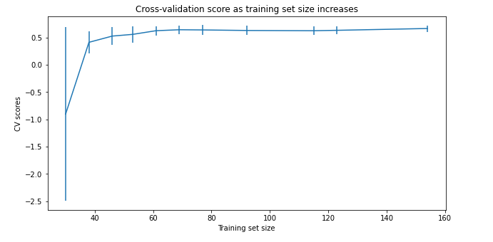
Modeling Results and Analysis 3
There's an initial rapid improvement in model scores as one would expect, but it's essentially levelled off by around a sample size of 40-50.

Slide 7

Summary and Conclusions
The States with the highest number of resorts have the most open days status throughout the year.
The average ticket price by state were revealed for the weekend per state
The northern and eastern States have the highest total night skiing because of shorter days in terms of hours
The more chairs /runs and, quad lift could affect the ticket price positively
Notes:
- A comparison between the States have been explored by: total area, population and resorts per state, and other skiable data.
The States with the highest number of resorts have the most open days status throughout the year.
The northern and eastern States have the highest total night skiing because of shorter days in terms of hours (i.e. nights have the most hours in these regions).
The PCA was utilized to get to the summary statistics for the state/resort differentiation, the average ticket price by state were revealed for the weekend per state.
Rhode Island was not carried through as the NaN values were not needed.
A correlation heat map was created to look for the correlations in all variables. The variables (summit and base elevation) were extremely correlated with the night skiing and number of resorts per capita.
The variable “AdultWeekend” has many different correlations with other variables, such as, snow making and runs.
Scatter plots were created to visualize the correlation of ticket prices and the other variables. The variables vertical_drop and projected days open have the most correlations.
The more chairs /runs and, quad lift could affect the ticket price positively.

