Slide 1



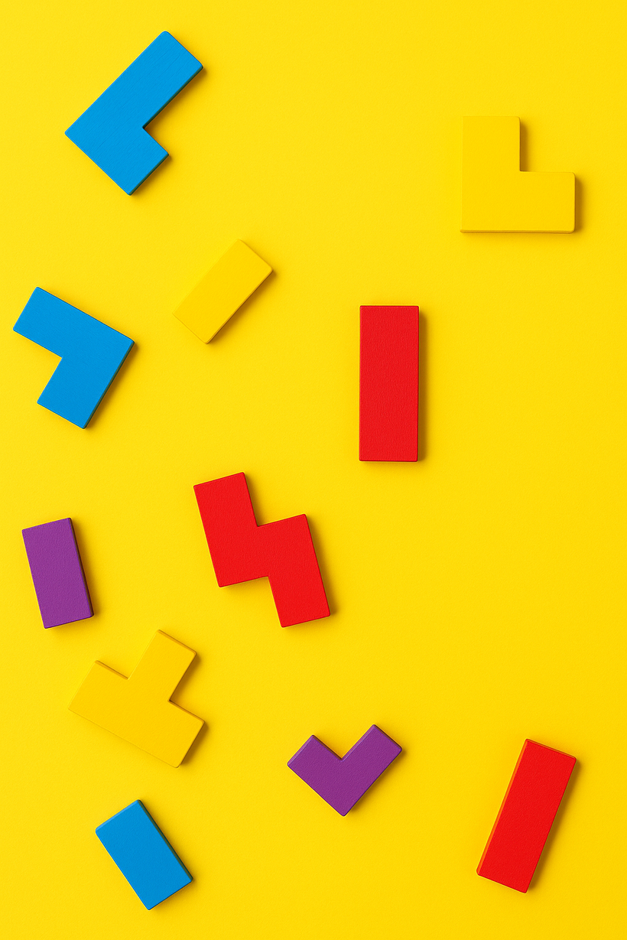
AI INNOVATIONS LAB
Genetic Algorithm for Tetris AI
A Study by [Author Name] on improving Tetris gameplay using genetic algorithms for enhanced AI performance.

Slide 2




Genetic Algorithm Approach
An innovative solution to train Tetris AI effectively
The genetic algorithm (GA) approach models the evolution of solutions through population dynamics. By encoding board features into a genome, we assess performance based on fitness scores. This adaptive method utilizes selection, crossover, and mutation to refine AI capabilities, enabling the model to learn and improve continuously over generations.
2

Slide 3




The height of the board is crucial as taller configurations can lead to quicker game over scenarios. The algorithm assigns weight to prevent excessive height buildup.
Board Height
Identifying holes in the board is significant; they represent unfilled gaps that hinder piece placement. The scoring function penalizes configurations with more holes to optimize gameplay.
Holes
A complete line is scored positively; when a row is entirely filled, it clears, providing points. The algorithm maximizes the number of lines cleared for a better outcome.
Complete Lines
The position of the pieces influences future placements; placing pieces strategically affects overall board structure. The scoring function evaluates placements that lead to more advantageous configurations.
Piece Position
3

Slide 4
Selection Process in Genetic Algorithms
Roulette Wheel Selection
Selection ensures that the fittest individuals contribute to the next generation of Tetris AI.
Crossover Mechanism for Feature Exchange
One-Point Crossover
Crossover combines genetic information from two parents to create offspring with blended features.
Mutation and Its Importance
Random Bit Flipping
Mutation introduces random changes to maintain genetic diversity and explore new solutions.
4

Slide 5

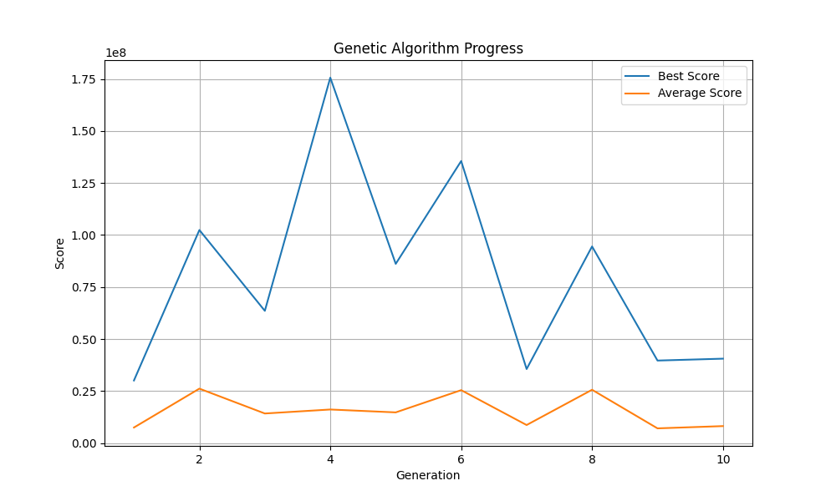

Fitness Evolution
Analysis of AI performance across the generations using a genetic algorithm
5

Slide 6
Peak Fitness
The generation with the highest fitness score showcased superior performance in gameplay. This generation effectively balanced the various scoring features, allowing the AI to demonstrate improved decision-making and adaptability, ultimately achieving higher scores than its predecessors.
Strategic Insights
The insights gained from this peak fitness generation can inform the design of more effective genetic algorithms. Understanding key strategies may lead to developing more competitive AI systems in Tetris and other complex games.
The Best Generation
Learnings from Results
Weight Vector
The weight vector determined in this generation played a crucial role in the AI's success. By analyzing the weights assigned to each feature, we can better understand the AI's strategic priorities, enabling further enhancements and refinements in future iterations.
Future Implications
Future work could explore additional features and operator variations that may enhance performance. By continuing to iterate on the genetic algorithm, we aim to further optimize the AI's gameplay capabilities and overall scores in Tetris.
Significance of Weights
Next Steps for Improvement
6

Slide 7



Final Test Scores
Analyzing the performance of the Tetris AI and its weights
The final test yielded a remarkable score, demonstrating the effectiveness of the genetic algorithm. By analyzing the weight vector, we can identify which board features contributed significantly to the performance. Notably, the scoring function emphasizes the importance of strategic placements and adaptability to various game states. These insights will guide future enhancements and optimizations, ensuring even better results in upcoming iterations.
7

Slide 8


Future Work and Conclusions
Ideas for expanding features and operator variants
Explore additional game features
Test parallel evaluation methods
Implement adaptive mutation rates
Introduce new crossover techniques
Enhance fitness scoring criteria
Conduct user experience studies
8

