Slide 1

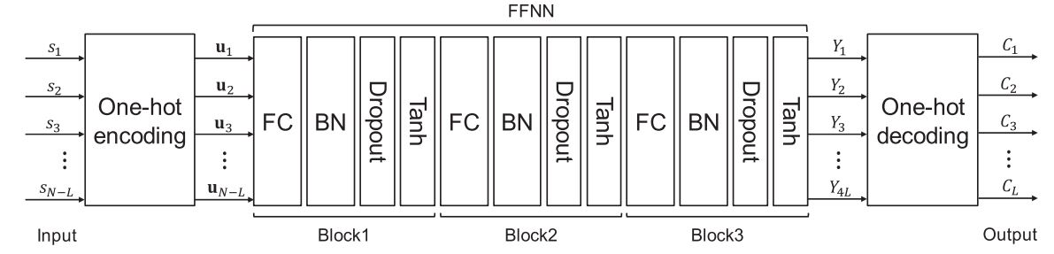
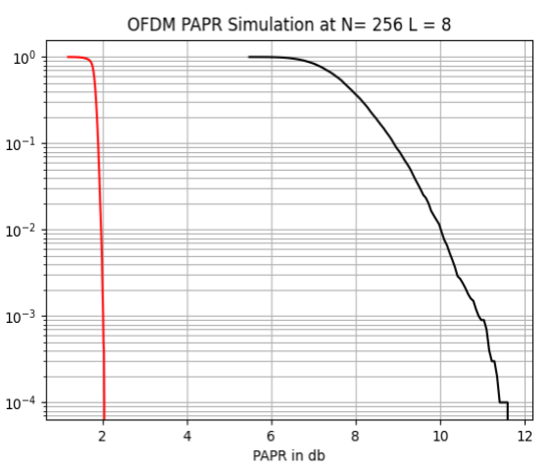
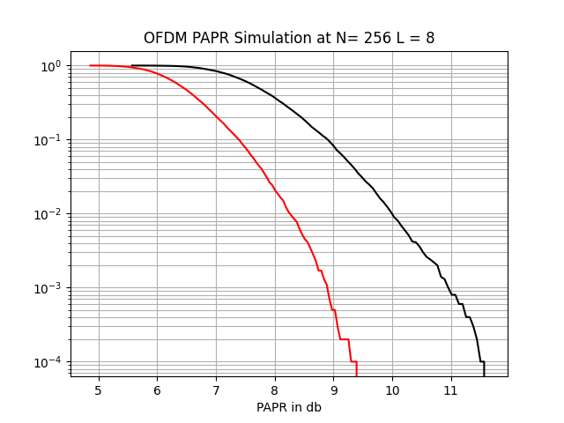
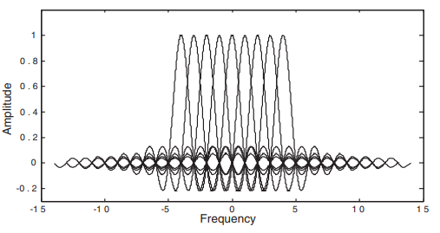
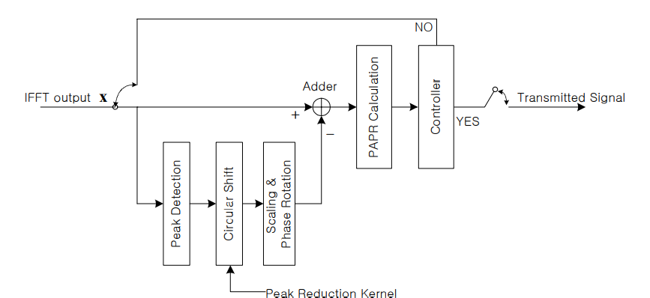
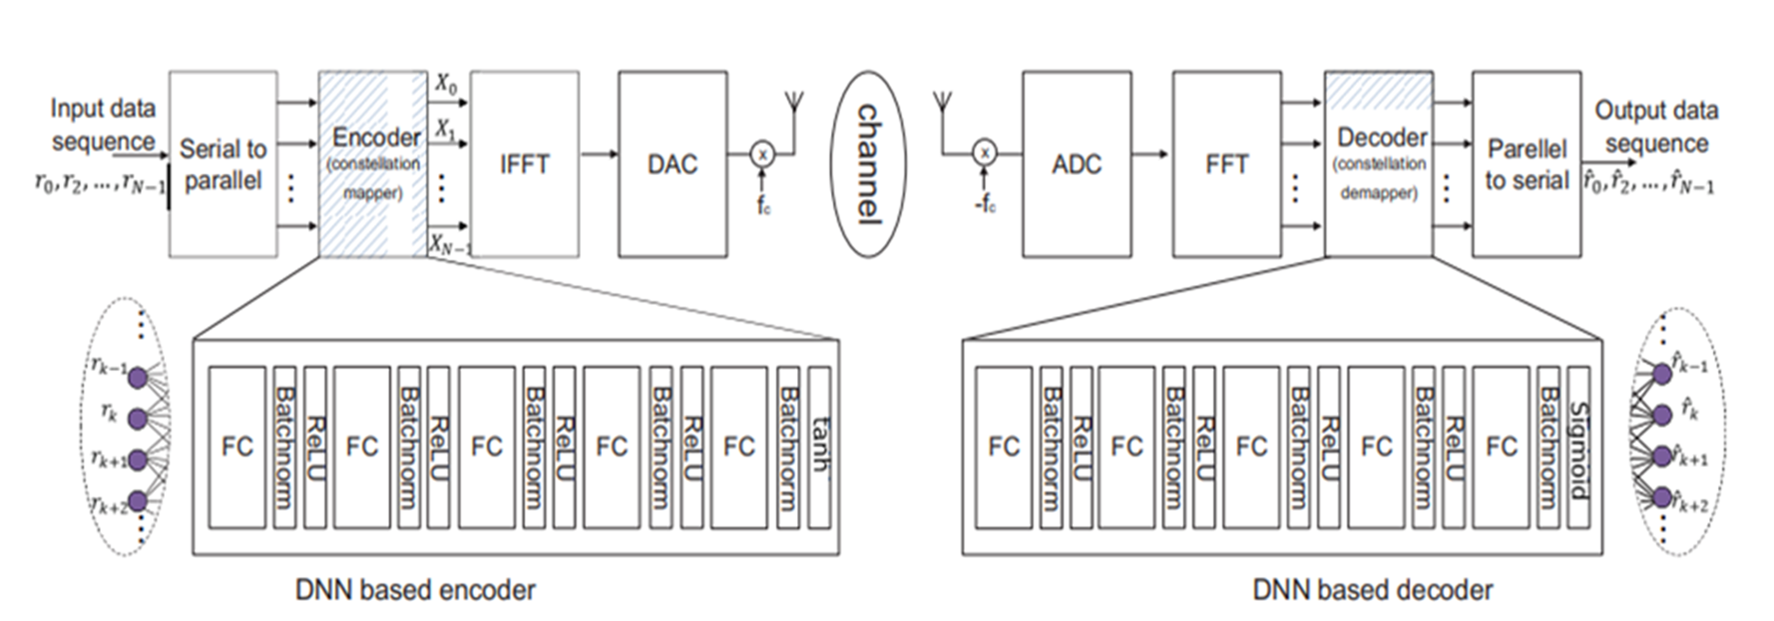
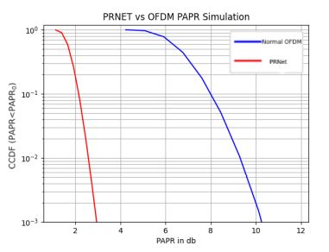
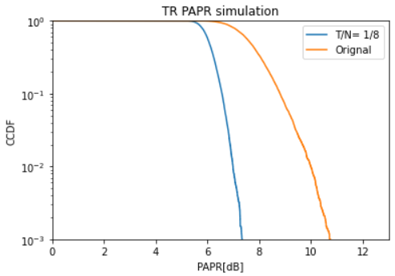
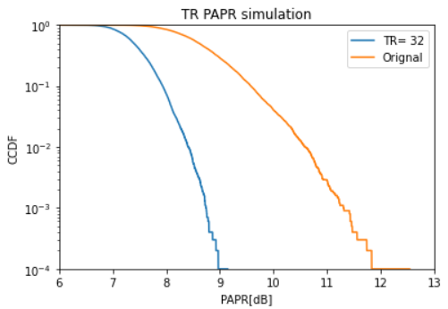
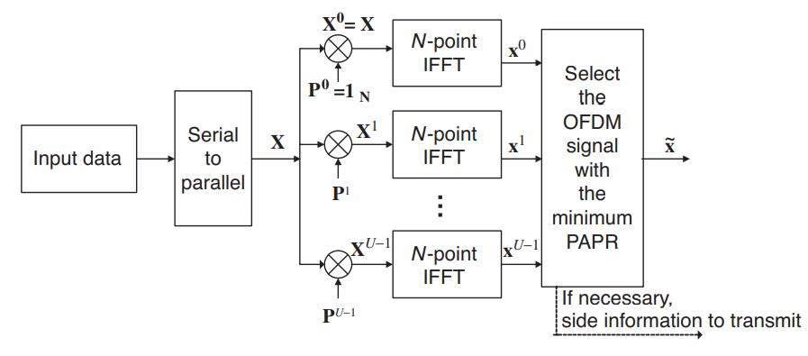
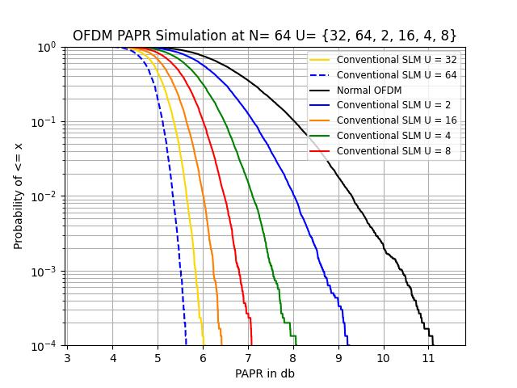
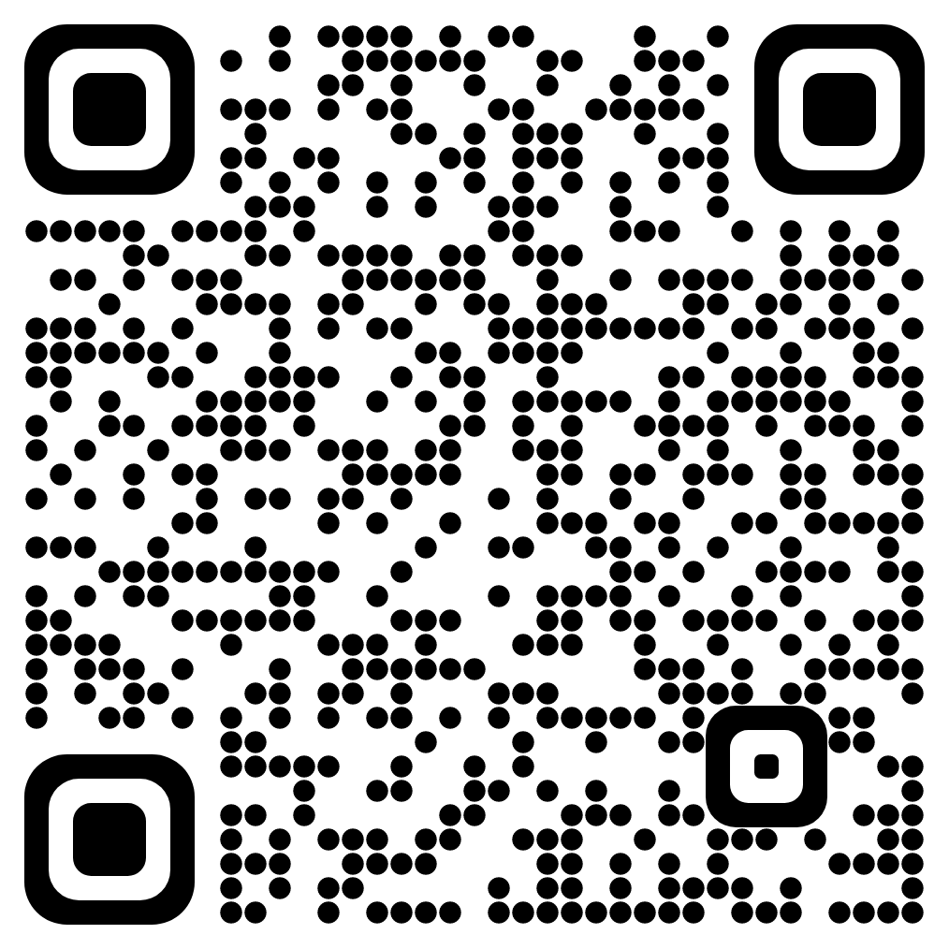
Machine Learning Techniques for PAPR Reduction in Multicarrier Communication Systems
Ahmed Fawzy; Rana Muhammad; Raneem Gaber; Amr Saeed; Metwaly Yahia; Marwan Yasser; Mustafa Ahmed; Youssef Salah
Under the supervision of Dr. Michael Ibrahim
Academic Year 2021 - 2022
Electronics and Electrical Communications Engineering Department, Faculty of Engineering, Ain Shams University
Main targets
Literature review of OFDM system. Literature review of PAPR problem and the “classical” approaches to solve such problem. Literature review of machine learning (ML) in general and the ML techniques for PAPR reduction. System modelling and simulation using TensorFlow ML framework. Performance evaluation of the classical and ML-based PAPR reduction techniques.
Designs and Implementations (cont.)
3- TRNet (Deep Learning): PAPR reduction using Feed Forward Neural Network based on Tone Reservation to adaptively generate peak cancelling signals. 4- PRNet (Deep Learning): Based on the autoencoder architecture of deep learning. The constellation mapping and demapping of symbols on each subcarrier is determined adaptively through a deep learning technique such that both the bit error rate (BER) and the PAPR of the OFDM system are jointly minimized.
No Activation Tanh [-5,5]
Designs and Implementations
1- Tone Reservation (Classical Technique): In TR, some OFDM subcarriers are reserved. These reserved subcarriers don’t carry any data information, they are only used for reducing PAPR. 2- Selective Mapping (Classical Technique): In selective mapping technique , the input data block is multiplied with U different phase sequences, and then the PAPR is calculated for each vector separately. And The sequence with the smallest PAPR is selected for final transmission.
TR-Kernel S-SCR TR
PRNET
Future work:
PAPR reduction using ICF and SLM deep learning techniques.
Implementing same techniques on 5G Signals.
Asymmetric autoencoder for less complex receiver for PRNet..
Using different optimizers and activation functions and investigating if it will lead to better performance.
Investigate the average power consumption of TRNet approach.
Contact Us:
Scan QR code to gain access to all our contact information.
SLM

