Slide 1

Evidence that
learning happened
افهمها. اثبتها. افتكرها.
Fahim finds the misconception behind an answer, chooses the next learning action, and checks retention.
STUDENT TRACK ASSESSMENT REVOLUTION
GenAI for Education Hackathon 2026
Team Fahim AI
Notes:
Opening: Fahim turns each learning interaction into evidence that a learner understood, corrected a misconception, and retained the concept.
Live prototype: https://fahim-ai-egypt.vercel.app/showcase

Slide 2

01 / PROBLEM
02
Correct answers can conceal persistent misconceptions
Arabic-speaking STEM learners can reach explanations quickly. Most tools stop before diagnosing the failed reasoning or checking whether the learning lasts.
THE FAILURE MODE
One-off correctness
The learner repeats the right answer, but the underlying reasoning remains wrong. The same gap returns in the next unit.
25M+
785,099
pre-university learners in Egypt
general secondary exam applicants, 2024/2025
“I found the answer. I still cannot explain it.”
Sources: Egypt Ministry of Education strategy and 22 July 2025 results release
Notes:
Problem statement: content access has improved faster than evidence of understanding.
Sources: https://moe.gov.eg/media/ekfp2puv/strategic_plan_en.pdf ; https://moe.gov.eg/ar/what-s-on/news/22-7-2025/

Slide 3
02 / USER + EVIDENCE
03
The first user: Mariam under exam pressure
She studies STEM in Arabic and English and needs to recover a specific concept gap before it appears again.
WHAT WE KNOW TODAY
MARIAM
High-stakes learner
Arabic explanation
English terminology
Desk research
National scale and documented capacity and infrastructure constraints.
Working MVP
Authentication, retrieval, citations, AI generation, signed grading, and spaced review run end to end.
Her job: understand the concept well enough to explain it, apply it, and recall it later.
Evidence boundary
We do not claim pilot learning outcomes yet. The next step is a consented classroom pilot.
Proven today: the workflow runs end to end. Next proof: measured learning improvement.
Notes:
Evidence today: desk research plus a production MVP. Do not imply that the pilot has already happened.
Application states a planned four-week pilot with one teacher and 12–20 learners.

Slide 4
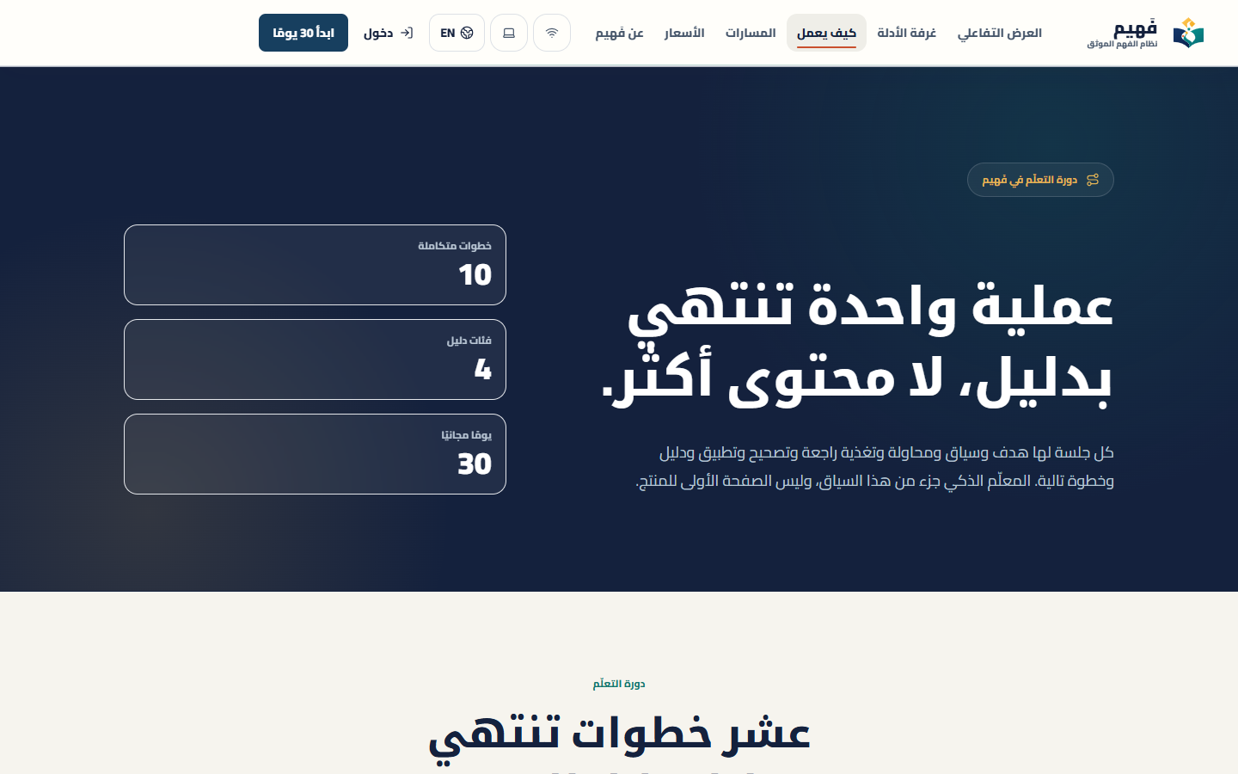
03 / SOLUTION + WHY GENAI
04
The Fahim learning loop
Each session links the learner’s source and reasoning to a specific intervention, a transfer task, and a scheduled review.
1
Trusted source
2
Learner attempt
3
Misconception
4
Targeted intervention
5
New application
Live product journey, not a concept mockup
6
Evidence + review
WHY GENAI IS REQUIRED
It interprets free-text reasoning, grounds the response in evidence, and creates the next test for this learner.
Notes:
GenAI is the adaptive reasoning layer. Fixed rules cannot respond to each learner's source, language, reasoning path, and misconception at scale.
Product reference captured from https://fahim-ai-egypt.vercel.app/how-it-works

Slide 5
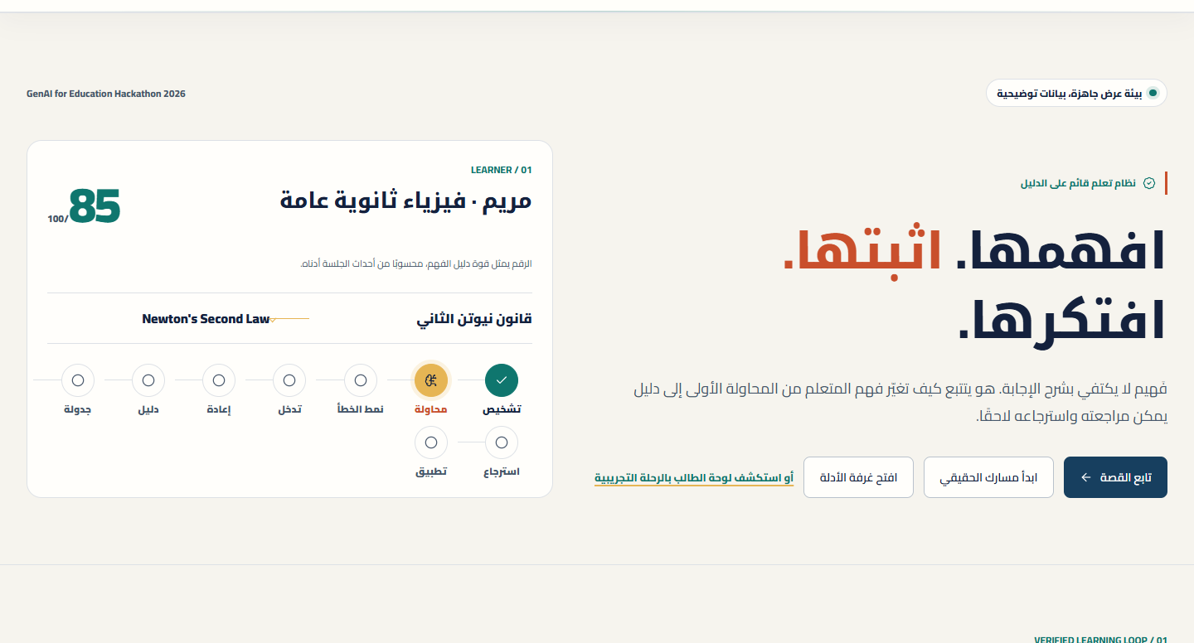

04 / DEMO STORY
05
Demo: Newton’s second law
Mariam explains one answer in her own words. Fahim identifies the likely misconception and tests it with a new task.
01
Start
Mariam opens Newton’s second law from a trusted source.
02
Reason
She explains the answer in her own words.
03
Diagnose
Fahim proposes a revisable misconception hypothesis.
04
Prove
A new task checks transfer, then schedules review.
One evidence chain connects the source, the learner’s reasoning, the diagnosis and the delayed review.
Notes:
Demo timing: 20 seconds hook, 30 seconds setup, 90 seconds hero path, 50 seconds trust, 30 seconds outcome, 20 seconds buffer.
Live demo: https://fahim-ai-egypt.vercel.app/showcase

Slide 6
05 / IMPACT + PROOF
06
Pilot measurement plan
The working MVP is ready for a consented four-week study of misconception correction and seven-day retention.
EVIDENCE LADDER
✓
✓
Need
Usability
Behavior
Learning
Adoption
Desk research
Working MVP
Pilot
Delayed check
Repeat cohort
4 weeks
12–20 learners
1 teacher
Primary outcome
Delayed measure
Misconception correction rate
Retention after 7 days
Guardrails: unsafe-answer rate and teacher review time
No pilot results are claimed in this deck.
Notes:
Pilot design: pre-check, guided learning session, immediate post-check, delayed check after seven days.
The pilot target is a hypothesis and should be approved with the partner teacher before launch.

Slide 7

06 / ADOPTION + TRUST
07
Adoption starts with the learner
Immediate study value creates the entry point. Teachers and institutions gain visibility into learning gaps without reading private chats.
BEACHHEAD
Secondary and university STEM learners preparing for high-stakes assessment
ADOPTION PATH
1
2
3
Student self-serve
Teacher cohort
School license
Immediate study value
Misconception signals
Outcome review
PRICING HYPOTHESES
Free access, Student Plus 99–149 EGP/month, Teacher Pro 249–399 EGP/month, schools priced per active learner
Privacy boundary
Teachers see patterns and priorities, not private learner chats.
Pilot discovery will test willingness to pay and retention. Prices are not final.
Notes:
Pricing is a hypothesis for validation, not a final commercial decision.
Adoption roles: learner uses, parent or school may fund, institution approves, teacher champions the workflow.

Slide 8

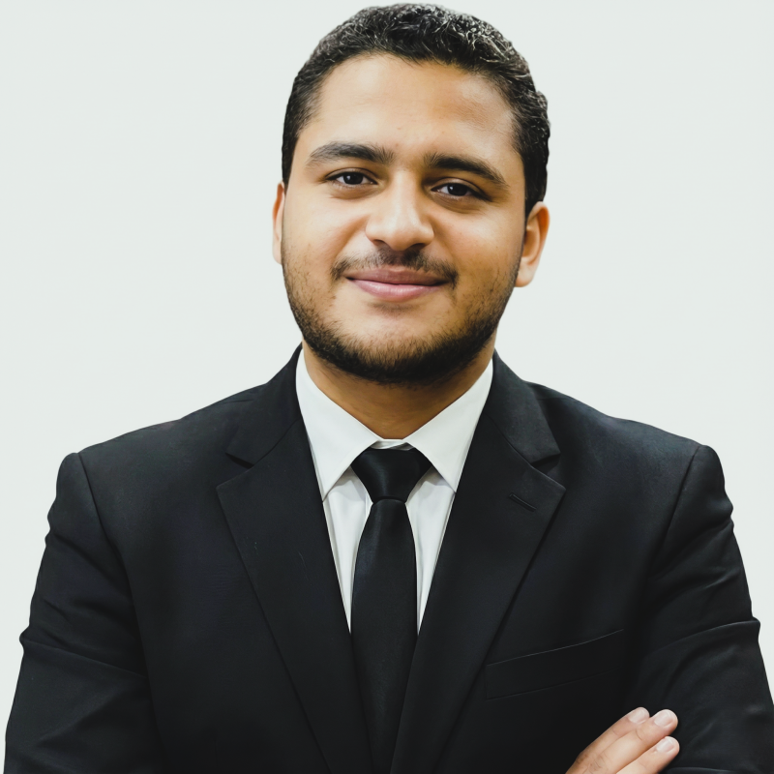
07 / TEAM + ASK
08
Pilot partnership
We seek one school or university partner for four weeks with 12–20 learners and one teacher.
Marwan Yasser Hassan Abdelghaffar
THE ASK
Team Leader, Helwan University, Level 3
A consented pilot partner
Success after four weeks
Measure misconception correction, delayed retention, teacher review time, and safety guardrails.
Mostafa Yasser Hassan Abdelghaffar
Capital University, Level 2
Basel Abdel-Maqsoud Ziada
New Mansoura University, Fresh graduate
LIVE PROTOTYPE
Jana Hossam Salah Abdelhakim
Scan to open the live prototype
Capital University, Level 4
Notes:
Close with a single ask: access to one partner setting for a measured four-week pilot.
Contact: marwanyasser23@science.helwan.edu.eg ; Demo: https://fahim-ai-egypt.vercel.app/showcase

Slide 9
APPENDIX / DIFFERENCE
09
Competitive difference
Fahim keeps the learner’s source, attempt, misconception, intervention, transfer task, and later review in one evidence chain.
Alternative
What it does well
What remains missing
Fahim’s difference
Generic AI assistants
Fast explanations and dialogue
Weak continuity between attempt, error, and later retention
Claim-level evidence and a persistent learning record
Content and video platforms
Breadth and structured courses
Consumption can look like progress
Attempt, transfer task, and delayed review
Practice apps
Repeatable questions and scoring
Limited free-text reasoning diagnosis
Revisable misconception hypothesis and targeted intervention
Defensible asset: a consented evidence graph of misconceptions, interventions, and retained understanding.
Notes:
Competitor references reviewed in product planning: ChatGPT Study Mode, NotebookLM, Perplexity Learn, Khan Academy, Coursera, and regional Arabic learning products.
Avoid claiming that no competitor can add similar features. The current differentiation is the integrated evidence workflow.

Slide 10
APPENDIX / TECHNICAL EXECUTION
10
Technical architecture and trust controls
Each model response passes through retrieval, authorization, provenance checks, and auditable product rules.
Trusted sources
Hybrid retrieval
AI model router
Evidence contract
Signed grading
Record
Files, curriculum, verified web
Keyword + semantic context
Three-provider failover
Verified, inferred, teaching
Server-side assessment
Progress + review
155
65
3
23
automated tests
RLS-protected tables
AI provider failover
production routes checked
Security boundary
Supabase Auth and RLS, protected routes, server-side authorization, signed quiz results, and credential issuance outside the model
Notes:
Technical validation reflects the current repository verification: 155 tests, 65 tables with RLS coverage, three AI provider failover paths, and 23 production routes checked.
Do not present these engineering checks as learning-outcome evidence.

Slide 11
APPENDIX / PILOT PLAN
11
Four-week pilot protocol
The study tests whether the workflow corrects misconceptions and preserves improvement under classroom conditions.
WEEK 0
WEEK 1
WEEKS 2–3
WEEK 4
Prepare
Observe
Adapt
Measure
Consent, teacher review, baseline task, known-good content
Run the hero workflow and log failure modes
Target misconceptions and schedule spaced review
Post-check, seven-day retention, teacher debrief
DECISION GATE
Pilot outputs
Continue only if the pilot shows usable diagnosis, measurable delayed retention, acceptable teacher review time, and no unresolved safety issue.
Anonymized evidence report
Teacher workflow findings
Priority product changes
Notes:
Pilot scope should remain small enough for direct observation and fast iteration.
All pilot outcomes must be reported with sample size, dates, setting, method, and limitations.

Slide 12
APPENDIX / Q&A DEFENSE
12
Judge questions and direct answers
The current evidence boundary stays clear: the product works, while learning impact still requires a measured pilot.
01
Why GenAI?
It adapts to source, language, reasoning, and misconception. Rules alone cannot do this at scale.
02
How do you limit wrong answers?
Retrieval, citations, evidence labels, human review paths, and model failover.
03
What works today?
A production MVP with end-to-end auth, RAG, grading, review, and learning evidence.
04
What remains unproven?
Learning outcomes, willingness to pay, and classroom adoption under real conditions.
05
What do you need now?
One partner for a consented four-week pilot with 12–20 learners and one teacher.
Live demo: fahim-ai-egypt.vercel.app/showcase
marwanyasser23@science.helwan.edu.eg
Notes:
Use this slide only for Q&A or as a backup close.
Live demo: https://fahim-ai-egypt.vercel.app/showcase

