Slide 1

Turn every answer into
evidence of understanding
افهمها. اثبتها. افتكرها.
A bilingual learning system that diagnoses misconceptions, teaches the missing concept, tests transfer, and schedules the right review.
SOURCE
ATTEMPT
DIAGNOSE
PROVE
STUDENT TRACK · ASSESSMENT REVOLUTION
WORKING PROTOTYPE
GenAI for Education Hackathon 2026 · Team Fahim AI
Notes:
Opening hook: a correct answer is not proof of understanding. Fahim turns an answer into a traceable learning decision.
Live prototype: https://fahim-ai-egypt.vercel.app/showcase

Slide 2
01 / PROBLEM
02
A correct answer can hide the wrong understanding
Most platforms score the answer. Generic AI explains the topic. Neither proves what the learner actually understood.
THE ANSWER
MEMORIZED
Repeated the model answer without a causal explanation.
Acceleration is −3 m/s²
SIGN CONFUSION
Treats negative acceleration as slowing down in every case.
✓ Correct
But why?
FRAGILE TRANSFER
Cannot apply the same idea when the direction changes.
The problem is not access to content. It is invisible misunderstanding.
Notes:
Use this example as the hook: the same correct answer can come from different mental models, so the next learning action should not be identical.
Fahim is designed to reveal that hidden state before it becomes the next repeated mistake.

Slide 3
02 / PEOPLE + CONTEXT
03
The same blind spot affects the whole learning system
Fahim starts with Egyptian secondary and university STEM learners studying concepts in Arabic and terminology in English.
01
LEARNER
02
TEACHER
03
FAMILY / SCHOOL
“I received an answer, but I still repeat the same mistake.”
“I see scores, not the misconception behind each score.”
“Completion percentages do not prove durable understanding.”
Needs a precise next step
Needs actionable class signals
Needs credible progress evidence
Beachhead
High-stakes bilingual STEM learning where a hidden misconception becomes the next lost mark.
Notes:
The learner is the first user, but the value compounds across teacher and institution workflows.
The initial use case is deliberately narrow: bilingual STEM concepts under assessment pressure.

Slide 4
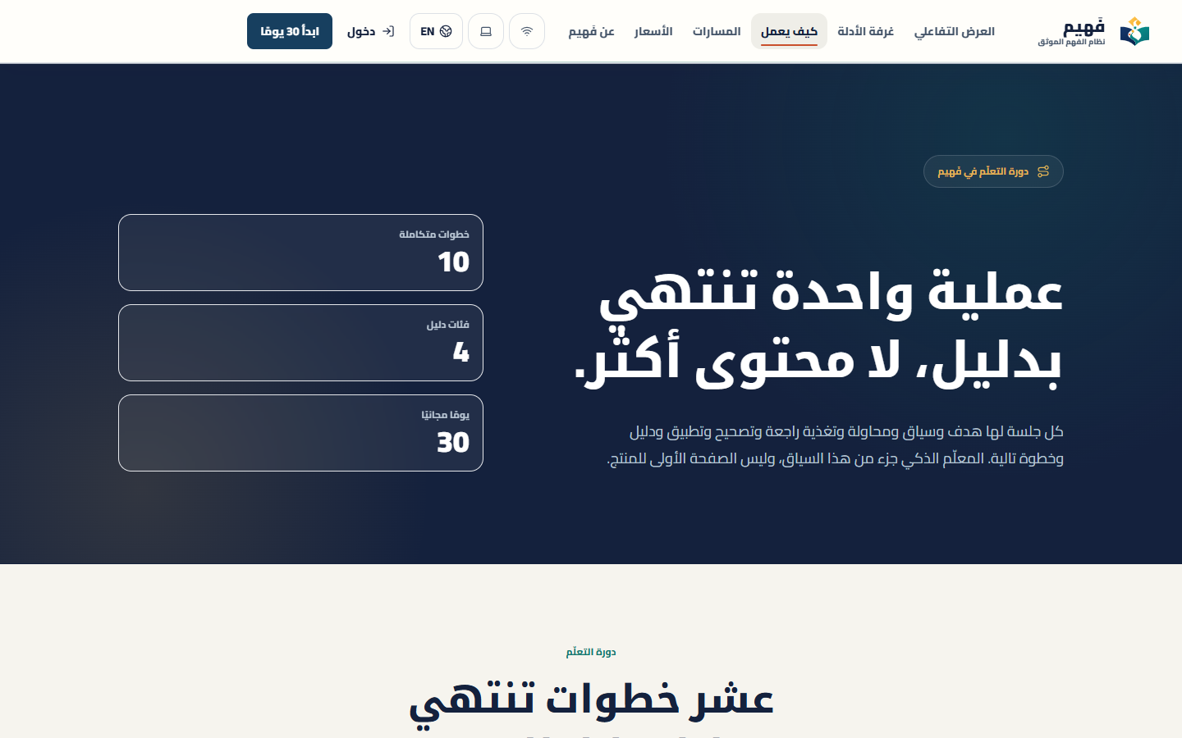
03 / SOLUTION + WHY GENAI
04
The Fahim learning loop
Each session links the learner’s source and reasoning to a specific intervention, a transfer task, and a scheduled review.
1
Trusted source
2
Learner attempt
3
Misconception
4
Targeted intervention
5
New application
Live product journey, not a concept mockup
6
Evidence + review
WHY GENAI IS REQUIRED
It interprets free-text reasoning, grounds the response in evidence, and creates the next test for this learner.
Notes:
GenAI is the adaptive reasoning layer. Fixed rules cannot respond to each learner's source, language, reasoning path, and misconception at scale.
Product reference captured from https://fahim-ai-egypt.vercel.app/how-it-works

Slide 5
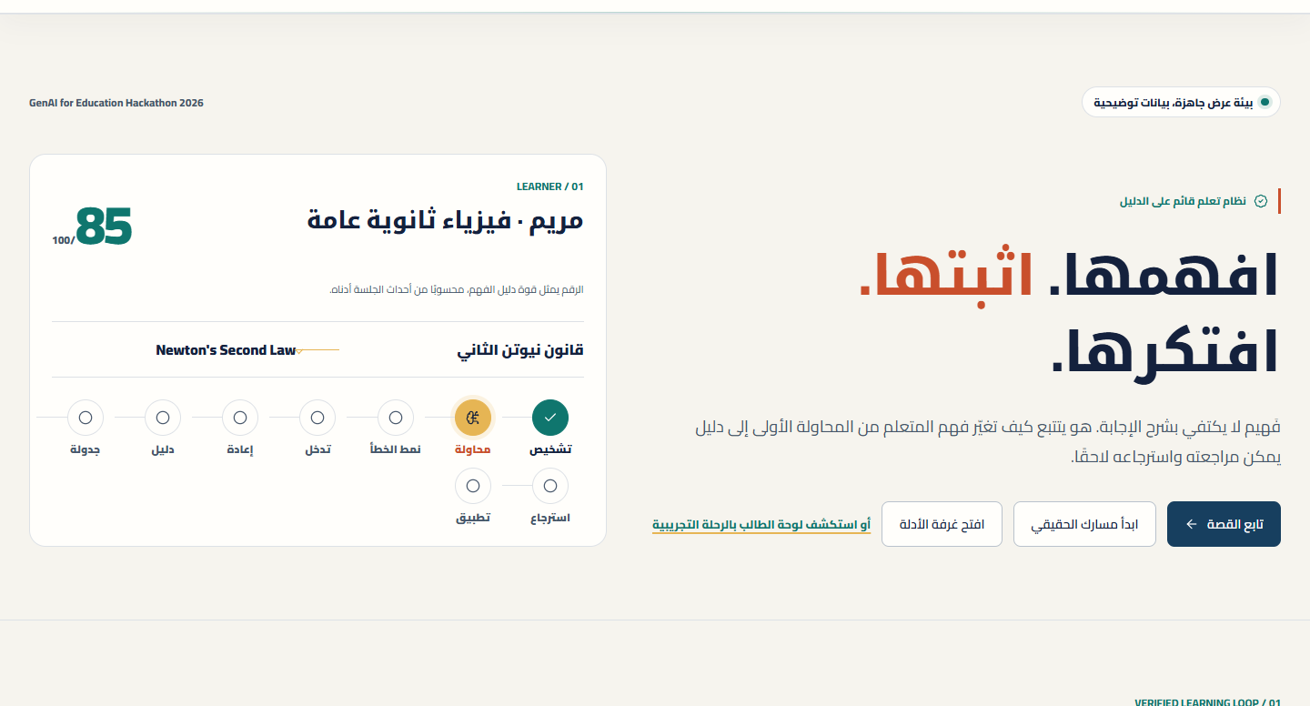

04 / DEMO STORY
05
Demo: Newton’s second law
Mariam explains one answer in her own words. Fahim identifies the likely misconception and tests it with a new task.
01
Start
Mariam opens Newton’s second law from a trusted source.
02
Reason
She explains the answer in her own words.
03
Diagnose
Fahim proposes a revisable misconception hypothesis.
04
Prove
A new task checks transfer, then schedules review.
One evidence chain connects the source, the learner’s reasoning, the diagnosis and the delayed review.
Notes:
Demo timing: 20 seconds hook, 30 seconds setup, 90 seconds hero path, 50 seconds trust, 30 seconds outcome, 20 seconds buffer.
Live demo: https://fahim-ai-egypt.vercel.app/showcase

Slide 6
05 / WHY GENAI
06
GenAI is the adaptive reasoning layer
The model is not a decorative chatbot. It interprets reasoning, chooses an intervention, and generates the next valid test.
01
UNDERSTAND
02
DIAGNOSE
Read open-ended Arabic and English answers, not only multiple choice.
Form a revisable misconception hypothesis from the learner’s explanation.
03
ADAPT
04
PROVE
Generate the smallest explanation that addresses this exact reasoning gap.
Create a fresh transfer question at the right difficulty and language.
SAFETY RAIL
RAG grounding · claim-level citations · confidence boundaries · signed grading · educator review
Notes:
Explain why a rules engine is not enough: the input is open-ended reasoning in two languages and the response must adapt to a specific misconception.
The model operates inside product controls; it does not decide authorization or certificate issuance.

Slide 7
06 / INNOVATION
07
Four ideas competitors rarely connect
Fahim’s differentiation is not one AI feature. It is the evidence chain connecting the learner’s source, reasoning, intervention, transfer, and review.
DIAGNOSE
TRUST
MISCONCEPTION ATLAS
EVIDENCE CONTRACT
Recurring errors become patterns that can guide the next learning action.
Separate sourced facts, inference, teaching explanation, and uncertainty.
ACCESS
PROOF
BILINGUAL CONCEPT BRIDGE
LEARNING EVIDENCE GRAPH
Arabic term, English term, definition, pronunciation, and common confusion.
Show how mastery was earned across attempts, transfer, and spaced review.
Content platforms deliver lessons · Generic AI delivers answers · Fahim builds verified understanding
Notes:
Do not claim competitors cannot build these features. The differentiation is the integrated, persistent workflow and bilingual education context.
This slide maps directly to the 25% innovation criterion.

Slide 8
07 / TECHNICAL EXECUTION
08
From prompt to protected learning record
A working architecture connects adaptive GenAI to retrieval, assessment, authorization, and a persistent evidence record.
Learner UI
Secure API
AI router
Retrieval
Assessment
Learning record
TypeScript web app
Vercel functions
Gemini + fallback
Hybrid context
Signed grading
Supabase + RLS
155
65
3
LIVE
automated tests
RLS-protected tables
provider paths
production deployment
TRUST CONTROLS
Auth + RLS · rate limits · schema validation · audit logs · provenance · local-first sync
Notes:
The prototype is deployed and testable. The architecture is intentionally modular so providers and curricula can change without rewriting the learner experience.
Engineering proof is not presented as learning-outcome evidence.

Slide 9
08 / IMPACT + INCLUSION
09
Designed for Egyptian classrooms, ready to scale
Inclusion is part of the system architecture, not a later accessibility checklist.
AR / EN
LOW
AA
PRIV
BILINGUAL STEM
LOW BANDWIDTH
ACCESSIBLE UI
PRIVACY BOUNDARY
Explain in Arabic while preserving the English terminology students meet in courses and exams.
Local-first progress and lightweight learning flows preserve continuity when connectivity is unstable.
Keyboard navigation, readable contrast, motion controls, and speech-ready interactions.
Teachers see misconception patterns and priorities, not private learner conversations by default.
REACH PATH
LEARNER
CLASSROOM
INSTITUTION
Notes:
Impact begins with immediate individual study value, then expands through teacher signals and institution-level support.
This slide maps to educational impact and accessibility criteria without claiming measured outcomes that have not yet been collected.

Slide 10
09 / FEASIBILITY + SCALE
10
A credible path from prototype to adoption
The competition deliverable already works. The next steps convert it into classroom evidence, teacher workflow, and repeatable distribution.
NOW
NEXT
THEN
WORKING PRODUCT
CLASSROOM VALIDATION
INSTITUTIONAL SCALE
Learner loop, RAG sources, quizzes, spaced review, completion credentials, live deployment.
Small consented study of diagnosis quality, immediate transfer, delayed recall, and teacher time.
Classes, analytics, curriculum governance, verified partnerships, and organization controls.
SUSTAINABLE MODEL
FREE
STUDENT PLUS
TEACHER PRO
SCHOOLS
Trust + acquisition
Affordable depth
Class insights
Active learner license
Pricing remains a testable hypothesis; the product architecture and adoption path are already implemented.
Notes:
Feasibility is demonstrated by the live prototype and modular infrastructure. Market pricing and retention will be validated rather than asserted.
The pilot is one next-step workstream, not the center of the competition story.

Slide 11
10 / TEAM
11
A student team building for a problem we live
Four contributors united around product engineering, learning design, research, and storytelling.
Marwan Yasser Hassan
Abdelghaffar
Mostafa Yasser Hassan
Abdelghaffar
MA
MY
TEAM LEADER
TEAM MEMBER
Basel Abdel-Maqsoud
Abdel-Maqsoud Ziada
Jana Hossam Salah
Abdelhakim
BZ
JH
TEAM MEMBER
TEAM MEMBER
No titles for show. One shared responsibility: make learning visible, adaptive, and trustworthy.
Notes:
Introduce the team quickly by name and role. Do not use photos, invented specialist titles, or inflated credentials.
Move directly from the team to the final promise and live prototype.

Slide 12
11 / CLOSE
12
Do not ask whether they finished.
Ask what they can prove.
Fahim transforms study from content consumption into a traceable cycle of understanding.
WORKING
DISTINCT
READY
Bilingual prototype
Evidence architecture
Clear validation path
EXPERIENCE FAHIM AI
fahim-ai-egypt.vercel.app
We are seeking mentorship, classroom access, and direct feedback from educators.
Notes:
Close on the product promise, not on the absence of pilot data.
Ask judges to experience the live prototype and evaluate the integrated learning loop.
Live demo: https://fahim-ai-egypt.vercel.app/showcase

