Slide 1
Android: Notifier (Server)
Notifications from a mobile phone on a computer
with end-to-end encryption
Kristof Krenn, Markus Weber

Slide 2
Initial Problem
Notification delivery in plain text
Messages, Mightytext
Pushbullet added end-to-end encryption

Slide 3
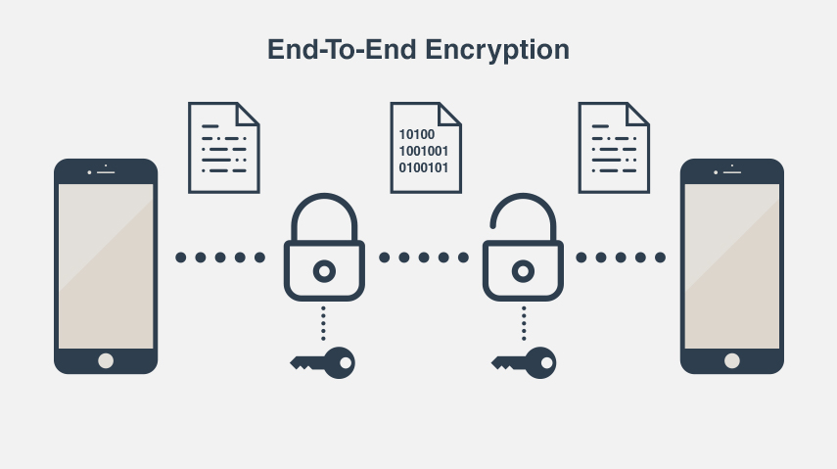
End-to-end encryption
Indirect connection
Server not able to read message
Key only on computer and mobile phone

Slide 4
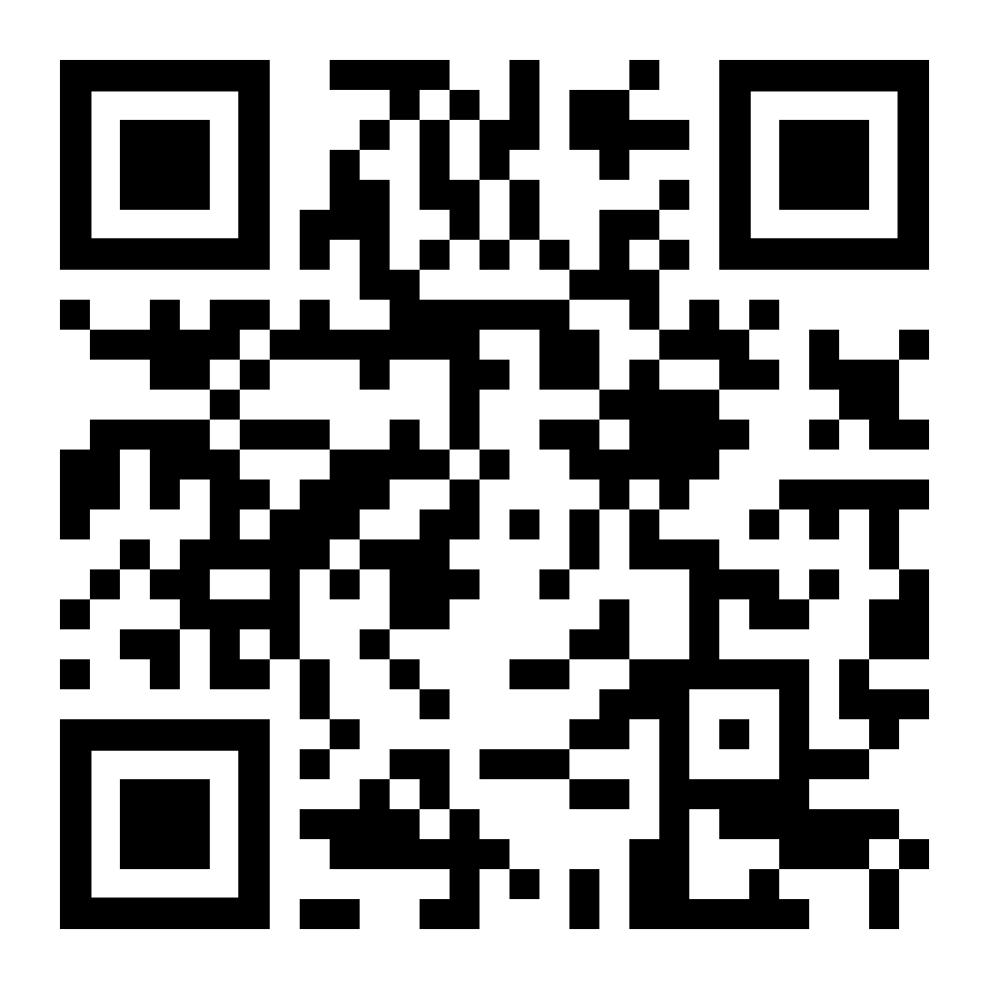
Key sharing
How can we share the key without the server to know about it?
QR-Code (Barcode)
Microsoft Tags
Beacon
NFC

Slide 5
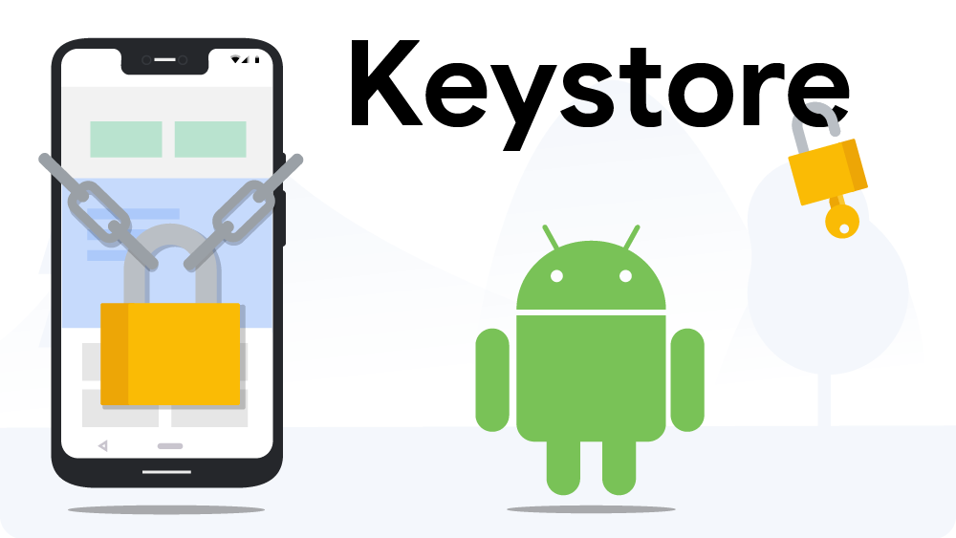
Keystore
Encrypt/decrypt app specific data
Passwords, tokens, etc.
How can we protect the key used for encryption?
Android Keystore!

Slide 6
Approach
Desktop client
Create key and QR-code
Regularly poll from the server
App
Scan QR-code and retrieve key
Protect key with Android Keystore
Encrypt notification/message with key
and send to server
Server
Store received (encrypted) notifications
Deliver notifications for desktop client

Slide 7
Difficulties
How to protect key?
Mobile device
Desktop
YubiKey
How to authenticate?
Username/Password
OAuth
Token

Slide 8
Secure Enclaves
Mobile (Android)
Titan M (Google)
StrongBox Keymaster
S3FV9RR (Samsung)
Desktop (MacOS)
T2 chip (T1 successor)
iPhone like security on the Mac

Slide 9
LIVE DEMO

