Slide 1
Lab: Setup Environment

Slide 2
Agenda
Installation
Verify `travel-sample` bucket is available
Use the web console and cbq lightly to explore

Slide 3
Installation

Slide 4





Install Locally
Run installer or copy the .app over or run the OS package manager to install the package.
Set up the cluster
Install the sample buckets
ensure you have `travel-sample`

Slide 5
Download and Install 4.0 Beta
If you already have 4.0 DP, you can continue working with that release.
http://couchbase.com/download and then click on Pre-Release
http://packages.couchbase.com/releases/4.0.0-beta/couchbase-server-enterprise_4.0.0-beta-windows_amd64.exe
http://packages.couchbase.com/releases/4.0.0-beta/couchbase-server-enterprise_4.0.0-beta-macos_x86_64.zip
http://packages.couchbase.com/releases/4.0.0-beta/couchbase-server-enterprise_4.0.0-beta-ubuntu12.04_amd64.deb
http://packages.couchbase.com/releases/4.0.0-beta/couchbase-server-enterprise-4.0.0-beta-centos6.x86_64.rpm

Slide 6
Setup New Single Node Cluster
Include query and indexing services
Install sample buckets
Create new default bucket
Set password
Open the cbq console and run some queries!

Slide 7
Uninstallation of 3.0
Mac OS X: Remove or rename the Couchbase directory in ~/Library/Application Support
Linux: Uninstall using your package manager (rpm -e couchbase-server or dpkg -r couchbase-server) Remove or rename the couchbase directory in /opt
Windows: Run the uninstaller; if it fails, then run the installer for 4.0 beta

Slide 8
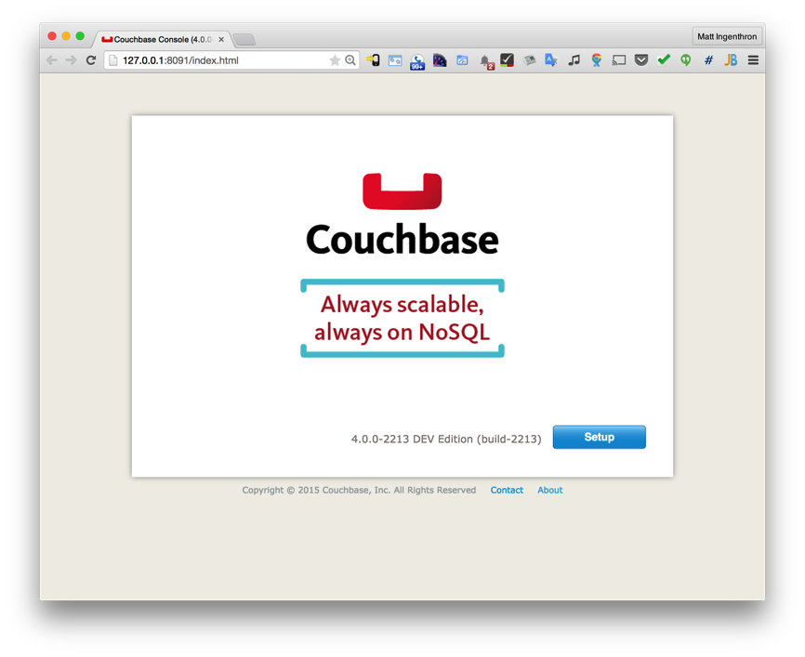
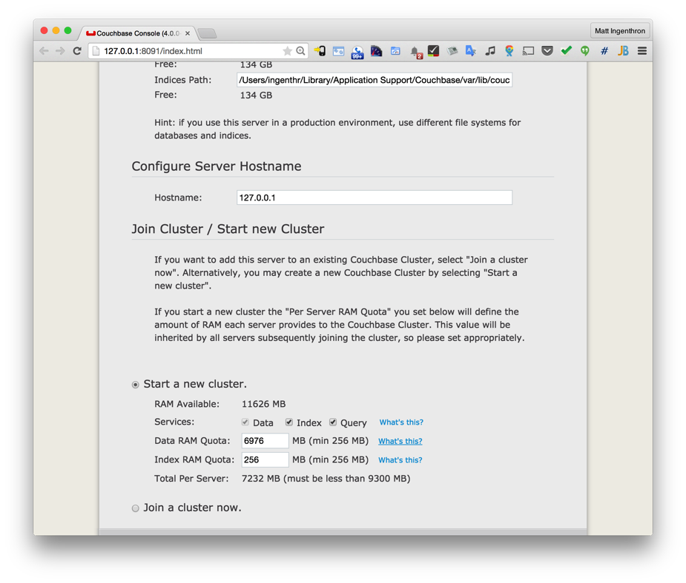
Step 1
Click “Setup”
Important: Check the box next to Index and Query Services.

Slide 9
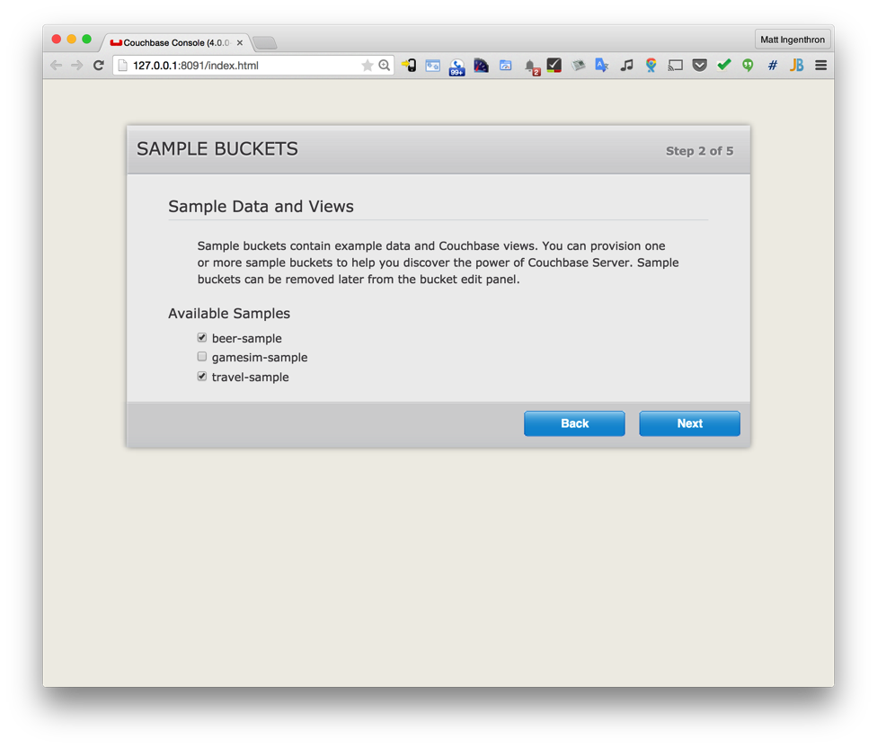
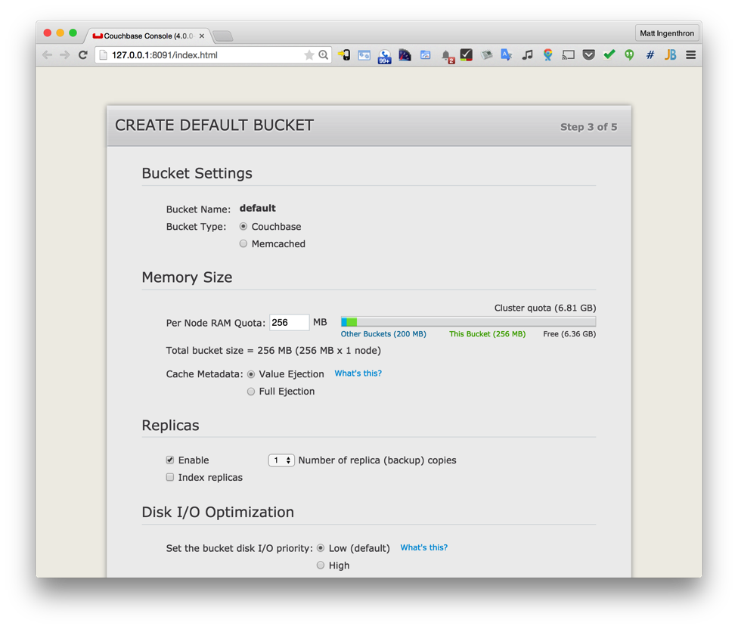
Steps 2 & 3
Check the boxes next to beer-sample and travel-sample.
Create a Couchbase Default Bucket with memory between 256MB and 1024MB.

Slide 10
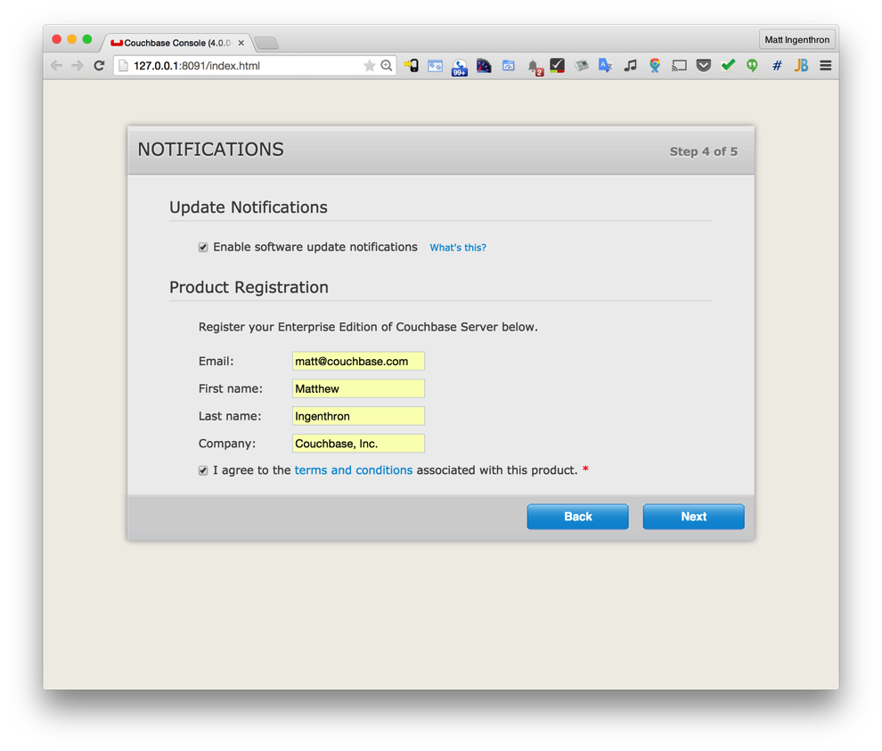
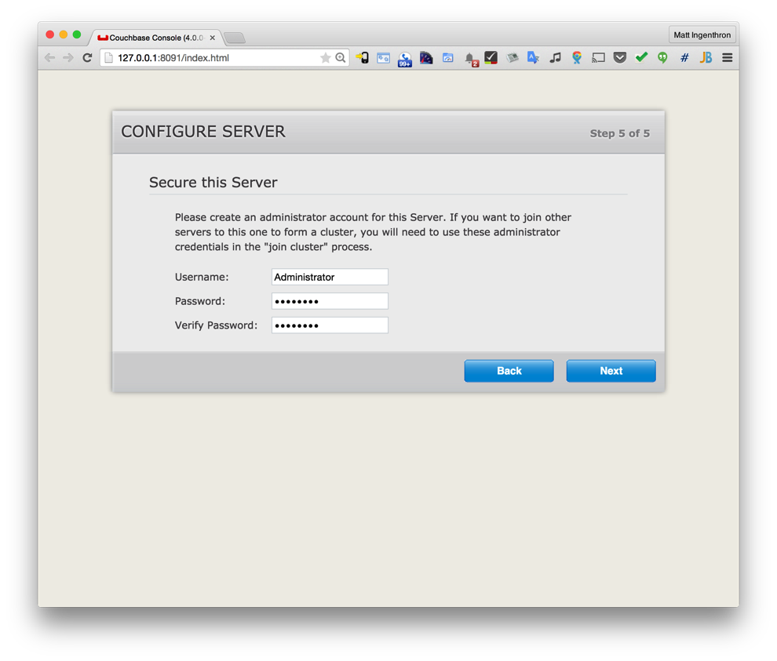
Steps 4 & 5
Register for update notifications and do product registration.
Set a password. Any will do but be sure you remember it.

Slide 11
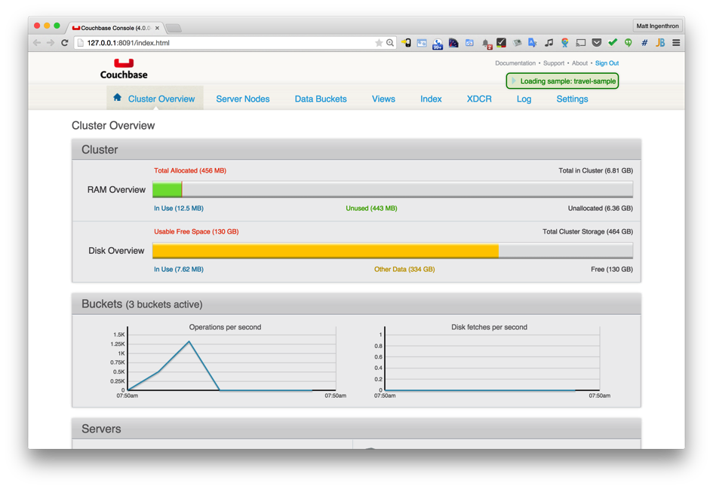
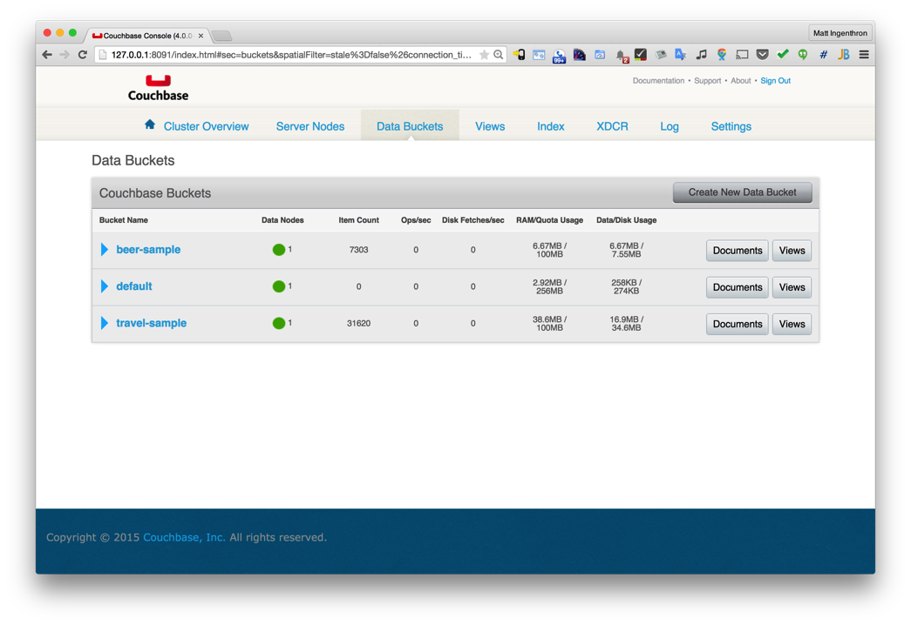
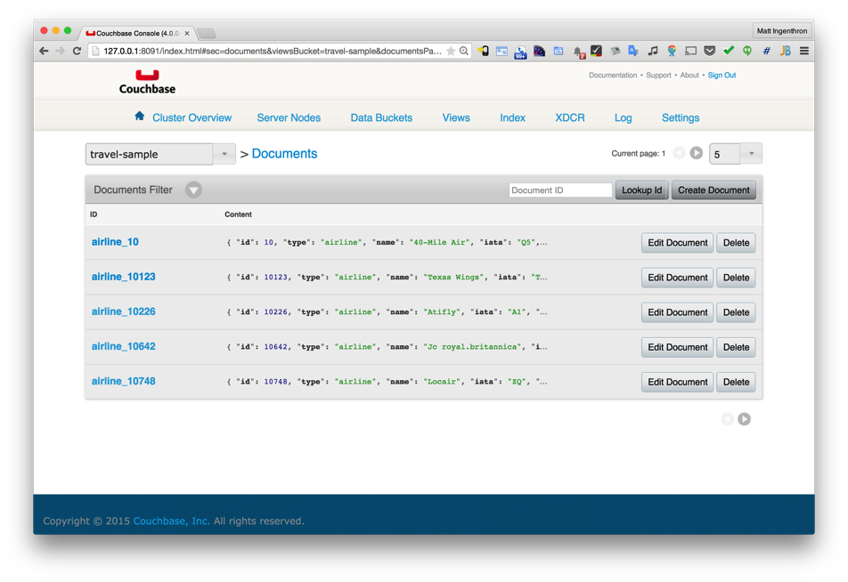
Explore, Verify and Study Documents
Explore the console.
Verify you have the travel-sample bucket.
Study the documents in the travel-sample bucket.

Slide 12
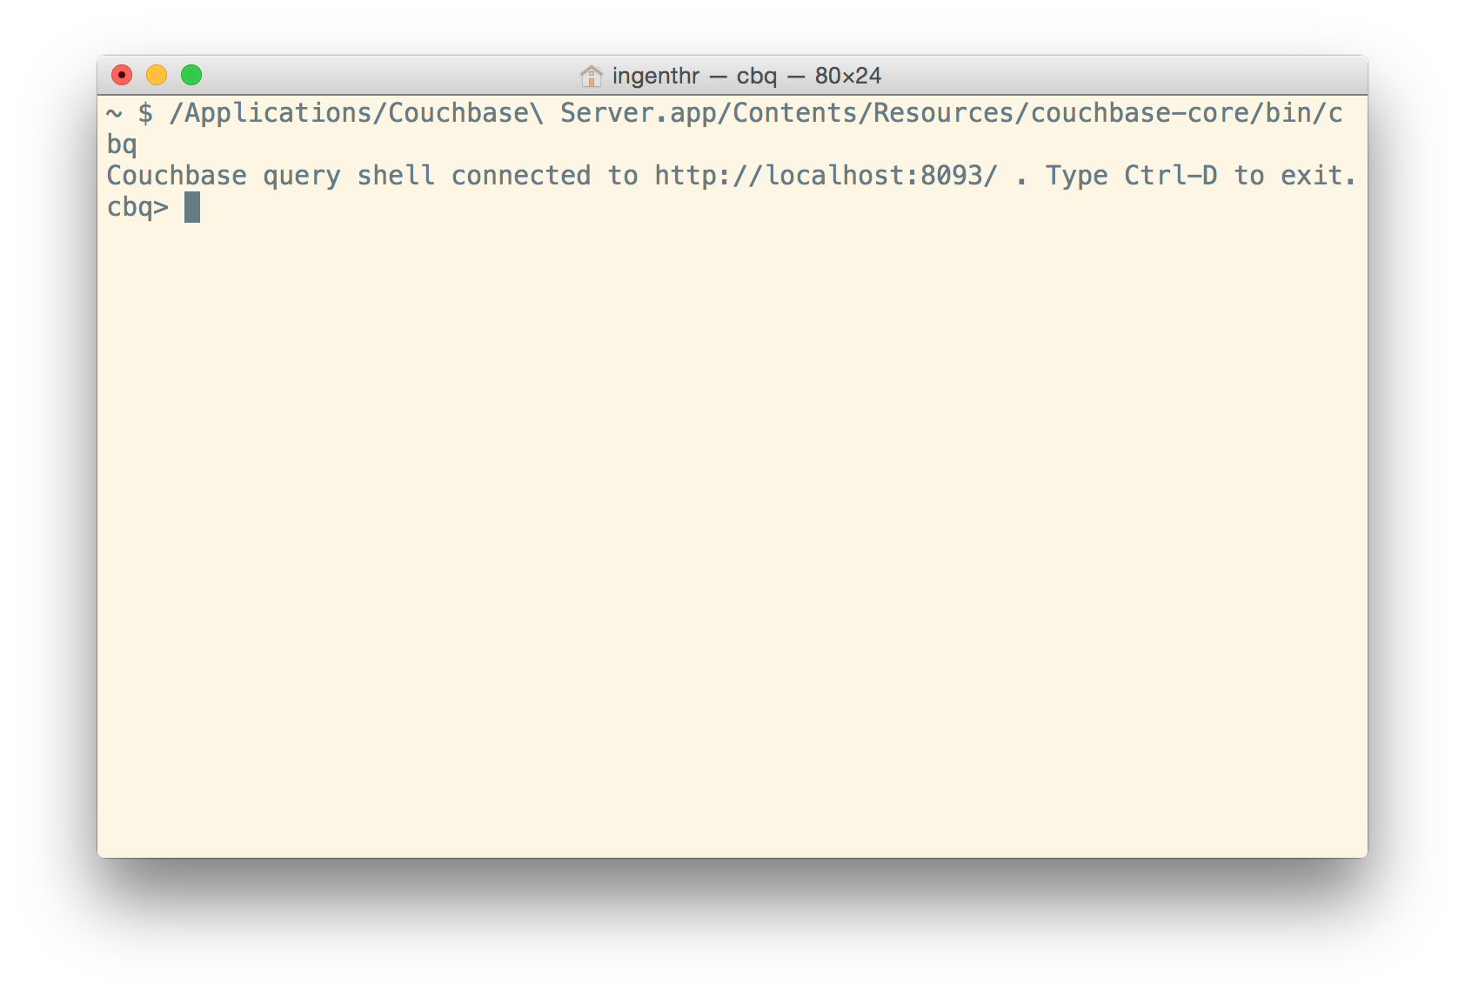
Try the `cbq` command line tool.
Windows:
shell> C:\Program Files\Couchbase\Server\bin\cbq.exe
Mac OS X:
shell> /Applications/Couchbase\ Server.app/Contents/Resources/couchbase-core/bin/cbq
Linux:
shell> /opt/couchbase/bin/cbq
Notes:
TODO: add instructions for Linux and Windows.

Slide 13
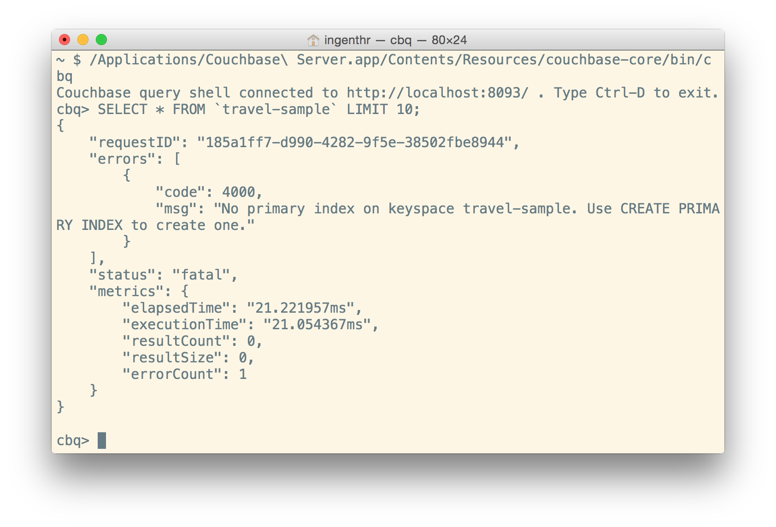
Try a simple select statement
Execute a simple select:
shell> SELECT * FROM `travel-sample` LIMIT 10;
Note the backticks (`) are required around the bucket name to escape it in N1QL’s syntax.
Also, note that the capitals are not required on key words such as SELECT, FROM and LIMIT.

Slide 14
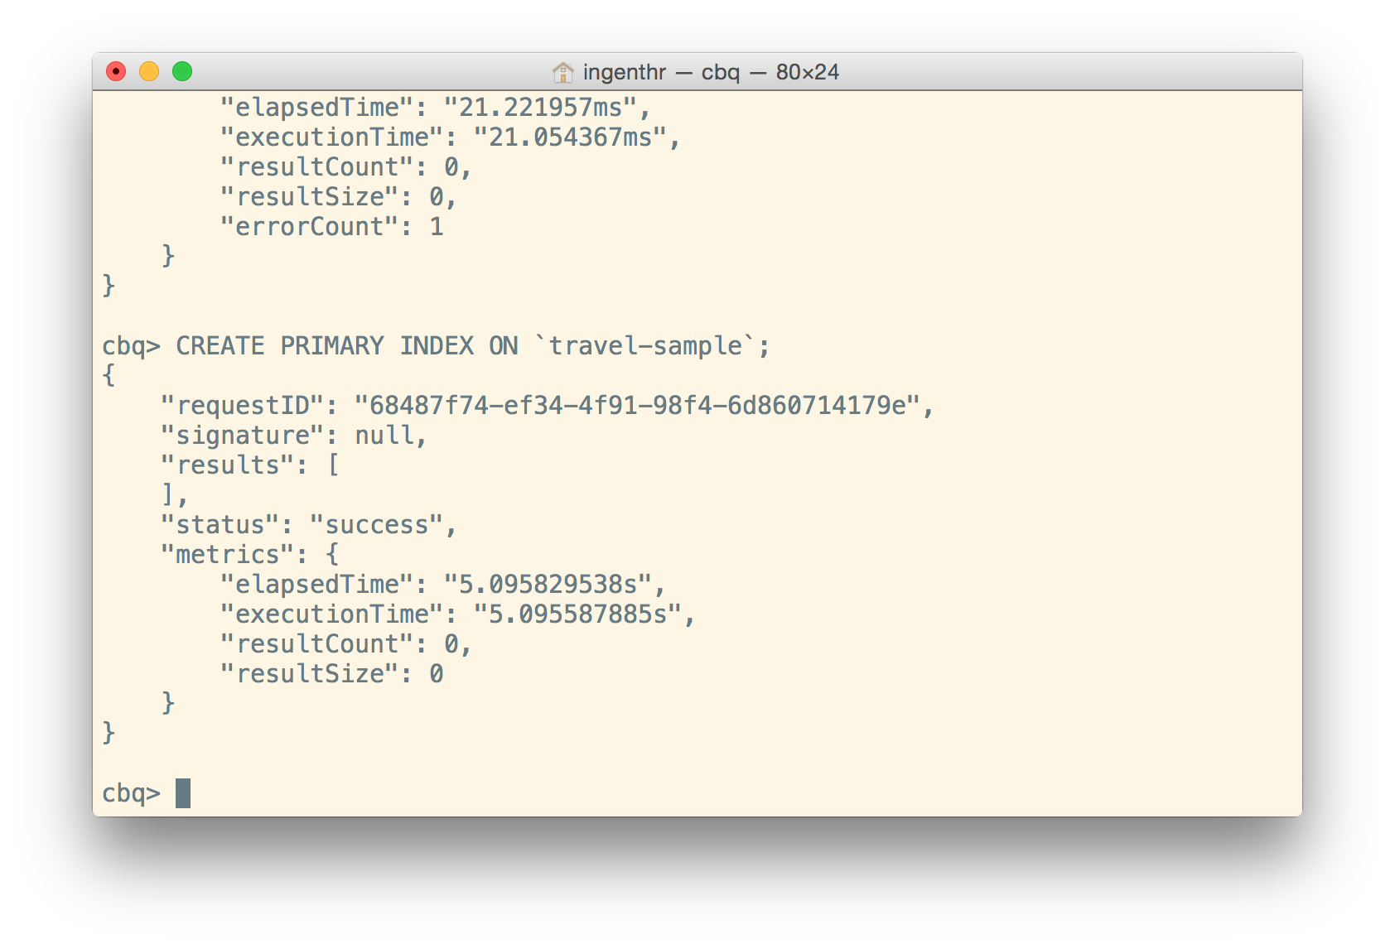
Create an index and try a select again
Create a primary index:
shell> CREATE PRIMARY INDEX on `travel-sample` USING GSI;
This will create a global secondary index (a.k.a. “GSI index”) over the primary key for the data in this keyspace (a.k.a. bucket in the current release).
Execute a simple select:
shell> SELECT * FROM `travel-sample` LIMIT 10;

Slide 15
Some Queries to Try
How many airports are in the `travel-sample`?
What are the different distinct document types (as represented by “type”) in the `travel-sample`?
What are the “names” of places one can eat as an “activity” in the “city” of London?
Refer to the N1QL Cheatsheet: http://docs.couchbase.com/files/Couchbase-N1QL-CheatSheet.pdf

Slide 16
Some Queries to Try
How many airports are in the `travel-sample`?
SELECT COUNT(airportname) FROM `travel-sample` WHERE type="airport”;
What are the different distinct document types (as represented by “type”) in the `travel-sample`?
select DISTINCT type FROM `travel-sample`;
What are the “names” of places one can eat as an “activity” in the “city” of London?
SELECT name FROM `travel-sample` WHERE activity = "eat" AND city = "London";
Refer to the N1QL Cheatsheet: http://docs.couchbase.com/files/Couchbase-N1QL-CheatSheet.pdf

Slide 17
Other Resources
4.0 Beta Documentation: http://docs.couchbase.com/4.0
4.0 Guide to What’s New: http://docs.couchbase.com/4.0/intro/whats-new.html#whats-new
Sample travel app: http://docs.couchbase.com/4.0/travel-app/index.html
N1QL and SQL Differences: http://docs.couchbase.com/4.0/n1ql/n1ql-basics/N1QLSQL.html

Slide 18
Questions?

Slide 19
Thank you.

