Slide 1
Lab: SDK Intro

Slide 2
Agenda
Bootstrapping
Insert/Get
Simple N1QL Select

Slide 3
Bootstrapping

Slide 4
Installation
Open your IDE
Navigate to the server/code directory
Import the lab-02_sdk_intro/initial as a maven project (use the finished directory if you simply want to review)

Slide 5
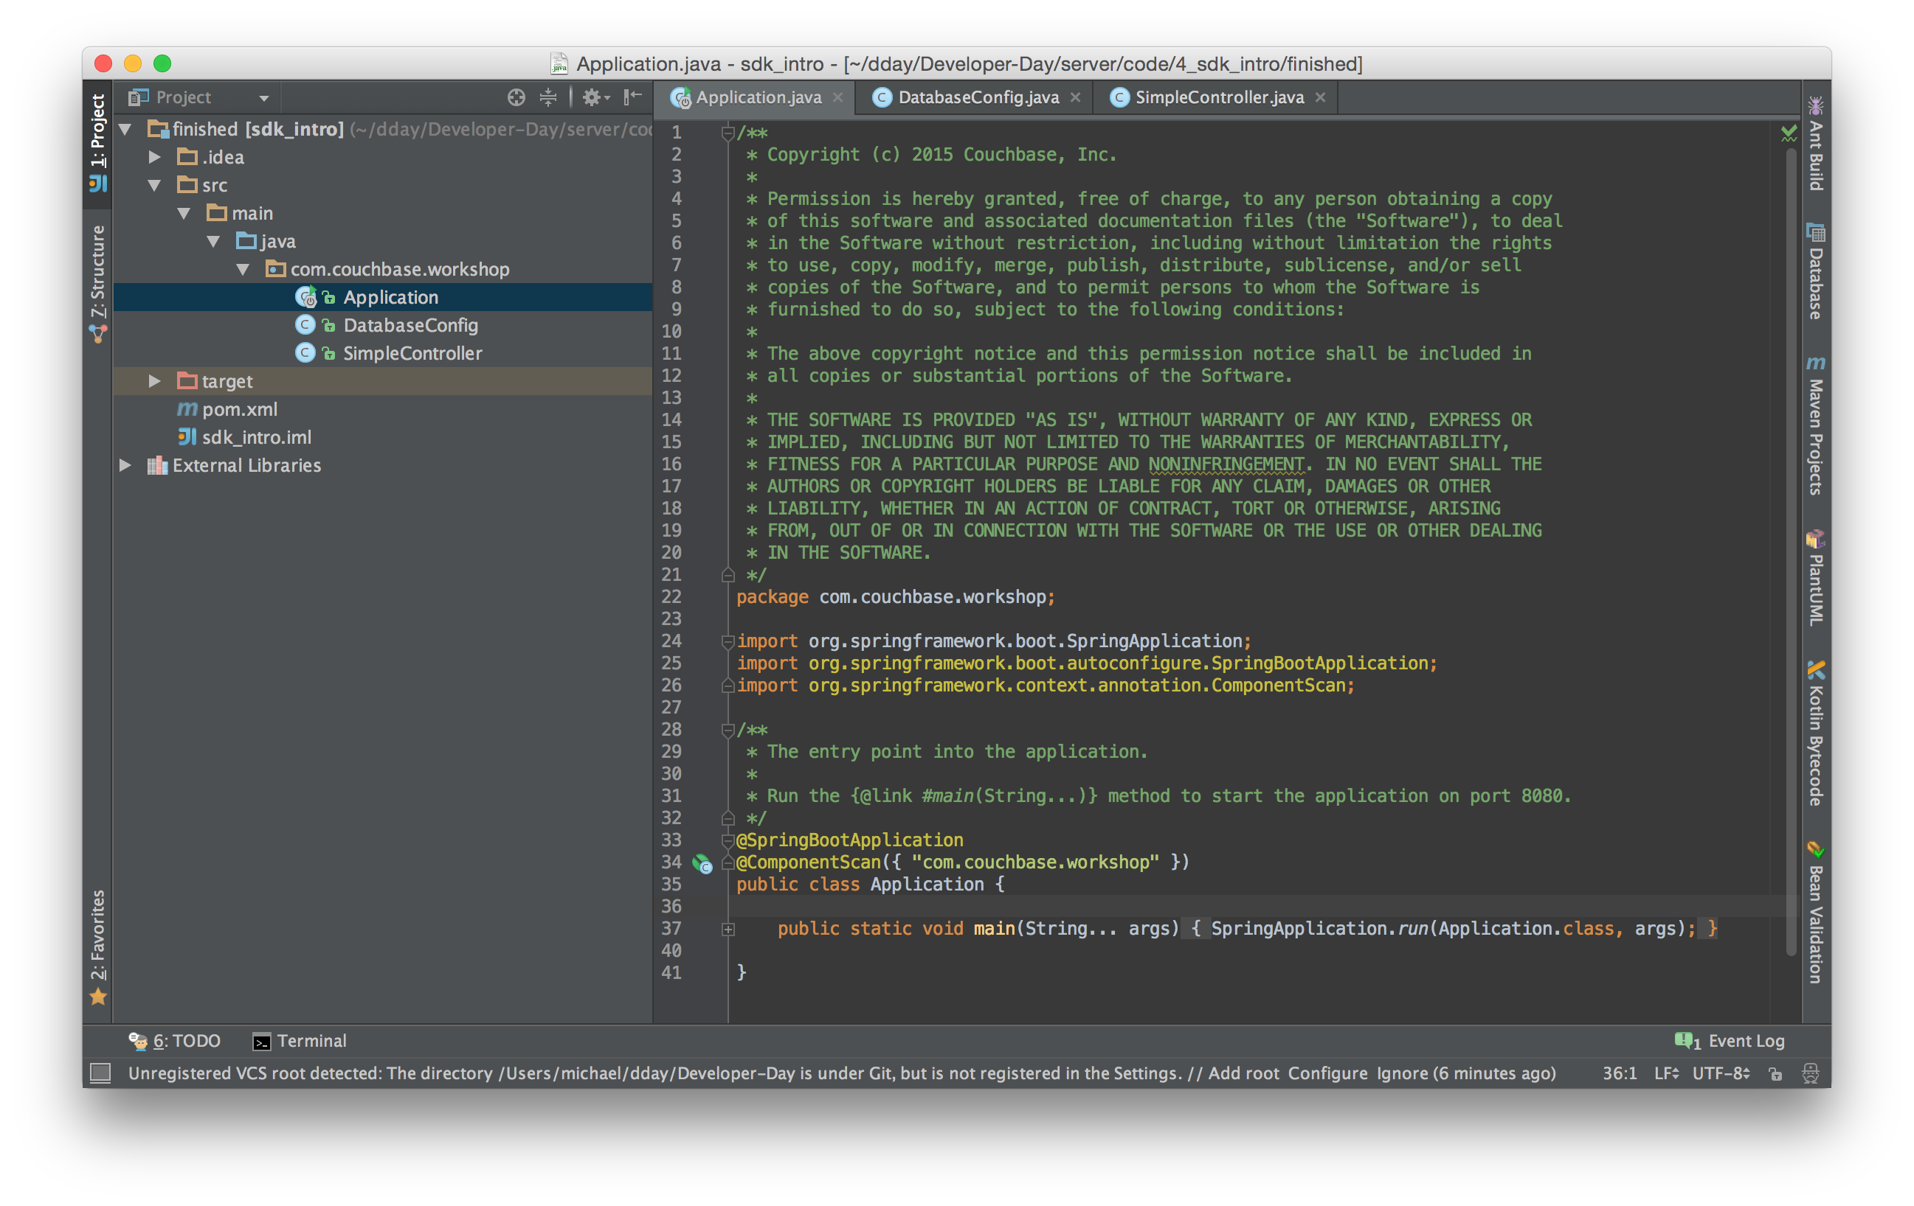

Slide 6
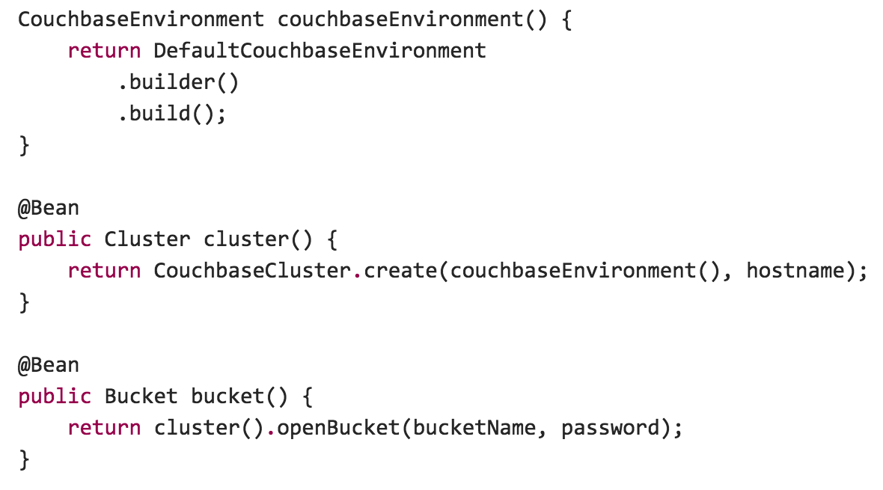
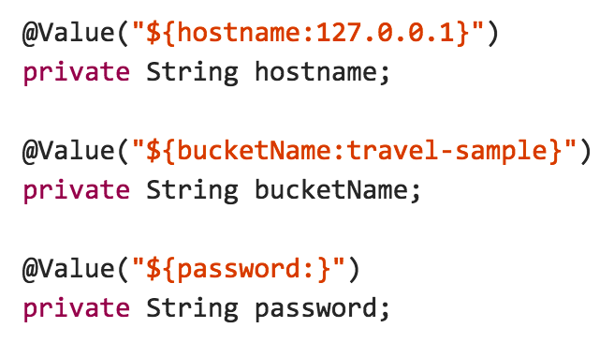
Bootstrapping

Slide 7
Bootstrapping

Slide 8
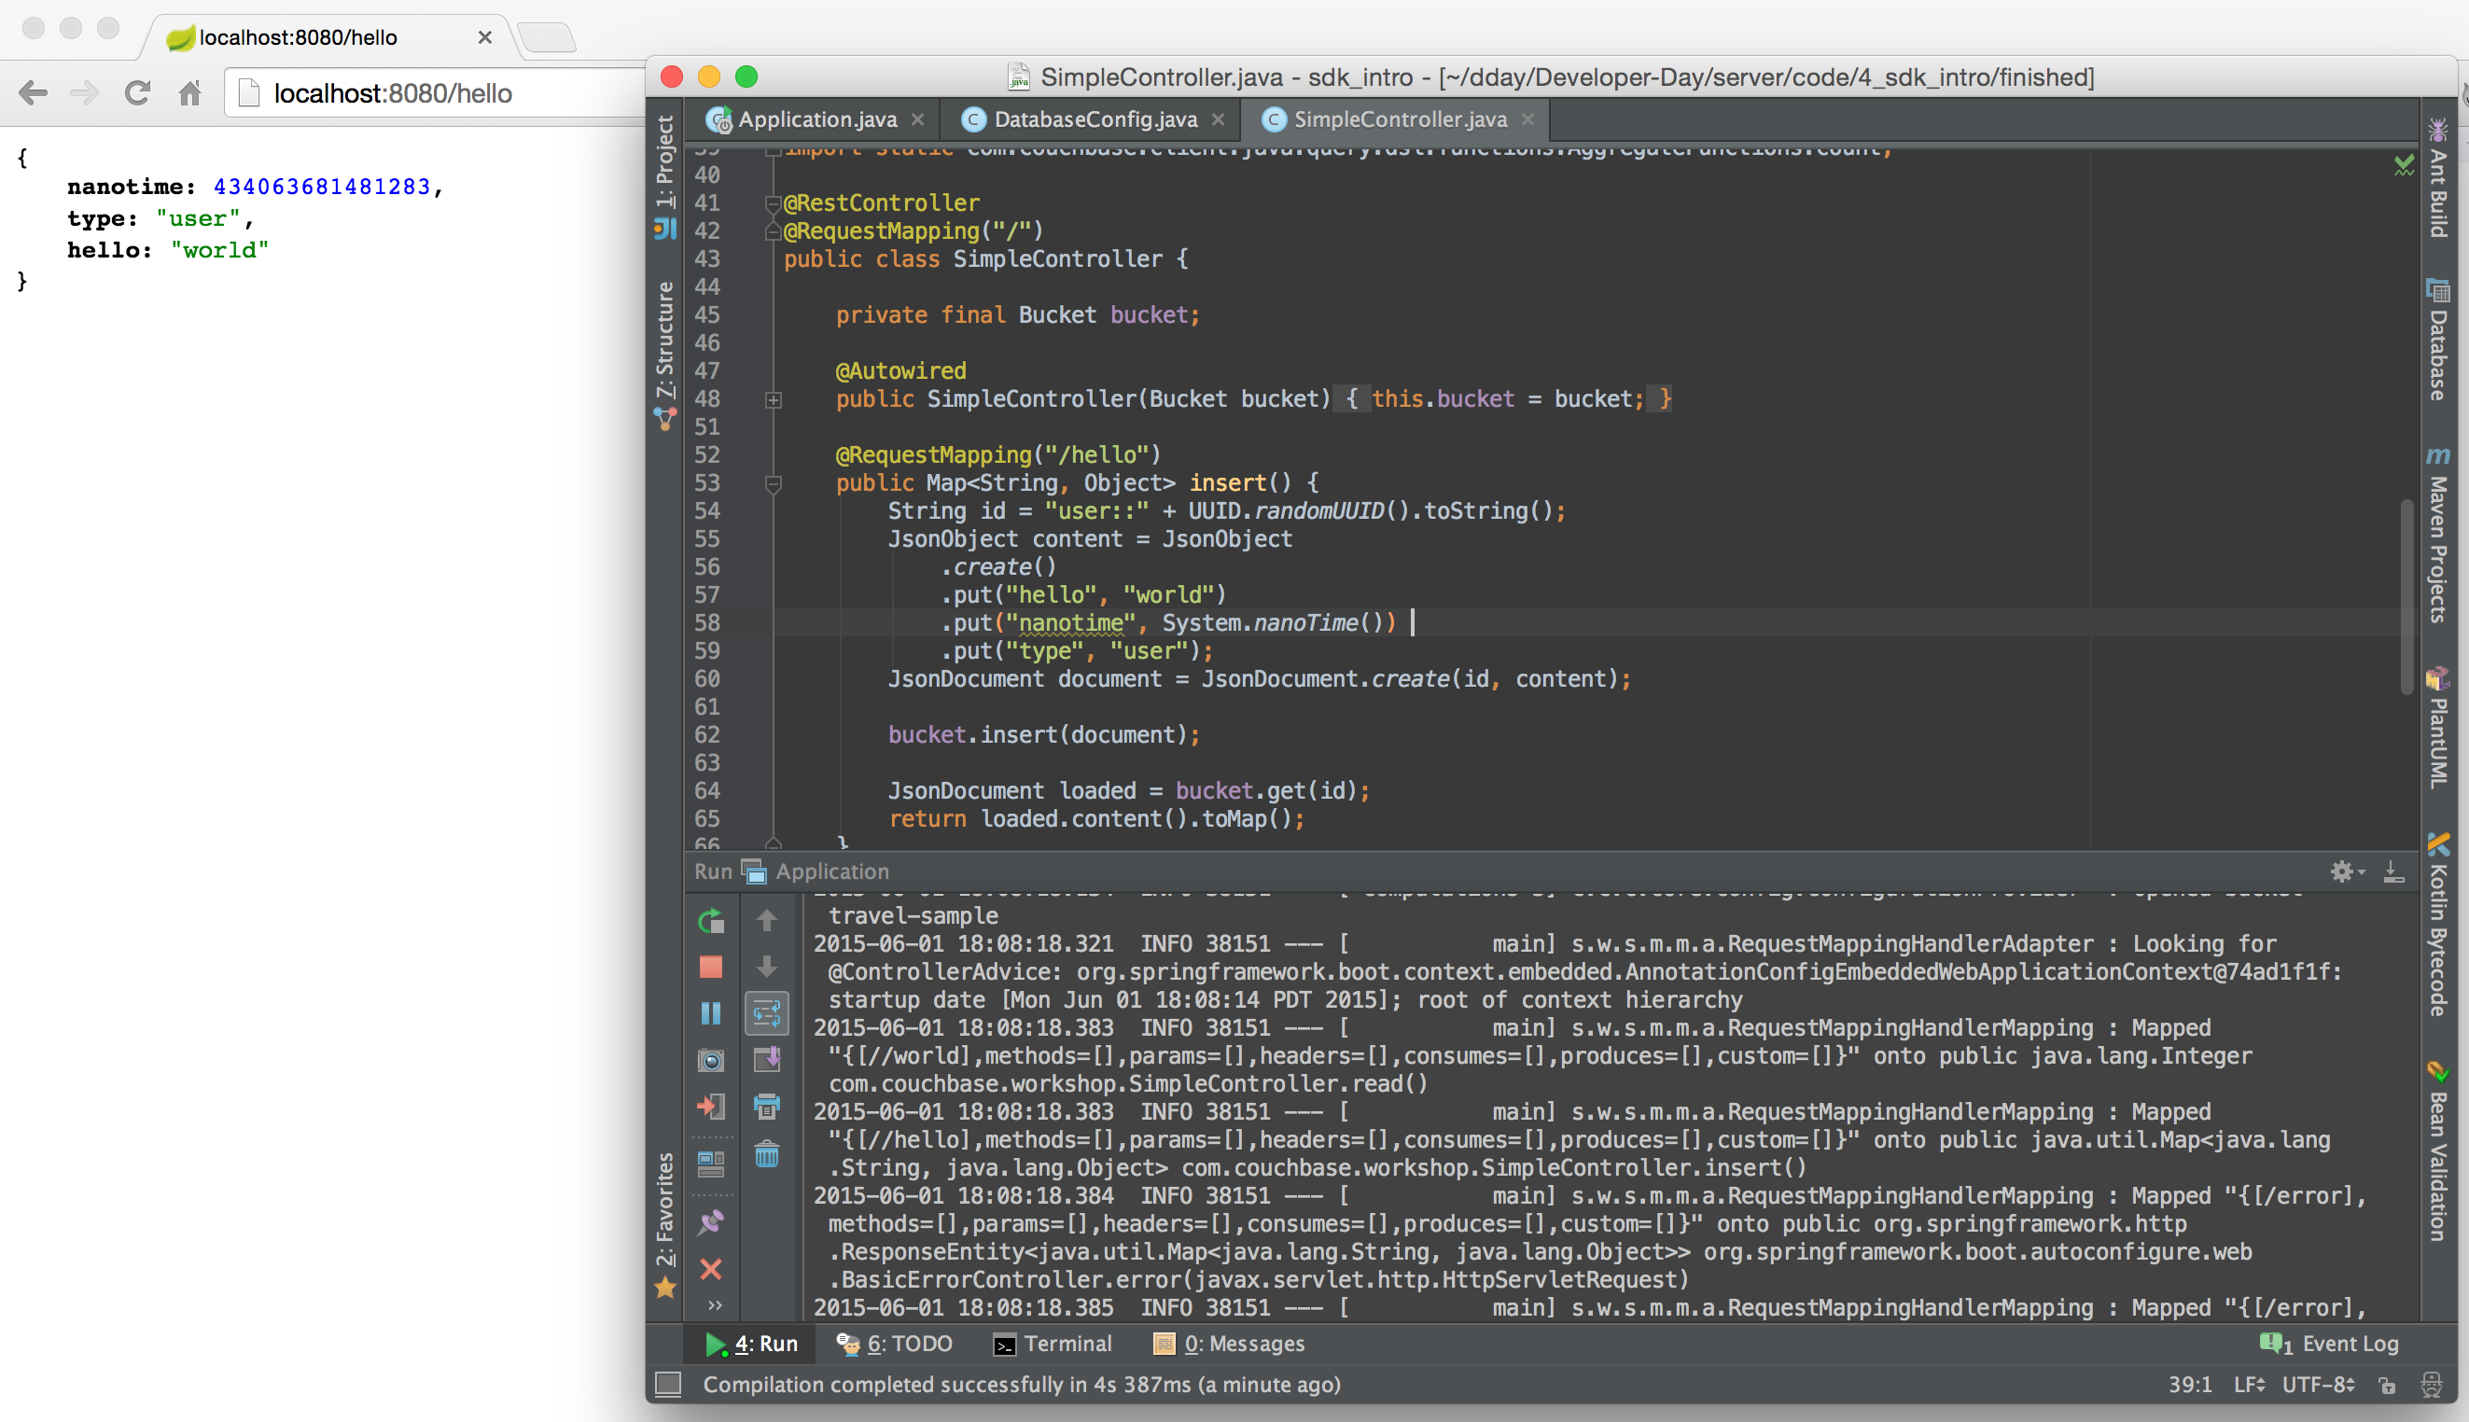
Bootstrapping

Slide 9
Insert/Get

Slide 10
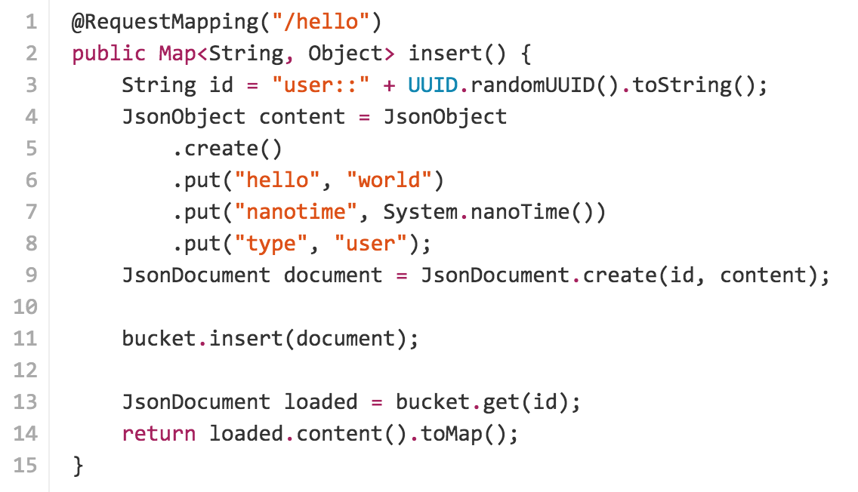
Insert/Get

Slide 11
Simple N1QL Select

Slide 12
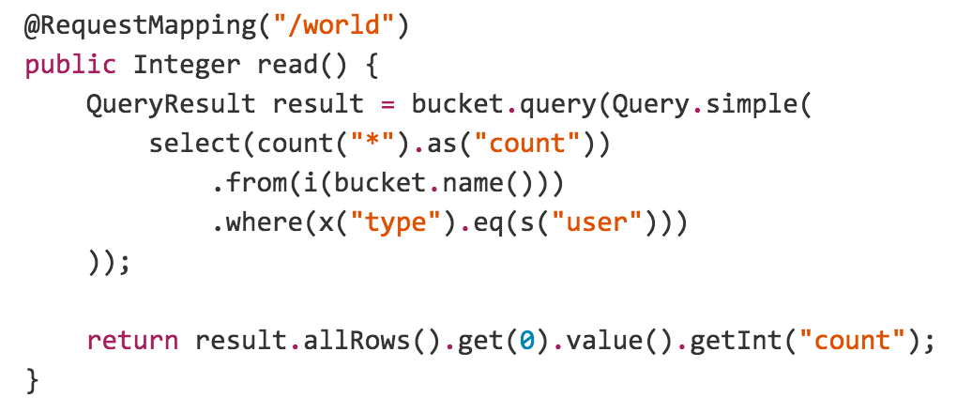
Simple N1QL Select
Perform simple N1QL count statement to verify it’s working.
Ensure a primary index!

Slide 13
Questions?

Slide 14
Thank you.

