Slide 1
Lab: Advanced N1QL

Slide 2
Agenda
Index Management
Read Your Writes
Parameterized Queries
Prepared Queries

Slide 3
Index Management

Slide 4
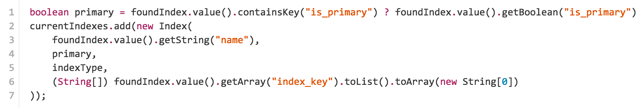
Listing Indexes
N1QL Query to list all indexes
Build “Index” value objects

Slide 5
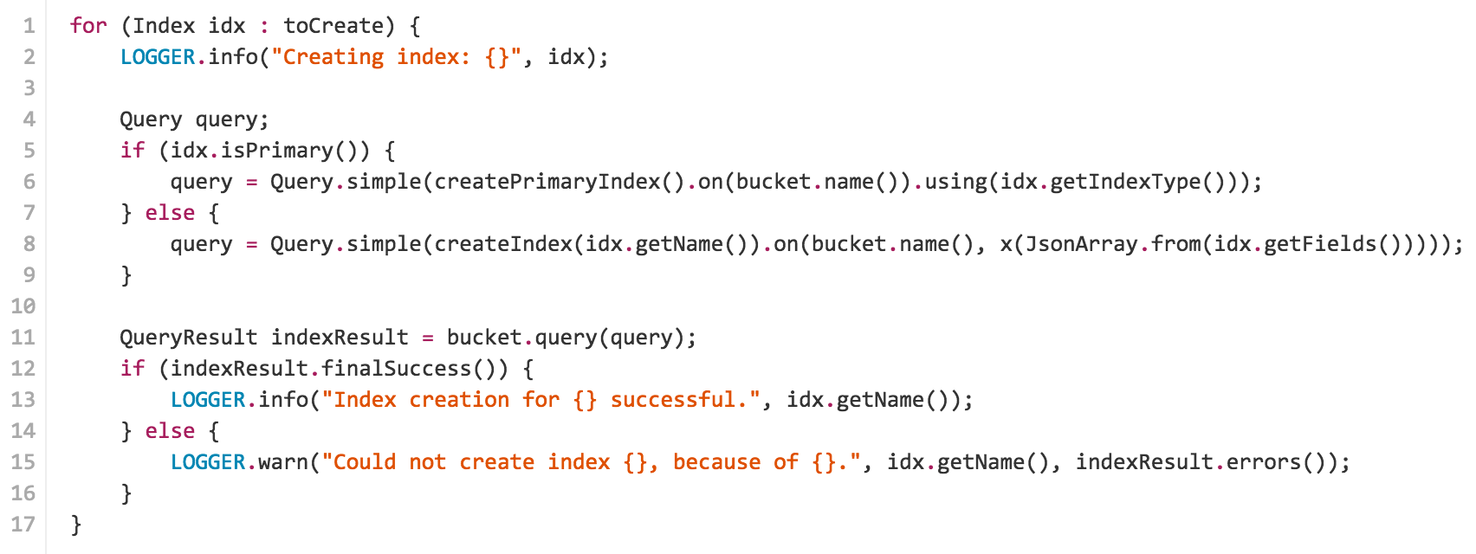
Create Indexes

Slide 6
Read Your Writes

Slide 7
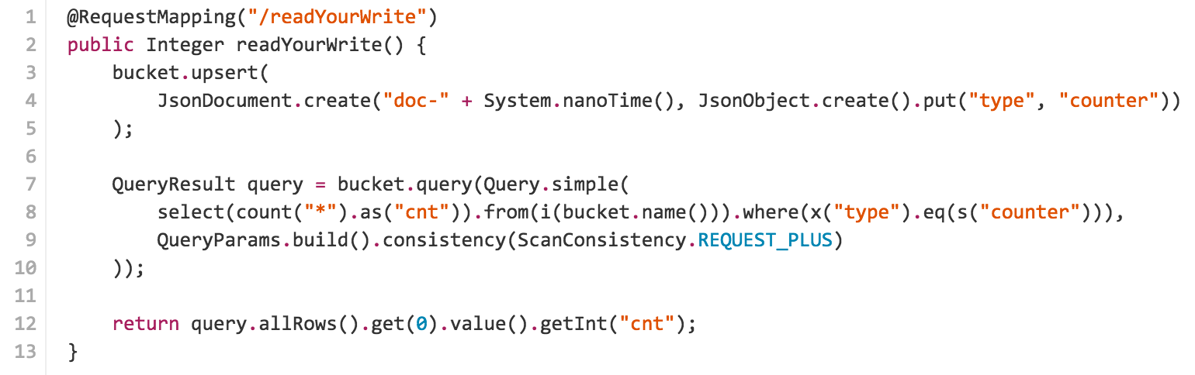
Read Your Writes

Slide 8
Parameterized Queries

Slide 9
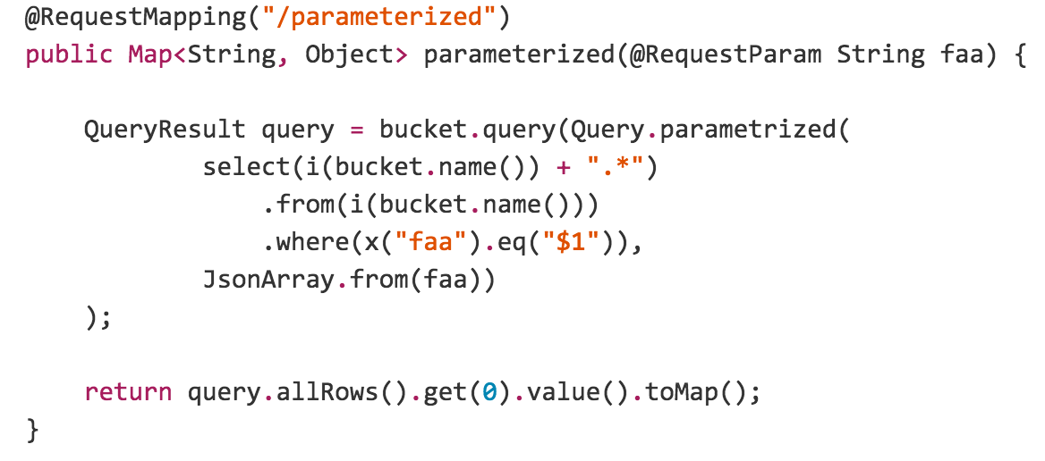
Parameterized Queries

Slide 10
Prepared Queries

Slide 11
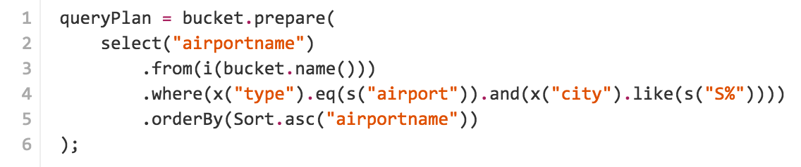
Prepared Queries

Slide 12
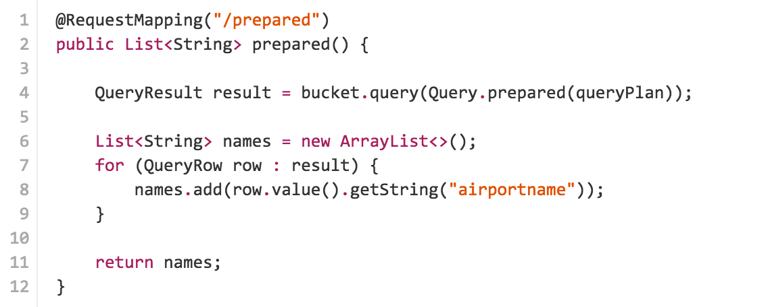
Prepared Queries

Slide 13
Questions?

Slide 14
Thank you.

