Slide 1
Programming Couchbase
Notes:
Lecture: SDKs [30min]
How it works, what SDKs we provide, etc.

Slide 2
Agenda
Overview of services and programming model
Description of the features of the SDKs
Including other frameworks/integrations
Documents and APIs
What does it mean to be a Document in Couchbase
APIs used to program against Couchbase

Slide 3
Overview

Slide 4
All are Key Value stores at some level or another
Couchbase has key-value at it’s core
A JSON Document store is a special case of the Key-Value Store
Couchbase prefers operating with Documents
N1QL as a service gives you one of the most powerful and expressive ways of accessing JSON documents
Views in Couchbase continue as a great way to deal with things like aggregation or data that has very different shapes
N1QL Query
JSON Documents
Views
Key Value Store

Slide 5
Couchbase SDKs
What does it mean to be a Couchbase SDK?
Functional
Allow for querying, execution of other directives such as defining indexes and checking on index state.
API
abucket.NewN1QLQuery( “SELECT * FROM default LIMIT 5” )
.Consistency(gocouchbase.RequestPlus);
Functional
Manage connections to the bucket within the cluster for different services.
Provide a core layer where IO can be managed and optimized.
Provide a way to manage buckets.
API
insertDesignDocument()
flush()
listDesignDocuments()
Functional
Hold on to cluster information such as topology.
API
Reference Cluster Management
openBucket()
info()
disconnect()
Functional
Give the application developer a concurrent API for basic (k-v) or document management
API
get()
insert()
upsert()
remove()
Functional
Allow for view querying, building of queries and reasonable error handling from the cluster.
API
abucket.NewViewQuery().Limit().Stale()
CRUD
View Query
N1QL Query
Bucket
Cluster

Slide 6









Languages and Interfaces for Couchbase
j
Official SDKs
Java – Version 2.1
.NET – Version 2.1
Node.js – Version 2.0
Python – Version 2.0
For each of these we have
Full Document support
Interoperability
Common yet idiomatic Programming Model
Others: Erlang, Perl, TCL, Clojure, Scala
PHP – Version 2.0
C – Version 2.5
Go – Version 1.0 DP
Ruby – Version 2.0 DP
JDBC and ODBC

Slide 7
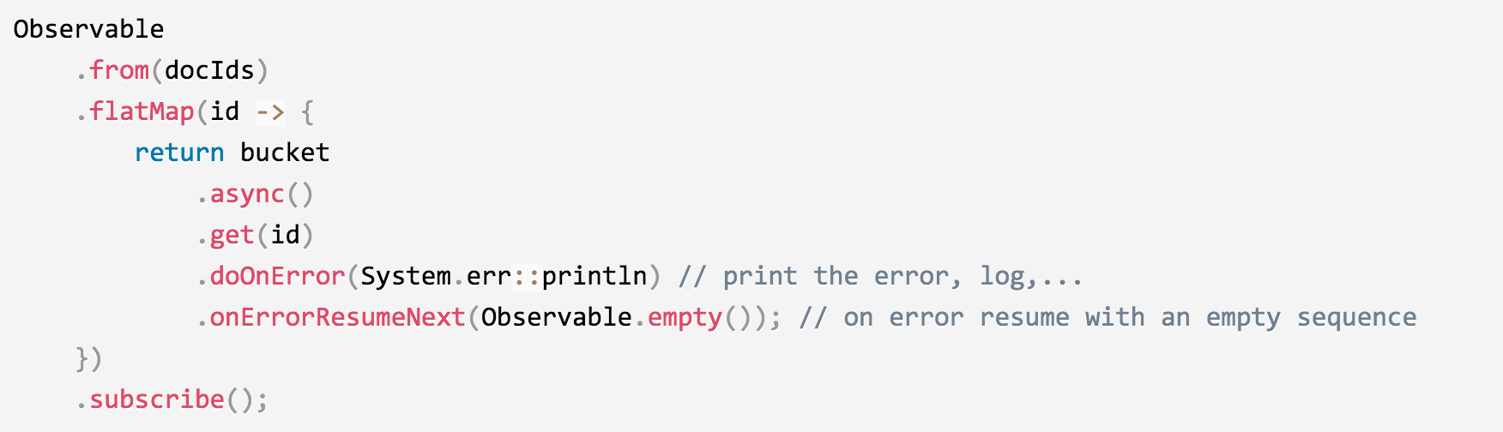
Java SDK for Couchbase
Java
2.0 – More document oriented
2.1 – Pluggable retries, event bus, DNS SRV bootstrap, experimental N1QL, experimental geospatial support
2.2 – (future) Official N1QL support, official geospatial support
Synchronous interface
Synchronous interface will pipeline calls from multiple actors which works well if you have many requests on a container
Asynchronous Interface
Based on Reactive Extensions for Java, RxJava
Frameworks for Java developers
Spring Data Framework
Reactive Couchbase for Scala
Scala Play Framework
Support for Java Caching JSR-107

Slide 8
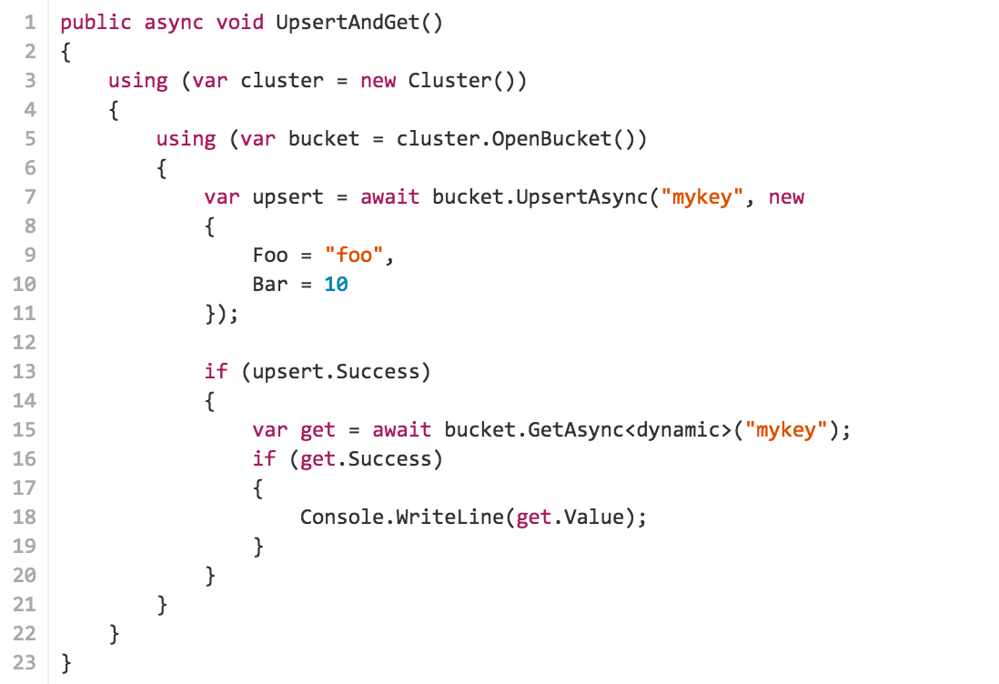
.NET SDK for Couchbase
.NET
2.0 – Document oriented, vastly improved connection management
2.1 – Task-based Asynchronous Pattern, pluggable transcoders, networking enhancements
2.2 – (future) Official N1QL support, official geospatial support
Integration for .NET
LINQ (language integrated query)
ASP.NET Session Providers
Contrib for new features

Slide 9
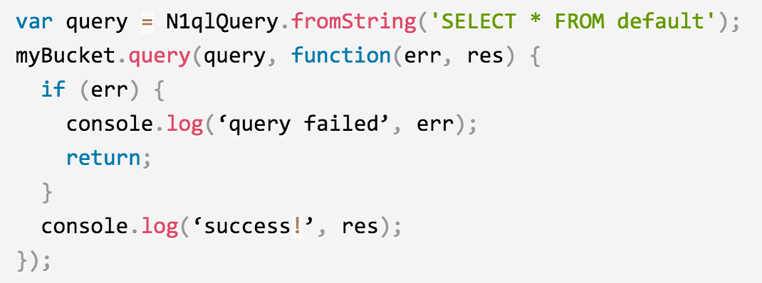
Node.js SDK for Couchbase
Node.js
2.0 – More document oriented, revised view interface, experimental N1QL support, streaming view results and automatic pipelining of multi-operations
2.1 – (future) N1QL official support
Based on and bundles libcouchbase, the super-fast event-oriented C SDK/library for Couchbase
Asynchronous Interface
All responses are through callbacks as expected
Frameworks for Node.js developers
Couchbase Ottoman
Kouch: Mongoose-like porting framework
arrest-couchbase, fast-api, sofa-odm, couchtard
33 dependencies on npm!

Slide 10
Bootstrapping

Slide 11


Client Setup: Getting Cluster Configuration
make connection
receive topology
Couchbase Client
App Server
Notes:
Couchbase client
Basically, give people an overview of how the SDK’s get notified when there is a topology change via async REST.
On the SDK side, we make sure the SDK’s as much as possible, get to the know the new cluster config – over streaming API.

Slide 12
Documents and the API
Our first-class citizens

Slide 13
The Document
j
Documents are integral to the SDKs.
There are many implementations, depending on the content type.
A Document contains:
Property | Description
ID | The bucket-unique identifier
Content | The value that is stored
Expiry | An expiration time
CAS | The Compare-And-Swap identifier

Slide 14
Document Implementations
j
Document implementations are language specific.
All support JSON in its different forms.
In addition, some support:
Serialized objects
Unquoted Strings
Binary pass-through
Legacy
…

Slide 15
Future Additions
Some slides about
- how the sdk connects and grabs the config
- supported setups/constraints
- things to watch out
Maybe some sdk-specific slides? java, lcb, .net API architecture specifics

Slide 16
The API
From Clusters to Documents

Slide 17
Future Additions
Some slides about
Cluster (incl connecting and disconnecting)
Bucket (add explanation of all other possible methods, including persistence constraints)
double check all examples (may be outdated!)
ClusterManager
BucketManager
Maybe some sdk-specific slides? java, lcb, .net API samples

Slide 18
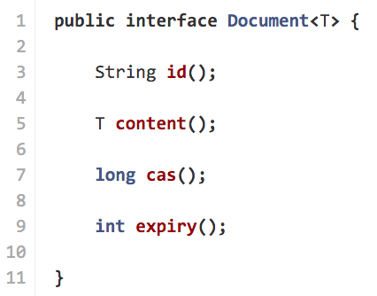
The Document
j

Slide 19
Document Implementations
j
Document implementations are language specific.
All support JSON in its different forms.
In addition, some support:
Serialized objects
Unquoted Strings
Binary pass-through
Legacy
…

Slide 20
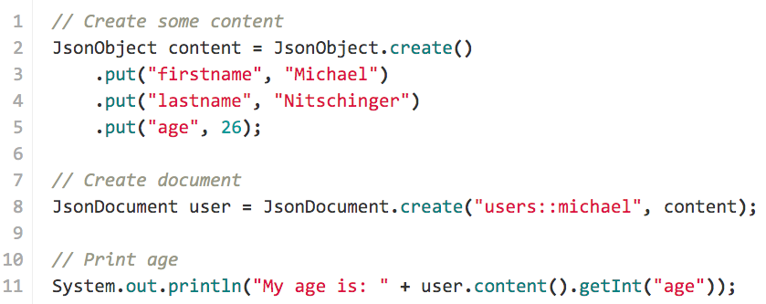
Example Document - Java

Slide 21
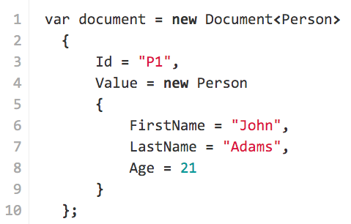
Example Document - .NET

Slide 22
Bucket API – Modifying Documents
insert() the document if it does not exist
replace() the document if it does exist
upsert() the document (insert or replace)
remove() the document
append() data to the document
prepend() data to the document
counter() for increment/decrement type operations

Slide 23
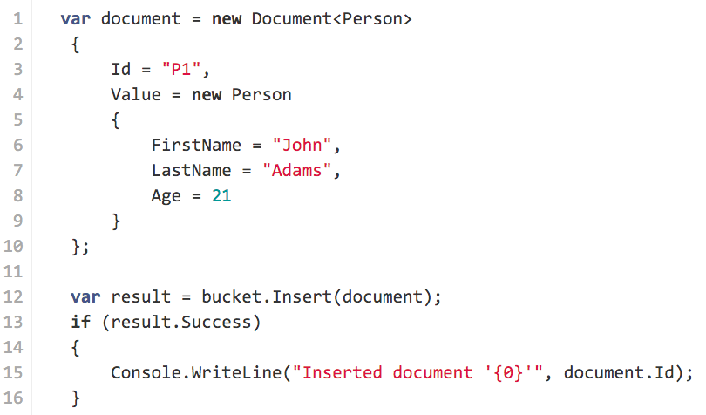
Insert .NET

Slide 24
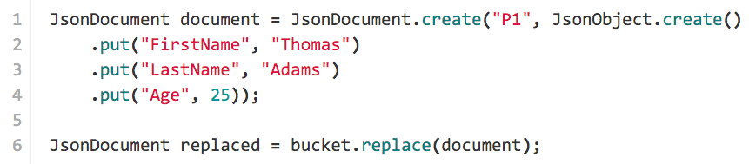
Replace Java

Slide 25
Bucket API – Retrieving Documents
get() the document
getFromReplica() if the master is not available
getAndLock() to load the document and write-lock it
getAndTouch() to load the document and reset the expiry

Slide 26
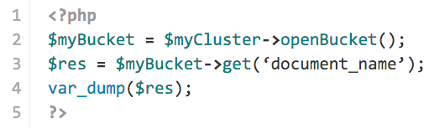
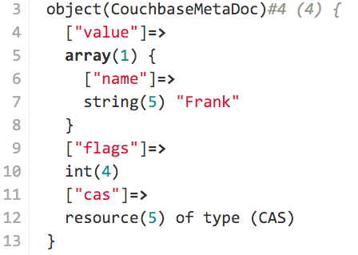
Get PHP

Slide 27
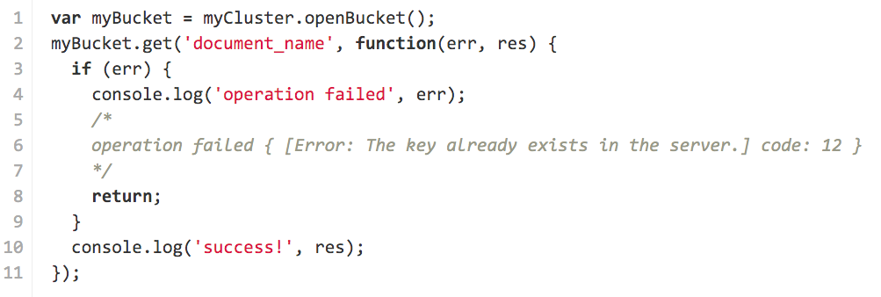
Get NodeJS

Slide 28
Bucket API – Querying
query() is possible for
Views
N1QL (experimental until 4.0 GA)
Streams N response rows as they arrive from the server
Loads more than one Document based on Criteria
Typically used to satisfy secondary and advanced querying use cases

Slide 29
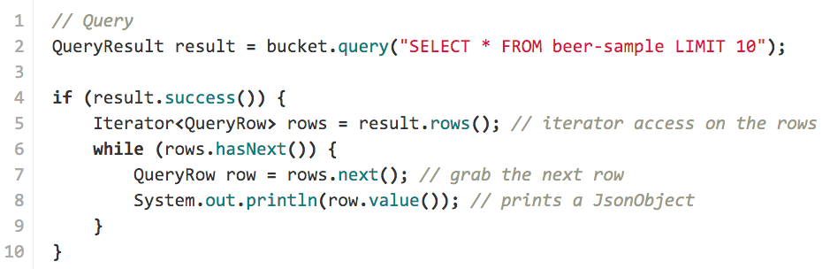
Sync Querying Java

Slide 30
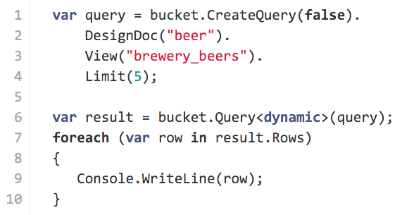
Querying .NET

Slide 31
A Word about Couchbase Mobile

Slide 32
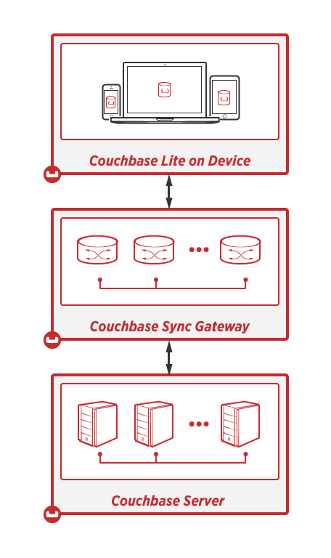
Couchbase Mobile Overview
Couchbase Lite
On-device, lightweight, native embedded JSON database
Sync Gateway
Synchronize on-device Couchbase Lite with Couchbase Server in the cloud
Couchbase Server
High performance, scalable, always-on JSON database in the cloud

Slide 33
Questions?

Slide 34
Thank you.

