Slide 1
Comparative Analysis of Automated and
Manual Ontology Engineering for Modeling
Clinical Trial Outcomes in Diabetes
Marin Marian
Supervised by Romana Pernisch

Slide 2
Setting and Motivation
Goal: Investigating two ontology engineering approaches in the context of outcome measures in clinical trials for diabetes (I & II)
Why clinical trial outcomes in diabetes?
9.3% of the worldwide population suffers from diabetes
Among the top 10 causes of death in adults, with an estimated 4 million deaths around the world in 2017
Clinical trials are essential for determining the efficacy and safety of new diabetic treatment methods for preventing, diagnosing, treating, and managing diabetes

Slide 3
Setting and Motivation
Why ontologies?
Their use is becoming increasingly popular in various fields, including medicine and healthcare
In large-scale research studies, such as those focused on diabetes, ontologies can serve as a valuable tool for efficiently analysing numerous outcome measures across trials

Slide 4
Problem and Research question
Ontology engineering
Time-consuming and laborious
Requires a deep understanding of the domain and the ability to organise knowledge in a structured manner
Great accuracy and representation of the domain
More control over the modelling process
An automated approach to ontology engineering
Reduces time and effort
Handles large amounts of data and ensure consistency
Limited domain expertise
Difficulties with ambiguity

Slide 5
Problem and Research question
The performance of automated techniques in comparison to manually constructed ontologies remains an open question.
RQ: Do automated steps, such as concept identification and classification, in ontology engineering outperform manual ontology modelling in the context of clinical trial outcomes for diabetes?

Slide 6
Approach
Manually modelling an outcome measures ontology (in a group of 3)
Finding relevant clinical trials (aprox. 300 clinical trials were used)
Identifying the outcome measures
Defining classes (Biomarker, DiabeticDisease, EndpointScore, OutcomeMeasurementTool ,Questionnaire + every outcome measure in the ontology is also modeled as a separate class)
Defining annotation properties and object properties (relationships)

Slide 7
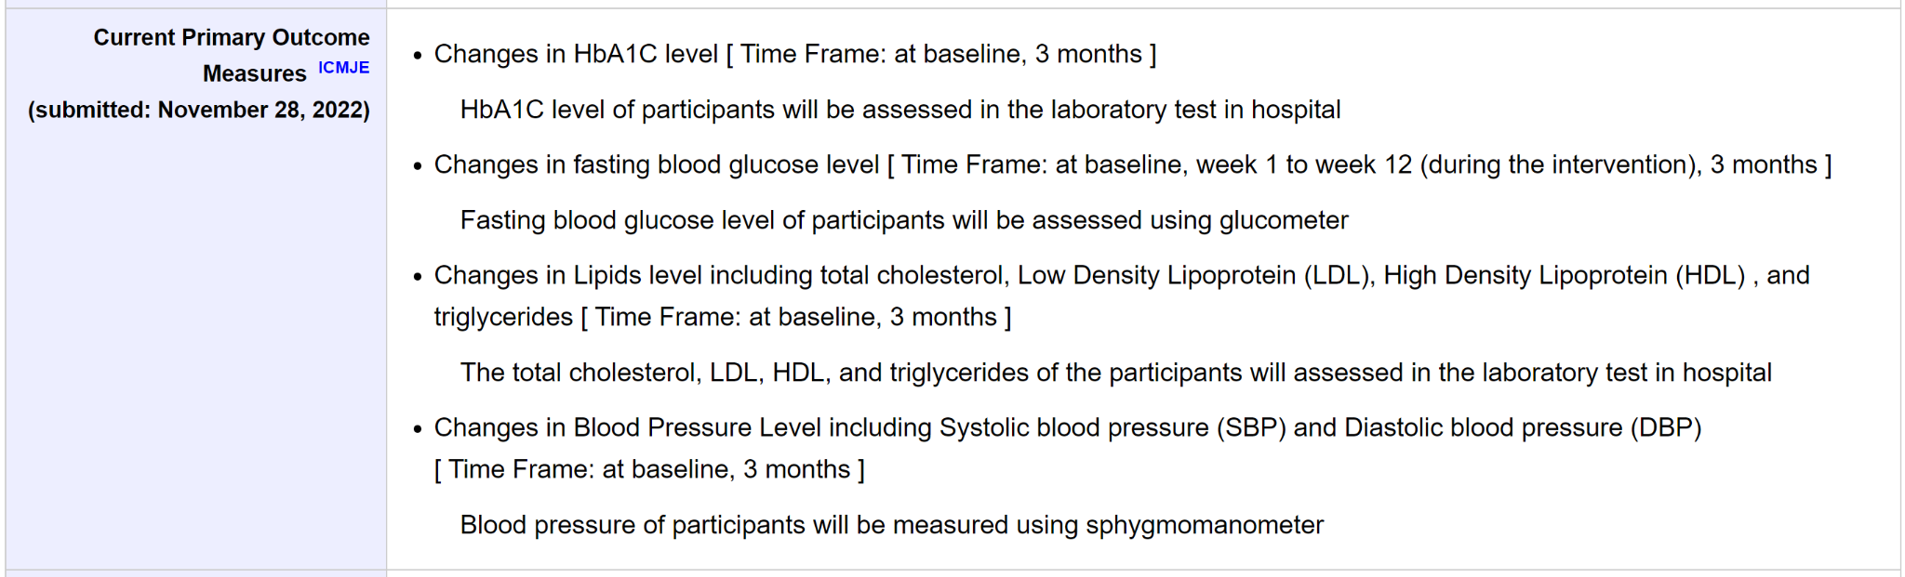
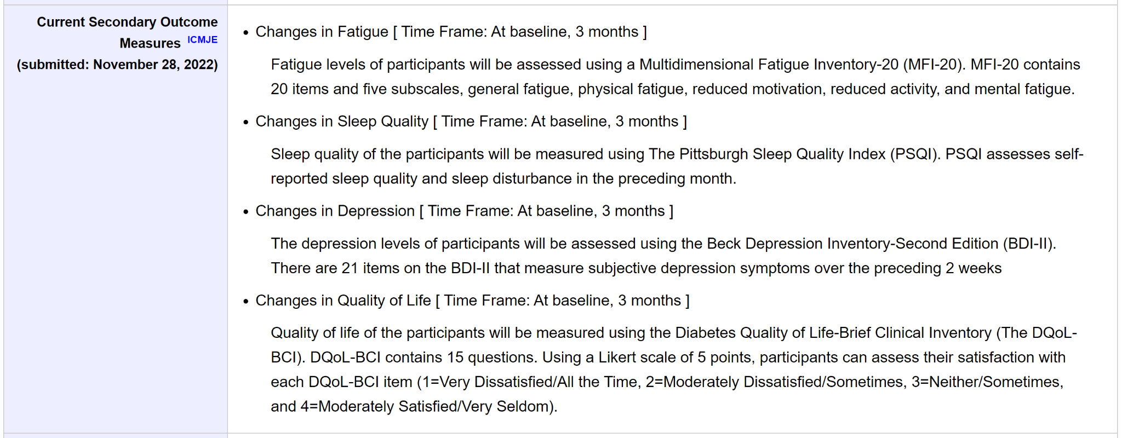
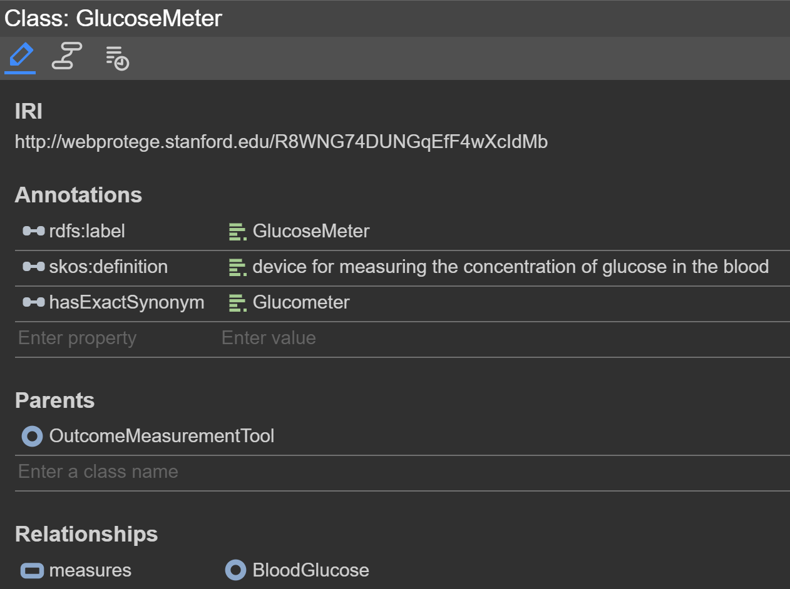
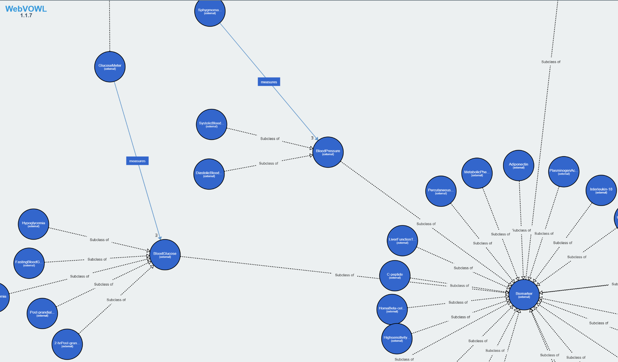

Slide 8
Approach
Automated steps for ontology engineering
Data Collection (from 10000 clinical trials)
Concept extraction
using Named Entity Recognition (NER)
using a filtering function
Concept categorization
using Support Vector Machines (SVM) - semi-supervised
using K-means clustering - unsupervised

Slide 9
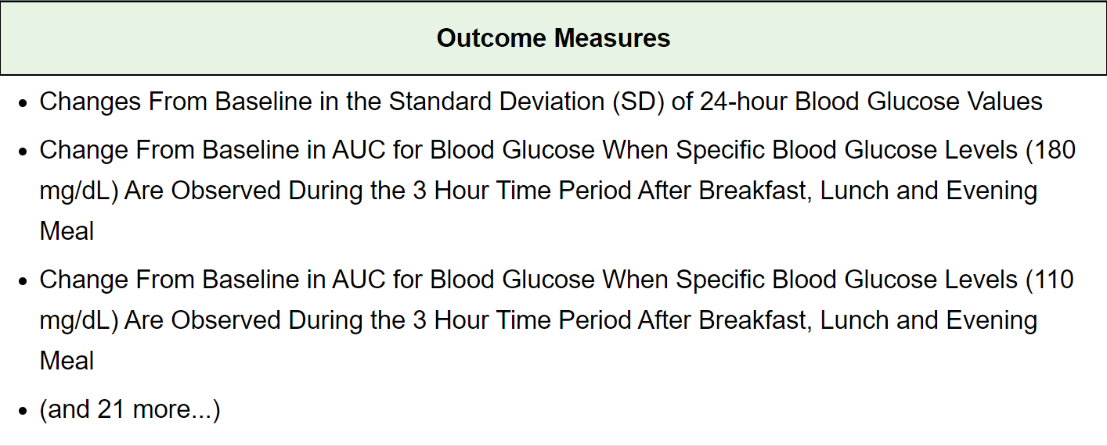
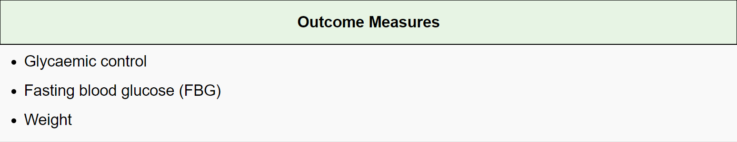
Approach
Automated steps for ontology engineering
concept extraction using a filtering function
Outcome measures representation in clinical trials (this section of the trial protocols was used for both ontologies)
Notes:
Might delete relevant outcome measures and this can impact the completeness of the extracted concepts and potentially may result in missing important information.

Slide 10
Evaluation protocol
Evaluating the modelled ontology
using competency questions (e.g. listing all the endpoint subtypes for diabetes, which are a score)
using the Ontology Pitfall Scanner (OOPS)
Evaluating the automated techniques for ontology engineering
creating an annotated subset to obtain gold labels and compare them with the predicted labels
calculating evaluation metrics (accuracy, precision, recall, and F1 score)

Slide 11
Findings
Modelled ontology
the ontology is able to answer specific queries and provide relevant information
OOPS identified several pitfalls, such as the presence of unconnected ontology elements, the absence of disjointness axioms and inverse relationships
Automated approaches for concept extraction (NER and the filtering function) and classification (SVM and K-means clustering)
SVM:
using NER: accuracy = 49%
using filtering: accuracy = 78%
K-means clustering: resulting clusters did not resemble at all the expected classes of measures

Slide 12
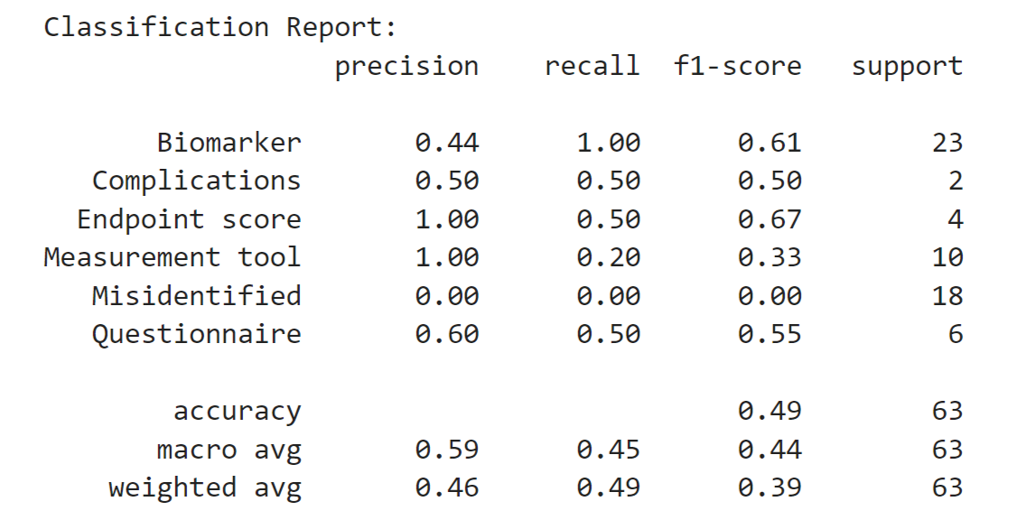
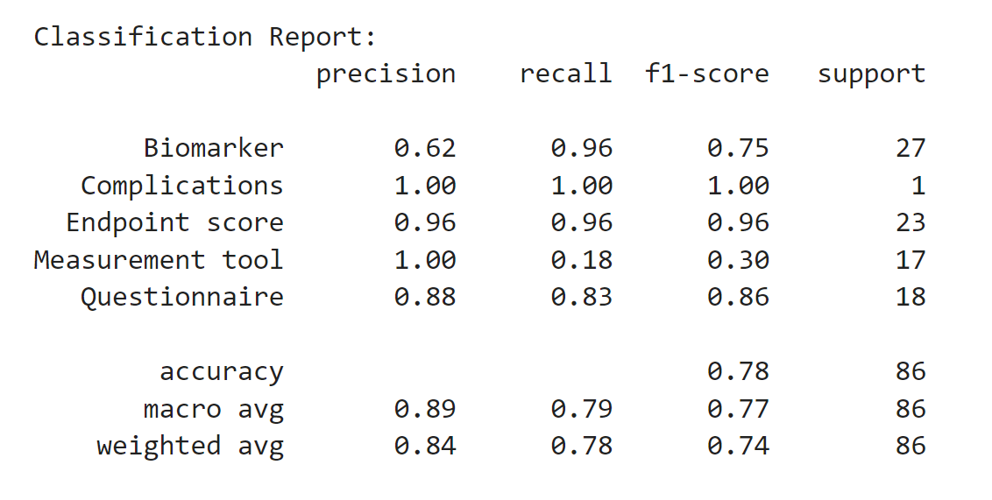
Findings
Evaluation metrics for the SVM classification model
(a) using NER: accuracy = 49% (b) using filtering: accuracy = 78%

Slide 13
Conclusions
Modelled an ontology for clinical trial outcome measuress in diabetes
Investigated the performance of automated techniques in ontology engineering
An improved SVM-based approach could be utilized to assist in the process of ontology engineering.
Further evaluation is required once an automated ontology is generated and compared to the manually modelled ontology, assessing the coverage, quality of both ontologies, and their effectiveness in supporting clinical trials research in diabetes

