Slide 1

customization made easy

Slide 2
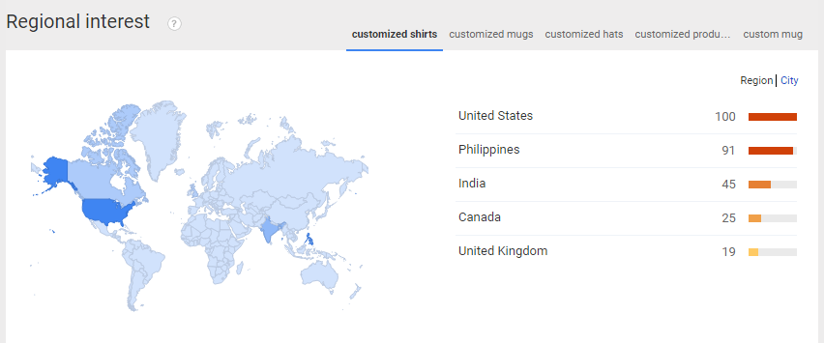

Slide 3
Survey shows that 9 out of 10 people want customized items in Cagayan de Oro

Slide 4
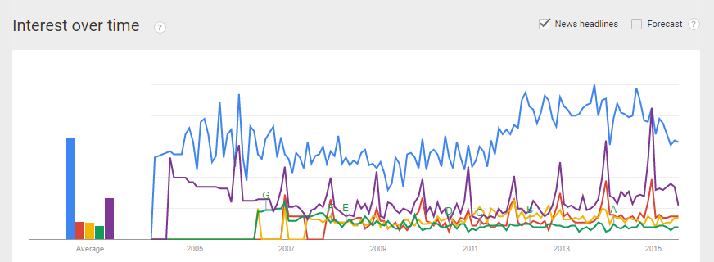

Slide 5
Survey shows that 24 customizing shops are known in Cagayan de Or City and 6 delivers door to door
2 shops

Slide 7
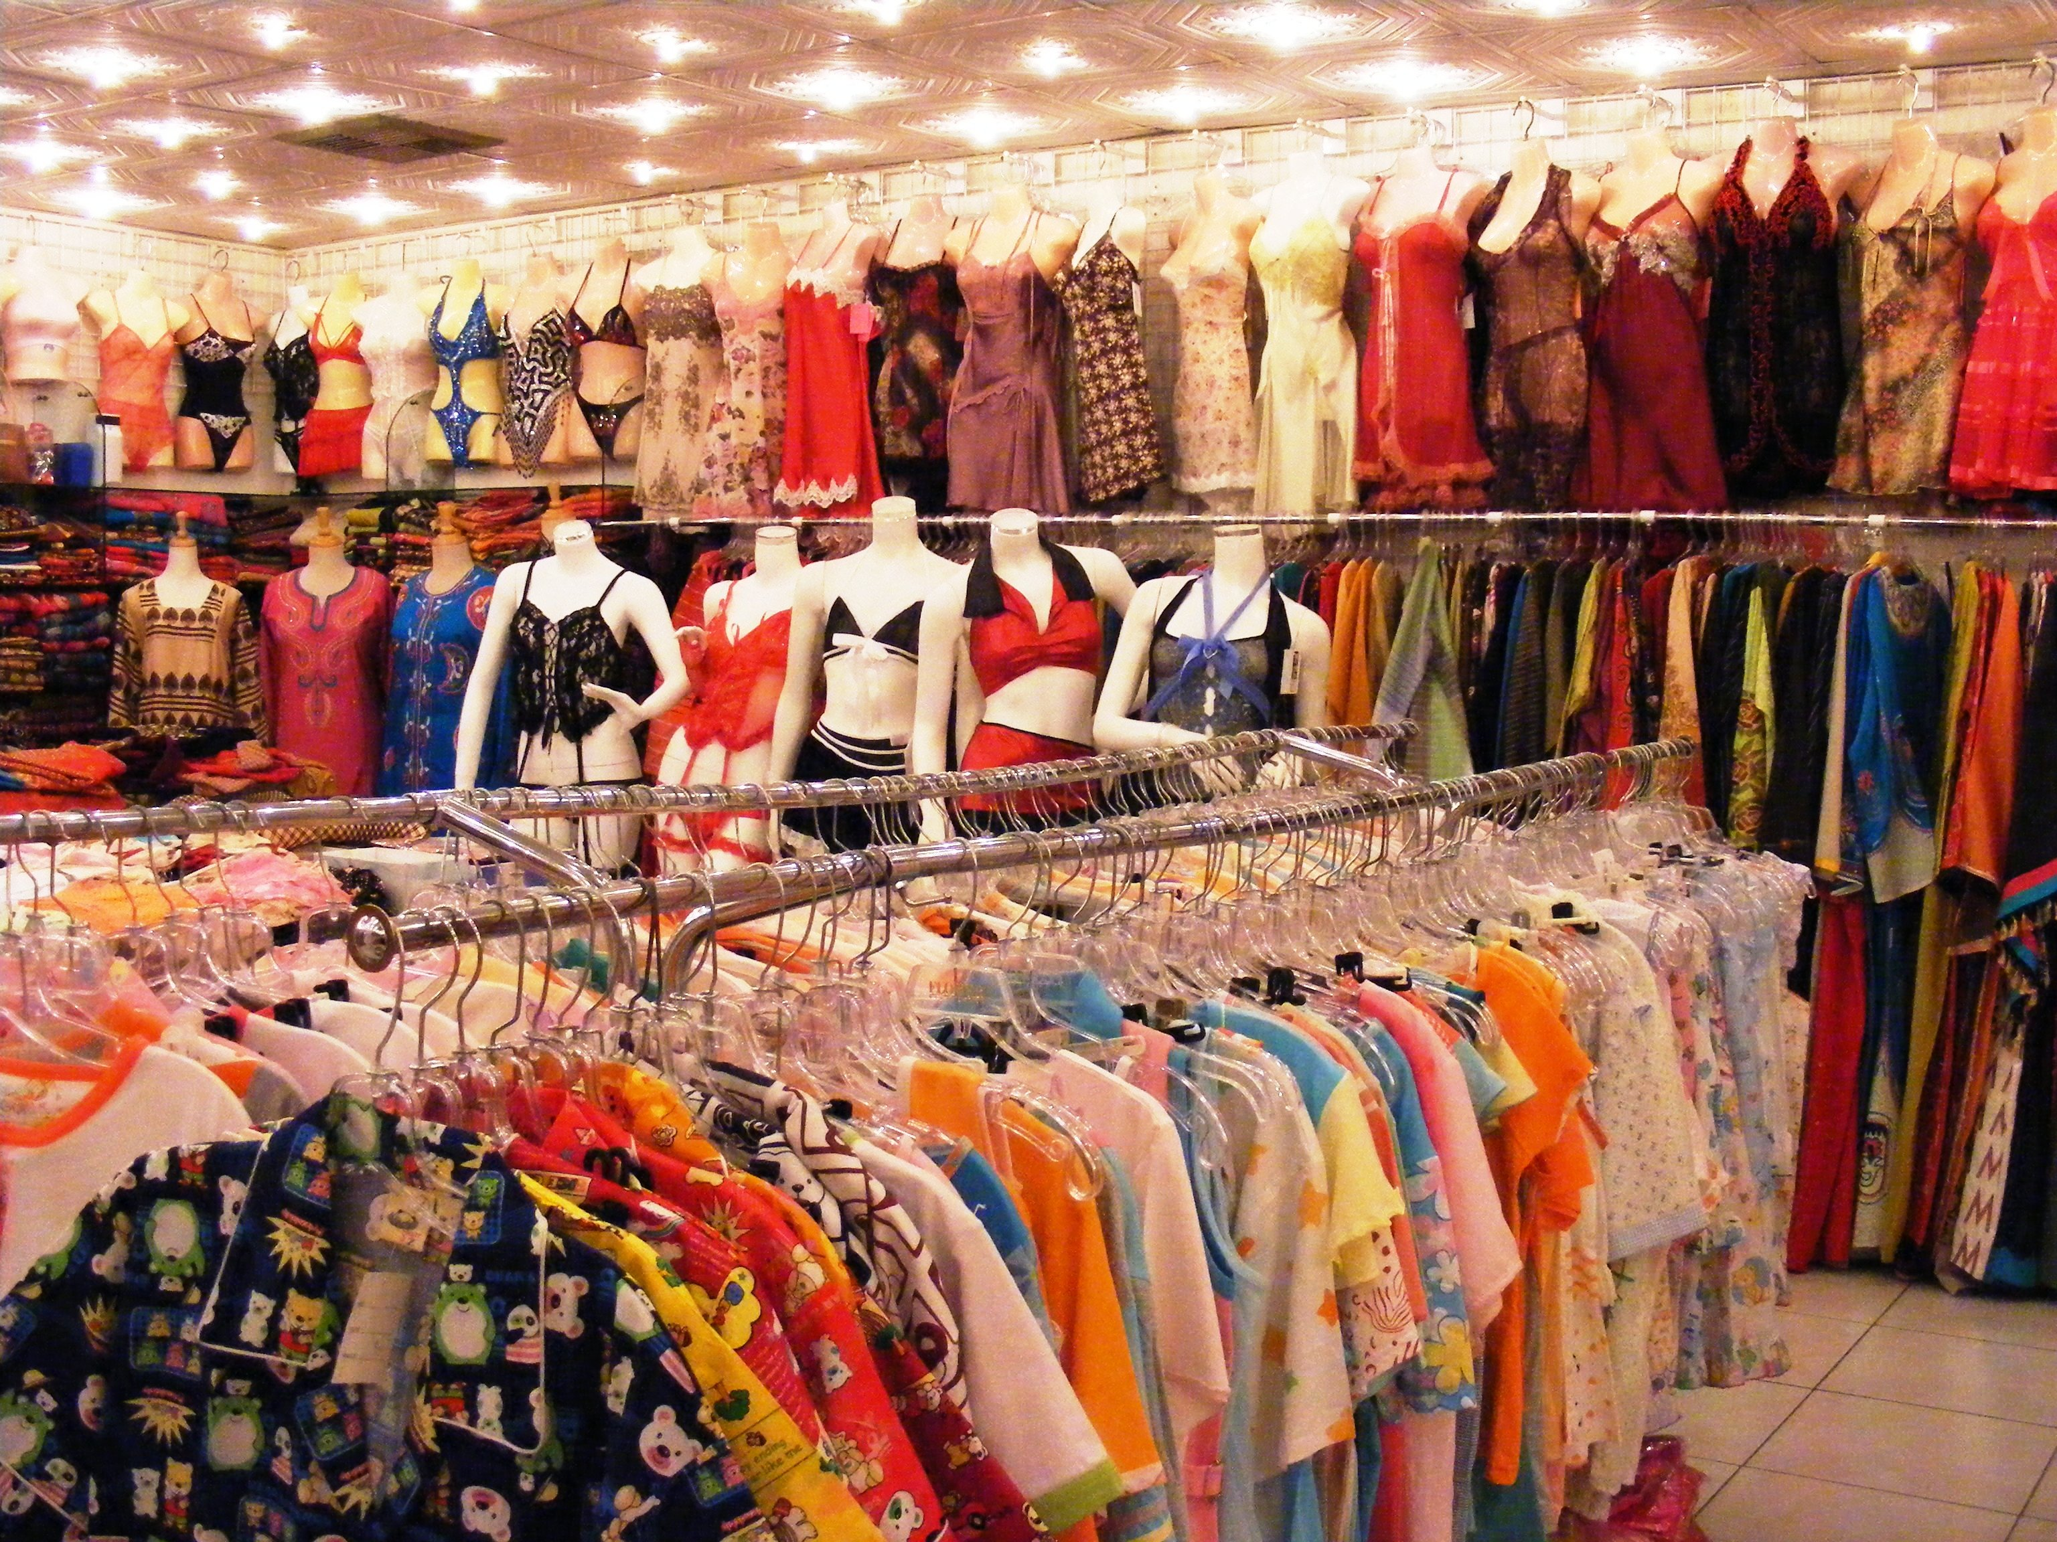
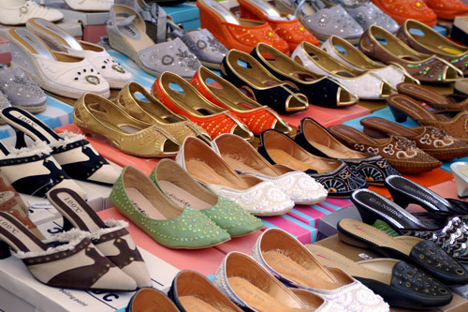
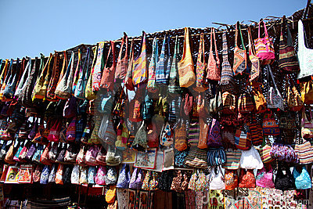
Problems:
Abundance of items for sale which aren’t sold.
Difficulty in finding places where you can customize your own items.
Designers difficulty in setting up their own stalls where customers can locate them.

Slide 8

Customer
Designer

