Slide 1


ML 2024 Project
Master Degree in Computer Science
ML course
Type Project: A
Team name: TripleM
Michela Faella
m.faella1@studenti.unipi.it
Margherita Merialdo
m.merialdo@studenti.unipi.it
Mary Alrayes
m.alrayes@studenti.unipi.it
Academinc Year: 2024/2025
28/01/2025
1

Slide 2

Objectives
The main goal of the project is developing, from scratch, a framework for building a neural network able to solve classification and regression tasks. Then, the framework has been evaluated on “Monk’s problem” and applied on ”ML-CUP” dataset
2

Slide 3

Methods
We developed a multi-layer fully connected feed-forward neural network, employing backpropagation for weight optimization. The learning process leverages mini-batch gradient descent to efficiently minimize the error function and enhance model performance.
REGULARIZATION
L1(Lasso)
L2(Ridge)
ACTIVATION FUNCTIONS
Sigmoid, TanH
ReLU, ELU
MOREOVER
momentum, nesterov momentum, hold-out, k-fold cross validation, early stopping, dropout, learning rate decay, balancing data, grid search
WEIGHT INITIALIZATIONS
Random, Gaussian
Xavier, He
3

Slide 4



Libraries
4

Slide 5
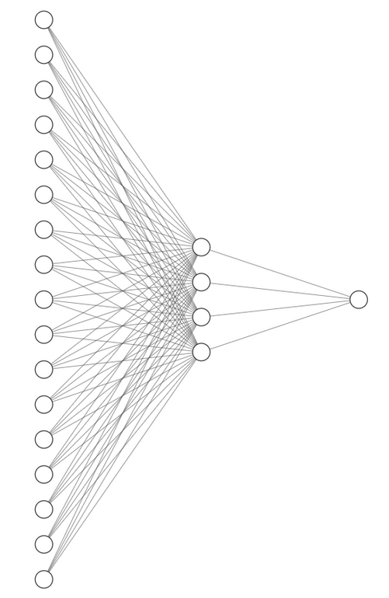
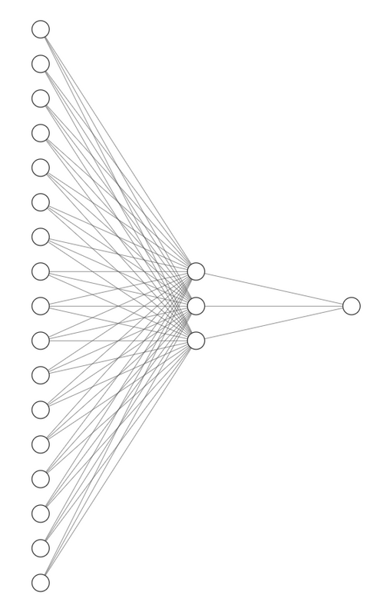
MONK’s Architectures
MONK 1 / MONK 3
MONK 2
The input features of the Monks datasets were transformed using one-hot encoding, resulting in an input layer with 17 units.
For Monk 1 and Monk 3, the hidden layer consists of 4 neurons, whereas for Monk 2, it consists of 3 neurons.
Early stopping, based on validation loss, was applied as the stopping criterion.
5

Slide 6
Model Selection (monk.train)
Fold 1
Fold 2
Fold 3
Fold 4
Fold 5
Model Assement
TR (monk.train)
TS (monk.test)
6

Slide 7
MONK’s Results
Task | #Unit, eta, momentum, lambda(L2), nesterov, eta decay | batch size, activation function, init, epochs | MSE(TR/TS) | Accuracy (TR/TS) (%)
Monk 1 | 4, 0.1, 0.9, 0.0, False, 0.2 | 2, Sigmoid, Gaussian, 200 | 0.0000 / 0.5000 | 100% / 100%
Monk2 | 3, 0.3, 0.85, 0.0, False, 0.01 | 6, Sigmoid, Gaussian, 200 | 0.0000 / 0.4413 | 100% / 100%
Monk 3 | 4, 0.05, 0.85, 0.0, False, 0.8 | 7, Sigmoid, Gaussian, 200 | 0.0573 / 0.5005 | 94% / 96%
Monk 3 (reg.) | 4, 0.05, 0.85, 0.005, False, 0.8 | 8, Sigmoid, Gaussian, 200 | 0.0655 / 0.5000 | 93% / 97%
7

Slide 8
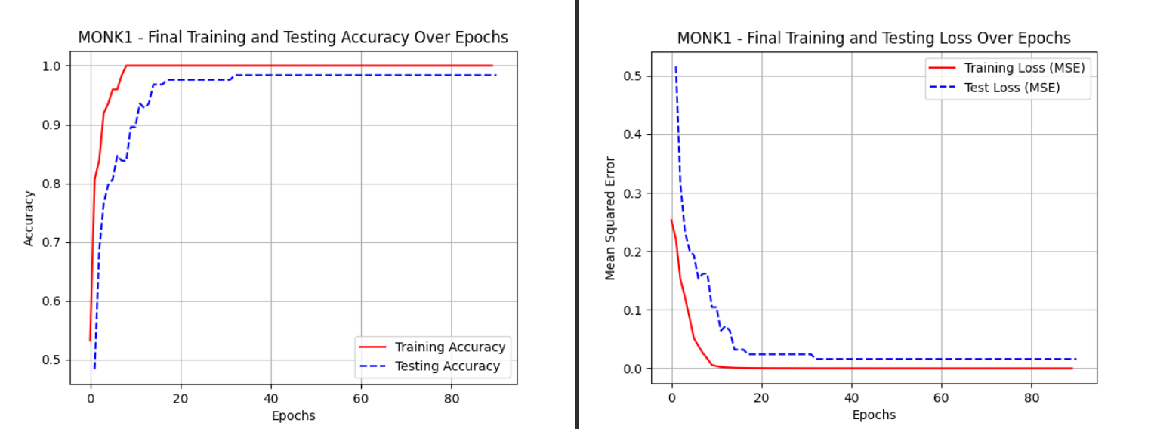
Monk 1
Results
8

Slide 9
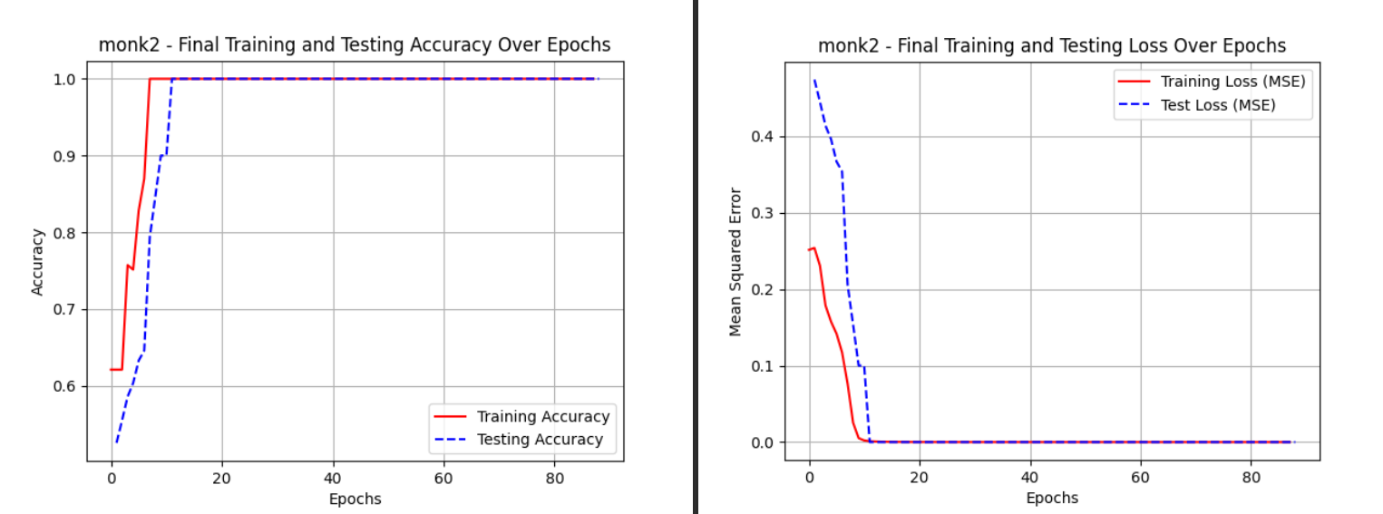
Monk 2
Results
9

Slide 10
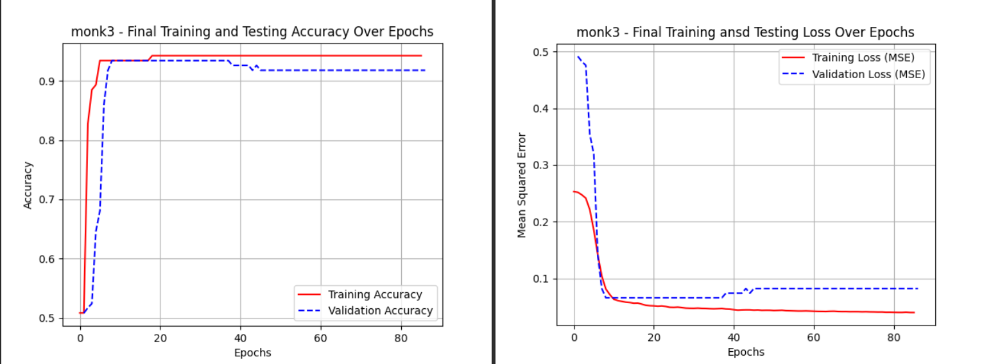
Monk 3
Results
10

Slide 11
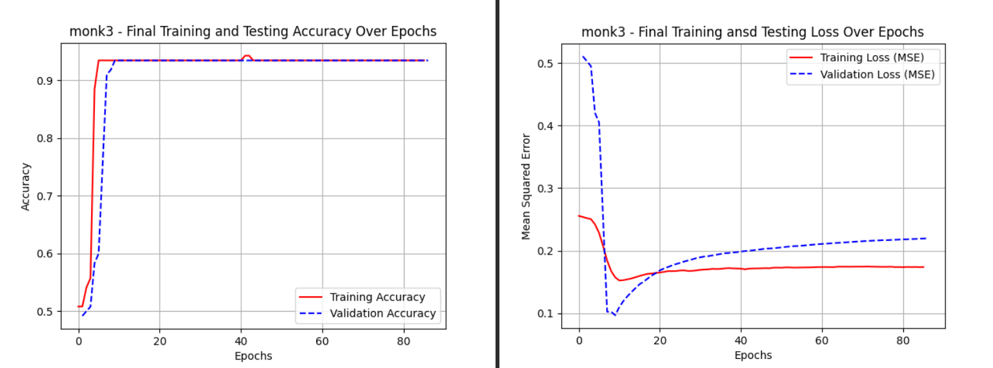
Monk 3(reg)
Results
11

Slide 12
CUP’s Architectures
The input features of the Cup datasets were transformed using normalization techniques, specifically Min-Max scaling and Z-score[1] normalization, resulting in an input layer with 12 units. Among these, Z-score normalization was ultimately selected.
To enhance robustness and reduce the impact of random variations, such as differences in weight initialization, we implemented an ensemble method consisting of 10 models, each trained independently 8 times.
12

Slide 13
MODEL SELECTION (ML-CUP-24-TR)
Fold 1
Fold 2
Fold 3
Fold 4
Fold 5
TR
Model Assement
TR
Assement
80%
20%
Blind Test
TR (ML-CUP-24-TR)
TS(ML-CUP-24-TS)
13

Slide 14
ML Cup approaches
Hyperparameters | Possible Values
layer size | [30,40] [40,50] [50,60]
eta | [0.0005, 0.001, 0.0025]
momentum | [0.8, 0.85, 0.9]
lambda | [0.005, 0.01, 0.05]
Dropout | [0.0, 0.01]
eta decay | [0.0, 0.0001, 0.001]
w_init | He, Xavier
Nesterov | True, False
loss | MEE, MSE
activation function | RELU, ELU
14

Slide 15
Task | #Unit, eta, momentum, lambda(L2), Nesterov, eta decay, Dropout | batch size, activation function, w_init, epoch | MEE(TR/TS) | MSE(TR/TS)
Model 1 | [50, 60], 0.0025, 0.9, 0.005, True, 0.0001, 0.01 | 32, ReLU, Xavier, 200 | 0.743/0.777 | 0.278/0.299
Model 2 | [50, 60], 0.0025, 0.9, 0.005, True, 0.0, 0.01 | 32, ReLU, Xavier, 200 | 0.744/0.764 | 0.278/0.288
Model 3 | [50, 60], 0.0025, 0.9, 0.01, False, 0.0001, 0.01 | 32, ReLU, Xavier, 200 | 0.744/0.757 | 0.277/0.281
Model 4 | [50, 60], 0.0025, 0.9, 0.005, True, 0.001, 0.01 | 32, ReLU, Xavier, 200 | 0.744/0.766 | 0.278/0.290
Model 5 | [50, 60], 0.0025, 0.9, 0.01, False, 0.0, 0.01 | 32, ReLU, Xavier, 200 | 0.743/0.758 | 0.277/0.282
Model 6 | [50, 60], 0.0025, 0.9, 0.01, False, 0.001, 0.01 | 32, ReLU, Xavier, 200 | 0.744/0.758 | 0.278/0.283
Model 7 | [50, 60], 0.0025, 0.9, 0.005, False, 0.0001, 0.01 | 32, ReLU, Xavier, 200 | 0.705/0.722 | 0.255/0.269
Model 8 | [50, 60], 0.0025, 0.9, 0.005, False, 0.001, 0.01 | 32, ReLU, Xavier, 200 | 0.706/0.723 | 0.256/0.269
Model 9 | [50, 60], 0.0025, 0.9, 0.005, False, 0.0, 0.01 | 32, ReLU, Xavier, 200 | 0.705/0.723 | 0.255/0.269
Model 10 | [50, 60], 0.0025, 0.85, 0.005, False, 0.0001, 0.01 | 32, ReLU, Xavier, 200 | 0.720/0.730 | 0.265/0.278
CUP’s Results
15

Slide 16
CUP’s Final Results
Task | MEE(TR/VL/TS) | MSE(TR/VL/TS) | LOSS VAR (TR/TS)
Ensemble | 0.745/0.882/0.745 | 0.268/0.413/0.278 | 0.00008/0.0001
16

Slide 17
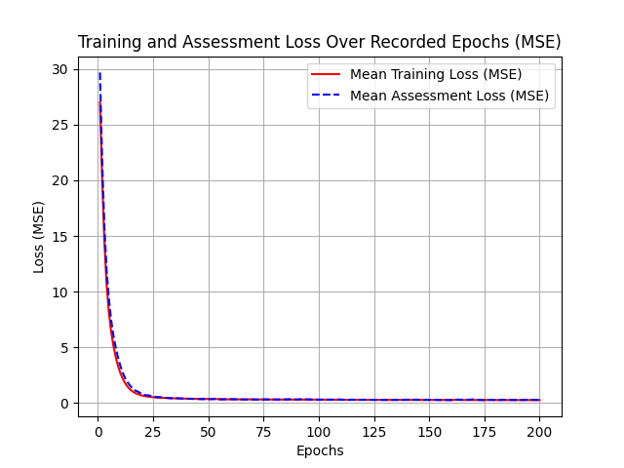
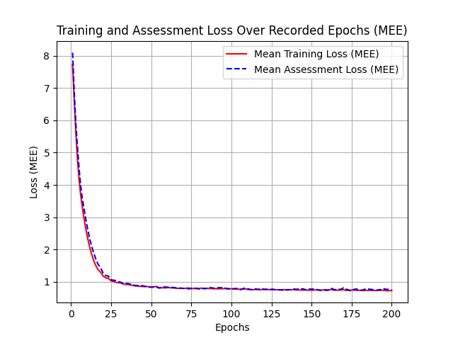
CUP
Results
17

Slide 18
Discussion
We systematically evaluated different weight initialization techniques to determine which worked best with our model. The methods we tested included: Xavier Initialization[2], He Initialization[2].
Regularization techniques, including L1, L2, and dropout, were explored, with L2 regularization being the final choice, while dropout was utilized in some models of the ensemble. Additionally, early stopping based on validation loss was employed to prevent overfitting.
We also leveraged the Nesterov accelerated gradient, which provided significant advantages in terms of convergence speed and stability. Furthermore, with the use of mini-batch gradient descent, we implemented an eta decay strategy to adapt the learning rate dynamically during training, further enhancing optimization performance.
18

Slide 19
Conclusion
Through this project, we had the opportunity to implement and deepen our understanding of the concepts studied during the course. Building a Neural Network framework from scratch allowed us to grasp the significance of both model selection and evaluation. We now fully appreciate the crucial role of selecting the optimal hyperparameters, as they can significantly impact the overall performance of the model.
19

Slide 20
References
[1] Jiawei Han, Micheline Kamber e Jian Pei. Data Mining: Concepts and Techniques (Third Edition): Chapter 3
[2] Kumar, S. K. (2017). On weight initialization in deep neural networks. arXiv preprint arXiv:1704.08863.
20

Slide 21
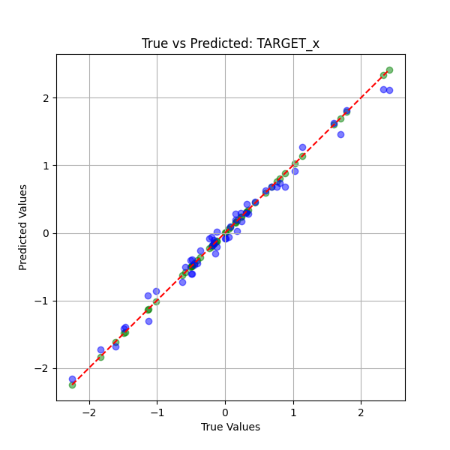
Appendix
Figure: Comparison of True Values (green points) and Predicted Values (blue points) for Target X Variable to Evaluate Model Performance
21

Slide 22
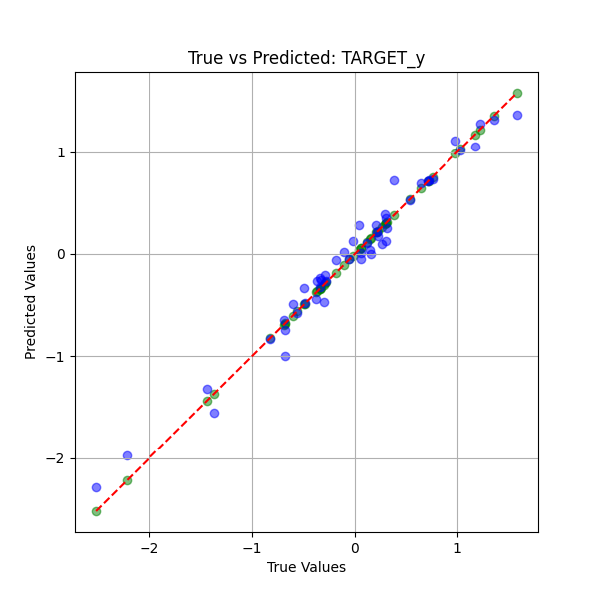
Figure: Comparison of True Values (green points) and Predicted Values (blue points) for Target Y Variable to Evaluate Model Performance
22

Slide 23
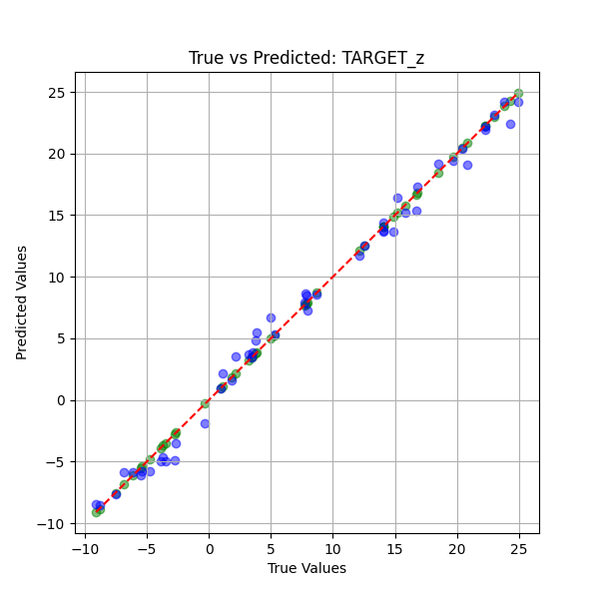
Figure: Comparison of True Values (green points) and Predicted Values (blue points) for Target Z Variable to Evaluate Model Performance
23

