Slide 1

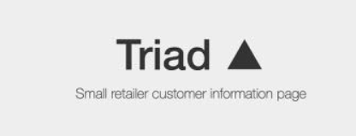

Slide 2
Overview
Introduction
Dataset Description
Exploratory Data Analysis
Methodology

Slide 3
Introduction
Traid helps small retailers in understanding their customer needs using a machine learning model.
The application facilitates for a business-to-customer sales within a budget.

Slide 4

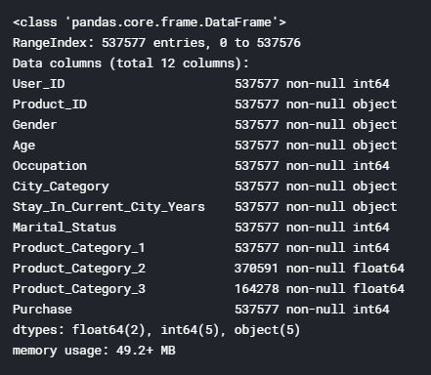
Dataset Description:
The dataset is obtained from Kaggle.
The data comprises of customer information of his/her interest of
Each column consists of customer related data filled by th

