Slide 1
ENHANCED PIPELINE 4x4 MULTIPLIER A Modified Hierarchical Design Approach
Prepared By:
Nirmeen Al-Sheikh 1200200
Leena Affouri 1200335
Mariam Hamad 1200837

Slide 2
Abstract
This project focuses on the development of a very efficient 4x4-bit folded pipeline multiplier. Using a modified hierarchical design method, this multiplier delivers exceptional processing performance while drastically decreasing power consumption, hardware resources, and necessary size. It performs well in practical testing using an FPGA implementation, costing only 0.2 mW, saving over 20% of the space, and exhibiting a low latency of 3 ns from input to output utilizing a 22 nm process library.

Slide 3
4x4 Enhanced Pipeline Multiplier Project Highlights
The project successfully achieved its primary goal of designing and implementing a 4x4 Enhanced Pipeline Multiplier. Additionally, we emphasized optimization, conducted a comparative analysis.
Our design includes the following key components:
Functional 4x4 Multiplier: The project's primary achievement is the successful design and implementation of a functional 4x4 Enhanced Pipeline Multiplier.
Component Designs: We meticulously designed several essential components to ensure precise and efficient operation.
Optimization: Our project focused on optimizing the design for efficiency, taking into account factors such as area, power consumption, and speed.

Slide 4
Comparative Analysis: We conducted a comparative analysis of flip-flop designs and MUX implementations to make informed design choices.
Area, Power, and Delay Calculations: We performed calculations to assess the physical space required for each component of the system, as well as its power consumption and delay characteristics. These calculations contributed to efficient resource utilization.

Slide 5
Design History & Comparison of Literature
From Sluggish Giants to Efficient Champions

Slide 6
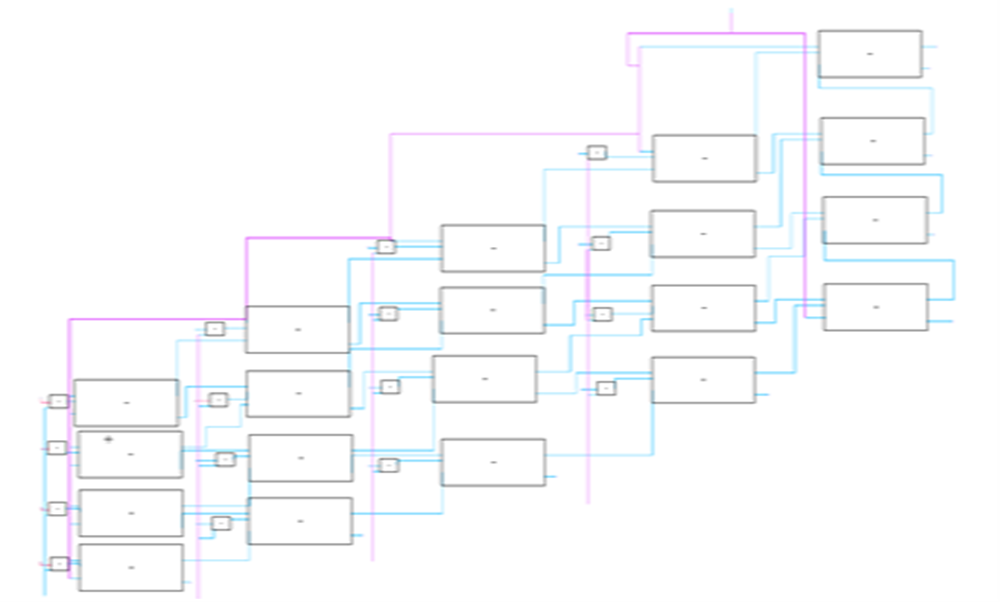
Proposed Design Block Diagram

Slide 7
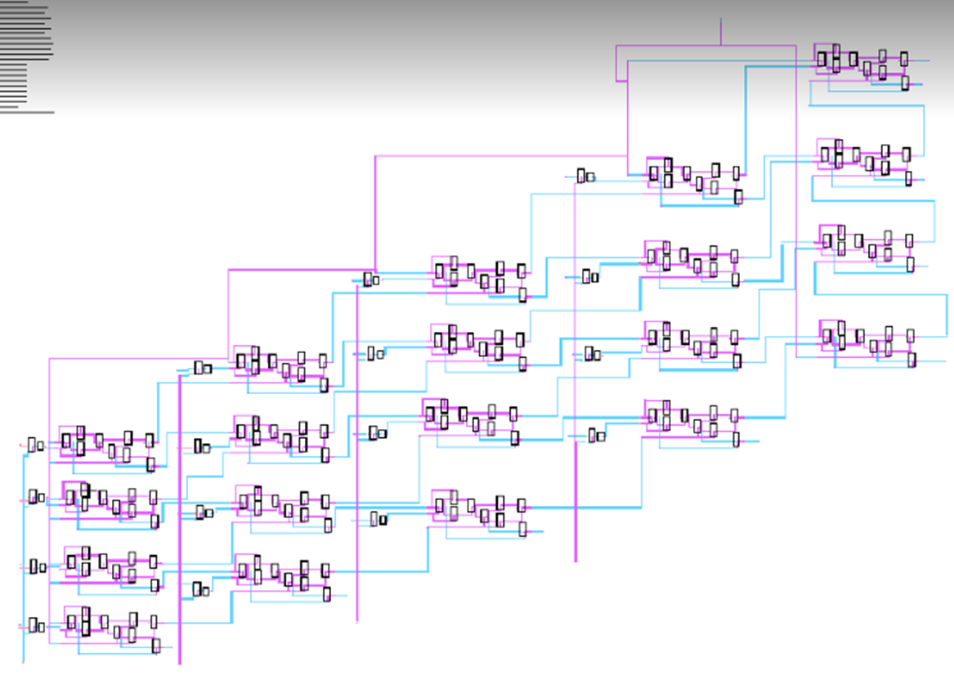
Design Schematic

Slide 8
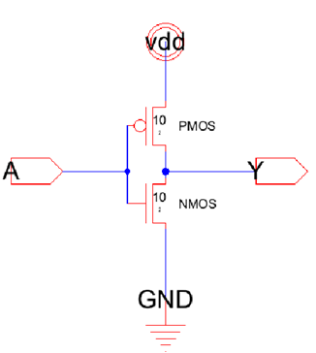
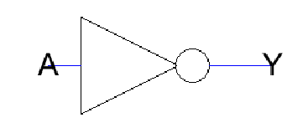
Invertor Gate
Design circuit, layout, simulations and sizing
Invertor Symbol
Invertor Schema

Slide 9
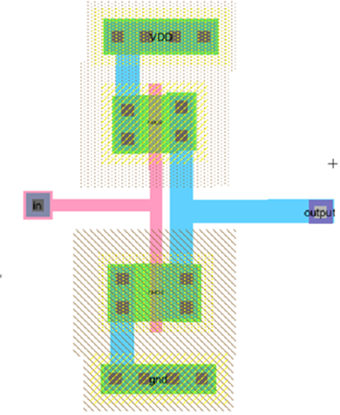
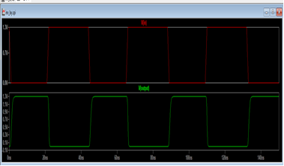
Invertor layout
Invertor waveform

Slide 10
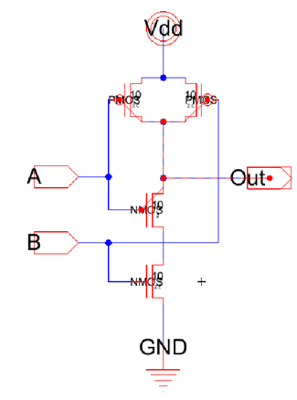

NAND Gate
NAND Schema
NAND Symbol

Slide 11
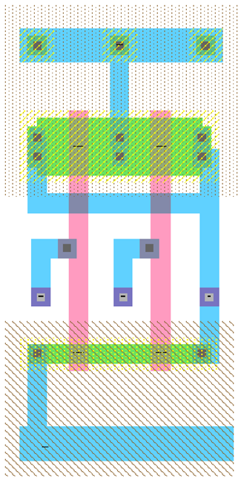
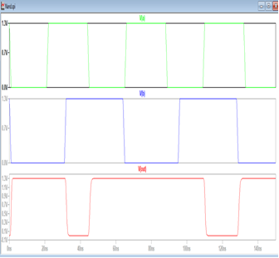
NAND layout
NAND waveform

Slide 12
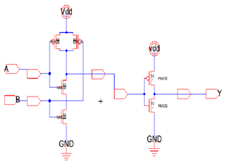
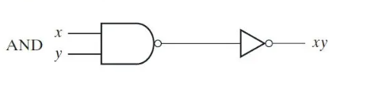
AND Gate
AND Schema
AND Symbol

Slide 13
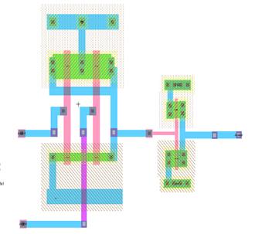
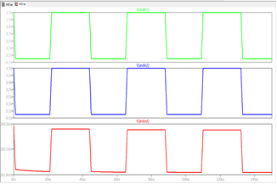
AND layout
AND waveform

Slide 14
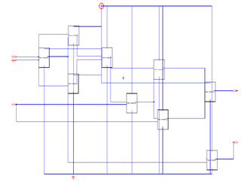
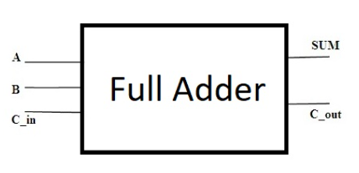
FULL ADDER
FULL ADDER Schema
FULL ADDER Symbol

Slide 15
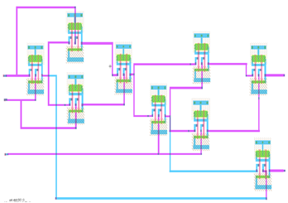
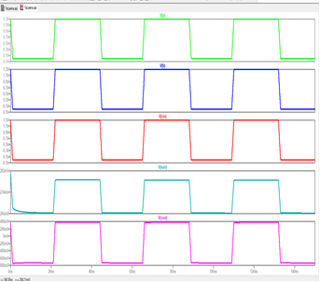
FULL ADDER layout
FULL ADDER waveform

Slide 16
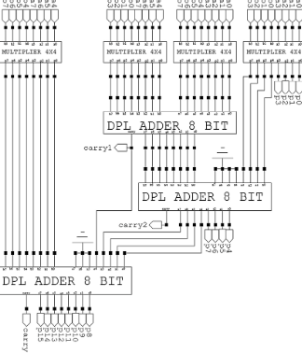
1- Parallel Processing:
Circuit Optimization
By Splitting the 8x8 multiplication into smaller parts and calculate them in parallel for faster and more efficient processing.

Slide 17
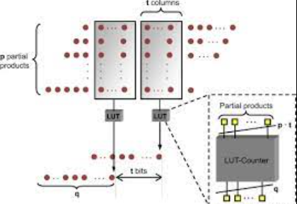
2- Optimize Partial Product Reduction:
Improving efficiency using techniques like carry-save adders or Wallace tree multipliers, reducing resource usage while maintaining speed.

Slide 18
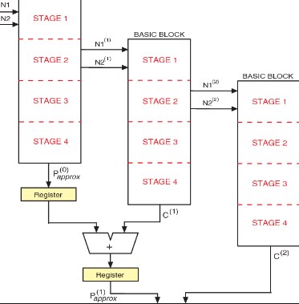
3- Pipelining:
By dividing the multiplication into stages to keep bits flowing smoothly, enhancing throughput, and minimizing delays.

Slide 19
Power Analysis of the System
Full Adder Power Consumption:
Each full adder, composed of 9 NAND gates, exhibits a power consumption of approximately 16.38 pW, considering the low supply voltage and current characteristics.
AND Gate Power Consumption:
The 16 AND gates within the system have a slightly higher power consumption, approximately 312 pW per gate, owing to the inherent characteristics of their logic functions.
Total System Power Consumption:
The total power consumption for the entire system, considering all full adders and AND gates, amounts to approximately 5319.6 pW (Pico watts). This level of power consumption is exceptionally low, highlighting the system's energy-efficient design.

Slide 20
Area Analysis of the System
We've examined the space our digital system occupies. Here's the breakdown:
Full Adders: 20 of them use 3,600 um².
Inverters: We've got 16, taking up 320 um².
NAND Gates: Another 16, using 320 um².
Overall, our system covers 4,240 um².

Slide 21
Delay and Critical Path - Summary
In our quest for optimized performance, we've closely examined delays and critical paths. Our maximum delay is 8.2ns, ensuring signals stabilize efficiently. Remarkably, we maintain stability with a 19ns propagation delay.
Our pipeline architecture, breaking down operations, minimizes critical path delays. This enhances overall system speed and efficiency.

