Slide 1
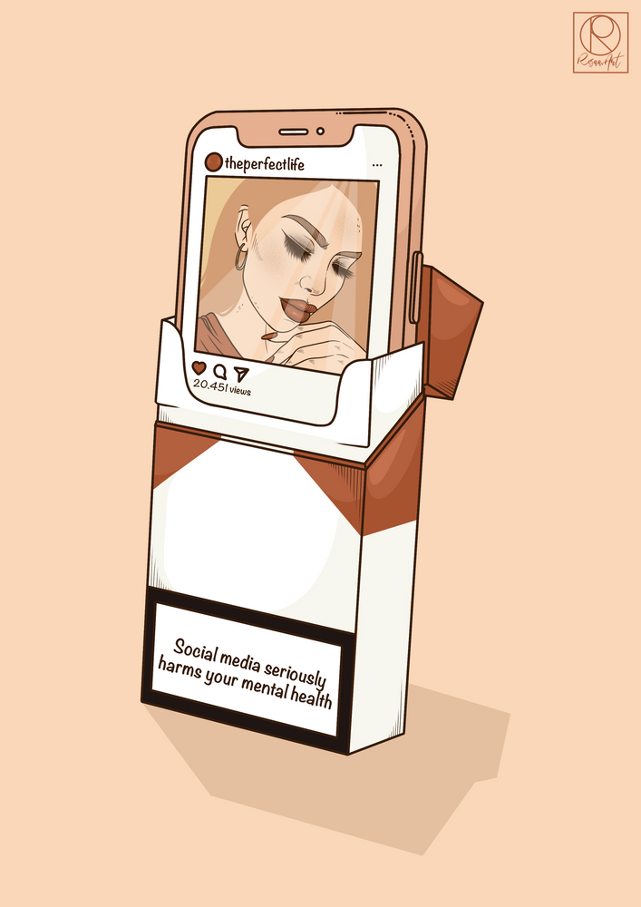
Does Instagram impact negatively on the mental health of teenagers and young adults?
Bhavya, Gargi and Maryam
Research Writing
Mentored by: Amrita Ma’am
Notes:
Line spacing + Page numbers

Slide 2

Abstract
This research is conducted to examine the addiction of social media, especially Instagram and the impact of Instagram on the mental health of teenagers and young adults.
We have worked on primary data acquired through a questionnaire consisting questions regarding mental health- self-esteem, loneliness and Instagram addiction.
We’ve used a sample of 20 individuals of the age group 16-21.
We plan to test the association of Instagram usage to self-esteem and loneliness and investigate if it affects the two negatively.
It is hypothesized that Instagram has a negative impact on self esteem and loneliness.

Slide 3
Content
01 Introduction
02 Literature Review
03 Methodology
04 Analysis
05 Conclusion
07 Team
06 Bibliography

Slide 4
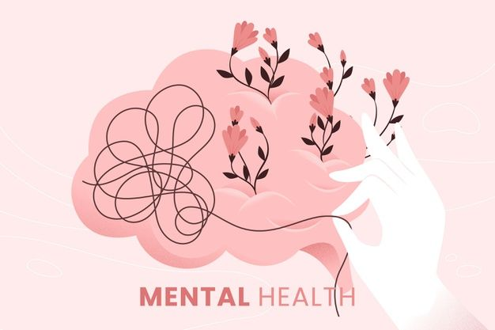
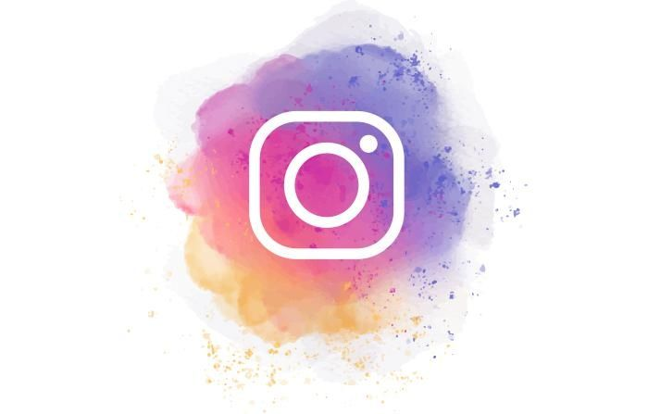
Introduction
01
In the light of rapid proliferation of social media apps, Instagram is the new Facebook for teenagers and young adults.
Loneliness may be defined as "a state that reflects an individual's own perception of deficiencies in his or her network of social associations."
Self-esteem clears as feelings of self-worth and self-respect
As much as it is a source of communication, sharing memories and socializing; with the easy access to internet, it has become more and more addictive; to the extent that it has social, physical and mental impact on the users’ lives.

Slide 5
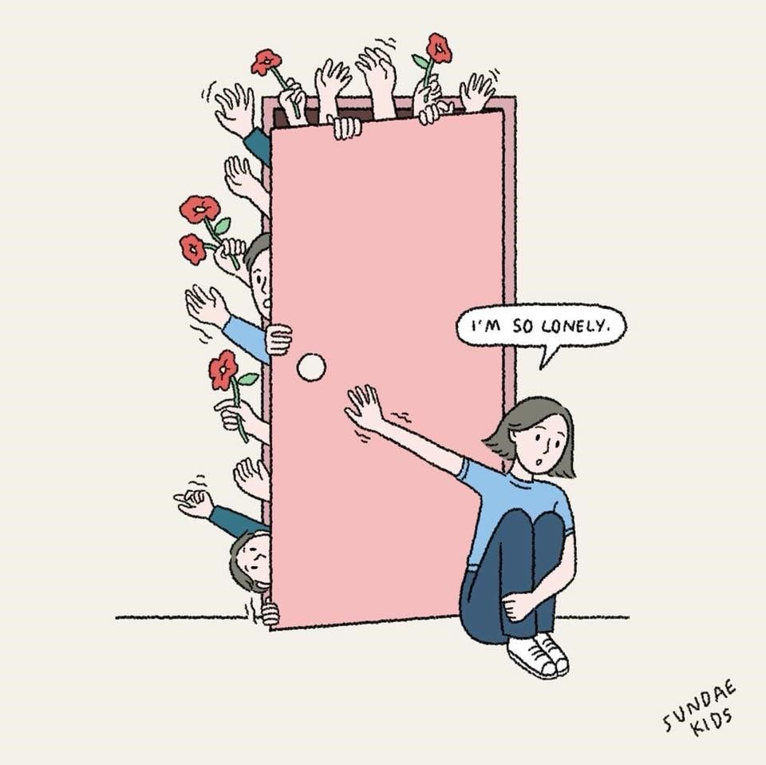
Literature Review
02
With the rapid growth and development in the field of Information Technology and an easy access to the internet, individuals tend to be more and more dependent on social media, especially Instagram when it comes to young adults. A variety of studies have found correlations between increased use of social media and a bunch of mental health issues.
Loneliness is defined as “A social situation experienced by the individual as one where there is an unpleasant or inadmissible lack of certain relationships. Loneliness is a distressing, painful experience that humans want to avoid.
Self-esteem clears as feelings of self-worth and self-respect.
A study conducted by Hou,Y., Xiong, D., Jiang, T., Song, L., & Wang, Q. in 2019 was to investigate the Social media addiction: Its impact, mediation, and intervention. The results proved that higher usage of social media impacts negatively on the mental health of the users and further tested the effectiveness of intervention by creating two groups, control and experimental.
This study will narrow it down to one application, i.e., Instagram and investigate its impact on the self esteem and loneliness in teenagers and young adults.

Slide 6
Methodology
03
I
II
III
01
02
03
04
05
Questionnaire
16 questions.
Age group:16-21.
Self-esteem, Loneliness and Instagram addiction
Excel and SPSS
Correlation found.
Findings
End analysis.
Response Analysis
Self-esteem and loneliness scales scored.
Instagram addiction analyzed.
Negative/Positive Impact
Once associated- impact found.

Slide 7
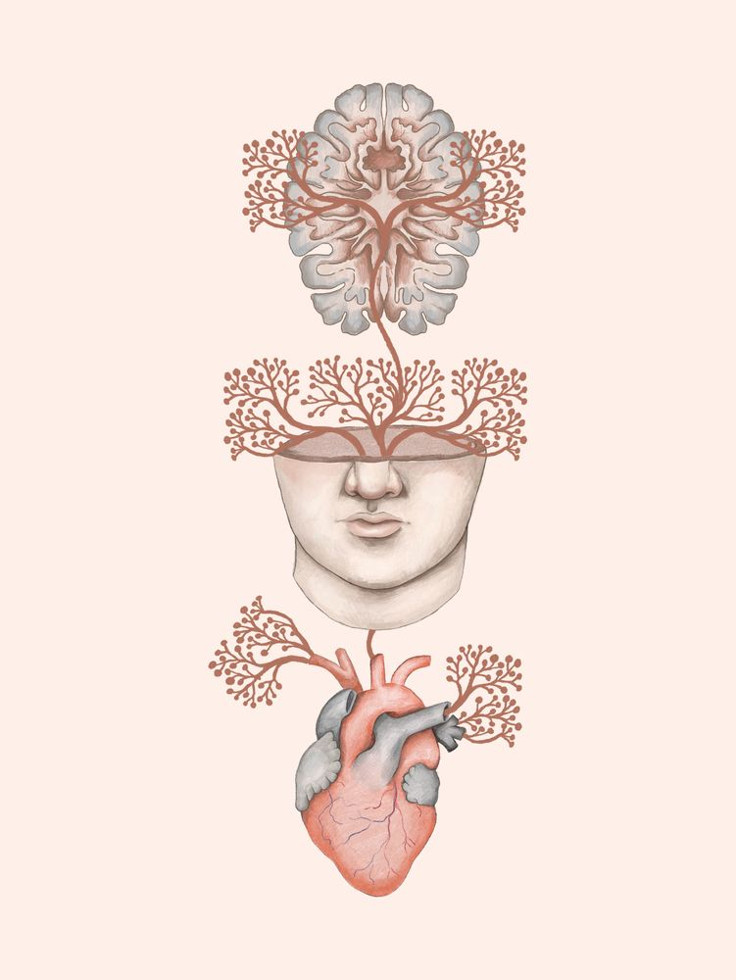
Analysis
04
Null Hypothesis: Instagram does not have a negative impact on the mental health of teenagers and young adults.
Alternate Hypothesis: Instagram has a negative impact on the mental health of teenagers and young adults.
Self-esteem and loneliness scale was scored
The social media addiction level was measured.
The P-Value was evaluated with the help of excel which helped in rejecting the Null Hypothesis.
Correlation was found between social media and Self-esteem/ loneliness via excel and SPSS.

Slide 8
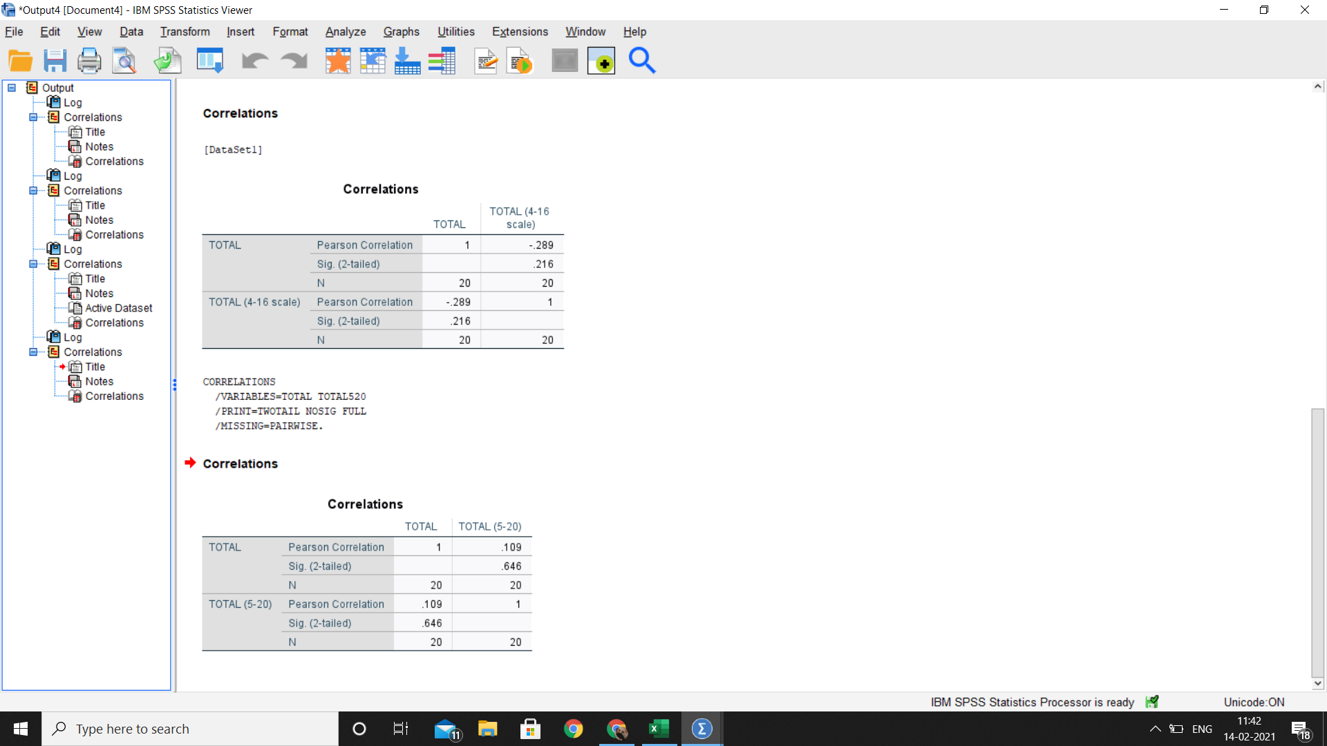
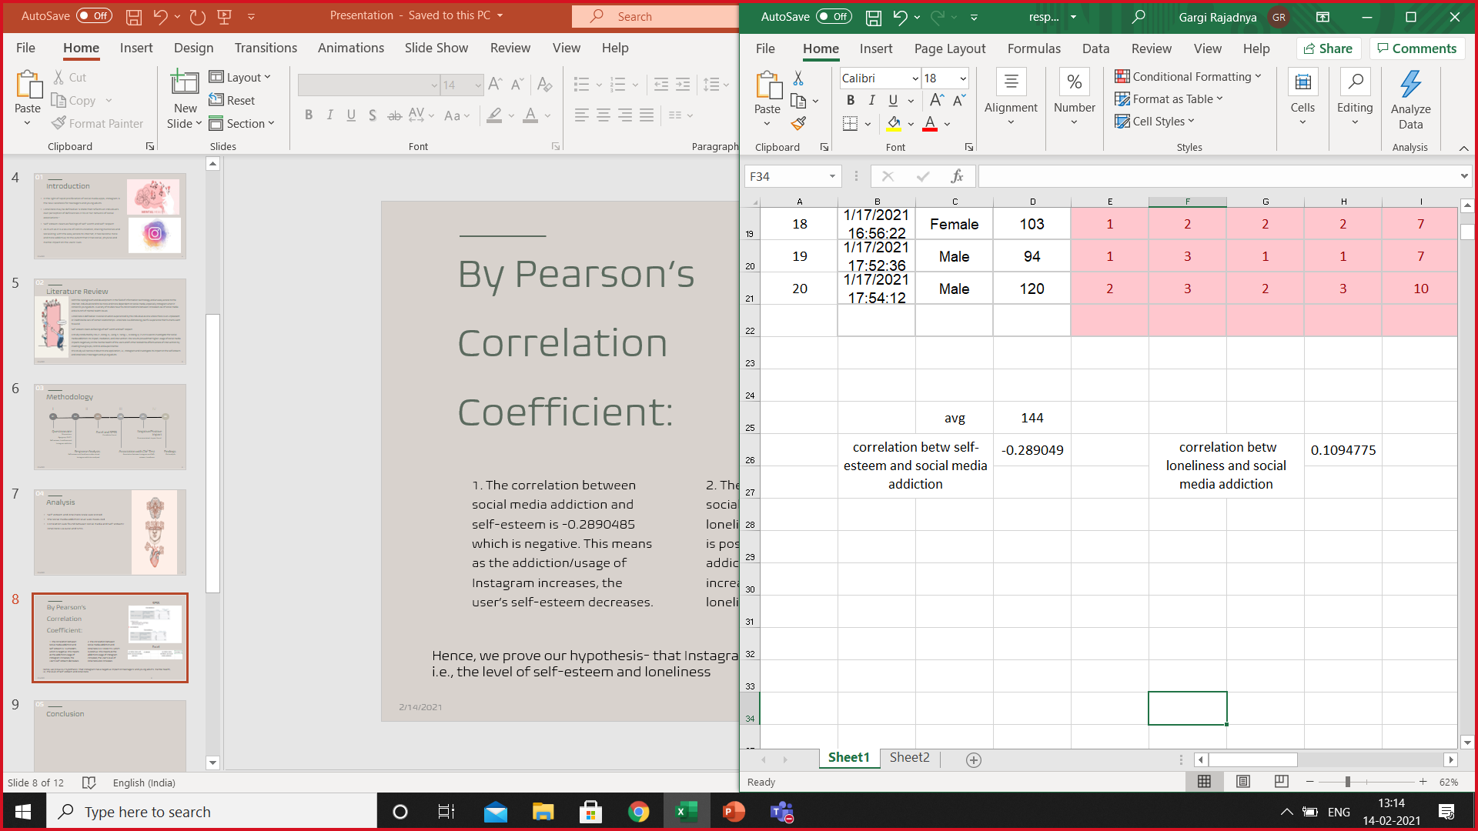
By Pearson’s Correlation Coefficient:
05
SPSS
1. The correlation between social media addiction and self-esteem is -0.2890485 which is negative. This means as the addiction/usage of Instagram increases, the user’s self-esteem decreases.
2. The correlation between social media addiction and loneliness is 0.10947755 which is positive. This means as the addiction/usage of Instagram increases, the user’s level of loneliness also increases.
Excel

Slide 9
Conclusion
06
Since, the correlation between social media addiction and self-esteem is -0.2890485 which is negative, it can be concluded that as addiction/usage of Instagram increases, the user’s self-esteem decreases and;
The correlation between social media addiction and loneliness is 0.10947755 which is positive, meaning as the addiction/usage of Instagram increases, the user’s level of loneliness also increases.
Hence, we reject the null hypothesis- that Instagram doesn’t have a negative impact on teenagers’ and young adult’s mental health, i.e., the level of self-esteem and loneliness.
Although, there can be many reasons for increased levels of loneliness and decreased levels of self-esteem, we can also infer that Instagram does have an effect on mental health of teenagers and young adults.

Slide 10
Bibliography
07
http://www.integrativehealthpartners.org/downloads/ACTmeasures.pdf#page=61
https://docs.google.com/document/d/12s39QphZCqI2fNi10Fn75cl3F_Hr7o2-yk-cU4C_LTc/edit
https://osf.io/jcwb9/download
https://www.researchgate.net/publication/271880765_
https://cyberpsychology.eu/article/view/11562/10369
https://uxdesign.cc/the-psychology-of-why-social-media-is-so-addictive-67830266657d

Slide 11
References
08
Przybylski, A. K., Murayama, K., DeHaan, C. R., & Gladwell, V. (2013). Motivational, emotional, and behavioural correlates of fear of missing out. Computers in Human Behaviour, 29, 1814-1848.
Social Media and Loneliness - Forever connected? Roman Yavich2, Nitza Davidovitch1 & Zeev Frenkel2
Instagram and its Relationship Between Self-Esteem and Depression Amongst Young Adults. Cheyanne, El Khouly.
Yang, C. (2016). Instagram Use, Loneliness, and Social Comparison Orientation: Interact and Browse on Social media, But Do not Compare. Cyber psychology & Behaviour. 703 – 708
Greenwood, S. Perrin, A & Duggan, M (November., 2016). Social Media Update. Facebook Usage and Engagement is on The Rise, While Adoption of Other Platforms Hold Steady.
Bhat, S. A. (2017). Social Networking Sites and Mental health: a review. International Journal of Advanced Educational Research 2 (5), 357-360.
The Social media addiction: Its impact, mediation, and intervention. Hou, Y., Xiong, D., Jiang, T., Song, L., & Wang, Q. in 2019
Cramer, S. (2017). Instagram ranked worst for young people’s mental health. RSPH
Barker V. Older adolescents' motivations for social network site use: the influence of gender, group identity, and collective self-esteem. Cyberpsychol Behav. 2009 Apr;12(2):209-13. doi: 10.1089/cpb.2008.0228. PMID: 19250021.

Slide 12
Summary
09
Collection of Data: Primary data collected | Type of Data: Quantitative data
Method of data collection: Questionnaire | Research Design: Correlational Design- cross-sectional design/ survey design
Analysis: SPPS, EXCEL- CORRELATION | CONCLUSION: We reject the null hypothesis- that Instagram doesn’t have a negative impact on teenagers’ and young adult’s mental health, i.e., the level of self-esteem and loneliness

Slide 13
ACKNOWLEDGEMENT
10
This paper and the research behind it would not have been possible without the guidance and constant support of our Research Writing professor, Amrita Banerjee. Her enthusiasm and knowledge kept our work on track.
We would like to thank NMIMS deemed to be university for this opportunity and for providing us with almost all the necessary resources that were essential for carrying out this research.
Also, we’re much obliged for the contributions of our respondents who took out the time to fill our survey so that we could get primary data and helped us get the responses that were generated.
Finally, we would like to express our gratitude to the various sources from which we extracted the data for this project, without which none of this would truly be possible.

Slide 14
Team
11
Bhavya
75252019027
Gargi
75252019019
Maryam
75252019003

Slide 15
Thank You
12

