Slide 1
Image classification
Presented by : Maryam Sharafi
Instructed by Dr.Bahrani

Slide 2
TABLE OF CONTENTS
01
02
03
04
05
06
Problem defenition
models
datasets
Training results
comparison
conclusion

Slide 3
01
Problem defenition

Slide 4
Problem defenition
Binary classification
Comparing models (CNN from scratch vs fine tuned vgg16)
Using different datasets and comparing them to find the best results

Slide 5
02
models

Slide 6
Custom-built CNN model layers
6 convolutional layers
3 max pooling layers
First two convolutional layers 32 filters
1
second two convolutional layers 64 filters
third two convolutional layers 128 filters

Slide 7
Segmentation Network
32, Conv3x3
32, Conv3x3
64, Conv3x3
64, Conv3x3
128, Conv3x3
128, Conv3x3
Dense 128
Max-pool2x2
Drop out 0.2
Drop out 0.5
Max-pool2x2
Drop out 0.3
Max-pool2x2
Drop out 0.4

Slide 8
Fine tuned vgg16 model layers
Random flip and rotation after input layer
13 convolutional layers
5 max pooling layers
2
Global avg pooling 2d
Using vgg16 functional

Slide 9
Segmentation Network
64, Conv3x3
64, Conv3x3
128, Conv3x3
128, Conv3x3
256, Conv3x3
256, Conv3x3
256, Conv3x3
512, Conv3x3
512, Conv3x3
512, Conv3x3
512, Conv3x3
512, Conv3x3
512, Conv3x3
Global avg pooling 2d
Dense (256)
Dropout 0.5
Dense 1
Max-pool2x2
Max-pool2x2
Max-pool2x2
Max-pool2x2
Max-pool2x2

Slide 10
03
datasets

Slide 11
datasets
cifar10
Combined dataset
The CIFAR-10 dataset consists of 60000 32x32 color images in 10 classes, with 6000 images per class. There are 50000 training images and 10000 test images.
.
Combined dataset consists of cats and dogs images from
Cifar10 dataset
+
kaggle cats and dogs images.

Slide 12
cifar10
32X32
64X64
In this project, the cats and dogs images from cifar10 dataset are used for binary classification.
test images are spited into validation and test datasets
Well we have
10000 training 32*32 images,
500 validation 32*32 images,
500 test 32*32 images
In this project, the cats and dogs images from cifar10 dataset are used for binary classification.
test images are spited into validation and test datasets
Well we have
10000 training 64*64 images,
500 validation 64*64 images,
500 test 64*64 images

Slide 13
Combined dataset
32X32
At first images had different sizes but after preprocessing all images are 32*32. the dataset is about three times larger than cifar10 dataset.
Well we have
25495 training 32*32 images,
4498 validation 32*32 images,
6998 test 32*32 images

Slide 14
04
Training results

Slide 15
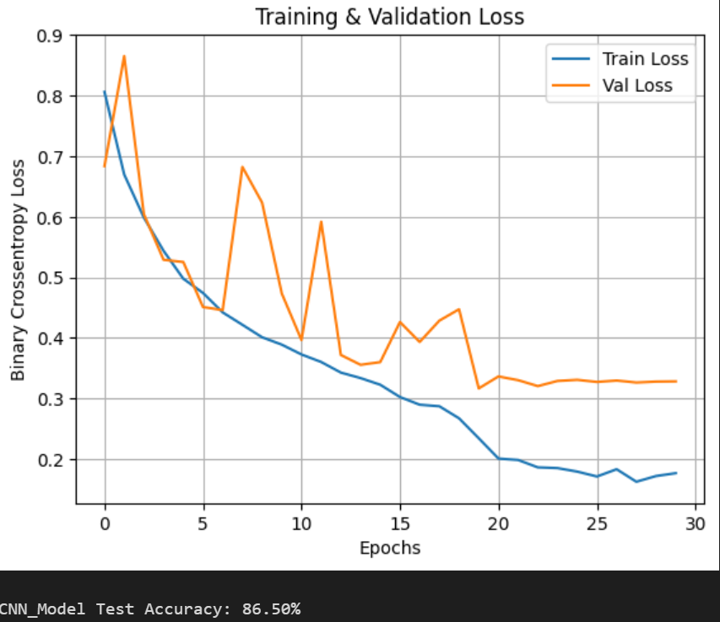
Cifar10(32*32) + custom-built model

Slide 16
Cifar10(32*32) + custom-built model
Confusion matrix
48 | 452
413 | 87

Slide 17
Cifar10(32*32) + custom-built model
Classification report
support | F1-score | recall | precision
500 | 0.87 | 0.90 | 0.84 | 0
500 | 0.86 | 0.83 | 0.90 | 1
1000 | 0.86 |  |  | accuracy
1000 | 0.86 | 0.86 | 0.87 | Macro avg
1000 | 0.86 | 0.86 | 0.87 | weighted avg

Slide 18
0.9376
0.1625
0.3167
0.8780
Best train accuracy
Best validation accuracy
Best train loss
Best validatioln loss

Slide 19
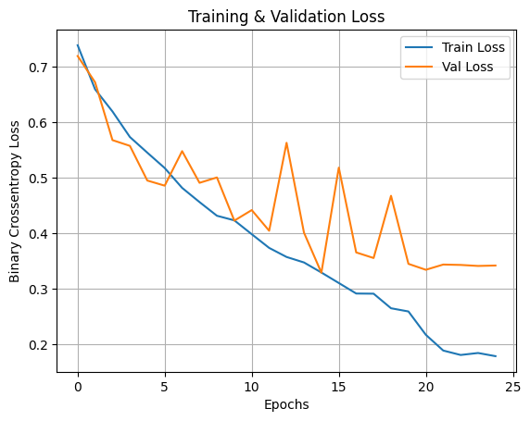
Cifar10(64*64) + custom-built model

Slide 20
Cifar10(64*64) + custom-built model
Confusion matrix
86 | 414
416 | 84

Slide 21
Cifar10(64*64) + custom-built model
Classification report
support | F1-score | recall | precision
500 | 0.83 | 0.83 | 0.83 | 0
500 | 0.83 | 0.83 | 0.83 | 1
1000 | 0.83 |  |  | accuracy
1000 | 0.83 | 0.83 | 0.83 | Macro avg
1000 | 0.83 | 0.83 | 0.83 | weighted avg

Slide 22
0.9307
0.1785
0.3287
0.875
Best train accuracy
Best validation accuracy
Best train loss
Best validatioln loss

Slide 23
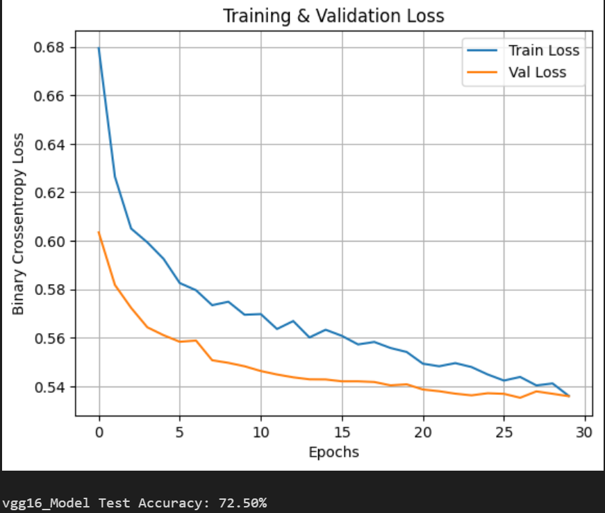
Cifar10(32*32) + vgg16 model

Slide 24
Cifar10(32*32) + vgg16 model
Confusion matrix
131 | 369
356 | 144

Slide 25
Cifar10(32*32) + vgg16 model
Classification report
support | F1-score | recall | precision
500 | 0.73 | 0.74 | 0.72 | 0
500 | 0.72 | 0.71 | 0.73 | 1
1000 | 0.72 |  |  | accuracy
1000 | 0.72 | 0.72 | 0.73 | Macro avg
1000 | 0.72 | 0.72 | 0.73 | weighted avg

Slide 26
0.7301
0.5360
0.535
0.7329
Best train accuracy
Best validation accuracy
Best train loss
Best validatioln loss

Slide 27
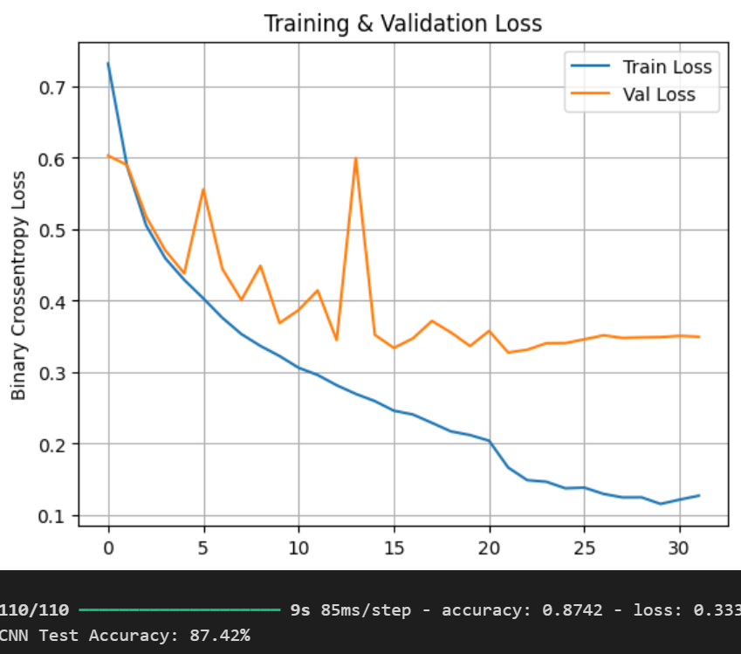
Combined dataset + custom-built model

Slide 28
Combined dataset + custom-built model
Confusion matrix
493 | 3006
3112 | 387

Slide 29
Combined dataset + custom-built model
Classification report
support | F1-score | recall | precision
3499 | 0.87 | 0.86 | 0.89 | 0
3499 | 0.72 | 0.89 | 0.86 | 1
6998 | 0.87 |  |  | accuracy
6998 | 0.87 | 0.87 | 0.87 | Macro avg
6998 | 0.87 | 0.87 | 0.87 | weighted avg

Slide 30
0.9552
0.1156
0.3275
0.8759
Best train accuracy
Best validation accuracy
Best train loss
Best validatioln loss

Slide 31
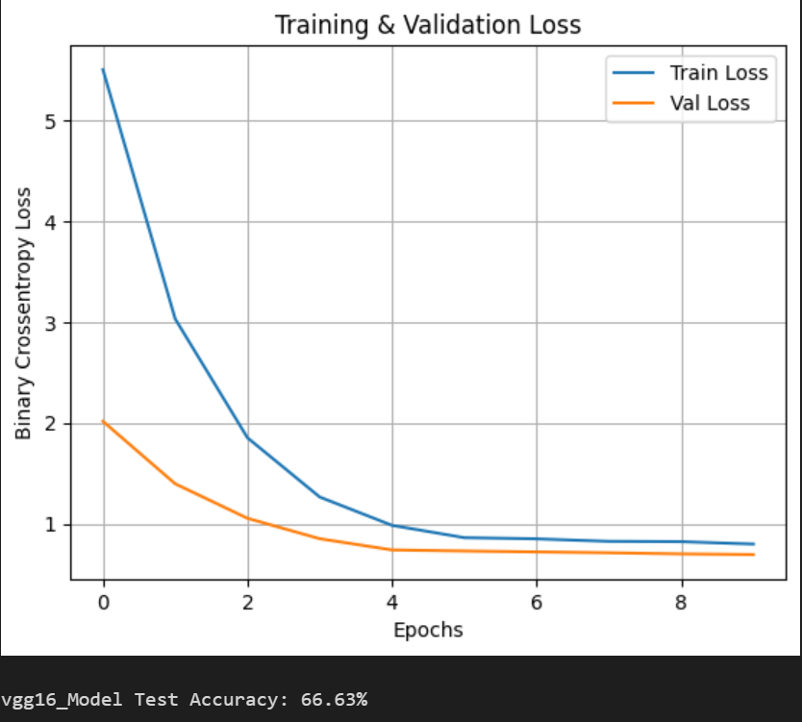
Combined dataset + vgg16 model

Slide 32
Combined dataset + vgg16 model
Confusion matrix
1366 | 2133
2530 | 969

Slide 33
Combined dataset + vgg16 model
Classification report
support | F1-score | recall | precision
3499 | 0.65 | 0.61 | 0.69 | 0
3499 | 0.68 | 0.72 | 0.65 | 1
6998 | 0.67 |  |  | accuracy
6998 | 0.67 | 0.67 | 0.67 | Macro avg
6998 | 0.67 | 0.67 | 0.67 | weighted avg

Slide 34
0.6373
0.7985
0.6946
0.6736
Best train accuracy
Best validation accuracy
Best train loss
Best validatioln loss

Slide 35
05
comparison

Slide 36
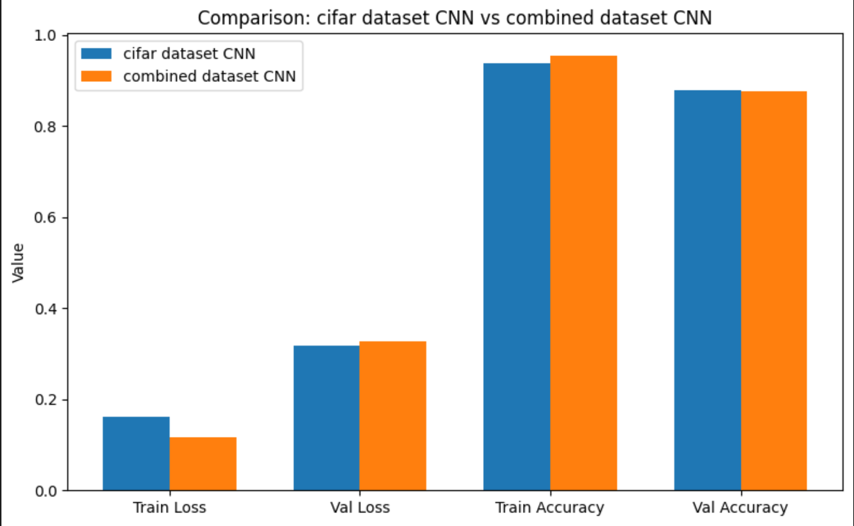
Comparing custom-built model with different datasets

Slide 37
Custom—built model
Train dataset: better result in larger dataset
More diverse images
validation dataset: better result in cifar dataset
distribution shift in combined dataset
Loss information with resizing down images in combined dataset
Limited capacity of model for larger dataset
Slightly difference( depending on weight initialization, shuffle, or batch splits)

Slide 38
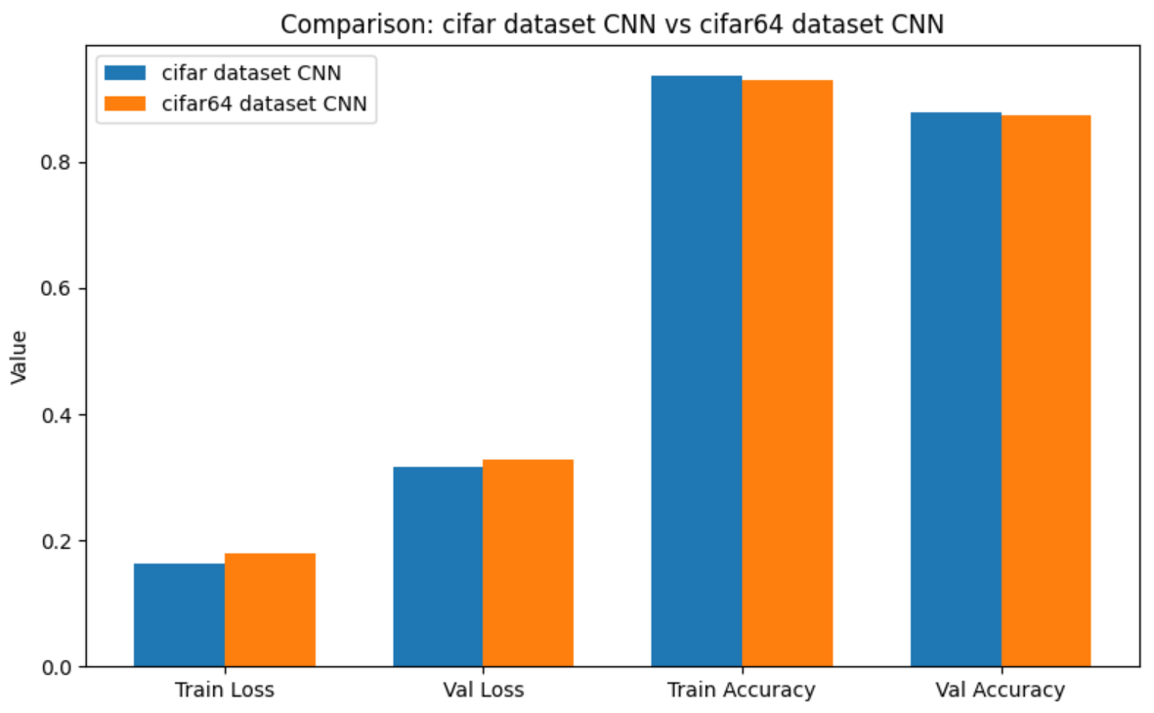
Comparing custom-built model with different sizes Cifar datasets

Slide 39
Custom—built model + cifar10
Train dataset: better result in 32X32 dataset
64X64 version is harder to optimize
validation dataset: better result in 32X32 dataset
Up scaling doesn’t add any new feature
Model capacity isuue (larger input -> more complexity)

Slide 40
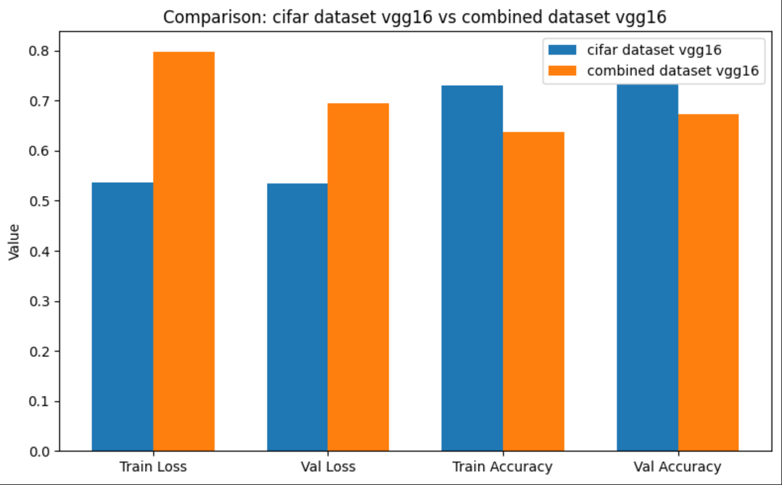
Comparing vgg16 model with different datasets

Slide 41
vgg16 model
Train dataset: better result in cifar dataset
Same distribution in cifar dataset
extra variability in combined dataset -> harder optimization
validation dataset: better result in 32X32 dataset
distribution shift in combined dataset
Loss information with resizing down images in combined dataset
Vgg16 is pretrained with 224X224 images

Slide 42
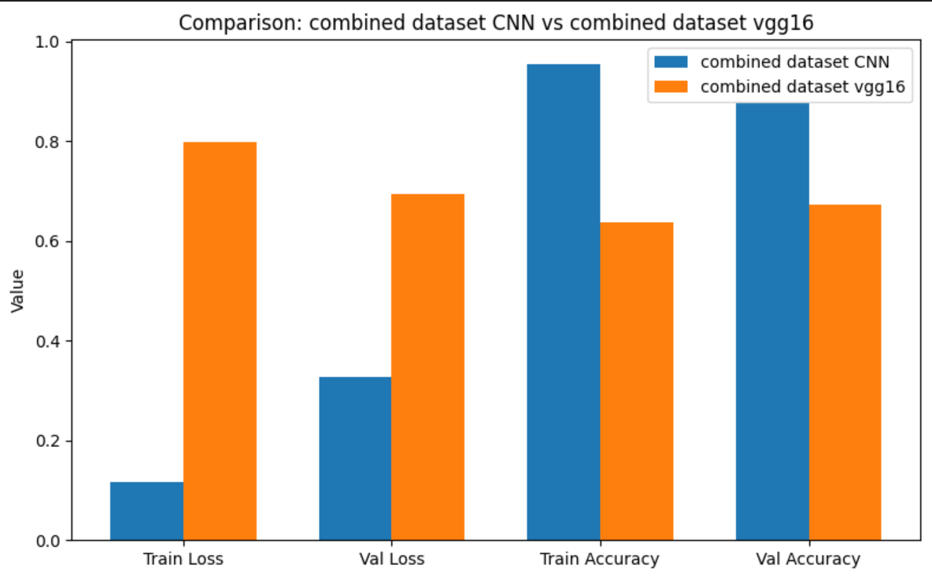
Comparing different models with combined datasets

Slide 43
Combined dataset
Train dataset: much better result in
custom-built model
Input resolution mismatch -> Vgg16 is pretrained with 224X224 images
Custom-built model learn from scratch(learns directly from your data distribution)
validation dataset: much better result in
custom-built model
distribution shift in combined dataset
Loss information with resizing down images in combined dataset
Model capacity vs data ->VGG16 has ~138 million parameters(causes underfit with small size images)
Custom-built model is Smaller model -> perform better with 32*32 images

Slide 44
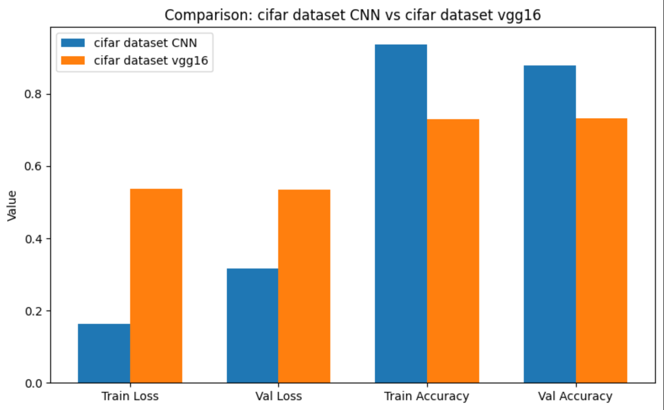
Comparing different models with Cifar datasets

Slide 45
Combined dataset
Train dataset: better result in
custom-built model
Input resolution mismatch -> Vgg16 is pretrained with 224X224 images
Custom-built model learn from scratch(learns directly from your data distribution)
validation dataset: better result in 32X32 dataset
distribution shift in combined dataset
Loss information with resizing down images in combined dataset
Model capacity vs data ->VGG16 has ~138 million parameters(causes underfit with small size images)
Custom-built model is Smaller model -> perform better with 32*32 images

Slide 46
06
conclusion

Slide 47
conclusion
Our experiments show that the performance of a model depends strongly on both the dataset and the architecture. The custom-built CNN, designed for small inputs, consistently outperformed the fine-tuned VGG16 on CIFAR datasets, achieving higher accuracy and lower loss. This is because lightweight models adapt better to low-resolution images like 32×32 and even showed more stability when scaled to 64×64, although performance slightly decreased due to loss of fine detail. When trained on the combined dataset, the custom CNN also generalized well, benefiting from the larger data size. In contrast, VGG16, originally designed for high-resolution ImageNet images, struggled when downscaled to 32×32 inputs—its pretrained filters did not transfer effectively, leading to lower accuracy and higher loss on both CIFAR and combined datasets. Overall, these results highlight that for small-scale datasets, custom models tailored to input size can outperform heavy pretrained networks, while larger datasets favor lightweight CNNs more than overparameterized models like VGG16 at low resolutions.

Slide 48
Thanks!

