Slide 1




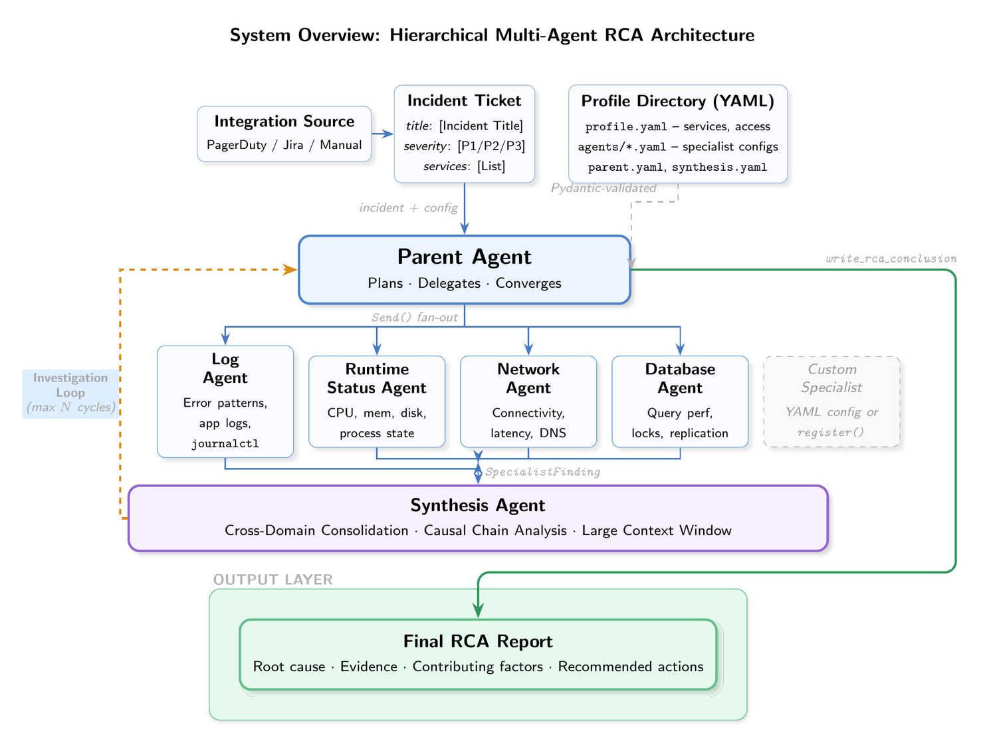
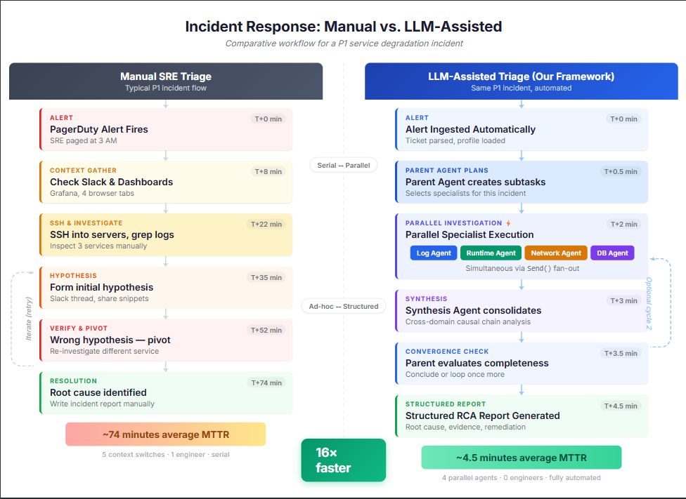





OPEN SOURCE LLM-ASSISTED TRIAGE: A MULTI-AGENT FRAMEWORK FOR AUTOMATED INCIDENT ROOT CAUSE ANALYSIS
Github
Automated fault diagnosis for microservice systems using LLM-powered specialist agents
Authors
Advisor
Consultant
Affiliations
Kalhar Pandya
Dr. Maryam Tanha
Dr. Dawood Sajjadi, Director of SRE, Fortinet
Northeastern University, Khoury College of Computer Sciences
Introduction
System Overview: Hierarchical Multi-Agent RCA Architecture
Results & Analysis
Modern distributed systems make incident diagnosis slow and expert-dependent. This study presents a multi-agent RCA framework using LLMs to autonomously investigate microservice faults by correlating container logs, process states, and configurations in parallel across services, reducing manual SRE triage and cutting Mean Time to Resolution.
The agent correctly identified the root cause in all six experiments: 6/6 accuracy, averaging 2.2 cycles, 89 seconds, and $0.27 per run on GPT-4.1.
Simple cases (EXP-02, EXP-04) resolved in a single cycle when logs had clear error codes. EXP-05 (DNS corruption) was the hardest at 3 cycles, 155s, and $0.58, because symptoms appeared one layer away from the actual fault.
Five fault domains, two failure modes: total outages (EXP-02, EXP-03) and partial degradation (EXP-01, EXP-04, EXP-05, EXP-06). Degraded-but-running faults consistently needed more investigation cycles.
The iterative loop proved critical for indirect faults. In EXP-05, cycle 1 found symptoms in Postfix logs, but two more rounds were needed to trace them to a corrupted /etc/resolv.conf.
At $0.04 to $0.58 per run, the cost stays well within range for production use where faster diagnosis pays for itself.
Objective
Design a multi-agent system that can diagnose microservice incidents on its own - spinning up specialists in parallel, reasoning over multiple cycles, and staying within safe execution boundaries.
Put it to the test on real fault-injected deployments and measure whether it finds the right root cause.
Methodology
Conclusion
This study employed a systems design and empirical validation approach to investigate LLM-driven automated incident RCA in microservice environments.
What this work contributes:
A LangGraph-based fan-out architecture where the LLM decides which specialists to dispatch in parallel, with no hardcoded pipeline.
An iterative reasoning loop: if the first pass is inconclusive, the synthesis agent requests another cycle with targeted follow-up commands.
A deny-first security layer that blocks writes, redirects, and network tools during live container introspection.
YAML-driven deployment profiles so teams can onboard new services without writing code.
Where it goes next:
Kubernetes-native execution to move beyond SSH and Docker exec into production clusters.
Human-in-the-loop command approval for environments where full autonomy is not yet appropriate.
Evaluation on real-world incidents without pre-defined ground truth.
The framework was implemented using LangGraph: Parent Agent (LLM orchestrator) → parallel specialist fan-out via Send API → Synthesis Agent → iterative loop or conclusion.
Four specialist agent types were developed (Log, Runtime Status, Docker Specs, and Network), each self-registering at runtime with no code changes per deployment.
Controlled fault injection experiments (6 designed, 6 completed) were run on a 4-service Mail App deployed on AWS EC2, covering database, web server, mail transport, DNS, and OS-level memory faults.
Ground-truth validation compared the agent's identified root cause against each injected configuration change per experiment.
Key References
Szandala, "AIOps for Reliability," ICCS 2025 | Kholkar & Ahuja, "Guardrail Policy-as-Prompt," arXiv 2025 | Huang et al., "Resilience of Multi-Agent," arXiv 2024 | Zhang et al., "AgentOrchestra," arXiv 2025 | Yu et al., "Triangle," FSE 2025 | Xu et al., "OpenRCA," ICLR 2025 | Hong et al., "MetaGPT," ICLR 2023
Salman et al., "HyLift 5G/6G," Computers 2025 | Ashraf & Talavera, "Autonomous Agents in SE," 2025 | Zhang et al., "AIOps Survey," ACM Comp. Surveys 2025 | Liao et al., "SageCopilot," IEEE TSC 2025 | Zhou et al., "D-Bot," arXiv 2023 | Xu et al., "DivLog," ICSE 2024 | Li et al., "LACP," arXiv 2025
Fu et al., "MARCA," Complex & Intell. Sys. 2026 | AWS Blog, "SRE Assistants + MCP," 2025 | Bai et al., "AOI Framework," arXiv 2025 | Chen et al., "RCACopilot," EuroSys 2024 | Yue et al., "MasRouter," arXiv 2025 | Zhang et al., "FLASH," MS Research 2024

