Slide 1
Heart Disease Health Indicators
GET STARTED
Notes:
Creadit picture : Unsplash Cerys Lowe @ceryslowe_1
Link : https://unsplash.com/photos/o2vx3hOPbUM

Slide 2
Introduction
Heart Disease is among the most prevalent chronic diseases in the United States, impacting millions of Americans each year and exerting a significant financial burden on the economy. In the United States alone, heart disease claims roughly 647,000 lives each year — making it the leading cause of death.
Notes:
Creadit picture : Unsplash Sharon McCutcheon @sharonmccutcheon
Link : https://unsplash.com/photos/wC3aBi-ETrQ

Slide 3
Goals
Use survey responses from the (BRFSS) Behavioral Risk Factor Surveillance System for predicting heart disease risk , preventive health practices and risk behaviors that are linked to chronic diseases in the adult population.
Notes:
Creadit picture : Unsplash Sharon McCutcheon @sharonmccutcheon
Link : https://unsplash.com/photos/wC3aBi-ETrQ

Slide 4
Content
This dataset contains 253,680 survey responses from BRFSS Which contain 22 colmuns factors can be used in diagnosing coronary heart disease. The Behavioral Risk Factor Surveillance System (BRFSS) is a health-related telephone survey that is collected annually by the CDC.
Notes:
Creadit picture : Unsplash Sharon McCutcheon @sharonmccutcheon
Link : https://unsplash.com/photos/wC3aBi-ETrQ

Slide 5

Anaconda
Jupyter notebook
Libraries (pandas , numpy , matplotlib , seaborn , sklearn ) .
TOOLS
Notes:
Creadit picture : Unsplash Sharon McCutcheon @sharonmccutcheon
Link : https://unsplash.com/photos/wC3aBi-ETrQ

Slide 6
Loading The Data
STEPS
Cleaning The Data
Data Visualization
Exploratory Data Analysis (EDA )
Preprocessing The Data
Splitting The Data
Model Building
Evaluation
Conclusion

Slide 7
VISUALIZATION

Slide 8
THE TARGET COLMONS IS : Heart Diseaseor Attack
TARGET
Notes:
Creadit picture : Unsplash Sharon McCutcheon @sharonmccutcheon
Link : https://unsplash.com/photos/wC3aBi-ETrQ

Slide 9
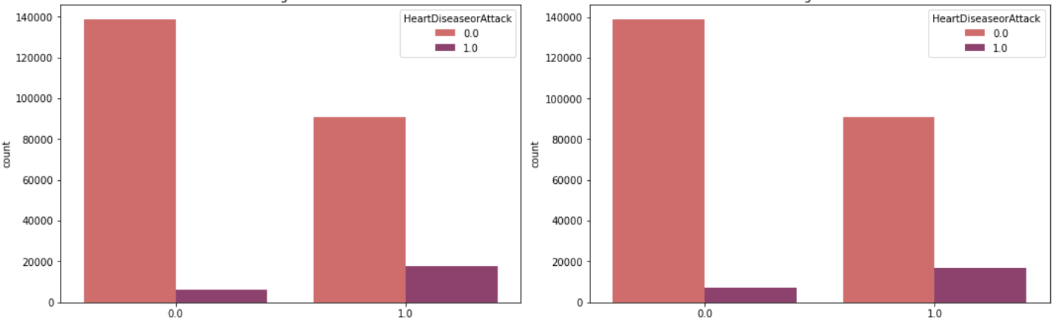
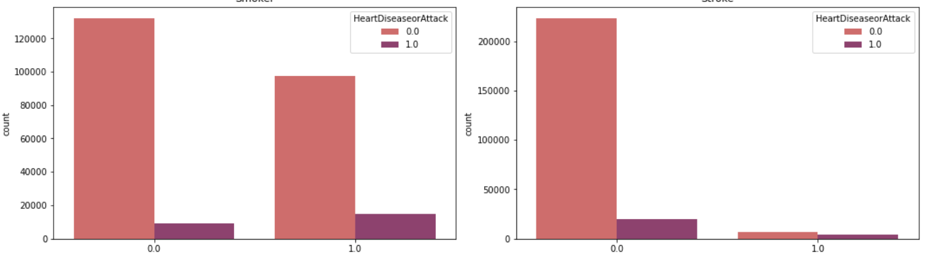
From the graph, it is clear to us from the sample of people that the rate of heart disease increases in people who suffer from high blood pressure and high cholesterol
High BP
High Chol
From the graph, the incidence of heart disease increases among smokers, in addition that the majority of people with strokes have heart disease.
Smoker
Stroke

Slide 10
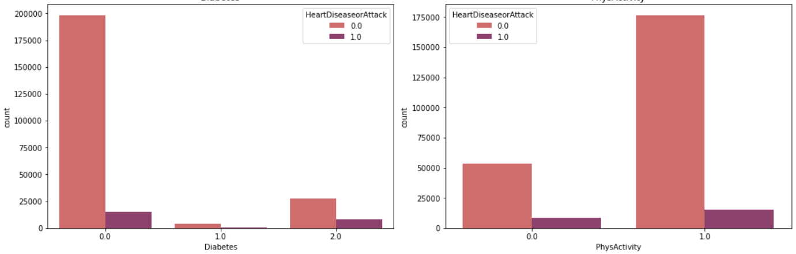
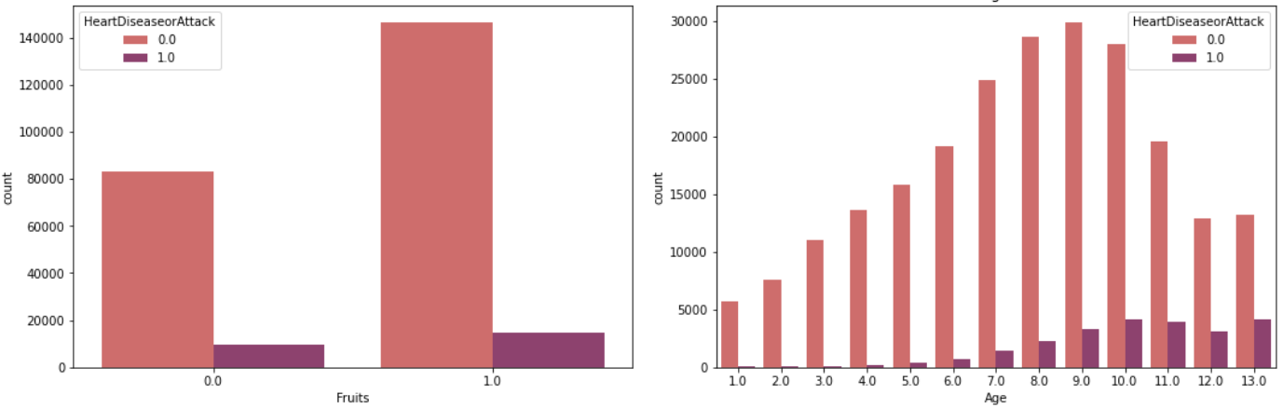
from the graph the incidence of heart disease increases in people who do not practice in any physical activity. While there is no direct effect between diabetes and heart patients
From the graph, the rate of heart disease decreases in people who eat fruit. Also, as we get older, the incidence of heart disease increases
Notes:
It is clear to us from the graph that the incidence of heart disease increases in people who do not engage in any physical activity. While there is no direct effect between diabetes and heart patients

Slide 11
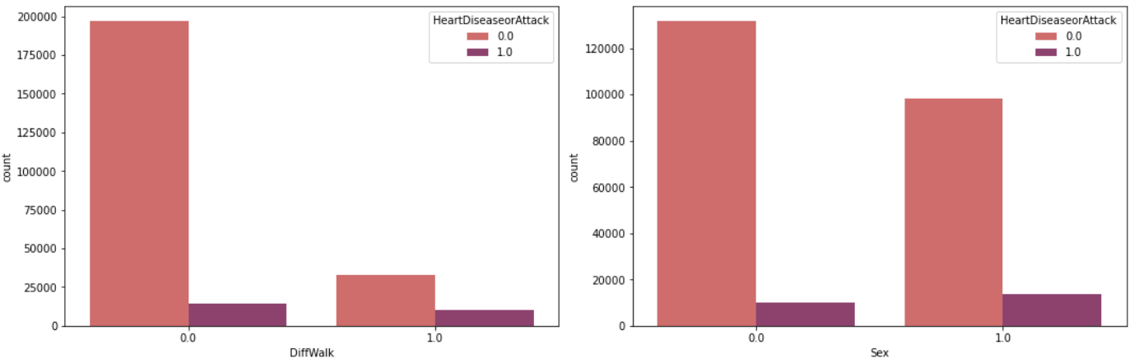
From the graph, there is no direct effect between people who have difficulty walking, climbing stairs and heart disease. While it is clear to us that the incidence of heart disease is higher in men

Slide 12
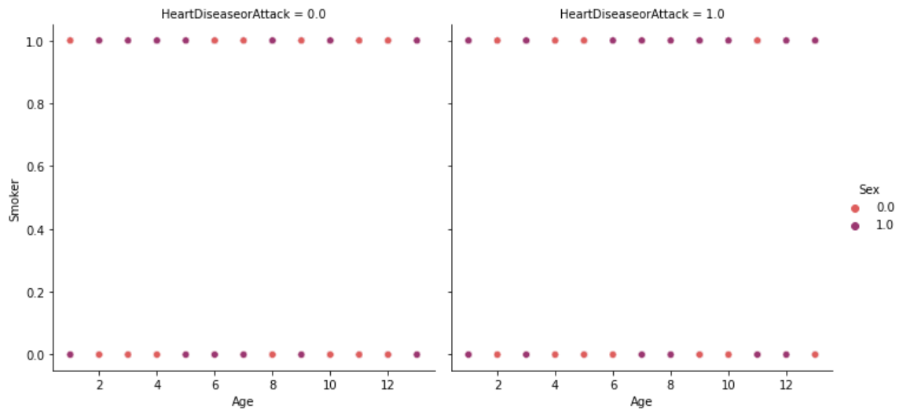
From the graph heart disease is higher in men who smoke

Slide 13
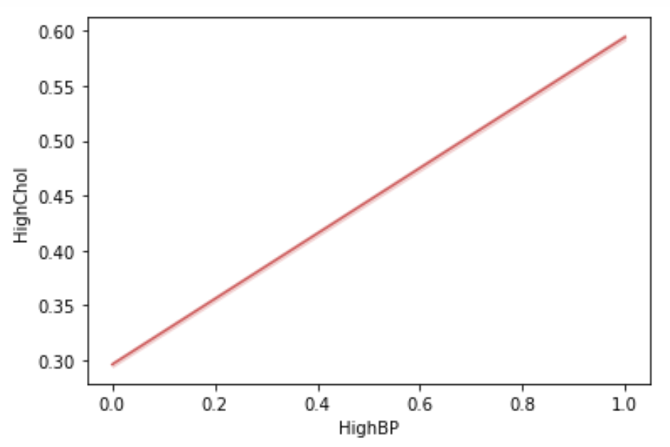
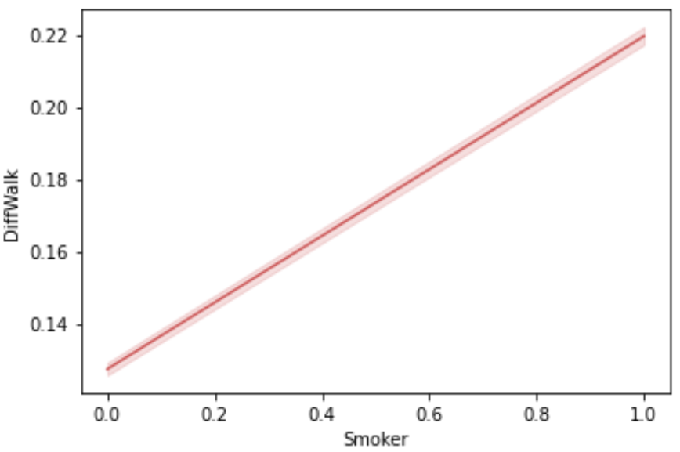
When blood pressure is high, cholesterol is high
When a person smokes, then get more difficult to walk and climb stairs

Slide 14
MODELING

Slide 15

Modeling
KNeighborsClassifier
GradientBoostingClassifier
Logistic Regression
RandomForestClassifier
XGBClassifier
AdaBoostClassifier
Accuracy: 88.2522%
Log Loss: 4.0575 Score : 0.88046
Accuracy: 89.5423%
Log Loss: 3.6119
Score : 0.89423
Accuracy: 90.2850%
Log Loss: 3.3554
Score : 0.8879
.
Accuracy: 89.5149%
Log Loss: 3.6214
Score : 0.8930
Accuracy: 88.0601%
Log Loss: 4.1239
Score : 0.8937
Accuracy: 89.5194%
Log Loss: 3.6198
Score : 0.8921
Notes:
Logistic Regression': 0.8937075413435805, 'KNN': 0.8804638715432649, 'Random Forest': 0.8879663304284179, 'XGBClassifier': 0.8921064068254078, 'AdaBoostClassifier': 0.8930899608865711, 'GradientBoostingClassifier': 0.8942336283995517
KNeighborsClassifier ****Results**** Accuracy: 88.2522% Log Loss: 4.057550280624363
RandomForestClassifier ****Results**** Accuracy: 88.0601% Log Loss: 4.123913380908994
XGBClassifier ****Results**** Accuracy: 89.5194% Log Loss: 3.6198681138632183
AdaBoostClassifier ****Results**** Accuracy: 89.5149% Log Loss: 3.621450032738881
GradientBoostingClassifier ****Results**** Accuracy: 89.5423% Log Loss: 3.611966713168396

Slide 16
EVALUTING

Slide 17
EVALUTION
Random Forest Classifier gave me the best results and high accuracy
Notes:
Creadit picture : Unsplash Sharon McCutcheon @sharonmccutcheon
Link : https://unsplash.com/photos/wC3aBi-ETrQ

Slide 18
As we can see that certain features are contributing to our 'target' column like physical activity, and fruit and vegetable consumption, Smoking High Blood Pressure, High Cholesterol, and other features aren't contributing so to save time in the future to analyze data for a similar purpose.
Conclosion
Notes:
Creadit picture : Unsplash Sharon McCutcheon @sharonmccutcheon
Link : https://unsplash.com/photos/wC3aBi-ETrQ

Slide 19

Thank You
THE END
Notes:
Creadit picture : Unsplash Jade
@jinxx2020
Link : https://unsplash.com/photos/pKsZXmO-zG0

