Slide 1
Project
Data Analytics

Slide 2

Created By:
Maryam Aliakbari

Slide 3
Dataset: CustomerChurn.csv

Slide 4
Cleaning & Transforming Data
Remove “CustomerID”
In this project we do not need to observe the data of a particular customer, so we just remove it.
Rephrase Values of “MultipleLine”
We find out the relation between “PhoneService” and “MultipleLines”, that “No phone service” in “MultipleLines” is because of “No” Phone services. So, we re-phrase the values in this way: “No” to “SingleLine” , “Yes” to “MultipleLine” and “No phone service” to “No Phone”.
Remove “PhoneService”
Based on the previous transformation step, we’ve used “PhoneService” values in “MultipleLines”. So, we removed this variable.
Rephrase values of “SeniorCitizen” and Change Data Type.
Rephrasing the status of customer’s seniority from “1” to “Yes” and “0” to “No” after we change its data type to “Text”
Create new Column “MultiMember_Family”
We created a new column based on the concept of status of the family in two columns “Partner” and “Dependents”. The value of this column is “Single” if the customer has “No” partner and “No” dependent. Otherwise, it is “Multi Member”
Remove two columns
“Partner” and “Dependants”
Based on previous steps , as we used the most important part of the information of these two columns in a new column, we remove these two columns.

Slide 5
Cleaning & Transforming Data
Create “No_StreamingService”
Based on some initial EDA we found out that similar pattern of distribution between “StreamingMovies” and “StreamingTV”. So, we decided to combine these two in a new column “No_StreamingService” that shows how many streaming services a customer uses.
Remove two columns
“StreamingMovies” & “StreamingTV”
Based on the previous step, as we used the most important part of the information of these two columns in a new column, we removed these two columns.
Create “No_OtherService”
Based on some initial EDA we found out similar pattern of distribution among “OnlineSecurity” , “OnlineBackup”, “DeviceProtection” & “TechSupport”. So, we decided to merge these Supporting services status in a new column “No_OtherService” that shows how many other supportive services a customer uses.
Remove columns “OnlineSecurity” “OnlineBackup”, “DeviceProtection” & “TechSupport”
These columns have been removed based on the previous step, as we’ve used the summary of these columns value in “No_OtherService” column.
Fill the missing Data in “TotalCharges”
We found out that there are some missing data in “TotalCharges”, we also found out that these particular observations have “0” value in their “tenure”. So that means they have not been charged yet. We fill these observations missing value in “TotalCharges” with the value of “0”

Slide 6
About the Dashboard
Churn Slicer
To control the dashboard components for all, churned and not-churned clients
Variations
Illustrates the variations in demographic, behavioral and contract characteristics of clients
Focus
Enables to focus on each measure
Comprehensiveness
A comprehensive glimpse of all measure at once.
Compare
Enables to compare changes in several measures

Slide 7
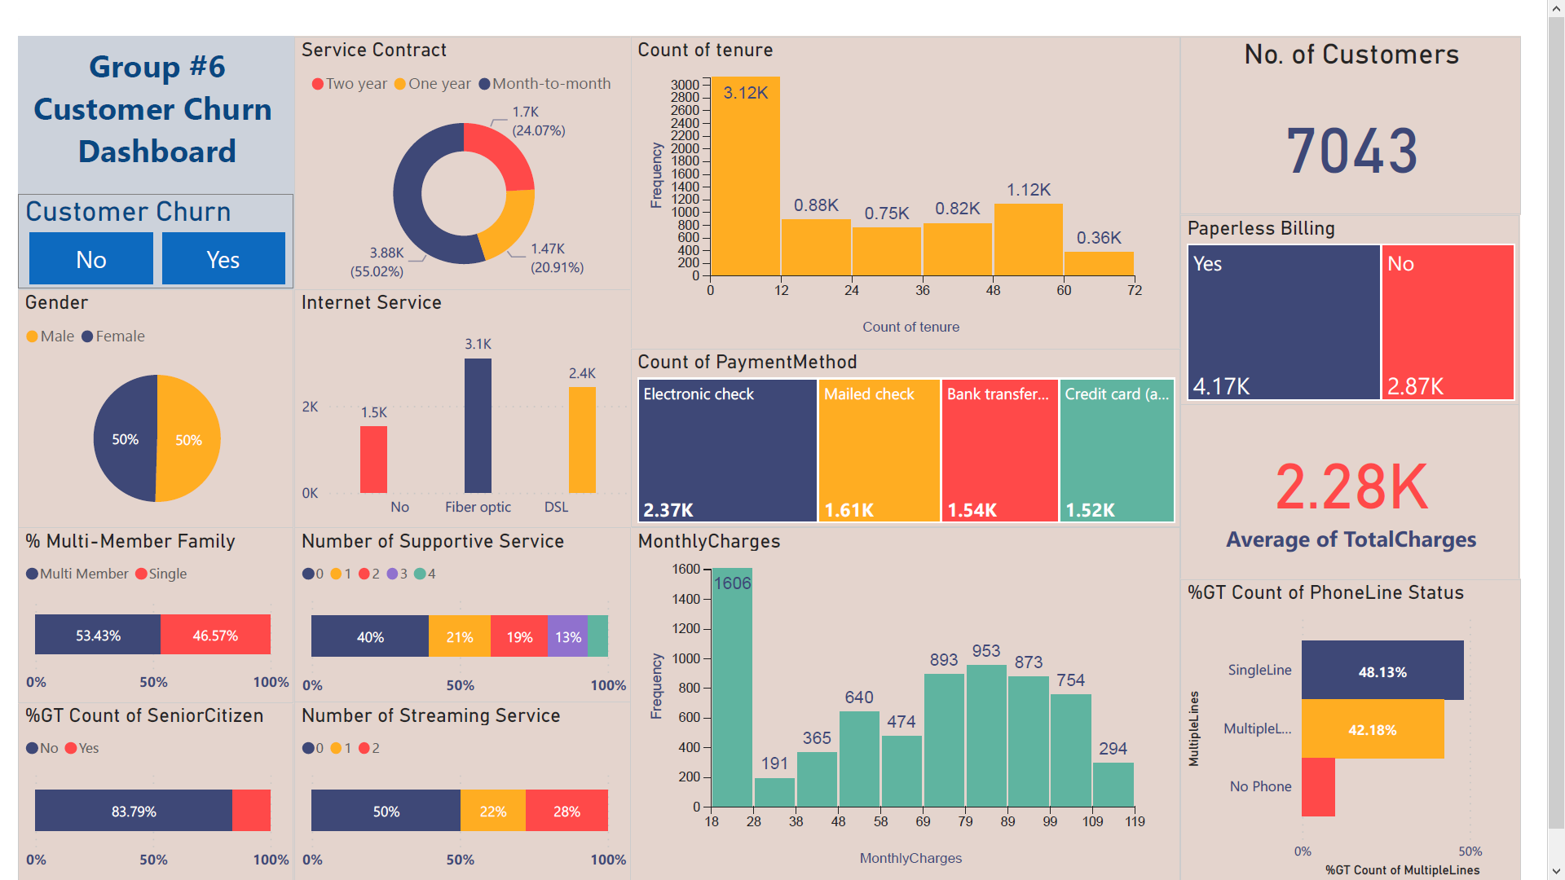
Dashboard - Full Customers View

Slide 8
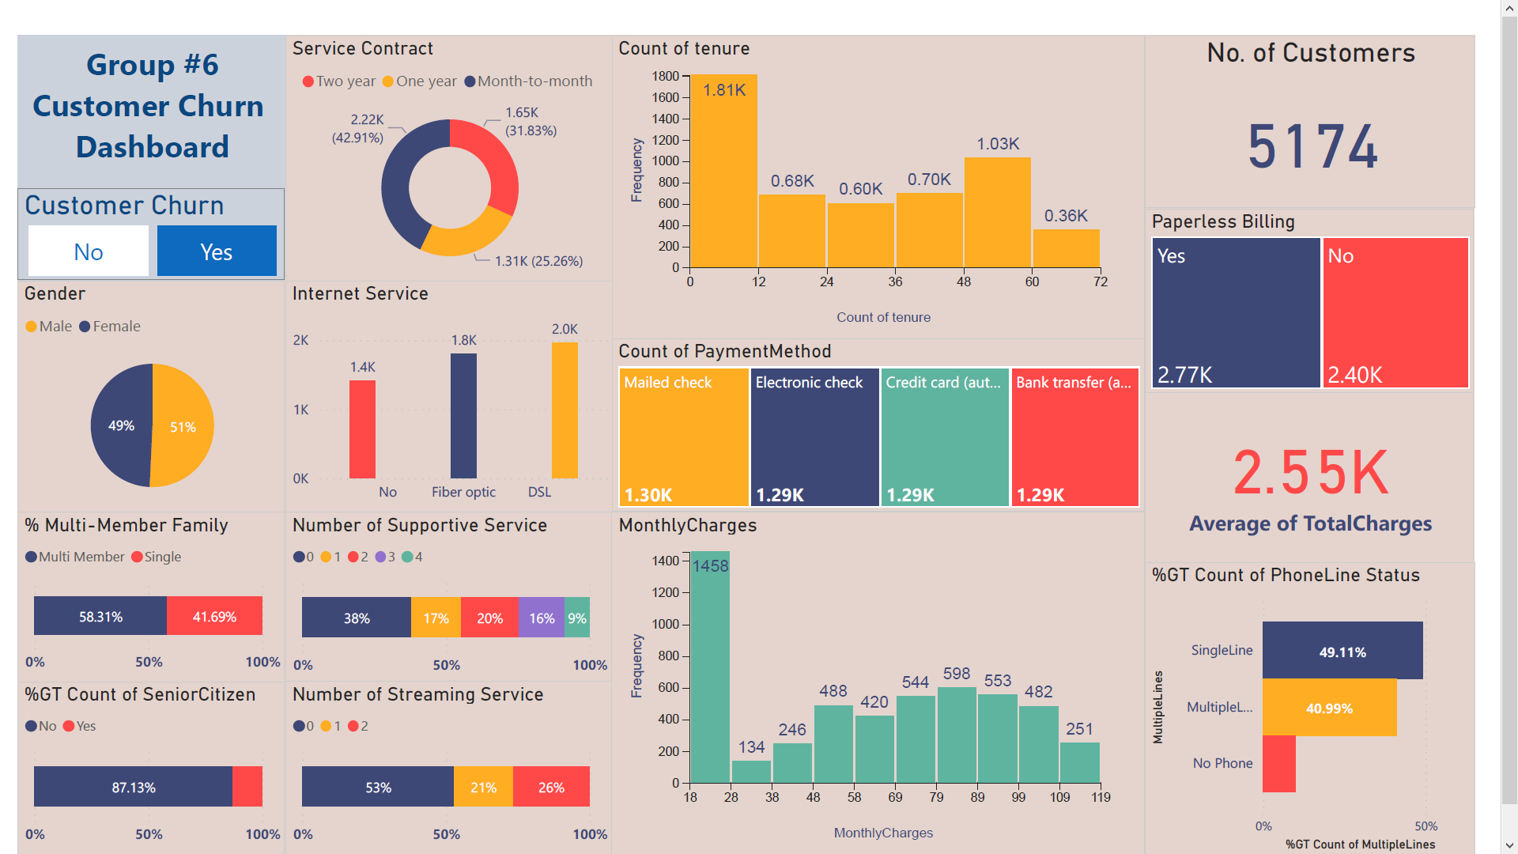
Dashboard - Not Churned Customers View

Slide 9
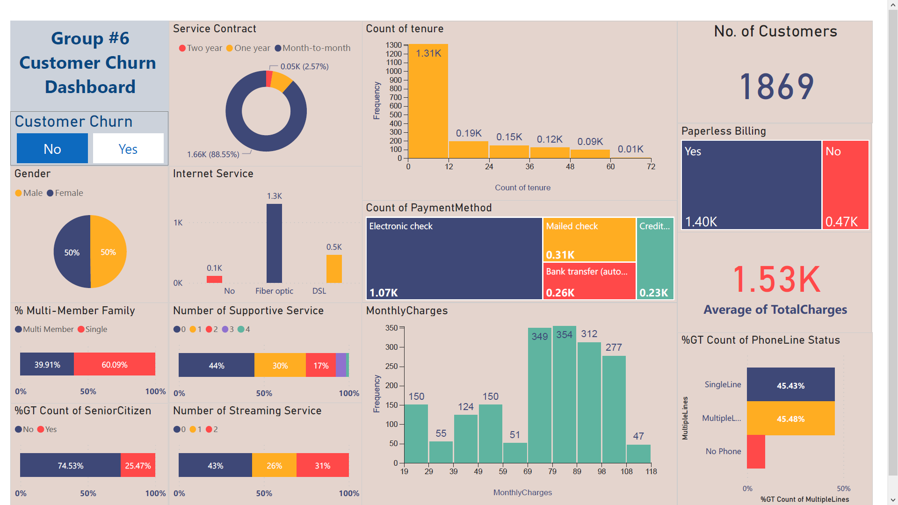
Dashboard - Churned Customers View

Slide 10
Results & Recommendations
“Churned” Customer Characteristics
compared to
“No-Churned Customers”
Recommendations to Decrease Churn Rate
Gender
Female
Promotion to increase dependents/partners
Multi-member family
Lower
Senior citizen
More
Special offers for long-term contracts
Service contract
More short-term
Phone services
More multiple-lines
Offering bundle services
No. of supportive services
Fewer
No. of streaming services
More
Offering loyalty rewards
Internet service
More Fiber Optic
Tenure
Less
Billing type
More paperless
Payment method
More e-checks
Avg. total charges
Less
Avg. monthly charges
More

Slide 11
About the Models
Problem Statement
Build a model to Predict “Churned Customers” in a telecommunication company
Target Variable
Churn
Selected Columns
All Columns
Fraction of Data for Modeling
70%
Classification Model
Two-Class Boosted Decision Tree
Two-Class Logistic Regression Model
&

Slide 12
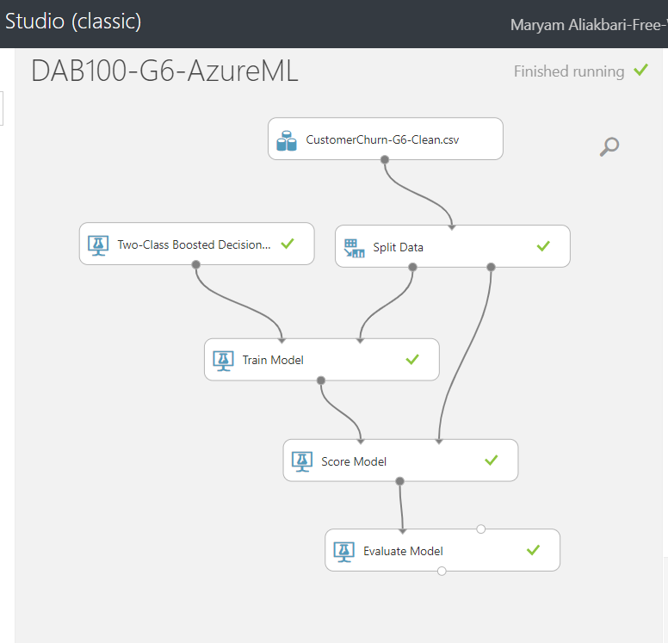
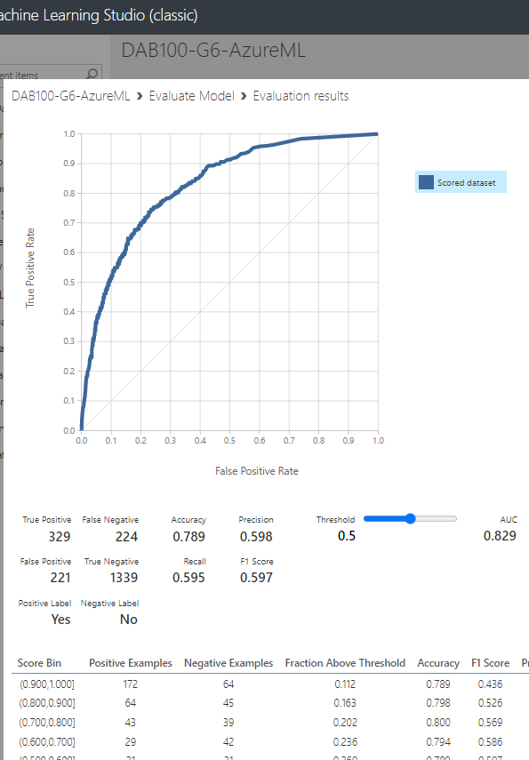
Decision Tree Model
Result

Slide 13
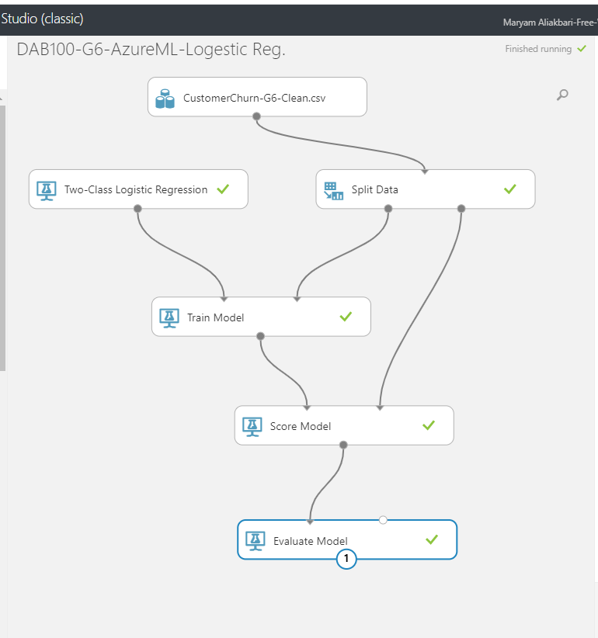
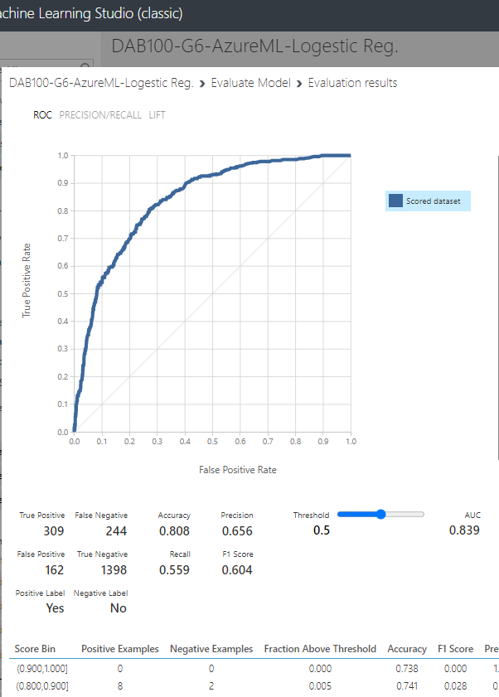
Logistic Regression Model
Result

Slide 14
Compare the Results of the Models
Logistic Regression Result
Decision Tree Result
Color Guide
Better Result
True Positive
False Negative
True Positive
False Negative
Worse Result
309
224
329
224
Equal
162
1398
221
1339
False Positive
True Negative
False Positive
True Negative
Positive Label
Yes
Accuracy
0.808
Accuracy
0.789
Precision
0.656
Precision
0.598
In overall the result of Logistic Regression Model is better than the result of Decision Tree Model
Recall
0.559
Recall
0.595
F1 Score
0.604
F1 Score
0.597
AUC
0.839
AUC
0.829

