Slide 1


An Investigation into the Correlation between Covid19-Related Deaths in 2020 and the Leading Causes of Death in the United States from 2015-2019
Notes:
Hi, this is the title of our project, which basically wants to relate different death causes with Covid deaths.
Naturally in the future slides we’ll talk more about it

Slide 2


Credits to:
Maryam AliakBari
Farzin Valiloo
Notes:
Our group is consisted of me and Farzin.

Slide 3

About the Subject
Let’s start with the subject …
Notes:
First, I’m going to talk about the subject and the problem

Slide 4

The planning and development of health policies should be based on:
Precise measurement and understanding of correct indices
Past and current profiles
Prediction of change over time
-- (Defo, 2014)
Notes:
Lets review some concepts.
-and it’s better to start with the health system!
Every health policy should make use of these three concepts:
1- Correct indices and the correct way of measuring them
2- The historical and present profiles of diseases and health issues
3- And ability to have an idea of what may happen in the future.

Slide 5



Review
The top 10 causes of death accounted for 55% deaths worldwide in 2019
(World Health Organization, 2020).
In early 2020 Covid caught the world off-guard
(Centre for Disaster Protection, Clarke, 2022).
Underlying death causes can contribute to the mortality rate of Covid-19
(USA Center for Disease Control and Prevention)
Notes:
According to WHO, in 2019, The top 10 causes of death accounted for 55% of deaths worldwide
As all of you remember, In the start of the year 2020, Covid-19 surprised the world,
despite of the warnings of some public health experts and commeracial risk modelers
Also, CDC claims that underlying conditions, … has contributed to the deaths caused by Covid.

Slide 6

Problem Statement
“Is there a difference in mortality rate of Covid-19 among the states with different highest causes of death in prior years to 2020?”
Notes:
we aim to explore the select death causes in different states in the U.S.,
between the years of 2014 and 2019,
and find potential implications and/or relationships between these causes and the mortality of Covid-19 in 2020.
In other words, have prior years’ top death causes implicate covid mortality rate in 2020?

Slide 7
Research Main Objectives
Exploring the select causes of death between 2014-2019 in the United States
Comparing the real data with the findings (mainly the effect of Covid-19)
Understanding the differences in patterns and distributions
Proposing actions influencing the discovered trends and patterns
Notes:
In this project we have followed this main objectives:
first, explored the database of death causes between 2014 and 2019
Then tried to find patterns or trend, and observed the distributions
Then compared the findings with Covid related deaths
And finally recommended some insights

Slide 8

About the Methodology
Let’s see the methods utilized …
Notes:
Now we know the problem and the concepts,
Here I’m going to talk briefly about the methods we used

Slide 9
Let’s review the course of action we’ve followed
Data Exploration
Descriptive Analysis
Statistical Analysis & ML
1
3
5
2
4
6
Data Cleaning
Data Manipulation
Conclusion
Notes:
This is the overview of the course of action we have followed for this project.
And no need to say that It is basically the roadmap of a typical data analysis process

Slide 10




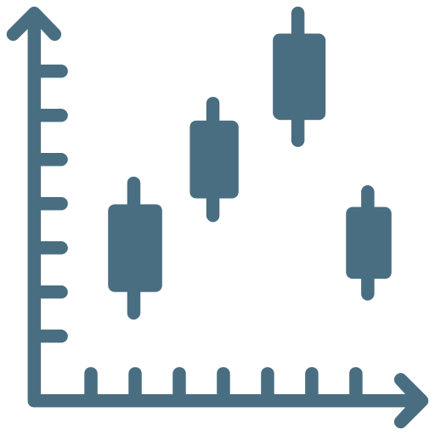

STEPS | STEPS | OBJECTIVES | TOOLS
 | Data Exploration | Finding inconsistencies (missing data, excessive columns, wrongly formatted data , etc.) | MS Excel Python Tableau
 | Data Cleaning | Addressing the potential issues | Python
 | Descriptive Analysis | Getting the clear understanding of the data Determining required transitions and complimentary data | Python Tableau
 | Data Manipulation | Merging and joining all data | Python’s Libraries Pandas NumPy
 | Analysis | Statistical hypotheses testing Machine Learning | Python’s Libraries SciPy PyCaret
 | Conclusion | Discussing the results Implications & Limitations Future recommendations
Notes:
And this is the more detailed view of the course of action.
As you may notice, preparing and transforming datasets took most of our time and effort

Slide 11

About the Data
Let’s talk about the data …
Notes:
Now lets talk about the data sets that we have used

Slide 12




Datasets
US Weekly Deaths
Covid 19 Deaths
Weekly No. of 13 top death causes in all US states from 2014 - 2019
16,903 Rows
2 Categorical Features
17 Numeric Features
(Source: U.S. government, data.gov)
Weekly No. of 13 death causes in all US states from 2020 - 2022
3623 Rows
2 Categorical Features
19 Numeric Features
(Source: U.S. government, data.gov)
US Population 2010-2019
US Population 2020
Estimation of population in each US state for 2010-2019 No. rows
51 Rows
1 Categorical Features
19 Numeric Features
(Source: U.S. Census Bureau, census.gov)
Estimation of population in each US state for 2020
52 Rows
1 Categorical Features
3 Numeric Features
(Source: populationu.com)
Notes:
WE have used 4 separate datasets:
The main data set was the weekly data of select causes of death in the states of the U.S. between 2014-2019
Two other datasets were the of these states yearly data of population
And the final one was basically the same as the first one but for 2020 that included Covid19

Slide 13
Data Exploration & Cleaning
Main datasets issues
Numbers stored as texts
Comma sign inside numerical values
Different state names in different datasets
Missing values
Unnormalized form of the raw data (based on population of the states)
Notes:
We have faced a number of issues when cleaning and preparing and merging the data like:
Numbers stored as texts
Comma sign inside numerical values
Different state names in different datasets
Missing values
Unnormalized form of the raw data

Slide 14


About the Analysis
Let’s start the analysis …
Notes:
Now it is the time for the analysis. Farzin will continue from here

Slide 15


Data manipulation
Issues with the main data set:
Solutions
Not comparable (normalized)
On a weekly basis
Add population data (yearly)
Aggregate data (yearly)
Aggregate the data for the years 2014-2019
Ranking death causes in each state based on the normalized data
Extracting top (n) causes in each state

Slide 16
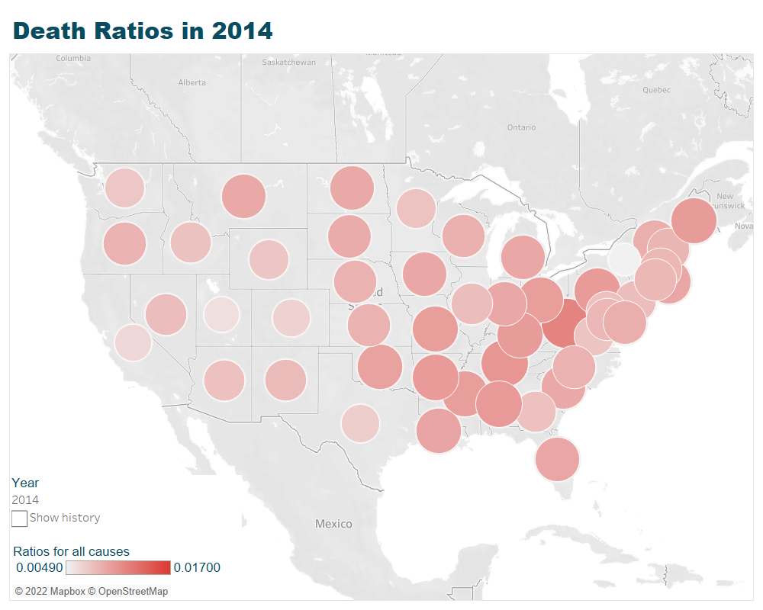
Descriptive Analysis
2014

Slide 17
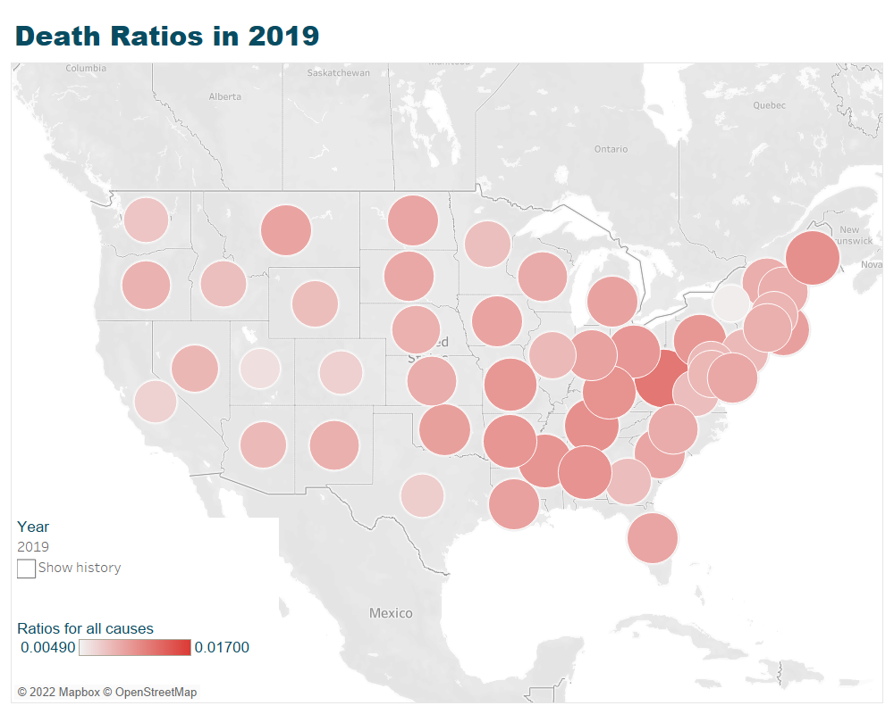
Descriptive Analysis
2019

Slide 18
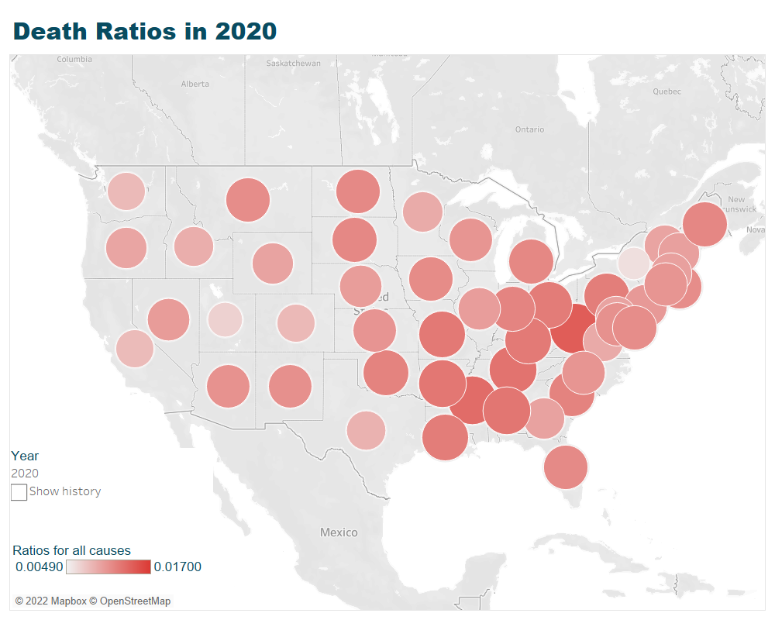
Descriptive Analysis
2020

Slide 19
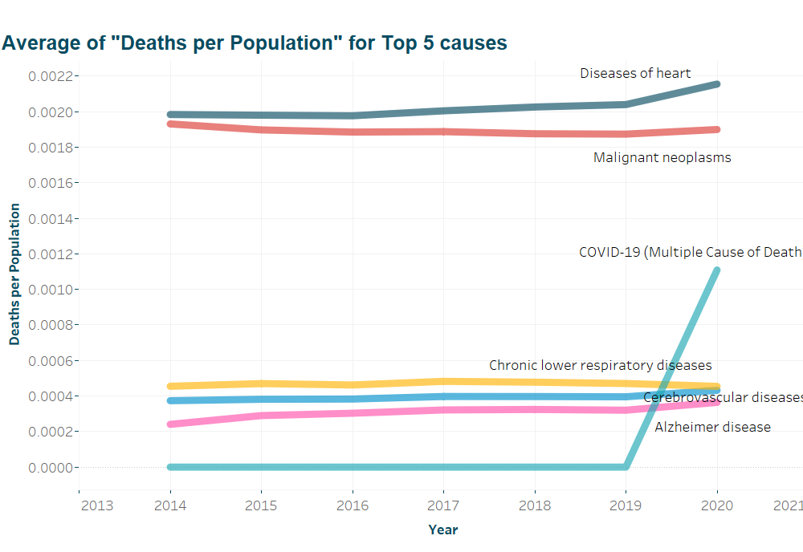
Descriptive Analysis cont’d
The trend of top 5 death causes and Covid-19 between 2014 and 2020

Slide 20
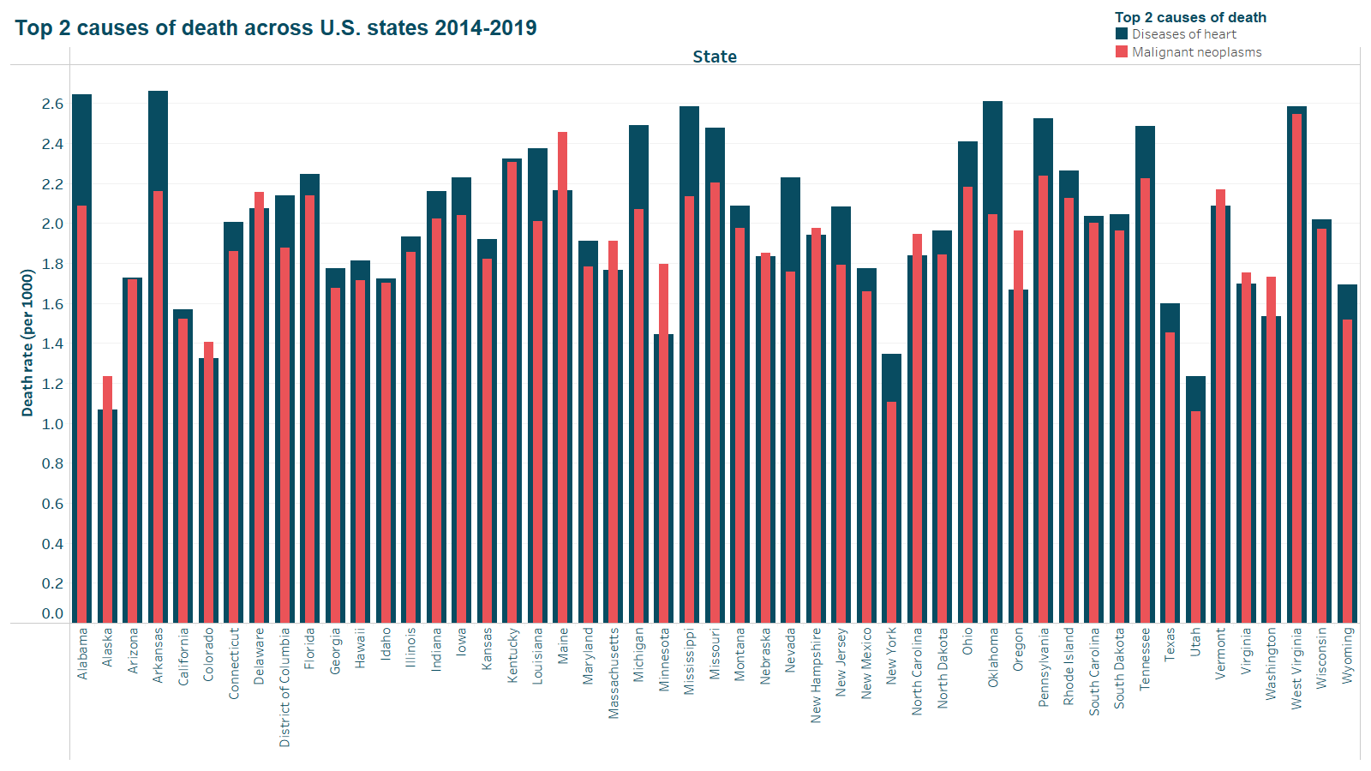
Descriptive Analysis cont’d
See how the top 2 causes of death distribute among all the states

Slide 21

Data Exploration & Cleaning
Insights from Descriptive analysis
Two first cause of deaths in every state:
Disease of heart
Malignant neoplasms
Two groups of states based on their top cause of death
Notes:
we aim to explore the select death causes in different states in the U.S. between the years 2014 and 2019 and find potential implications and/or relationships between these causes and the mortality of Covid-19 in 2020.
In other words, have prior years’ top death causes implicate covid mortality rate in 2020

Slide 22
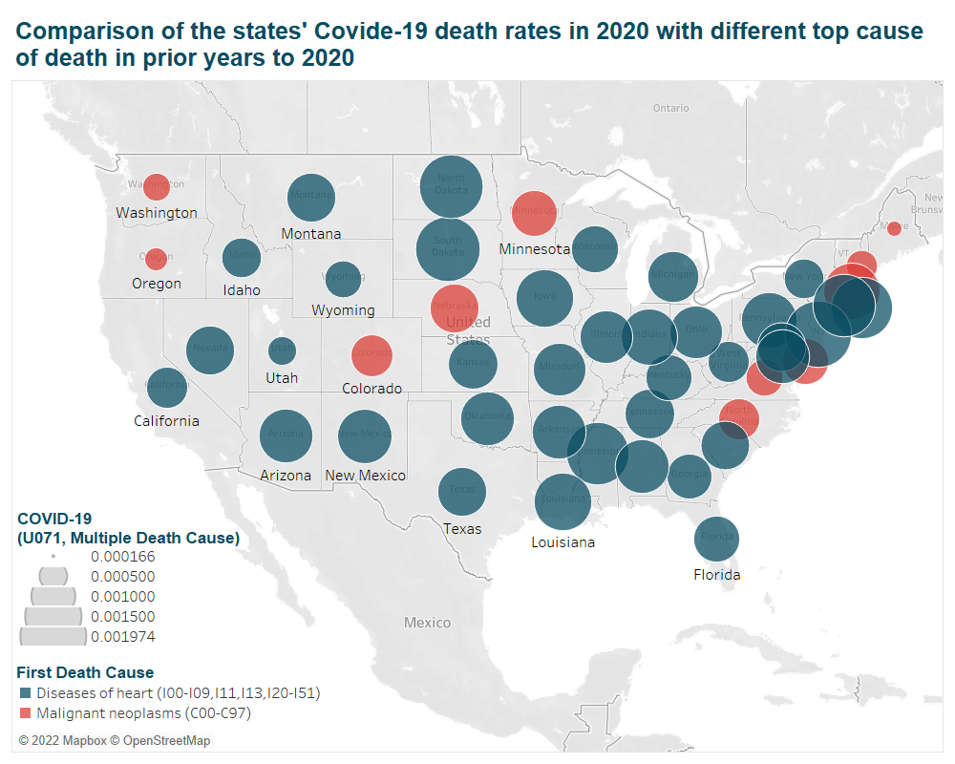
Statistical Analysis
See the death rate of Covid-19 in different groups of states
Notes:
This chart is based on the death rate of covid in two groups of states. It seems that orange states have lower death rate

Slide 23
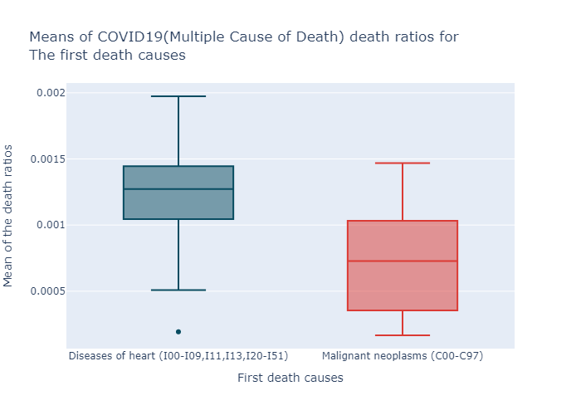


Statistical Analysis
Group A
States which their TOP death cause is “Diseases of heart”,
Group b
States whose top death cause is “Malignant neoplasms”
H0
There is no difference in the means of death rates caused by COVID19 (Multiple Cause of Death)
H1
The mean of death rates caused by COVID19 (Multiple Cause of Death) in is higher in states group A than that of group B
P-value <0.01 So we can reject the null value in alpha = 99 %
Notes:
This box plot also is consistent with the previous slide’s claim. So we create hypotheses

Slide 24
More Analysis
about the Second toHowp cause?
No need! As they are the same as top first.

Slide 25
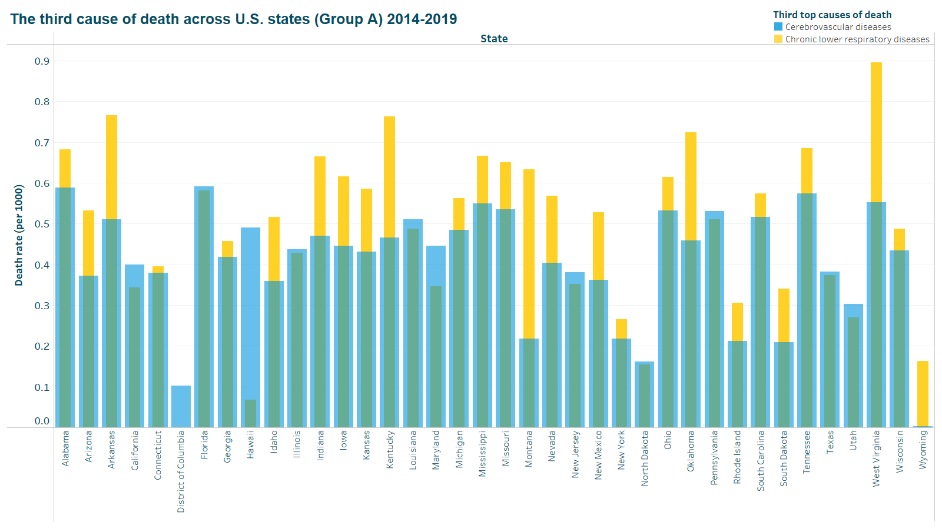
Statistical Analysis
How about the Third top cause?

Slide 26
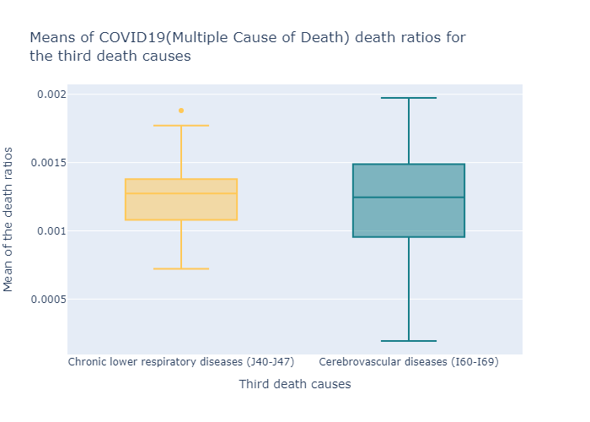


Statistical Analysis
Group AC
States which their Third death cause is “Chronic lower respiratory diseases (J40-J47) ”
Group AD
States which their Third death cause is “Cerebrovascular diseases (I60-I69) ”
H0
There is no difference in the means of death rates caused by COVID19 (Multiple Cause of Death)
H1
The mean of death rates caused by COVID19(Multiple Cause of Death) in is not equal in states group AC than and group AD
P-value > 0.01 so we cannot reject the null hypotheses in alpha = 99 %
Notes:
We drill down the first group which consists of about 35 states. As their second top cause of deaths is the same,
we’’ move to the third top cause: Only 2 causes:
Chronic lower respiratory disease
Cerebrovascular diseases
As before we create two groups of states
This box plot doesn’t show any differences between groups with different top third causes, let’s create new hypotheses.
Null hypotheses is not rejected

Slide 27
More Analysis
How about other causes of death?
Machine learning to fit a model

Slide 28
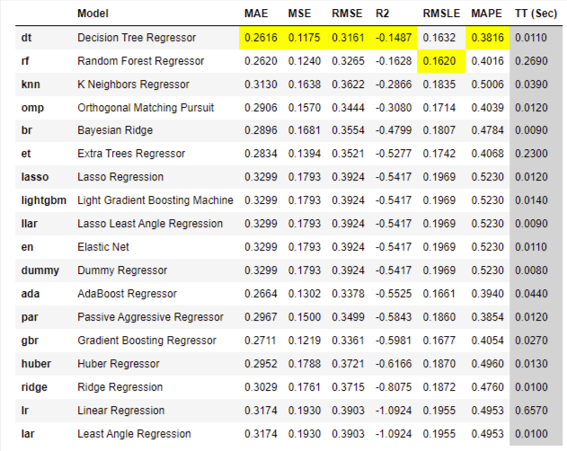

Slide 29
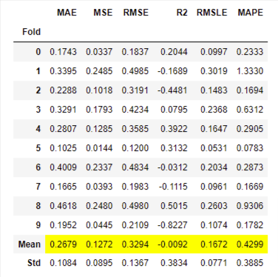
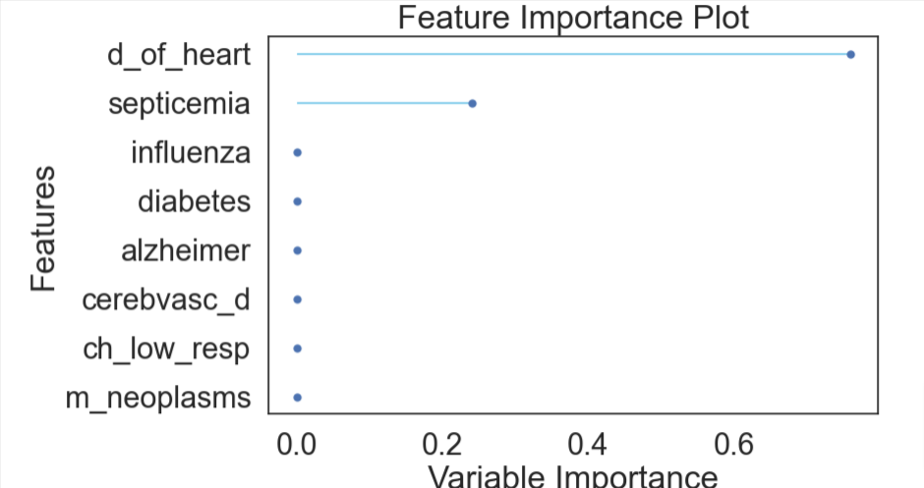
Decision Tree Tuned
Notes:
Still not good enough but let's see the feature importance
So:
Somewhat consistent with statistics

Slide 30
About the Results & Conclusion
So, what does this analysis implicate?
Notes:
Now we are going to conclude the results and review their possible implications

Slide 31
There is a significant difference between Covid caused death rates of these two groups of states:
Although ML algorithms did not produce perfect results, but Feature importance analysis was consistent with findings in the statistical analysis
States whose top cause of death in previous years was Heart Diseases
States whose top cause of death in previous years was Malignant neoplasms
Notes:
As the statistical tests have shown:,
we can see a significant difference among the two groups of states in terms of Covid death rate in 2020
Although our use of ML was not perfect, but the feature importance showed a consistent result with the statistical analysis

Slide 32

Implications
Covid is far from over:
Among group A states, few states that had lower death:
To warn states in group A
Their systems and actions can be studied
Notes:
(Source: (Harvard University, School of Public Health, n.d.)
So, what implications do these results have:
First, according to the School of Public Health of Harvard University, Covid is far from over
so maybe if states in Group A are more cautious about their patients, with Heart diseases when a new wave of Covid breaks out,
they can be more successful in keeping their death rates low.
Some states that were in group A, actually had low Covid death rate.
By investigating their courses of action in 2020, maybe we can find practical instructions for controlling Covid death rates.
And other states can learn from them

Slide 33
Limitations
Final Transformed Dataset is too small for a Machine-learning model
Nature of this study needed many steps of data transformation and aggregation
The purpose was to get a grasp of the feature importance
Problem itself
Limited available data
Notes:
These are the limitations of our study
For example, because we were not able to find a more detailed population dataset, our final transformed data had lower rows of data
so ML models could not fully be utilized.
And you can see the other limitations

Slide 34

Recommendations
To whom it may concern…
Notes:
And our recommendations for future research and projects

Slide 35


Recommendations for future works
Adding more detailed complimentary datasets (enriching)
Tracking Covid behavior and comparing the results in upcoming years
Comparing with other regions using the same methods
Notes:
One is basically finding and merging more related datasets
The other is, to compare the findings of this research with other regions of the world if possible
And the last one is to wait and track the behavior of covid in upcoming years
and then compare the results with more data we will have about covid

Slide 36

Resources
Our study couldn’t have been done without …
Notes:
The resources we used are in the next slide which include the tools and datasets and articles

Slide 37








Tools
Tableau 2022.3
SciPy 1.7.3
MS Office 365
Python 3.7.11
Pandas 1.3.5
NumPy 1.21.5
PyCaret 2.3.10
Matplotlib 3.5.3

Slide 38
References
Center for Disease Control and Prevention (CDC) . (n.d.). Excess Deaths Associated with COVID-19. Retrieved from cdc.gov: https://www.cdc.gov/nchs/nvss/vsrr/covid19/excess_deaths.htm#dashboard
Clarke, D. (2022, April 9). Covid-19 caught the world off guard - pandemics must never surprise us again. Retrieved from disasterprotection.org: https://www.disasterprotection.org/blogs/covid-19-caught-the-world-off-guard-pandemics-must-never-surprise-us-again
DEFO, B. K. (2014). Beyond the 'transition' frameworks: the cross-continuum of health, disease and mortality framework. Retrieved from Global health action: https://doi.org/10.3402/gha.v7.24804
Harvard University, School of Public Health. (n.d.). The latest on the coronavirus. Retrieved from hsph.harvard.edu: https://www.hsph.harvard.edu/news/hsph-in-the-news/the-latest-on-the-coronavirus/
populationu.com. (n.d.). US States by Population. Retrieved from populationu.com: https://www.populationu.com/gen/us-states-by-population
U.S. Census Bureau. (n.d.). State Population Totals and Components of Change: 2010-2019. Retrieved from census.gov: https://www.census.gov/data/tables/time-series/demo/popest/2010s-state-total.html
U.S. Government. (n.d.). The home of the U.S. Government’s open data. Retrieved from Data.gov: https://catalog.data.gov/dataset/weekly-counts-of-deaths-by-state-and-select-causes-2014-2018
World Health Organization. (2020, December 09). The top 10 causes of death. Retrieved from www.who.int: https://www.who.int/news-room/fact-sheets/detail/the-top-10-causes-of-death
For picture & photos: https://www.flaticon.com/

Slide 39
Thanks
&, … Stay Safe!

