Slide 1

Fraud Predicting Model for E-Commerce Companies
by Maryam Adigozalzada
Data Science Intensive Capstone Project
Springboard Curriculum
Project Mentor Dipanjan Sarkar
May 26, 2022

Slide 2
Goals and Objectives
Many E-Commerce companies are struggling to streamline their security systems to ensure their online transactions are based on verified consumer identities.
Fraudsters use stolen identity data (like Social Security numbers, addresses, and card details) to create a synthetic ID and steal funds from accounts, take out loans, or create new credit lines in the name of the customer (Trivedi, 2021).
This model is aimed to help smaller E-Commerce companies identify potentially fraudulent customers and transactions using digital footprint revealed by analyzed data

Slide 3
Data Collection/Sourcing
Data Source: https://www.kaggle.com/datasets/aryanrastogi7767/ecommerce-fraud-data
The Dataset consists of 2 CSV files both containing information on eCommerce transactions made by customers.
File 1: Customer_DF (1).csv (25.6 kB) File has 10 columns and 167 entries
File 2: cust_transaction_details (1).csv(55.67 kB) File has 11 columns and 622 entries

Slide 4
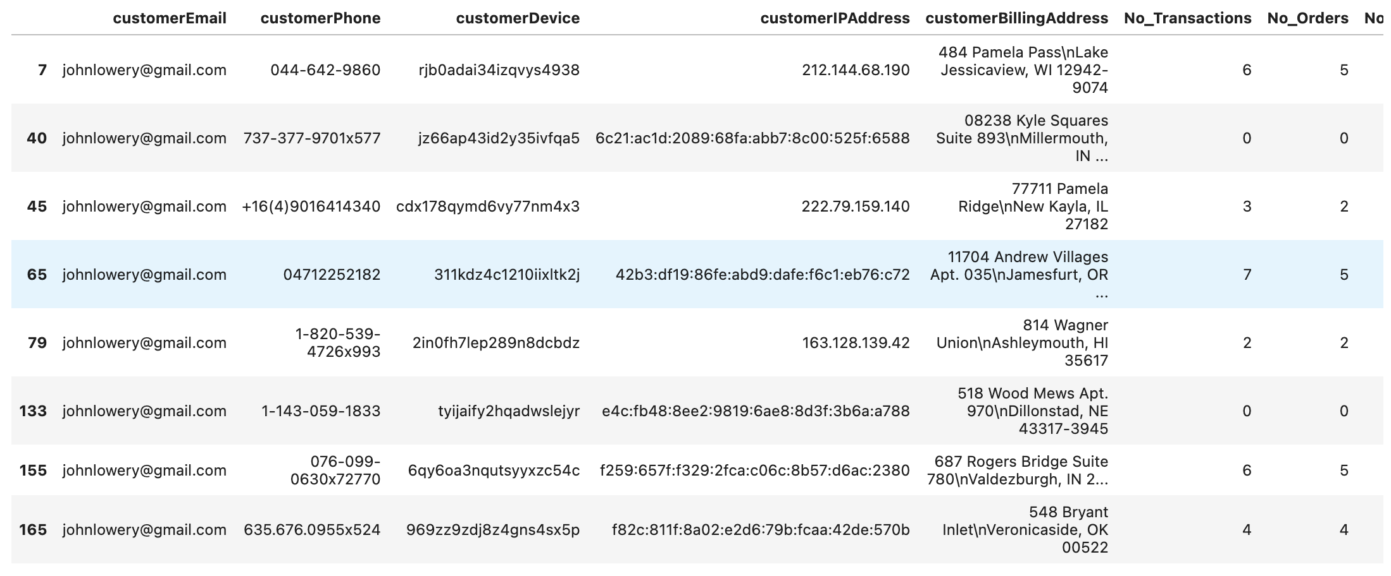
Data Wrangling
‘johnlowery@gmail.com’ is a potential criminal with a duplicated email address, which was marked as a Fraud in the transactions dataset.

Slide 5
EDA
Initial EDA revealed that out of total 2615 orders 9.83% were detected as being fraudulent. However, out of 623 transactions the 41.25% were marked as fraud.
Payment method provider analysis revealed that payment made using 16 digit JCB and Visa cards were less likely to detect fraud fulfilling the majority of the fraudulent orders.

Slide 6
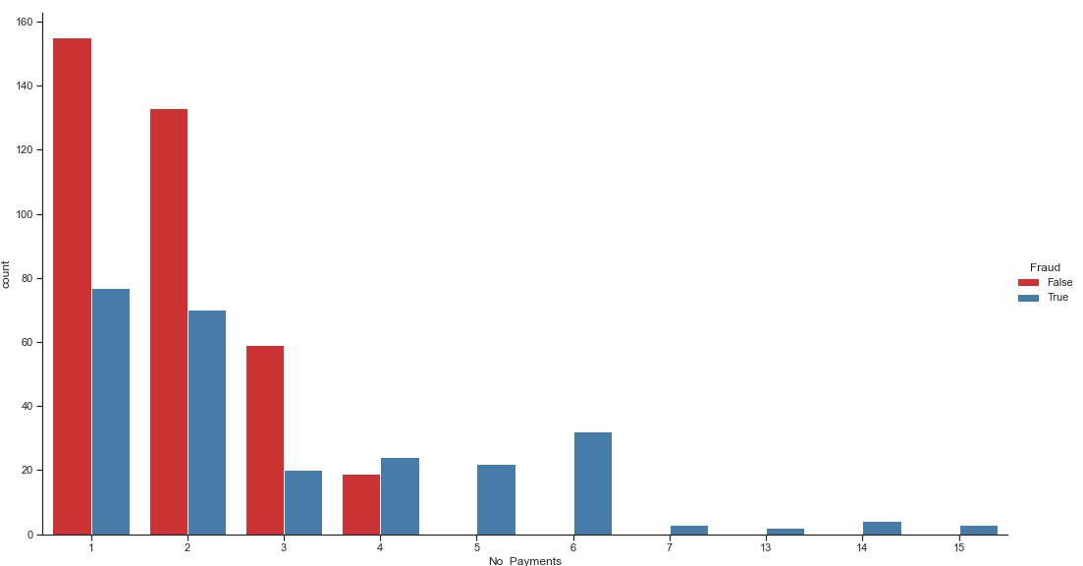
EDA - No of payments by Fraud Cases
All payment attempts above 4 results in Fraud.

Slide 7
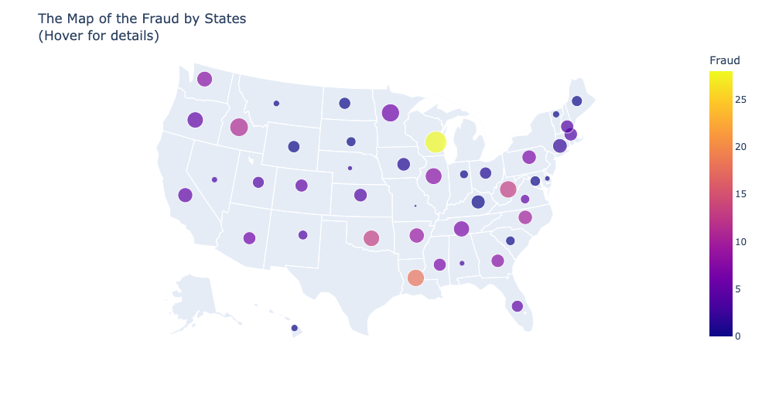
EDA – Where are the criminals?
The analysis of the geographic spread of Fraudulent activity revealed that 11% of all detected cases originated in Wisconsin.

Slide 8
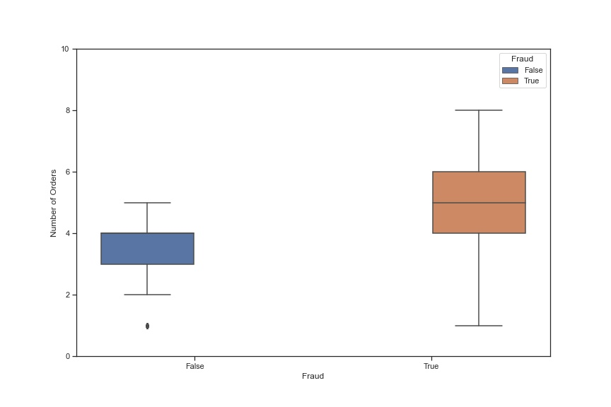
EDA – Box Plot
The box plot shows a distinct difference in the mean and distribution of orders between fraudulent and valid cases.

Slide 9
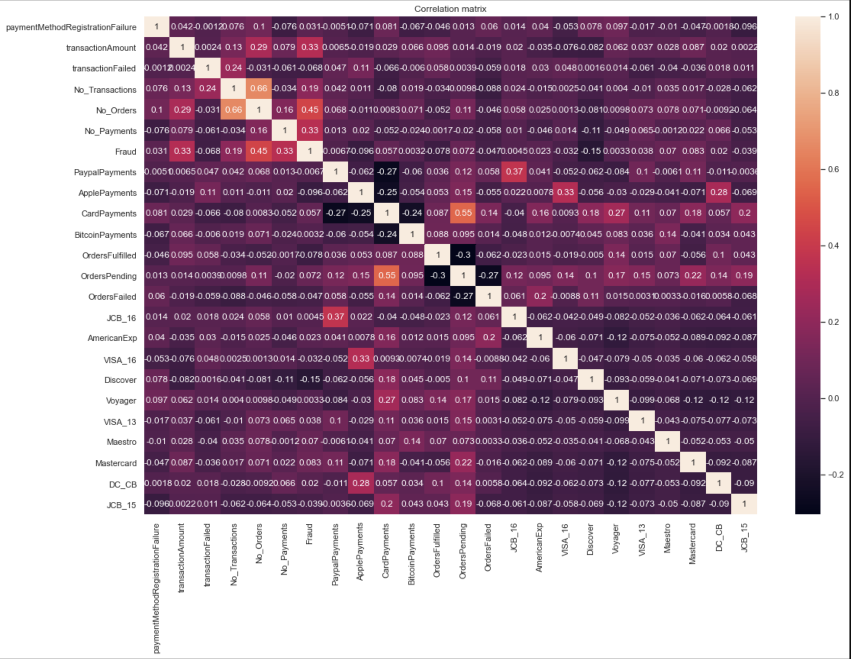
Preprocessing and Training Data Development
Preprocessing portion of this project involved the creation of the dummy variables to prepare categorical features for modeling. According to the scaled correlation matrix, the highest dependencies were detected between Fraud and the Number of Orders (0.45), Number of Payments (0.33), and Transaction Amount (0.33).

Slide 10
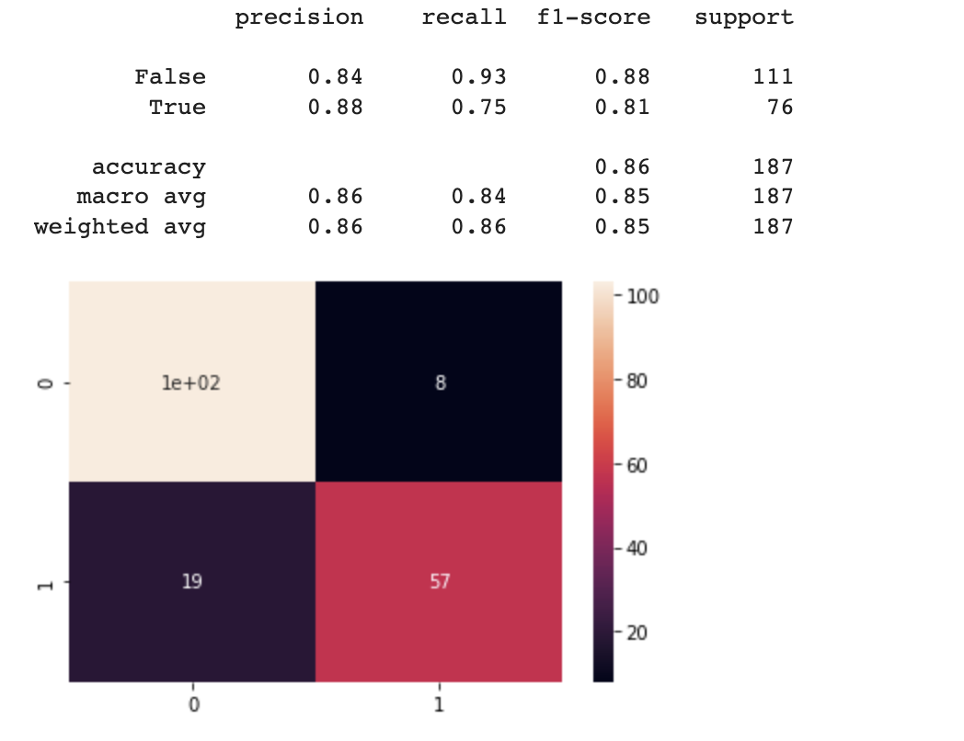
Data Modeling
I have tested Logistic Regressor, Random Forest Classifier, and Support Vector Machine-based models.
See confusion matrix as the accuracy score metric.
WINNER: Random Forest Classifier with accuracy precision of 86%, recall of 0.83, and F1 score of 0.85

Slide 11
References and Credits
Trivedi, V., I., & Trivedi, V. (2021, April 30). E-commerce fraud to surpass $20B in 2021, an 18% jump over last year, report finds. Payments Dive. https://www.paymentsdive.com/news/e-commerce-fraud-to-hit-20-billion-2021-an-18-jump-from-prior-year/599312/
A big Thank you to my amazing Mentor Dipanjan Sarkar

