Slide 1
SOKOBAN
maryam
Notes:
empty leaderboard
load non existing user
create new game
empty input
create new user
game
reset button
next few levels
- coin coin movement rule
quit
updated leaderboard
create new game
with existing user
load game
with non existing user
load user
game
complete all levels
load game
user that completed all levels
leaderboard
with more than 3 users, only show top 3
same levels arranged based on ???
invalid entry - remove white spaces infront and behidn the string

Slide 2
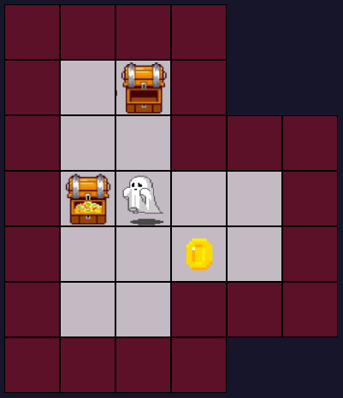

SOKOBAN
EMPTY CHEST
AIM
Push all Coins into Chests.
RULES
Player can move in 4 directions with arrow keypress
Player and Coins cannot move through walls, only through Floors and Chests
Player can push a Coin (not blocked by a Wall or another Coin)
WALL
COIN
IN CHEST
COIN
PLAYER
FLOOR
PLAYER ON CHEST
Notes:
Grid not randomized, saved in state
Things to consider
- Paint maps from strings (split into rows, split into individual elements – columns)
Coordinates of player, the preceding point and the following point
Adding restrictions (wall, double coins…)

Slide 3
WIREFRAMING
Notes:
Helped a lot, to come up w little details such as errors when someone creates a new user with an existing username.

Slide 4
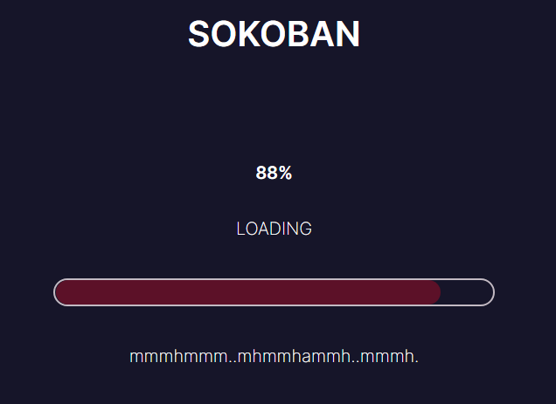
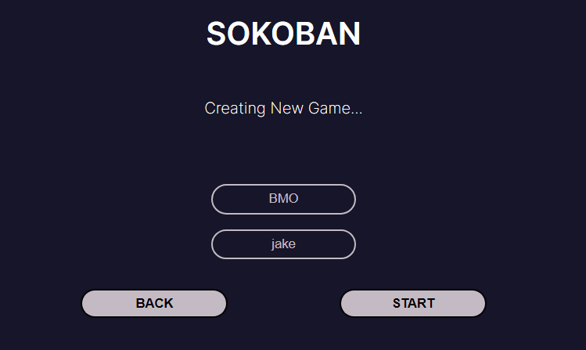
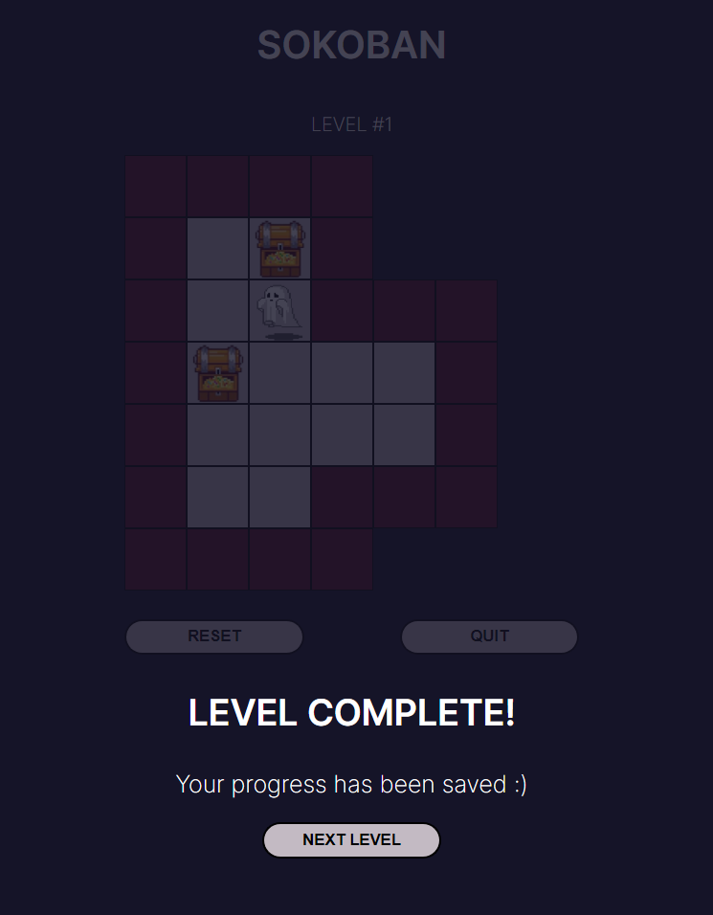
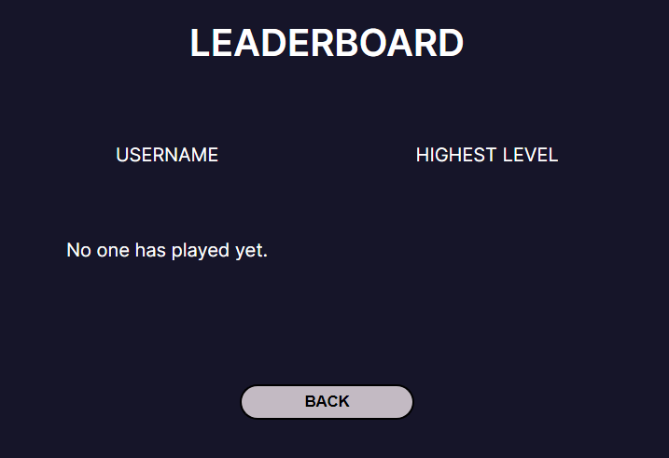
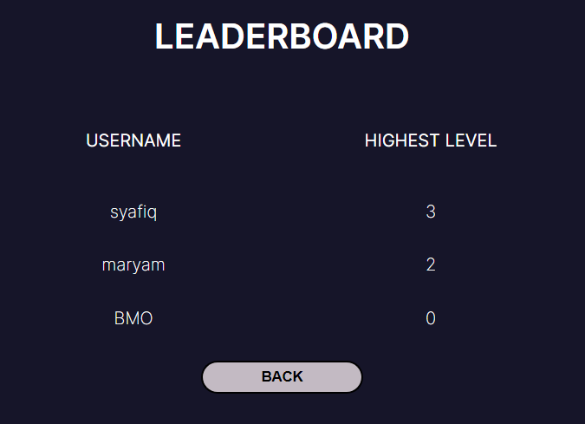
++
CREATING/LOADING GAME
Error messages
LOADING BAR PAGE
GAME
Reset
Quit
Next Level
LEADERBOARD
Empty
Filled

Slide 5
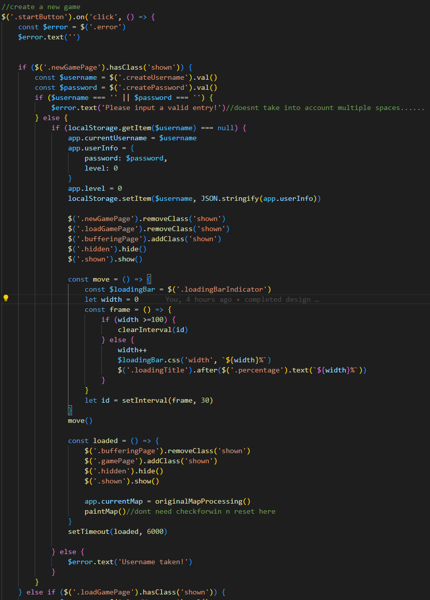

CODE
Access input value, username and password
Check for empty entries and return error message when necessary
Valid entry:
Check for existence of username in localStorage (getItem()), return error when necessary
Update state (app) and localStorage
Hide other pages and show the next page: bufferingPage
BufferingPage
move()
Width changes 0 – 100 in 30ms intervals
Adjusts width and text(%) of loading bar
100: clearInterval()
loaded()
Changes to gamePage after 6000ms (loading bar is complete)
JSON.stringify() | JSON.parse
Notes:
Smtg to think about, how to counter entry with multiple spaces/other invalid entries

Slide 6
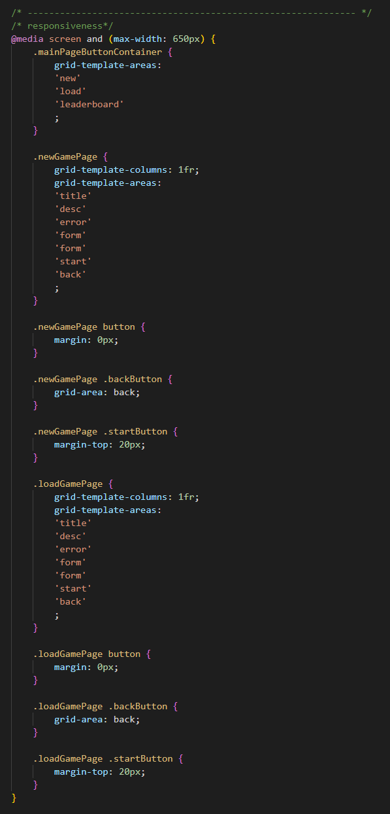
RESPONSIVENESS

Slide 7
PRECEDING
PRECEDING
PLAYER
PLAYER
FOLLOWING
FOLLOWING
PRECEDING
FOLLOWING
RESTR R1
R,C
R,C
R,C
RESTR C1
PLAYER
RESTR R
RESTR C
cannot be over grid
cannot walk past wall etc

