Slide 1
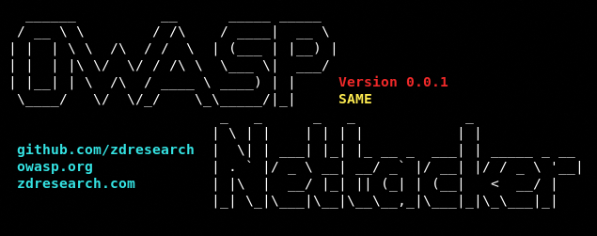
OWASP-Nettacker

Slide 2
What is OWASP Nettacker
OWASP Nettacker project was created to automate information gathering, vulnerability scanning and in general to aid penetration testing engagements.
Nettacker is able to run various scans using a variety of methods and generate scan reports(in HTML/TXT/JSON/CSV format) for applications and networks, including discovering open ports, services, bugs, vulnerabilities, misconfigurations, default credentials, subdomains, etc.
Nettacker can be run as a command-line utility (including running as a Docker container), API, Web GUI mode or as Maltego transforms

Slide 3
Installation & Configuration of OWASP Nettacker
Implementing OWASP Nettacker involves several steps, including installation, configuration, and running the tool. For Windows OWASP Nettacker displayed some limitations on my end, therefore I used a Linux image in the docker to install the Nettacker.
Prerequisites
Python 3.x: Ensure you have Python 3.x installed on your system.
Git: You need Git to clone the OWASP Nettacker repository.
Steps
Pull Ubuntu’s image i.e. ‘ubuntu:24.04’ on docker desktop
Run the image using the following command;
docker run -it ubuntu:24.04
Update the apt-getand install pre-reqisite packages using the commands;
apt-get update
apt-get install python3
apt-get install pip
apt install python3.12-venv
Activate the virtual environment;
Python -m venv venv
source venv/bin/activate

Slide 4
Installation & Configuration of OWASP Nettacker
Clone the Repository (directly on Linux or import the downloaded code through docker desktop):
git clone https://github.com/OWASP/Nettacker.git
git clone https://github.com/username/Netacker.git
Install Dependencies:
python3 -m pip install -r docs/requirements.txt
Following are the packages not installed through requirements.txt, therefore installed them manually
Multiprocess
Numpy
Netaddr
Texttable
aiohttp
Sqlalchemy
check if installation is successful using the command; ‘python nettacker.py’

Slide 5
Basic types of scans in Nettacker
Using OWASP Nettacker involves running it through the command line to perform various types of scans, such as network scanning, information gathering, and vulnerability detection. Here's how to use OWASP Nettacker:
Scan option: https://github.com/OWASP/Nettacker/wiki/Modules#scan-modules
Port Scan: https://github.com/OWASP/Nettacker/wiki/Modules#ports-scanned-by-nettacker
Vulnerabilities options: https://github.com/OWASP/Nettacker/wiki/Modules#vuln-modules
Brute Modules: https://github.com/OWASP/Nettacker/wiki/Modules#brute-modules

Slide 6
How to Run the tool?
1. Basic Command Structure
Nettacker is run through the command line. The basic command structure is:
python nettacker.py -i <target> -m <module> -o <output_file> -f <format>
2. Commonly Used Options
-i, --target: Define the target IP address, domain name, or CIDR range.
-m, --module: Specify the module to use (e.g., port_scan, http_brute, subdomain_scan, etc.).
-o, --output: Specify the output file name.
-f, --format: Set the output format (e.g., HTML, JSON, XML, etc.).
-l, --list: Display all available modules.
-v, --verbose: Increase output verbosity.
For example, to scan a target IP with the port_scan module and save the output in HTML format:
python nettacker.py -i https://pulse.10pearls.com/v2/home -m http_status_scan -o report.html –f html

Slide 7
Live Demo
Run docker desktop application
Run the container manually on the application.
Run power shell as administrator then execute;
docker exec -it 9bf14ccec3ab sh
docker exec -t -i vigorous_hofstadter /bin/bash
cd tmp/Nettacker-master/
Run the ls command to make sure it has nettacker.py
python3 -m venv venv
source venv/bin/activate
python nettacker.py -i https://pulse.10pearls.com/v2/home -m http_status_scan -o report.html

Slide 8
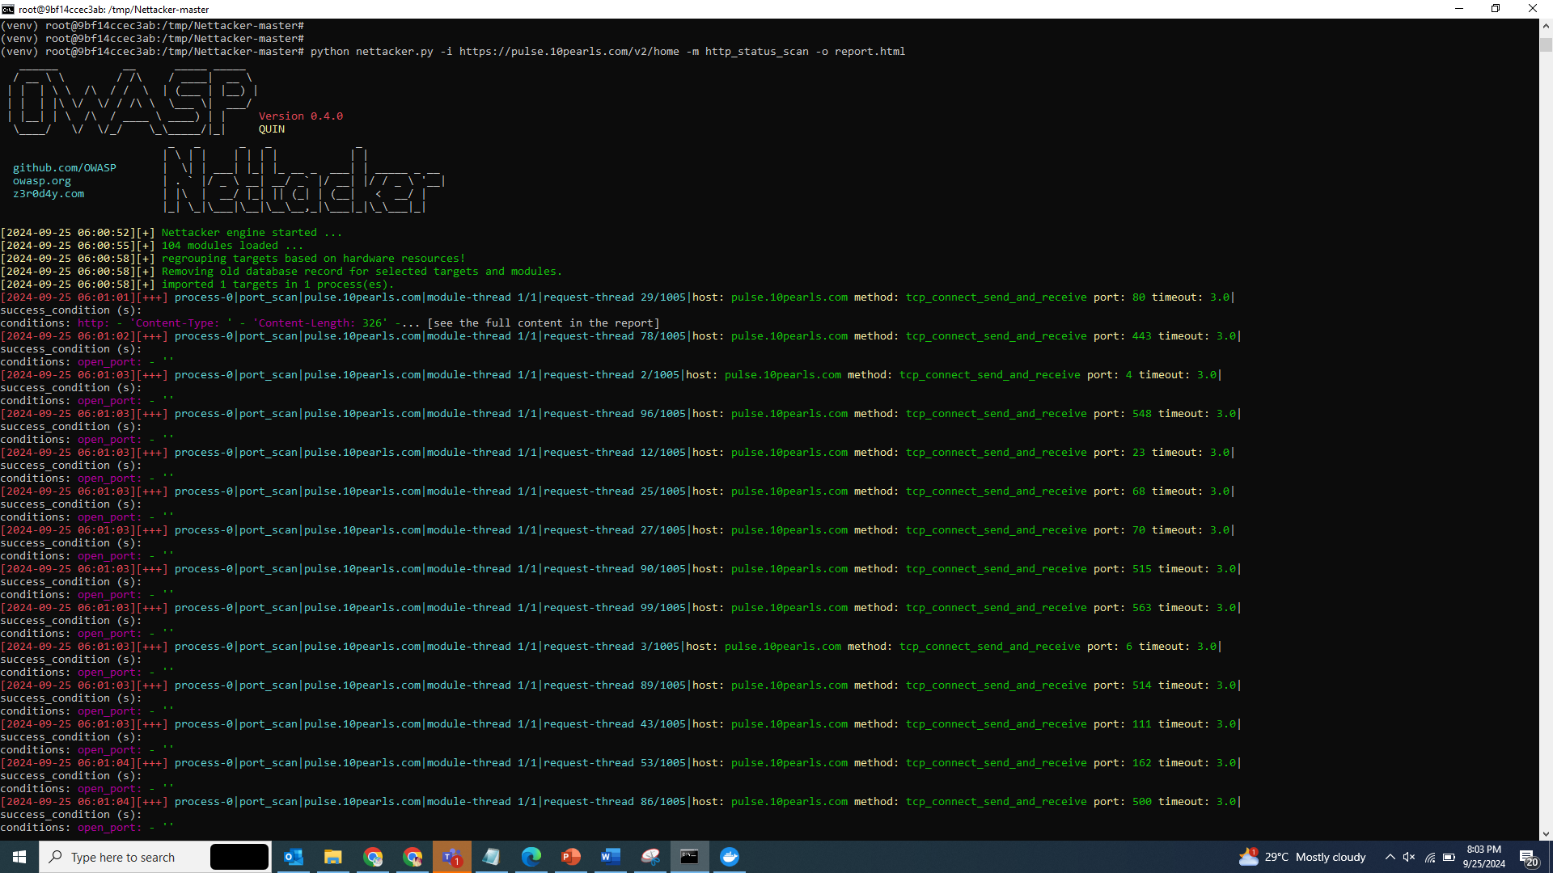
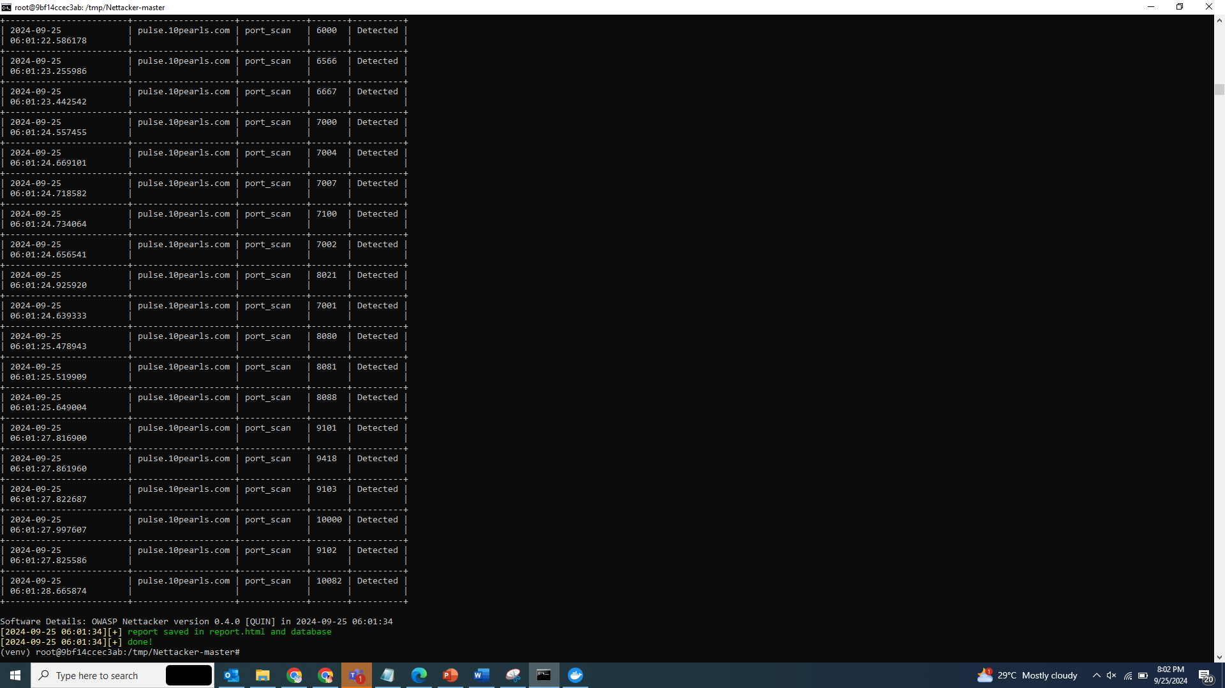
Reference images for port scan
Reference Report: file:///C:/Users/maryam.asad/Downloads/tmp/Nettacker-master/report.html

Slide 9
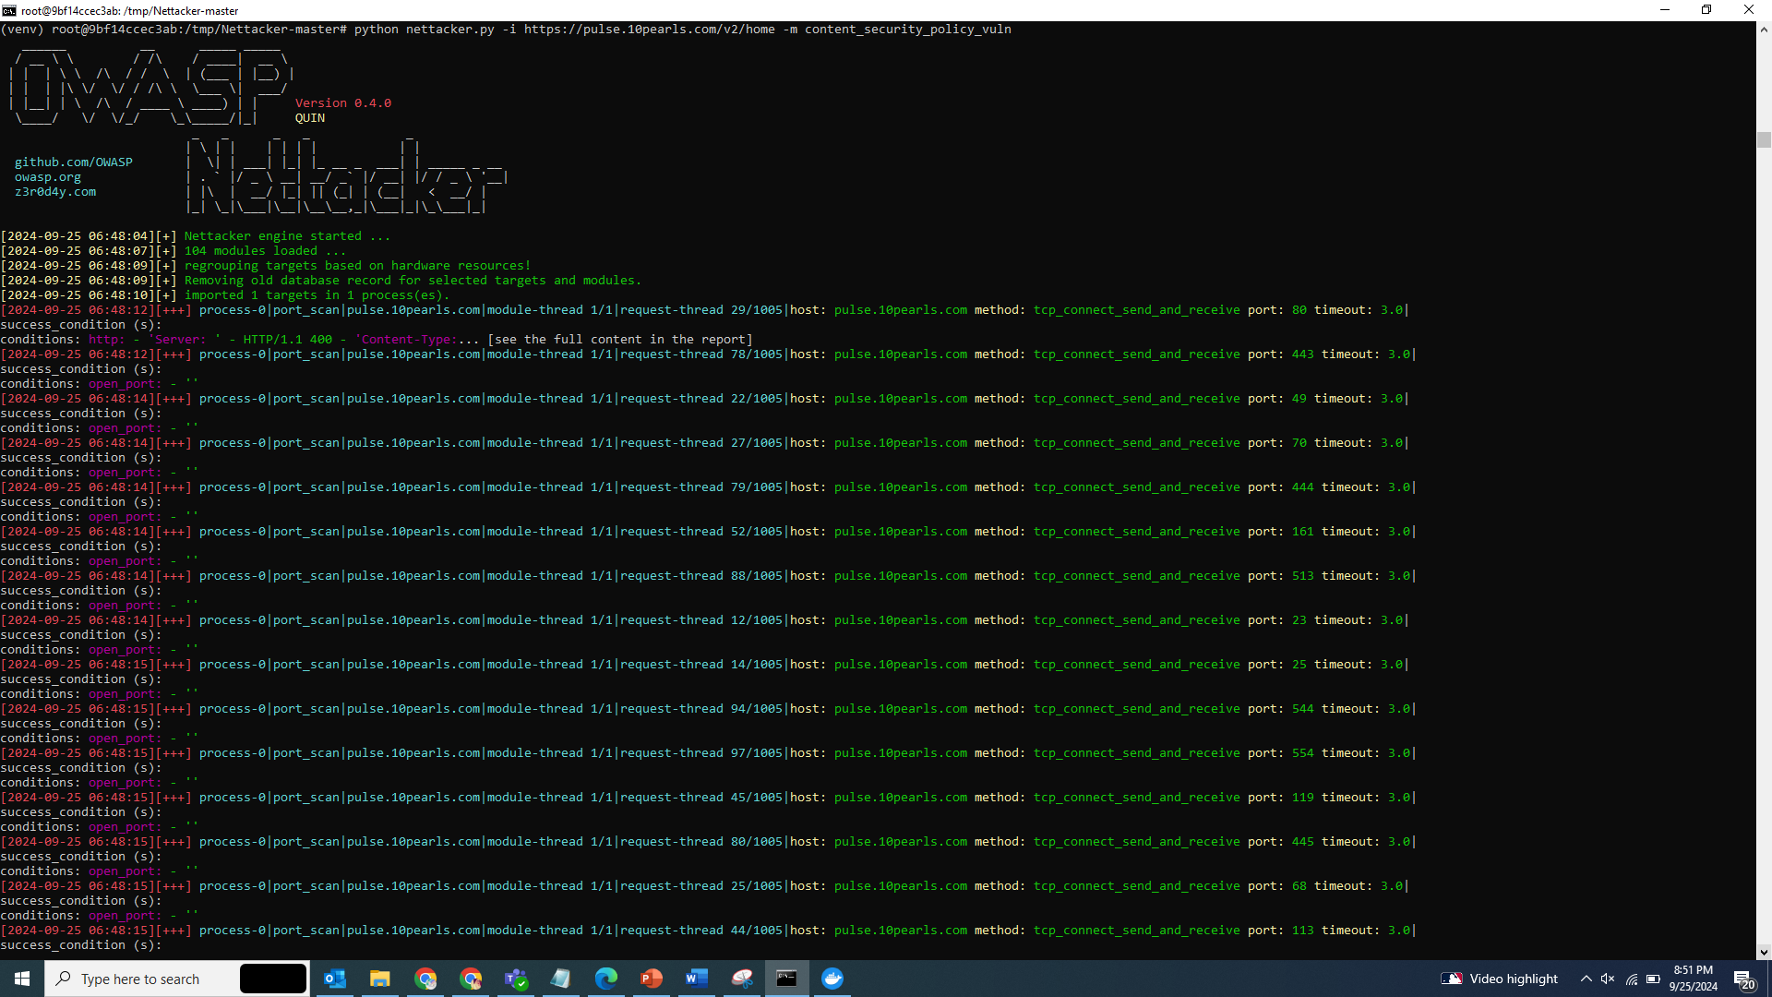
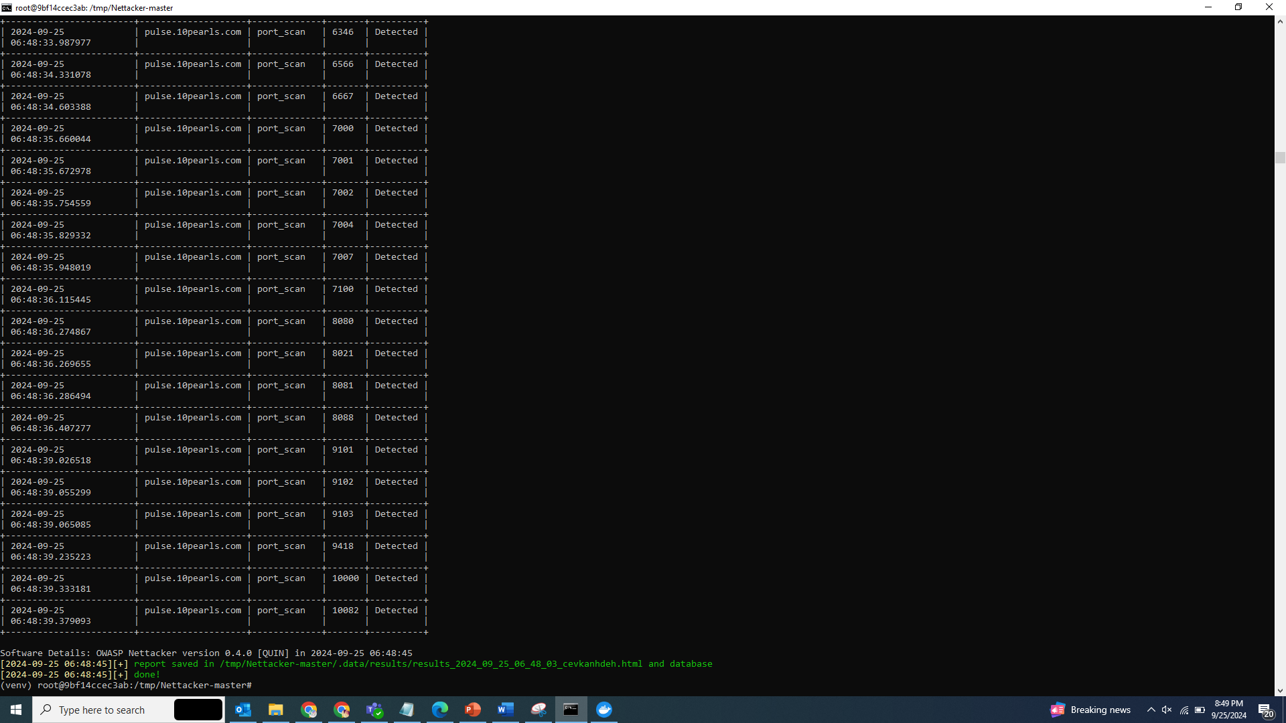
Vulnerability Scan
python nettacker.py -i https://pulse.10pearls.com/v2/home -m content_security_policy_vuln
Reference Report: file:///C:/Users/maryam.asad/Downloads/tmp/Nettacker-master/.data/results/results_2024_09_25_06_53_45_cucbnbucwn.html

