Slide 1
Longitudinal Plots: All trials

Slide 2
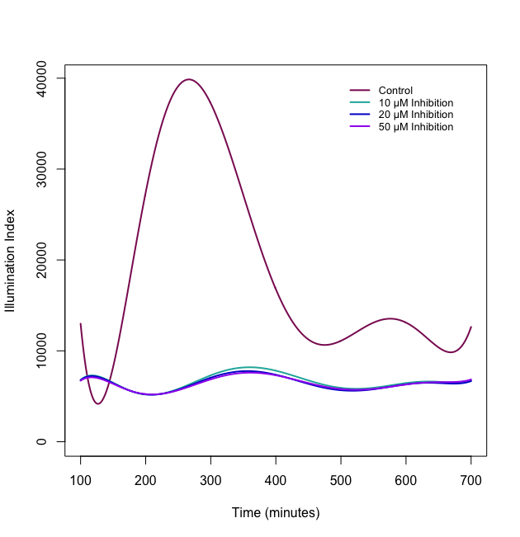
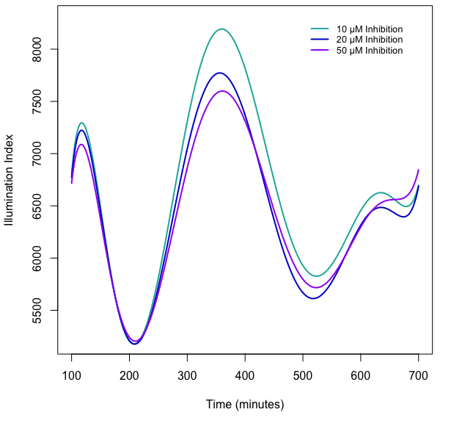
Illumination Trial 1: All Concentration Curves
Illumination Trial 1: INH Concentration curves

Slide 3
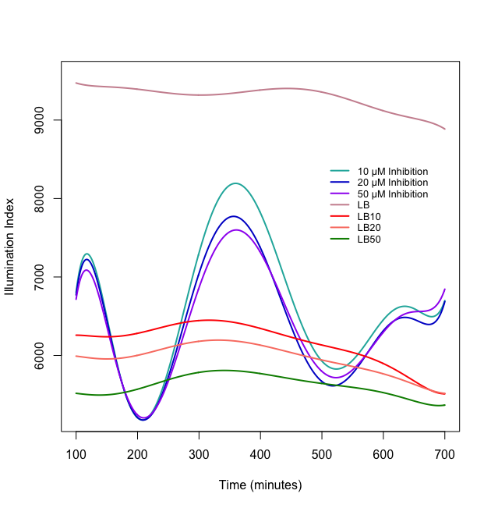
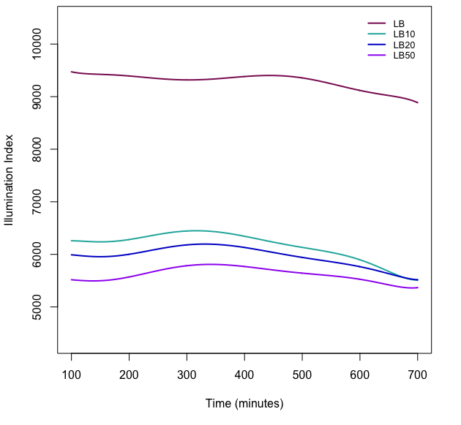
Illumination Trial 1: INH + LB Curves
Illumination Trial 1: LB Curves

Slide 4
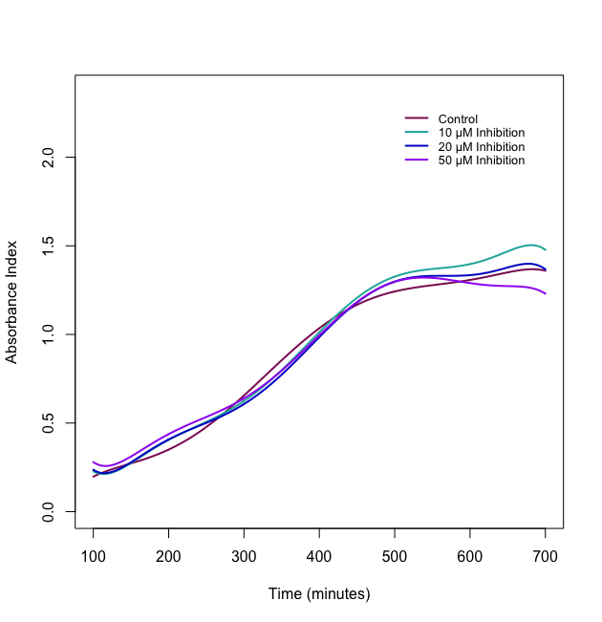
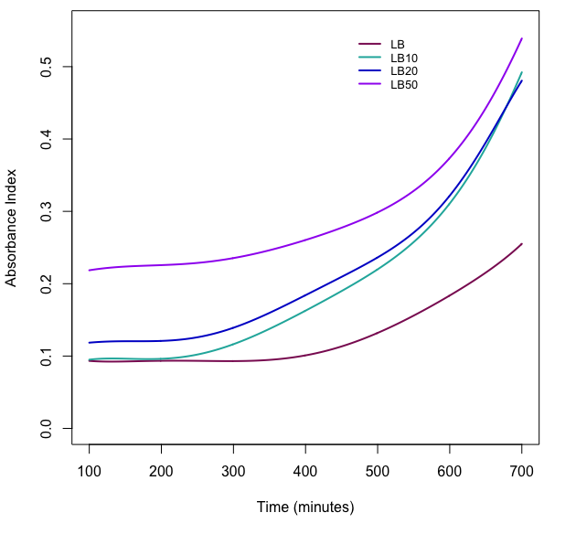
Absorbance Trial 1: All Concentration Curves
Absorbance Trial 1: All LB Concentration Curves

Slide 5
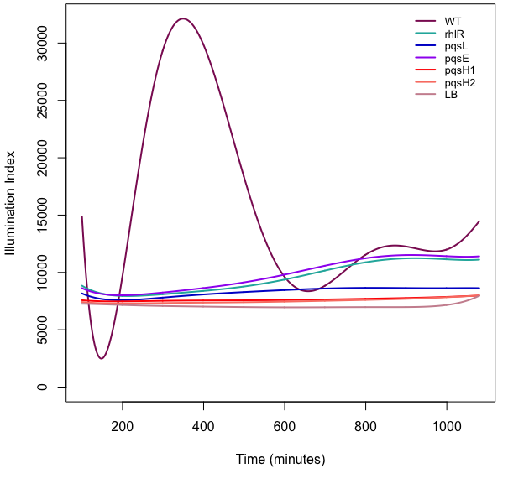
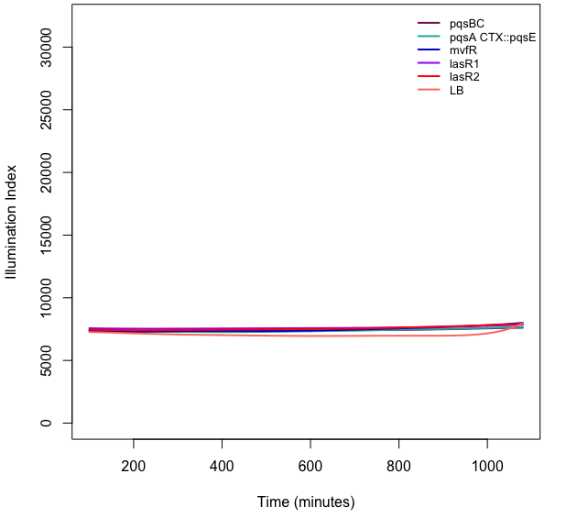
Illumination Trial 2: First Half Deletion Curves
Illumination Trial 2: Second Half Deletion Curves

Slide 6
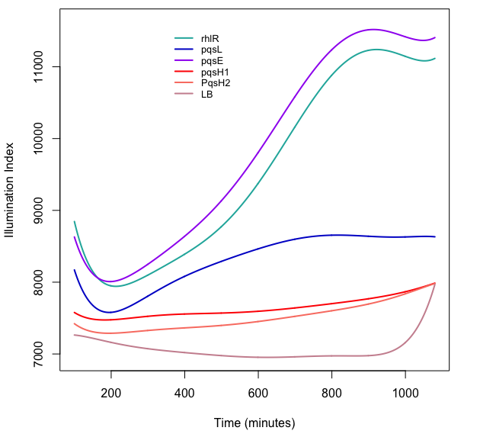
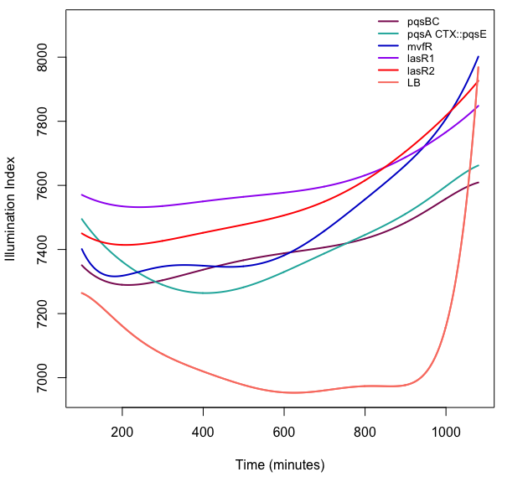
Illumination Trial 2: First Half Focused Deletion Curves
Illumination Trial 2: Second Half Focused Deletion Curves

Slide 7
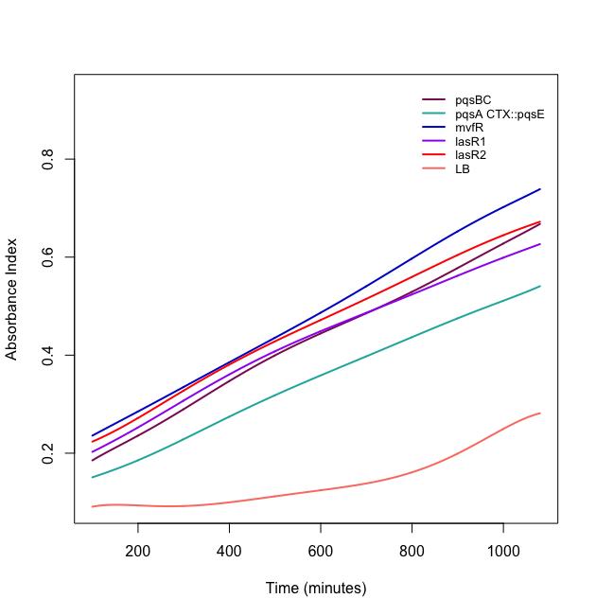
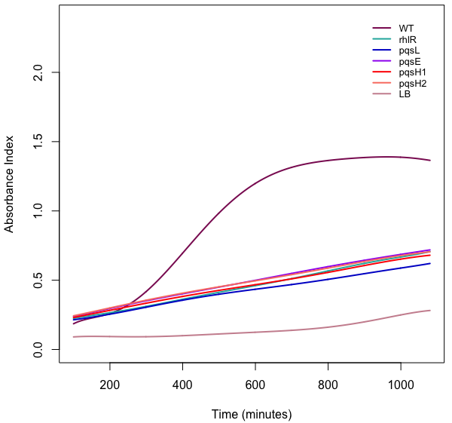
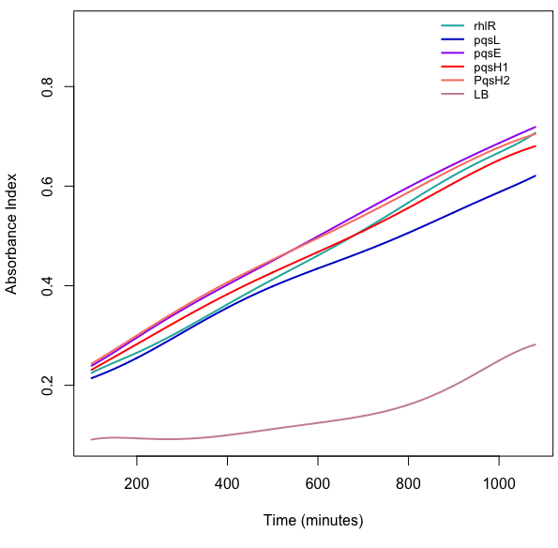
Trial 2: OD curves
First Half
First Half (no WT)
Second Half

Slide 8
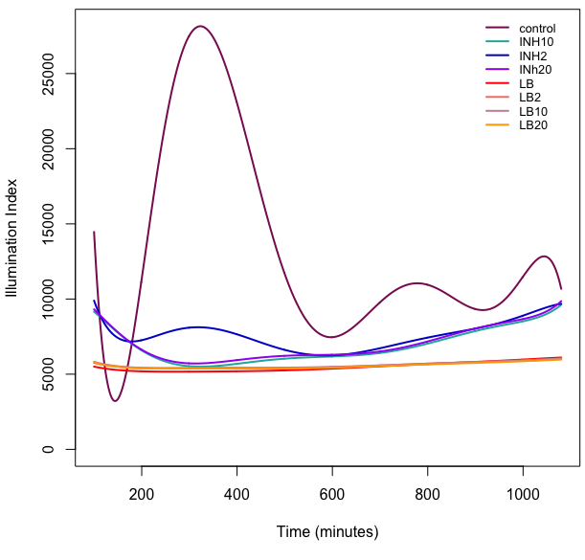
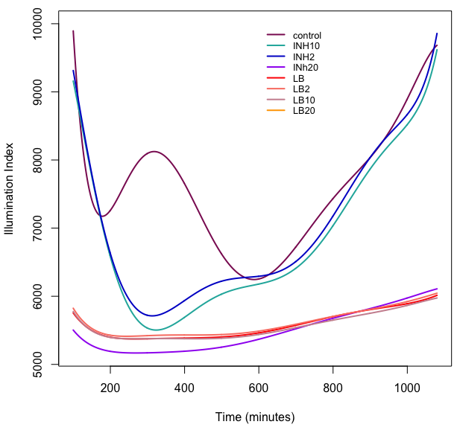
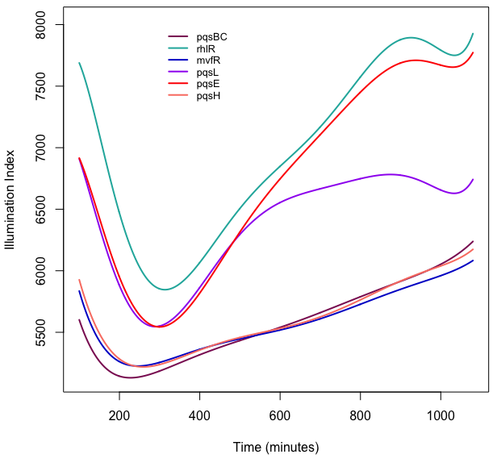
Trial 3: Illumination Curves
All inhibition curves
Focused inhibition curves
Gene deletion curves

Slide 9
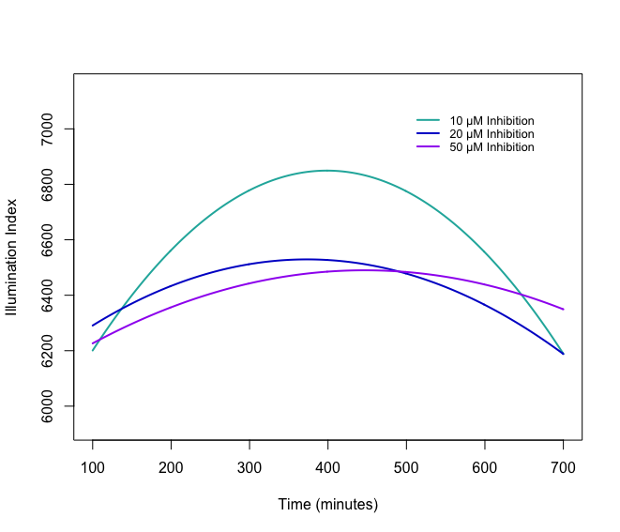
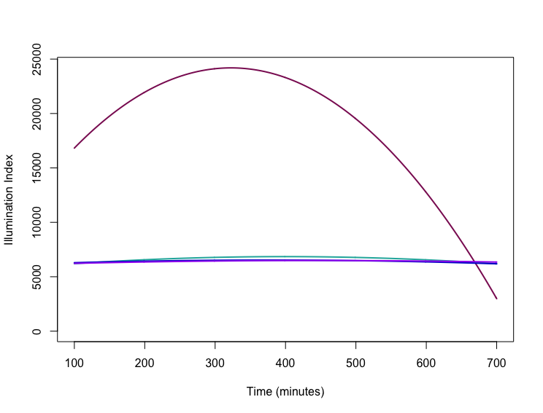
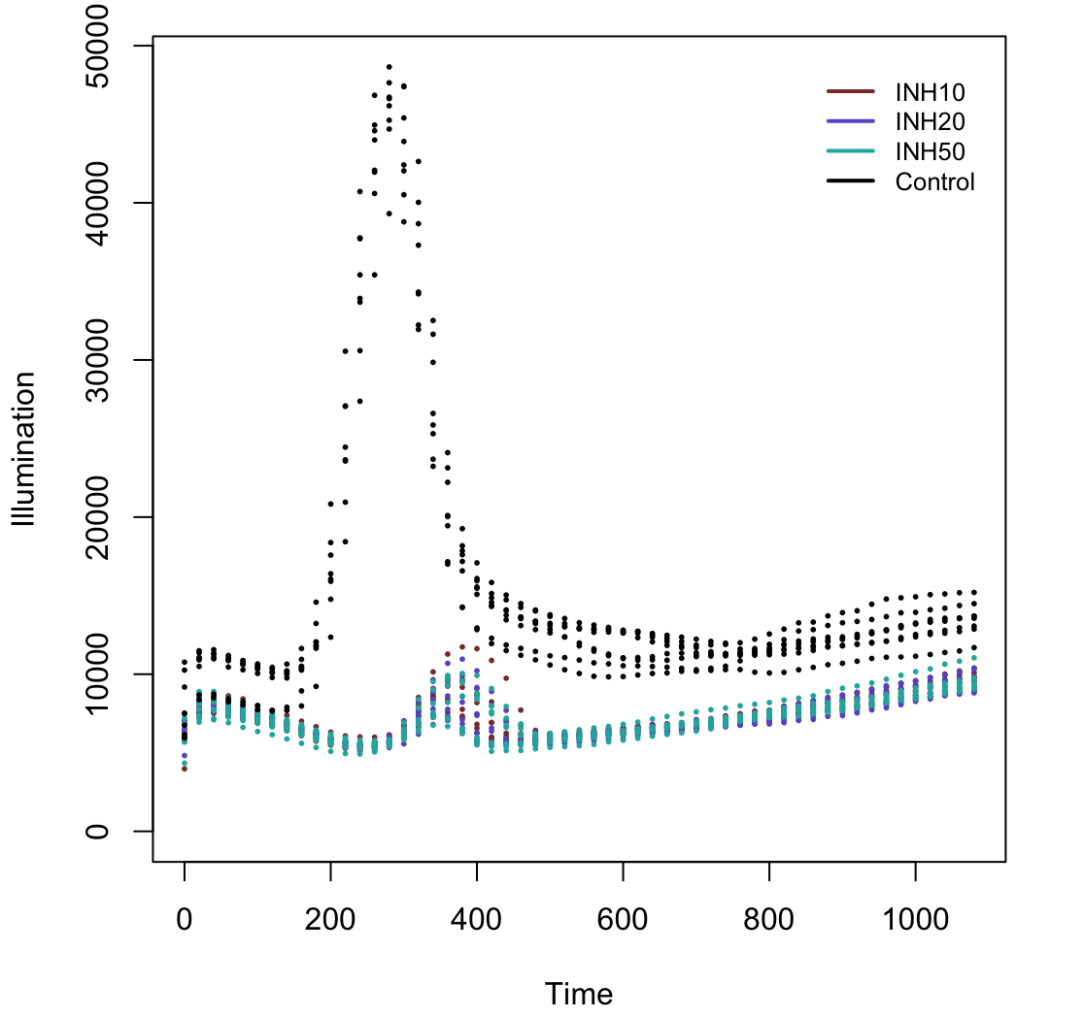
≠
Trial 1: Illumination Curves
10, 20, 50 INH Curves (poly: 2)
Non-Longitudinal Curves

Slide 10
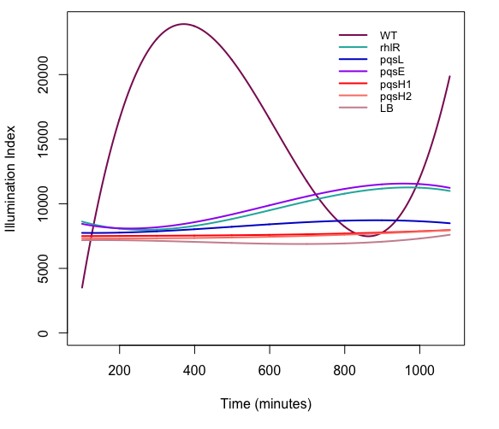
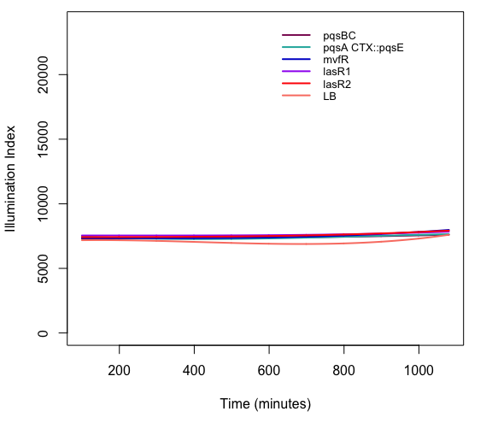
Trial 2: Illumination Curves
1st half of gene deletion curves (poly: 3)
2nd half of gene deletion curves (poly: 3)

Slide 11
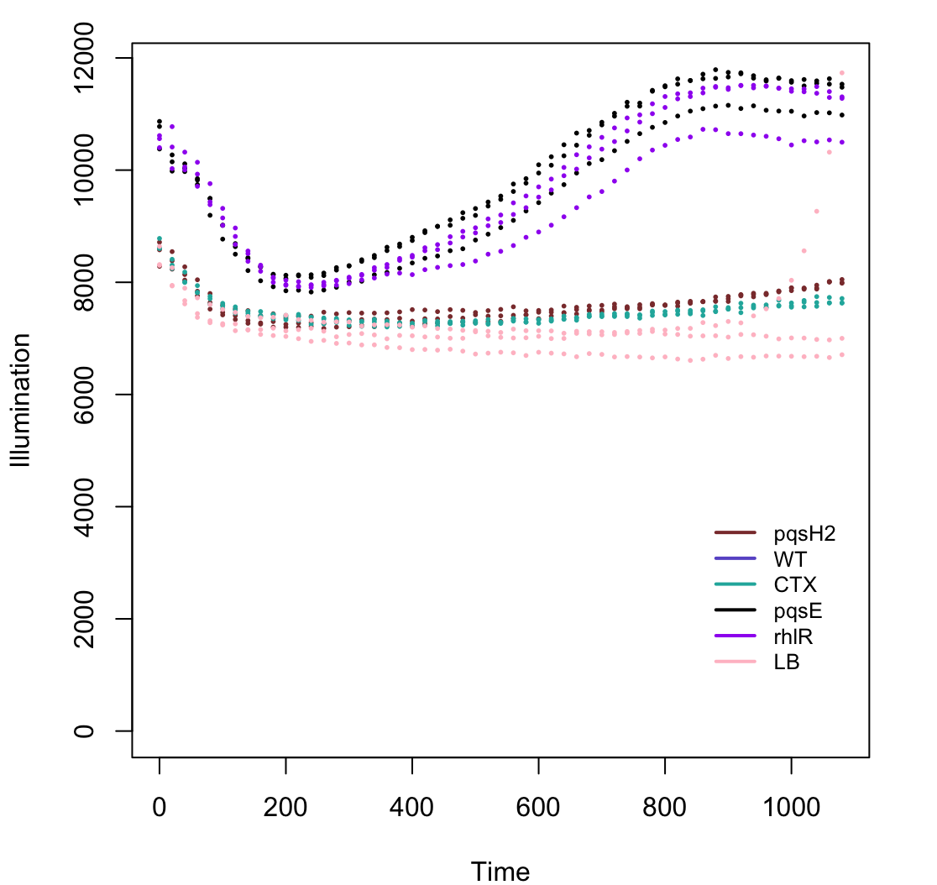
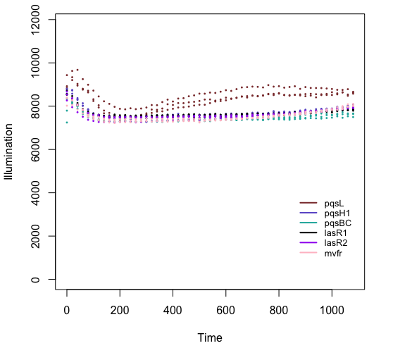
Trial 2: Raw Data Curves
1st half raw data curves
2nd half raw data curves

Slide 12
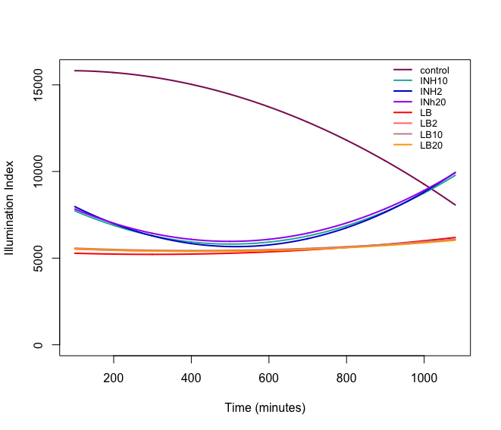
Trial 3: Illumination Curves
Inhibition curves (poly: 2)
Non-Longitudinal Curves

