Slide 1

Bank Account Management System
By
Maryam Bayzhigitova
Moldir Kumarbek
(BD-2005)

Slide 2

Agenda
Introduction
Working process:
Reflection
Screenshots of our project steps
Conclusion:
Learning outcomes
Summary

Slide 3

The “Bank Account Management System” project is a model of Banking Management System. The system provides the access to the customer to create an account, deposit/withdraw the cash from his account, also to view reports of all accounts present. In this project, we show how banking system works with branches and how Banking Management System facilitates banking transactions by customers.

Slide 4

Reflection:
Maryam Bayzhigitova
Write SQL query for DML statements.
Write the subqueries.
Select information about project.
Create ERD using Crow’s Foot notation.
Documenting our work.
Moldir Kumarbek
Create database.
Write ALTER TABLE statements.
Write the queries.
Create ppt for presentation.

Slide 5
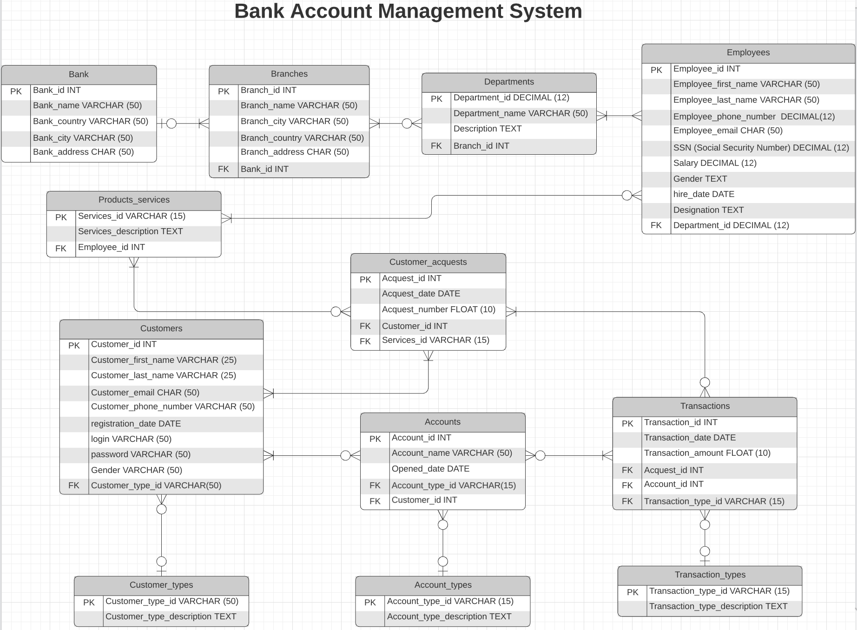
Crow’s Foot notation

Slide 6
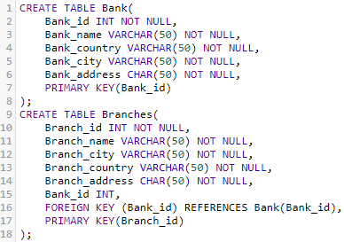

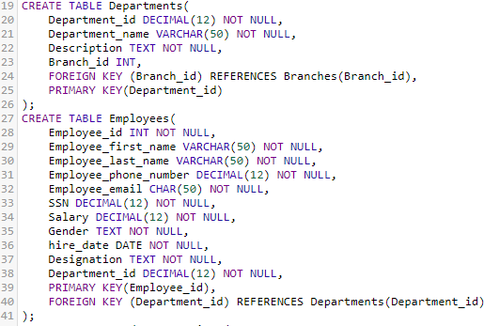
Create tables and ALTER table

Slide 7
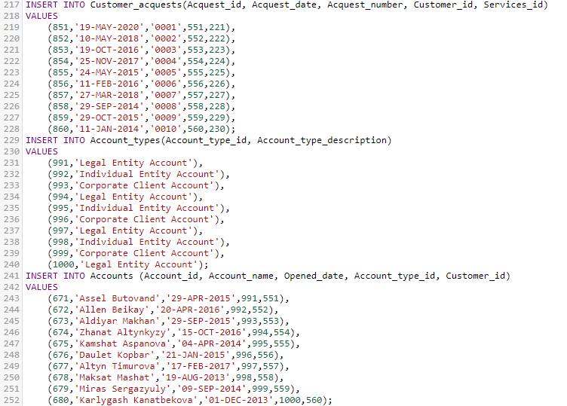
DML Statements: INSERT INTO (1/5)

Slide 8
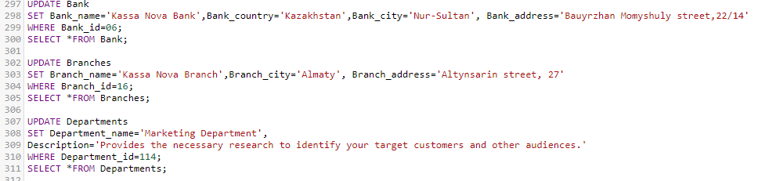
UPDATE Statement (2/5)

Slide 9
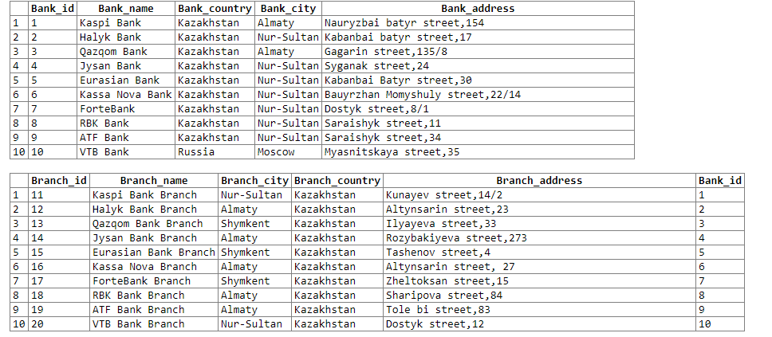
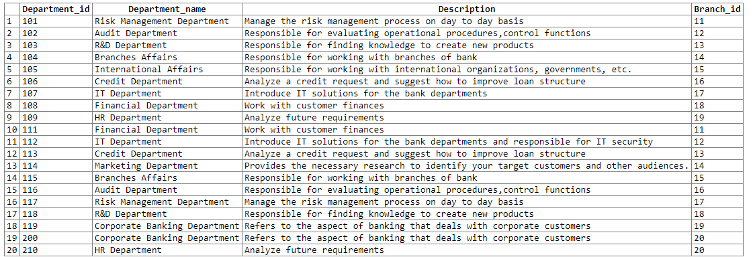
Results of UPDATE Statement (3/5)

Slide 10
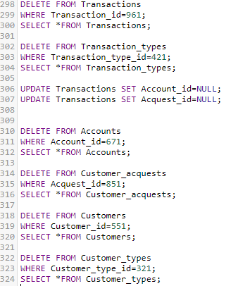
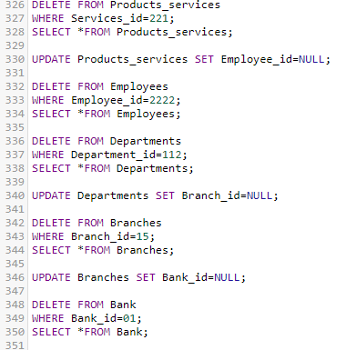
DELETE Statement (4/5)

Slide 11
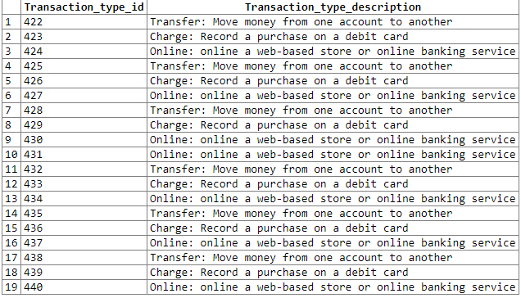
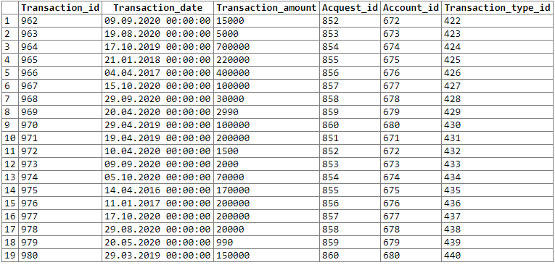
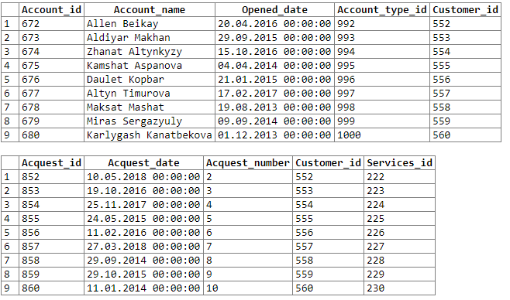
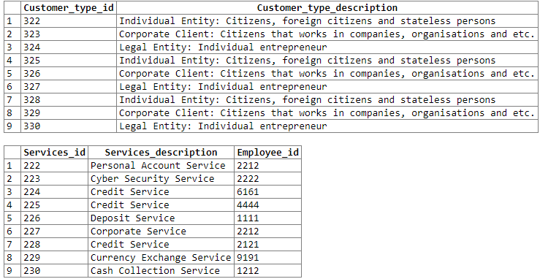
Results of DELETE Statement (5/5)

Slide 12
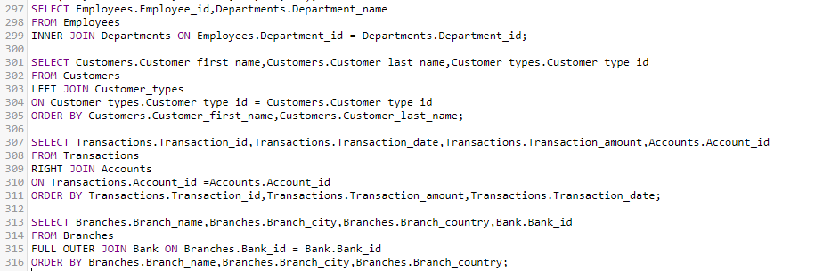
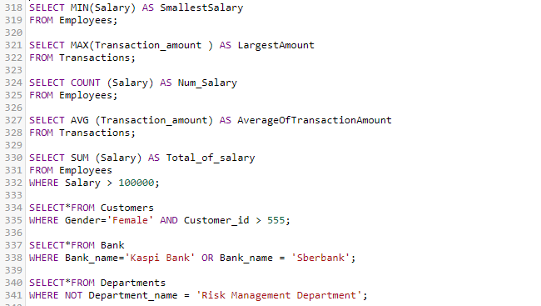
Queries (1/2)

Slide 13
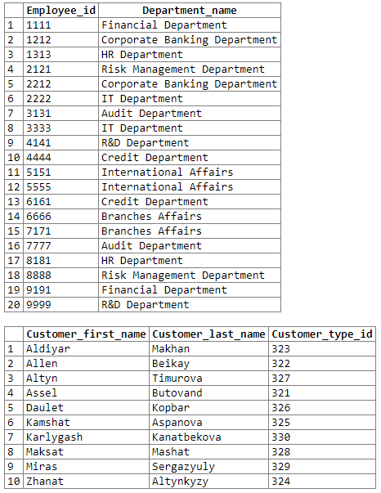
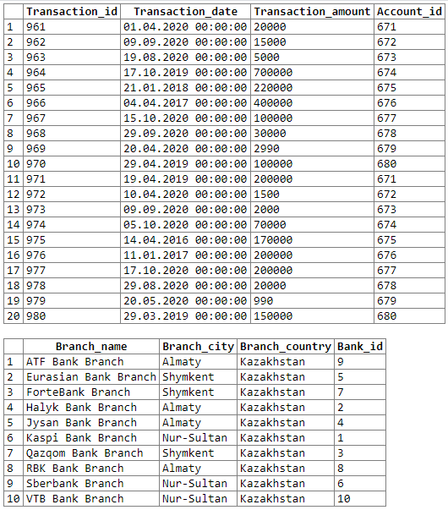
Results of Queries (2/2)

Slide 14
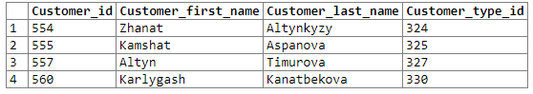
Subqueries (1/2)

Slide 15
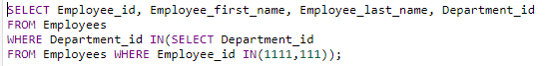

Subqueries (2/2)

Slide 16

Learning outcomes from the project work：
In the process of completing the work, we learned a lot. We collected a lot of information in the completion studio to improve our shortcomings and lack of knowledge. In addition, we have established a good tacit understanding in the team and completed the final work with good cooperation, so we have established a tacit understanding and cooperation during the work.

Slide 17

The Bank Account Management System is an application for maintaining a person’s account in a bank. In this project we tried to show the working of a banking account system and cover the basic functionality of a Bank Account Management System.
The main aim of this project is to develop software for Bank Account Management System.
This project is developed using online SQL Server language.

Slide 18


