Slide 1
Balanced Distribution Adaptation for Transfer Learning
IEEE International Conference on Data Mining, ICDM, 2017
Machine Learning – Maryam Sadat Hashemi

Slide 2

1) Mathematical definition of the problem
Labeled source domain = $\left\{x_{s_{i}}, y_{s_{i}}\right\}\begin{matrix}n \\ i=1\end{matrix}$

Slide 3

1) Mathematical definition of the problem
Labeled source domain = $\left\{x_{s_{i}}, y_{s_{i}}\right\}\begin{matrix}n \\ i=1\end{matrix}$

Slide 4

1) Mathematical definition of the problem
Labeled source domain = $\left\{x_{s_{i}}, y_{s_{i}}\right\}\begin{matrix}n \\ i=1\end{matrix}$
Unlabeled target domain = $\left\{x_{t_{j}}\right\}\begin{matrix}m \\ j=1\end{matrix}$

Slide 5

1) Mathematical definition of the problem
Labeled source domain = $\left\{x_{s_{i}}, y_{s_{i}}\right\}\begin{matrix}n \\ i=1\end{matrix}$
Unlabeled target domain = $\left\{x_{t_{j}}\right\}\begin{matrix}m \\ j=1\end{matrix}$

Slide 6

1) Mathematical definition of the problem
Labeled source domain = $\left\{x_{s_{i}}, y_{s_{i}}\right\}\begin{matrix}n \\ i=1\end{matrix}$
Unlabeled target domain = $\left\{x_{t_{j}}\right\}\begin{matrix}m \\ j=1\end{matrix}$
$$X_{s}= X_{t}$$
$$Y_{s}= Y_{t}$$
$${P_{s}(x}_{s})≠{P_{t}(x}_{t})$$
$${P_{s}(y_{s}|x}_{s})≠{P_{t}(y_{t}|x}_{t})$$

Slide 7

1) Mathematical definition of the problem
Labeled source domain = $\left\{x_{s_{i}}, y_{s_{i}}\right\}\begin{matrix}n \\ i=1\end{matrix}$ Assumption: $X_{s}= X_{t}$, $Y_{s}= Y_{t}$
Unlabeled target domain = $\left\{x_{t_{j}}\right\}\begin{matrix}m \\ j=1\end{matrix}$ ${P_{s}(x}_{s})≠{P_{t}(x}_{t})$ , ${P_{s}(y_{s}|x}_{s})≠{P_{t}(y_{t}|x}_{t})$

Slide 8
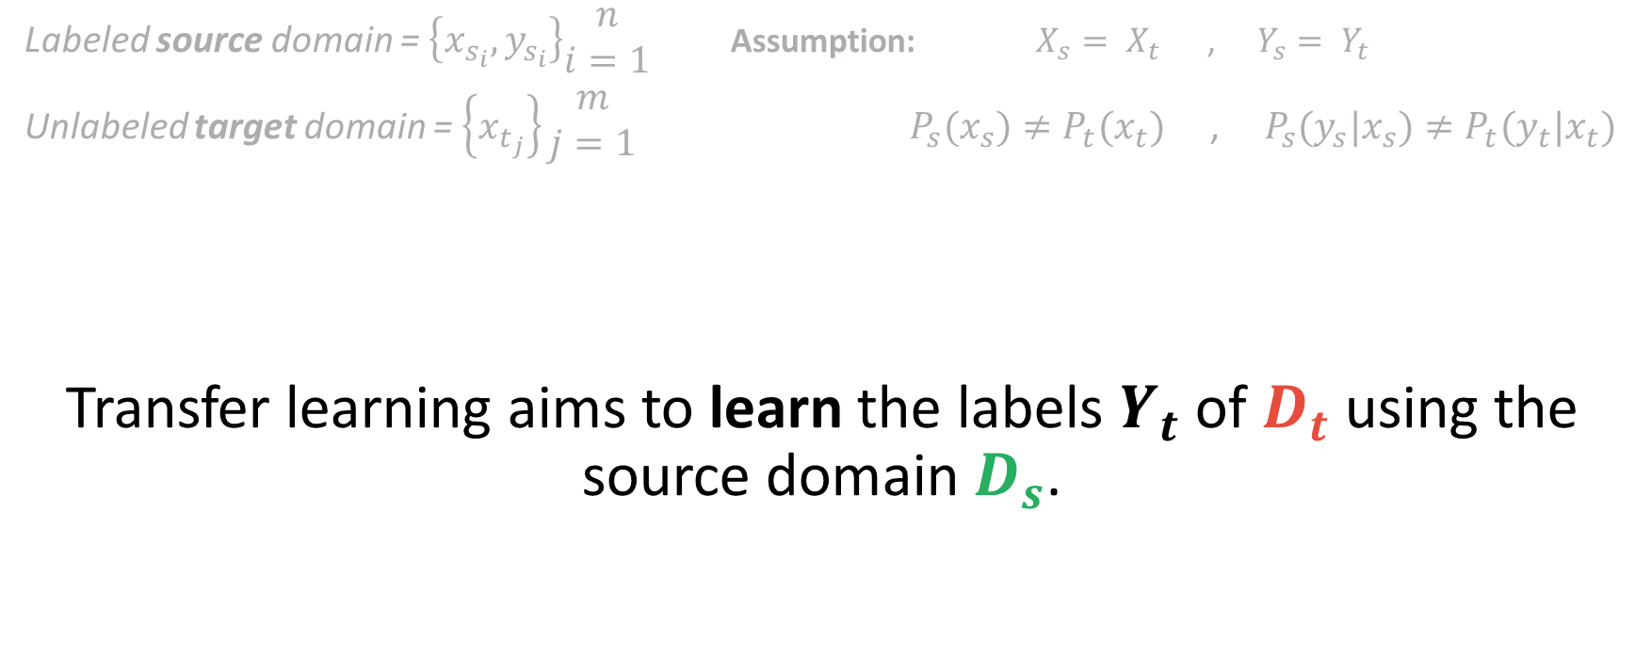
1) Mathematical definition of the problem
Labeled source domain = $\left\{x_{s_{i}}, y_{s_{i}}\right\}\begin{matrix}n \\ i=1\end{matrix}$ Assumption: $X_{s}= X_{t}$, $Y_{s}= Y_{t}$
Unlabeled target domain = $\left\{x_{t_{j}}\right\}\begin{matrix}m \\ j=1\end{matrix}$ ${P_{s}(x}_{s})≠{P_{t}(x}_{t})$ , ${P_{s}(y_{s}|x}_{s})≠{P_{t}(y_{t}|x}_{t})$
Transfer learning aims to learn the labels $Y_{t}$ of $D_{t}$ using the source domain $D_{s}$.

Slide 9

1) Mathematical definition of the problem
Labeled source domain = $\left\{x_{s_{i}}, y_{s_{i}}\right\}\begin{matrix}n \\ i=1\end{matrix}$ Assumption: $X_{s}= X_{t}$, $Y_{s}= Y_{t}$
Unlabeled target domain = $\left\{x_{t_{j}}\right\}\begin{matrix}m \\ j=1\end{matrix}$ ${P_{s}(x}_{s})≠{P_{t}(x}_{t})$ , ${P_{s}(y_{s}|x}_{s})≠{P_{t}(y_{t}|x}_{t})$
Transfer learning aims to learn the labels $Y_{t}$ of $D_{t}$ using the source domain $D_{s}$.

Slide 10
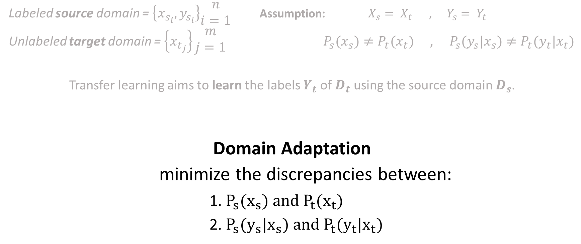
1) Mathematical definition of the problem
Labeled source domain = $\left\{x_{s_{i}}, y_{s_{i}}\right\}\begin{matrix}n \\ i=1\end{matrix}$ Assumption: $X_{s}= X_{t}$, $Y_{s}= Y_{t}$
Unlabeled target domain = $\left\{x_{t_{j}}\right\}\begin{matrix}m \\ j=1\end{matrix}$ ${P_{s}(x}_{s})≠{P_{t}(x}_{t})$ , ${P_{s}(y_{s}|x}_{s})≠{P_{t}(y_{t}|x}_{t})$
Transfer learning aims to learn the labels $Y_{t}$ of $D_{t}$ using the source domain $D_{s}$.
Domain Adaptation
minimize the discrepancies between:
1. ${P_{s}(x}_{s}) and {P_{t}(x}_{t})$
2. ${P_{s}(y_{s}|x}_{s}) and {P_{t}(y_{t}|x}_{t})$

Slide 11

2) What is the problem?
Problem 1:
Most of the existing distribution adaptation methods adapt either marginal distribution, conditional distribution or both.

Slide 12
2) What is the problem?
Problem 1:
Most of the existing distribution adaptation methods adapt either marginal distribution, conditional distribution or both.
But current methods consider the effect of both distributions to be the same.

Slide 13

2) What is the problem?
Problem 1:
Most of the existing distribution adaptation methods adapt either marginal distribution, conditional distribution or both.
But current methods consider the effect of both distributions to be the same.
When the datasets are much more dissimilar marginal distributions
When the datasets are similar conditional distributions

Slide 14


2) What is the problem?
Problem 1:
Therefore, how to adaptively
leverage the importance of
each distribution is a critical
problem.

Slide 15
2) What is the problem?
Problem 2:
Class imbalance often exists in many transfer learning scenarios.

Slide 16
2) What is the problem?
Problem 1:
Class imbalance often exists in many transfer learning scenarios.
Existing methods often ignore this issue by treating the classes as balanced across domains.

Slide 17
2) What is the problem?
Problem 2:
Therefore, how to handle the
class imbalance situation in
transfer learning is another
important challenge.

Slide 18

3) What is the solution?
Solution 1:
Balanced Distribution Adaptation

Slide 19
3) What is the solution?
Solution 1:
BDA

Slide 20
3) What is the solution?
Solution 1:
BDA
which can not only adapt marginal and conditional distributions between domains, but also regulate the importance of these two distributions in a balanced way.

Slide 21
3) What is the solution?
Solution 2:
Weighted Balanced Distribution Adaptation

Slide 22
3) What is the solution?
Solution 2:
WBDA

Slide 23
3) What is the solution?
Solution 2:
WBDA
can adaptively change the weight of each class when performing distribution adaptation.

Slide 24

4) BDA
$$Dist\left(D_{s,}D_{t}\right)≈Dist{(P (x}_{s}),{P(x}_{t}))+Dist({P(y_{s}|x}_{s}),{P(y_{t}|x}_{t}))$$

Slide 25

4) BDA
$$Dist\left(D_{s,}D_{t}\right)≈(1−μ)Dist{(P (x}_{s}),{P(x}_{t}))+μDist({P(y_{s}|x}_{s}),{P(y_{t}|x}_{t}))$$

Slide 26

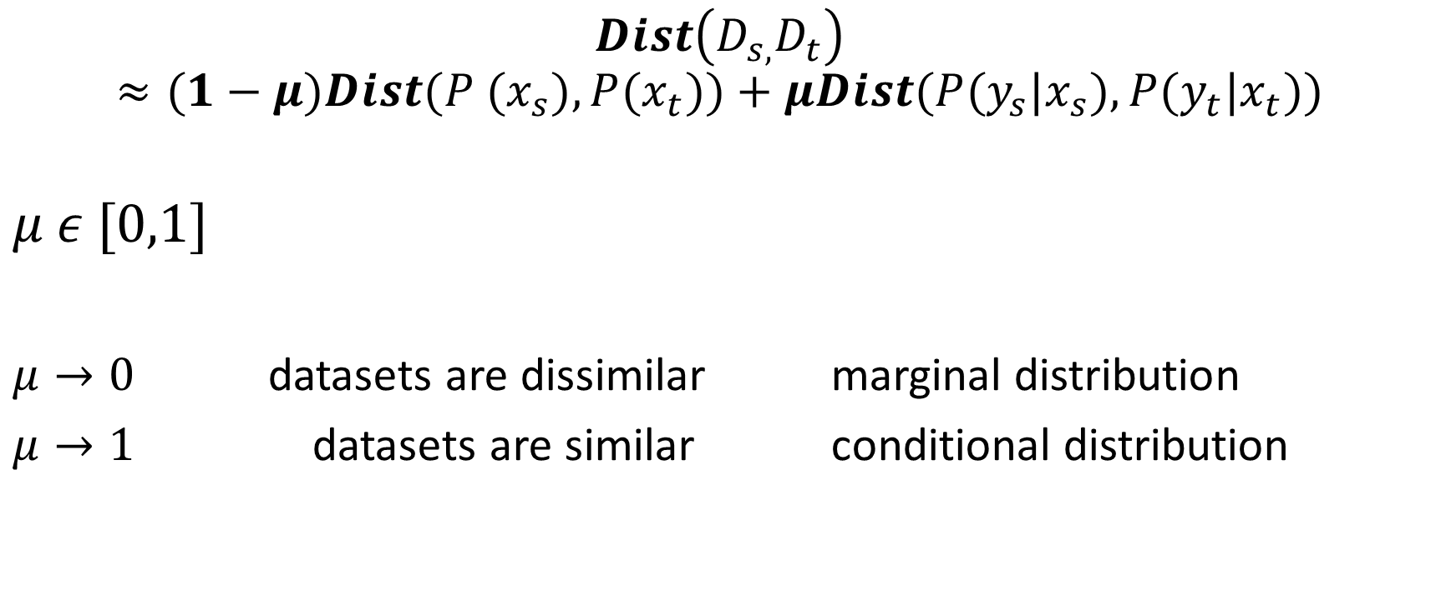
4) BDA
$$Dist\left(D_{s,}D_{t}\right)≈(1−μ)Dist{(P (x}_{s}),{P(x}_{t}))+μDist({P(y_{s}|x}_{s}),{P(y_{t}|x}_{t}))$$
$$μ ε [0,1]$$
$μ→0$ datasets are dissimilar marginal distribution
$μ→1$ datasets are similar conditional distribution

Slide 27

4) BDA
$$Dist\left(D_{s,}D_{t}\right)≈(1−μ)Dist{(P (x}_{s}),{P(x}_{t}))+μDist({P(y_{s}|x}_{s}),{P(y_{t}|x}_{t}))$$
How to compute this equation?

Slide 28
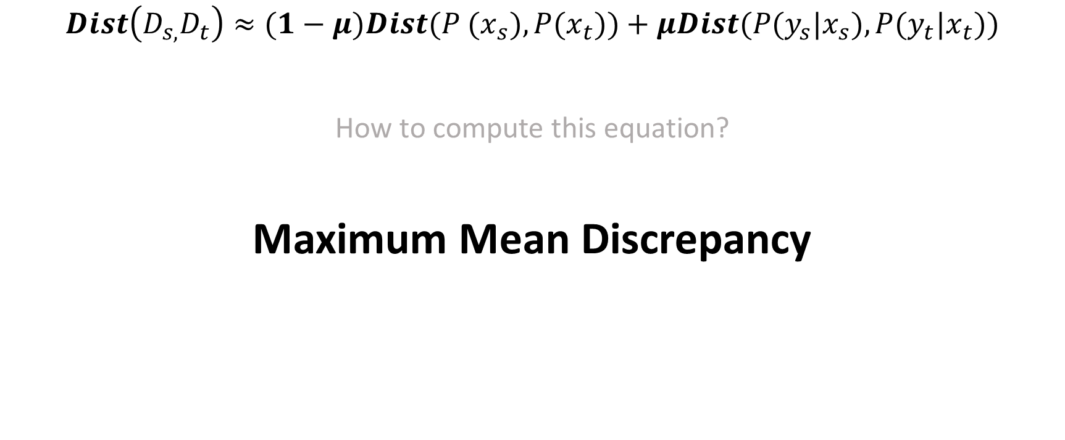
4) BDA
$$Dist\left(D_{s,}D_{t}\right)≈(1−μ)Dist{(P (x}_{s}),{P(x}_{t}))+μDist({P(y_{s}|x}_{s}),{P(y_{t}|x}_{t}))$$
How to compute this equation?
Maximum Mean Discrepancy

Slide 29

4) BDA
$$Dist\left(D_{s,}D_{t}\right)≈(1−μ)Dist{(P (x}_{s}),{P(x}_{t}))+μDist({P(y_{s}|x}_{s}),{P(y_{t}|x}_{t}))$$
MMD

Slide 30
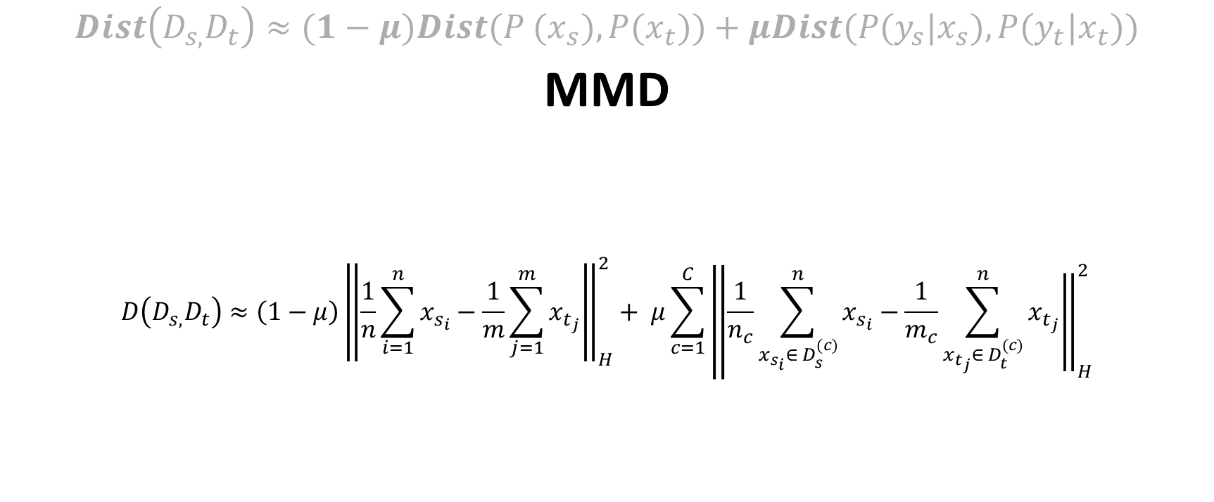
4) BDA
$$Dist\left(D_{s,}D_{t}\right)≈(1−μ)Dist{(P (x}_{s}),{P(x}_{t}))+μDist({P(y_{s}|x}_{s}),{P(y_{t}|x}_{t}))$$
MMD
$$D\left(D_{s,}D_{t}\right)≈\left(1−μ\right)\left\|\frac{1}{n}\sum_{i=1}^{n}{x_{s_{i}}}\right.−{\left.\frac{1}{m}\sum_{j=1}^{m}{x_{t_{j}}}\right\|}_{H}^{2}+ μ\sum_{c=1}^{C}{\left\|\frac{1}{n_{c}}\sum_{x_{s_{i}}∈ D_{s}^{(c)}}^{n}{x_{s_{i}}}\right.−{\left.\frac{1}{m_{c}}\sum_{x_{t_{j}}∈ D_{t}^{(c)}}^{n}{x_{t_{j}}}\right\|}_{H}^{2}}$$

Slide 31
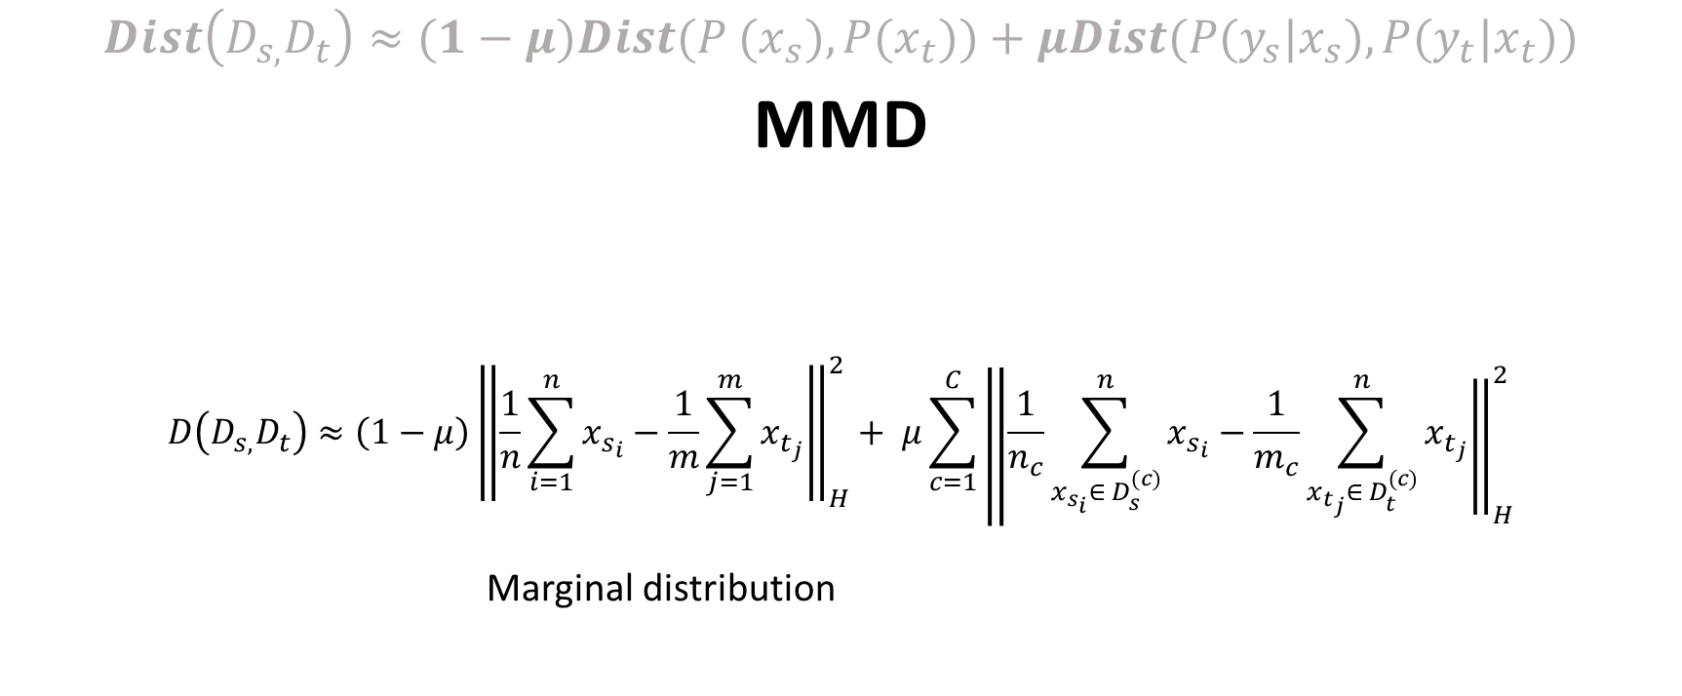
4) BDA
$$Dist\left(D_{s,}D_{t}\right)≈(1−μ)Dist{(P (x}_{s}),{P(x}_{t}))+μDist({P(y_{s}|x}_{s}),{P(y_{t}|x}_{t}))$$
MMD
$$D\left(D_{s,}D_{t}\right)≈\left(1−μ\right)\left\|\frac{1}{n}\sum_{i=1}^{n}{x_{s_{i}}}\right.−{\left.\frac{1}{m}\sum_{j=1}^{m}{x_{t_{j}}}\right\|}_{H}^{2}+ μ\sum_{c=1}^{C}{\left\|\frac{1}{n_{c}}\sum_{x_{s_{i}}∈ D_{s}^{(c)}}^{n}{x_{s_{i}}}\right.−{\left.\frac{1}{m_{c}}\sum_{x_{t_{j}}∈ D_{t}^{(c)}}^{n}{x_{t_{j}}}\right\|}_{H}^{2}}$$
Marginal distribution

Slide 32
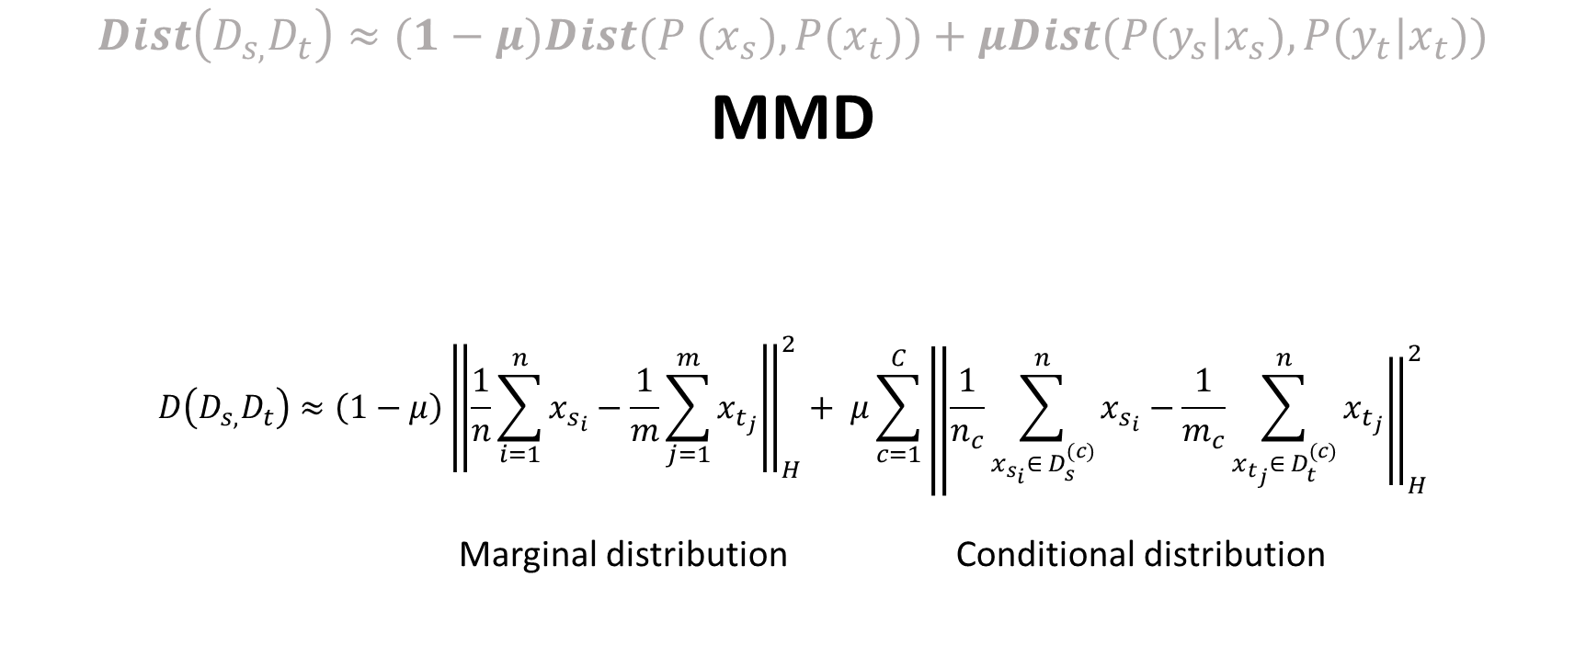
4) BDA
$$Dist\left(D_{s,}D_{t}\right)≈(1−μ)Dist{(P (x}_{s}),{P(x}_{t}))+μDist({P(y_{s}|x}_{s}),{P(y_{t}|x}_{t}))$$
MMD
$$D\left(D_{s,}D_{t}\right)≈\left(1−μ\right)\left\|\frac{1}{n}\sum_{i=1}^{n}{x_{s_{i}}}\right.−{\left.\frac{1}{m}\sum_{j=1}^{m}{x_{t_{j}}}\right\|}_{H}^{2}+ μ\sum_{c=1}^{C}{\left\|\frac{1}{n_{c}}\sum_{x_{s_{i}}∈ D_{s}^{(c)}}^{n}{x_{s_{i}}}\right.−{\left.\frac{1}{m_{c}}\sum_{x_{t_{j}}∈ D_{t}^{(c)}}^{n}{x_{t_{j}}}\right\|}_{H}^{2}}$$
Marginal distribution Conditional distribution

Slide 33

4) BDA
$$D\left(D_{s,}D_{t}\right)≈\left(1−μ\right)\left\|\frac{1}{n}\sum_{i=1}^{n}{x_{s_{i}}}\right.−{\left.\frac{1}{m}\sum_{j=1}^{m}{x_{t_{j}}}\right\|}_{H}^{2}+ μ\sum_{c=1}^{C}{\left\|\frac{1}{n_{c}}\sum_{x_{s_{i}}∈ D_{s}^{(c)}}^{n}{x_{s_{i}}}\right.−{\left.\frac{1}{m_{c}}\sum_{x_{t_{j}}∈ D_{t}^{(c)}}^{n}{x_{t_{j}}}\right\|}_{H}^{2}}$$

Slide 34
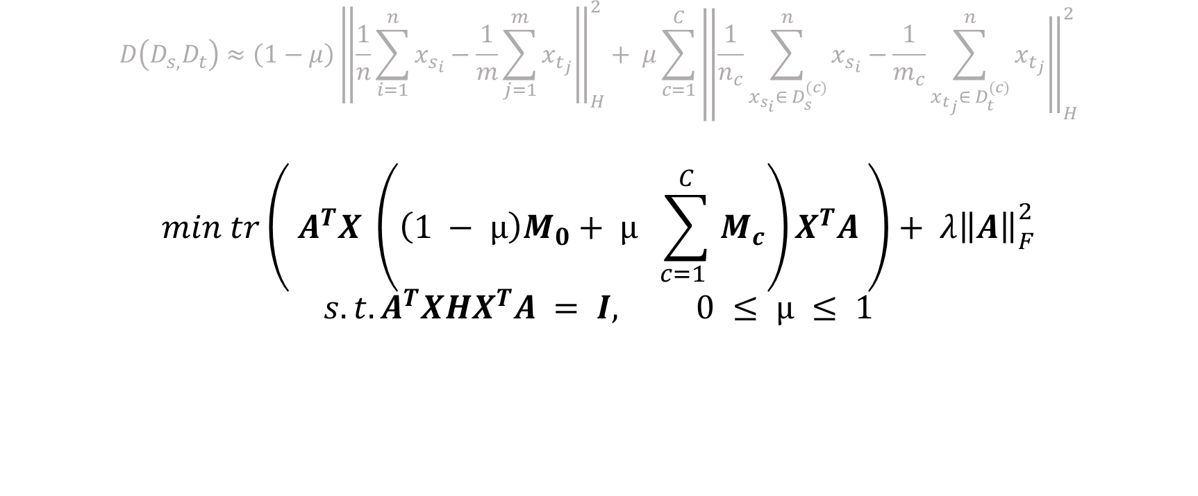
4) BDA
$$D\left(D_{s,}D_{t}\right)≈\left(1−μ\right)\left\|\frac{1}{n}\sum_{i=1}^{n}{x_{s_{i}}}\right.−{\left.\frac{1}{m}\sum_{j=1}^{m}{x_{t_{j}}}\right\|}_{H}^{2}+ μ\sum_{c=1}^{C}{\left\|\frac{1}{n_{c}}\sum_{x_{s_{i}}∈ D_{s}^{(c)}}^{n}{x_{s_{i}}}\right.−{\left.\frac{1}{m_{c}}\sum_{x_{t_{j}}∈ D_{t}^{(c)}}^{n}{x_{t_{j}}}\right\|}_{H}^{2}}$$
$$min tr\left( A^{T}X \left(\left(1 − µ\right)M_{0}+ µ \sum_{c=1 }^{C}{M_{c}}\right)X^{T}A \right)+ λ{\left\|\left.A\right\|\right.}_{F}^{2}$$
$$s.t.A^{T}XHX^{T}A = I, 0 ≤ µ ≤ 1$$

Slide 35
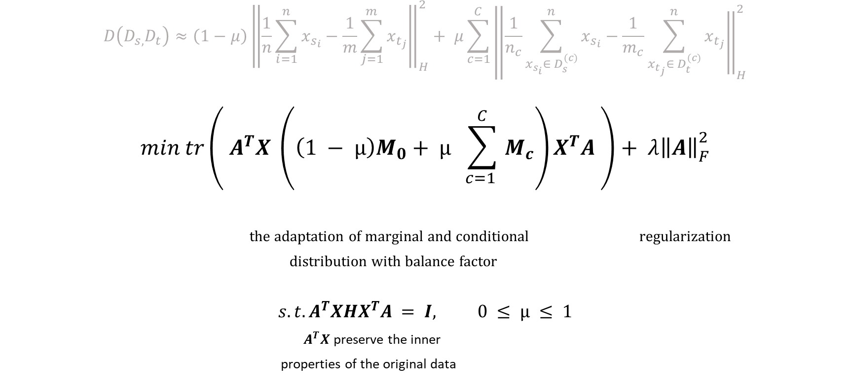
4) BDA
$$D\left(D_{s,}D_{t}\right)≈\left(1−μ\right)\left\|\frac{1}{n}\sum_{i=1}^{n}{x_{s_{i}}}\right.−{\left.\frac{1}{m}\sum_{j=1}^{m}{x_{t_{j}}}\right\|}_{H}^{2}+ μ\sum_{c=1}^{C}{\left\|\frac{1}{n_{c}}\sum_{x_{s_{i}}∈ D_{s}^{(c)}}^{n}{x_{s_{i}}}\right.−{\left.\frac{1}{m_{c}}\sum_{x_{t_{j}}∈ D_{t}^{(c)}}^{n}{x_{t_{j}}}\right\|}_{H}^{2}}$$
$$min tr\left( A^{T}X \left(\left(1 − µ\right)M_{0}+ µ \sum_{c=1 }^{C}{M_{c}}\right)X^{T}A \right)+ λ{\left\|\left.A\right\|\right.}_{F}^{2}$$
the adaptation of marginal and conditional regularization
distribution with balance factor
$$s.t.A^{T}XHX^{T}A = I, 0 ≤ µ ≤ 1$$
$A^{T}X$ preserve the inner
properties of the original data

Slide 36

4) BDA
$$min tr\left( A^{T}X \left(\left(1 − µ\right)M_{0}+ µ \sum_{c=1 }^{C}{M_{c}}\right)X^{T}A \right)+ λ{\left\|\left.A\right\|\right.}_{F}^{2}$$
$$s.t.A^{T}XHX^{T}A = I, 0 ≤ µ ≤ 1$$

Slide 37

4) BDA
$$min tr\left( A^{T}X \left(\left(1 − µ\right)M_{0}+ µ \sum_{c=1 }^{C}{M_{c}}\right)X^{T}A \right)+ λ{\left\|\left.A\right\|\right.}_{F}^{2}$$
$$s.t.A^{T}XHX^{T}A = I, 0 ≤ µ ≤ 1$$
$L=tr\left( A^{T}X \left(\left(1 − µ\right)M_{0}+ µ \sum_{c=1 }^{C}{M_{c}}\right)X^{T}A \right)+ λ{\left\|\left.A\right\|\right.}_{F}^{2}$ + $tr\left( ({I − A}^{T}XHX^{T}A)Φ \right)$

Slide 38

4) BDA
$$min tr\left( A^{T}X \left(\left(1 − µ\right)M_{0}+ µ \sum_{c=1 }^{C}{M_{c}}\right)X^{T}A \right)+ λ{\left\|\left.A\right\|\right.}_{F}^{2}$$
$$s.t.A^{T}XHX^{T}A = I, 0 ≤ µ ≤ 1$$
$L=tr\left( A^{T}X \left(\left(1 − µ\right)M_{0}+ µ \sum_{c=1 }^{C}{M_{c}}\right)X^{T}A \right)+ λ{\left\|\left.A\right\|\right.}_{F}^{2}$ + $tr\left( ({I − A}^{T}XHX^{T}A)Φ \right)$
Set derivative $∂L/∂A = 0$
$\left( X\left(\left(1 − µ\right)M_{0}+µ \sum_{c=1 }^{C}{M_{c}} \right){ X}^{T}+ λI\right)$ $A = XHX^{T}AΦ$

Slide 39


4) BDA
$$min tr\left( A^{T}X \left(\left(1 − µ\right)M_{0}+ µ \sum_{c=1 }^{C}{M_{c}}\right)X^{T}A \right)+ λ{\left\|\left.A\right\|\right.}_{F}^{2}$$
$$s.t.A^{T}XHX^{T}A = I, 0 ≤ µ ≤ 1$$
$L=tr\left( A^{T}X \left(\left(1 − µ\right)M_{0}+ µ \sum_{c=1 }^{C}{M_{c}}\right)X^{T}A \right)+ λ{\left\|\left.A\right\|\right.}_{F}^{2}$ + $tr\left( ({I − A}^{T}XHX^{T}A)Φ \right)$
Set derivative $∂L/∂A = 0$
$\left( X\left(\left(1 − µ\right)M_{0}+µ \sum_{c=1 }^{C}{M_{c}} \right){ X}^{T}+ λI\right)$ $A = XHX^{T}AΦ$
the optimal transformation matrix A d smallest eigenvectors.

Slide 40


4) BDA
$$min tr\left( A^{T}X \left(\left(1 − µ\right)M_{0}+ µ \sum_{c=1 }^{C}{M_{c}}\right)X^{T}A \right)+ λ{\left\|\left.A\right\|\right.}_{F}^{2}$$
$$s.t.A^{T}XHX^{T}A = I, 0 ≤ µ ≤ 1$$
$L=tr\left( A^{T}X \left(\left(1 − µ\right)M_{0}+ µ \sum_{c=1 }^{C}{M_{c}}\right)X^{T}A \right)+ λ{\left\|\left.A\right\|\right.}_{F}^{2}$ + $tr\left( ({I − A}^{T}XHX^{T}A)Φ \right)$
Set derivative $∂L/∂A = 0$
$\left( X\left(\left(1 − µ\right)M_{0}+µ \sum_{c=1 }^{C}{M_{c}} \right){ X}^{T}+ λI\right)$ $A = XHX^{T}AΦ$
the optimal transformation matrix A d smallest eigenvectors.
$μ$?

Slide 41
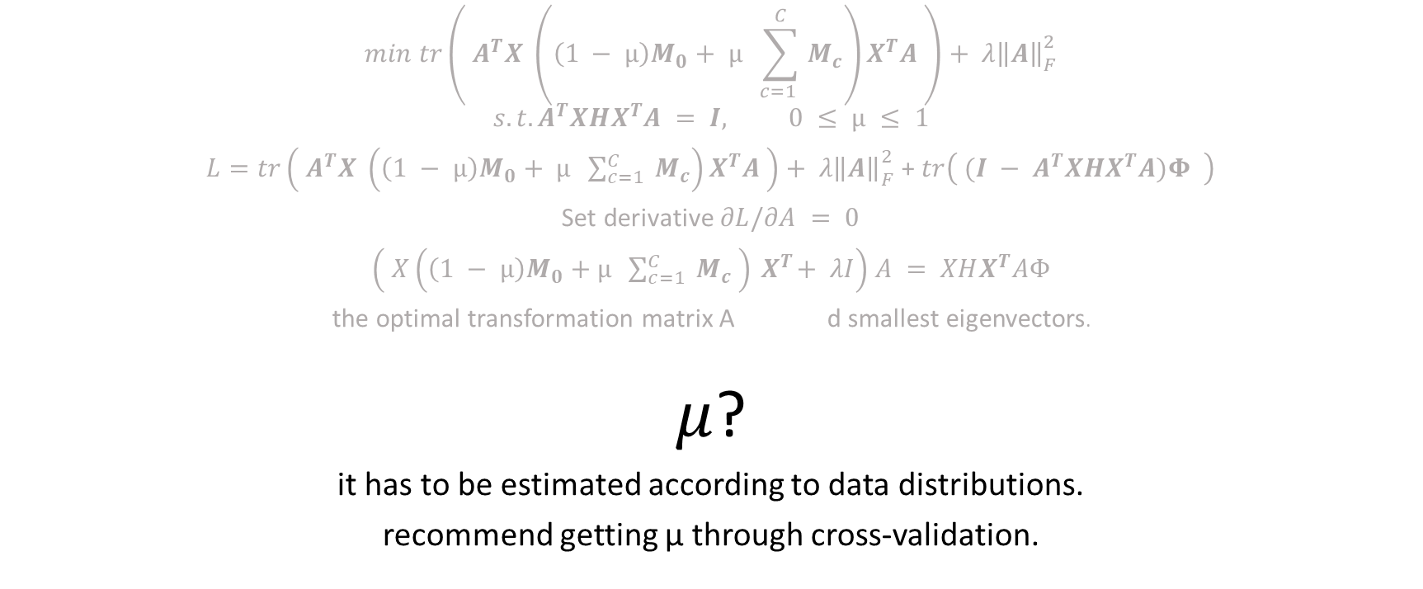
4) BDA
$$min tr\left( A^{T}X \left(\left(1 − µ\right)M_{0}+ µ \sum_{c=1 }^{C}{M_{c}}\right)X^{T}A \right)+ λ{\left\|\left.A\right\|\right.}_{F}^{2}$$
$$s.t.A^{T}XHX^{T}A = I, 0 ≤ µ ≤ 1$$
$L=tr\left( A^{T}X \left(\left(1 − µ\right)M_{0}+ µ \sum_{c=1 }^{C}{M_{c}}\right)X^{T}A \right)+ λ{\left\|\left.A\right\|\right.}_{F}^{2}$ + $tr\left( ({I − A}^{T}XHX^{T}A)Φ \right)$
Set derivative $∂L/∂A = 0$
$\left( X\left(\left(1 − µ\right)M_{0}+µ \sum_{c=1 }^{C}{M_{c}} \right){ X}^{T}+ λI\right)$ $A = XHX^{T}AΦ$
the optimal transformation matrix A d smallest eigenvectors.
$μ$?
it has to be estimated according to data distributions.
recommend getting µ through cross-validation.

Slide 42

5) WBDA
$$Dist\left(D_{s,}D_{t}\right)≈Dist{(P (x}_{s}),{P(x}_{t}))+Dist({P(y_{s}|x}_{s}),{P(y_{t}|x}_{t}))$$

Slide 43

5) WBDA
$$Dist({P(y_{s}|x}_{s}),{P(y_{t}|x}_{t}))$$

Slide 44

5) WBDA
$Dist({P(y_{s}|x}_{s}),{P(y_{t}|x}_{t}))$ =
$${\left\|\left.P(y_{s}|x_{s}) −P(y_{t}|x_{t})\right\|\right.}_{H}^{2}=$$

Slide 45
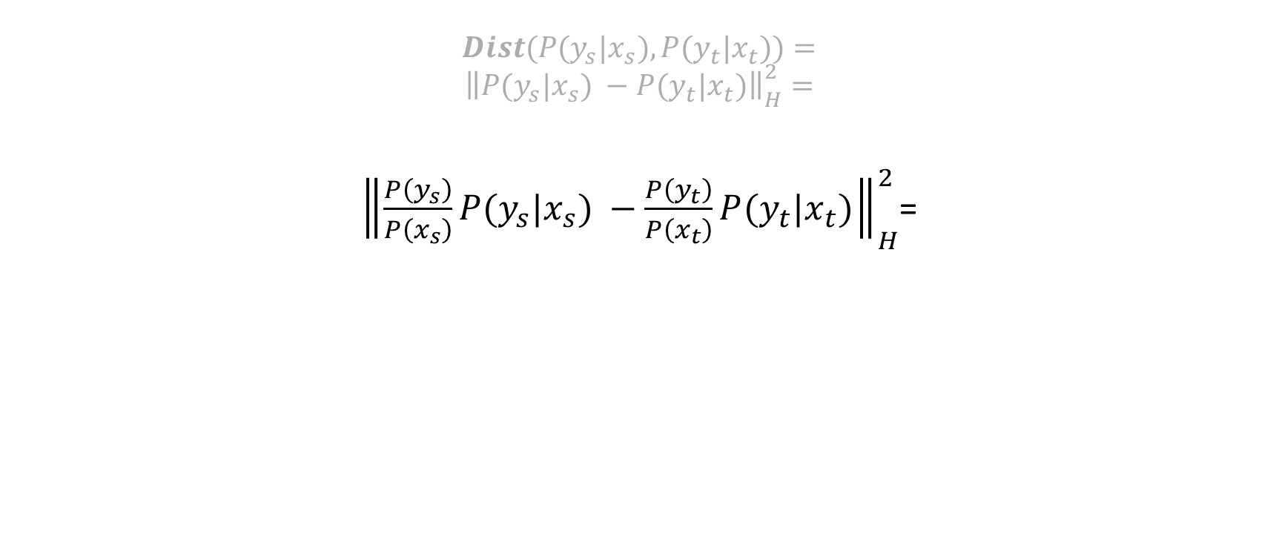
5) WBDA
$$Dist({P(y_{s}|x}_{s}),{P(y_{t}|x}_{t}))=$$
$${\left\|\left.P(y_{s}|x_{s}) −P(y_{t}|x_{t})\right\|\right.}_{H}^{2}=$$
${\left\|\left.\frac{P\left(y_{s}\right)}{P\left(x_{s}\right)}P(y_{s}|x_{s}) −\frac{P\left(y_{t}\right)}{P\left(x_{t}\right)}P(y_{t}|x_{t})\right\|\right.}_{H}^{2}$=

Slide 46
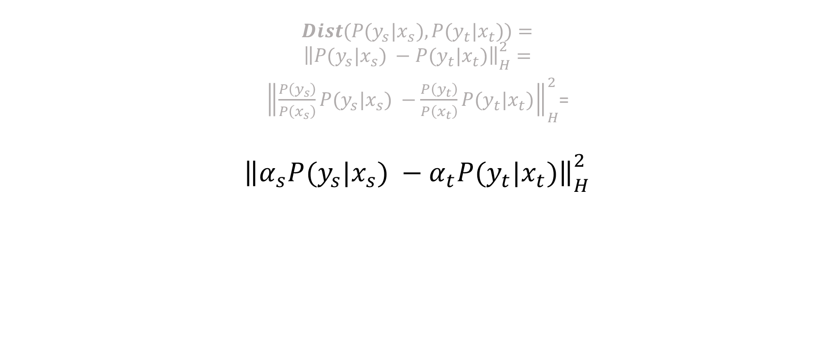
5) WBDA
$$Dist({P(y_{s}|x}_{s}),{P(y_{t}|x}_{t}))=$$
$${\left\|\left.P(y_{s}|x_{s}) −P(y_{t}|x_{t})\right\|\right.}_{H}^{2}=$$
${\left\|\left.\frac{P\left(y_{s}\right)}{P\left(x_{s}\right)}P(y_{s}|x_{s}) −\frac{P\left(y_{t}\right)}{P\left(x_{t}\right)}P(y_{t}|x_{t})\right\|\right.}_{H}^{2}$=
$${\left\|\left.α_{s}P(y_{s}|x_{s}) −α_{t}P(y_{t}|x_{t})\right\|\right.}_{H}^{2}$$

Slide 47
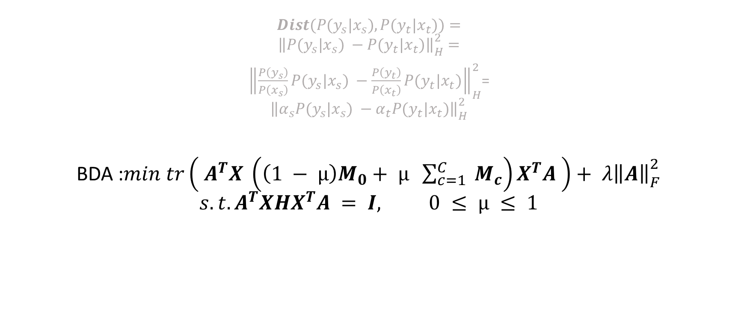
5) WBDA
$$Dist({P(y_{s}|x}_{s}),{P(y_{t}|x}_{t}))=$$
$${\left\|\left.P(y_{s}|x_{s}) −P(y_{t}|x_{t})\right\|\right.}_{H}^{2}=$$
${\left\|\left.\frac{P\left(y_{s}\right)}{P\left(x_{s}\right)}P(y_{s}|x_{s}) −\frac{P\left(y_{t}\right)}{P\left(x_{t}\right)}P(y_{t}|x_{t})\right\|\right.}_{H}^{2}$=
$${\left\|\left.α_{s}P(y_{s}|x_{s}) −α_{t}P(y_{t}|x_{t})\right\|\right.}_{H}^{2}$$
BDA :$min tr\left( A^{T}X \left(\left(1 − µ\right)M_{0}+ µ \sum_{c=1 }^{C}{M_{c}}\right)X^{T}A \right)+ λ{\left\|\left.A\right\|\right.}_{F}^{2}$
$$s.t.A^{T}XHX^{T}A = I, 0 ≤ µ ≤ 1$$

Slide 48
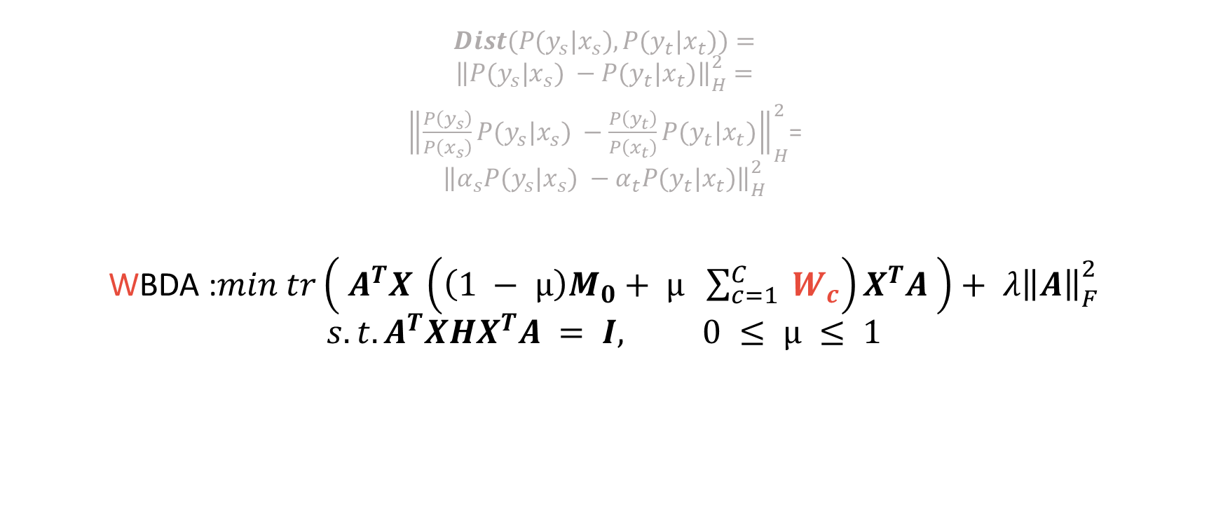
5) WBDA
$$Dist({P(y_{s}|x}_{s}),{P(y_{t}|x}_{t}))=$$
$${\left\|\left.P(y_{s}|x_{s}) −P(y_{t}|x_{t})\right\|\right.}_{H}^{2}=$$
${\left\|\left.\frac{P\left(y_{s}\right)}{P\left(x_{s}\right)}P(y_{s}|x_{s}) −\frac{P\left(y_{t}\right)}{P\left(x_{t}\right)}P(y_{t}|x_{t})\right\|\right.}_{H}^{2}$=
$${\left\|\left.α_{s}P(y_{s}|x_{s}) −α_{t}P(y_{t}|x_{t})\right\|\right.}_{H}^{2}$$
WBDA :$min tr\left( A^{T}X \left(\left(1 − µ\right)M_{0}+ µ \sum_{c=1 }^{C}{W_{c}}\right)X^{T}A \right)+ λ{\left\|\left.A\right\|\right.}_{F}^{2}$
$$s.t.A^{T}XHX^{T}A = I, 0 ≤ µ ≤ 1$$

Slide 49
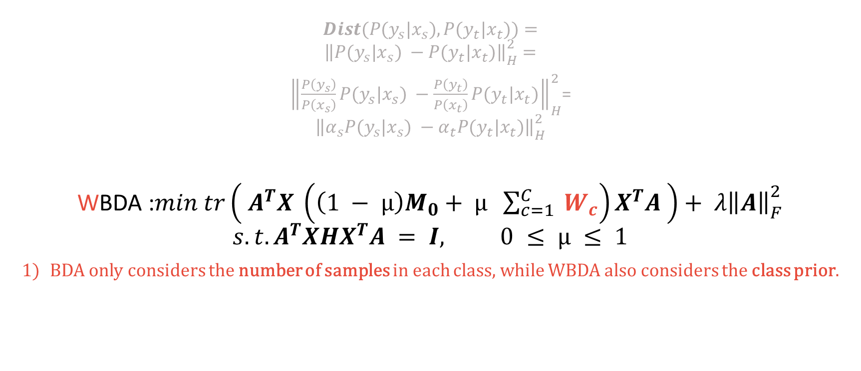
5) WBDA
$$Dist({P(y_{s}|x}_{s}),{P(y_{t}|x}_{t}))=$$
$${\left\|\left.P(y_{s}|x_{s}) −P(y_{t}|x_{t})\right\|\right.}_{H}^{2}=$$
${\left\|\left.\frac{P\left(y_{s}\right)}{P\left(x_{s}\right)}P(y_{s}|x_{s}) −\frac{P\left(y_{t}\right)}{P\left(x_{t}\right)}P(y_{t}|x_{t})\right\|\right.}_{H}^{2}$=
$${\left\|\left.α_{s}P(y_{s}|x_{s}) −α_{t}P(y_{t}|x_{t})\right\|\right.}_{H}^{2}$$
WBDA :$min tr\left( A^{T}X \left(\left(1 − µ\right)M_{0}+ µ \sum_{c=1 }^{C}{W_{c}}\right)X^{T}A \right)+ λ{\left\|\left.A\right\|\right.}_{F}^{2}$
$$s.t.A^{T}XHX^{T}A = I, 0 ≤ µ ≤ 1$$
BDA only considers the number of samples in each class, while WBDA also considers the class prior.

Slide 50
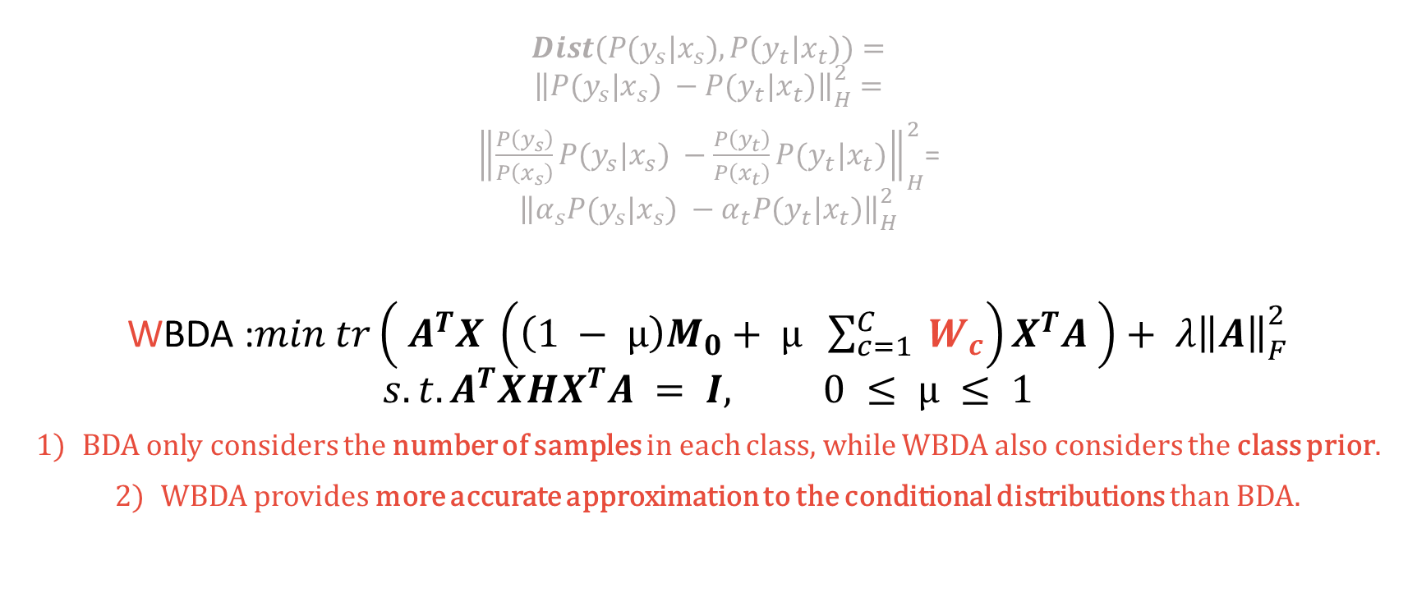
5) WBDA
$$Dist({P(y_{s}|x}_{s}),{P(y_{t}|x}_{t}))=$$
$${\left\|\left.P(y_{s}|x_{s}) −P(y_{t}|x_{t})\right\|\right.}_{H}^{2}=$$
${\left\|\left.\frac{P\left(y_{s}\right)}{P\left(x_{s}\right)}P(y_{s}|x_{s}) −\frac{P\left(y_{t}\right)}{P\left(x_{t}\right)}P(y_{t}|x_{t})\right\|\right.}_{H}^{2}$=
$${\left\|\left.α_{s}P(y_{s}|x_{s}) −α_{t}P(y_{t}|x_{t})\right\|\right.}_{H}^{2}$$
WBDA :$min tr\left( A^{T}X \left(\left(1 − µ\right)M_{0}+ µ \sum_{c=1 }^{C}{W_{c}}\right)X^{T}A \right)+ λ{\left\|\left.A\right\|\right.}_{F}^{2}$
$$s.t.A^{T}XHX^{T}A = I, 0 ≤ µ ≤ 1$$
BDA only considers the number of samples in each class, while WBDA also considers the class prior.
WBDA provides more accurate approximation to the conditional distributions than BDA.

Slide 51
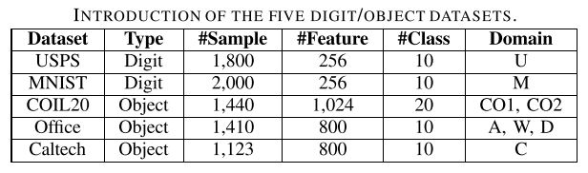
6) Datasets

Slide 52
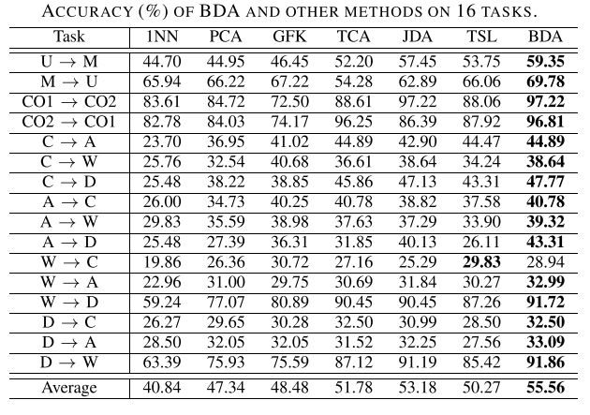
7) Performance Evaluation of BDA

Slide 53
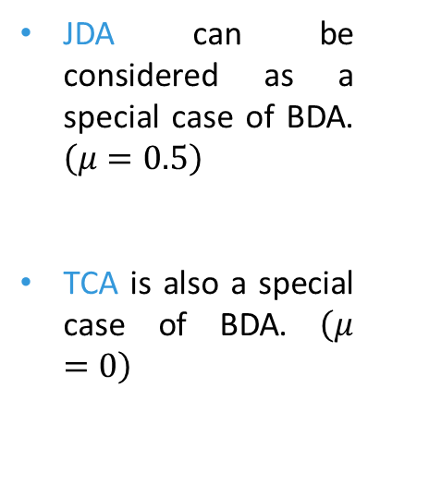
7) Performance Evaluation of BDA
JDA can be considered as a special case of BDA. $\left(μ=0.5\right)$
TCA is also a special case of BDA. $\left(μ=0\right)$

Slide 54
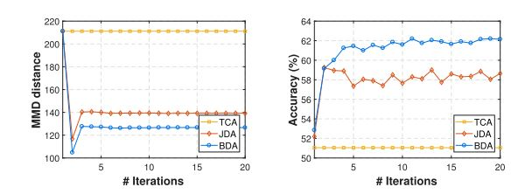
8) Effectiveness of distribution adaptation

Slide 55
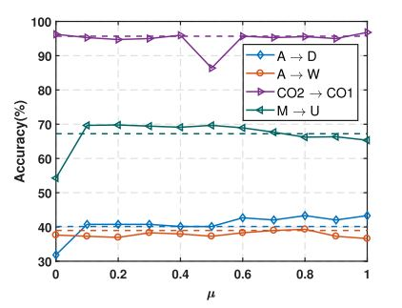
9) Effectiveness of Balance Factor

Slide 56
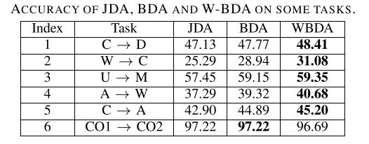
10) Effectiveness of Weighted BDA

Slide 57
Easy Transfer Learning By Exploiting Intra-domain Structures
IEEE International Conference on Multimedia and Expo, ICME, 2019

Slide 58
1) What is the problem?
Problem 1:
Most traditional and deep TL methods are parametric methods that have to go through an expensive and time-consuming process to tune a lot of hyperparameters.

Slide 59

1) What is the problem?
Problem 1:
Most traditional and deep TL methods are parametric methods that have to go through an expensive and time-consuming process to tune a lot of hyperparameters.
Problem 2:
Cross-validation is not available in TL since there are often no labeled data in the target domain.

Slide 60
1) What is the problem?
Problem 1:
Most traditional and deep TL methods are parametric methods that have to go through an expensive and time-consuming process to tune a lot of hyperparameters.
Problem 2:
Cross-validation is not available in TL since there are often no labeled data in the target domain.
Problem 3:
Although the recent AutoML methods can automatically tune the hyperparameters they are unable to handle the different distributions between domains in TL and take a long time to converge.

Slide 61
1) What is the problem?
Problem 1:
Most traditional and deep TL methods are parametric methods that have to go through an expensive and time-consuming process to tune a lot of hyperparameters.
Problem 2:
Cross-validation is not available in TL since there are often no labeled data in the target domain.
Problem 3:
Although the recent AutoML methods can automatically tune the hyperparameters they are unable to handle the different distributions between domains in TL and take a long time to converge.

Slide 62
1) What is the problem?
These challenges restrict the
real application of TL, especially
on devices that require instant
local computing with limited
Resources.

Slide 63
2) What is the solution?
Solution:
Easy Transfer Learning

Slide 64
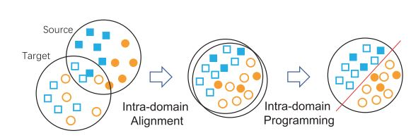
3) EasyTL

Slide 65

4) Intra-domain Programming
Instead of learning $y_{t}$directly,
the algorithm focuses on learning the
Probability Annotation Matrix M.

Slide 66
4) Intra-domain Programming
Probability Annotation Matrix

Slide 67

4) Intra-domain Programming
Probability Annotation Matrix
$$M= \left[⋯\right]$$

Slide 68
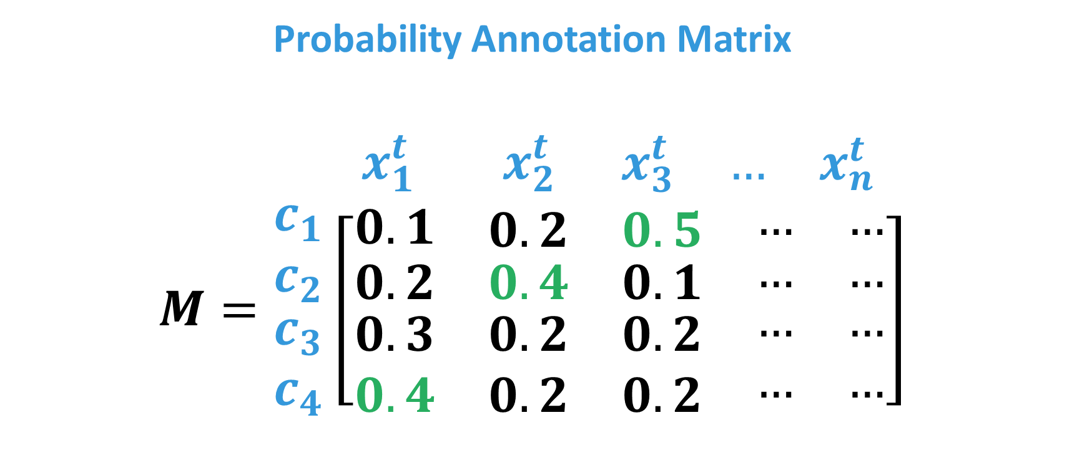
4) Intra-domain Programming
Probability Annotation Matrix
$\begin{matrix}{ x}_{1}^{t} & { x}_{2}^{t} & \begin{matrix}x_{3}^{t} & … & x_{n}^{t}\end{matrix}\end{matrix}$
$$M=\begin{matrix}c_{1} \\ c_{2} \\ \begin{matrix}c_{3} \\ c_{4}\end{matrix}\end{matrix}\left[\begin{matrix}0.1 & \begin{matrix}0.2 & 0.5 & \begin{matrix}… & …\end{matrix}\end{matrix} \\ \begin{matrix}0.2 \\ \begin{matrix}0.3 \\ 0.4\end{matrix}\end{matrix} & \begin{matrix}\begin{matrix}0.4 & 0.1 & \begin{matrix}… & …\end{matrix}\end{matrix} \\ \begin{matrix}\begin{matrix}0.2 \\ 0.2\end{matrix} & \begin{matrix}0.2 \\ 0.2\end{matrix} & \begin{matrix}\begin{matrix}… \\ …\end{matrix} & \begin{matrix}… \\ …\end{matrix}\end{matrix}\end{matrix}\end{matrix}\end{matrix}\right]$$

Slide 69

4) Intra-domain Programming
Instead of learning $y_{t}$directly,
the algorithm focuses on learning the
Probability Annotation Matrix M.

Slide 70

4) Intra-domain Programming
Instead of learning $y_{t}$directly,
the algorithm focuses on learning the
Probability Annotation Matrix M.
Cost Function?

Slide 71

4) Intra-domain Programming
Instead of learning $y_{t}$directly,
the algorithm focuses on learning the
Probability Annotation Matrix M.
Cost Function?
$$𝓘= \sum_{j}^{n_{t}}{\sum_{c}^{C}{D_{cj}M_{cj}}}$$

Slide 72

4) Intra-domain Programming
$$𝓘= \sum_{j}^{n_{t}}{\sum_{c}^{C}{D_{cj}M_{cj}}}$$

Slide 73

4) Intra-domain Programming
$$𝓘= \sum_{j}^{n_{t}}{\sum_{c}^{C}{D_{cj}M_{cj}}}$$
Distance Matrix D?

Slide 74

4) Intra-domain Programming
$$𝓘= \sum_{j}^{n_{t}}{\sum_{c}^{C}{D_{cj}M_{cj}}}$$
$$D_{cj} = ||x_{tj} − h_{c}||$$

Slide 75

4) Intra-domain Programming
$$𝓘= \sum_{j}^{n_{t}}{\sum_{c}^{C}{D_{cj}M_{cj}}}$$
$$D_{cj} = ||x_{tj} − h_{c}||$$
$$h_{c}=\frac{1}{\left|Ω_{s}^{(c)}\right|}\sum_{i}^{n_{s}}{x_{i}^{s}. 𝕀(y_{i}^{s}=c)}$$

Slide 76

4) Intra-domain Programming
$$𝓘= \sum_{j}^{n_{t}}{\sum_{c}^{C}{D_{cj}M_{cj}}}$$

Slide 77

4) Intra-domain Programming
$$min 𝓘= \sum_{j}^{n_{t}}{\sum_{c}^{C}{D_{cj}M_{cj}}}$$
$$s.t. \left\{\begin{aligned}0≤M_{cj}≤1 \\ \sum_{c}^{C}{M_{cj}}=1, ∀j ε \{1, …, n_{t}\} \\ \sum_{j}^{n_{t}}{M_{cj}}≥1, ∀c ε \{1, …,C\}\end{aligned}\right.$$

Slide 78

4) Intra-domain Programming
$$min ℐ= \sum_{j}^{n_{t}}{\sum_{c}^{C}{D_{cj}M_{cj}}} s.t. \left\{\begin{aligned}0≤M_{cj}≤1 \\ \sum_{c}^{C}{M_{cj}}=1, ∀j ε \{1, …, n_{t}\} \\ \sum_{j}^{n_{t}}{M_{cj}}≥1, ∀c ε \{1, …,C\}\end{aligned}\right.$$
How to solve it?

Slide 79

4) Intra-domain Programming
$$min ℐ= \sum_{j}^{n_{t}}{\sum_{c}^{C}{D_{cj}M_{cj}}} s.t. \left\{\begin{aligned}0≤M_{cj}≤1 \\ \sum_{c}^{C}{M_{cj}}=1, ∀j ε \{1, …, n_{t}\} \\ \sum_{j}^{n_{t}}{M_{cj}}≥1, ∀c ε \{1, …,C\}\end{aligned}\right.$$
How to solve it?
Package PuLP

Slide 80

4) Intra-domain Programming
$$min ℐ= \sum_{j}^{n_{t}}{\sum_{c}^{C}{D_{cj}M_{cj}}} s.t. \left\{\begin{aligned}0≤M_{cj}≤1 \\ \sum_{c}^{C}{M_{cj}}=1, ∀j ε \{1, …, n_{t}\} \\ \sum_{j}^{n_{t}}{M_{cj}}≥1, ∀c ε \{1, …,C\}\end{aligned}\right.$$
Package PuLP
Obtain M

Slide 81

4) Intra-domain Programming
$$min ℐ= \sum_{j}^{n_{t}}{\sum_{c}^{C}{D_{cj}M_{cj}}} s.t. \left\{\begin{aligned}0≤M_{cj}≤1 \\ \sum_{c}^{C}{M_{cj}}=1, ∀j ε \{1, …, n_{t}\} \\ \sum_{j}^{n_{t}}{M_{cj}}≥1, ∀c ε \{1, …,C\}\end{aligned}\right.$$
Package PuLP
Obtain M
The label of $x_{j}^{t}$is given by the softmax function

Slide 82

4) Intra-domain Programming
$$min ℐ= \sum_{j}^{n_{t}}{\sum_{c}^{C}{D_{cj}M_{cj}}} s.t. \left\{\begin{aligned}0≤M_{cj}≤1 \\ \sum_{c}^{C}{M_{cj}}=1, ∀j ε \{1, …, n_{t}\} \\ \sum_{j}^{n_{t}}{M_{cj}}≥1, ∀c ε \{1, …,C\}\end{aligned}\right.$$
The label of $x_{j}^{t}$is given by the softmax function:
$y_{j}^{t}=\underset{r}{argmax}{\frac{M_{rj}}{\sum_{c}^{C}{M_{cj}}}} for r∈\{1, …, C\}$

Slide 83

4) Intra-domain Programming
$$min ℐ= \sum_{j}^{n_{t}}{\sum_{c}^{C}{D_{cj}M_{cj}}} s.t. \left\{\begin{aligned}0≤M_{cj}≤1 \\ \sum_{c}^{C}{M_{cj}}=1, ∀j ε \{1, …, n_{t}\} \\ \sum_{j}^{n_{t}}{M_{cj}}≥1, ∀c ε \{1, …,C\}\end{aligned}\right.$$
$y_{j}^{t}=\underset{r}{argmax}{\frac{M_{rj}}{\sum_{c}^{C}{M_{cj}}}} for r∈\{1, …, C\}$
This classifier does not involve any parameters to tune explicitly.

Slide 84
5) Intra-domain Alignment
Transfer feature Learning

Slide 85
5) Intra-domain Alignment
Transfer feature Learning
Reduce the domain divergence

Slide 86
5) Intra-domain Alignment
CORrelation ALignment

Slide 87
5) Intra-domain Alignment
CORAL

Slide 88

5) Intra-domain Alignment
CORAL
nonparametric
$$z^{r}=\left\{\begin{aligned}x^{r}. {(cov\left(x^{s}\right)+E_{s})}^{−\frac{1}{2}}.{(cov\left(x^{t}\right)+E_{t})}^{\frac{1}{2}} if r=s \\ x^{r} if r=t\end{aligned} \right.$$

Slide 89

6) Algorithm EasyTL
EasyTL: Easy Transfer Learning
Input: Feature matrix $x_{s}$, $x_{t}$ for ${\text{Ω}}_{s}$ and ${\text{Ω}}_{t}$, respectively; and label vector $y_{s}$ for ${\text{Ω}}_{s}.$ Output: Predicted label vector $y_{t}$ for target domain. 1: (Optional) Perform intra-domain alignment. 2: Obtain the probability annotation matrix M and compute $y_{t}$ 3: return Label vector $y_{t}$ for ${\text{Ω}}_{t}$

Slide 90

7) Accuracy on Image-CLEF and Office-Home

Slide 91


7) Accuracy on Image-CLEF and Office-Home

Slide 92


7) Accuracy on Image-CLEF and Office-Home

Slide 93


7) Accuracy on Image-CLEF and Office-Home

Slide 94


7) Accuracy on Image-CLEF and Office-Home

Slide 95

8) Accuracy on Amazon Review dataset

Slide 96


8) Accuracy on Amazon Review dataset

Slide 97


8) Accuracy on Amazon Review dataset

Slide 98

9) Accuracy on Office-Caltech dataset

Slide 99


9) Accuracy on Office-Caltech dataset

Slide 100


9) Accuracy on Office-Caltech dataset

Slide 101

10) Evaluation of Extensibility We

