Slide 1
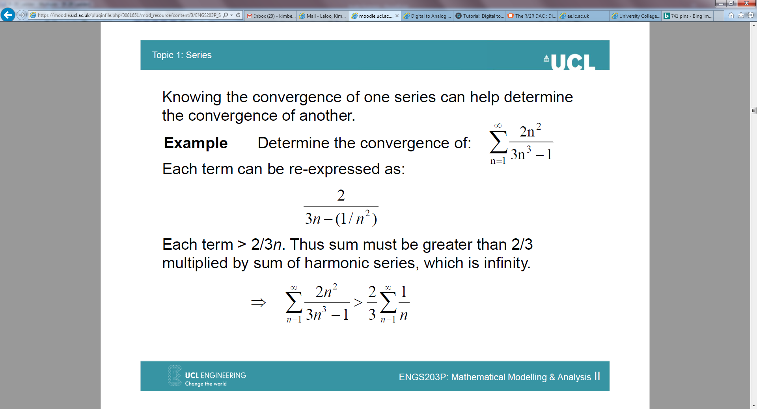
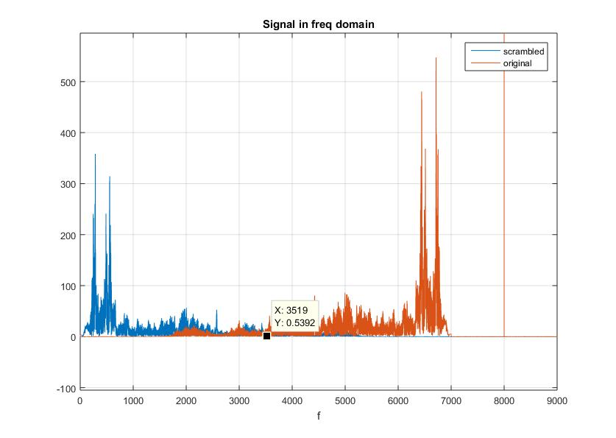
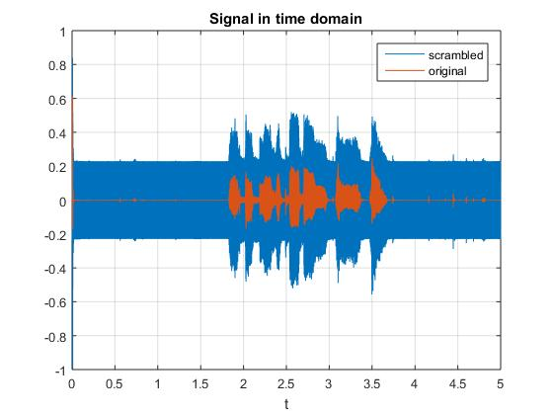
Scrambled Signal
DC Offset
Analog-to-Digital Converter (ADC)
feed to MSP432
Digital Signal Processing
4th order Low-pass Filter
Speaker
Digital-to-Analog Converter (DAC)
Digital Notch Filter
R-2R ladder
Intelligible signal
Scenario X
Real-Time Audio Descrambler

Slide 2
How does descrambling work?
Fundamentals of scrambling:
Signal flipped in the frequency domain multiplied by sine function at 7kHz.
8kHz high-amplitude frequency added filtered using infinite impulse response (IIR) notch filter at 8kHz.

Slide 3
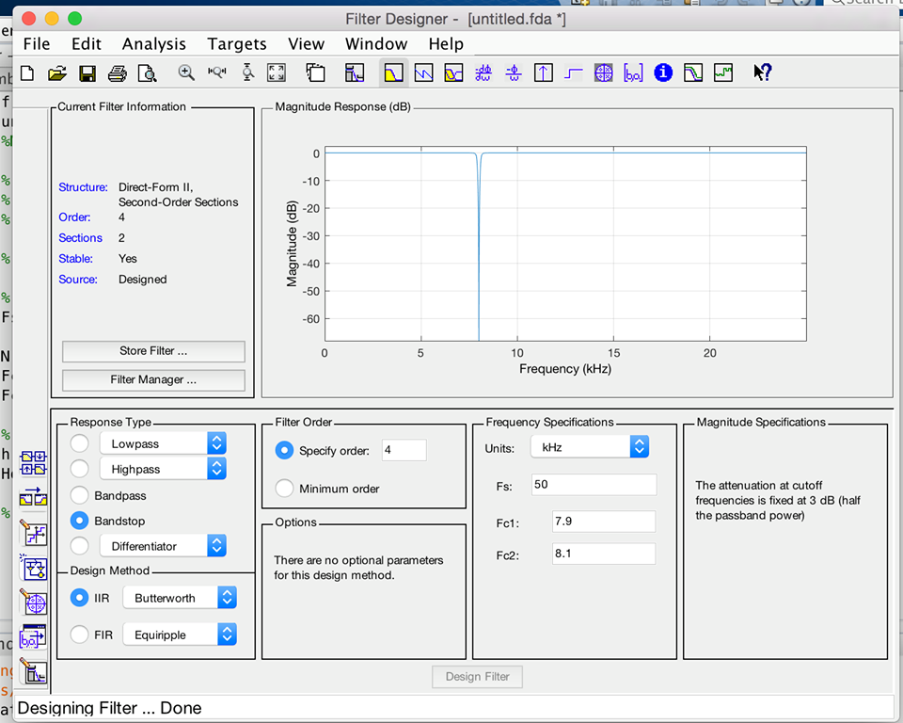
Analogue-to-Digital (ADC) Converter and Digital Notch Filter
We used an Infinite Impulse Response (IIR) Digital Filter. Here, the output depends on present and past inputs alongside past outputs.
8kHz cut-off frequency bandstop (notch) filter.
Modulation to 7kHz sine wave carrier to flip the signal (sine wave was saved in advance for efficiency).
To test the notch filter we connected the signal generator to pin 5.0 and varied frequency.
Signal at 8kHz was then attenuated.
Generated using the ‘fdatool’ in MATLAB.

Slide 4
Digital Signal Processing within MSP432/ Code
ADC -> Remove DC -> Remove 8kHz frequency -> Multiply by 7kHz sine wave -> Add DC -> Map 10 to 8 bits (P2) -> DAC (Analog)
We used a scope and measured the output of the MSP (P6.0) to monitor how much time interrupt requires to complete all the operations, and to measure frequency (50kHz).
ADC input should be 0-1.2V (P5.0).
Output to internal master clock (P4.3) and then checked with scope frequency of 48MHz.

Slide 5
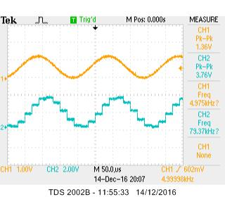
Digital-to-Analogue Converter (DAC)
R-2R Circuit

Slide 6
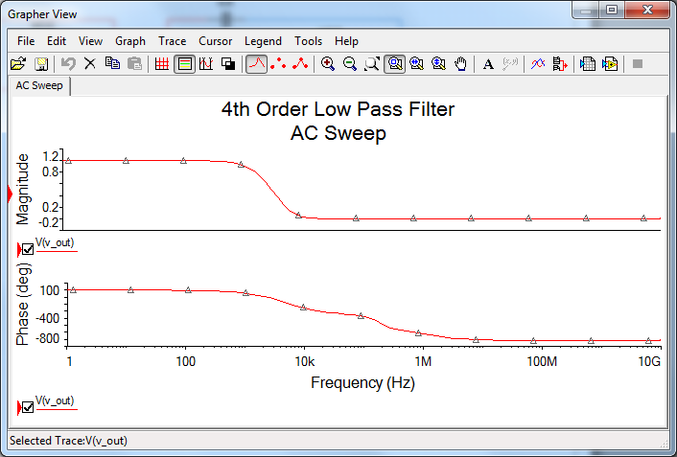
4th Order Low Pass Filter
We had a gain of 10.
Low-pass filter will get rid of the upper-sideband introduced with the sine wave ~Sallen-Key.

Slide 7
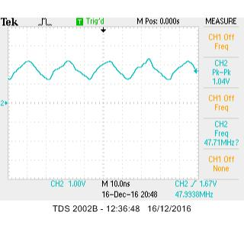
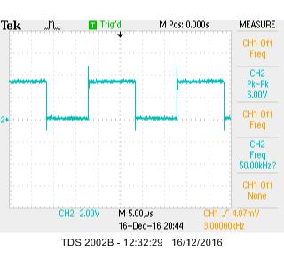
Testing
Pin 6- Confirms sampling rate (50kHz) and shows us duration taken to run system.
Pin 4.3- Internal Master Clock

Slide 8
Speaker Output with Intelligible Signal Demonstration

