Slide 1

CAR RENTAL SYSTEM
NABAHA TAHIR CT-21009
HAYAH AHMED CT-21010
TAYYABA ZAHRA CT-21013
MARYAM IFRAN CT-21018

Slide 2

WHAT IS CAR RENTAL SYSTEM?

Slide 3
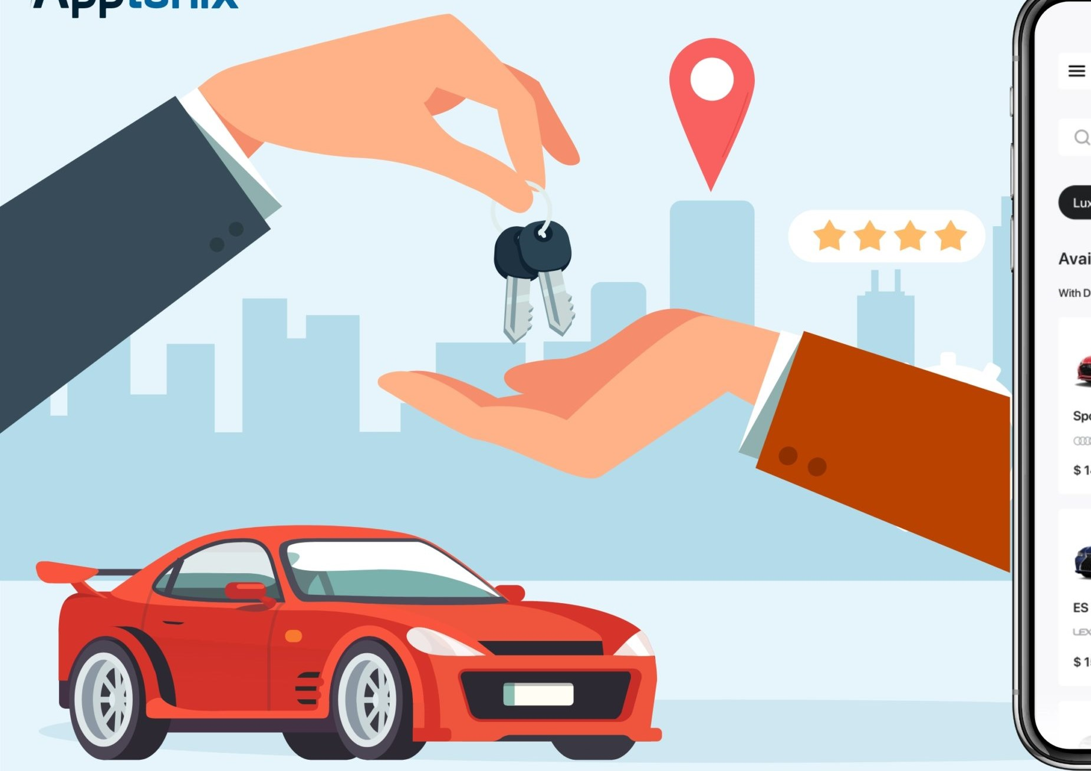
INTRODUCTION:
A car rental system is a software application that enables individuals or organizations to rent vehicles for a specific period of time. The company has a car fleet that is categorized based on their make, model, and features.

Slide 4

Components of Car rental System
User Interface: Provides an intuitive platform for customers to interact with the system.
Database:
Stores all necessary information related to vehicles, customers, reservations, and transactions.
Administrative Tools: Equips car rental companies with the means to manage their operations effectively.

Slide 5

CAR RENTAL PROCESSES
RESERVATION : To initiate the rental process, customers can make reservations online or by phone.
PICK-UP : On the day of pickup, the customer goes to the designated rental location and presents a valid driver's license and a credit card for payment.
RENTAL AGREEMENT : The rental agreement includes essential details: rental period, location, car model, rental rate, payment info, and requested features.
CAR INSPECTION : Before departure, the customer and rental agent inspect the car for pre-existing damage.
RENTAL PERIOD: During the rental period, the customer is accountable for the car and rented features, complying with terms like mileage and fuel.
RETURN: At the end of the rental period, the customer returns the car to the designated rental location.
PAYMENT: The customer's credit card is charged for the rental rate, any additional features rented, and any fees or charges incurred during the rental period.

Slide 6


PROBLEM
OF
ORGANIZATION

Slide 7
MANUAL BOOKING PROCESS
The manual booking process in a car rental system is time-consuming, error-prone, and limits access to booking services. It involves manual data entry, paper-based forms, and phone calls, leading to inefficiencies and potential mistakes in bookings.

Slide 8
Our car rental system overcomes the problem of manual booking by implementing an automated booking system
The automated booking system allows customers to make reservations conveniently online or through a user-friendly mobile application
SOLUTIONS
It enables customers to easily modify or cancel their reservations online, providing flexibility and convenience.
By implementing an automated booking system, our car rental system improves efficiency, accuracy, and customer convenience, enhancing the overall booking experience for both customers and the car rental company.
The system provides real-time information on vehicle availability, allowing customers to select from a wide range of options and secure their bookings instantly.
.

Slide 9

ENTITIES
This entity represents an administrator who manages the car rental system.
The Employee Access entity represents the access level and permissions assigned to each employee within the system.
RENTAL AGREEMENT
The Rental Agreement entity represents an agreement between customer and car rental company for the rental of a specific car.
ADMIN
EMPLOYEE ACCESS
The Employee entity represents an employee working for the car rental company.
CUSTOMER
The Customer entity represents a person who wants to rent a car.
EMPLOYEE
CAR REVIEW
The Car Review entity stores customer reviews or feedback about a specific rental car.

Slide 10

ENTITIES
The Order entity represents the order made by the customer for a specific car.
The Car entity represents a vehicle that can be rented by a customer.
The Car Maintenance entity stores maintenance records of each car in the rental fleet.
ORDER
CAR
CAR MAINTENANCE
DAMAGE REPORT
The Damage Report entity represents any reported damages during the rental period.
CAR AVAILABILITY
The Car Availability entity represents the availability status of each car. It tracks the dates when a car is available for rent.
CAR CATEGORY
The Car Category entity represents a group of cars with similar characteristics.

Slide 11
ENTITIES
LOCATION
The Location entity represents the rental locations where customers can pick up and return their rented cars.
RENTAL STATUS
The Rental Status entity represents the status of a rental agreement, such as "Reserved," "In Progress," or "Completed."
RENTAL EXTENSION
The Rental Extension entity represents the extension requests for rental agreements.
PAYMENT METHOD
Payment Method entity represents the method used by the customer to pay for the rental.
INSURANCE
The Insurance entity represents the insurance policies selected for the rented cars.
TRANSACTION
The Transaction entity represents the record of the payment made for the rental agreement.

Slide 12
ENTITIES
CAR IMAGE
The Car Image entity represents images associated with each car in the rental fleet.
DISCOUNT
The Discount entity represents any available discounts or promotional codes that can be applied to rental agreements.

Slide 13
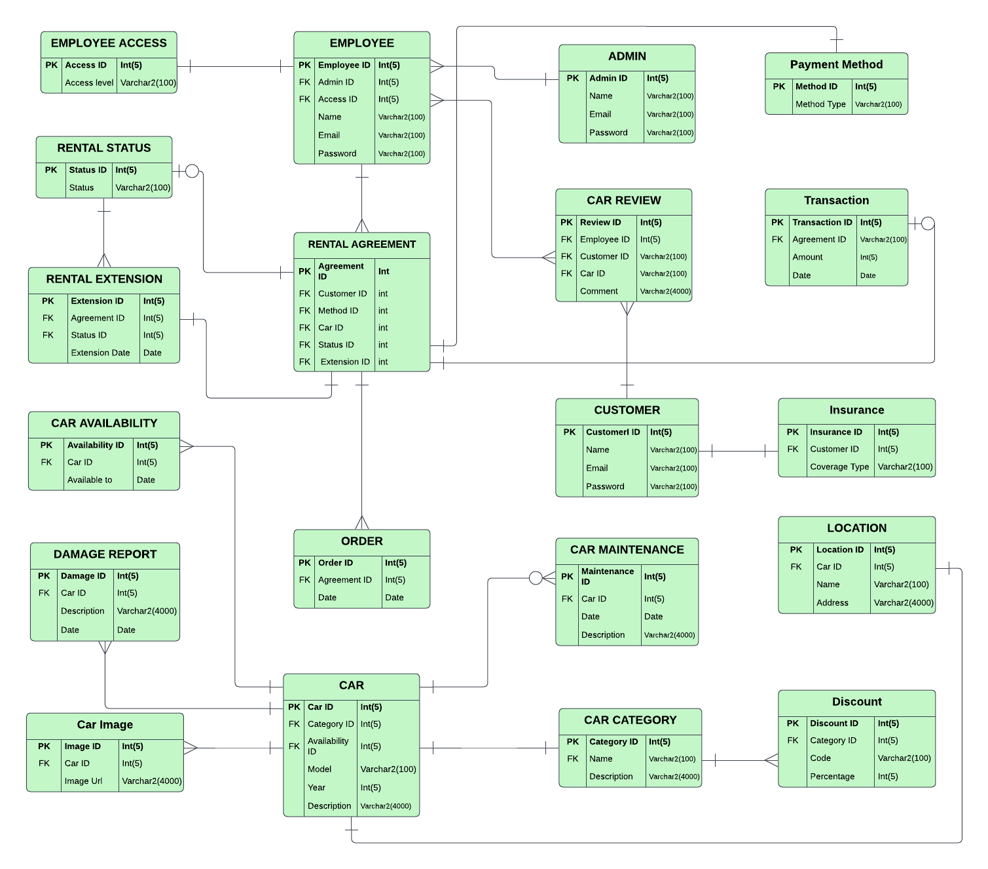
PHYSICAL
ERD

Slide 14
FOREIGN
KEYS
No foreign keys
CustomerID(FK)
CarID (FK)
PaymentMethodID(FK)
StatusID (FK)
RentalExtensionID (FK)
EmployeeID (FK)
EMPLOYEE
CAR REVIEW
Admin ID (FK)
ADMIN
EmployeeID (FK)
CustomerID (FK)
CarID (FK)
EMPLOYEE ACCESS
RENTAL AGREEMENT

Slide 15
No foreign keys
CarCategoryID(FK)
CarAvailabilityID (FK)
ORDER
CAR MAINTENANCE
No foreign key
CustomerID (FK)
CarID (FK)
CUSTOMER
CarID (FK)
CAR
CAR CATEGORY

Slide 16
No foreign keys
CarCategoryID(FK)
CarAvailabilityID (FK)
DAMAGE REPORT
CAR AVAILABILITY
CarID (FK)
CarID (FK)
RENTAL STATUS
Car Image (FK)
CAR
PAYMENT METHOD

Slide 17
Agreement ID (FK)
Status ID (FK)
Customer ID (FK)
LOCATION
CarCategoryID (FK)
TRANSACTION
Category ID (FK)
RENTAL EXTENSION
Agreement ID (FK)
INSURANCE
DISCOUNT

Slide 18
Step by step process
Of Creating Database
Creation of tables
General constraints
DDl statements through queries
Foreign
keys
Data insertion

Slide 19
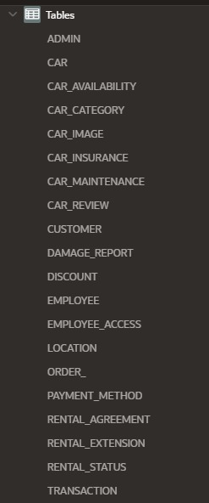
of
creation
Tables

Slide 20

GENERAL CONSTRAINTS
General constraints are also known as integrity constraints, these are rules or conditions applied to the data in a database management system (DBMS) just to ensure data integrity and consistency.
In our Car Rental System we have applied general constraints with the help of ALTER COMMAND just to ensure data accuracy, consistency, and adherence to predefined rules.

Slide 21

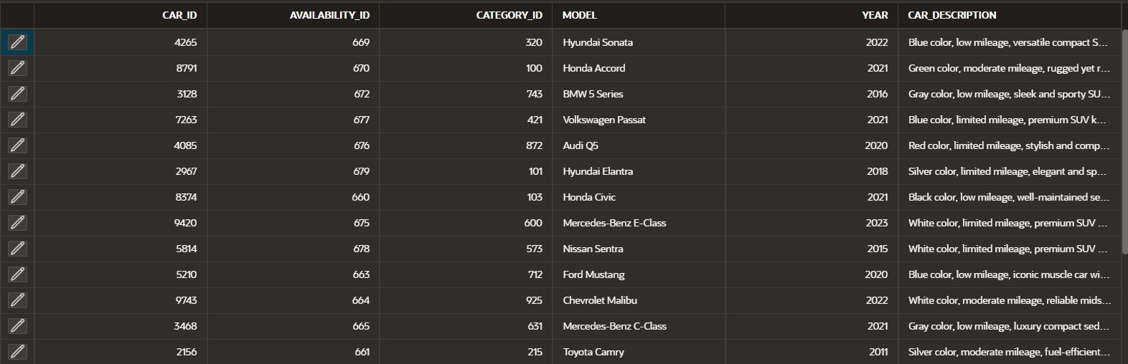
of
Insertion
Records
ADMIN
CAR

Slide 22
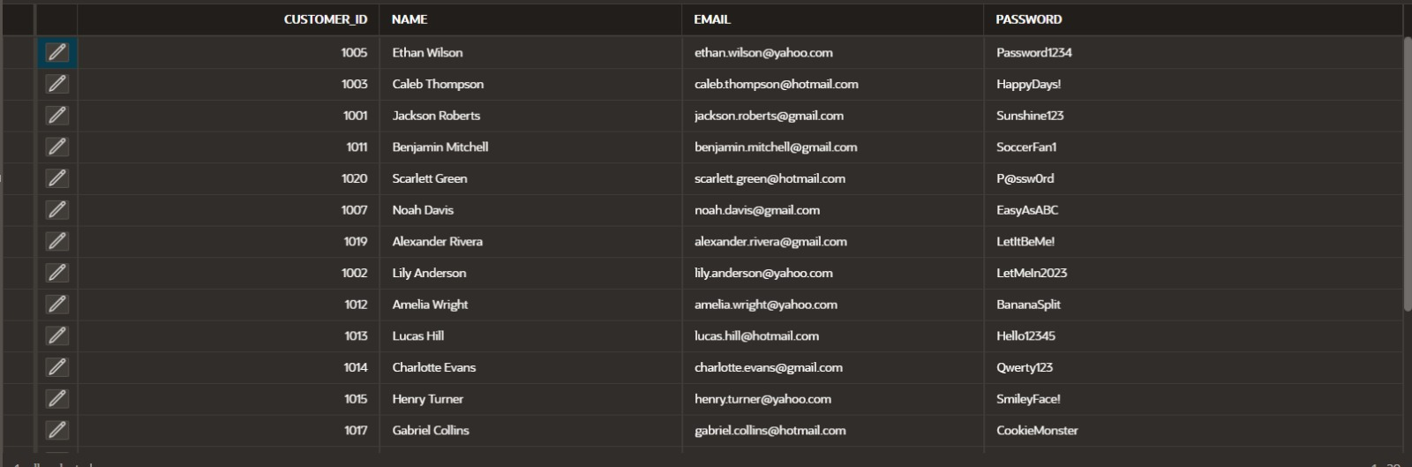
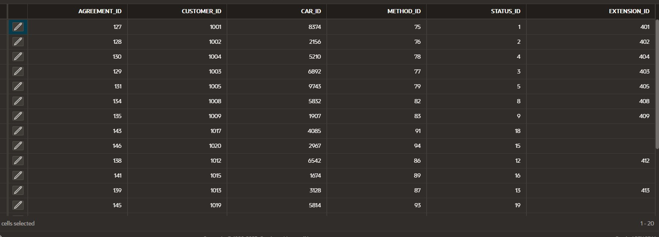
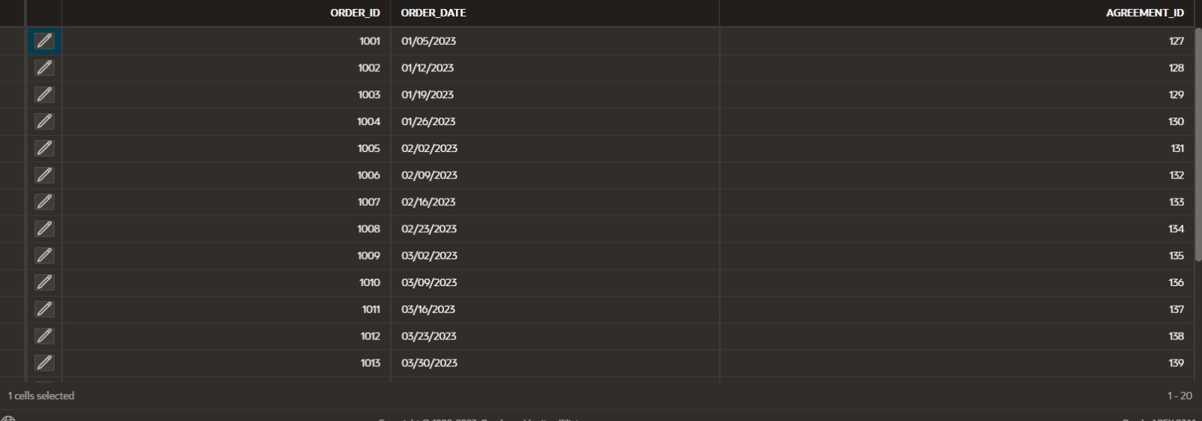
CUSTOMER
RENTAL AGREEMENT
ORDER

Slide 23
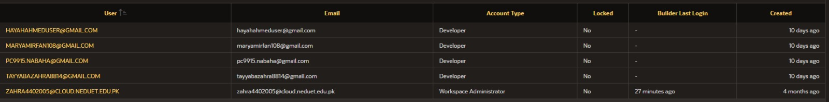
user
Assigning
privilege

Slide 24

In conclusion, our Car Rental System offers a transformative solution that simplifies and enhances the car rental experience. With user-friendly online booking, transparent pricing, and flexible options, we provide convenience and peace of mind to customers. By streamlining administrative tasks and integrating with other systems, our platform empowers car rental companies to optimize operations and drive success. Join us in embracing a future of efficient and seamless mobility with our innovative Car Rental System.
CONCLUSION

