Slide 1
Topic Modeling
UN Speeches

Slide 2
Agenda
Topic Modeling
Analysis
Usefulness of Topic Modeling
Application of Topic Modeling in Other Public Policy Settings
Topic Modeling tradeoffs

Slide 3
Topic Modeling
Topic models are a suite of algorithms/statistical models that uncover the hidden/latent topics in a collection of documents.
LDA has shown excellent results in practice and therefore has been widely adopted.
Notes:
For example, ‘romantic’, ‘scary’, and ‘family’ will appear more often in documents related to the movie. ‘technology’, ‘computer’, and ‘algorithm’ will appear more often in the computer science documents.

Slide 4
Analysis
Corpus: UN speeches (1970 to 2015)
Countries with relatively few speeches:
South Sudan – 5
Montenegro – 10
Highest number of speeches by a country = 46

Slide 5
Analysis – Steps
Punctuation and numbers were removed
A vectorizer was created with the following parameters
ngram_range(1,1) – only unigrams selected
min_df = 5 – words that appeared in less than 5 documents ignored
max_df = 0.8 – words that appeared in >80% documents ignored
English stop words removed & text converted to lowercase
Column of text was vectorized
LDA model instantiated
Number of components specified
Fit LDA model to vectorized text

Slide 6
Analysis – Full Dataset
Number of topics = 4
Topic | Top Words
1 | social global republic process challenges african sustainable reform poverty democratic
2 | peoples africa situation south republic independence relations problems war developing
3 | africa developing global south small resources change today trade african
4 | nuclear weapons europe problems process european conference role global disarmament
Notes:
the longer the distance between bubbles, the more different they are. The bubble representing Topic 2 (i.e. Topic_1 in our dataframe) is the biggest - this means that the percentage of speeches about that topic are the highest in the corpus we have.

Slide 7
Analysis – Full Dataset
Number of topics = 4
Topic | Top Words | Label
1 | social global republic process challenges african sustainable reform poverty democratic | Sustainable Development (in developing nations)
2 | peoples africa situation south republic independence relations problems war developing | Conflict and Political Unrest in the Global South
3 | africa developing global south small resources change today trade african | Development Challenges in the Global South
4 | nuclear weapons europe problems process european conference role global disarmament | Nuclear Weapons & Disarmament

Slide 8
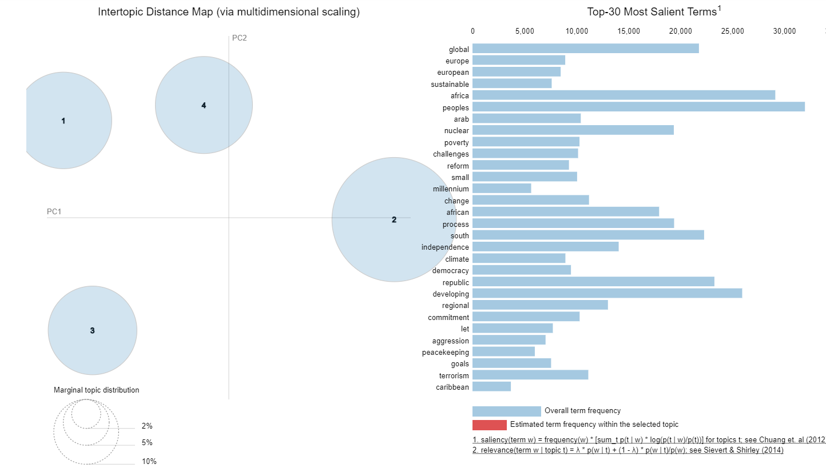

Slide 9
Analysis – USA Pre 2001
Number of topics = 3
Topic | Top Words
1 | democracy treaty peacekeeping century children said terrorism destruction democratic conflicts
2 | negotiations conference parties session problems energy process peaceful shall settlement
3 | reality problems china republic strength foreign resolution achieve need issues

Slide 10
Analysis – USA Pre 2001
Number of topics = 3
Topic | Top Words | Label
1 | democracy treaty peacekeeping century children said terrorism destruction democratic conflicts | Peacekeeping & Democracy
2 | negotiations conference parties session problems energy process peaceful shall settlement | Negotiations
3 | reality problems china republic strength foreign resolution achieve need issues | Regional Stability

Slide 11
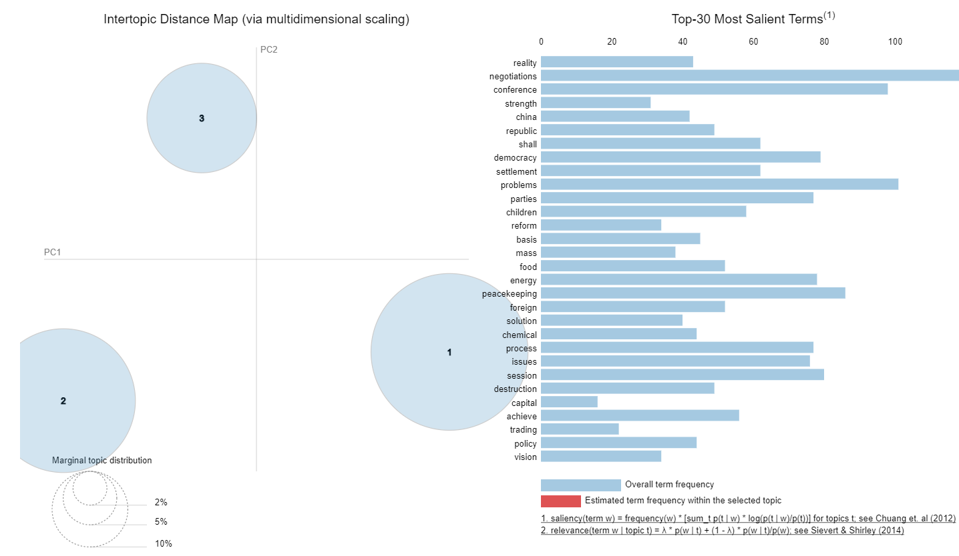

Slide 12
Analysis – USA Post 2001
Number of topics = 3
Topic | Top Words
1 | come israel change challenges Palestinians region pursue palestinian responsibility conflict
2 | russia conflict come like order young strong iran different look
3 | terror terrorists regime iraqi east terrorist fight middle liberty iraqs

Slide 13
Analysis – USA Post 2001
Number of topics = 3
Topic | Top Words | Label
1 | come israel change challenges Palestinians region pursue palestinian responsibility conflict | Israel-Palestine Conflict
2 | russia conflict come like order young strong iran different look | Russia–Syria–Iran–Iraq coalition
3 | terror terrorists regime iraqi east terrorist fight middle liberty iraqs | Terrorism in the East

Slide 14
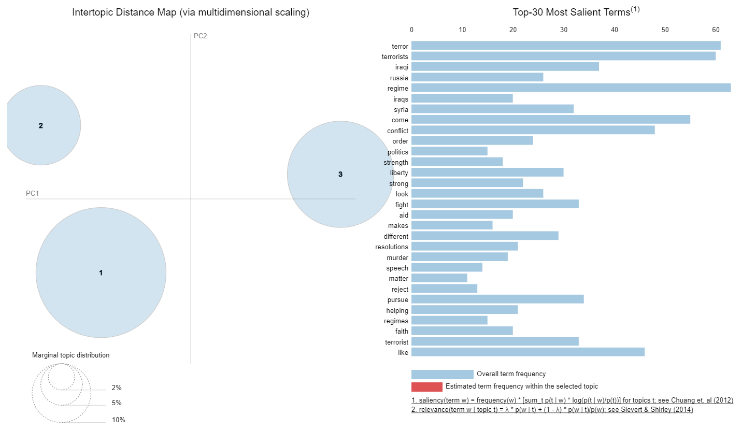

Slide 15
Analysis – Pakistan
Number of topics = 3
Topic | Top Words
1 | disarmament settlement conference agreement Africa negotiations powers independence order special
2 | islamic situation foreign africa islam problem problems indian race independence
3 | terrorism kashmiri afghan dialogue democracy indian pakistans prosperity social democratic

Slide 16
Analysis – Pakistan
Number of topics = 3
Topic | Top Words | Label
1 | disarmament settlement conference agreement Africa negotiations powers independence order special | Disarmament Negotiations
2 | islamic situation foreign africa islam problem problems indian race independence | Islam
3 | terrorism kashmiri afghan dialogue democracy indian pakistans prosperity social democratic | Terrorism

Slide 17
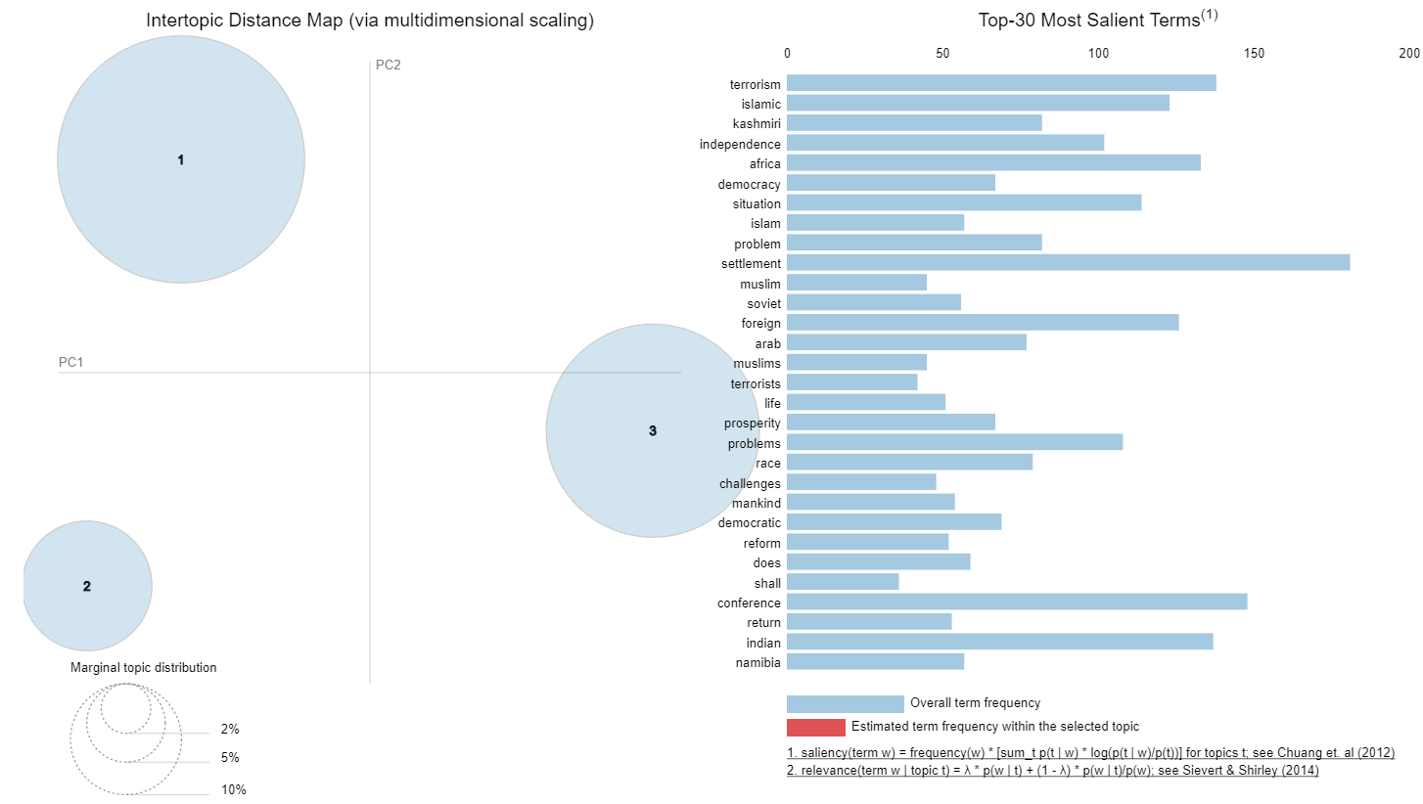

Slide 18
Usefulness of Topic Modeling
As more information becomes available, it becomes progressively more difficult to understand the information or find what we are looking for.
Topic modeling: a tool to organize, understand and summarize large collections of text. Useful for:
Discovering hidden patterns
Annotating documents according to the discovered topics
Using these annotations to organize, search and summarize texts

Slide 19
Application of Topic Modeling in Other Public Policy Settings
Legal sector: to provide document summaries of subject-matter to lawyers
Education sector: Topic Modeling of Twitter Data to Identify Issues Impacting Women and Girls’ Education During the COVID-19 Pandemic
Health sector: Examining the flow of topics in the field of women’s health, by analyzing news articles on healthcare using topic modeling

Slide 20
Topic Modeling Tradeoffs
Topic modeling is notoriously more challenging to do when the text is shorter.
When run on different datasets, LDA (widely used topic modeler) suffers from "order effects" i.e. different topics are generated if the order of training data is shuffled.
The better the model is i.e. higher perplexity, the less humans are able to understand and interpret it.
Notes:
For instance, when the corpus consists of tweets as opposed to news articles. Such order effects introduce a systematic error for any study. This error can relate to misleading results;

Slide 21
Additional Analysis
USA
UN Security Council Members
Using the Gensim corpus:
Overall analysis
USA
Can access here.

Slide 22
Thank you!

