Slide 1


CLINIVORA
Emergency & Clinic Queue
Management System
Progress Presentation
Java 21 · JavaFX FXML · SQLite · Custom DSAs
Group Leader
MIR MARYAM NAVEED
Team members
NUPUR TASHNOVA ISLAM
SEEAM SAJIM
AMINJON
1 Home
2 Topic
3 DSAs
4 Algorithm
5 Progress
6 Thanks

Slide 2
Topic & Architecture
Progress update · Clinivora
Clinivora helps clinics manage ER triage, doctor assignment, routine queues, and operations reports.
What we are building
UI = FXML · Logic = Java
• Patient registration & profiles
• Emergency Room: Needs Triage → Priority Queue → Active floor
• ESI priority (P1–P5) for who is seen next
• Routine queue, doctors, reports (PDF/CSV)
• Themes & languages (EN / Urdu RTL / Chinese)
• Roles: Admin, Reception, Triage, Doctor
Professor requirement: screens in .fxml files
Controller (.java) maps to FXML via fx:controller
Controller stands between UI and services
FXML Views → Controllers → Services
↘ Custom DSAs + SQLite
14 FXML screens (Login, Dashboard, ER, …)
Not built as pure-Java windows
1 Home
2 Topic
3 DSAs
4 Algorithm
5 Progress
6 Thanks

Slide 3
Data Structures (5)
Progress update · Clinivora
Course names · custom implementations (not java.util internals) · live in DSA Laboratory
ArrayList
HashMap
Priority Queue
Linked List
Stack
DynamicArray
HashTable
IndexedMinHeap
DoublyLinkedList
ArrayStack
Used for:
Lists, graph vertices
Used for:
ESI counts, heap index
Used for:
ER who-is-next board
Used for:
Patient / case timeline
Used for:
Patients form Undo
Why:
Fast index · append O(1)*
Why:
Average O(1) lookup
Why:
Extract min O(log n)
Why:
Insert at ends O(1)
Why:
LIFO undo O(1)
1 Home
2 Topic
3 DSAs
4 Algorithm
5 Progress
6 Thanks

Slide 4
Algorithm — ESI Triage Ordering
Progress update · Clinivora
Priority Queue (Indexed Min-Heap) decides who is treated next
TriageService.buildPriorityQueue()
1. Load emergency cases with status TRIAGED
2. For each case with ESI (P1–P5), PUSH into IndexedMinHeap
3. Order key: priority rank first (P1 before P5), then earlier arrival
4. POP until empty → ordered list for ER Priority Queue table
Complexity
• push / pop ≈ O(log n)
• build full ordered board ≈ O(n log n)
Why a heap? Efficient “next patient” extracts & priority updates
(vs re-sorting a full ArrayList every time)
Demo path
In the running app:
1. Login as triage / admin
2. Open Emergency Room
3. Show Priority Queue panel
4. Open DSA Laboratory
5. Select Priority Queue (IndexedMinHeap)
6. Run push / pop
Bonus algorithm: Graph BFS O(V+E)
1 Home
2 Topic
3 DSAs
4 Algorithm
5 Progress
6 Thanks

Slide 5
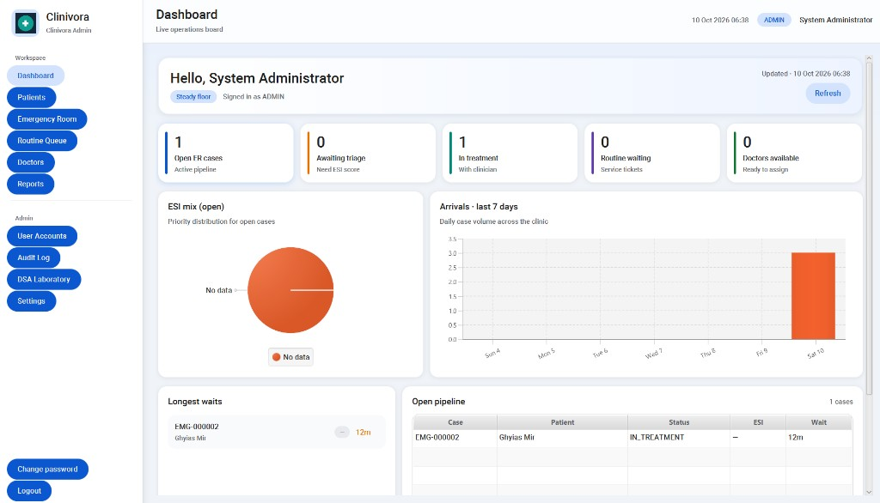
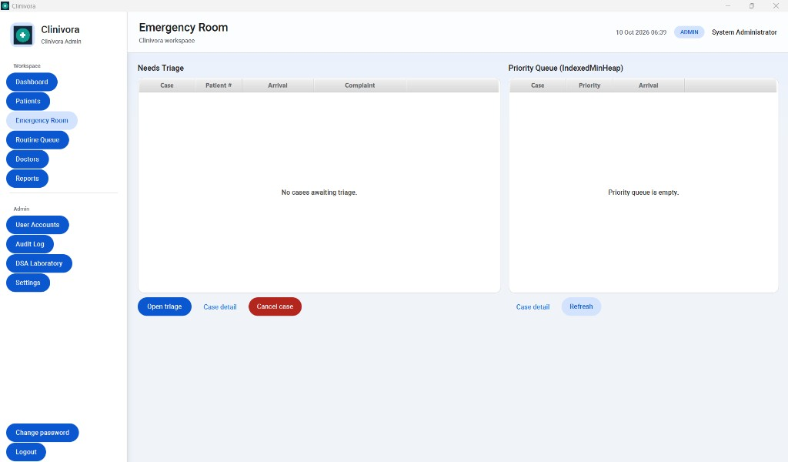
Progress — Live UI
Progress update · Clinivora
Dashboard ops board · Emergency Room floor boards · themes & i18n · reports · accounts
Dashboard — KPIs, ESI mix, waits, pipeline
Emergency Room — triage / priority / active floor
1 Home
2 Topic
3 DSAs
4 Algorithm
5 Progress
6 Thanks

Slide 6
Thank you — open to feedback
Progress presentation · professor may propose changes or modifications
Leader: MIR MARYAM NAVEED
Members: NUPUR TASHNOVA ISLAM · SEEAM SAJIM · AMINJON
Run: mvn javafx:run · Demo: admin / AdminDemo!2026
Topic
Data Structures
Algorithm
Screenshots
1 Home
2 Topic
3 DSAs
4 Algorithm
5 Progress
6 Thanks

