Slide 1
Big Data Platforms
Class Session#2

Slide 2
Review the previous session
We’ve talked about Low-level infrastructure of GC
Compute engine
Storage
Security
Networking
This session we will discuss the higher level of GC products

Slide 3
Big Data Solutions by Google
GFS
Google File System, invented in 2002
MapReduce
A solution to index the exploding volume of content on the web , invented in 2004
Apache Hadoop
Hadoop has moved far beyond its beginning in web indexing and now used as a well-known solution for big data challenges in different industries, invented in 2005
4) Cloud Big table
It addresses the problem of recording and retrieving millions of streaming user actions with hight throughput
5) Dremel
Dremel breaks data into small chunks called shards, and compresses them into a columnar format across distributed storage.
6) Google continued to innovate to solve its big data and ML challenges
TensorFlow specialized TPU hardware and Auto ML is going to come.

Slide 4
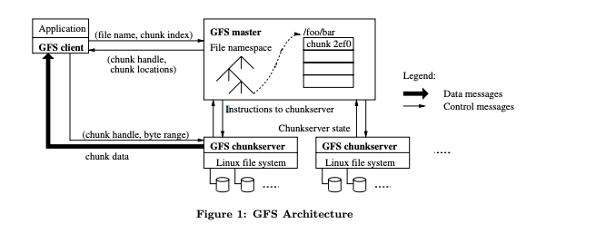
Google File System
Google created GFS, or the Google File System to handle sharding and storing
A database shard, or simply a shard, is a horizontal partition of data in a database or search engine. Each shard is held on a separate database server instance, to spread load.
GFS is the foundation for cloud storage and also for what would become BigQuery managed storage.
The largest GFS clusters have more than 1,000 nodes with 300 TB disk storage capacity.
Paper: https://static.googleusercontent.com/media/research.google.com/en//archive/gfs-sosp2003.pdf

Slide 5
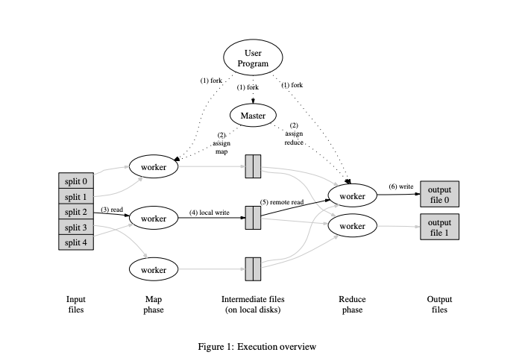
Map Reduce
A solution to index the exploding volume of content on the web.
Map Reduce manages large-scale data processing across large clusters of different servers.
MapReduce programs are automatically parallelized and executed on a large cluster of connected machines.
Paper: https://static.googleusercontent.com/media/research.google.com/en//archive/mapreduce-osdi04.pdf

Slide 6
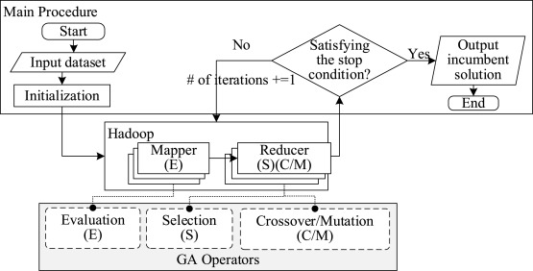
Apache Hadoop
An advanced web indexing approaches used for big data platforms
A collection of open-source software utilities that facilitates using a network of many computers to solve problems involving massive amounts of data and computation.
Hadoop Distributed File System(HDFS), Yarn, MapReduce, and libraries are 4 main components of Apache Hadoop. Paper
Used Genetec Algorithm to improve the performance, Paper
Each mapper can evaluate (denoted by E in Fig) the fitness of each chromosome in the shard and then output the 2-tuple 〈key,value〉=〈fitness, chromosome〉 to Hadoop. Afterward, any results with the same key in the mapper is merged in the form of 〈key,value list〉, where the value list indicates the multiple chromosomes corresponding to the same index key (i.e. fitness). Then the 2-tuple 〈key,value list〉 is send to different reducers for selection (denoted by S in Fig) and crossover/mutation (denoted by C/Min Fig) operations.

Slide 7
SQL vs Hadoop
Hadoop and SQL both manage data, but in different ways
Hadoop is a framework of software components, while SQL is a programming language.
SQL works on structured data while Hadoop can be used for unstructured and live data as well as structured data
Hadoop handles larger data sets but only writes data once
SQL is easier to use but more difficult to scale.
Hadoop is a framework that stores Big Data in distributed systems and then processes it parallelly
Short YouTube clip from Intricity101 Channel to explain 3 main comparisons between SQL and Hadoop

Slide 8
Examples of Hadoop
Some of the prominent users listed include Amazon, EBay, Facebook, Google, IBM, LinkedIn, the New York Times, Rackspace and Yahoo.
Financial services companies use analytics to assess risk, build investment models, and create trading algorithms
Retailers use it to help analyze structured and unstructured data to better understand and serve their customers.
Internet of Things (IoT) devices
Telecommunications companies
public sector programs, ranging from anticipating and preventing disease outbreaks to crunching numbers to catch tax cheats.

Slide 9
Cloud Big table
As Google's needs grew, we faced the problem of recording and retrieving millions of streaming user actions with high throughput, that became Cloud Bigtable which was an inspiration behind Hbase or MongoDB.
MongoDB is a document database with the scalability and flexibility that you want with the querying and indexing that you need
https://www.mongodb.com/what-is-mongodb

Slide 10
Dremel
One issue with MapReduce is that developers have to write code to manage all of the infrastructure.
So between 2008 and 2010, Google started to move away from MapReduce to process and query large data sets.
Dremel took a new approach to big data processing where Dremel breaks data into small chunks called shards, and compresses them into a columnar format across distributed storage.
Dremel became the query engine behind BigQuery.
Paper

Slide 11
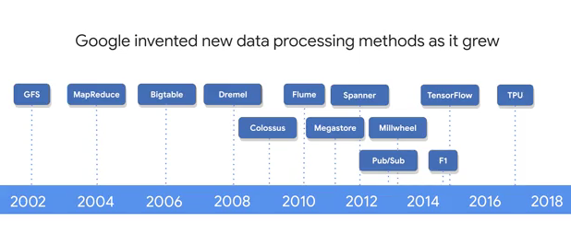
Data Processing

Slide 12
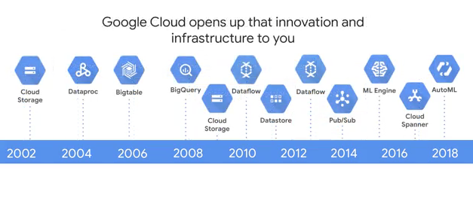
Google tools for Data Processing

Slide 13
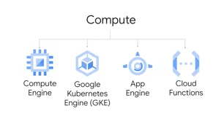
Compute Engines on GCP

Slide 14
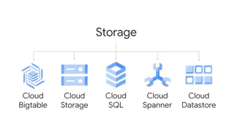
Storage Services on GCP

Slide 15
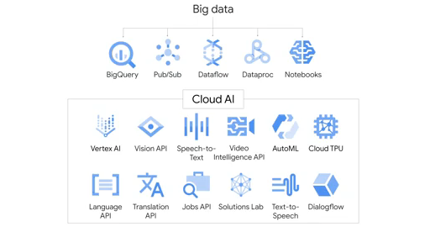
Google Cloud Services

Slide 16
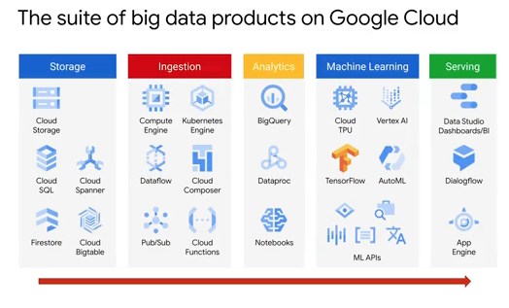
Big Data Products on GC

Slide 17
An Example of Big data

Slide 18
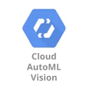
An Example of Big data
Keller Williams is a US real estate company.
Keller Williams uses “AutoML Vision” to automatically recognize specific features of houses, like this house has a built-in bookcase.
This application uses the object detection capabilities of AutoML Vision to find and tag key aspects of the home that customers might want to search on.

Slide 19

An Example of Big data
GO-JEK is an Indonesia-based company that gives shared motorcycle rides, brings goods, and provides a wide variety of other services for over two million families across 50 cities in Indonesia.
they have over one million drivers delivering goods and giving rides across 50 cities and GO-JEK gets censored data from all of these drivers. So GO-JEK manages more than five terabytes per day of data for analysis.
They need to leverage this data to tell thier drivers where demand from customers is strongest and how to get there.
Their big challenge :"Most of the reports are produced one day later so we couldn't identify the problems that were happening as soon as possible."

Slide 20
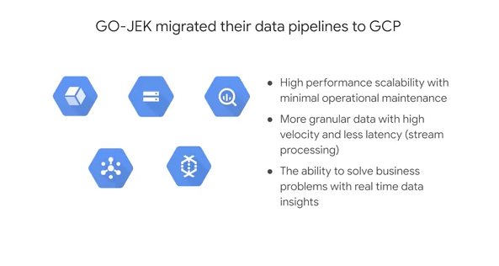
An Example of Big data

Slide 21
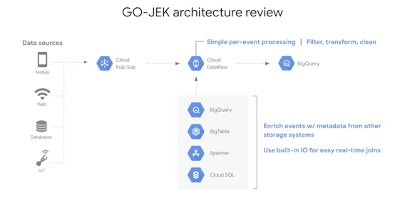
An Example of Big data

Slide 22
Several roles in a Successful big data organization
data engineers, to build the pipelines and do the clean data.
Decision makers, to decide how deep you want to invest in a data-driven opportunity while weighing the benefits for the organization.
Analysts, to explore the data for insights and potential relationships that could be useful as features in a machine learning model.
Statisticians, to help make your data-inspired decisions with their added rigor.
Applied machine learning engineers, who have real-world experience building production machine learning models from the latest and best information and research by the researchers.
Data scientists, who have the mastery over analysis, statistics, and machine learning.
Analytics managers to lead the team.

Slide 23
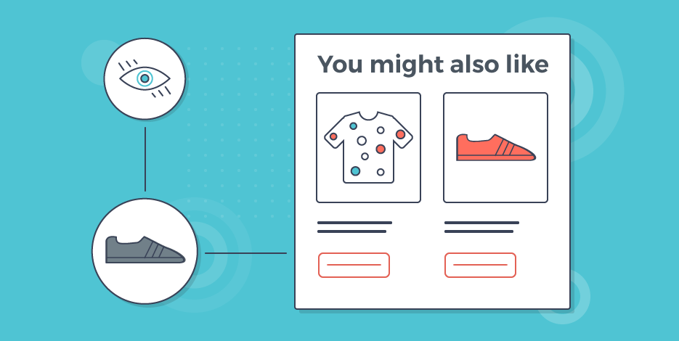
Product Recommendation using Clou SQL
Product Recommendations is one of the most common ML problems employed by business.
If the application has already been developed on-premise, first we should migrate the app into the GC.
We can explore an e-commerce product recommendations.
Where a ML model learns what you like and don't like, what you buy and don't buy, and then starts to suggest similar products that you may not have discovered by yourself.
You can then help inform the model explicitly by starring, up voting, or down voting your own personal rating of an item, or maybe by adding the item to the shopping cart.

Slide 24
Examples of Recommendation Systems
One cool example of a recommendation system is Smart Reply in Gmail.
Google Photos recommends similar photos or groups of similar photos so that you can add them into an album
Google Maps now serves personalized restaurant recommendations.
A core aspect of a recommendation system is that you need to train and serve it at scale.

Slide 25
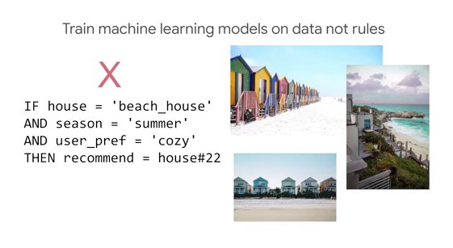
Rental House Recommendation App.

Slide 26
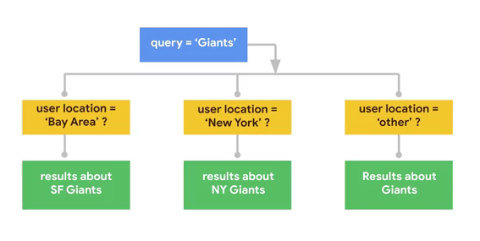
Respond to the Queries Traditionally

Slide 27
Respond to the Queries by ML
we have a data set of a query term and the links that people liked.
Google itself used a deep learning model called Rank Brain to suggest a good response to each query
machine learning is this idea that we want to teach the computer using examples, not with rules.
A history of good labeled data, any such application is a possible application for machine learning.
More information about Rank Brain Algorithm, link

Slide 28
How rental housing recommendations work?
Rating : Users rate a few houses
Training: A ML model is created to predict a user’s rating of a house
Recommending: For each user, the model is applied to every unrated house and the top 5 houses for that user are saved.
where is the machine learning here?
have to figure out how to find the users who are most like you
How many users to consider. Three users, five users, seven users, how many?
And how to weight the different factors such as the overall popularity of the items you have in common and so on.

Slide 29
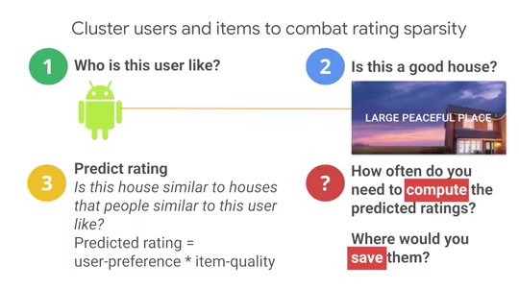
How rental housing recommendations work?

Slide 30
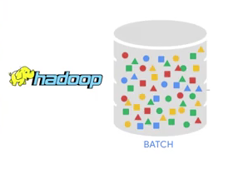
Compute rating using Hadoop cluster
There are thousands of houses and millions of users
we compute the rating that every user will give every house, we do that computation in a scalable way.
We don't want to do it on a single machine, we want to do it in a fault tolerant way that can scale to large datasets.
a typical solution for computation that has to happen over large datasets in a fault tolerant way is to do it in a big data platform like Apache Hadoop.

Slide 31
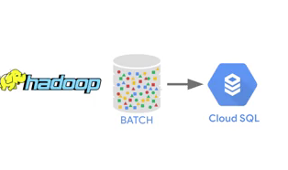
Store the Ratings
There are thousands of houses and millions of users
we compute the rating that every user will give every house, we do that computation in a scalable way.
We don't want to do it on a single machine, we want to do it in a fault tolerant way that can scale to large datasets.

Slide 32
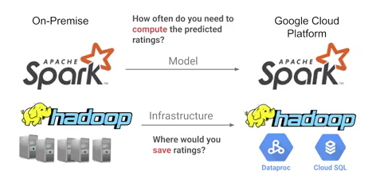
Migrate your recommendation system to GC

Slide 33
Refrences
Tree House Teach Group
Data Management Tech Target
Oracle
Cloud.google.com

