Slide 1
Big Data Platforms
Class Session#3

Slide 2
Solve the House Recommendation problem
Use Cloud Dataproc on GC instead of Spark on on-premise
Use Cloud SQL on GC instead of Cloud SQL
Since the computing predicted ratings is done once a day, the data is not in real time. So Hadoop batch is enough
You will practice Dataproc and Cloud SQL on the lab session.

Slide 3
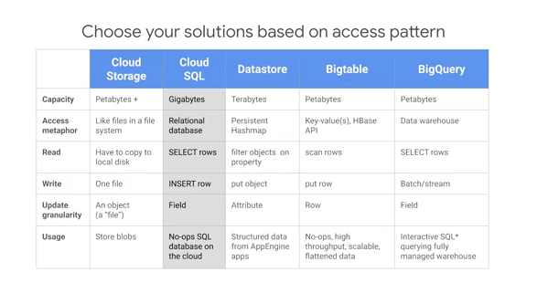

Slide 4
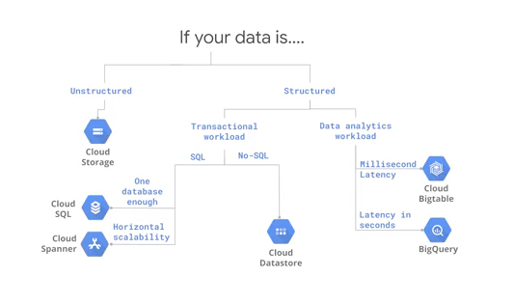
A map of choosing right storage
For our housing recommendation use case, we want to store the ratings and predictions.
This is a structured dataset of user ratings and houses. It's built for a transactional workload, writes and reads, and one database is enough for a small dataset and hence we pick Cloud SQL.

Slide 5
Cloud SQL
Cloud SQL supports most MySQL statements and functions even stored procedures, triggers and views.
GCP manages the MySQL Instance for you. This means things like backup and replication
it's on the Cloud so you can connect to it from anywhere.
you get Google Security. Cloud SQL resides in secure Google datacenters.

Slide 6
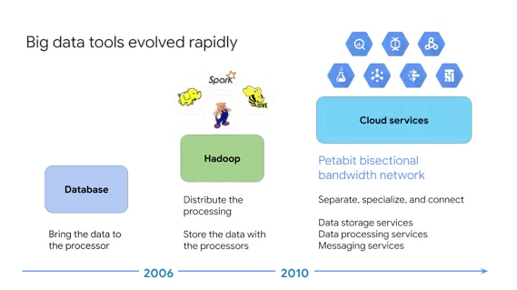
Big data computations

Slide 7
Lab, running a Spark job using Cloud Dataproc
Run a pi example from on-premise spark job to Dataproc GC.

Slide 8
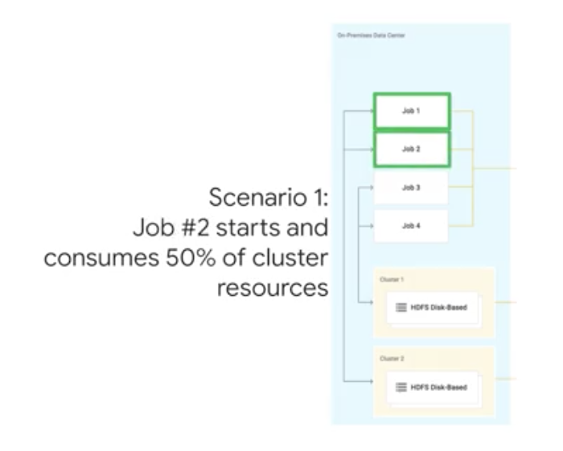
On-premise challenges
Get starved out of resources
Waste of Resources (Overprovisioned)
The problem here lies in the “static nature” of the on premise cluster capacity.

Slide 9
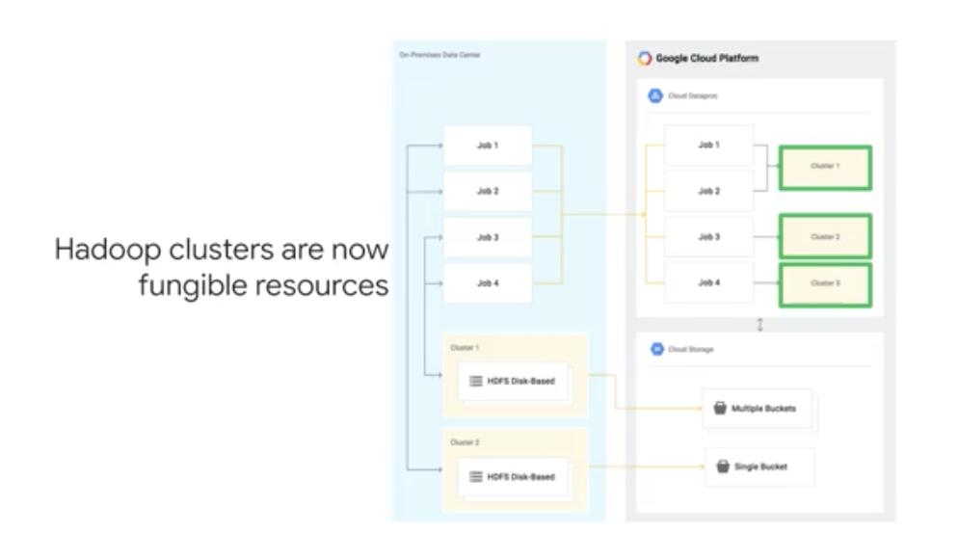
Cloud Dataproc manage Hadoop products

Slide 10
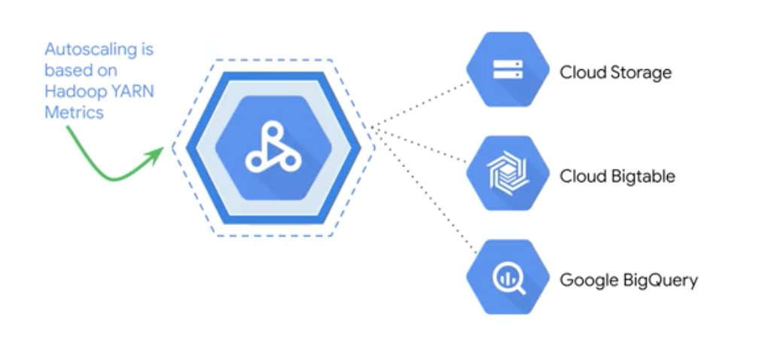
Turn down clusters automatically
Turn down clusters automatically with Scheduled Deletion.
Autoscaling works as long as you don't store your data in HDFS.

Slide 11
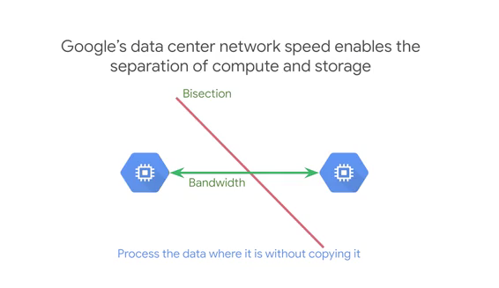
Google's datacenter bandwidth between compute and storage
the bisectional bandwidth is a rate of communication, at which servers on one side of the line can communicate with servers on the other side.
With enough bisectional bandwidth, any server can communicate with any other server at full network speeds.
With petabit bisectional bandwidth, that communication is so fast that it no longer makes sense to transfer the files and store them locally.

Slide 12
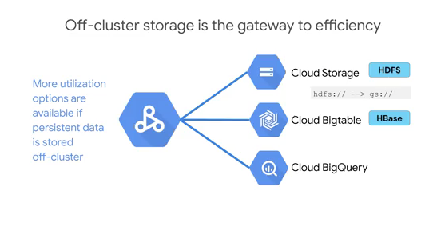
Off-cluster storage
Off-cluster means using Google Cloud Storage to store input and output the data.
if you have your data in Bigtable, you can use the HBase connector, and there's a BigQuery connector that you can use to work with data if the data is in the Analytics warehouse.

Slide 13
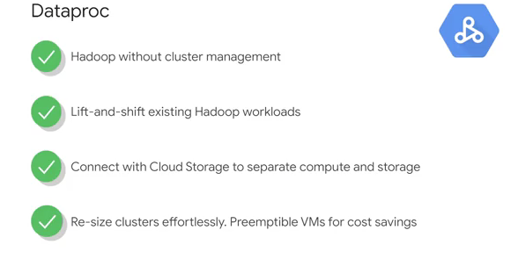
Dataproc Recap

Slide 14
BigQuery
Introduction to Big Query
Fast SQL Query Engine
Managed Storage for Datasets
Insight from Geographic data
Choosing the right Model
Scenario: predicting Customer Lifetime value
Creating ML models with SQL
Introduction to BigQuery and ML
ML project phases
Key features walkthrough

Slide 15
BigQuery
Its serverless
Flexible pricing model
Data encryption and security
Geospatial data types and functions
Foundation for BI and AI

Slide 16
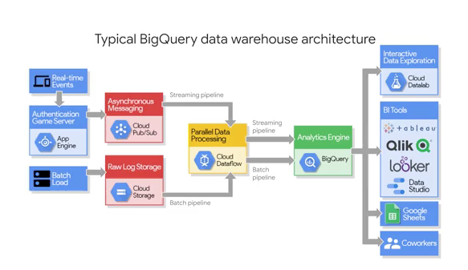
BigQuery

Slide 17
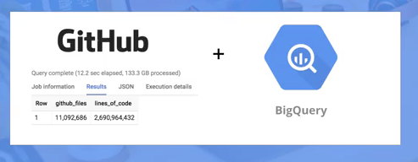
BigQuery Demo
Analyzing large datasets at scale
Challenge : Big data and slow queries
Serverless data analysis with BigQuery
Demo: Query 2 billion lines of code in less than 30 seconds

Slide 18
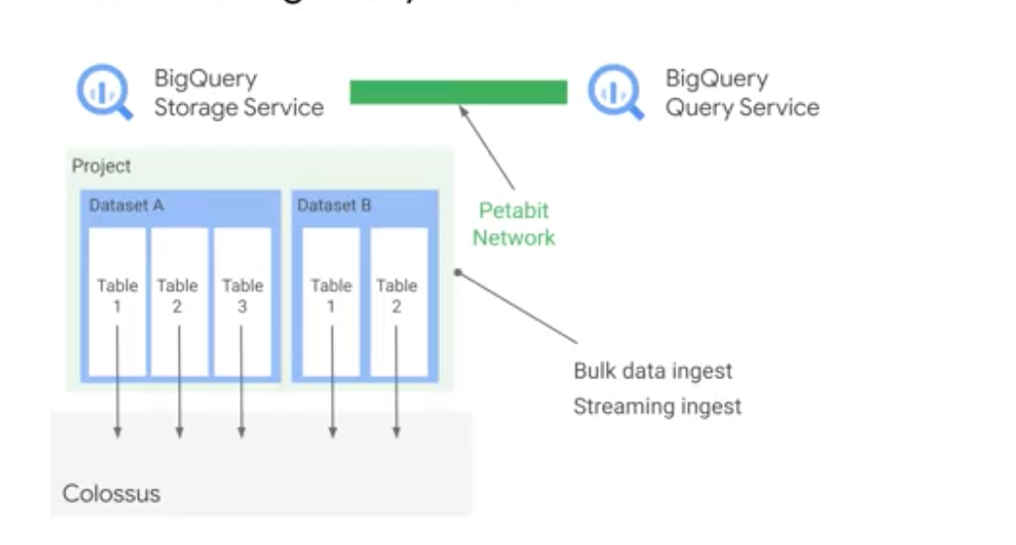
How does BigQuery actually work?
BigQuery has tow services in one, a fast SQL query engine and also a fully managed storage layer for loading and storing your datasets.
The two services are connected by Google's high-speed internal network
Recall that this super-fast network enables us to separate compute and storage.

Slide 19
BigQuery Storage Services
First up is the BigQuery storage services:
The storage service automatically manages the data that you ingest into the platform.
Data is contained within a project in what are called datasets, which would have zero to many tables or views.
Each column of that table highly compressed in Google's internal Colossus file system, which provides durability and global availability.
This is the same data back-end that power some of Google's most popular applications, like Google Photos and Gmail.

Slide 20
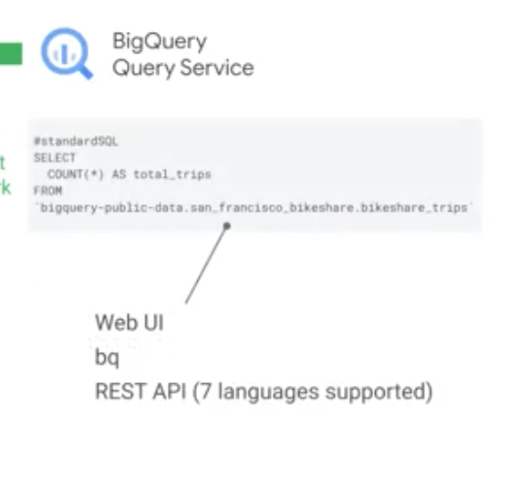
BigQuery Query Services
BigQuery query services:
runs interactive or batch queries that are submitted through the console, the BigQuery web UI, the BQ command-line tool, or via the REST API.
The query service can also run query jobs and data contained in other locations, that are hosted somewhere else in Cloud storage.
However, BigQuery is most efficient when it's working off of data contained within its own what's called native BigQuery storage.
BigQuery automatically optimize the SQL statements syntax wherever possible, it works the columns of data that you actually want to process in return as part of your output.

Slide 21
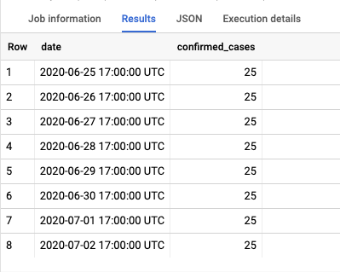
Query Exploration
Browse the bigquery-public-dataset
Browse the Scheme, Details and Preview tabs
Use More option and filter command
SELECT cols FROM table LIMIT
SELECT
date,
confirmed_cases
FROM
`bigquery-public-data.covid19_italy.data_by_province`
LIMIT
8

Slide 22
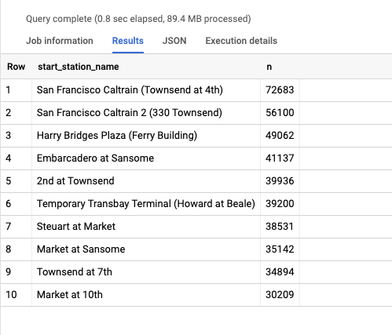
Query Exploration
# top 10 stations by trip volume
SELECT
start_station_name,
COUNT(trip_id) AS n
FROM
`bigquery-public-data.san_francisco_bikeshare.bikeshare_trips`
GROUP BY
start_station_name
ORDER BY
n DESC
LIMIT
10

Slide 23
Refrences
Tree House Teach Group
Data Management Tech Target
Oracle
Cloud.google.com

