Slide 1
Big Data Platforms
Class Session#4

Slide 2
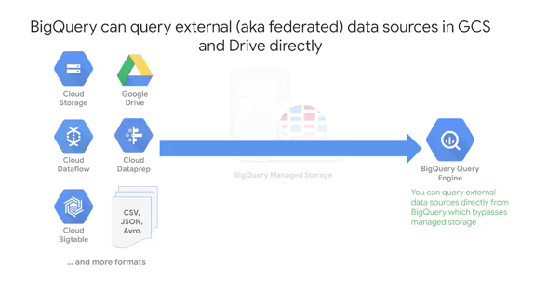
Big Query Storage
Your data is fully managed by BigQuery: automatically replicated, backed up and set up to auto scale for your query needs.
You also have the option of querying external data sources

Slide 3
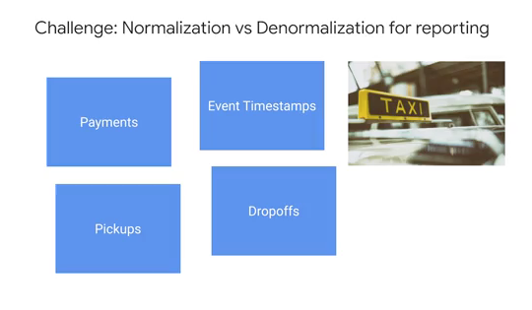
Database Normalization
The concept of normalization which is the act of breaking up one huge table into component child tables
Big SQL join can be an option
Another optimized option for normalization is using an “array data type”.
More information about data structure array data type

Slide 4
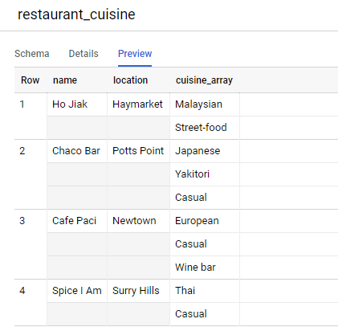
Array Data Type
The huge benefit of using array data type structure is that you have a single table which has all the fields in a single place to analyze.

Slide 5
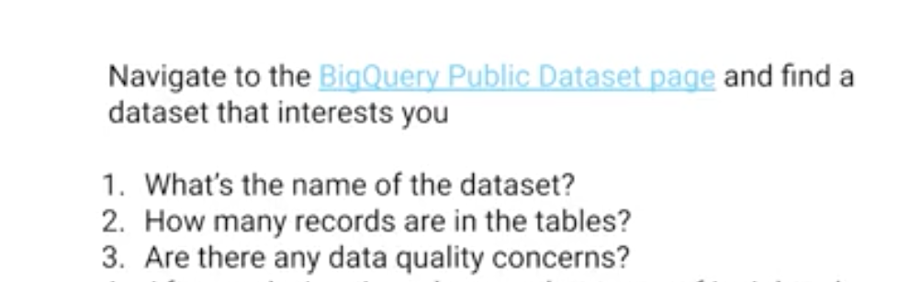
Bigquery Demo
Work on bigquery-public-data dataset on tablename noaa_hurricanes.hurricanes

Slide 6
BigQuery Demo: Geographic data
Work on bigquery-public-data dataset on tablename noaa_hurricanes.hurricanes
Watch and follow this video from programmer manager of public dataset at Google Cloud.

Slide 7
Cloud Dataprep
Dataprep provides a UI to inspect the quality of your datasets
The Dataprep is a product of GCP offered in partnership with Trifacta.
Using Dataprep, you can load in a sample of your BigQuery dataset into an exploration view, which will then provide you with some neat column histogram charts.
The main advantage to Cloud Dataprep is for teams want to use a UI for data exploration, and want to spend minimal time coding to build their pipelines.

Slide 8
Refrences
Cloud.google.com

