Slide 1
Big Data Platforms
Class Session#5

Slide 2
Learning
Process of ML is like learning a baby to recognize a rose flower, we show them different pictures of a rose flower then ask them to recognize a rose flower in a flowers garden.
Supervised and Unsupervised learning
major ML problems
Forecasting
Classifying
Recommendation system
Suggested ML model association with the problem
Linear regression -> Forecasting
Logistic regression -> Classification
Recommendations -> Matrix factorization

Slide 3
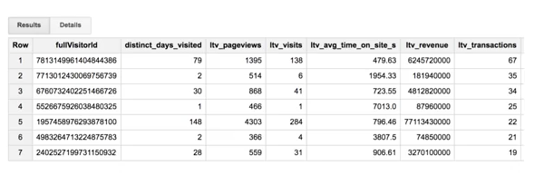
customer LTV Use Case
Lifetime value or LTV, is a common metric in marketing, which is where we'll estimate how much revenue, or profit we can expect from a customer. Our goal is to target high-value customers with special promotions and incentives.
We are forecasting a number
linear regression can be a right model
Remember that in ML, we feed in columns of data, and then let the model figure out the relationship to best predict that label.

Slide 4
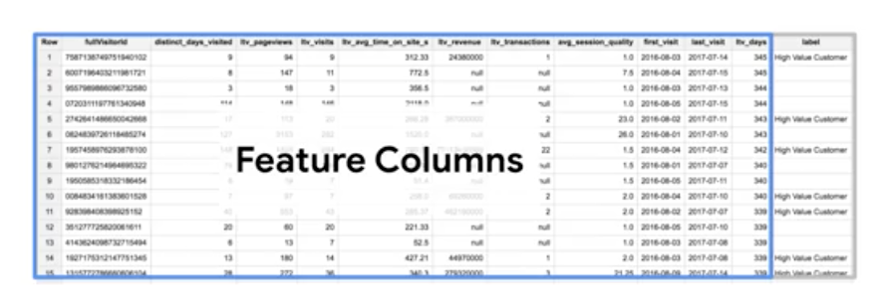
Customer LTV Use Case
Labels can also be binary values. Like if they are a high-value customer, or not.
Understanding the quality of the data in each column(feature), and working with other teams to get more features or more history is often the hardest part of any ML project.
You can even combine or transform these features in a process called Feature Engineering.
You can implement it by using this link tutorial.

Slide 5
Predicting LTV
predicting on future data. Say some new data comes in, that you don't have a label for. You don't know whether or not these new customers will have a high LTV or not.
But you do have a rich history of labeled examples for your model that train on. So you can train a model on the known data, and then once trained and we're happy with the model's performance, we can then use it to predict on the test dataset, that unknown data.

Slide 6
The ML project phases
Make or find the dataset that meet your target
Preprocessing step
In this stage we do feature engineering, understand features, analyze them clean them , split the dataset into different train/test tables
Create model
you can do it ML in your structured data sets inside of BigQuery using SQL in just a few minutes.
Evaluate the model

Slide 7
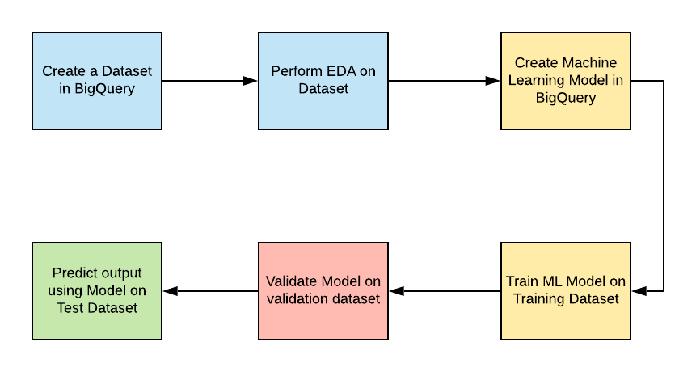
Create the model with BigQuery
you create the model with just a SQL statement
write a SQL prediction query and invoke ML.predict.
review the results
evaluate the model

Slide 8
MLBQ Demo: baby weight prediction
We want to predict new babies weight to announce government what is the avg weight would be for babies

Slide 9
Refrences
Cloud.google.com
https://cloud.google.com/bigquery-ml/docs
https://cloud.google.com/bigquery-ml/docs/logistic-regression-prediction

